Slide 1
electrika
By:- KANIKA
2010991910
G-17

Slide 2
ACKNOWLEDGEMENT
I would like to thank Mr. Lavish Arora our Front end Instructor who guided us for making this project.
Also I would like to thank him for makin us understand the concepts in a better way and making us comfortable with this subject.
I would like to thank Mr Rishab, our spoc, who was always there to make us feel connected with our instructors at any point of time

Slide 3
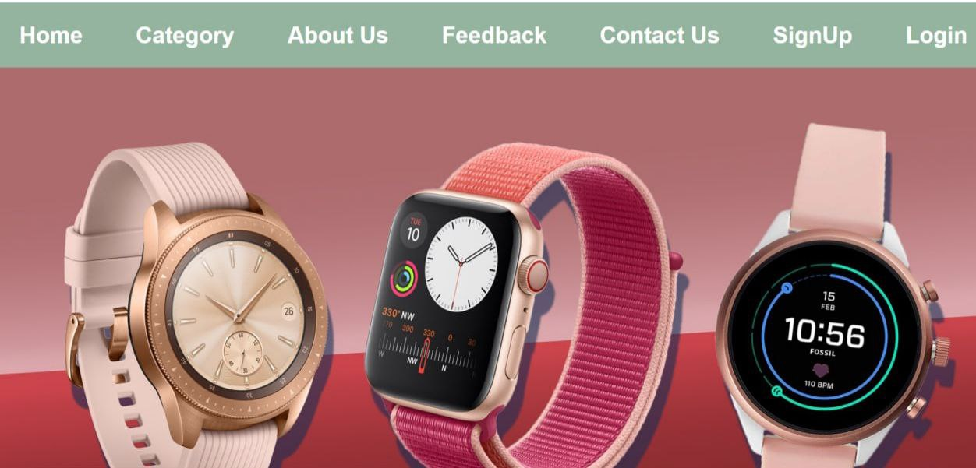
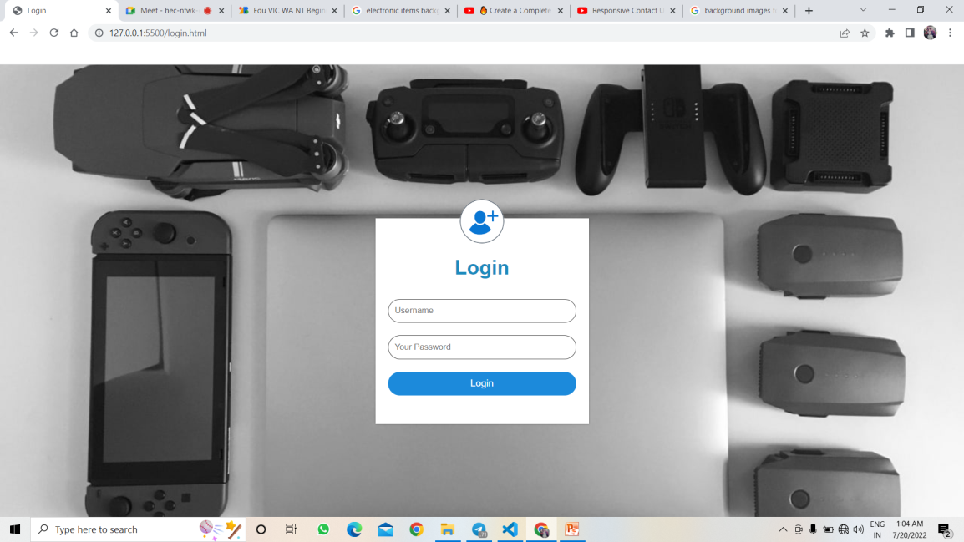
Home

Slide 4
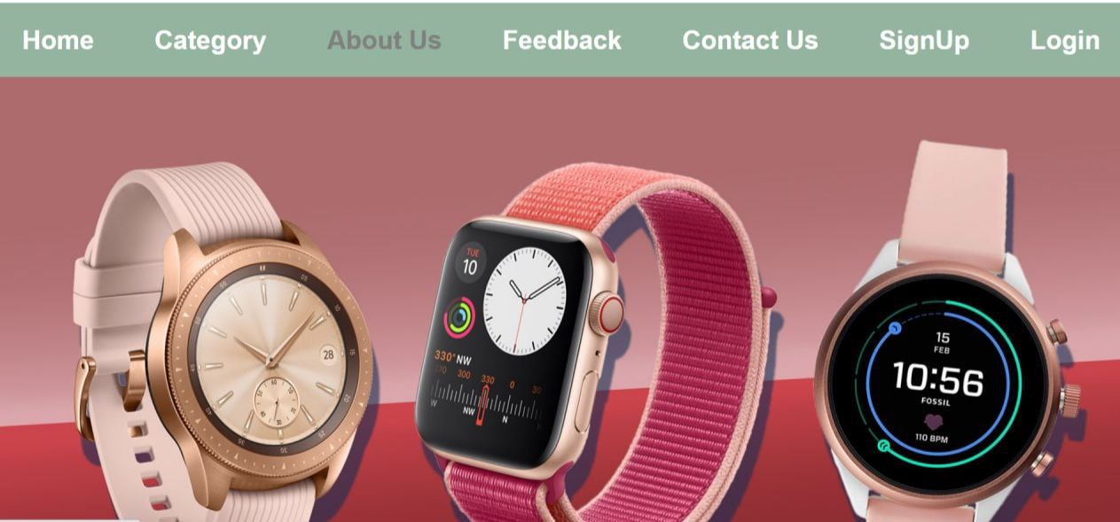
Mouse hover function

Slide 5
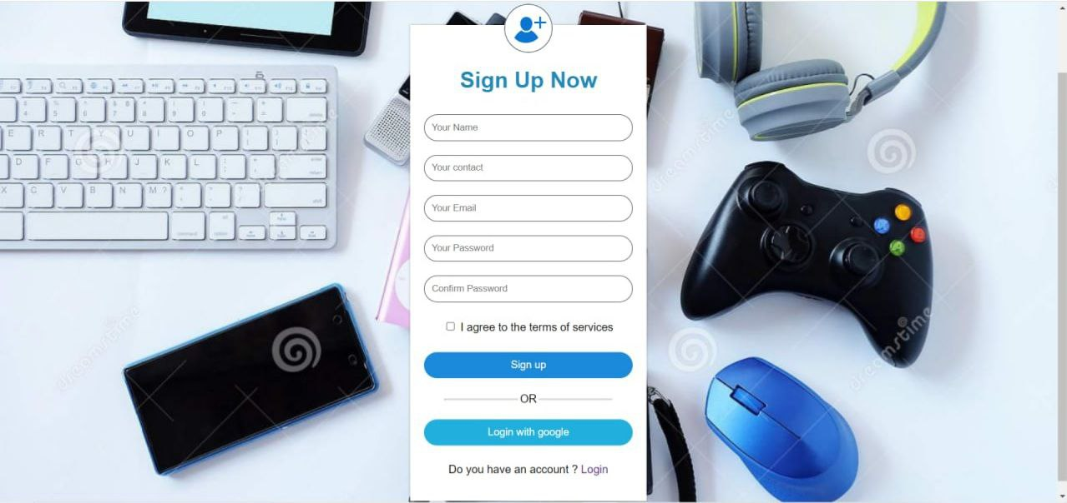
sign-up page

Slide 6
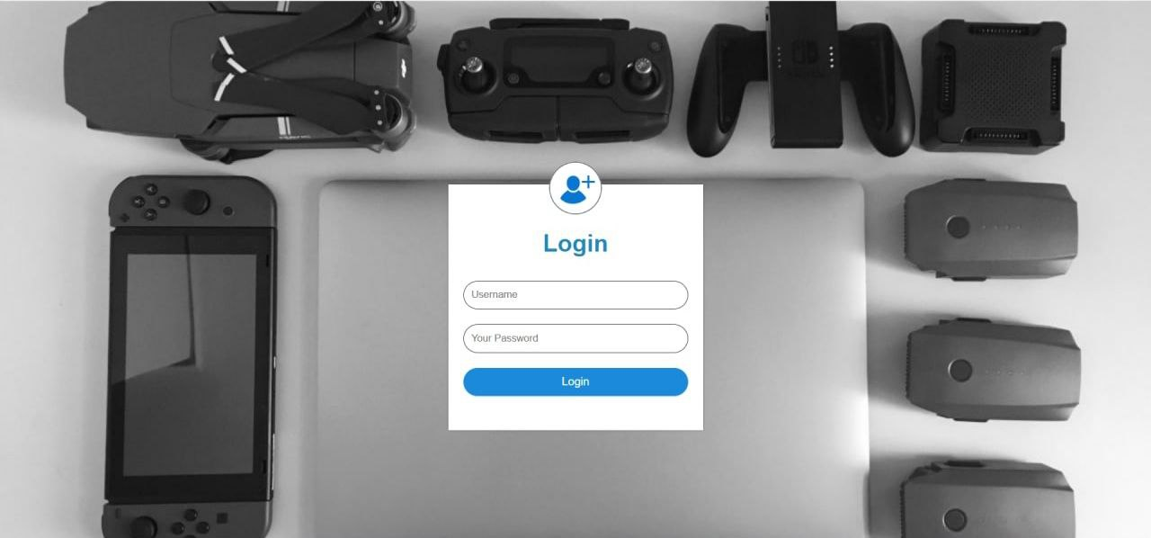
Login page

Slide 7

About Us PAGE

Slide 8
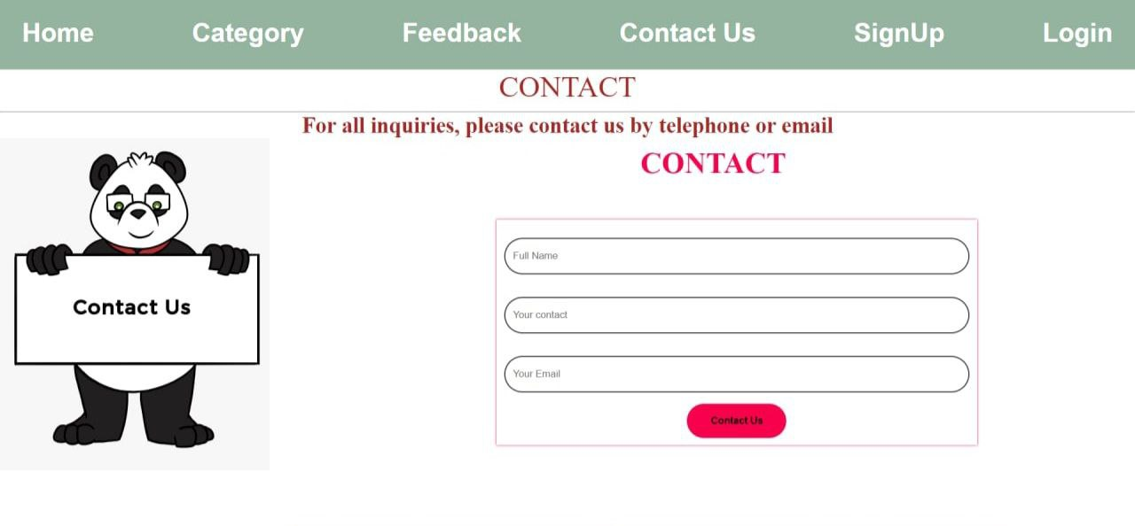
CONTACT US PAGE

Slide 9
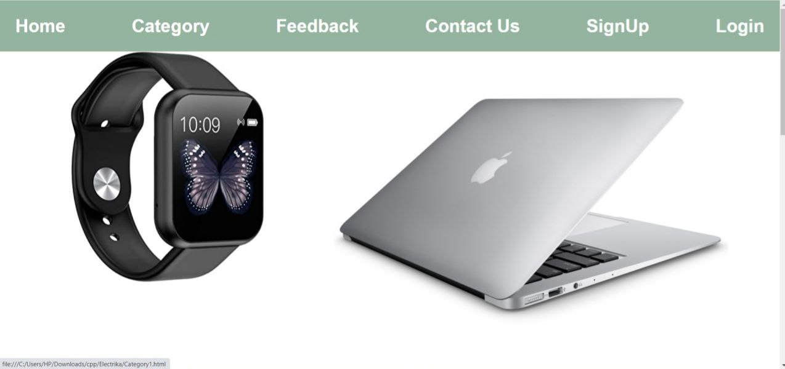
CATEGORY PAGE

Slide 10
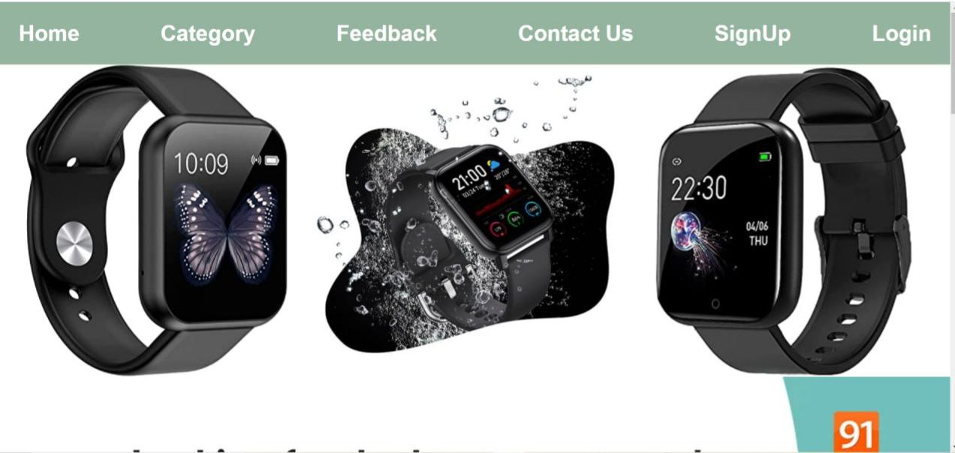
SUB-CATEGORY PAGE

Slide 11
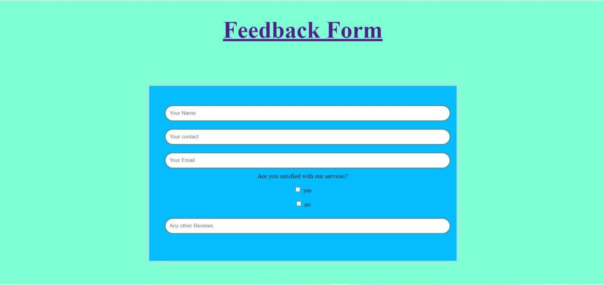
Feedback page

Slide 12
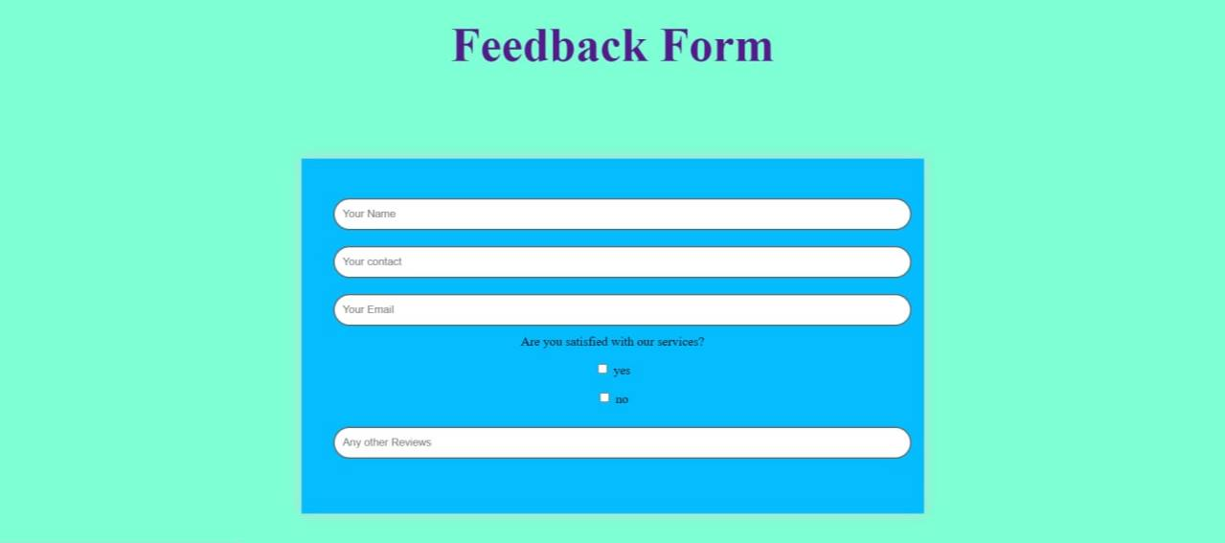
Back to home page
The title feedback form can be clicked to return to the home page.

Slide 13
bibliography
www.wikipidea.com
www.geesforgeeks.com
www.unsplash.com
www.google.com

Slide 14


