Slide 1
Data Science Assignment-ReUNion
BY: Kanika Bhardwaj

Slide 2

contents
Problem Statement
Introduction
Data Summary
Methodology
Exploratory Data Analysis
Data Processing
Implementing ML algorithms
Challenges
Conclusion

Slide 3
Problem Statement:
A person’s creditworthiness is often associated (conversely) with the likelihood they may default on loans.
We’re giving you anonymized data on about 1000 loan applications, along with a certain set of attributes about the applicant itself, and whether they were considered high risk.
0 = Low credit risk i.e. high chance of paying back the loan amount
1 = High credit risk i.e. low chance of paying back the loan amount

Slide 4
Data Summary:
Applicant.csv dataset:
Unique ID: applicant_id (string)
Other fields:
Primary_applicant_age_in_years (numeric)
Gender (string)
Marital_status (string)
Number_of_dependents (numeric)
Housing (string)
Years_at_current_residence (numeric)
Employment_status (string)
Has_been_employed_for_at_least (string)
Has_been_employed_for_at_most (string)
Telephone (string)
Foreign_worker (numeric)
Savings_account_balance (string)
Balance_in_existing_bank_account_(lower_limit_of_bucket) (string)
Balance_in_existing_bank_account_(upper_limit_of_bucket) (string)
Loan.csv dataset:
Target: high_risk_application (numeric)
Other fields:
applicant_id (string)
Months_loan_taken_for (numeric)
Purpose (string)
Principal_loan_amount (numeric)
EMI_rate_in_percentage_of_disposable_income (numeric)
Property (string)
Has_coapplicant (numeric)
Has_guarantor (numeric)
Other_EMI_plans (string)
Number_of_existing_loans_at_this_bank (numeric)
Loan_history (string)

Slide 5


Slide 6
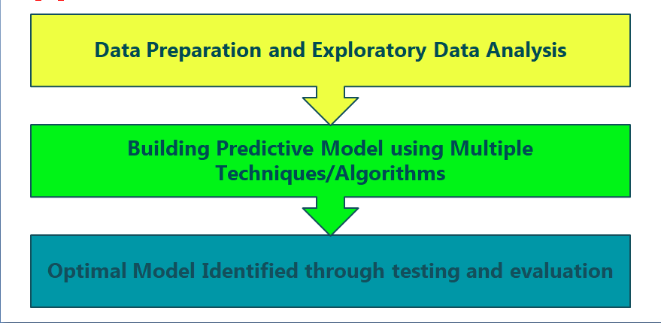
Approach

Slide 7

Exploratory data Analysis
Univariate analysis
Bivariate analysis
Multivariate analysis

Slide 8
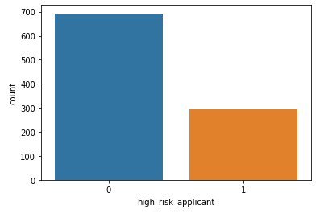
ANALYSIS OF DEPENDENT VARIABLE
As we can see from above graph that both classes are not in proportion and we have imbalanced dataset. We need to do normalize the data in next step.
0 = Low credit risk i.e. high chance of paying back the loan amount
1 = High credit risk i.e. low chance of paying back the loan amount

Slide 9
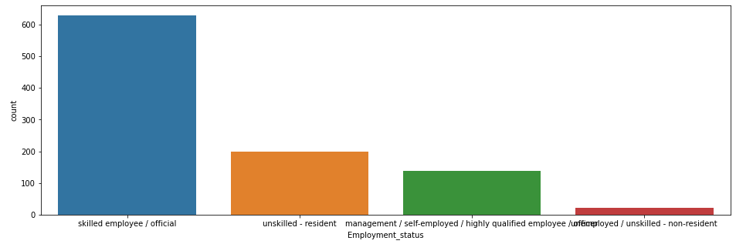
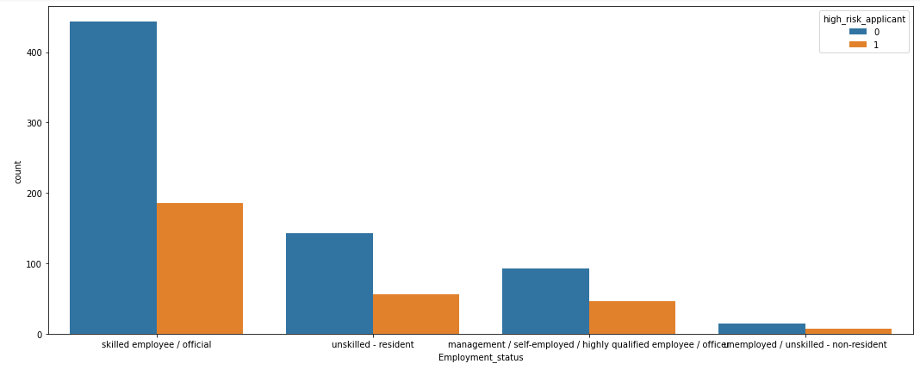
Analysis on the basis of employment status

Slide 10
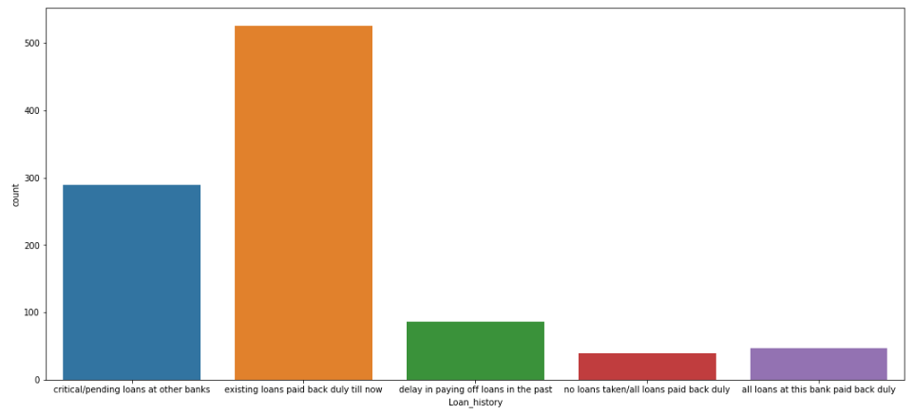
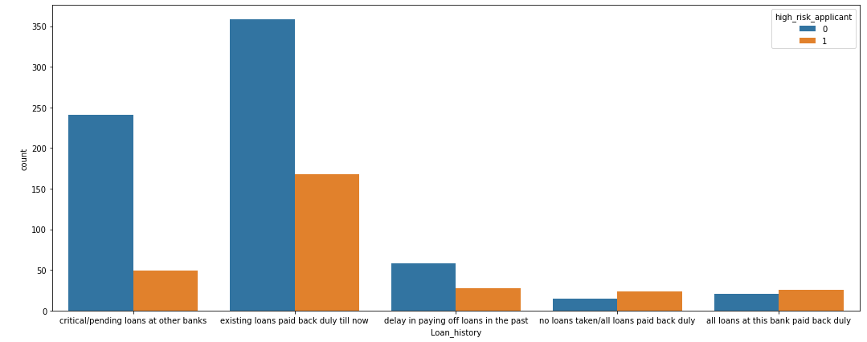
Analysis on the basis of loan history
Customers who belong to the category existing loan paid back are less risky, they are expected to pay back loan to the company as their history is good.

Slide 11
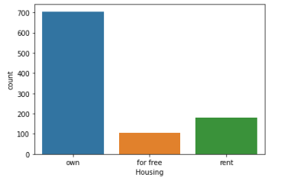
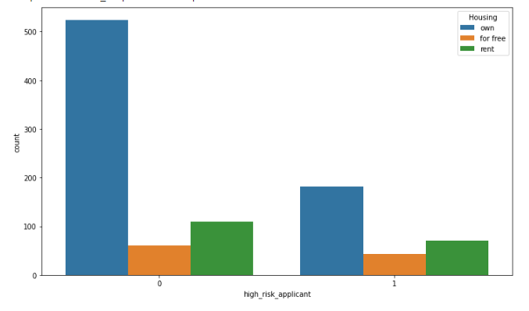
Analysis of Housing

Slide 12
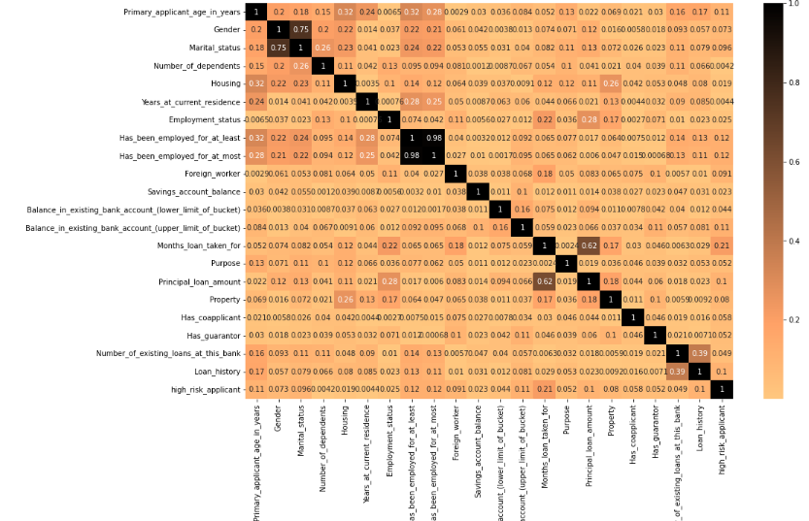
Multivariate analysis

Slide 13
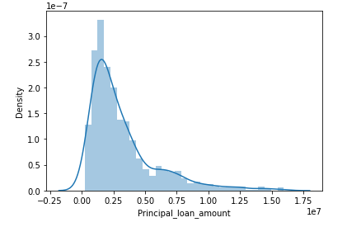
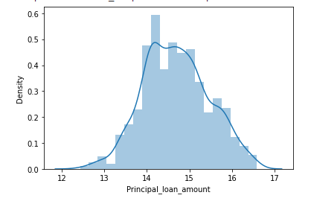
Analysis on continuous variable: Principal loan amount
Original data distribution
After applying log transformation

Slide 14
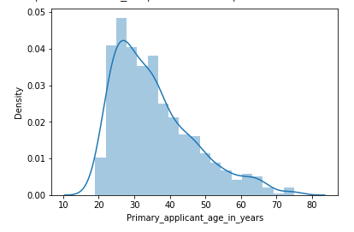
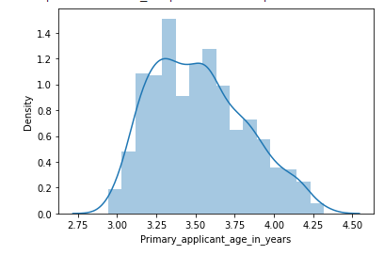
Analysis on basis of applicant age
Original data distribution
After applying log transformation

Slide 15
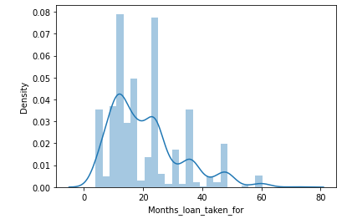
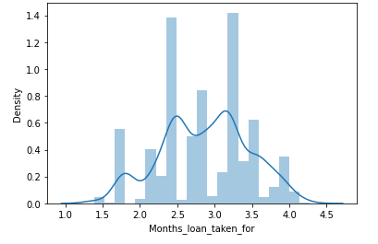
Analysis on months loan taken for
Original data distribution:
Data distribution after log transformation:

Slide 16
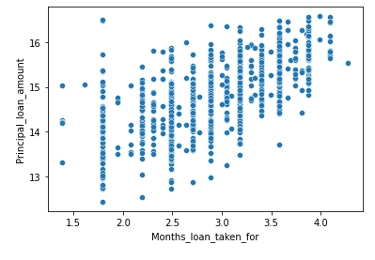
Relationship between loan amount and moths loan taken for:

Slide 17
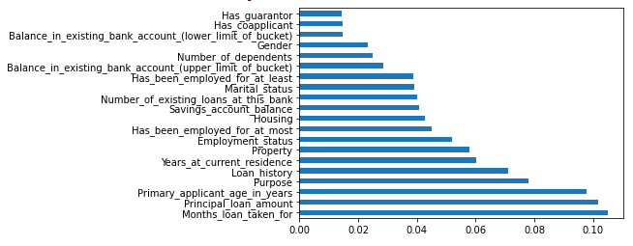
Feature selections
Use inbuilt class feature_importances of tree based classifiers
Plot graph of feature importances for better visualization

Slide 18
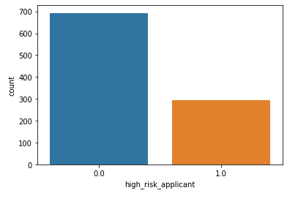
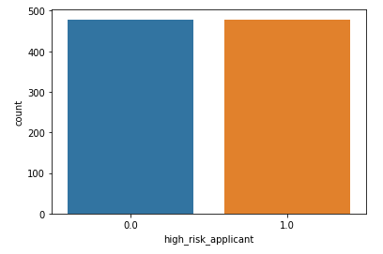
Balanced the dataset by Smote
Original distribution of target variable:
After applying the smote technique
SMOTE (Synthetic Minority Oversampling Technique) – Oversampling is one of the most commonly used oversampling methods to solve the imbalance problem. It aims to balance class distribution by randomly increasing minority class examples by replicating them. After performing SMOTE
operation we get this balance dataset.

Slide 19

Machine Learning Classifier Algorithms

Slide 20

Model building
Logistic Regression
KNeighborsClassifier
RandomForestClassifier

Slide 21
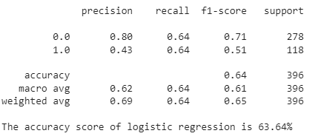
Logistic regression
The accuracy that we get from logistic regression is 63.64%

Slide 22
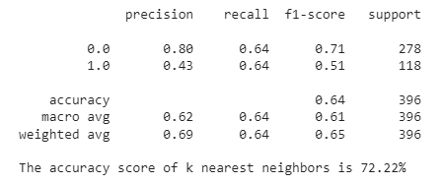
K-neighbors Classifier
The accuracy that we from KNN Classifier is 72.22%.

Slide 23
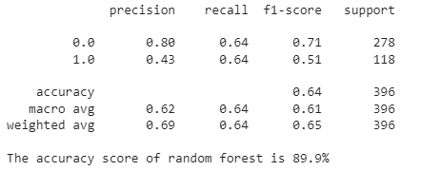
Random- Forest Classifier
The accuracy we get by using random forest classifier as 89.9%.

Slide 24
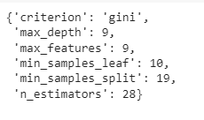
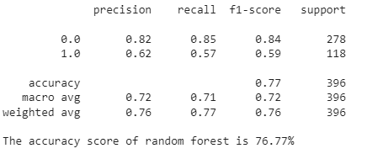
After applying hyper parameter tuning:

Slide 25
Challenged face:
We summarize four major challenges in this project of credit risk.
First, data imbalance in credit risk is quite severe. Although several approaches such as over-sampling and under-sampling (usually chosen to under-sample the majority) have been proposed to solve this problem, the results are still unsatisfactory in terms of both effectiveness and efficiency.
Second, the shortage of benchmark datasets is serious. Most existing works use private datasets, thus the results of performance comparison cannot be fair enough.
Third, most machine learning models are black boxes since they are generally not transparent. Information transparency should be noticed.
Fourth, the application of deep learning models is still limited in credit risk.
These four challenges are what we are supposed to overcome in future work. We hope more and more deep advanced models will emerge in this area.

Slide 26
Conclusion:
On the basis of employment Status it be concluded that skilled employees are less risky than any other category.
Customer who belong to the category existing loan paid back are less risky, they are expected to pay back loan to the company as their history is good.
Random forest gives good accuracy as 89.9% with good F1 score.

Slide 27
Thank you

