Slide 1
Capstone Project
ZOMATO RESTAURANT CLUSTERING AND SENTIMENT ANALYSIS by Kanika Bhardwaj

Slide 2
Table of contents
Problem Statement
Business Problem Analysis
Data Summary
Methodology
Exploratory Data Analysis
Restaurant Clustering
Sentiment Analysis
Conclusion

Slide 3
Problem Statement
Zomato is an Indian restaurant aggregator and food delivery start-up founded by Deepinder Goyal and Pankaj Chaddah in 2008. Zomato provides information, menus and user-reviews of restaurants, and also has food delivery options from partner restaurants in select cities.
India is quite famous for its diverse multi cuisine available in a large number of restaurants and hotel resorts, which is reminiscent of unity in diversity. Restaurant business in India is always evolving. More Indians are warming up to the idea of eating restaurant food whether by dining outside or getting food delivered. The growing number of restaurants in every state of India has been a motivation to inspect the data to get some insights, interesting facts and figures about the Indian food industry in each city. So, this project focuses on analysing the Zomato restaurant data for each city in India.
The Project focuses on Customers and Company, you have to analyze the sentiments of the reviews given by the customer in the data and made some useful conclusion in the form of Visualizations. Also, cluster the zomato restaurants into different segments. The data is visualized as it becomes easy to analyse data at instant. The Analysis also solve some of the business cases that can directly help the customers finding the Best restaurant in their locality and for the company to grow up and work on the fields they are currently lagging in.
This could help in clustering the restaurants into segments. Also the data has valuable information around cuisine and costing which can be used in cost vs. benefit analysis
Data could be used for sentiment analysis. Also the metadata of reviewers can be used for identifying the critics in the industry.

Slide 4
Data Summary
Zomato Restaurant names and Metadata
Name : Name of Restaurants
Links : URL Links of Restaurants
Cost : Per person estimated Cost of dining
Collection : Tagging of Restaurants w.r.t. Zomato categories
Cuisines : Cuisines served by Restaurants
Timings : Restaurant Timings
Zomato Restaurant reviews
Restaurant : Name of the Restaurant
Reviewer : Name of the Reviewer
Review : Review Text
Rating : Rating Provided by Reviewer
MetaData : Reviewer Metadata - No. of Reviews and followers
Time: Date and Time of Review
Pictures : No. of pictures posted with review

Slide 5
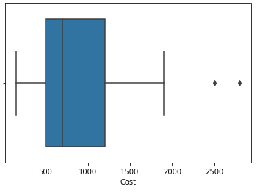
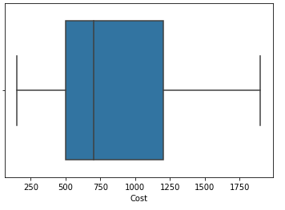
Outliers
Outliers
After removing the outliers

Slide 6
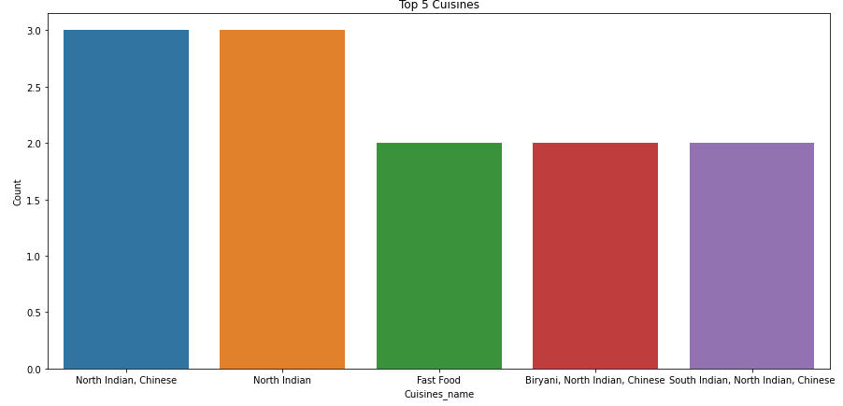
Top 5 Cuisines
i)North Indian, Chinese
ii)North Indian
iii)Continental
iv)Ice Cream, Desserts
v)Fast Food

Slide 7
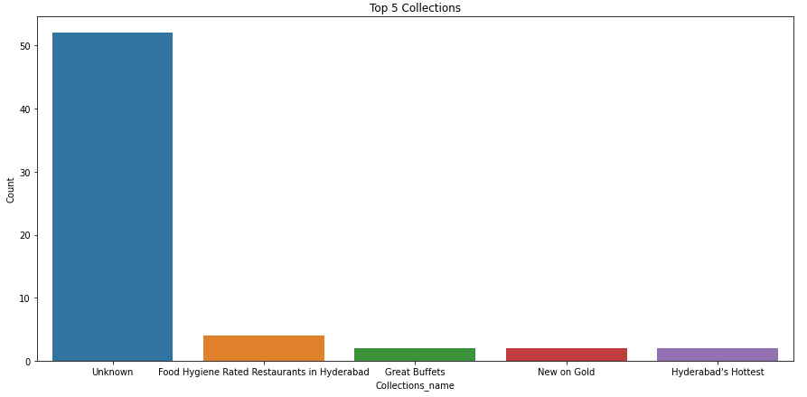
Top 5 Collections
i) Unknown
ii)Food Hygiene Rated Restaurants in Hyderabad
iii)Great Buffets
iv)Trending This Week
v)Hyderabad's Hottest

Slide 8
Applying Silhouette Score Method
Silhouette score is used to evaluate the quality of clusters created using clustering algorithms such as K-Means in terms of how well samples are clustered with other samples that are similar to each other. The Silhouette score is calculated for each sample of different clusters. The following distances need to be found out for each observations belonging to all the clusters:
Mean distance between the observation and all other data points in the same cluster. The mean distance is denoted by a
Mean distance between the observation and all other data points of next nearer cluster. The mean distance is denoted by b.

Slide 9
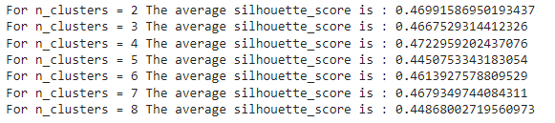
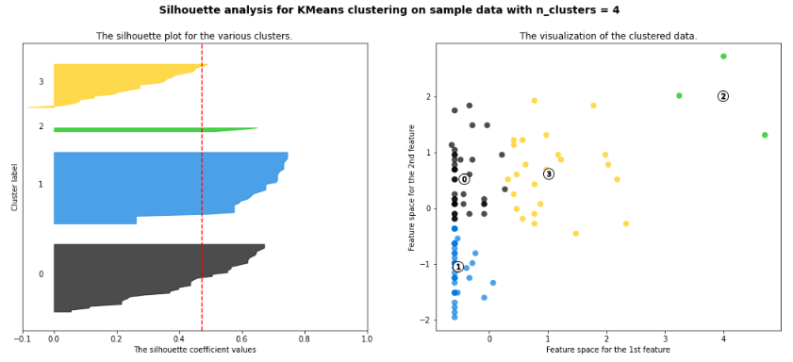

Slide 10
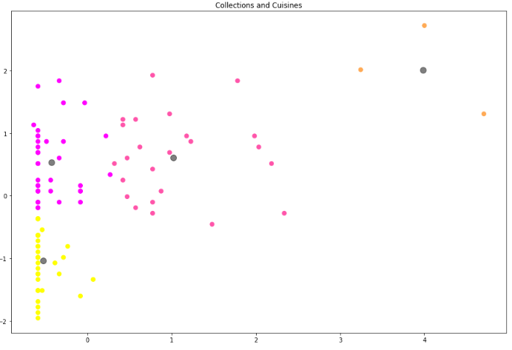
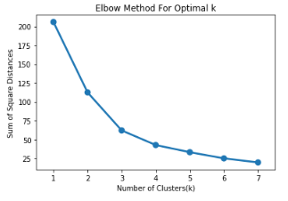
K Mean Clustering

Slide 11
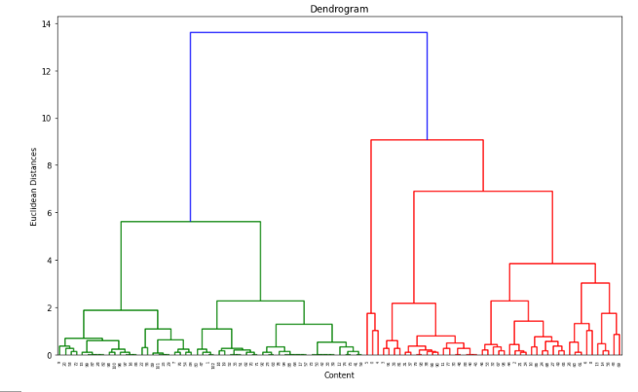
Dendrogram to find optimal number of cluster

Slide 12
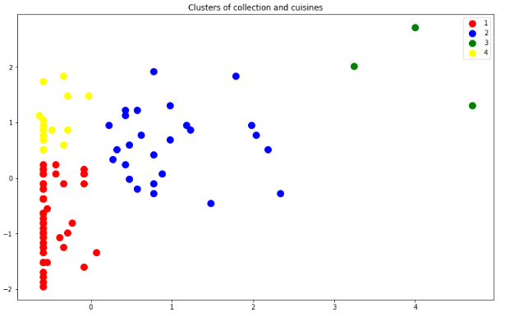
Agglomerative hierarchical Clustering

Slide 13
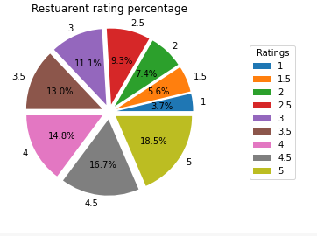
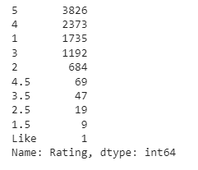
Zomato Restaurant reviews
Counts of Ratings
Plotting of ratings

Slide 14

Results by Logistic Regression
We have applied logistic regression on reviews dataset. getting 82% Accuracy on model

Slide 15
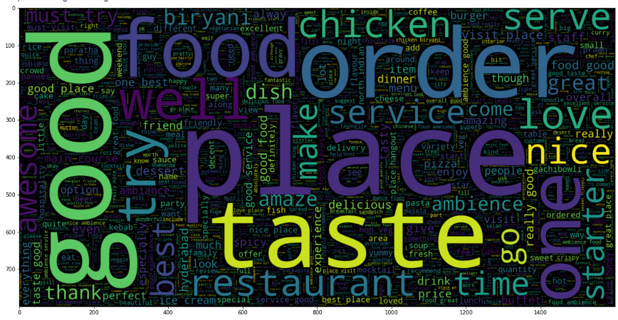
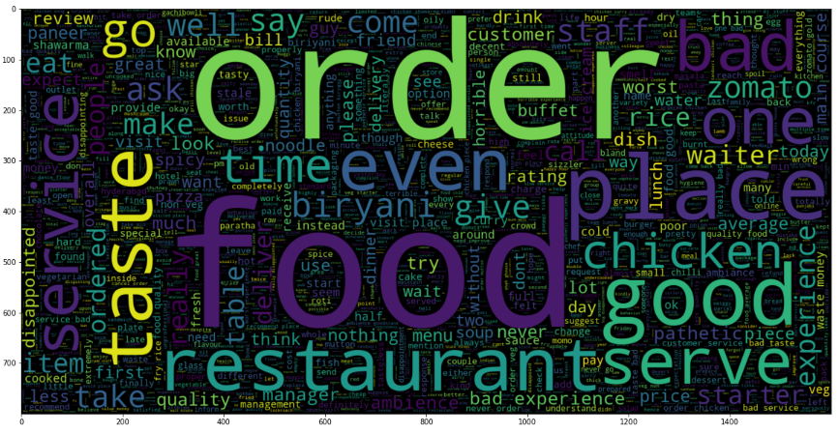
Positive and Negative Word Clouds

Slide 16
Conclusion
Clustering Analysis
Top 5 cuisines are
i)North Indian, Chinese ii)North Indian iii)Continental
iv)Ice Cream, Desserts v)Fast Food
Bottom 5 cuisines are
i) American, Fast Food, Salad, Burger
ii)Continental, Italian, North Indian, Chinese iii)North Indian, Italian, Continental, Asian iv)Mexican, Italian, North Indian, Chinese, Salad v)Momos
Top 5 collections are :
i) Unknown ii)Food Hygiene Rated Restaurants in Hyderabad
iii)Great Buffets iv)Trending This Week v)Hyderabad's Hottest

Slide 17
Conclusion (conti…..)
Bottom 5 collections are
i)Sneak Peek Hyderabad ii)Best Milkshakes iii)Happy Hours, Top-Rated, Gold Curated iv)Best Bakeries v)Great Breakfasts, Late Night Restaurants
In collection top 3 vocab used is week, visit and veggie
In cuisines top 3 vocab used is wrap, thai and sushi
For n_clusters = 4, we get highest silhouette score is 0.4722959202437076
From elbow method we get 4 number of cluster is best among all.
Used dendogram to find optimal number of cluster
Applied agglomerative hierarchical clustering from this we find 4 number of cluster good fit our model.
By applying different clustering algorithms to our dataset. we get the optimal number of cluster is equal to 4.

Slide 18
Conclusion
Sentiment Analysis
Restaurants with negative reviews should be worked with in order to arrive at a win-win situation.
Ratings should be collected on a category basis such as rating for packaging, delivery, taste, quality, quantity, service, etc. This would help in targeting specific fields that are lagging.
We have categorize rating in 3 types i.e. good, bad and average. 4500+ good, 1700+ bad and 900+ average ratings given by customer.
We have applied logistic regression on reviews dataset. getting 82% Accuracy on model.

Slide 19
Thank You

