Slide 1
Capstone Project
EDA on Airbnb booking by Kanika Bhardwaj

Slide 2
Table of contents
Problem statement
Objective
Data summary
Analysis based on:
Neighborhood group
Price
Room types
Number of reviews
Longitude and latitude
Conclusion

Slide 3
Problem Statement
❖ For this project we are analyzing Airbnb’s New York City(NYC) data of 2019. NYC is not only the most famous city in the world but also top global destination for visitors drawn to its museums, entertainment, restaurants and commerce.
❖ Our main objective is to find out the key metrics that influence the listing of properties on the platform. For this, we will explore and visualize the dataset from Airbnb in NYC using basic exploratory data analysis (EDA) techniques. ❖ Data analysis on thousands of listings provided through Airbnb is a crucial factor for the company.
❖ We will be finding out the distribution of every Airbnb listing based on their location, including their price range, room type, listing name, and other related factors.

Slide 4
Objectives
We try to answer following questions for Airbnb:
What can we learn about different hosts and areas?
What can we learn from predictions? (ex: locations, prices, reviews, etc)
Which hosts are the busiest and why?
Is there any noticeable difference of traffic among different areas and what could be the reason for it?

Slide 5
Objectives(conti……)
Find top 10 hosts with most listings
Find the top three hosts based on their turnover
Find total no. of nights spend per location
Total no. of nights spends per room types
Top 10 highest listing neighborhood

Slide 6
Data Summary
There are 49,000 observations with various types of field in our dataset. List of field:
Id
Name
Host_name
Neighbourhood_group
Neighbourhood
Latitude
Longitude
Room_type
Price
Minimum_nights
Number_of_reviews
Last_review
Reviews_per_month
Calculated_host_listing_count
availabilty_365

Slide 7
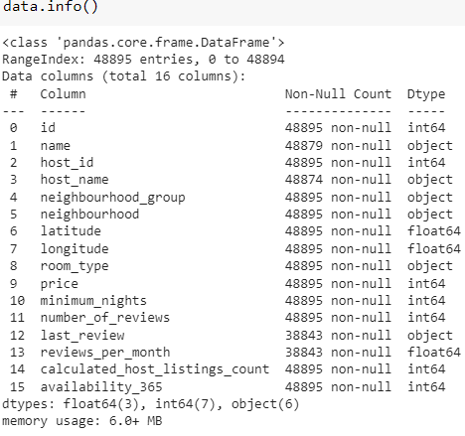
Checking data types and non-null values count
The columns with missing values are
name,
host_name,
last_review, and
reviews_per_month
because these having non-null count less than 48895 (dataframe size).
The last two are missing over 10,000 rows of data each.
The number of reviews per month can be interesting to analyze, so the best way to deal with this column is to replace all NaN values with zeros.
As for the other three columns, they will not be used in this analysis and should be dropped

Slide 8
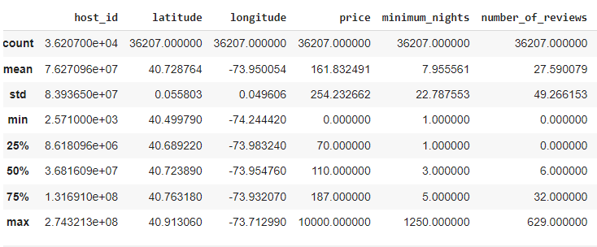
Exploring and Visualizing Data
At first glance, the summary statistics shows us that
the average price is 161.83,
the average minimum nights stay is 7.95 nights,
the average number of reviews is 27.59 per listing,
a host has an average of 9.15 places listed and
availability averages 152.30 vacant days per year.
Most importantly, the min price is showing as zero and the max price as 10,000. Something isn't right with the data, so need to look into this issue and check for outliers

Slide 9


After cleaning the data
Initially dataset has 16 columns and 48,895 rows, but a significant number of values seem to be missing from the last_review and reviews_per_month columns. It includes information about the listings, such as id, host name, room type, price, and neighborhood.
After cleaning data set, details are as below
5 different type neighborhood groups,
221 neighborhoods,
26388 unique hosts,
3 types of room available for rental.
36207 listings, and
12 columns

Slide 10
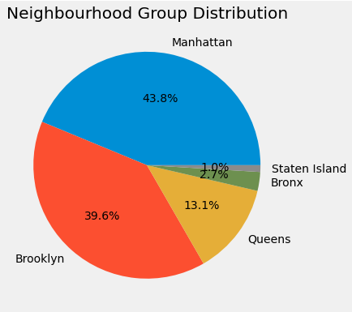
What can we learn about different hosts and areas?
The pie chart above shows that Airbnb Listings in New York are near Manhattan, and Brooklyn has the highest share of hotels. We also know that from this map of Neighborhood Group.
We can see that Manhattan has the highest number of listings - making up for 43.8% of the total - followed by Brooklyn with 39.6%. The other three groups have significantly less listings: Queens (13.1%), Bronx (2.7%), and Staten Island (1%).

Slide 11
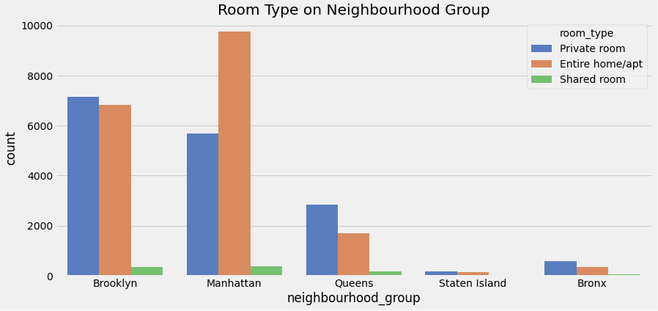
Room type on Neighbourhood Group
The graph shows that the Entire Home/Apartment is listed most near Manhattan, while Private Rooms and Apartments Near Brooklyn are Nearly equal.
from this plot, we can infer that although the number of Airbnb's in Manhattan is more, The number of private Airbnb in Brooklyn is way more than in Manhattan.
also, the total number of shared rooms are comparatively very less than another type

Slide 12
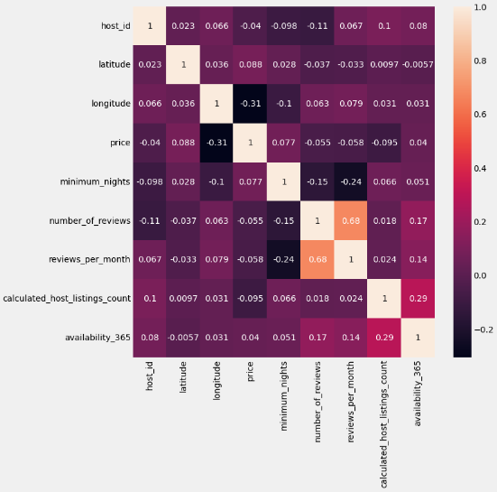
Correlation between different variables
From the above graph, we can see that there is not a strong correlation except review_per_month and number_of_review. We need to try a price prediction using some machine learning model

Slide 13
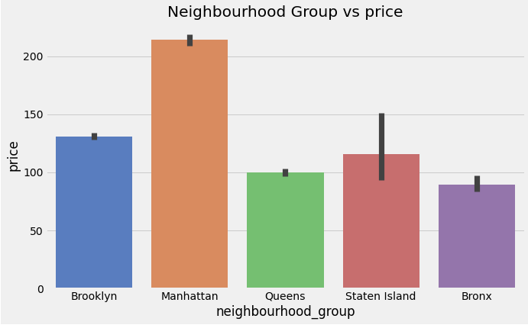
Price Prediction

Slide 14
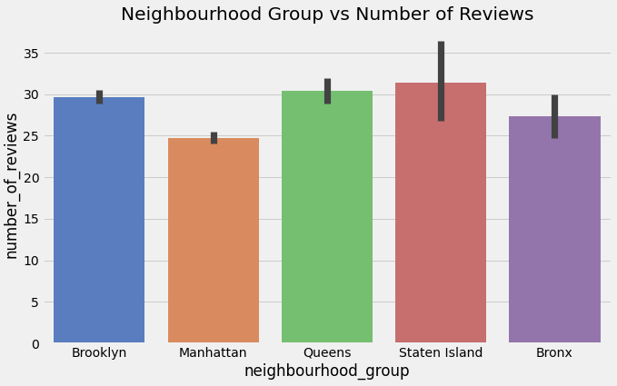
Reviews Prediction

Slide 15
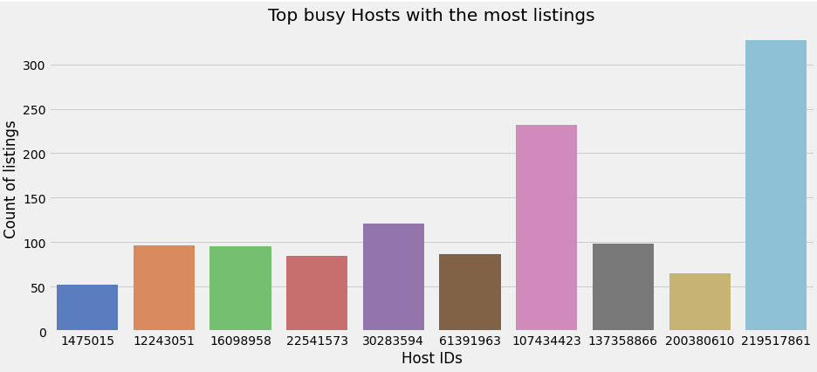
Top busy hosts

Slide 16
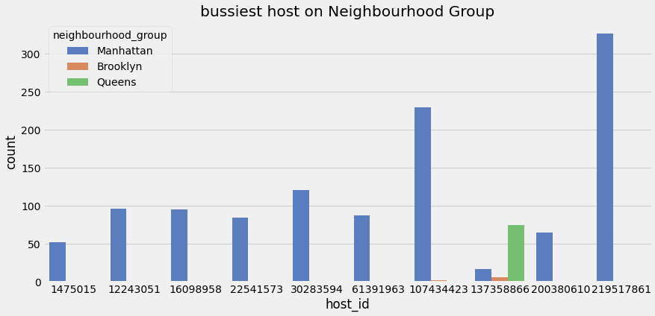
Busiest Host
All busiest hosts belong to Manhattan group and Manhattan group is already having most no of listing.

Slide 17

Room Types on Neighbourhood Group
The graph shows that the Entire Home/Apartment is listed most near Manhattan, while Private Rooms and Apartments Near Brooklyn are Nearly equal.

Slide 18
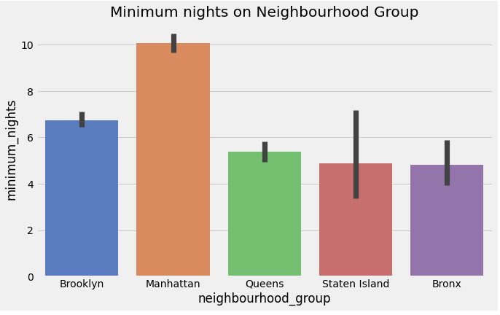
Minimum nights on Neighbourhood Group
The graph shows that Manhattan has the highest count for minimum_nights.

Slide 19
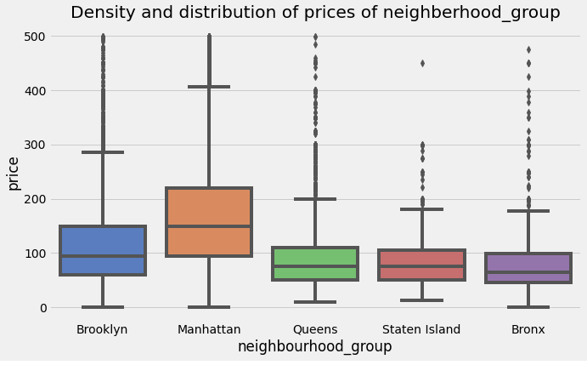
Density and Distribution of prices
With a box plot we can definitely observe a couple of things about distribution and density of prices for Airbnb in NYC Groups.
First, we can state that Manhattan has the highest range of prices for the listings with $150 price as average observation, followed by Brooklyn with $90 per night.
Queens and Staten Island appear to have very similar distributions, Bronx is the cheapest of them all

Slide 20
Conclusion
Price depends on Neighbourhood group. Its high in Manhattan. Manhattan is the city which has a lot of price fluctuations.
We can even find the less prices for some listings in particular neighbourhood. We can even find the costliest listings in the same neighbourhood.
We can get the famous host (Sonder from Manhattan) from the number of properties he is offering. He owns many properties throughout Manhattan, New York, which in turn is the busiest city in New York.
Manhattan is the place which is famous and can be a good option for the companies to invest on properties of Entire home/Apt.

Slide 21
Thank You

