Slide 1
0
DMBS
GROUP PROJECT:PR24
Human Resources Management System
Kanika Gupta 2022ume0210
Sparsh Gupta 2021ucs0119
Nilesh Patel 2021ucs0104

Slide 2
1
PROBLEM STATEMENT
"HR processes are inefficient and error-prone due to disjointed systems for attendance, leaves, payroll, and branch management."

Slide 3
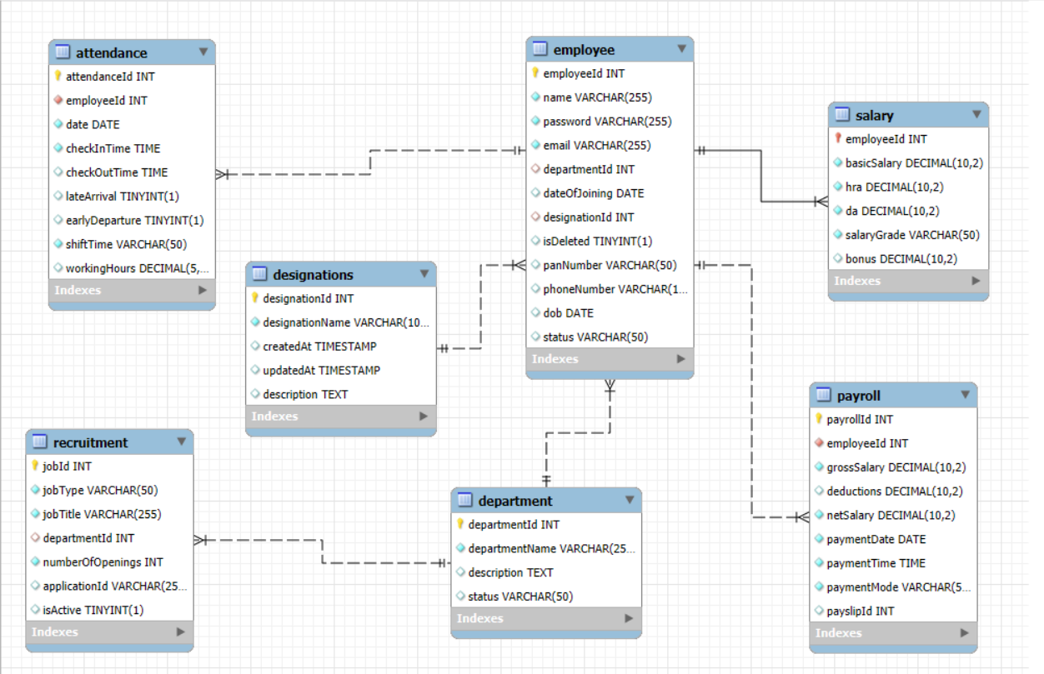
SCHEMA
2

Slide 4
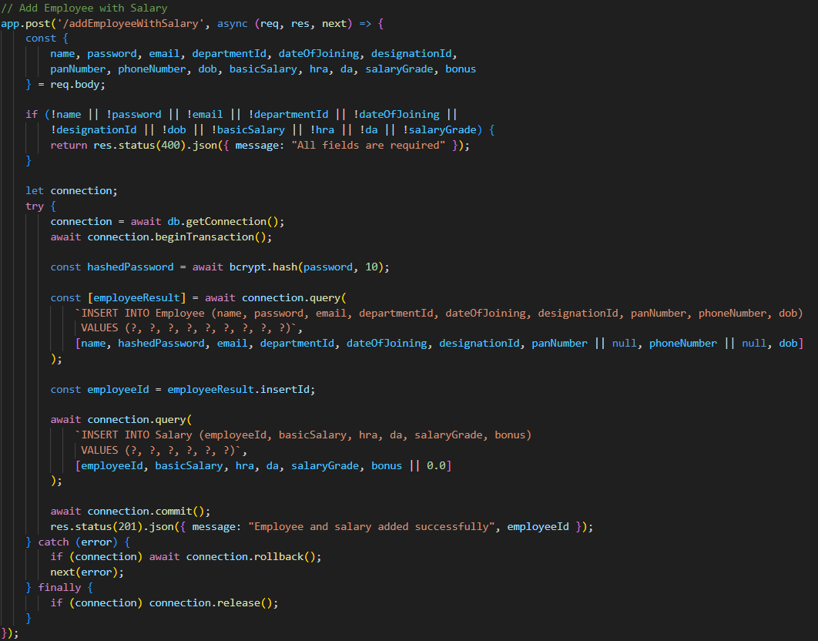
TRANSACTION CONCURRENCY CONTROL
4

Slide 5

3
DEMONSTRATION

Slide 6
THANK YOU
PR24

