Slide 1
WIP : Parkinson’s wearing-off Detection: Forecasting, App Design, and Behavior Feedback
KANIA GUPTA
Kyushu Institute of Technology
Interim Presentation
1

Slide 2
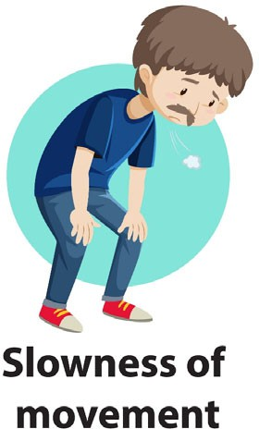
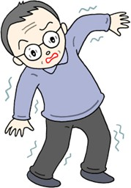
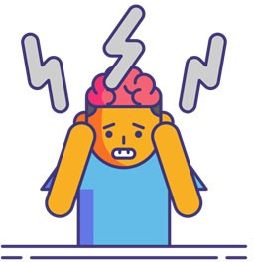
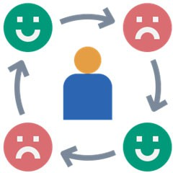
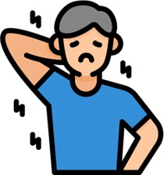
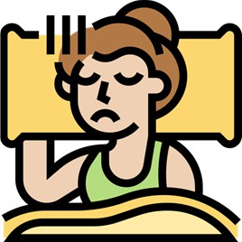

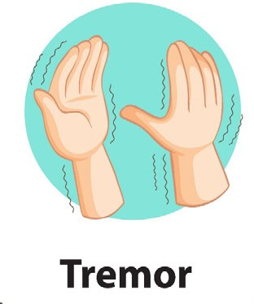
Parkinson’s Disease (PD)
Research Background
Parkinson’s Disease (PD)
PD is a slowly progressive disorder of the nervous system due to loss of dopamine-producing brain cells.
Motor Symptoms Non-Motor Symptoms
Symptoms and its severity vary for each patient
+
→
Affects daily life & Quality of Life (QoL)
Postural Instability
Mental Functions
Mood
(Bradykinesia)
Collaborate with clinicians for customized treatment
Muscle stiffness (Rigidity)
Sleep
J. Massano and K. P. Bhatia, ‘Clinical Approach to Parkinson’s Disease: Features, Diagnosis, and Principles of Management’, Cold Spring Harb Perspect Med, vol. 2, no. 6, Jun. 2012, doi: 10.1101/cshperspect.a008870.
S. Sveinbjornsdottir, ‘The clinical symptoms of Parkinson’s disease’, Journal of Neurochemistry, vol. 139, no. S1, pp. 318–324, 2016, doi: 10.1111/jnc.13691.
2

Slide 3
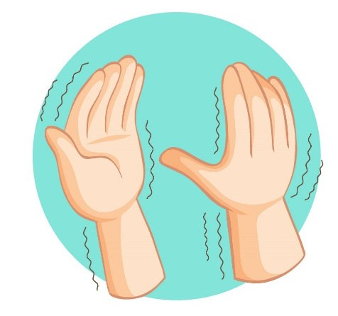




Wearing-Off Phenomenon (WO)
Research Background
Wearing-Off Phenomenon (WO)
Patients undergo Levodopa treatment (L-dopa) to alleviate the symptoms.
5. Over time,
#3 shortens causing discomfort
to the PD patient
1. PD patient experiences symptoms
3. PD patient are relieved of symptoms
4. Symptoms start
to re-appear before the next prescribed medicine intake (wearing-off)
2. Anti-PD medicine intake as prescribed
Wearing-off needs to be monitored & reported by PD patients to re- adjust the treatment plan.
A. Antonini et al., ‘Wearing-off scales in Parkinson’s disease: Critique and recommendations: Scales to Assess Wearing-Off in PD’, Mov. Disord., vol. 26, no. 12, pp. 2169–2175, Oct. 2011, doi: 10.1002/mds.23875.
D. Colombo et al., ‘The “Gender Factor” in Wearing-Off among Patients with Parkinson’s Disease: A Post Hoc Analysis of DEEP Study’, The Scientific World Journal, Jan. 20, 2015. https://www.hindawi.com/journals/tswj/2015/787451/
Victorino, John Noel, et al. "Understanding wearing-off symptoms in Parkinson’s disease patients using wrist-worn fitness tracker and a smartphone." Procedia Computer Science 196 (2022): 684-691.
3
Victorino, John Noel, et al. "Predicting wearing-off of Parkinson’s disease patients using a wrist-worn fitness tracker and a smartphone: A case study." Applied Sciences 11.16 (2021): 7354.

Slide 4
Research Objectives
To develop and compare machine learning models for predicting Parkinson’s disease wearing-off episodes using Garmin-based Victorino dataset after 1 hour.
To deploy the best-performing model for real-time prediction and integrate it into a user-friendly application for clear result visualization.
To assess behavioral changes in patients by introducing feedback questions via FonLog based on prediction insights.
4

Slide 5
Related Search
1. Victorino et al. (2021) Predicting Parkinson’s Wearing-Off Using Wearables
Used Garmin + FonLog data
Achieved up to 76.9% balanced accuracy
Personalized ML models for real-life prediction
[Applied Sciences, 2021]
2. Victorino et al. (2022) Understanding Wearing-Off Symptoms via Smart Devices
Analyzed sleep, steps, drug timing as key indicators
Showed feasibility of commercial trackers
[Procedia Computer Science, 2022]
5

Slide 6
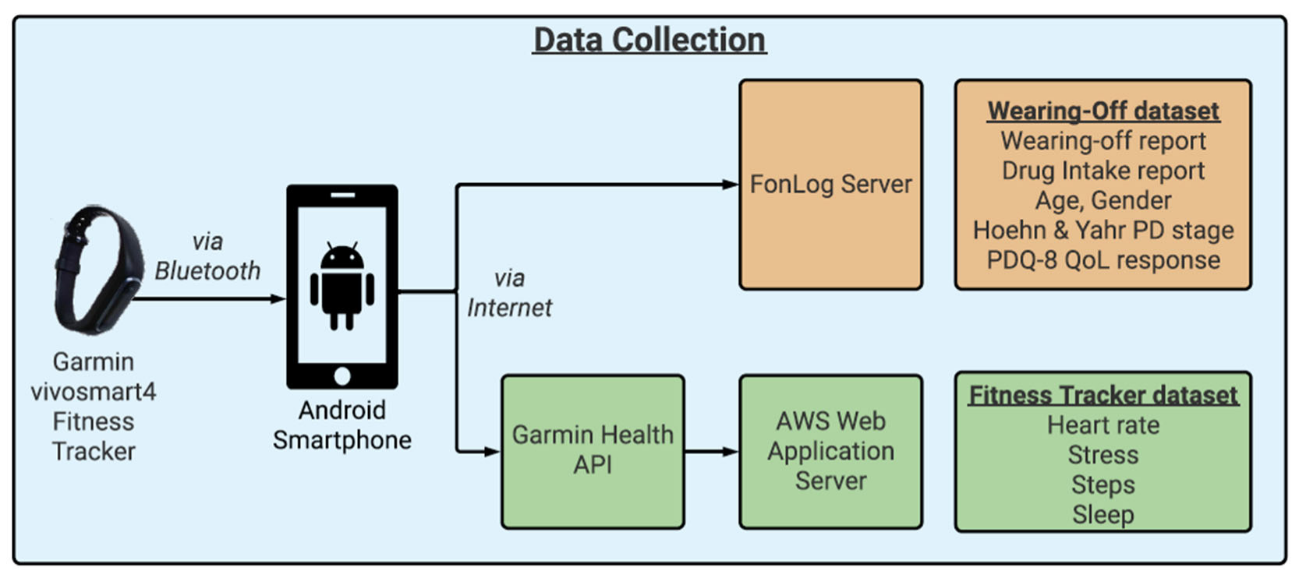
Previously Collected Data Process
Research Method
Data Collection Process
PD patients who are aware of wearing-off
PD participants were asked to contribute 30 days’ worth of data from 23rd February’21 to 24th March’21
Wear fitness tracker
Report wearing-off period and drug intake period using a smartphone app
Victorino, John Noel, et al. "Understanding wearing-off symptoms in Parkinson’s disease patients using wrist-worn fitness tracker and a smartphone." Procedia Computer Science 196 (2022): 684-691.
Victorino, John Noel, et al. "Predicting wearing-off of Parkinson’s disease patients using a wrist-worn fitness tracker and a smartphone: A case study." Applied Sciences 11.16 (2021): 7354.
6

Slide 7
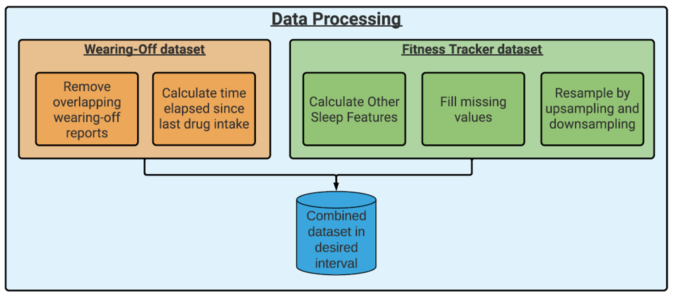
Data Processing
Research Method
Data Processing

Slide 8
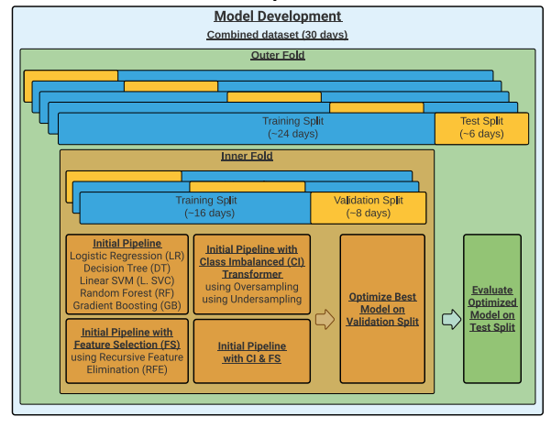
Model Development
Research Method
Data Processing

Slide 9
Garmin vivosmart4 Datasets
Experiments
Garmin vivosmart4 Datasets
Data Type | Granularity | Description
Heart rate | 15-second interval | Beats per minute (bpm)
Steps | 15-minute interval | Cumulative count per interval (minimum: 0)
Stress score | 3-minute interval | Estimated stress score (0 – 100) 0 – 25: Resting state 26 – 50: Low stress 51 – 75: Medium stress 76 – 100: High stress -1: not enough data to detect stress -2: too much motion
Sleep classification & Sleep period | Per calendar date | Start and end time per sleep classification Light sleep Rapid eye movement (REM) sleep Deep sleep Awake
7
Garmin, ‘vívosmart 4 - Heart Rate Variability and Stress Level’, Heart Rate Variability and Stress Level. Oct. 2020. Accessed: Apr. 06, 2021. [Online]. Available: https://www8.garmin.com/manuals/webhelp/vivosmart4/EN-US/GUID-9282196F-D969-404D-B678-F48A13D8D0CB.html
9

Slide 10
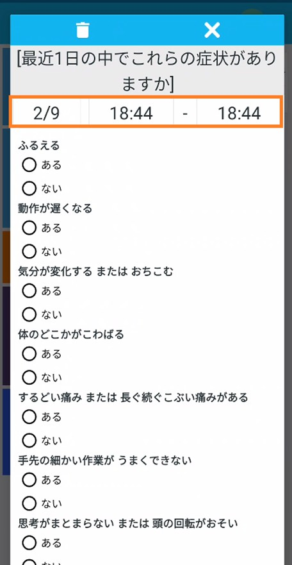
Smartphone Application Dataset
Experiments
Smartphone Application Dataset
Data collection tool to record experienced symptoms (using Japanese Wearing-Off Questionnaire or WoQ-9)
Tremors
Slowing down of movement
Change in mood / Depression
Rigidity of muscles
Sharp pain / Prolonged dull pain
Impairment of complex movement of hands & fingers
Difficulty integrating thoughts / slowing down of thought
Anxiety / Panic attacks
Muscle spasm
Drug intake and its effects were also part of WoQ-9
Age, Gender, Hoehn and Yahr PD Stage, PDQ-8 QoL response (one time)

Slide 11
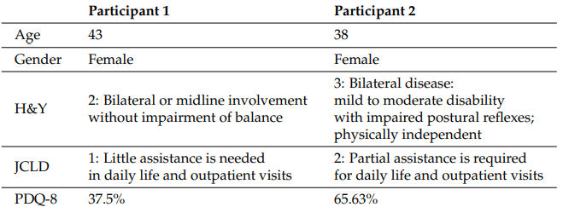
Participant Demographics
Experiments
11

Slide 12
Best hyperparameter configuration performance on the validation set
Results and Discussion
Model Development
Participant1_15mins
Participant1_15secs
 | Balanced Accuracy | F1 Score | Precision
Initial Pipeline | 0.5591 | 0.5079 | 0.5779
Feature Selection | 0.5687 | 0.4990 | 0.5957
Class Imbalance | 0.5621 | 0.5068 | 0.5747
Feature Selection + Class Imbalance | 0.5656 | 0.4419 | 0.6662
 | Balanced Accuracy | F1 Score | Precision
Initial Pipeline | 0.5491 | 0.4771 | 0.5192
Feature Selection | 0.5433 | 0.4582 | 0.5204
Class Imbalance | 0.5592 | 0.5176 | 0.6224
Feature Selection + Class Imbalance | 0.5484 | 0.4827 | 0.5223
Metrics
CI
Participant2_15mins
Participant2_15secs
 | Balanced Accuracy | F1 Score | Precision
Initial Pipeline | 0.6660 | 0.1081 | 0.0580
Feature Selection | 0.6922 | 0.1308 | 0.0747
Class Imbalance | 0.7557 | 0.1959 | 0.1384
Feature Selection + Class Imbalance | 0.7301 | 0.1358 | 0.0747
 | Balanced Accuracy | F1 Score | Precision
Initial Pipeline | 0.6588 | 0.0770 | 0.0402
Feature Selection | 0.6583 | 0.0788 | 0.0421
Class Imbalance | 0.7287 | 0.1016 | 0.0541
Feature Selection + Class Imbalance | 0.7850 | 0.1544 | 0.0866
12

Slide 13
Comparison of learning algorithm performance on the validation set using the CI best pipeline
Results and Discussion
Model Development
Participant1_15secs
Participant1_15mins
 | Balanced Accuracy | F1 Score | Precision
LR | 0.5170 | 0.4459 | 0.5148
DT Classifier | 0.5564 | 0.5344 | 0.5570
Linear SVC | 0.4731 | 0.3937 | 0.4621
RF Classifier | 0.5420 | 0.4688 | 0.5254
GB Classifier | 0.5587 | 0.4994 | 0.5719
 | Balanced Accuracy | F1 Score | Precision
LR | 0.5041 | 0.4494 | 0.4535
DT Classifier | 0.5499 | 0.4992 | 0.5149
Linear SVC | 0.5083 | 0.4316 | 0.4625
RF Classifier | 0.5326 | 0.4641 | 0.4978
GB Classifier | 0.5464 | 0.4812 | 0.5159
Metrics
GB
Participant2_15secs
Participant2_15mins
 | Balanced Accuracy | F1 Score | Precision
LR | 0.6130 | 0.0864 | 0.0454
DT Classifier | 0.7100 | 0.1783 | 0.1283
Linear SVC | 0.5691 | 0.0765 | 0.0400
RF Classifier | 0.6078 | 0.0965 | 0.0528
GB Classifier | 0.6940 | 0.1154 | 0.0621
 | Balanced Accuracy | F1 Score | Precision
LR | 0.5599 | 0.0548 | 0.0286
DT Classifier | 0.6709 | 0.0848 | 0.0447
Linear SVC | 0.6216 | 0.0707 | 0.0369
RF Classifier | 0.5729 | 0.0726 | 0.0395
GB Classifier | 0.7139 | 0.0949 | 0.0502
13

Slide 14
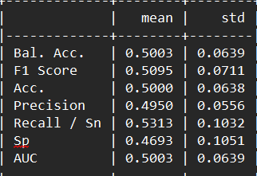
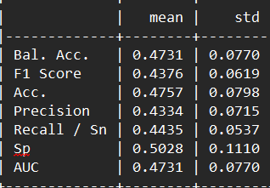
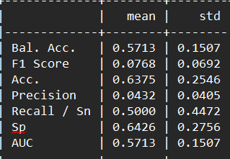
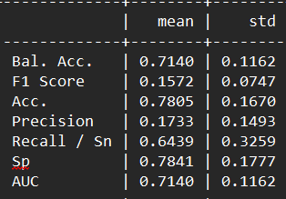
Average performance of best model on the test set using the CI best pipeline + GB best model using final Pipeline
Results and Discussion
Model Development
Participant1_15mins
Participant1_15secs
Metrics
Participant2_15mins
Participant2_15secs

Slide 15
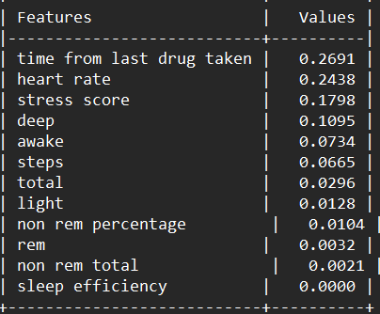
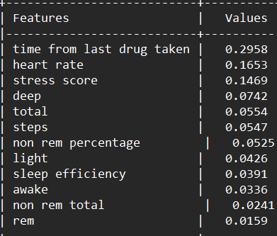
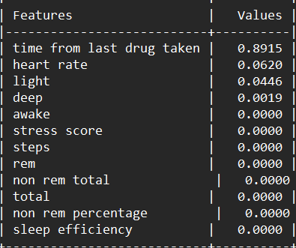
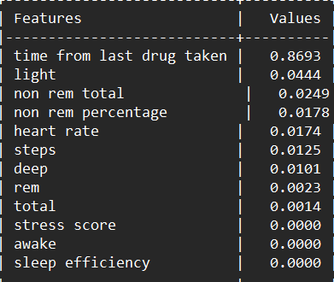
Permutation feature importance for the CI best pipeline + GB best model using final pipeline
Results and Discussion
Participant1_15mins
Participant1_15secs
Participant2_15mins
Participant2_15secs
15

Slide 16
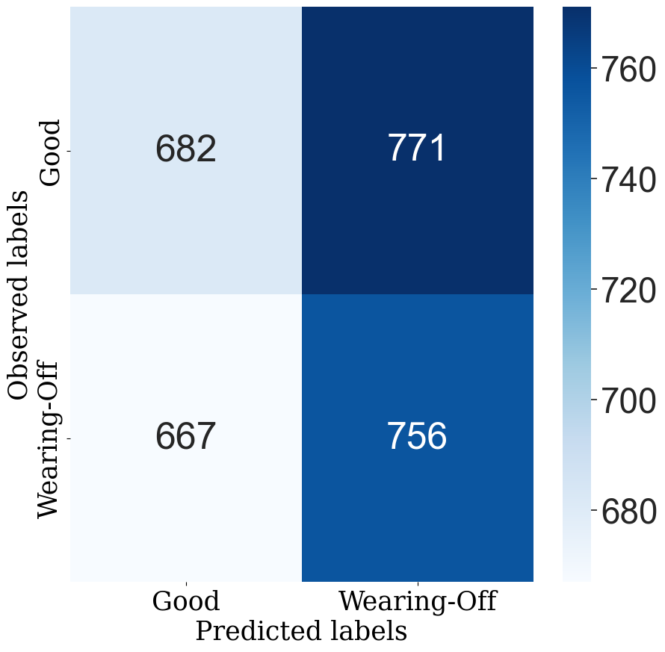
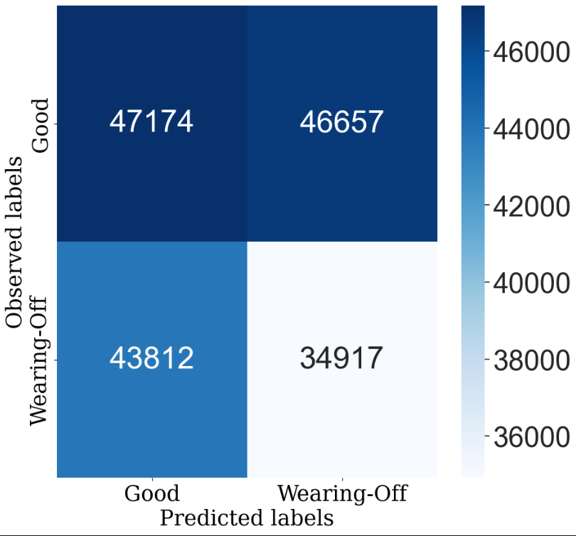
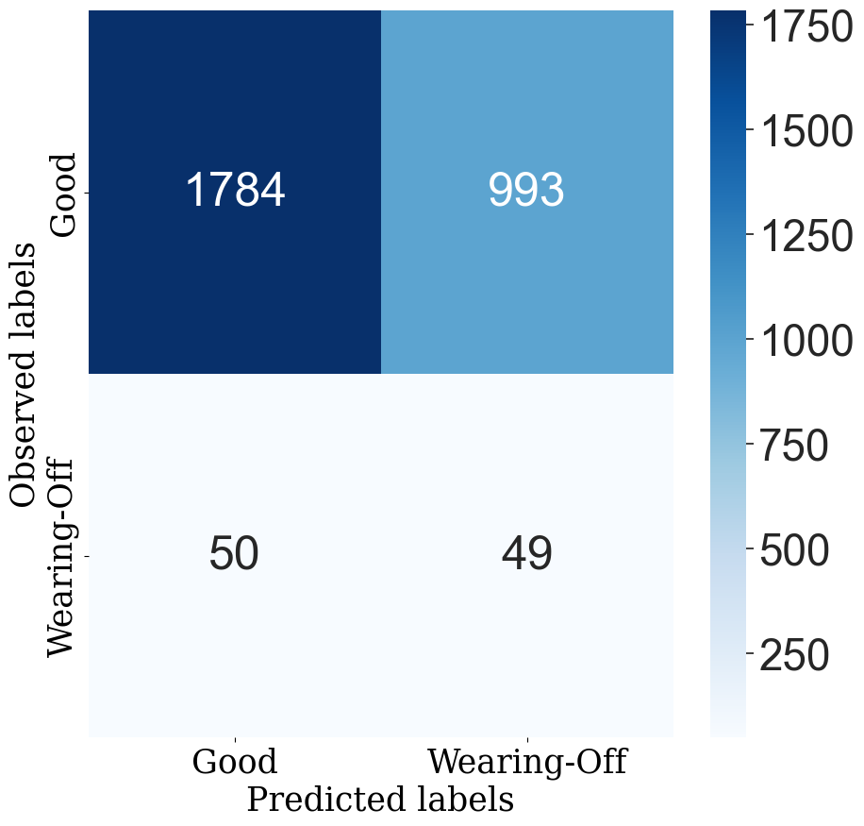
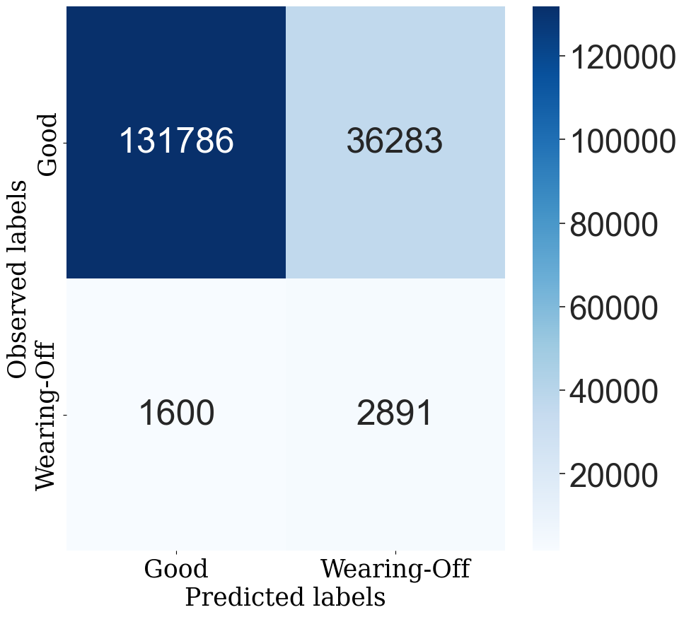
CONFUSION MATRIXs
Results and Discussion
Participant1_15mins
Participant1_15secs
Participant2_15mins
Participant2_15secs
16

Slide 17
Future Work
Summary and Future Prospectives
Future Work
Install the model with the best performance on the server and confirm that it can make real-time predictions
Improve the application (including design) to display the prediction results in an easy-to-understand manner
Set up new questions in FonLog so that we can record how participants changed their behavior based on the results

Slide 18
THANK YOU

Slide 19






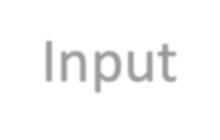

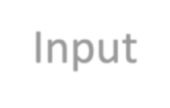

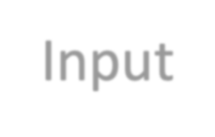








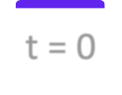
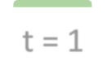





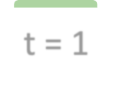




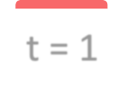









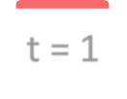




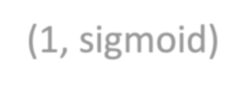
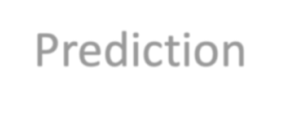

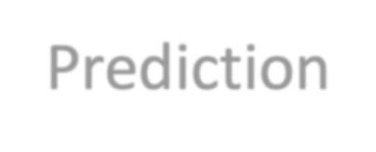




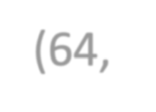

Models Considered
Models Considered
Current Time Models:
Input: current time step (t = 0)
Output: next hour (t = 1)
𝑦_{t+1} = 𝑓 (𝑋_{t}, 𝑦_{t}), 𝑋_{t} = {𝑥₁,𝑥₂, … ,𝑥₁₄}
Baseline Model
Linear Model
Single time-step Dense Model
Input t = 0
Label t = 1
Input t 0
Label t = 1
Input t 0
Label t = 1
t = 1
Dense
t = 1
Dense
t = 1
Dense
Prediction
(1, sigmoid)
Prediction
Dense
(6 ReL )
(6 ReL )
Prediction
4,
u
Note:
4,
u
Shown as hourly interval
Data is in every 15-minute interval (1 hour = 4 rows)
(1, sigmoid)

Slide 20
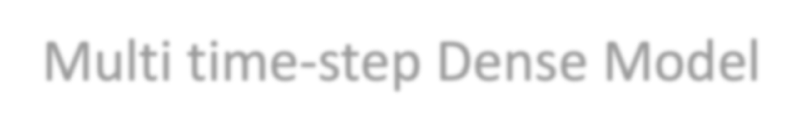








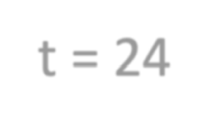

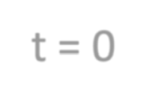
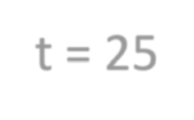
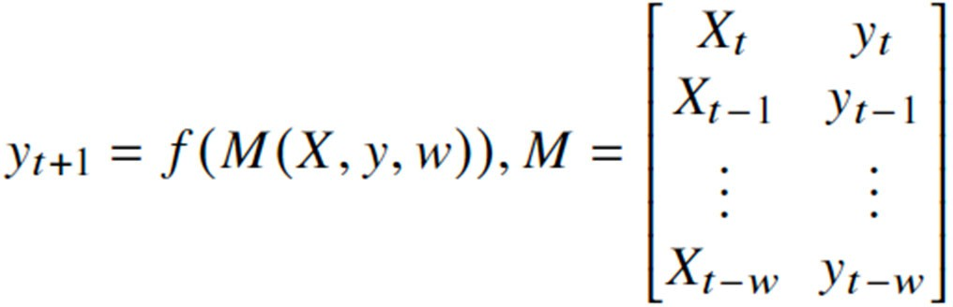














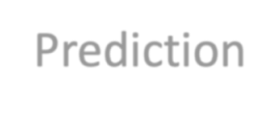
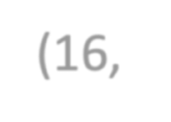



Models Considered
Models Considered
Day Models:
Input: from the last day (t = 0…24)
Output: next hour (t = 1)
Multi time-step Dense Model
Input
Label
t = 0
…
t 24
t = 25
Flatten
Dense
t = 25
Dense
Dense
(1 ReL )
(1 ReL )
Prediction
6,
u
6,
u
(1, sigmoid)

Slide 21
CNN Model
CNN Model
Input
Labels
…
t = 25
t = 26
t = 27
t = 0
t = 24
Conv1D ((16,24), ReLu)
Dense
(16, ReLu), (1, sigmoid)
t = 26
t = 25
t = 27
Predictions

Slide 22




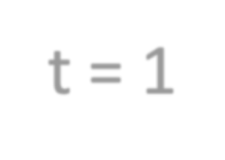

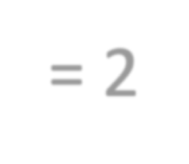
















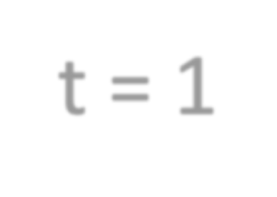
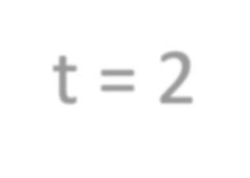
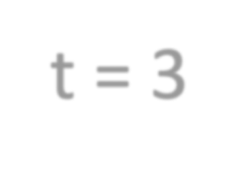










LSTM Model
Input
t 0 t = 1 = 2
t
LSTM
LSTM
LSTM
t = 1
t = 2
t = 3
Prediction
t = 1
t = 2
t = 3
Label

Slide 23


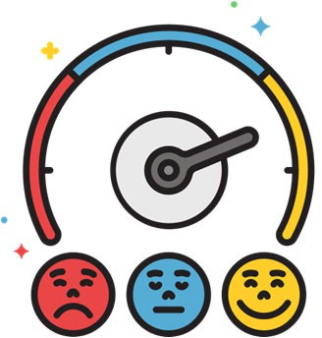


Participants’ Demographics
Participants’ Demographics
Participants H&Y Score JCLD PDQ-8
4
6
Mean Age
57.1 yrs. old
(𝜎 = 15.059)
2.8
(𝜎 = 0.632)
2 = bilateral involvement without impairment of balance,
1.7
(𝜎 = 0.483)
1 = Little assistance
2 = Partial assistance
42.50%
(𝜎 = 0.192)
Higher score means worse QoL

Slide 24
Can a wrist-worn fitness tracker datasets be used to forecast wearing-off in the next hour?
Can a wrist-worn fitness tracker datasets be used to forecast wearing-off in the next hour?
Current Time Models AUC Performance across 10 participants
Current Time Models
Single time-step Dense model
Balanced Accuracy: 79.05% ± 7.09%
AUC: 69.14% ± 10.60%
100.00%
90.00%
80.00%
70.00%
60.00%
50.00%
40.00%
30.00%
20.00%
10.00%
0.00%
AUC Score
Baseline
Linear
Single time-step Dense Model

Slide 25
Can a wrist-worn fitness tracker datasets be used to forecast wearing-off in the next hour?
Can a wrist-worn fitness tracker datasets be used to forecast wearing-off in the next hour?
1-day Models AUC Performance across 10 participants
1-day Models
CNN model
Balanced Accuracy: 80.64% ± 10.36%
AUC: 60.52% ± 30.26%
100.00%
90.00%
80.00%
70.00%
60.00%
50.00%
40.00%
30.00%
20.00%
10.00%
0.00%
AUC Score
Multi time-step Dense Model CNN LSTM

Slide 26


Which among the six deep learning architectures performed well in forecasting wearing-off in the next hour?
Which among the six deep learning architectures performed well in forecasting wearing-off in the next hour?
Architectures | Bal. Acc. | AUC | Precision | Recall
Baseline | 79.05% ± 07.09% | 50.20% ± 05.68% | 07.81% ± 10.16% | 07.59% ± 09.66%
Linear | 79.05% ± 07.09% | 64.71% ± 16.25% | 05.08% ± 06.34% | 28.73% ± 33.58%
 | 79.05% ± 07.09% |  | 06.25% ± 13.50% | 06.15% ± 15.83%
LSTM | 50.00% ± 00.00% | 57.83% ± 17.13% | 03.20% ± 05.17% | 08.10% ± 14.78%
Single time-step
Dense
69.14% ± 10.60%
^{Multi time-step} 80.64% ± 10.36% 60.23% ± 28.33% 18.55% ± 32.29% 36.17% ± 42.24%
Dense
CNN 80.64% ± 10.36% 60.52% ± 30.26% 18.61% ± 31.98% 25.06% ± 39.10%
Multi time-step Dense & CNN had high scores in Bal. Acc. Precision, & Recall
Single time-step Dense had the highest AUC

Slide 27

Discussion
Discussion
Multi time-step Dense & CNN models still had a recall score lower than 50%
Low recall score = Missed wearing-off forecast
69
0
5
0
AUC metric had been considered to balance true positive rate (recall) & false positive rate

Slide 28









Discussion
Discussion
Need to adjust the threshold value for the forecast probability

Slide 29

Related Works: Detecting Wearing-Off
Related Works: Detecting Wearing-Off
Study | Goal | Data Used | Result
Hoff et al, 2004 | Detection: wearing-off, dyskinesia | Accelerometer | Sensitivity: 60% - 71% Specificity: 66% - 76%
Keijsers, 2006 | Detection: wearing-off, bradykinesia, hypokinesia, tremor | Accelerometer | Sensitivity: 97% Specificity: 97%
Hssayeni, 2019 | Detection: wearing-off | Accelerometer, Gyroscope | Accuracy: 90.5% Sensitivity: 94.2% Specificity: 85.4%
Aich, 2020 | Detection: Wearing-off, Gait features | Accelerometer | Random Forest: 96.72% accuracy
Focused on using motion data
Generalized models for the participants (except for Hssayeni, 2019)
Detection of wearing-off rather than prediction
J. I. Hoff, V. van der Meer, and J. J. van Hilten, ‘Accuracy of Objective Ambulatory Accelerometry in Detecting Motor Complications in Patients With Parkinson Disease’, Clinical Neuropharmacology, vol. 27, no. 2, pp. 53–57, Apr. 2004.
N. L. W. Keijsers, M. W. I. M. Horstink, and S. C. A. M. Gielen, ‘Ambulatory motor assessment in Parkinson’s disease’, Movement Disorders, vol. 21, no. 1, pp. 34–44, 2006, doi: https://doi.org/10.1002/mds.20633.
M. D. Hssayeni, M. A. Burack, J. Jimenez-Shahed, and B. Ghoraani, ‘Assessment of response to medication in individuals with Parkinson’s disease’, Med Eng Phys, vol. 67, pp. 33–43, May 2019, doi: 10.1016/j.medengphy.2019.03.002.
S. Aich et al., ‘A Supervised Machine Learning Approach to Detect the On/Off State in Parkinson’s Disease Using Wearable Based Gait Signals’, Diagnostics, vol. 10, no. 6, p. 421, Jun. 2020, doi: 10.3390/diagnostics10060421.
25

Slide 30



Related Works: Non-Motor Aspect of PD & WO
Related Works: Non-Motor Aspect of PD & WO
PD patients’ blood pressure & heart rate were studied during WO.
There’s statistical difference in blood pressure change
Heart Rate
Highly sensitive to the effects of stress with clinical evidence
Worsen tremors, freezing of gait (FoG) and dyskinesia
Stress
Rapid eye movement sleep behavior disorder, sleep disturbances affect PD patients.
Sleep &
Sleep Stages
V. Pursiainen, J. T. Korpelainen, T. H. Haapaniemi, K. A. Sotaniemi, and V. V. Myllylä, ‘Blood pressure and heart rate in parkinsonian patients with and without wearing-off’, European Journal of Neurology, vol. 14, no. 4, pp. 373–378, 2007, doi: 10.1111/j.1468-1331.2007.01672.x.
M. Salsone et al., ‘Cardiac sympathetic index identifies patients with Parkinson’s disease and REM behavior disorder.’, Parkinsonism & related disorders, 2016, doi: 10.1016/j.parkreldis.2016.03.004.
J.-E. Lee, J.-S. Kim, D.-W. Ryu, Y.-S. Oh, I. R. Yoo, and K.-S. Lee, ‘Cardiac Sympathetic Denervation Can Predict the Wearing-off Phenomenon in Patients with Parkinson Disease’, J Nucl Med, vol. 59, no. 11, pp. 1728–1733, Nov. 2018, doi: 10.2967/jnumed.118.208686.
A. van der Heide, M. J. Meinders, A. E. M. Speckens, T. F. Peerbolte, B. R. Bloem, and R. C. Helmich, ‘Stress and Mindfulness in Parkinson’s Disease: Clinical Effects and Potential Underlying Mechanisms’, Movement Disorders, vol. 36, no. 1, pp. 64–70, 2021, doi: 10.1002/mds.28345.
24

Slide 31

Sleep Features

Slide 32

Conclusion
Conclusion
Can wrist-worn fitness tracker datasets be used to forecast wearing-off in the next hour?
YES, forecasting wearing-off using commercial wrist-worn fitness tracker datasets was feasible.
With current time data
With 1-day’s worth of data
Which among the DL architectures performed well in forecasting wearing-off in the next hour?
Single time-step Dense
Multi time-step Dense
CNN
Single time-step Dense
Multi time-step Dense
CNN
Highest AUC: 69.14% ± 10.60%
Highest balanced accuracy: 80.64% ± 10.36%
Detecting & forecasting earing-off was feasible within a certain limit, even with only commercial fitness tracker features.
Detection & Forecasting models can be used in PD management

Slide 33



Current Landscape in Detecting PD symptoms or wearing-off
Current Landscape in Detecting PD symptoms or wearing-off
In-Clinic Data Collection
Motor Aspect
Keijsers, 2006
Jeon, 2017
Sama, 2017
Aich, 2018 & 2020
Steinmetzer, 2019
Hssayeni, 2019
Non-Motor Aspect
Pursiainen, 2007
Salsone, 2016
Lee, 2018
van der Heide, 2021
UPDRS
MDS-UPDRS
& other clinical research
Subjective Assessment
Objective Assessment
Parkinson’s Disease Diary
Griffiths, 2012,
Farzanehfar, 2018 & other clinical studies that use Parkinson’s Kinetigraph (PKG)
Victorino, 2021: Detection of Wearing-off
Current Study Forecasting Wearing-off
WoQ
Continuous Home Data Collection
5

Slide 34
Executive Summary
Executive Summary
Can wrist-worn fitness tracker datasets be used to forecast wearing-off in the next hour?
YES, forecasting wearing-off using commercial wrist-worn fitness tracker datasets was feasible.
With current time data
With 1-day’s worth of data
Which among the DL architectures performed well in forecasting wearing-off in the next hour?
Multi time-step Dense
CNN
Single time-step Dense
Multi time-step Dense
CNN
Single time-step Dense
Highest balanced accuracy: 80.64% ± 10.36%
Highest AUC: 69.14% ± 10.60%
Forecasting wearing-off was feasible within a certain limit, even with only commercial fitness tracker features.
Forecasting models can be used in PD management
4

Slide 35

Garmin vivosmart4
Chosen due to sleek, lightweight; waterproof
Weight: 16.5g – 17.1g
Dimensions: 15 x 10.5 x 197 mm
Communicates with Garmin Health API via Garmin Connect smartphone app

Slide 36
FonLog Smartphone Application Dataset
FonLog Smartphone Application Dataset
Data | Description
WoQ-9 | Symptoms onset and drug intake time
Basic Information | Age, Gender
Hoehn and Yahr Scale (H&Y), Japan Ministry of Health, Labor, and Welfare’s classification of living dysfunction (JCLD) | Participant’s PD stage
Parkinson’s Disease Questionnaire (PDQ-8) | Participant’s QoL measurement specific to PD 0 – 100%, with 100% showing worst QoL

Slide 37
Model Development
Results and Discussion
Model Development
Developed personalized models
Data split
Training Set: 60%
Validation & Test Sets: 20%
Features Used
x₁ : Heartrate (HR)
x₂ : Number of steps (Step)
x₃ : Stress score (Stress)
x₄ : Awake duration (Awake)
x₅ : Deep sleep duration (Deep) x₆ : Light sleep duration (Light) x₇ : REM sleep duration (REM)
x₈ : Total non-REM sleep duration (NonREMTotal)
x₉ : Total sleep duration (Total)
x₁₀ : Time non-REM sleep percentage (NonREMPercentage)
x₁₁: Sleep efficiency (SleepEfficiency)
Metrics
Balanced Accuracy
AUC
Other metrics:
Accuracy, F1 Score, Precision, Recall
x₁₂ : Day of the week (TimestampDayofWeek)
x₁₃ : Sine value of Hour of the day (TimestampHourSin)
x₁₄ : Cosine value of hour of the day (TimestampHourCos)

Slide 38
Results and Discussion
Model Development
Metrics

