Slide 1


WiP: Prediction of QoL in healthy older adults using non-motor information from smart devices
Yu Makido^{*1}, John Noel Victorino^{*2}, Kengo Iwamoto^{*1}, Tomohiro Shibata^{*1}
^{*1} The Graduate School of Life Science and Systems Engineering, Kyutech, Japan
^{*2} Ateneo de Manila University, Philippines
12th International Conference on Informatics, Electronics & Vision (ICIEV)
Notes:
＜タイトル＞ 時間目安：研究背景と合わせて１分半
Hello everyone. My name is Makido from Kyushu Institute of Technology.
I will be presenting “WiP (Work-in-Progress): Prediction of QoL in healthy older adults using non-motor information from smart devices”.
（訳）
こんにちは。九州工業大学の槇戸です。
今回は、「WiP(ワークインプログレス)：スマートデバイスによる非運動性情報を用いた健常高齢者のQoL予測」というタイトルで発表します。

Slide 2
Background
There is a growing interest in well-being and quality of life (QoL) around the world.
・Emphasis on well-being in economically advanced countries [1]
・The World Happiness Report, published annually [2]
In general, QoL is assessed with a questionnaire consisting of multiple questions.
→ Can't we measure QoL more easily and continuously?
[1] MEXT, [ref. 8] on the improvement of well-being (direction in the next basic plan for the promotion of education).
URL https://www.mext.go.jp/kaigisiryo/content/000214299.pdf (Accessed on 05/18/2025)
[2] the Wellbeing Research Centre at the University of Oxford, Home — the world happiness report
URL https://worldhappiness.report/ (Accessed on 05/18/2025)
12th International Conference on Informatics, Electronics & Vision (ICIEV)
１
Notes:
＜研究背景＞ 時間目安：タイトルと合わせて１分半
This is the background.
There is a growing interest in well-being and quality of life (QoL) around the world.
Well-being encompasses not only physical health, but also mental and social dimensions, and refers to happiness throughout life.
It also encompasses both individual and societal prosperity, and in economically advanced countries, the concept of well-being is being emphasized as a way of thinking about happiness [1].
Oxford University’s Center for Well-Being Studies, in collaboration with the United Nations, publishes the annual World Happiness Report, which assesses the QoL in each country [2].
Generally, QoL is evaluated with a questionnaire consisting of multiple questions, but it is time-consuming to answer the questionnaire each time.
Therefore, it would be useful to be able to perform continuous QoL evaluation more easily.
（訳）
研究背景です。
現在、世界各国でウェルビーイングや QoL への関心が高まっています。
ウェルビーイングとは、身体的のみならず精神的・社会的にもいい状態であることをいい、一生を通した生涯的な幸福を指します。
また、一個人だけではなく地域や社会の豊かさも含まれており、経済先進国ではウェルビーイングで幸福感を捉える考え方が重視されています [1]。
オックスフォード大学ウェルビーイング研究センターは毎年国連とともに「世界幸福度報告」を発表しており、各国の人生に対する評価をスコア付けしています [2]。
QoL 評価は一般に複数の質問項目で構成される質問票で評価しますが、毎回質問票に答えるのは手間がかかります。
そこで、もっと簡単に継続的なQoL評価ができると便利です。

Slide 3
Research Purpose
To measure QoL easily and continuously by inputting non-motor information from smart devices into a prediction model.
・Non-motor information can be obtained automatically with only a commercial smart device.
A prior study that utilized non-motor information from smart devices for prediction is
Victorino et al.: predicting the wearing-off phenomenon of Parkinson‘s Disease [3].
→ We have changed his system so that it can be used for non-Parkinson's patients.
[3] J. N. Victorino, Y. Shibata, S. Inoue, T. Shibata, Predicting wearing-off of parkinson ’s disease patients using a wrist-worn fitness tracker and a smartphone: A case study, Applied Sciences 11 (16) (2021) 7354.
12th International Conference on Informatics, Electronics & Vision (ICIEV)
２
Notes:
＜研究目的＞ 時間目安：１分
The purpose of this study is to measure QoL easily and continuously by inputting non-motor information from smart devices into a prediction model.
Non-motor information refers to physical data such as heart rate and stress scores that do not use kinetic information such as acceleration.
And we can obtain it automatically with only a commercial smart device.
A prior study that utilized non-motor information from smart devices for prediction is Victorino et al.
His research uses non-motor information and symptom recording data from Parkinson's patients to predict symptom recurrence.
In this study we have changed his system so that it can be used for non-Parkinson's patients.
Q1. How accurate is it under motor information? (Related works)
A1. (Detailed results have not been compiled and will be looked into.)
（訳）
本研究の目的は、スマートデバイスから得られる非運動性情報を予測モデルに入力して、QoLを簡単かつ継続的に測定することです。
非運動性情報とは、加速度などの運動性情報を使わない、心拍数やストレススコアなどの身体的データを意味しています。
しかも、これらの情報は市販のスマートデバイスだけで自動的に入手することができます。
スマートデバイスからの非運動性情報を予測に活用した先行研究として、Victorinoらの研究があります。
彼の研究では、パーキンソン病患者の非運動性情報や症状の記録データを利用して症状の再発を予測しています。
本研究では、このシステムをパーキンソン病以外の患者にも使用できるように変更しました。
Q1.運動性情報の下ではどのくらいの精度が出ている？（関連研究）
A1.

Slide 4







System Overview
QoL Data
by FonLog
Non-motor Data
as input data
AWS Server
via Bluetooth
via Internet
Garmin Venu 3S
Smart Device
Smartphone
Prediction Model
as label data
FonLog Server
12th International Conference on Informatics, Electronics & Vision (ICIEV)
３
Notes:
＜システム概要＞ 時間目安：１分
The system consists of a smart device, a smart phone, two servers, and a prediction model.
In this study, Garmin Venu 3S is used as the smart device.
Non-motor information collected by the smart device is sent to the smartphone via Bluetooth.
The smartphone records the results of the QoL questionnaire in FonLog application, and the respective data is sent to the corresponding server.
After the end of the data collection period, all data are entered into the prediction model.
Non-motor information is used as input data and QoL data as label data.
Q1. Why was the Garmin Venu 3S chosen?
A1. The main reason was that prior research had created systems that read data from Garmin devices.
Other reasons are that it is lightweight, waterproof, and lasts about 10 days on a single charge.
（訳）
このシステムは、スマートデバイス、スマートフォン、サーバ、予測モデルで構成されています。
スマートデバイスで収集された非運動性情報はBluetooth経由でスマートフォンに送られます。
スマートフォンではFonLogでQoL質問票の回答結果が記録され、それぞれのデータは対応するサーバへ送信されます。
データ収集期間終了後に、すべてのデータが予測モデルに入力されます。
非運動性情報は入力データ、QoLデータはラベルデータとなります。

Slide 5
Garmin dataset
Data Type | Interval | Description
Heart Rate | 15-second | Beats per minute (bpm)
Steps | 15-minute | Cumulative count per interval (minimum: 0)
Stress Score | 3-minute | Estimated stress score (0 – 100) • 0 – 25: Resting state • 26 – 50: Low stress • 51 – 75: Medium stress • 76 – 100: High stress • -1: not enough data to detect stress • -2: too much motion
Sleep Classification & Sleep Period | Per calendar date | Start and end time per sleep classification Light, Rapid eye movement (REM), deep, awake
12th International Conference on Informatics, Electronics & Vision (ICIEV)
４
Notes:
＜Garminデータセット＞ 時間目安：QoLデータセットと合わせて１分
This is the Garmin data set.
This study used heart rate, step count, stress score, and sleep data.
The stress score was calculated by the Garmin smart device based on multiple data sets, such as heart rate.
（訳）
これがGarminデータセットです。
本研究では、心拍数、歩数、ストレススコア、睡眠データを利用しました。
ストレススコアは、Garminスマートデバイスが心拍数など複数のデータをもとに計算したものです。

Slide 6
QoL Questionnaire Dataset
QoL data was collected by setting up EuroQol's EQ-5D-5L in FonLog.
・Question
1. Degree of mobility 4. Pain / discomfort
2. Personal care 5. Anxiety / distraction
3. Daily activities
・Answer
1. No problem 4. Serious problem
2. Minor problem 5. Extreme problem
3. Moderate problem
12th International Conference on Informatics, Electronics & Vision (ICIEV)
５
Notes:
＜QoL質問票データセット＞ 時間目安：Garminデータセットと合わせて１分
QoL data was collected by setting up EuroQol's EQ-5D-5L in FonLog.
The EQ-5D-5L is a questionnaire in which the five questions shown on the slide are answered on a five-point scale from “no problem” to "extreme problem”.
Compared to other questionnaires, the EQ-5D-5L has fewer questions and can be answered quickly, which is why it was employed in this study.
（訳）
QoL質問票のデータは、FonLogにEuroQol社のEQ-5D-5Lを設定して収集しました。
EQ-5D-5Lは、スライドに示した５問に対し「問題なし」から「極度な問題」までの５段階で回答します。
他の質問票に比べて質問数が少なく、手短に答えられるため本研究で採用しました。

Slide 7
Experiment
We practically used a Garmin Venu 3S smart device and the FonLog app to evaluate the accuracy of predicting QoL from non-motor information.
・Participants: 10 healthy older adults
・Data collection period: 21 days
・QoL questionnaire: asked to answer 3 times a day
・Correct answer labels: 0, when all 5 questions were answered most healthy 1, otherwise
12th International Conference on Informatics, Electronics & Vision (ICIEV)
６
Notes:
＜実験方法＞ 時間目安：１分
Practically, We collected data using a Garmin smart device and FonLog and experimented to see if QoL could be measured.
Participants in the experiment were 10 healthy older adults, and the data collection period was 21 days.
The QoL questionnaire was requested three times a day, usually after meals.
As a result, most of the response results were all the healthiest, so label 0 was assigned only in this case, and label 1 was assigned in the remaining cases.
Q1. Why are questionnaires answered three times a day?
How did you decide how often to answer the questionnaire?
A1. Before the experiment, we discussed with the participants how frequently they would feel comfortable to answer the questionnaire.
They said 10 times was too much, so I suggested 3 or 5 and we decided to try 3 times.
（訳）
実際にGarminスマートデバイスとFonLogを使ってデータを収集し、QoLが測定できるか実験を行いました。
実験参加者は健常高齢者10名で、データ収集期間は21日です。
QoL質問票は1日3回、食後を目安に回答を依頼しました。
その結果、ほとんどの回答結果がすべて最も健康だったため、この場合のみラベル0を付与し、残りの場合にラベル1を付与しました。

Slide 8
Data Processing & Model Development
The Garmin data processing:
・Calculation of sleep features (e.g. Total Sleep Duration)
・Completion of missing values
・Resampling to 15-minute intervals
The following prediction model was then developed:
・Data split is 70% training data
・Metrics are accuracy, precision, recall, F1-score
・Algorithm of the model is Support Vector Machine (SVM)
・The parameters were fine-tuned using GridSearch (The kernel function is RBF)
12th International Conference on Informatics, Electronics & Vision (ICIEV)
７
Notes:
＜データ処理＆モデル開発＞ 時間目安：１分
We computed sleep features, completed missing values, and resampled to 15-minute intervals against the Garmin dataset to organize.
We then entered the data for 10 people into the model. An overview of the model is shown in the slide.
There were no restrictions on the algorithm used, but in this case we used a support vector machine.
The support vector machine
is capable of classifying even small amounts of data, as in this experiment, and
can handle predictions that are expected to be nonlinear problems with kernel tricks, and
is relatively robust to outliers introduced by sensor measurements.
（訳）
Garminデータセットに対し、睡眠特徴量の計算、欠損値の補完、15分間隔へのリサンプリングを行い、データセットを整理しました。
その後、10人分のデータをモデルへ入力しました。モデルの概要はスライドの通りです。
使用するアルゴリズムに制約はありませんでしたが、今回はサポートベクトルマシンを使いました。サポートベクトルマシンは、
(1)本実験のような少量のデータでも分類が可能で、
(2)非線形問題であると予想される予測でもカーネルトリックで対応可能で、
(3)センサ測定で生じる外れ値にも比較的ロバストです。

Slide 9
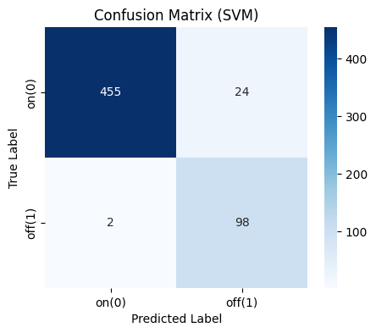
Results
Best parameters: C=100, gamma=0.1
Accuracy: 0.955095
Just under 30% of the total were labeled 1
F1 scores were high for both labels
Label | Precision | Recall | F1-score
0 | 0.995624 | 0.949896 | 0.972222
1 | 0.803279 | 0.980000 | 0.882883
Confusion matrix of test data
12th International Conference on Informatics, Electronics & Vision (ICIEV)
８
Notes:
＜実験結果＞ 時間目安：２枚で１分
This is the results of the experiment.
Just under 30% of the data used for the predictions were label 1.
Accuracy was about 0.96, and F1 scores were about 0.97 and 0.88, respectively, all high values.
The confusion matrix also shows that many of the data were correctly classified.
This indicates that QoL prediction using a smart device may be effective.
（訳）
実験結果はスライドに示した通りです。
予測に使用したデータのうち30%弱がラベル1でした。
Accuracyは約0.96、F1スコアがそれぞれ約0.97、約0.88となり、どれも高い数値となりました。
混同行列からも、多くのデータが正しく分類されたことが分かります。
これは、スマートデバイスを用いたQoLの予測が有効である可能性を示しています。

Slide 10
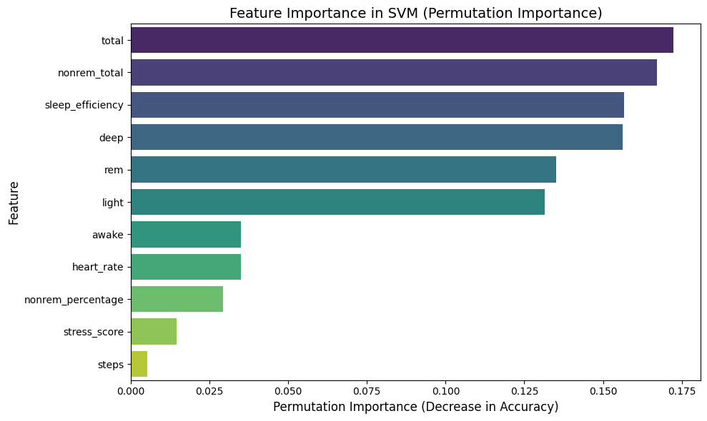
Results
Important features during prediction
Features on sleep turn out to be important for prediction
High correlation between sleep and QoL
12th International Conference on Informatics, Electronics & Vision (ICIEV)
９
Notes:
＜実験結果＞ 時間目安：２枚で１分
Also, this figure shows how important each feature was to the prediction.
The features marked with blue arrows are related to sleep, and most of the absolute values are higher than the others.
This suggests that there is a high correlation between sleep and QoL.
（訳）
また、この図は各特徴量がそれぞれどの程度予測にとって重要だったかを示しています。
青矢印を付けた特徴量は睡眠に関するものですが、ほとんどが他と比べて高い数値となっています。
睡眠とQoLには高い相関があると考えられます。

Slide 11
Conclusion & Future work
Conclusion
Prediction of QoL using non-motorized information obtained from smart devices
・Smart devices can be worn easily and are not difficult to use on a daily basis
・We may measure QoL easily and continuously
Future works
・Try to evaluate the performance of models other than SVM.
・Test the system on a larger and more diverse population, including non-healthy users
・Automate data acquisition, prediction, and provide the prediction results to users
12th International Conference on Informatics, Electronics & Vision (ICIEV)
１０
Notes:
＜まとめ＆今後の課題＞ 時間目安：１分半
In this study, QoL was predicted using non-motor information obtained from smart devices and performance of the model was evaluated.
As a result, both Accuracy and F1 scores were high.
Since the smart device can be worn easily and is not difficult to use on a daily basis, it was shown to be useful as a simple method for quantitative monitoring of QoL.
The future works, we are preparing to evaluate the performance of models other than SVM.
And we plan to verify whether this system is effective for users other than the healthy elderly, and to evaluate the accessibility, usability, and effectiveness of the system for a wider range of users.
We also plan to process the acquired data and make predictions in real time, so providing the predicted results to the user like a weather forecast.
Q1. What is novel/contribution about this research?
A1. It showed usefulness as a means to easily measure QoL with a smart device that can be easily worn in daily life
Q2.What kind of user do you want to add in your research?
A2.There are plans to conduct future experiments for people working at universities.
Other than that, I would like to compare it with people who have illnesses.
（訳）
本研究では、スマートデバイスから得られる非運動性情報を利用してQoLを予測し、モデルの性能を評価しました。
その結果、Accuracy、F1スコアともに高い値となりました。
スマートデバイスは手軽に着用でき、日常使いも難しくないため、QoLを定量的にモニタリングする簡便な手法としての有用性が示されました。
今後は、SVM以外のモデルでも性能を評価する準備を進めています。
また、健常高齢者以外にもこのシステムが有効かどうか検証し、より幅広いユーザに対するシステムのアクセシビリティ、ユーザビリティ、有効性を評価する予定です。
さらに、取得したデータの処理や予測をリアルタイムで行い、天気予報のように予測結果をユーザへ提供できるようにする予定です。
Q1.この研究の新規性は？
A1.日常生活で手軽に着用できるスマートデバイスで、簡単にQoLを測ることができる手段として有用性を示した

Slide 12
Thank you
12th International Conference on Informatics, Electronics & Vision (ICIEV)
Notes:
Thank you for your attention.
実際の発表：9分7秒

