Slide 1
Android Project
Kanika Bhatia
2110992719

Slide 2
01
Table of Contents
02
03
04
Project Description
Topic: Tic Tac Toe Game
Application
What work does my app do?
Technologies Used
The tools used to make this app are defined here
Working
How does my App work?
Flowcharts &screenshots
05
Screenshots of my App

Slide 3
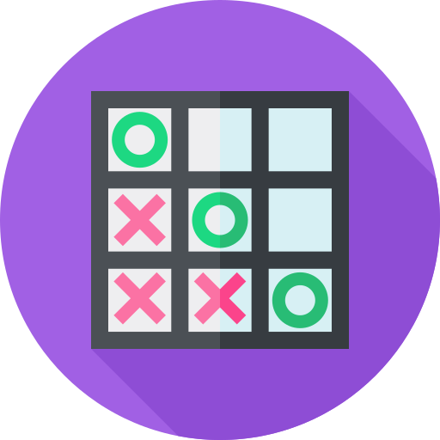
Tic Tac Toe
It is a game in which one player draws Xs and another player draws Os inside a set of nine squares and each player tries to be the first to fill a row of squares with either Xs or Os

Slide 4
Application
Game Initialization : It initializes or resets the game state. It clears the board, sets the game as active, and handles the scenario where the computer makes the first move if the player chooses O and plays against the computer.
Check for Winner : The function checks if any of the winning combinations are met on the current board.
Check for Draw : It checks if all cells are filled, indicating a draw.
Computer Move :If playing against the computer and it's the computer's turn, then it randomly selects an empty cell for the computer to mark. It then checks for a winner or a draw.

Slide 5
Technologies Used
CSS
Includes Colours, fonts, and layout of the app.
HTML
Javascript
It defines the meaning and structure of web content.
The board consists of nine cells, initially empty.
The JavaScript script begins with an event listener for the DOMContentLoaded event. It sets up variables for player sign & opponent selection

Slide 6
Working
Player Selection: The player can choose their sign (X or O).
Opponent Selection: The player can choose to play against another human or a computer.
Dynamic Board: The game board is dynamically created with clickable cells.
Game Logic: After each move, the game checks for a winner or a draw.
Computer Opponent: If the player chooses to play against the computer, the computer makes random moves.
Offline Accessibility (APK):In the APK version, users can access the portfolio even without an internet connection.

Slide 7
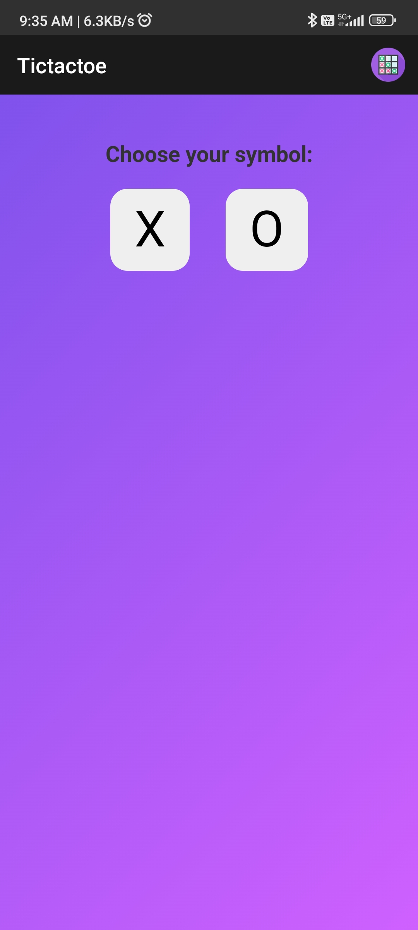
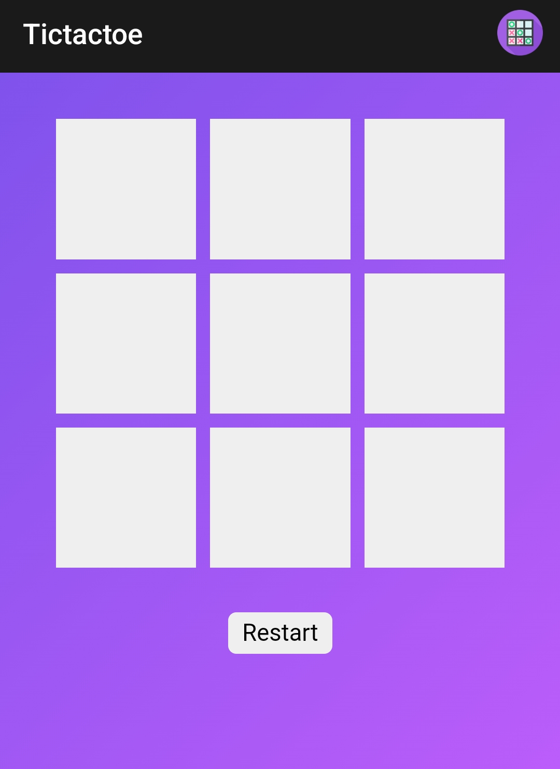
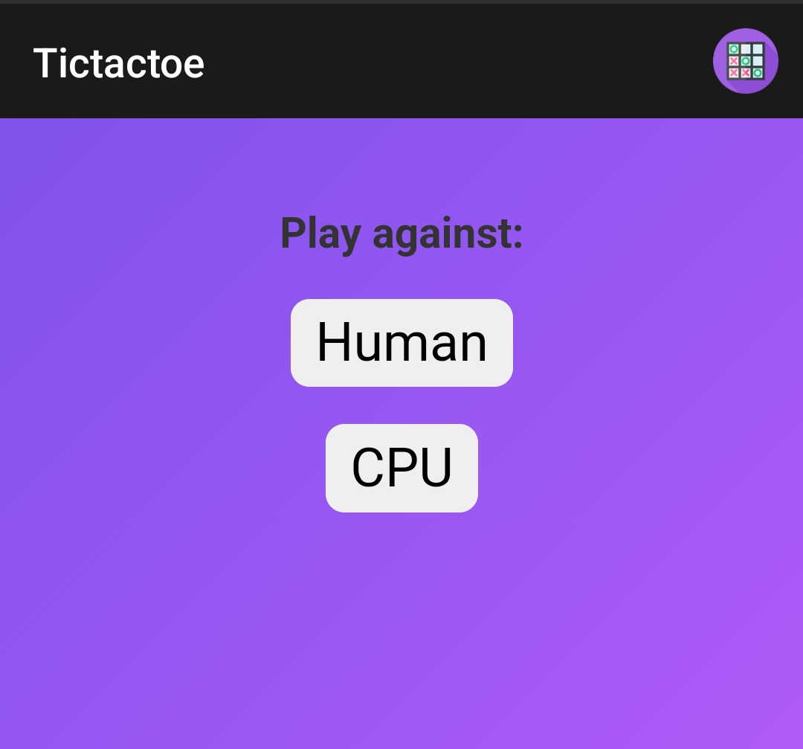
Screenshots

Slide 8
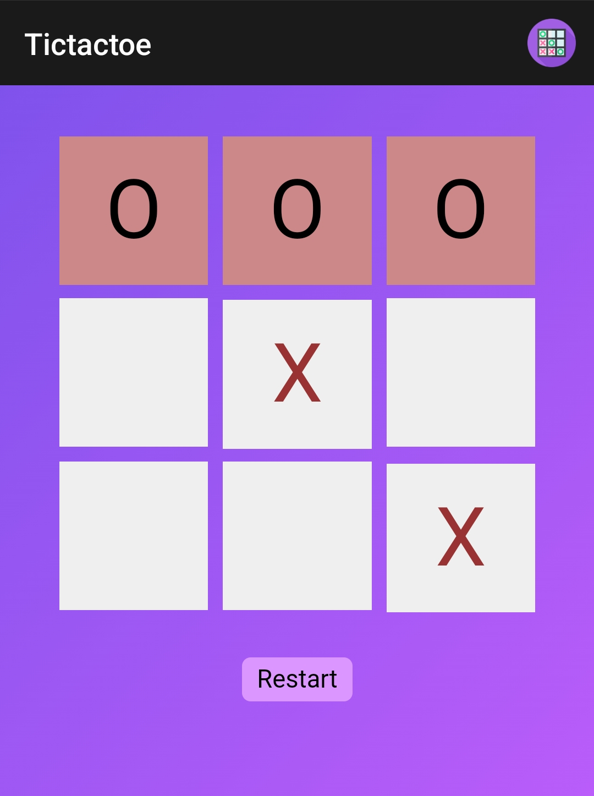
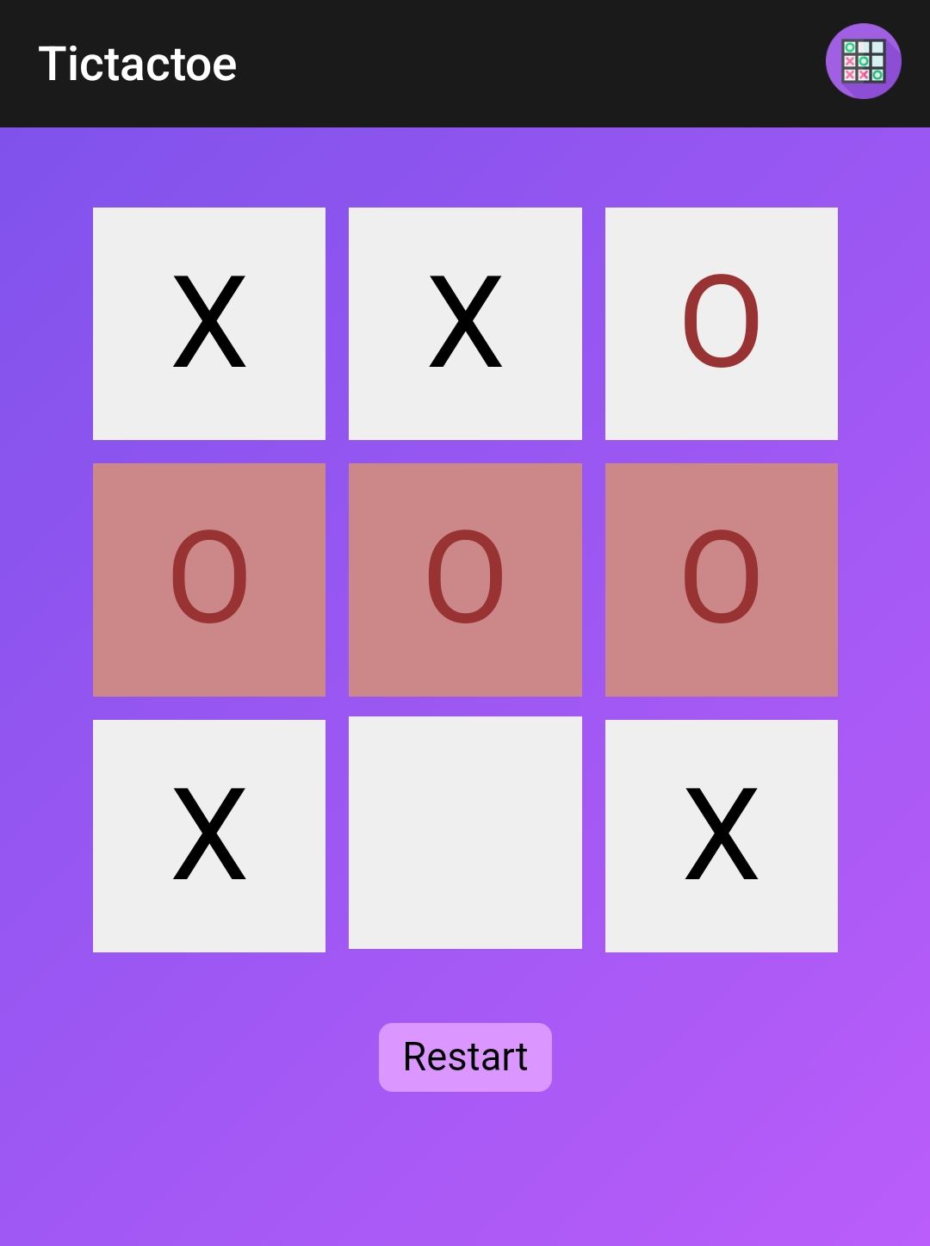
Screenshots

Slide 9
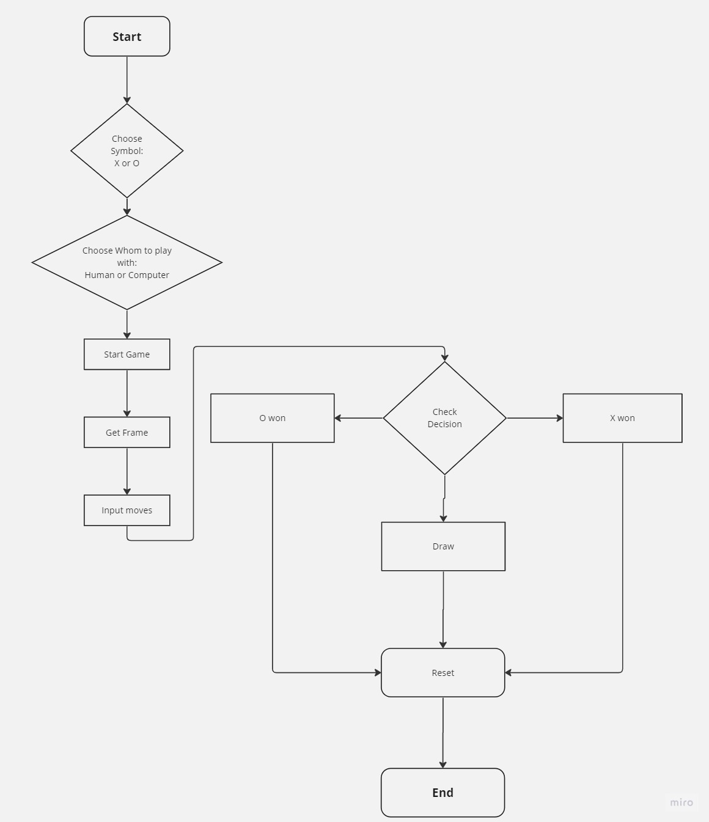
F L O W C H A R T

Slide 10
Thank You!

