Slide 1



Course Outline Day 1
Project Structuring
Select Frame
Upload File
Select Windows
Alert
RF Command Line
Create Custom Lib
Script Control Flow
Advance Data Management
Data Driven Test
API Test
Locating Element
HTML
Basic Xpath
Advance Xpath
Jenkins
Introduction
Installation
Run RF
Send Email
Custom Email Template

Slide 2
Project Structuring

Slide 3
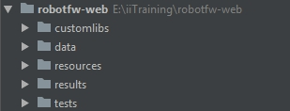
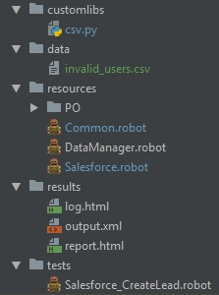
Project Structuring: Example

Slide 4
Web Locator

Slide 5
HTML Overview
Defines the contents of a web page
Tags
Provide sematic meaning about the document
Delimiters that mark the beginning and end of content
head(1), body(1), header, article, section, div, p, span, ul, li, table, footer
Looks line <body> some stuff </body> or <img src=“url”/>
Attributes
Official: id, title, name, href, scr, type, class
Custom: use data-some-attributes=‘some value’

Slide 6
Locator Strategies
HTML Id Click Link id=TheId
HTML Name Click Link name=Name
Link Text Click Link link=Your Link Text
Partial Link Text Click Link partial link=ur Link
XPath Click Link xpath=//a[@id=‘Theid’]

Slide 7
Advance Locators
Basic Xpath
Using parent/child/sibling relationships
Absolute
Relative
Finding elements by partial values
Start with
Contains

Slide 8
Basic Xpath
Xpath basic syntax
//Tag[attribute=‘some value’]
Example syntax
Click Element xpath=//a[@id=‘TheId’]
Try it
Experiment with a variety of tags & attributes
Watch the bottom left to see how many items are found
Warning
Finding a unique locator doesn’t mean it will work in in your script!

Slide 9
Using Parent, Child, Sibling Relationships
Absolute
xpath=//div[@id=‘DetailPage’]/a
Relative
xpath=//div[@id=‘nav-search’]/form/div[2]/div/input
xpath=//div[@class=‘nav-search’]//input

Slide 10
Partial Locators
Starts with
Click Element xpath=//input[@type=‘submit-123456’]
Click Element xpath=//input[starts-with(@type,’submit’)]
Contains
Click Element xpath=//input[@type=‘123456-submit-999’]
Click Element xpath=//input[contains(@type,’submit’)]
Click Element xpath=//a[contains(text(),’full or partial text’)]
Click Element xpath=//a[contains(.,’full or partial text’)]

Slide 11
More Xpath Example
Any html tag
//*[@attribute name ='attribute value']
Using more than one element
//htmltag[@attribute name='attribute value' and @attribute name='attribute value']
Identify the last element
//htmltag[@attribute name='attribute value'][last()]
Duplicate element
/descendant::htmltag[@attribute name='attribute value'][2]
Exactly text match
//htmltag[text()=‘exact text’]

Slide 12
Helping Tools

Slide 13


Helping Tools
ChroPath
Chrome extension for get relative xpath or absolute xpath
Robotcorder
Robotcorder generates RobotFramework test script by recording user interactions and scanning the html page.

Slide 14
Select Frame

Slide 15
Robot Framework: Select Frame
If your html page have the frame, first you need to select frame by using “Select Frame” Keywords from Selenium2Library
Select Frame works both with frames and iframes.
Use “Unselect Frame” Keyword to cancel the frame selection and return to the main frame.

Slide 16
Upload File

Slide 17
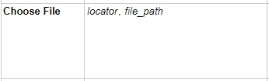
Robot Framework: Upload Files
You can use “Choose File” Keywords from Selenium2Library for upload file
Example:
Choose File xpath=//input[@id='j_id0:frm:csvFile’] E:\\data.csv

Slide 18

Lab 1

Slide 19

Helping Tools
Selenium IDE
Selenium Record and Playback tool for ease of getting acquainted with Selenium WebDriver.
Robotframework-DebugLibrary
A debug library for RobotFramework, which can be used as an interactive shell also

Slide 20
Select Windows

Slide 21
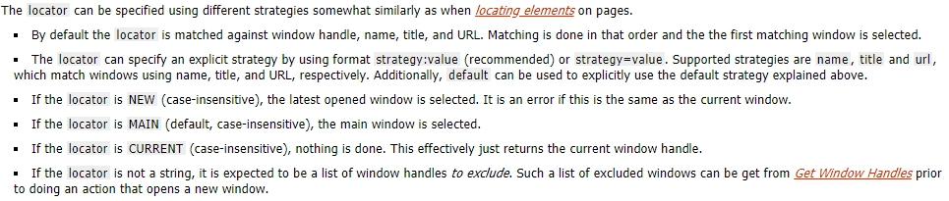
Robot Framework: Select Window
You can use “Select Window” Keywords from Selenium2Library to select browser window .

Slide 22
Alert

Slide 23
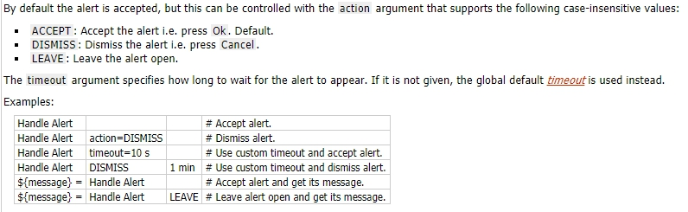
Robot Framework: Alert
You can use “Handle Alert” Keywords from Selenium2Library to handles the current alert and returns its message.

Slide 24
Lab 2

Slide 25
Robot Framework Command Line

Slide 26
Advanced Command Line Options
--outputdir (-d) defines where to create output files.
robot -d results test\suite1.robot
--reporttitle sets a title for the generated test report
robot --reporttitle “Aloha Report”
--logtitle sets a title for the generated test log
robot --logtitle “Aloha Log”
--timestameoutputs (-T) prevents result/log overwriting. Preserve multiple result.
robot --d results --timestampoutputs

Slide 27
Re-executing failed tests
Re-executing failed tests (--rerunfailed) appeared in Robot Framework 2.8. And since version 2.8.4 a new option (--merge) was added to rebot to merge output from different runs.
# first execute all test
robot --output original.xml tests
# then re-execute failing
robot --rerunfailed original.xml --output rerun.xml tests
# finally merge reports
rebot --merge original.xml rerun.xml

Slide 28
Randomizing Script Execution Order
Script files normally execute in alpha order
Can use the --randomize command flag
tests
suites

Slide 29
Get More Detailed Logs
Log have a default log level
This can be changed several ways
Command Line
--loglevel (-L) debug

Slide 30
Create Custom Library

Slide 31
Create a Custom Library
Robot Framework does so much!
If you need something specific
Create a module file
Add method(s) – Underscores for spaces
Declare the Library at the top of script
Call the method as a keyword

Slide 32
Lab 3

Slide 33
Script Control Flow

Slide 34
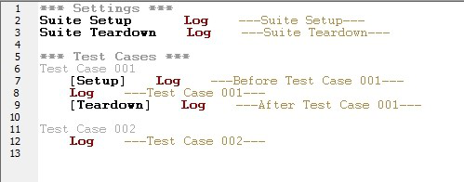
Setup and Teardown
Setup and teardown are just normal keywords with possible arguments. Not only test cases but also test suites can have a setup and a teardown

Slide 35
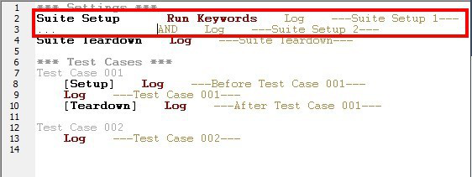
Setup and Teardown (Cont.)
Setup and teardown are always a single keyword. If you need to take care of multiple separate tasks, it is possible to create higher-level user keywords for that purpose.
An alternative solution is executing multiple keywords using the BuiltIn keyword Run Keywords.

Slide 36
IF ELSE – Making Decision
Test a condition and take the correction action
BuiltIn library
Run Keyword If ${Myvalue} == “Some data” Keyword
Can also have and Else If clause (multiple!)
Can also have an Else clause

Slide 37
Looping
Allows us to repeat things over and over
Uses
“Stress test” an application
Walk through lists and perform actions with each item
Repeat actions with different values
Perform mathematically sequenced algorithms
Always begin with :FOR
Loop through a range of numbers
Loop over a list of items
Optionally, can Repeat Keyword 5 times A Keyword

Slide 38
Advance Data Management

Slide 39
Dictionaries
A type of variable
Similar to a list (holds many items)
Instead of accessing via numerical index, use meaningful names
Uses: URLs for SUT, Attributes of a users, etc.
Referred to in Collections library and BuiltIn library
Lots of possible keywords!
Can be created in *** Variables *** section or locally via Create Dictionary keyword
&{MY_LIST} or &{MyList} or &{my_list}
&{TEST_USER} FirstName=Maria LastName=DB
Using: &{TEST_USER.FirstName}

Slide 40
Data Driven Test

Slide 41
Data Driven Test
Overview & Demo
Approaches
Built-In
Excel data file

Slide 42
Why Data-Driven Testing
Examine how different “set” of data will perform in the same test procedure
Login “Negative” testing
Valid email, invalid password = Error msg 1
Valid email, blank password = Error msg 2
Blank email, blank password = Error msg 3
Unregistered email, valid password = Error msg 4

Slide 43
Build-In Method
Create a Keyword with the common steps
Either in the Tests file or the App keyword file
It has [Arguments] to catch the data
Add [Test Template] to the test case
Associates the keyword having common steps
Add data rows to the test case
These will be passed into keyword [Arguments]

Slide 44
Custom Method with Excel
Design Test Data in Excel
Create Custom Library and Keyword to Read Data from Excel file
Call Keyword in Test Suite or Test Case

Slide 45
Custom Method with Excel
Required lib for customexcellibrary
openpyxl==2.2.2 \
pyexcel==0.2.0 \
pyexcel-io==0.1.0 \
pyexcel-xls==0.1.0 \
pyexcel-xlsx==0.1.0

Slide 46
Lab 4

Slide 47
Demo Lightning Experience

Slide 48
Service/API Test

Slide 49
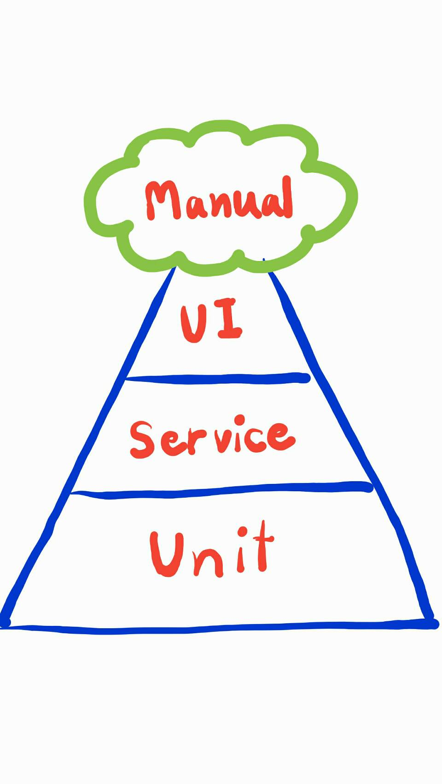



Software Testing - Pyramid
100
Test Cases
Tester
100
Test Cases
Tester
1000
Test Cases
Developer
Tester
10,000
Test Cases
Developer

Slide 50

Postman
API Test tools
Available on Mac, Windows and Linux
Windows installation
Download the setup file
Run the installer

Slide 51
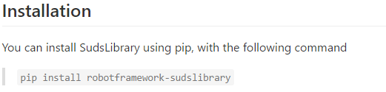
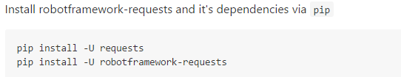
Library for API Test
Robot Framework’s library for testing API:
SOAP-based web services
SudsLibrary
RESTFul API
RequestsLibrary

Slide 52
Jenkins + Robot Framework

Slide 53
What is Jenkins?
Jenkins is a open source automation server which can be used to automate all sorts of tasks related to building, testing, and delivering or deploying software.

Slide 54
Setup Jenkins for Robot Framework
Install Jenkins
Download jenkins.war from https://jenkins.io/download/
Start jenkins “java -jar jenkins.war
Go to url https://localhost:8080
Install Plugin
Go to menu: Manage Jenkins -> Manage Plugins
Select Available tab
Search and select Robot Framework plugin
Search and select File System SCM plugin
Click Install without restart

Slide 55
Create Jenkins Jobs
Create Jenkins Job for Execute Robot Framework Script
Click New Item
Enter item name, select Free Style project
Click OK button
Configure Jenkins job

Slide 56
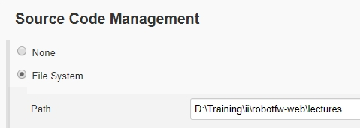
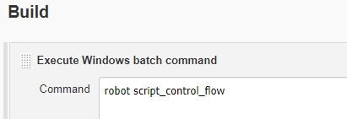
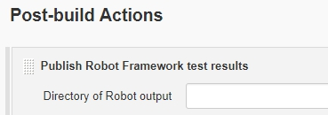
Create Jenkins Jobs
Configure Job
Set Source Code Management
Set Build
Set Post-build Actions

Slide 57
Jenkins Jobs Send Email Result
Configure Jenkins Editable Email Notification
Go to Management Jenkins -> Configure System
SMTP server from Extended E-mail Notification
Update Jenkins Job to Send the E-mail output file

Slide 58
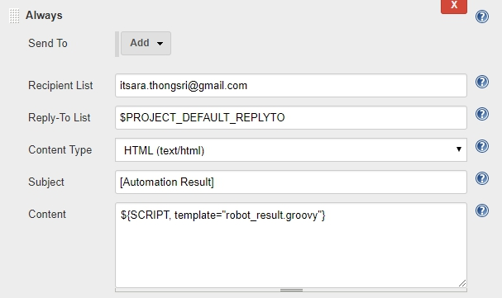
Jenkins Jobs Send Email Template
Configure email template
Create email-templates under jenkis home folder
Copy robot_result.groovy to email-templates folder
Example: C:\Users\itsara.th\.jenkins\email-templates\robot_result.groovy
Update Jenkins Job to Send email template

