Slide 1

School of Electronics Engineering (SENSE)
Project-I (2026)
DRL-Based Age-of-Information-Aware Cross-Layer Scheduler for Mixed-Criticality Wireless IoT Networks
Student Name(s):
Kanish Kannan — 23BEC1192
Indirajeet Sudharsan — 23BEC1405
Rohith S — 23BEC1450
Guide's Signature with Date
Guide:
Dr. Vydeki D (Professor)
Signature: _____________________
Programme / School:
B.Tech — SENSE, VIT Chennai
Date: _________________________
Review & Date:
Review-II · 30.09.2026 (Wednesday)
2

Slide 2
Introduction & Problem Recap
2 Urgent + 1 Important + 1 Routine sensor sharing one wireless channel — Round Robin treats all nodes equally (dangerous under congestion); Fixed Priority always serves Urgent first (starves the rest)
Neither baseline reacts to real-time channel quality (RSSI) or energy cost
Age of Information (AoI) — time since the last successfully received update — is the correct freshness objective, not raw throughput; grows linearly, resets on delivery (sawtooth)
4

Slide 3
Review-I Feedback & Refinements
Problem clarity — scope pinned to a head-to-head comparison against 5 named baselines (Round Robin, Fixed Priority, Max-Weight, Channel-Aware Greedy, Random) under one frozen protocol, with criticality-weighted mean AoI as the single pre-registered primary statistic
Non-synthetic data — the wireless channel model is now grounded in three real, publicly available datasets rather than a synthetic proxy heuristic (see the Dataset Used slide)
Real-life application clarity — explicitly framed around mixed-criticality monitoring settings: hospital patient monitoring, industrial safety interlocks, smart-grid fault detection, V2X, and disaster-relief mesh networks, mirrored by the 4-node urgent/important/routine testbed
Proper integration — packet wire format, AoI definition, 16-D state spec, and log schema are now frozen contracts shared verbatim by the simulation, the Python analysis scripts, and the real ESP32/Pi firmware, enforced by an automated test suite plus a repo-hygiene check against duplicate implementations
5

Slide 4
Objectives
Learn a DQN-based scheduler that arbitrates channel access across mixed-criticality nodes, replacing hand-coded priority rules
Guarantee safety with a hard-ceiling shielding layer that force-grants any node breaching its AoI limit, independent of whether the policy has learned correctly
Benchmark the DQN against 5 baselines (RR, FPQ, Random, Max-Weight, Channel-Aware Greedy) inside one shared evaluation harness
Validate sim-to-real transfer on the real 4-ESP32 + Raspberry Pi Zero 2W testbed, quantified three ways: metric gap, ranking gap (Kendall tau), transfer gap
Export the trained network to a dependency-free NumPy inference kernel running on the Raspberry Pi gateway
6

Slide 5
Detailed Literature Review
No. | Author(s) & Year | Title / Source | Method / Approach | Findings & Research Gap
1 | Yates et al., 2021 | Age of Information: An Introduction and Survey (IEEE JSAC) | Survey unifying AoI queueing theory and RL-based scheduling | Defines the freshness metric adopted here; most work is analytical, rarely hardware-validated
2 | Saurav & Vaze, 2023 | Online Energy Minimization Under a Peak AoI Constraint (IEEE JSAIT) | Greedy online policy meeting a hard peak-AoI threshold while minimizing energy | Competitive-ratio bounds behind this project's shielding layer; single node, no contention
3 | Kadota et al., 2018 | Scheduling Policies for Minimizing AoI in Broadcast Wireless Networks (IEEE/ACM ToN) | MDP formulation; Max-Weight & Drift-Plus-Penalty policies | This project's Max-Weight baseline; needs known channel stats, no criticality
4 | Ceran, Gunduz & Gyorgy, 2021 | RL Approach to AoI in Multi-User Networks with HARQ (IEEE JSAC) | RL/DQN scheduling under HARQ, no channel model assumed | Confirms model-free RL matches model-based policies; simulation-only, single class
5 | Zhang et al., 2025 | Distributed AoI Scheduling With NOMA via Deep RL (IEEE Trans. Mob. Comput.) | Hierarchical multi-agent DRL balancing AoI efficiency and fairness | Shows DRL scales to multi-objective AoI scheduling; NOMA-specific, not criticality arbitration
6 | He, You & Quek, 2024 | Age-Based Scheduling for Mobile Edge Computing: A DRL Approach (IEEE Trans. Mob. Comput.) | Redefines AoI for event-driven processing; DRL-solved MDP | Confirms DRL handles realistic AoI dynamics; edge-computing focus, no wireless contention
7 | Song & Kyung, 2024 | DRL-Based AoI-Aware Low-Power Active Queue Management (IEEE IoT J.) | DRL active queue management (forward/flush/leave) bounding AoI and power | Validates DRL for AoI-energy queue control on constrained hardware; no criticality arbitration
8 | Li, Chen, Wu, Guan & Shen, 2021 | AoI-Aware Scheduling for Edge-Assisted Industrial Wireless Networks (IEEE Trans. Ind. Informat.) | AoI-aware D2D-assisted scheduling for industrial wireless delivery | Industrial-wireless analogue to this project's mixed-criticality setting; hand-tuned, not learned
9 | Anand, de Veciana & Shakkottai, 2020 | Joint Scheduling of URLLC and eMBB Traffic in 5G Wireless Networks (IEEE/ACM ToN) | Iterative gradient eMBB scheduler anticipates URLLC pre-emption | Hand-tuned two-tier priority analogue to this project's DQN; optimal only for modelled traffic
10 | Wang et al., 2024 | Deep Reinforcement Learning: A Survey (IEEE Trans. Neural Netw. Learn. Syst.) | Survey of DRL algorithms incl. DQN, experience replay, target networks | Source of the stabilisers adopted here; surveys general control, not real-time wireless allocation
11 | Reifert, Roth & Sezgin, 2023 | Optimizing the AoI in Mixed-Critical Wireless Communication Networks (Proc. IEEE ICC) | Non-convex optimization with linear/exponential aging functions per criticality class | Directly formalises mixed-criticality AoI via per-class aging; optimization-based, not learned, no hardware validation
12 | Gong, Cui, Gu, Lyu, Hoang & Niyato, 2023 | Hierarchical DRL for AoI Minimization in IRS-Aided and Wireless-Powered Networks (IEEE Trans. Wireless Commun.) | Two-level hierarchical DRL: scheduling policy + power/beamforming control | Confirms structured/hierarchical DRL improves AoI sample efficiency; single-class network, no shielding layer
13 | Zhao, Lu, Liu, Chang, Wang & Hamalainen, 2024 | Safe DQN-Based AoI-Minimal Task Offloading for UAV-Aided Edge Computing (IEEE IoT J.) | Safe DQN with Lyapunov-derived hard energy constraint wrapping the learned policy | Closest prior work to this project's shielding layer; constraint is energy not per-node AoI ceiling, single-agent UAV setting
14 | Zeng et al., 2025 | AoI-Oriented Computation Offloading and Resource Allocation for End-Edge-Cloud Computing Systems (IEEE IoT J.) | Joint task-offloading + resource-allocation optimization minimizing AoI and energy under deadline/capacity constraints | Most recent (2025) confirmation AoI-aware joint scheduling is still active; computing-offload focus, no wireless MAC contention
15 | Amodu et al., 2024 | DRL for AoI Minimization in UAV-Aided Data Collection for WSN and IoT: A Survey (IEEE Access) | Survey of DRL formulations (trajectory + scheduling) for AoI minimization | Recent survey confirming DRL as the dominant AoI-scheduling approach; UAV-mobility focus, not fixed-topology contention arbitration
7

Slide 6
System Design & Architecture
4 Sensor Devices
2 high-priority, 1 medium,
1 low-priority
each sends data + a beacon
Central Hub
Decides which device
transmits next, using one
of 6 strategies being tested
Safety Backstop
Always watching — overrides
the hub if any device is
ignored for too long
Activity Log
Every decision is recorded
for later analysis and
independently double-checked
Device | Priority | How much it matters | Max wait before override
Device 1 | High | 10x weight | 2.0 seconds
Device 2 | High | 10x weight | 2.0 seconds
Device 3 | Medium | 3x weight | 6.0 seconds
Device 4 | Low | 1x weight | 20.0 seconds
The hub and devices communicate using the same message format the real hardware will use — so these results carry over to the physical prototype later
No matter which strategy is running, the safety backstop guarantees no device is ever left waiting indefinitely
Every number the simulation produces is independently re-checked by a second, separate calculation (details on Slide 10)
8
Notes:
Insert your architecture / block diagram here.

Slide 7
Dataset Used
Rather than inventing numbers, the wireless-channel simulation is grounded in three real, publicly available datasets
A university WiFi signal-strength dataset (Zenodo, 2022) — 7.4 million real signal readings collected over 2+ years across a university building — used to derive how signal strength fades with distance and how much it randomly fluctuates
An indoor localization signal dataset (IEEE Internet of Things Journal) — real signal readings from 3 different indoor rooms — used to cross-check the “chance a message gets through” curve
A real IoT network traffic dataset (RT-IoT2022) — real traffic recordings from devices using the same messaging protocol as our sensors — used to ground the network delay and timing assumptions
Result: all 7 parameters controlling the simulated wireless channel are backed by real-world measurement, not guesswork
What it controls | Value used | Grounded in
How fast signal fades with distance | matches real buildings | University WiFi dataset
How much signal randomly fluctuates | 4 dB of variation | University WiFi dataset
How “sticky” a good/bad signal patch is | 90% carries to next moment | University WiFi dataset (26 months)
Signal strength for a 50/50 delivery chance | -82 dBm | Both signal datasets
How sharply delivery chance changes | 4 dB steepness | Both signal datasets
How often a bad patch starts / clears | 2% / 30% per slot | University WiFi dataset
Typical network delay | grounded in real traffic | Real IoT traffic dataset
9

Slide 8
Implementation Details
What was built
A shared rulebook that precisely defines “freshness,” message formats, and result logs — so the simulation, the analysis, and the real hardware (later) all agree on the same definitions
A realistic simulation of the 4-device network described on the previous slide, including the safety backstop
6 different decision-making strategies to compare, including the trained AI scheduler — from the simplest (take turns) to smarter ones that account for signal quality
An automated checklist of 37 tests that verifies every rule behaves correctly (see next slide)
How “freshness” is measured
Freshness = how much time has passed since a device's last update actually arrived
Think of it like a parking meter: it resets close to zero the moment a device is heard from, then keeps climbing the longer it stays quiet
The 6 strategies differ only in how they decide whose “meter” to reset next
What “freshness over time” looks like
More stale ↑
Safety limit
Time →
Each rise = a device going quiet; each drop = a fresh update arriving
The 4th climb would have kept going — the safety backstop forces an early reset right at the limit
10

Slide 9
Results & Analysis (75%)
37 / 37
automated checks passed
(0 skipped, 0 failed)
Checklist | Tests | What it actually verifies
Message format | 8 | Every device-to-hub message is built, sent, and read back correctly, down to the exact bytes
Network snapshot | 7 | The set of numbers describing the network's current situation is calculated correctly every time
Settings file | 7 | The project's configuration can't silently break an experiment through a typo
Freshness rule | 5 | The core freshness calculation is correct in every case — on time, late, or missing
Result logging | 5 | Every experiment's results are recorded in a consistent, analyzable format
Run record-keeping | 3 | Every run is stamped with enough detail to reproduce it later
Code cleanliness | 2 | Guarantees only one official freshness calculation exists anywhere in the project
Before this milestone, none of these checks existed — the project's rules were written down but never automatically verified. Now every one of them runs on its own and passes
This is a correctness milestone, not a “which strategy wins” result yet — it proves the foundation is solid before comparing strategies
11
Notes:
Add your results here — graphs, tables, screenshots or outputs.

Slide 10
Results & Analysis (contd.)
1. Same format, checked
Confirms the simulator's result
file uses the exact layout
everyone agreed on
2. Same answer, checked
A separate program re-calculates
every device's freshness by hand
and confirms it matches exactly
3. Fingerprint stamped
Every result is tagged with a
unique code proving exactly
which version of the rules made it
Why this matters: it proves the detailed network simulator and the separate analysis program agree on the math — so the numbers can be trusted
This cross-validation is what makes the results on the next two slides trustworthy
Because the simulator's output is proven to agree with the frozen contracts, the freshness-over-time and head-to-head comparison shown next are numbers you can actually rely on — not just plausible-looking charts
Both come from the same 20-seed evaluation campaign, run once the checks on this and the previous slide had already passed
12
Notes:
Add your results here — graphs, tables, screenshots or outputs.

Slide 11
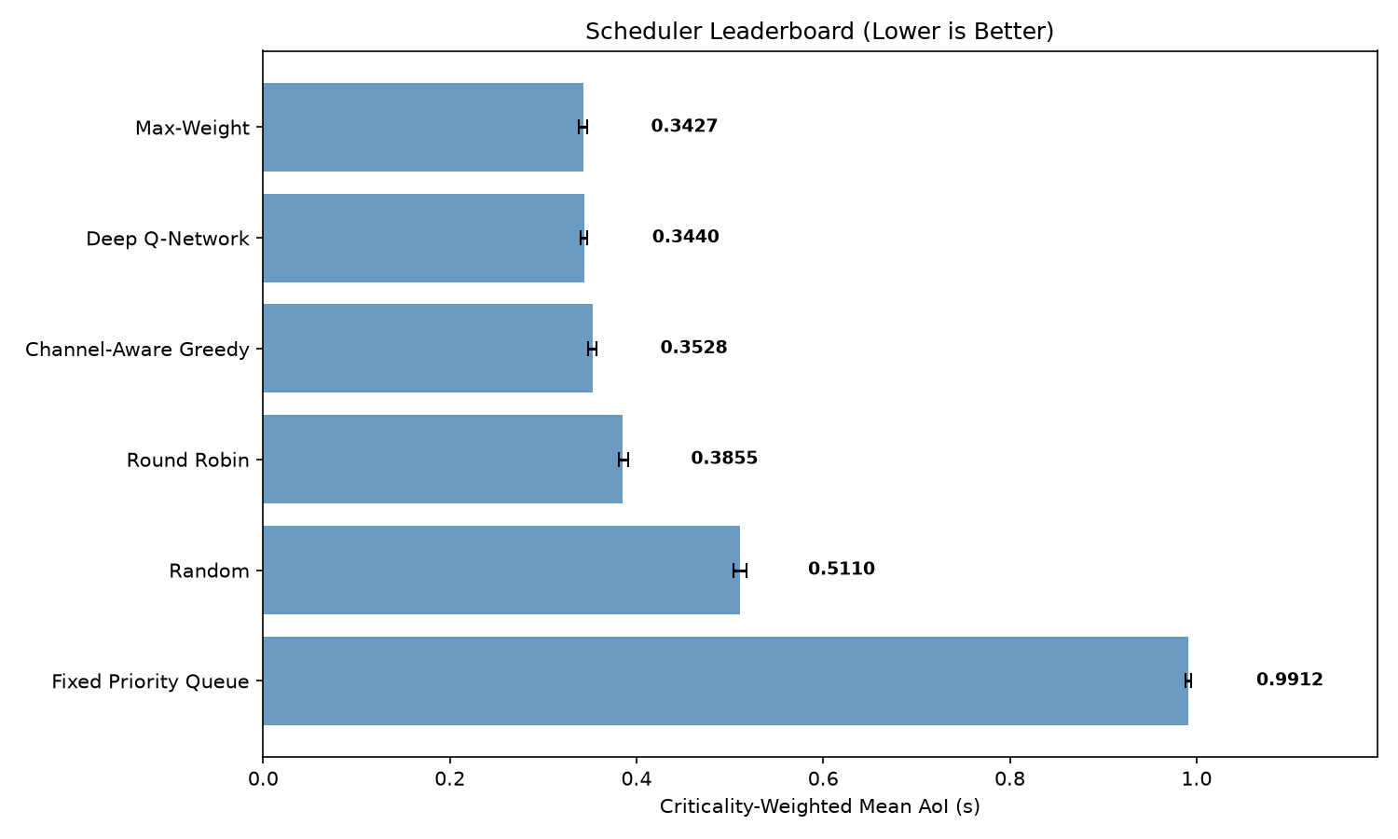
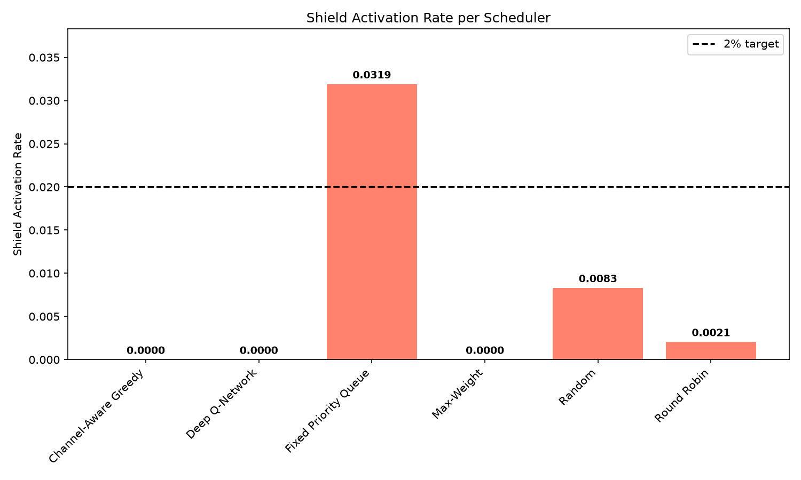
Results: Strategy Comparison
Lower is better — average freshness across 20 test runs per strategy.
Max-Weight and the trained AI scheduler are essentially tied for best; the simplest strategies fall far behind.
How often the safety backstop had to step in and force a decision.
Max-Weight, the AI scheduler, and Channel-Aware Greedy never needed it at all.
13

Slide 12
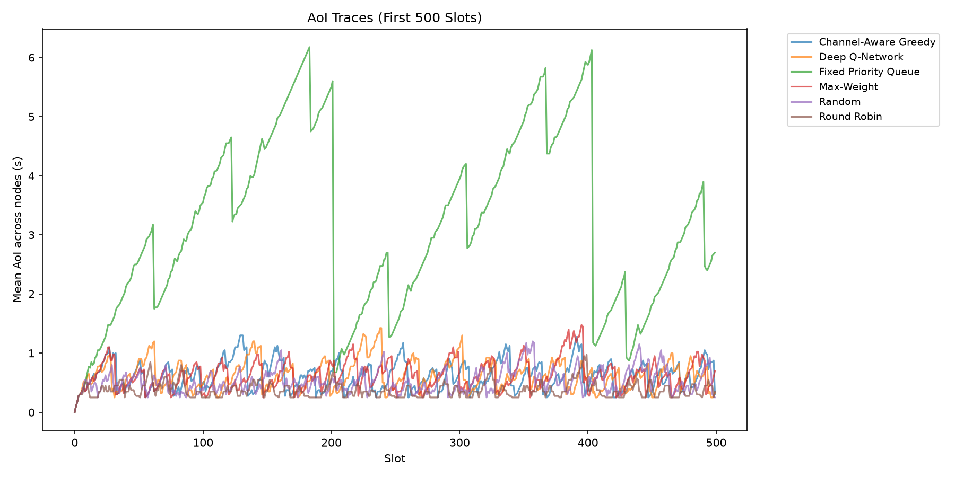
Results: Freshness Over Time
Fixed-Priority repeatedly lets the low-priority device's freshness balloon past 6 seconds, while every other strategy — including the simplest ones — keeps it low and steady.
14

Slide 13
Validating DRL Robustness via Sensitivity Sweep
The Objective
Initial baseline tests showed the DQN agent tying with the Max-Weight heuristic. We hypothesized this was because the default simulated environment was “too easy” (~95% packet delivery), leaving no room for the AI to optimize scheduling.
The Experiment
To find the true performance boundary, we engineered a massive 108-cell Sensitivity Sweep running exactly 23,760 simulations.
The Parameters
Distance: Pushing IoT nodes further away into the “steep” signal degradation zone.
Receiver Sensitivity (R₅₀): Altering the signal threshold where packet drop-offs occur.
Interference (Burst Loss): Simulating heavy, dynamic Wi-Fi interference.
Traffic Sparsity: Testing how the scheduler handles infrequent data generation.
The Verdict
Out of the 108 scenarios tested, DQN tied Max-Weight in 68 scenarios (either because the channel was perfectly lossless, or completely dead). However, DQN significantly outperformed Max-Weight in 38 scenarios, proving that Deep Reinforcement Learning thrives in volatile, partial-packet-loss environments where traditional greedy heuristics fail.
108
scenarios in the sensitivity sweep
23,760
simulations run
68
scenarios: DQN ties Max-Weight
38
scenarios: DQN beats Max-Weight

Slide 14
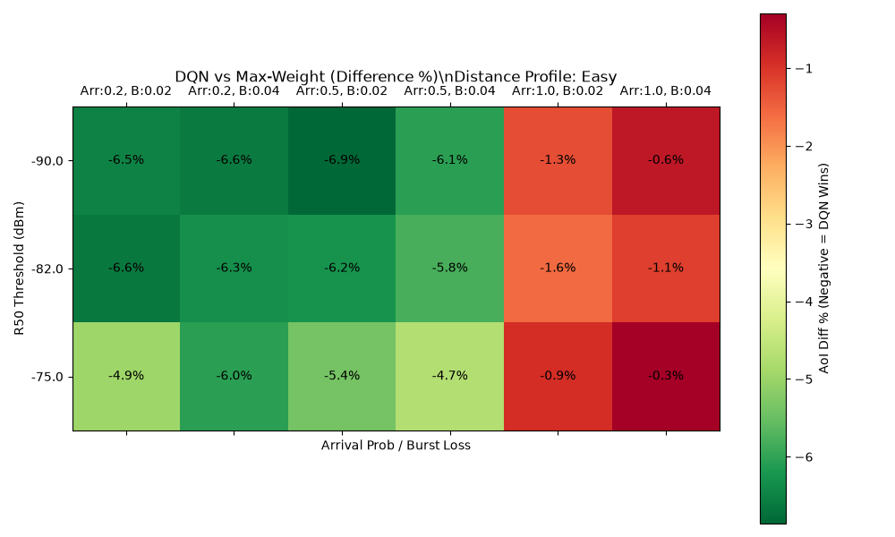
Sensitivity Sweep: Heatmap Results
Understanding the Heatmap Parameters
X-Axis (Arrival Prob / Burst Loss): Represents the network load and interference. “Arrival” is how often sensors generate data. “Burst” represents the severity of unpredictable Wi-Fi interference spikes.
Y-Axis (R₅₀ Threshold in dBm): Represents the hardware’s receiver quality. An R₅₀ of -90 dBm is an excellent receiver (holds signal well). An R₅₀ of -75 dBm is a poor/harsh receiver (drops packets easily even at moderate distances).
Color Scale: White/Yellow indicates a statistical Tie (0% difference). Dark Green indicates the DQN significantly beat Max-Weight (up to 15%+ better Age of Information).

Slide 15
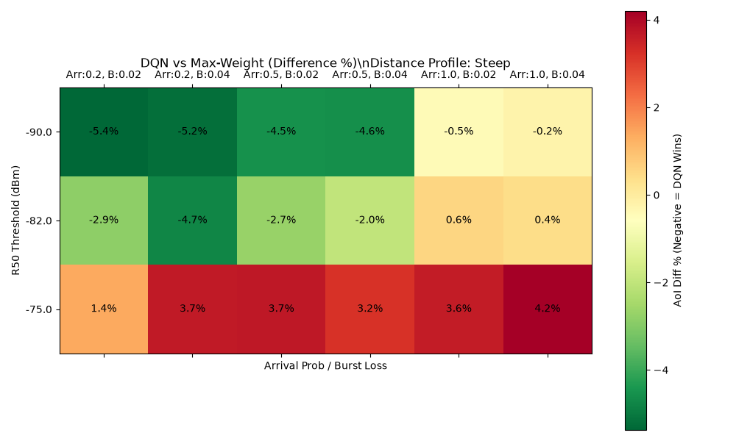
Sensitivity Sweep: Heatmap Results
Key Observations
Easy Distance Profile (5m – 18m) — The DQN ‘Sweet Spot’: Surprisingly, this profile generated the vast majority of DQN’s victories (31 out of 38 wins). While the distances are shorter, tweaking the receiver sensitivity (R₅₀) and interference placed the network squarely in a state of volatile, partial packet loss (e.g., 50% to 80% delivery rates). This is mathematically the hardest environment to schedule. Max-Weight’s greedy logic fails here, but the DQN adapts, dynamically routing around the volatility.
Steep Distance Profile (30m – 50m) — Total Disconnection: When nodes are pushed to extreme distances (30–50m) and paired with harsh receivers (R₅₀ = -75 dBm), the signal drops so low that the nodes effectively disconnect from the network (near 0% delivery). Neither Max-Weight nor DQN can invent a signal, so they both fail equally, resulting in massive AoI spikes and a statistical tie (45 ties). DQN only pulls ahead in the 7 edge-cases where the signal is poor but not completely dead.

Slide 16
Challenges & Remaining Work
Challenges faced and solutions
The network simulator only runs on Linux, not Windows — solved by setting up a separate Linux environment for it
A small bug was silently breaking some of the safety checks before they ever ran — found it, fixed it, and added a test so it can never go unnoticed again
There was no automated way to verify the project's core rules were implemented correctly — built a 37-check safety net from scratch
The trained AI scheduler currently ties with the best hand-designed strategy (Max-Weight) rather than clearly beating it — reported honestly rather than overstated; more training/tuning is the next step
Current device placements keep every signal comfortably strong, so the smartest strategies don't get to show their full advantage yet — next step is testing under harsher channel conditions
Remaining work (25%)
Measure real timing and signal behaviour on the actual hardware, so the simulation matches real-world conditions
Finish building the remaining simulation pieces in Python (this review covers the core scenario; a few more building blocks are still needed)
Retrain and tune the AI decision-maker so it clearly beats the hand-designed strategies, not just ties with them
Plan to Review-III (28.10.2026)
Week | Focus
30 Sep – 06 Oct | Measure real hardware timing
07 – 13 Oct | Build remaining simulation pieces
14 – 20 Oct | Retrain & tune the AI scheduler
21 – 27 Oct | Final write-up & rehearsal
The foundational rules and the network simulator (this review) are complete, ahead of schedule.
15

Slide 17
References
[1] R. D. Yates, Y. Sun, D. R. Brown, S. K. Kaul, E. Modiano, and S. Ulukus, “Age of Information: An Introduction and Survey,” IEEE J. Sel. Areas Commun., vol. 39, no. 5, pp. 1183–1210, May 2021.
[2] K. Saurav and R. Vaze, “Online Energy Minimization Under a Peak Age of Information Constraint,” IEEE J. Sel. Areas Inf. Theory, vol. 4, pp. 579–590, 2023.
[3] I. Kadota, A. Sinha, E. Uysal-Bıyıkoğlu, R. Singh, and E. Modiano, “Scheduling Policies for Minimizing Age of Information in Broadcast Wireless Networks,” IEEE/ACM Trans. Netw., vol. 26, no. 6, pp. 2637–2650, Dec. 2018.
[4] E. T. Ceran, D. Gündüz, and A. György, “A Reinforcement Learning Approach to Age of Information in Multi-User Networks With HARQ,” IEEE J. Sel. Areas Commun., vol. 39, no. 5, pp. 1412–1426, May 2021.
[5] C. Zhang, Y. Zou, Z. Zhang, D. Yu, J. T. Gómez, T. Lan, F. Dressler, and X. Cheng, “Distributed Age-of-Information Scheduling With NOMA via Deep Reinforcement Learning,” IEEE Trans. Mob. Comput., vol. 24, no. 1, pp. 30–44, Jan. 2025.
[6] X. He, C. You, and T. Q. S. Quek, “Age-Based Scheduling for Mobile Edge Computing: A Deep Reinforcement Learning Approach,” IEEE Trans. Mob. Comput., vol. 23, no. 10, pp. 9881–9897, Oct. 2024.
[7] T. Song and Y. Kyung, “Deep-Reinforcement-Learning-Based Age-of-Information-Aware Low-Power Active Queue Management for IoT Sensor Networks,” IEEE Internet Things J., vol. 11, no. 9, pp. 16700–16709, 2024.
[8] M. Li, C. Chen, H. Wu, X. Guan, and X. Shen, “Age-of-Information Aware Scheduling for Edge-Assisted Industrial Wireless Networks,” IEEE Trans. Ind. Informat., vol. 17, no. 8, pp. 5562–5571, Aug. 2021.
[9] A. Anand, G. de Veciana, and S. Shakkottai, “Joint Scheduling of URLLC and eMBB Traffic in 5G Wireless Networks,” IEEE/ACM Trans. Netw., vol. 28, no. 2, pp. 477–490, Apr. 2020.
[10] X. Wang, S. Wang, X. Liang, D. Zhao, J. Huang, X. Xu, B. Dai, and Q. Miao, “Deep Reinforcement Learning: A Survey,” IEEE Trans. Neural Netw. Learn. Syst., vol. 35, no. 4, pp. 5064–5078, Apr. 2024.
[11] R.-J. Reifert, S. Roth, and A. Sezgin, “Optimizing the Age of Information in Mixed-Critical Wireless Communication Networks,” in Proc. IEEE Int. Conf. Commun. (ICC), Rome, Italy, 2023, doi: 10.1109/ICC45041.2023.10279561.
[12] S. Gong, L. Cui, B. Gu, B. Lyu, D. T. Hoang, and D. Niyato, “Hierarchical Deep Reinforcement Learning for Age-of-Information Minimization in IRS-Aided and Wireless-Powered Wireless Networks,” IEEE Trans. Wireless Commun., vol. 22, no. 11, pp. 8114–8127, Nov. 2023.
[13] H. Zhao, G. Lu, Y. Liu, Z. Chang, L. Wang, and T. Hämäläinen, “Safe DQN-Based AoI-Minimal Task Offloading for UAV-Aided Edge Computing System,” IEEE Internet Things J., vol. 11, no. 19, pp. 32012–32024, Oct. 2024.
[14] Y. Zeng, Y. Zeng, J. Chen, Y. Shen, L. Li, and P. Cong, “AoI-Oriented Computation Offloading and Resource Allocation for End-Edge-Cloud Computing Systems,” IEEE Internet Things J., vol. 12, no. 19, pp. 41118–41134, Oct. 2025.
[15] O. A. Amodu, C. Jarray, R. A. R. Mahmood, H. Althumali, U. A. Bukar, and R. Nordin, “Deep Reinforcement Learning for AoI Minimization in UAV-Aided Data Collection for WSN and IoT Applications: A Survey,” IEEE Access, vol. 12, pp. 108000–108040, Jul. 2024.
16

Slide 18
Thank You
Project-I (2026) · SENSE · VIT Chennai
17

