Slide 1


Poornima University
Department of Computer Science and Engineering

Slide 2
Topic = Phishing Attack
Made by
KANISHK Manghnani
BCA(Cyber Security)
2023/15063

Slide 3
Contents
Introduction
What is phishing attack
Typical scenario of phishing
History of phishing attack
Types of phishing attack & examples
Phishing statistics in India
Prevention from phishing attack
Anti-phishing software
Punishment & Cyber law
Conclusion

Slide 4
Introduction
Phishing is a form of social engineering and a scam where attackers deceive people into revealing sensitive information or installing malware such as viruses, worms, adware, or ransomware.

Slide 5
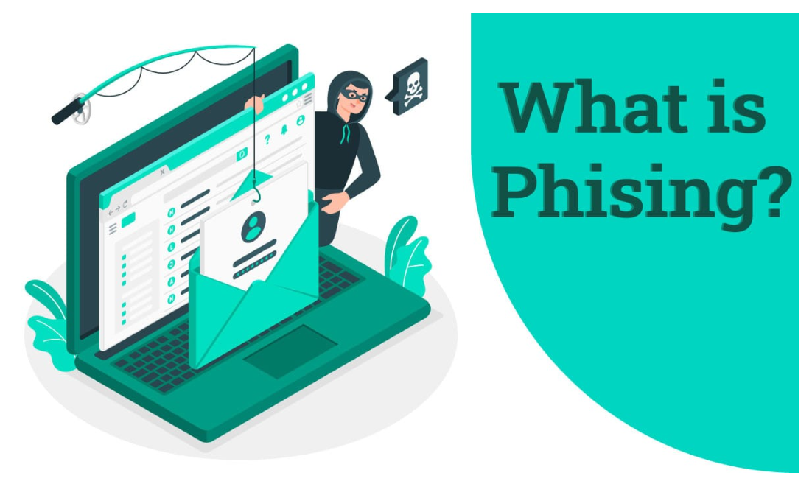
What is Phishing?
Phishing is a cyberattack that tricks people into sharing sensitive information, such as passwords, bank information, or credit card numbers. Phishing attacks can come in many forms, including emails, text messages, phone calls, or websites.

Slide 6
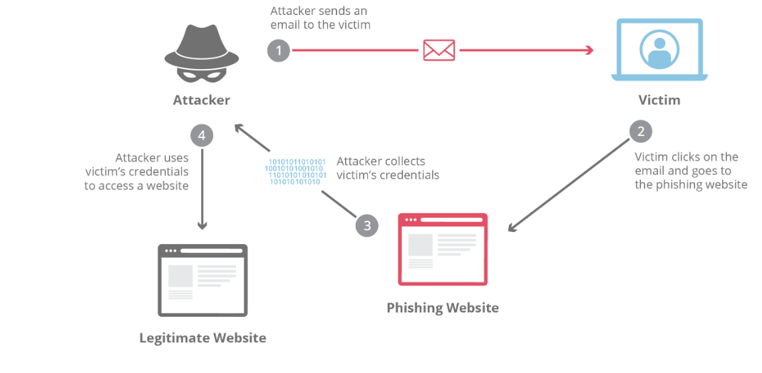
Typical scenario of phishing

Slide 7
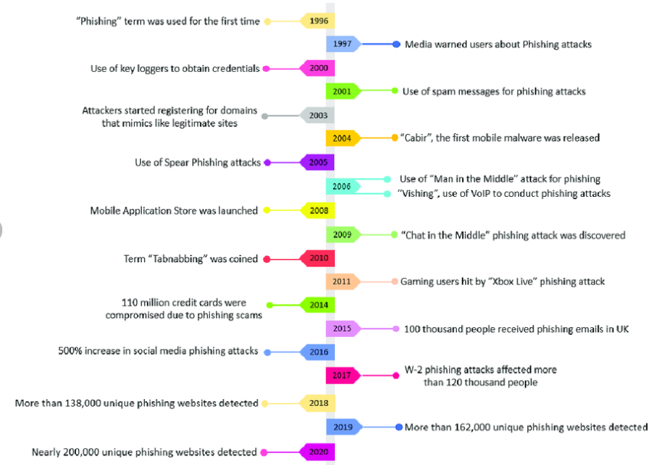
History of phishing

Slide 8
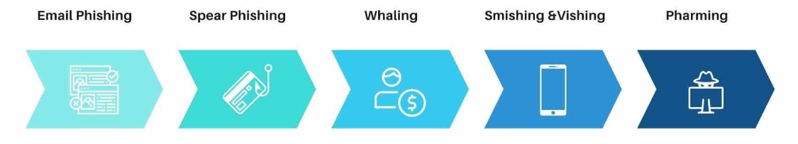
Types of phishing

Slide 9
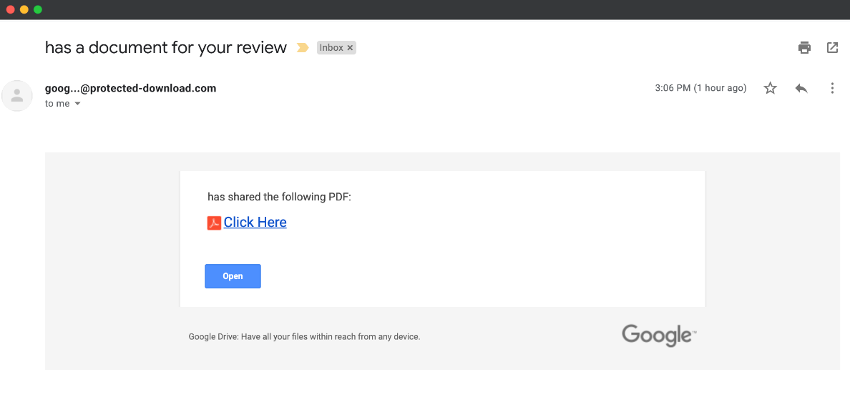
Email phishing & example
Phishing emails are deceptive messages that look like they're from a trusted organization or person, and are used to steal personal information or access online accounts.

Slide 10
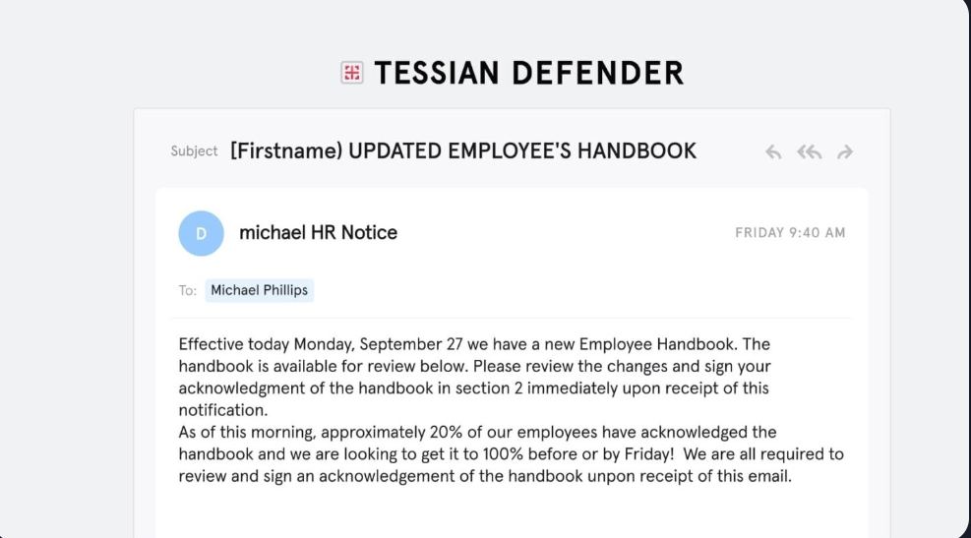
Spear phishing & example
Spear phishing is a type of phishing attack that targets specific individuals or organizations through malicious emails. The goal is to steal sensitive information or infect the target's device with malware.

Slide 11
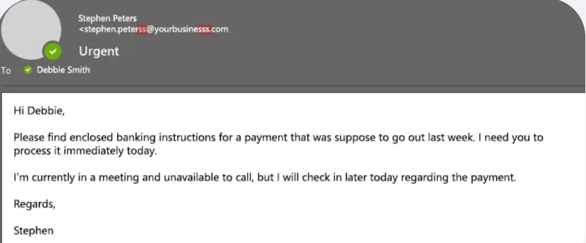
Whaling
Whaling phishing is a type of phishing attack that targets high-ranking executives in an organization, such as CEOs or CFOs. The goal is to trick the target into giving up sensitive information, such as passwords or access to administrative accounts.

Slide 12
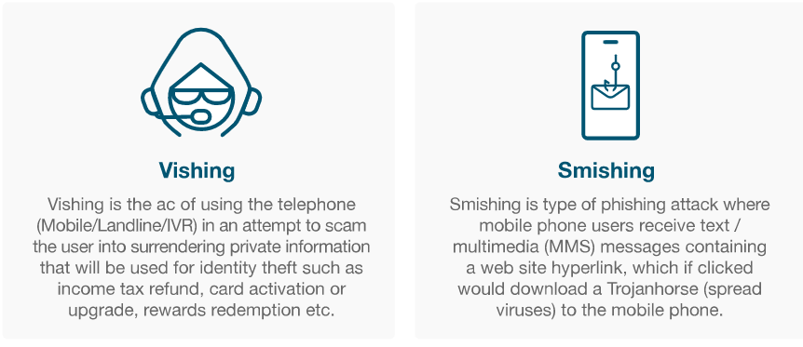
Smishing & Vishing
Smishing: Uses deceptive text messages to trick victims into sharing personal information or clicking malicious links.
Vishing: Uses voice calls or voicemails to manipulate victims into divulging confidential information.

Slide 13
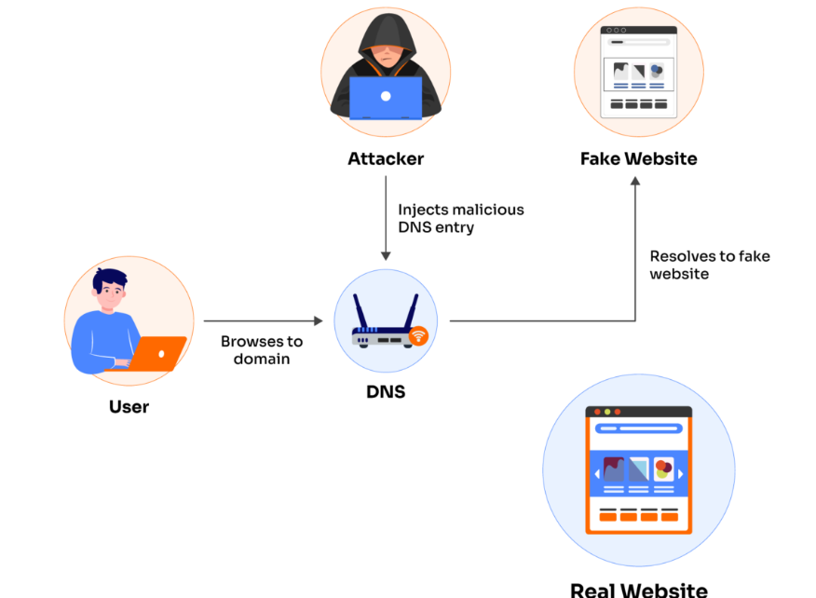
Pharming
Pharming is a type of cyberattack that tricks users into visiting fake websites that look like real ones. The goal is to steal users' personal information, such as passwords, credit card details, and usernames.

Slide 14
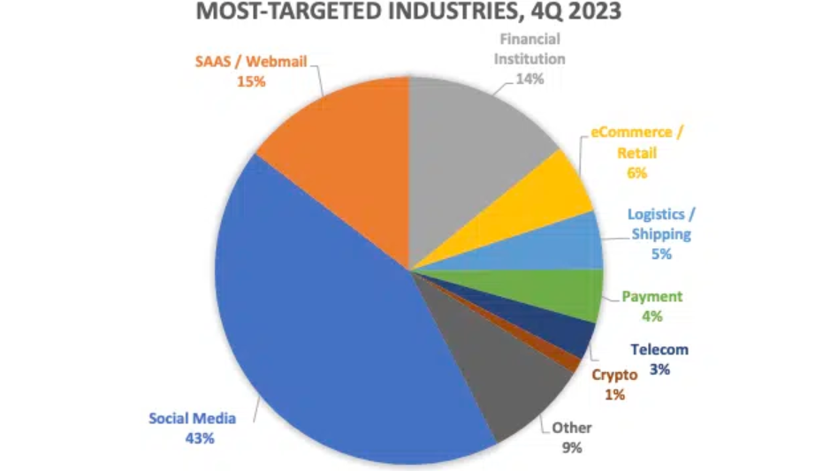
Phishing statistics in India
Most targeted industry in India in 4 quarter of 2023.

Slide 15
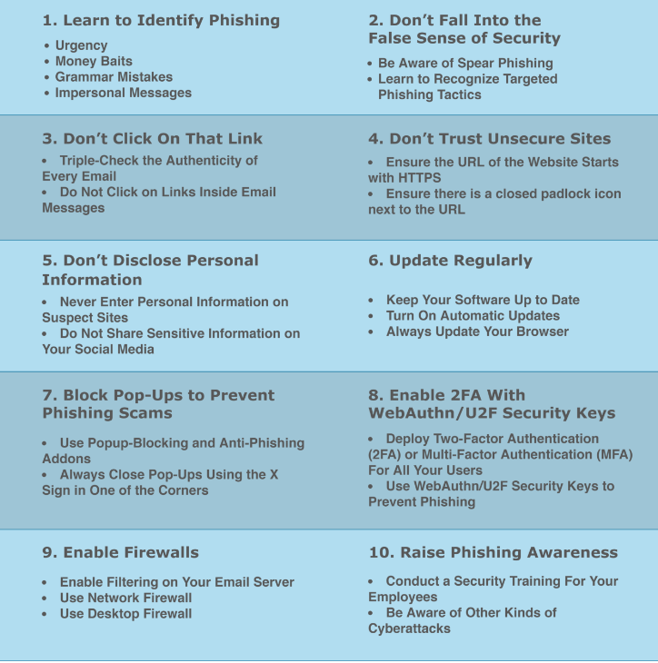
Prevention from phishing attack

Slide 16
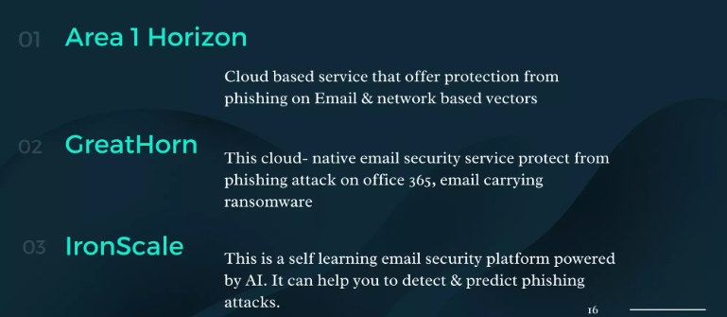
Anti-phishing software

Slide 17
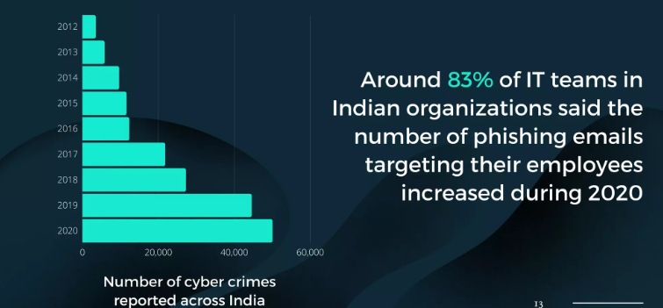
Phishing statistics in India

Slide 18
Punishment & Cyber law
In India, the Information Technology Act (IT Act) of 2000 is the primary legislation that deals with cybercrime. The IT Act covers a range of cyber offenses, including hacking, data theft, online fraud, and identity theft. The punishment for cybercrimes can vary depending on the specific offense and the circumstances of the case.
Cyber Terrorism (Section 66F of IT Act): Penalty: Imprisonment for life. Obscene Content (Section 67 of IT Act): Penalty: Imprisonment for a term which may extend to 3 years and with fine which may extend to five lakh rupees.

Slide 19
Conclusion
Phishing is a social engineering attack
Phishing attacks use fraudulent emails, text messages, phone calls, or websites to trick people into sharing sensitive data.
Phishing is a modern version of old ploys
Phishing is a modern version of older ploys to trick people into giving up information.
Phishing is a growing threat
Phishing attacks can have severe consequences, including data breaches, financial losses, and damage to reputation.
Phishing is hard to detect
It's hard to detect phishing attacks because hackers use sophisticated approaches and ever-changing tactics.
Phishing can be prevented
You can protect yourself from phishing attacks by being aware of the psychological factors that make you susceptible to these types of attacks. You can also use software tools like spam filters and antivirus software.
Phishing can be detected with DMARC email authentication protocols
DMARC tests every email that makes it through to your inbox and can help limit the possibility of phishing attacks.

