Slide 1
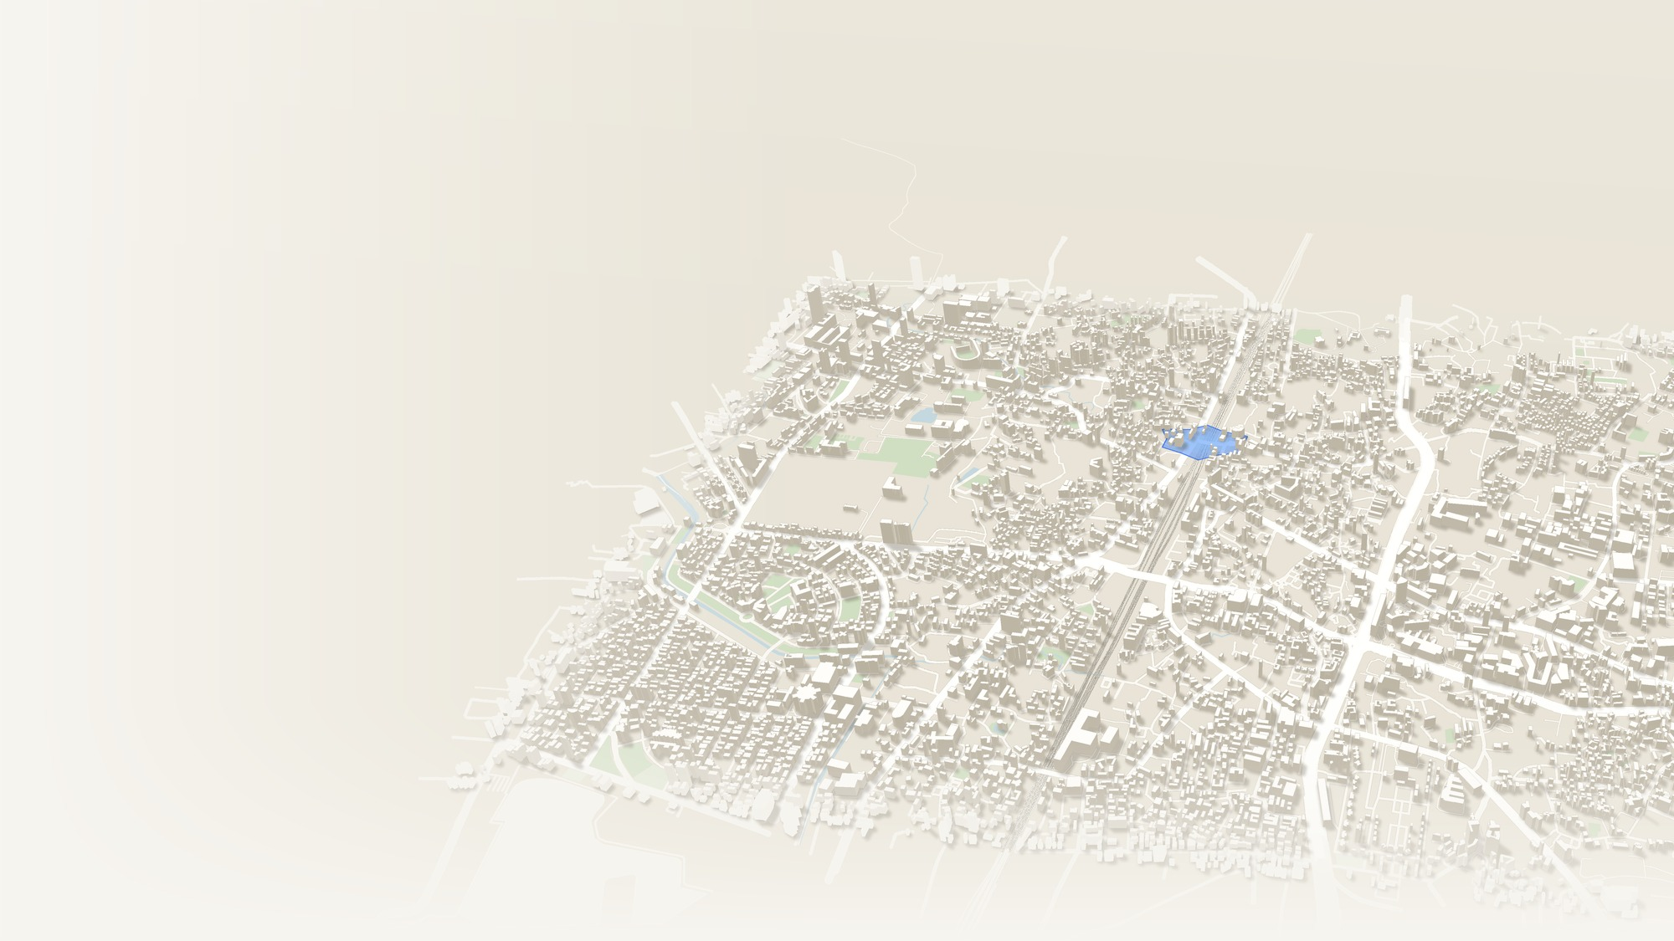




Vighanaway
HACKATHON PROTOTYPE
When Roads Fail,
Find a Way.
Flooded underpass
Blocked by corroborated reports
Start
!
Hospital
H
An emergency-adaptive navigation platform that recommends viable routes during floods, road closures and traffic disruptions, using evidence-based route intelligence.
Farther crossing
Alternative, still viable
Recommended: flyover
6 min longer, avoids the flood
01
02
03
04
05
Flood-aware route recommendations
Evidence-based incident verification
Explainable route decisions
Dynamic rerouting as conditions change
Alternatives when a destination becomes unreachable
01 / 06
Notes:
Open with the line: when roads fail, find a way. Vighanaway is an emergency-adaptive navigation platform. Normal navigation assumes roads work. In a monsoon flood that assumption breaks: an underpass fills with water, a road closes, a flyover jams. This 3D city is built from real OpenStreetMap roads and buildings. The red route is blocked by a flooded underpass. The grey route is a farther alternative. The teal route is what Vighanaway recommends: a flyover that reaches the hospital, a few minutes longer but viable. And it does more than draw a line: it verifies evidence, explains every decision, keeps rerouting as conditions change, and offers alternatives when a destination becomes unreachable. Next: the problem, how the engine thinks, and a live demo.

Slide 2
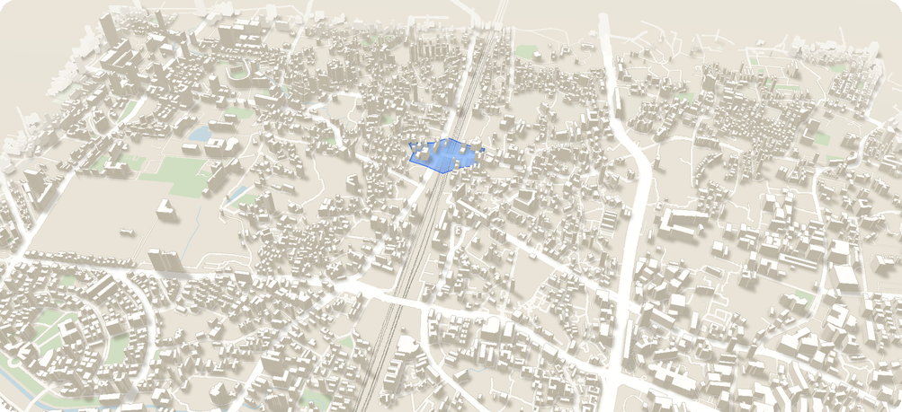



In an Emergency, the Shortest Path
Is Not Always the Right Path
02 — THE PROBLEM
Time-only routing no hazard check
16 min, through the flood
Vighanaway viability and evidence first
22 min, flyover
!
!
H
H
Navigation must weigh route viability, evidence quality and changing conditions, not travel time alone.
01
02
03
04
05
Underpasses can become flooded
Road closures can make routes unusable
Unverified reports create uncertainty
Congestion can make alternatives impractical
Little explanation of why a route should change
02 / 06
Notes:
Here is the core problem. Most navigation optimises for the fastest route. In an emergency the fastest route can be the wrong one. On the left, a time-only route goes straight through a flooded underpass. It shows a good ETA, but nothing about whether the road is passable and no reason for the choice. On the right, Vighanaway evaluates the same hazard, rejects that crossing, and recommends the flyover: a few minutes longer but viable. Underpasses flood, closures make routes unusable, unverified reports create doubt, congestion makes alternatives impractical, and users get little explanation. So navigation must weigh viability, evidence quality and changing conditions, not travel time alone.

Slide 3
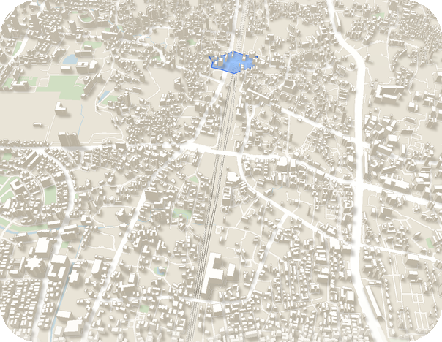
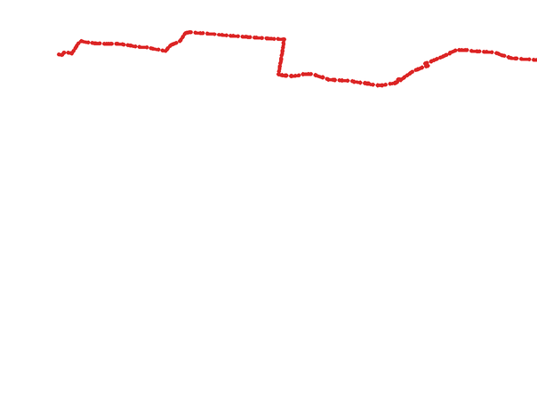


From Route Finding to Evidence-Based Route Intelligence
03 — THE SOLUTION
!
1
Select an origin and destination
2
Generate multiple candidate routes from real OpenStreetMap road-network data
3
Evaluate hazards, congestion, report age and verification status
4
Reject routes blocked by verified or corroborated impassable incidents
Recommended route
Flyover
22 min
5
Rank viable alternatives and explain the recommendation
6 min longer than your usual route
Avoids
Flooded underpass
6
Recalculate when new evidence changes the situation
Evidence
Corroborated reports
Confidence
Medium
Estimated travel time is congestion-adjusted minutes. Emergency-cost score is separate: it adds hazard, report-age and missing-data penalties and is used only to rank routes.
Illustrative prototype data
03 / 06
Notes:
This is how Vighanaway thinks. We move from route finding to evidence-based route intelligence, in six steps. One, pick an origin and destination. Two, generate several candidate routes from real OpenStreetMap road data. Three, evaluate hazards, congestion, report age and verification status. Four, reject any route blocked by a verified or corroborated impassable incident. Five, rank the viable options and explain the recommendation. Six, recalculate whenever new evidence arrives. The phone mockup shows the result in a 3D navigation view: the flyover at about 22 minutes, six minutes longer than the usual route, but it avoids the flooded underpass, with the evidence and a confidence label. All figures are illustrative prototype data. And note that estimated travel time is separate from the emergency-cost score, which is used only to rank.

Slide 4
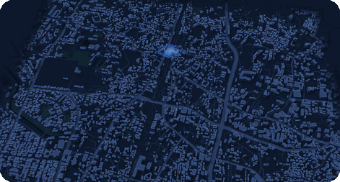

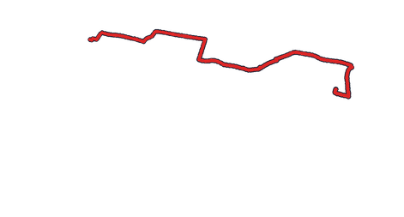


Every Route Decision Has a Reason
04 — THE INNOVATION
01
02
Incident timeline
Simulated events
Evidence-aware routing
Explainable decisions
One flood report
Unverified Route unchanged.
14:07
A single unverified report adds a warning and a penalty; it never blocks a route on its own. Corroborated or verified impassable incidents can make a route non-viable.
Every recommendation change shows the incident source, verification status, report age, hazards avoided and the reason for the change.
14:10
Independent report: knee-deep water
Corroborated Underpass non-viable.
Unverified: penalty. Corroborated or verified: can block.
Source, status, age, hazards, reason.
14:12
Traffic-police verification
Verified (simulated) Rejection confirmed.
03
04
14:15
Heavy flyover congestion
Congestion Switch if above threshold.
Stable adaptive rerouting
What-if emergency simulator
No needless flip-flopping. Reconsider when the current route becomes non-viable, or an alternative improves enough to cross the switching threshold.
Judges can simulate a flood report, road closure or congestion increase, and watch the route engine reassess every alternative.
Before 14:07 underpass route
After 14:15 farther crossing
Switch only above the threshold.
Flood report, closure, congestion.
04 / 06
Notes:
What makes Vighanaway different is that every route decision has a reason. First, evidence-aware routing: a single unverified report creates a warning and a penalty, but never blocks a route on its own. Only corroborated or verified impassable incidents can make a route non-viable. Second, explainable decisions: we show the source, verification status, report age, hazards avoided and why the recommendation changed. Third, stable adaptive rerouting: we do not flip routes needlessly; we reconsider when the current route fails or an alternative clearly crosses the switching threshold. Fourth, the what-if simulator, so judges can inject a flood, closure or congestion and watch the engine reassess. The timeline on the right is simulated: an unverified report changes nothing, a corroborating report rejects the underpass, simulated verification confirms it, then heavy flyover congestion can move us to a farther crossing.

Slide 5
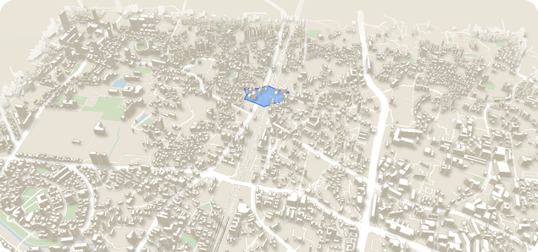


Deterministic Intelligence. Explainable Outcomes
05 — TECHNOLOGY AND SYSTEM ARCHITECTURE
User interface
Next.js + React + TypeScript
1
Interactive mapping
MapLibre GL JS + OpenStreetMap + locally stored PMTiles map tiles
2
Routing engine
Dijkstra shortest-path algorithm + Yen's k-shortest-path algorithm
3
Local PMTiles map, OpenStreetMap data, simulated incidents overlaid
Emergency route evaluator
Hard constraints, hazard penalties, congestion-adjusted travel time, report-age weighting, missing-data penalties
TypeScript engine with deterministic, testable rules
4
Responsive web app with installable Progressive Web App support
Recommendation engine
Route ranking, viability assessment, confidence labels, plain-language explanations, switching threshold
5
Optional Supabase Realtime for live cross-device incident reporting
Output
Recommended route + alternatives + evidence timeline + updated route when incidents change
Local map and scenario data support an offline demonstration
6
No machine learning or LLM makes route decisions. Simulated incidents stay separate from real road data.
05 / 06
Notes:
Here is the technology, and the key word is deterministic. The user interface is Next.js with React and TypeScript. Mapping uses MapLibre GL JS with OpenStreetMap data and locally stored PMTiles, so the demo works offline. The routing engine uses Dijkstra's algorithm and Yen's k-shortest-path algorithm to generate candidate routes. The emergency route evaluator applies hard constraints, hazard penalties, congestion-adjusted travel time, report-age weighting and missing-data penalties. The recommendation engine ranks routes, assesses viability, assigns confidence labels, writes plain-language explanations and applies the switching threshold. The output is a recommended route, alternatives, an evidence timeline and an updated route when incidents change. To be clear: no machine learning or LLM makes route decisions, so every outcome is testable and explainable. Simulated incidents are kept separate from real road-network data.

Slide 6
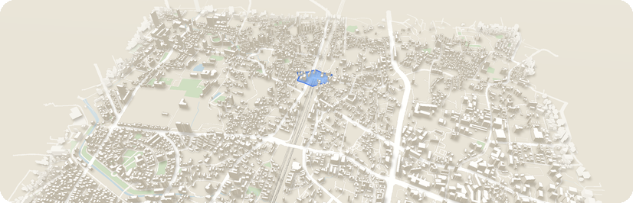


Demonstrate the Decision. Prove the Difference
06 — LIVE DEMO, IMPACT AND ROADMAP
Live hackathon demonstration
Potential impact
Future roadmap
Prototype, simulated incidents
What this enables
Proposed, not yet built
1
Start with three candidate routes
Better-informed route choices during emergencies
Official emergency-alert and traffic-authority integrations
2
Add one unverified flood report: the route stays unchanged, and the reason is shown
Transparent communication of uncertainty
Accessibility-aware route profiles
3
Corroborate a severe flood report: the underpass route is rejected
Voice guidance in Hindi, Punjabi and English
Adaptation to changing road conditions
More robust offline functionality
4
Increase flyover congestion: potential switch to the farther crossing
Route-capacity intelligence and evacuation load distribution
5
Open the evidence timeline: every change is explained
A foundation for inclusive, accessible emergency navigation
Carefully designed journey sharing and check-in
Vighanaway does not promise a safe route. It recommends a viable option based on available evidence, explains its reasoning, and adapts when conditions change.
H
Hackathon prototype. Incidents and congestion in the demonstration are simulated. Not validated for real emergency use.
06 / 06
Notes:
Now the demo, impact and roadmap. In the live demo I start with three candidate routes. I add one unverified flood report and the route stays unchanged, and the timeline shows why. I then corroborate a severe flood report and the underpass route is rejected. I raise congestion on the flyover and show a potential switch to the farther crossing, only if it clears the switching threshold. The evidence timeline explains every change. The potential impact is better-informed choices, transparent uncertainty, adaptation to changing roads, and a foundation for inclusive emergency navigation. The roadmap is proposed, not built: official alert integrations, accessibility-aware profiles, Hindi, Punjabi and English voice guidance, stronger offline support, route-capacity intelligence, and carefully designed journey sharing. Close with the statement on screen. This is a hackathon prototype with simulated data, not validated for real emergency use. Thank you.

