Slide 1
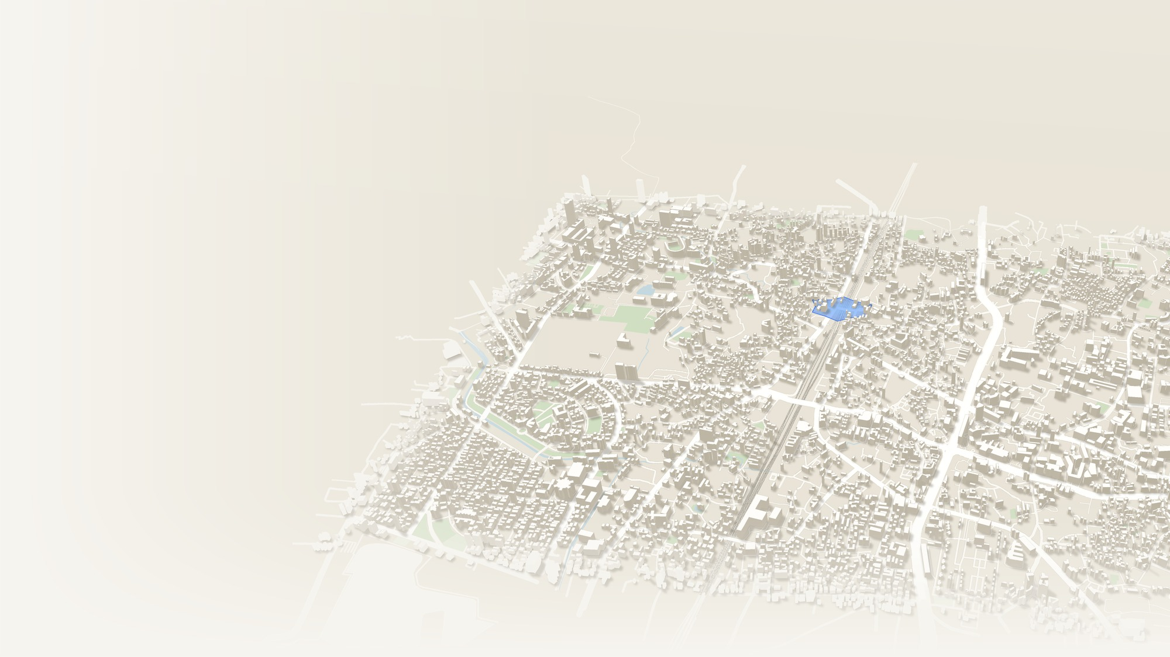
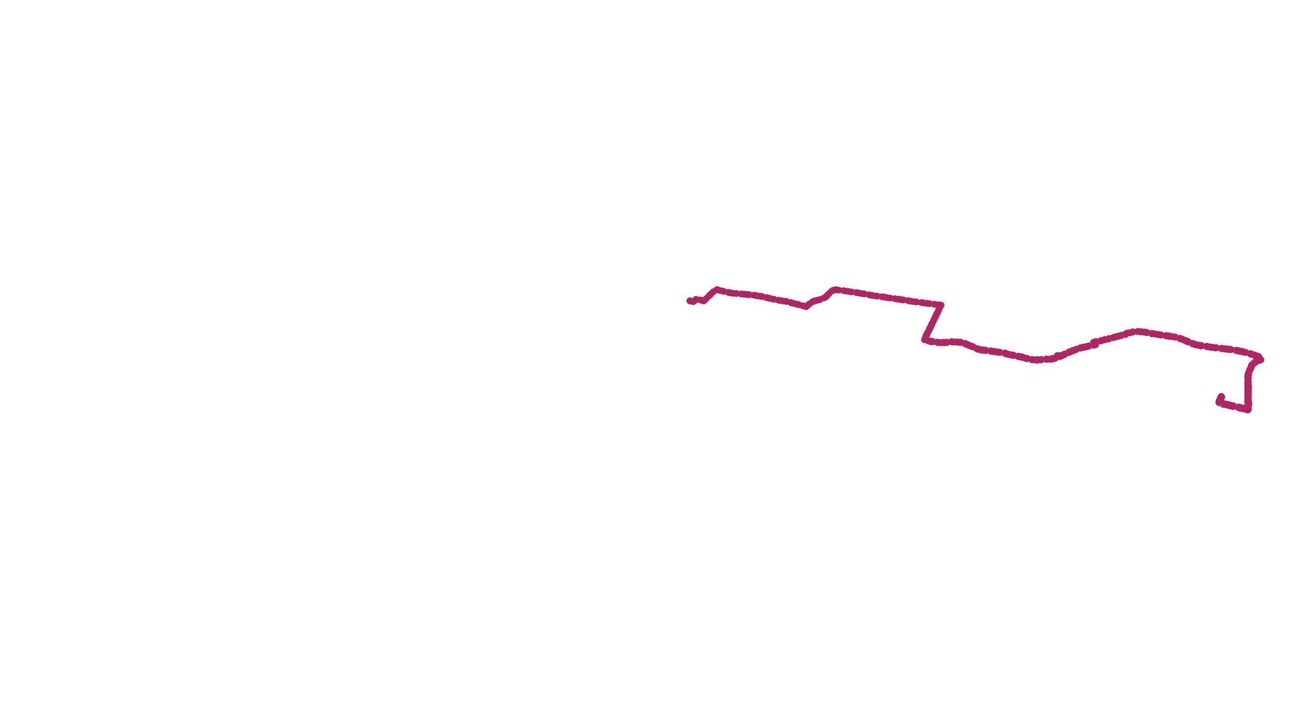



Vighnaway
HACKATHON PROTOTYPE
vighna (विघ्न) = obstacle. Vighnaway: obstacle, away.
When Roads Fail,
Find a Way.
Flooded underpass
Corroborated, 2 devices
Start
!
Hospital
H
“In a flood, the fastest route is the one that drowns first.”
Vighnaway weighs the evidence on every road (floods, closures, congestion, report age and status) and recommends a viable route, with the reason.
Farther crossing
Alternative, still viable
Recommended: flyover
+4 min, avoids the flood
01
02
03
04
05
Flood-aware route recommendations
No report is not the same as clear
Explainable route decisions
Dynamic rerouting as conditions change
Alternatives when a destination becomes unreachable
Simulated conditions on real roads · © OpenStreetMap contributors
01 / 06
Notes:
Pause one second, then: In a flood, the fastest route is the one that drowns first. Every monsoon the Andheri Subway fills with water, and navigation apps keep sending cars into it because on paper it is still the fastest way across the railway. Show of hands: who has followed an app into a road it should have known about? It said continue straight for 400 metres; it did not mention they were underwater. In Mumbai people pray to Vighnaharta, the remover of obstacles, before a journey. We thought he could use help with the routing. Vighna means obstacle: Vighnaway, obstacle away. The roads you will see are real OpenStreetMap roads; the flood is simulated, and we label it everywhere.

Slide 2
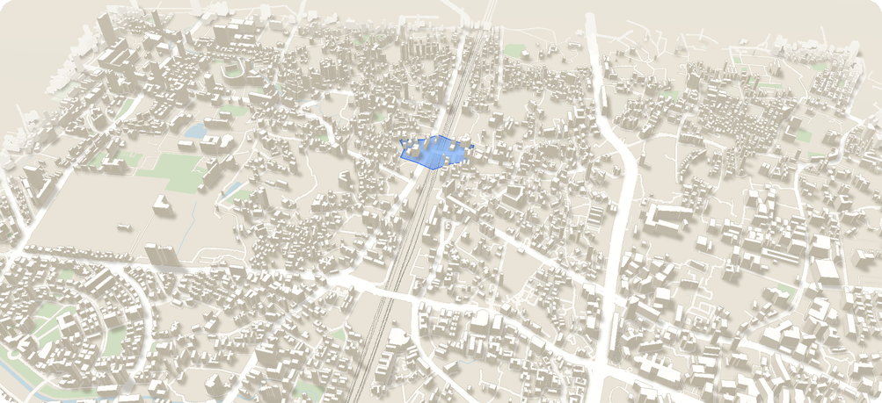
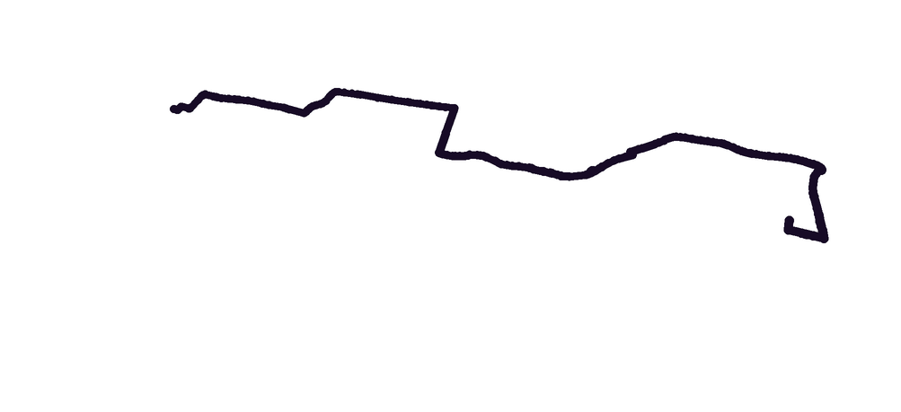
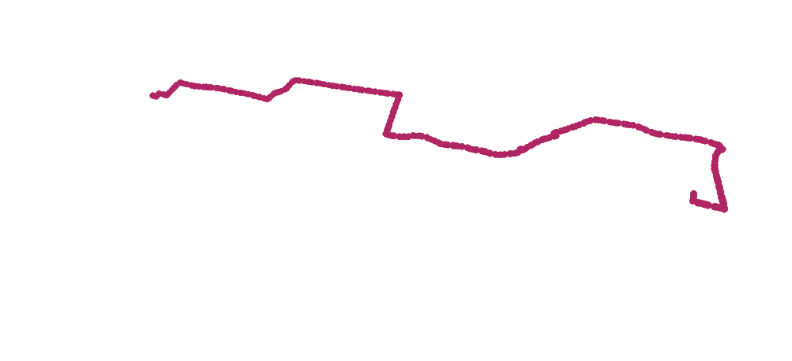
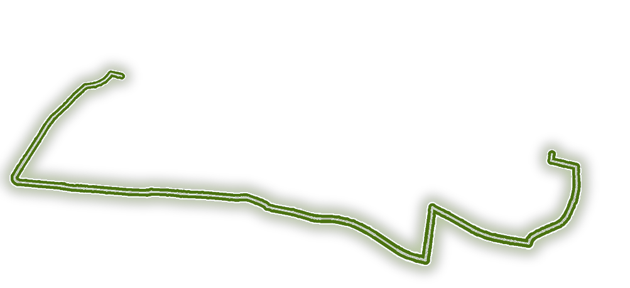
In an Emergency, the Shortest Path
Is Not Always the Right Path
02 — THE PROBLEM
Time-only routing no hazard check
11 min, through the flood
Vighnaway viability and evidence first
15 min, via flyover
!
!
H
H
Simulated scenario · © OpenStreetMap contributors
Navigation must weigh route viability, evidence quality and changing conditions, not travel time alone.
01
02
03
04
05
Underpasses can become flooded
Road closures can make routes unusable
Unverified reports create uncertainty
No report is treated as all clear
Little explanation of why a route should change
02 / 06
Notes:
The information that a road is blocked exists: people next to it, a control room, a rain alert. It is scattered, unverified and invisible when you choose your route. Time-only routing takes the subway: 11 minutes, through the water. We take the flyover: about 4 minutes longer. And the point most apps miss: no report is not the same as clear. On a flood-prone road during a rain alert, silence is a risk, not good news.

Slide 3
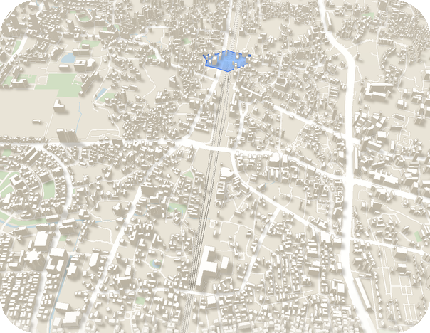
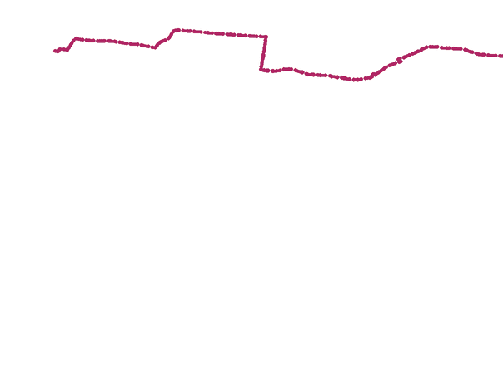
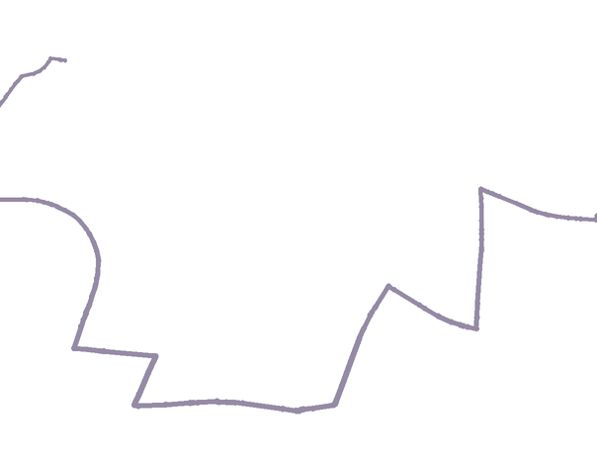
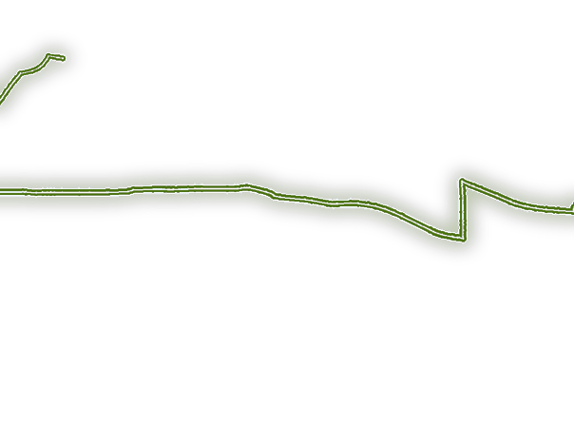
From Route Finding to Evidence-Based Route Intelligence
03 — THE SOLUTION
!
1
Select an origin and destination
2
Generate multiple candidate routes from real OpenStreetMap road-network data
3
Weigh hazards, congestion, report age, verification status, and silence on flood-prone roads
4
Reject routes blocked by verified or corroborated impassable incidents
Recommended route
Flyover
15 min
5
Rank viable alternatives and explain the recommendation
+4 min vs the usual route
Avoids
Andheri Subway flood
6
Recalculate when new evidence changes the situation
Evidence
Corroborated reports
Confidence
Medium
Estimated travel time is congestion-adjusted minutes. Emergency-cost score is separate: it adds hazard, report-age and missing-data penalties and is used only to rank routes.
Simulated · © OpenStreetMap contributors
03 / 06
Notes:
Six steps, all deterministic. Candidate routes come from the real road graph. We weigh every incident by its status and age, and a flood-prone road with no recent report costs a penalty. Corroborated or verified impassable incidents are hard blocks. The time we show is real minutes; the ranking cost is separate and never shown as time. Every recommendation comes with one sentence of reason, its evidence, and High, Medium or Low confidence, never a percentage.

Slide 4
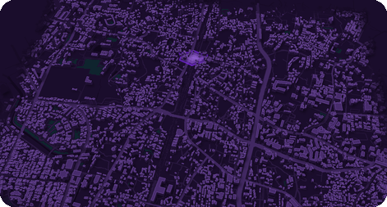
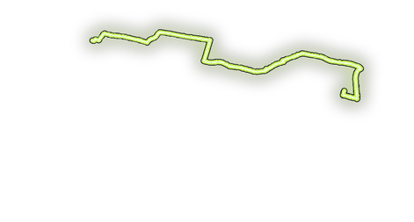
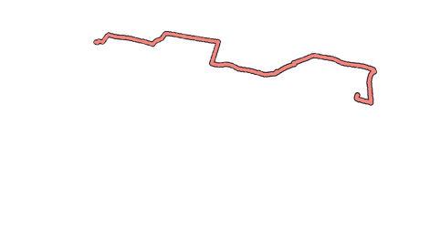
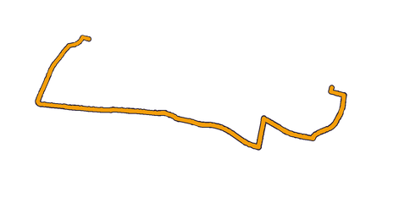
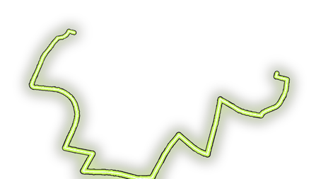
Every Route Decision Has a Reason
04 — THE INNOVATION
01
02
Incident timeline
Simulated events
Evidence-aware routing
Explainable decisions
One ankle-deep report
Unverified Route holds.
14:06
A single unverified report adds a warning and a penalty; it never blocks a route on its own. Corroborated or verified impassable incidents can make a route non-viable.
Every recommendation change shows the incident source, verification status, report age, hazards avoided and the reason for the change.
14:08
Second device: knee-deep water
Corroborated Subway not viable.
Unverified: penalty. Corroborated or verified: can block.
Source, status, age, hazards, reason.
14:09
Operator verification
Verified (simulated) Route holds, already right.
03
04
14:11
Heavy congestion on the flyover
Corroborated Switch: saves 3 min.
Stable adaptive rerouting
Checkable decisions
No needless flip-flopping. Reconsider when the current route becomes non-viable, or an alternative improves enough to cross the switching threshold.
The phone and the control room compute the route independently and agree. Every decision gets a receipt anyone can re-run.
Before 14:06 Andheri Subway
After 14:11 farther crossing
Switch only above the threshold.
Same evidence, same route, every time.
© OpenStreetMap contributors
04 / 06
Notes:
Four ideas. One unverified report is a penalty, not a block. Every change names its incident, status, source and age. We switch only when the gain beats max(2 minutes, 10%), so the route does not flicker. And decisions are checkable: the phone and the control room compute independently and agree, and every decision gets a receipt anyone can re-run. The timeline on the right is exactly what you are about to see live. Then switch to the live demo.

Slide 5
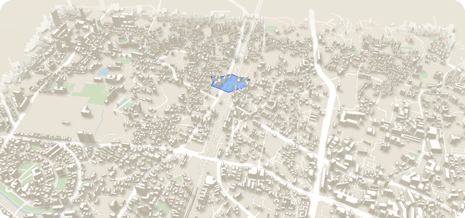
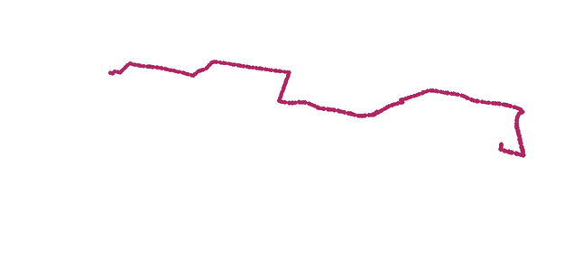

Deterministic Intelligence. Explainable Outcomes
05 — TECHNOLOGY AND SYSTEM ARCHITECTURE
Citizen app
Expo (React Native) Android app on Google Maps; English, Hindi, Marathi
1
Control room
Next.js web console: verify reports, run the simulation, receipts, judge QR
2
API and data
NestJS, Postgres + PostGIS snapping and corroboration, socket.io with resync
3
Real OpenStreetMap roads of Andheri (23,177 edges), simulated incidents. © OpenStreetMap contributors
Shared route engine
One pure TypeScript engine on phone and console: Yen k-shortest paths, hard blocks, evidence-weighted penalties
The server never sends routes. It sends evidence
4
Phone and console reach the same route: matching parity hash
Recommendation engine
Route ranking, viability assessment, confidence labels, plain-language explanations, switching threshold
5
Keeps routing offline on cached incidents; reports relay by QR
Output
Recommended route, alternatives, a one-sentence reason and a decision receipt
Shared Zod contracts; tests on engine, API, app and console
6
No machine learning or LLM makes route decisions. Simulated incidents stay separate from real road data.
05 / 06
Notes:
The citizen app is an Expo Android app on Google Maps; the control room is a Next.js console; the API is NestJS on Postgres with PostGIS for snapping and corroboration, with socket.io and sequence resync. The key design choice: the server never sends routes. It sends evidence, and one pure TypeScript engine runs on the phone and in the console. No machine learning or LLM makes a route decision. That is why it works offline and why you can check every decision.

Slide 6
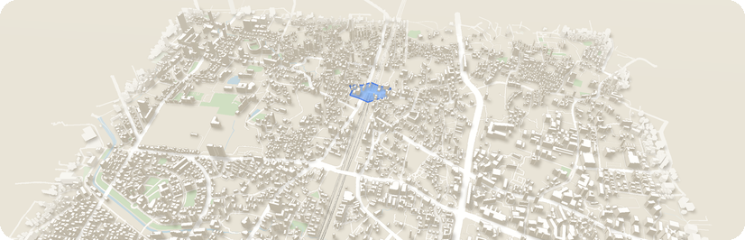


Demonstrate the Decision. Prove the Difference
06 — LIVE DEMO, PROOF AND ROADMAP
Live hackathon demonstration
Honest numbers
Built, and next
Prototype, simulated incidents
20 seeded simulated scenarios
Working in the prototype today
1
Start trip: Andheri Subway, 11 min, Low confidence (no recent reports)
Usual route hit a confirmed block in 8 of 20
Built: step-free walking, prefer well-lit roads
2
One unverified ankle-deep report: the route holds, and says why
Built: hospital load spreading
Avoiding it cost a median 0.3 min, 2.9 at worst
3
A second device reports knee-deep: corroborated, rerouted via the flyover
Built: Hindi and Marathi interface
Slower for nothing in 5 of 20, and we publish it
Built: offline routing, QR report relay
4
Flyover jams, hospital road closes: nearest reachable hospital, call 112
Modelled minutes, never “lives saved”
Next: live SACHET/IMD alerts and traffic feeds
5
Judges report by QR; reset and replay gives identical decisions
Next: a city pilot with a real control room
In a flood, the fastest route is the one that drowns first. Vighnaway takes the one with the evidence.
H
Hackathon prototype. Incidents and congestion in the demonstration are simulated. Not validated for real emergency use.
Simulated · © OpenStreetMap contributors
06 / 06
Notes:
Recap the live demo. Then the honest numbers: 20 seeded simulated scenarios on the real road graph. The usual route hit a confirmed block in 8 of 20; avoiding it cost a median of 0.3 extra minutes, 2.9 at worst; and in 5 of 20 we were slower for nothing, which we publish. Already built beyond the demo: step-free walking, a well-lit preference, hospital load spreading, offline QR relay, Hindi and Marathi. Next: live alerts and traffic, and a city pilot. Close: In a flood, the fastest route is the one that drowns first. Vighnaway takes the one with the evidence. Obstacle, away. Thank you.

