Slide 1
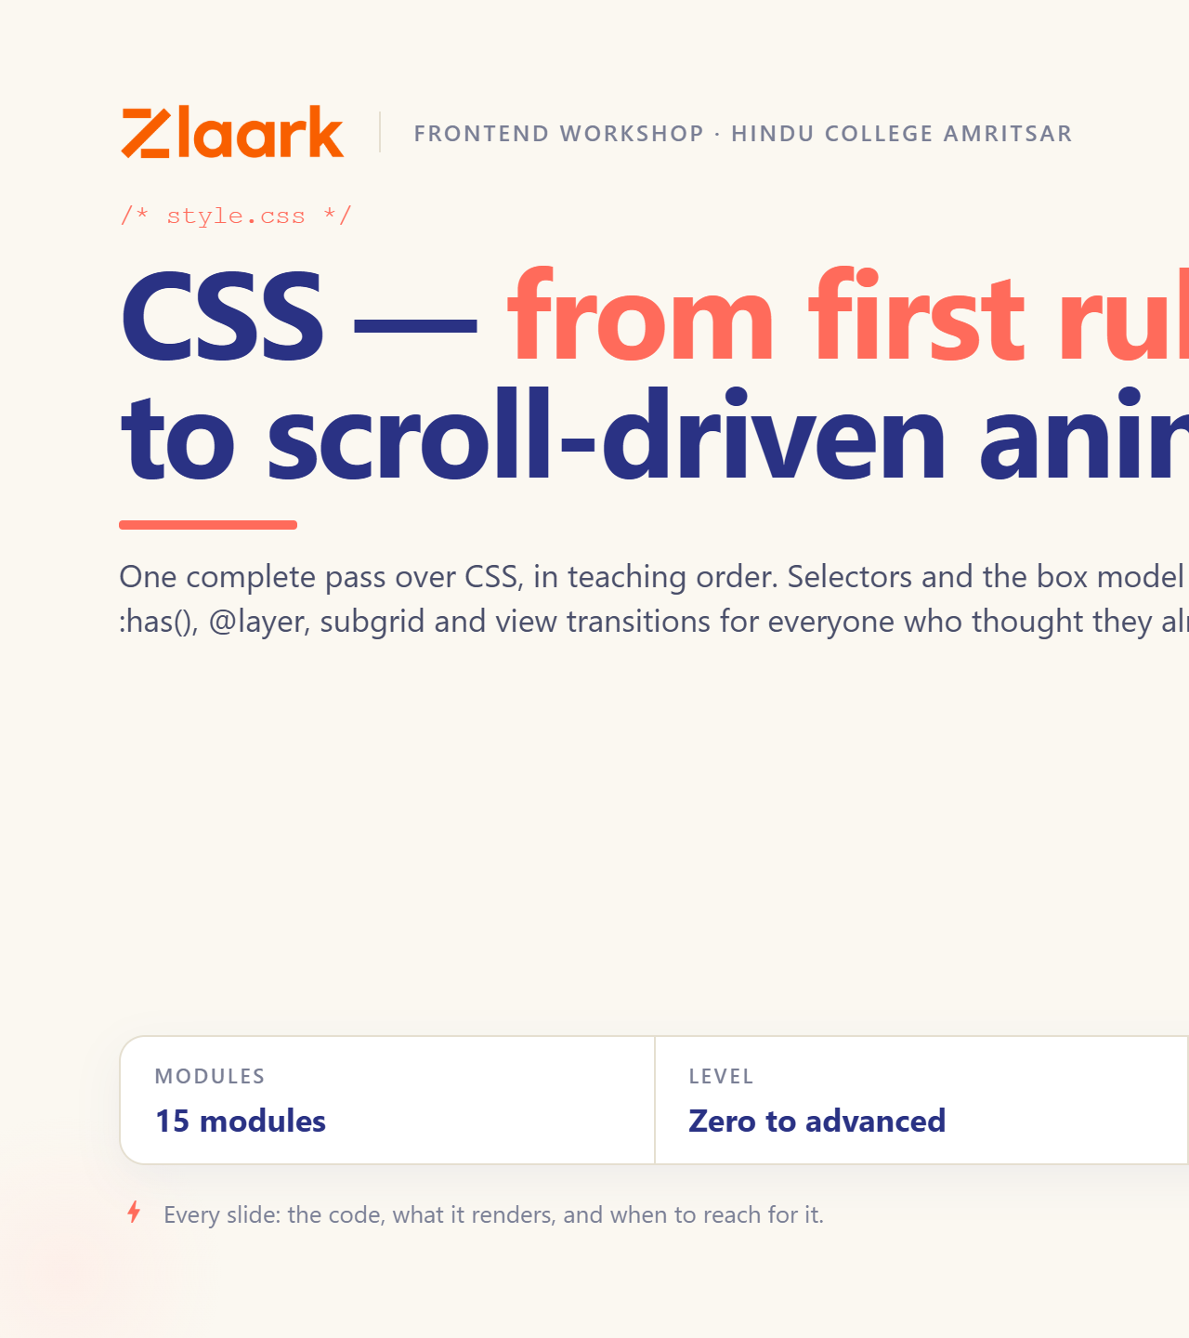
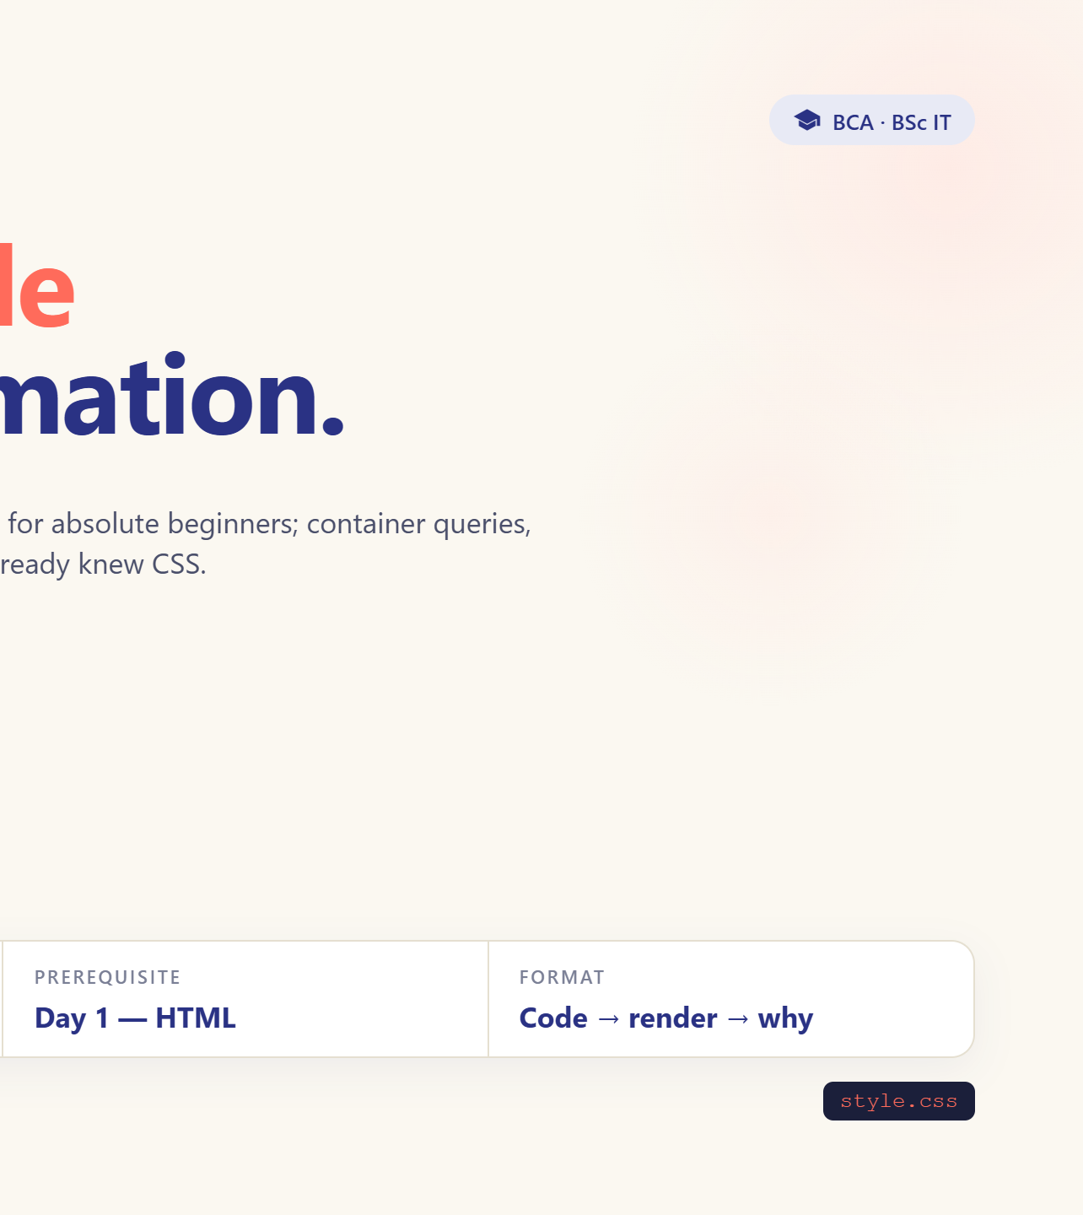
Notes:
Welcome to Day 2. Yesterday: structure. Today: everything you can see.

Slide 2
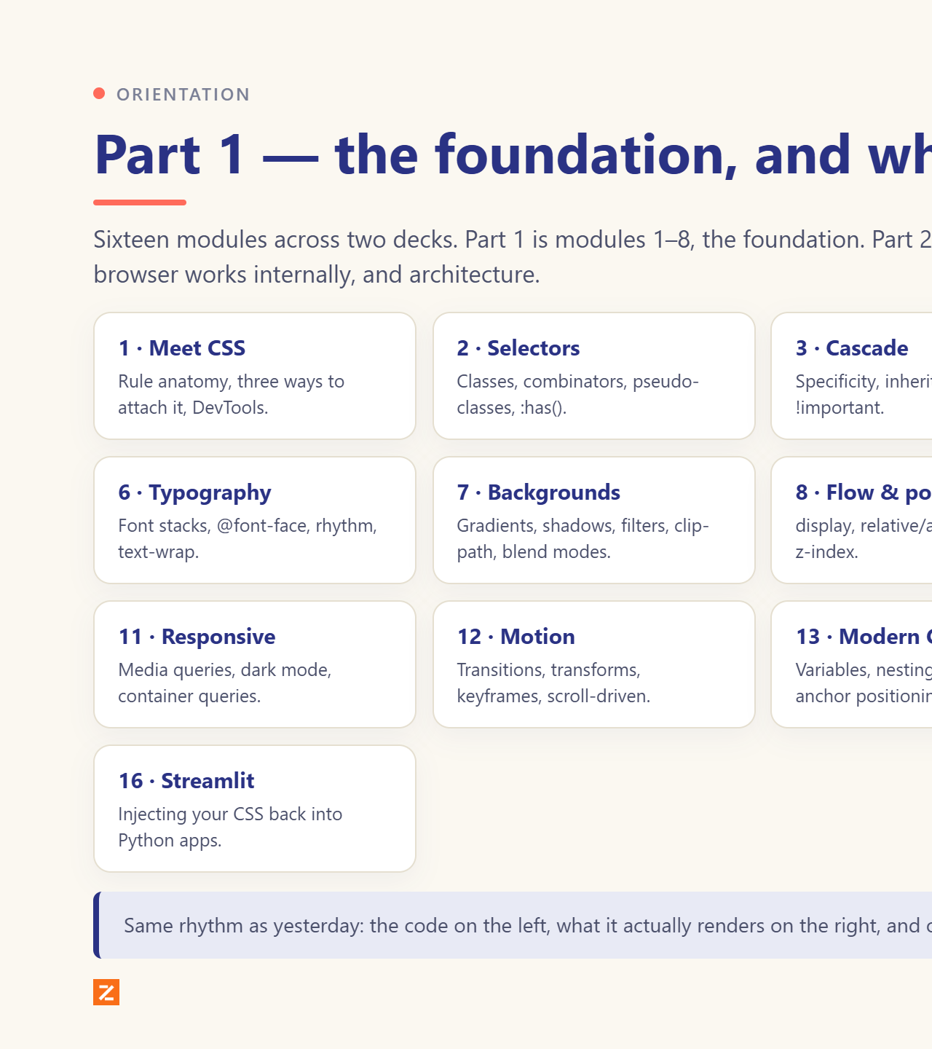
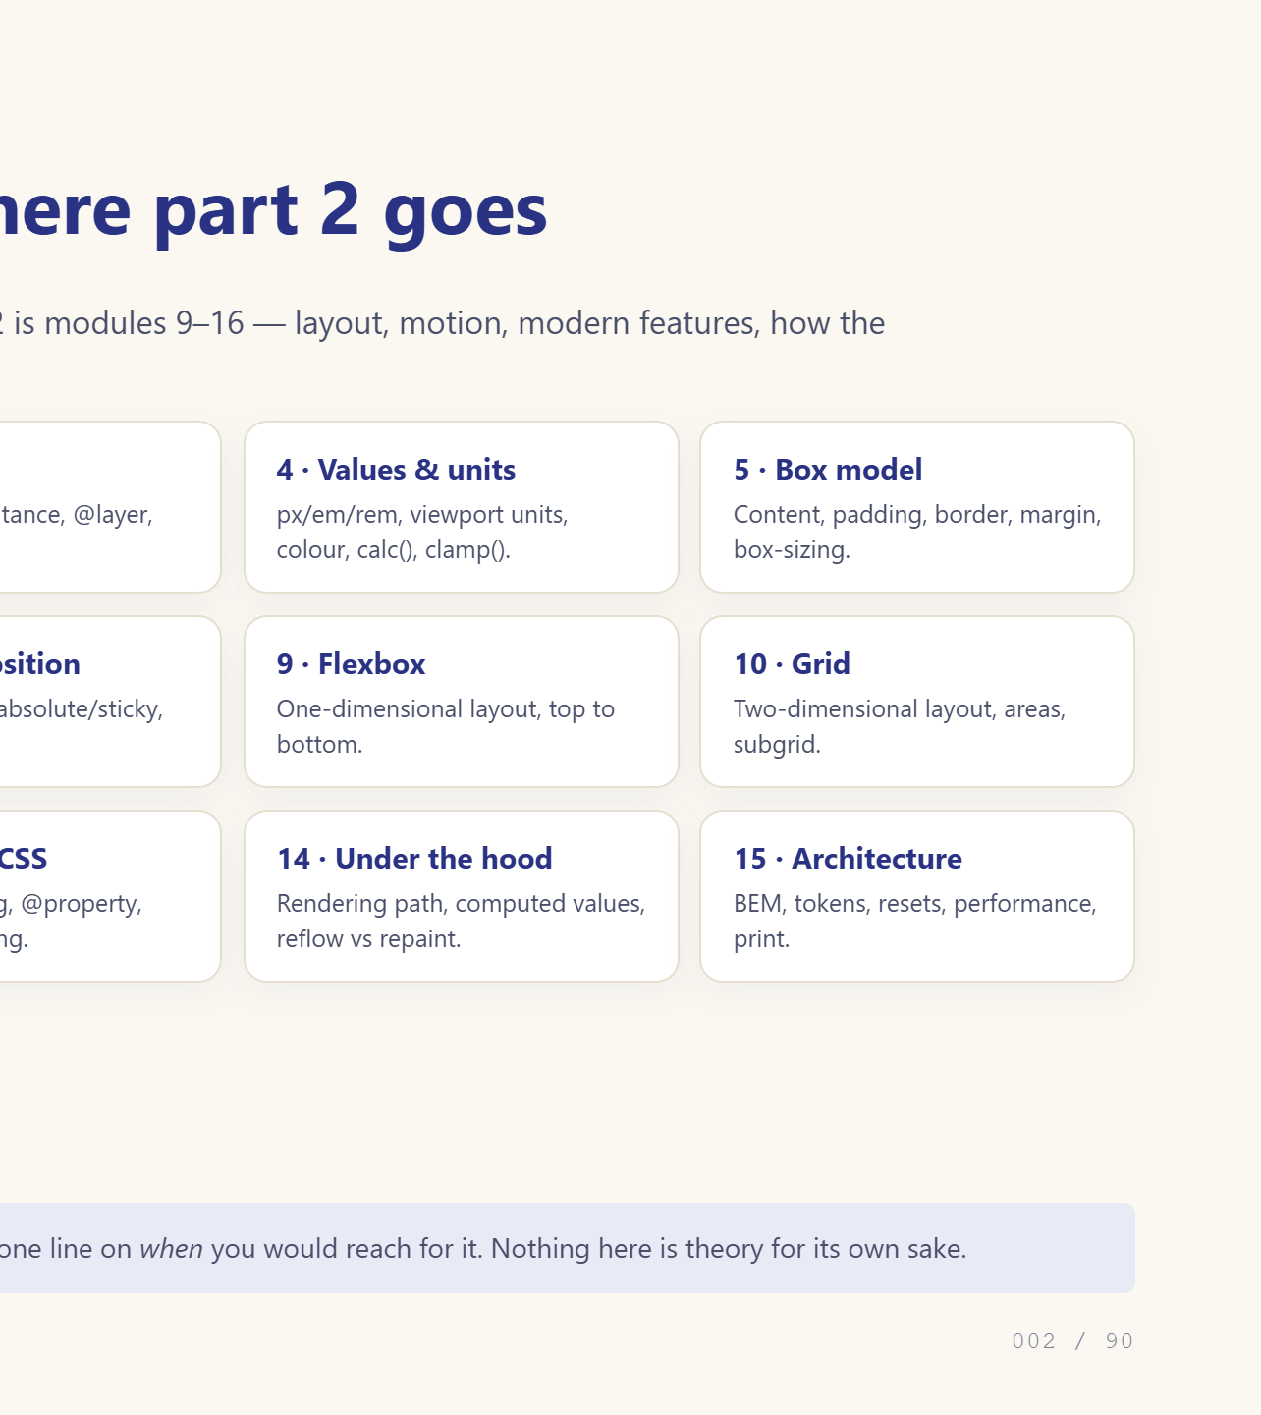
Notes:
Read the fifteen modules out. Tell them where the

Slide 3
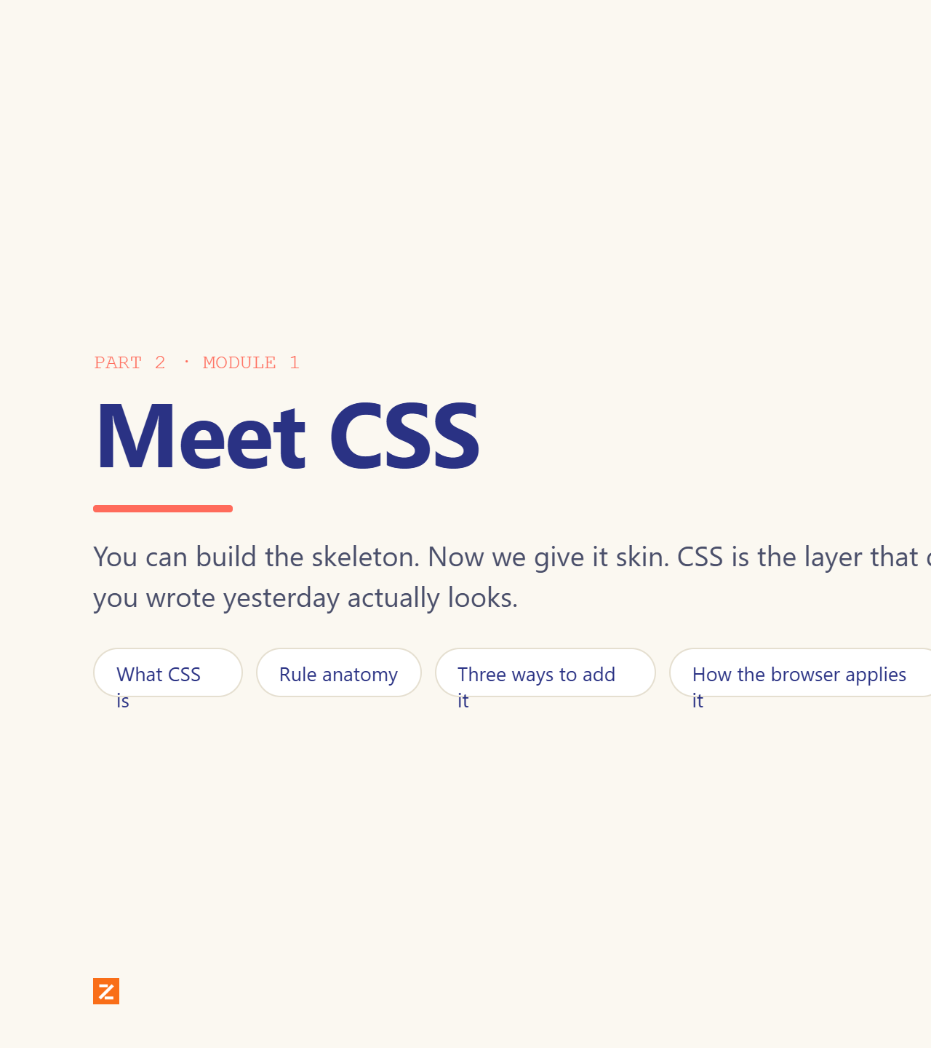
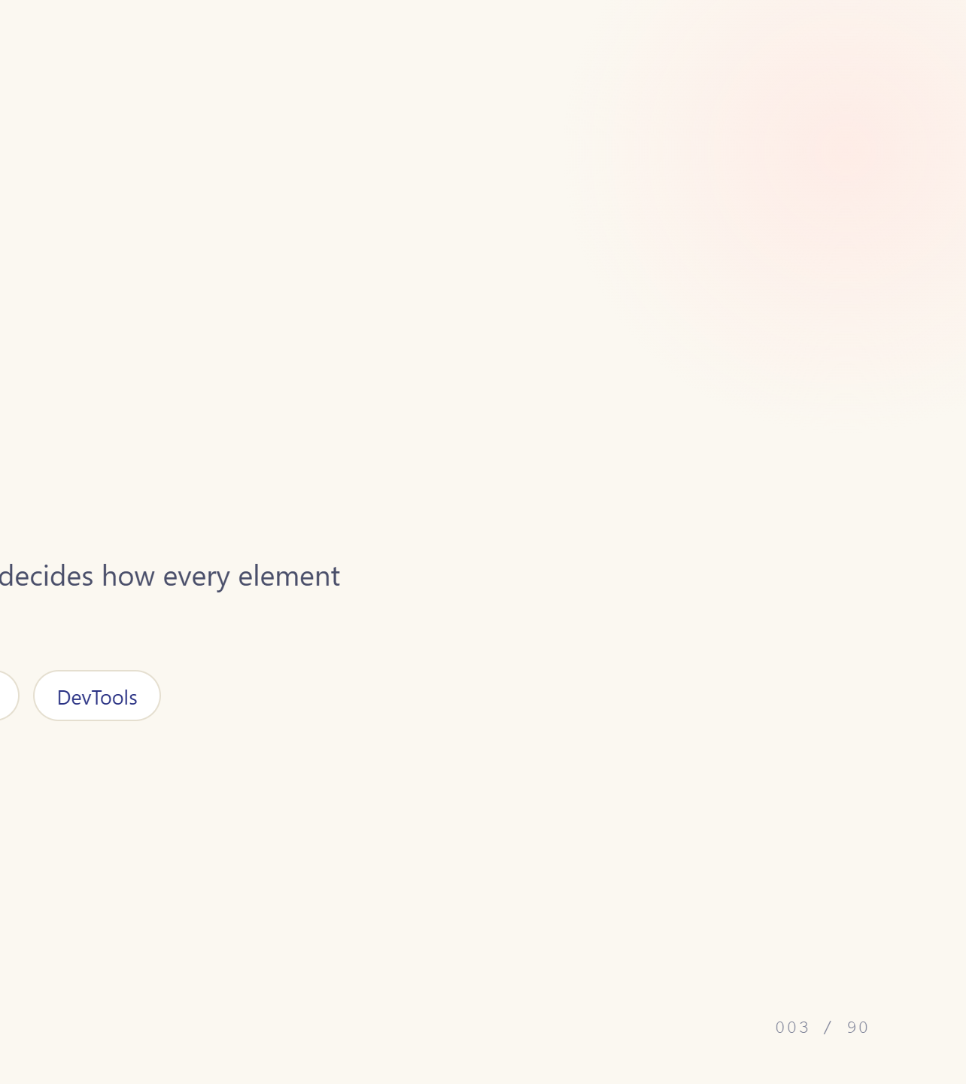
Notes:
Module divider. Say what changes in this module.

Slide 4
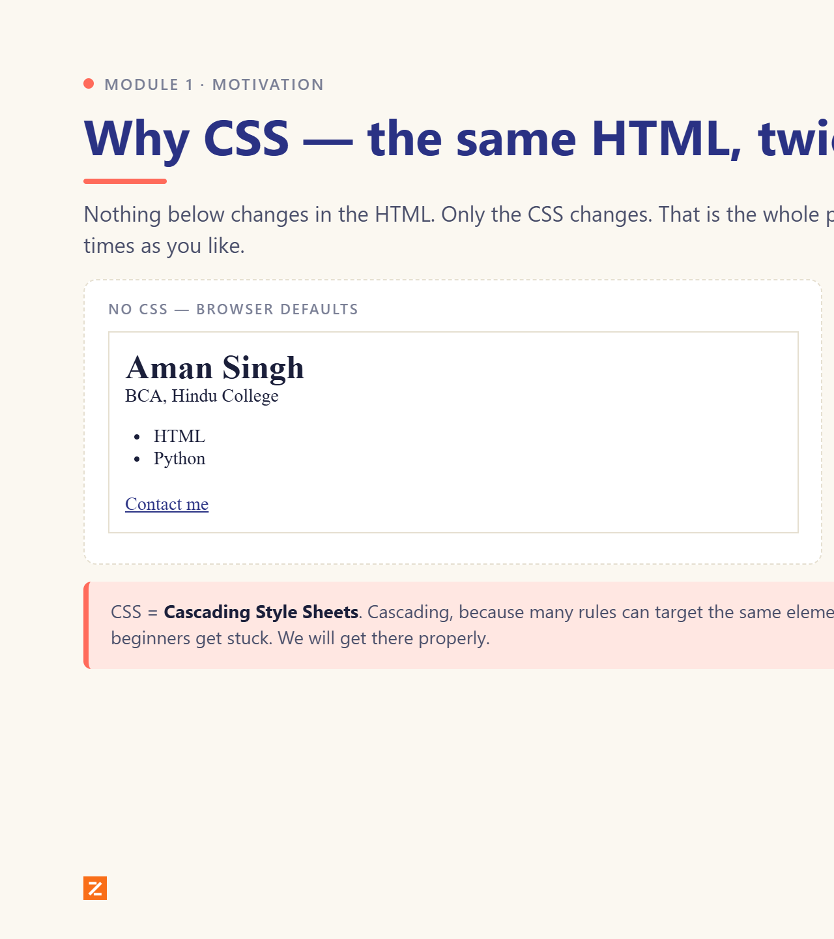
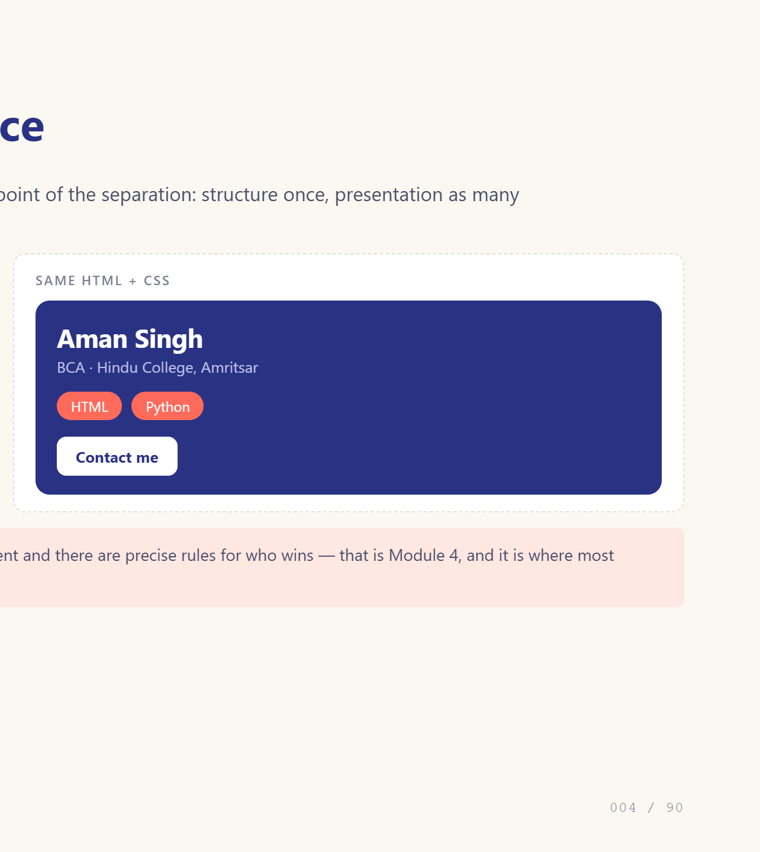
Notes:
HTML without CSS is a document; with CSS it is a product.

Slide 5
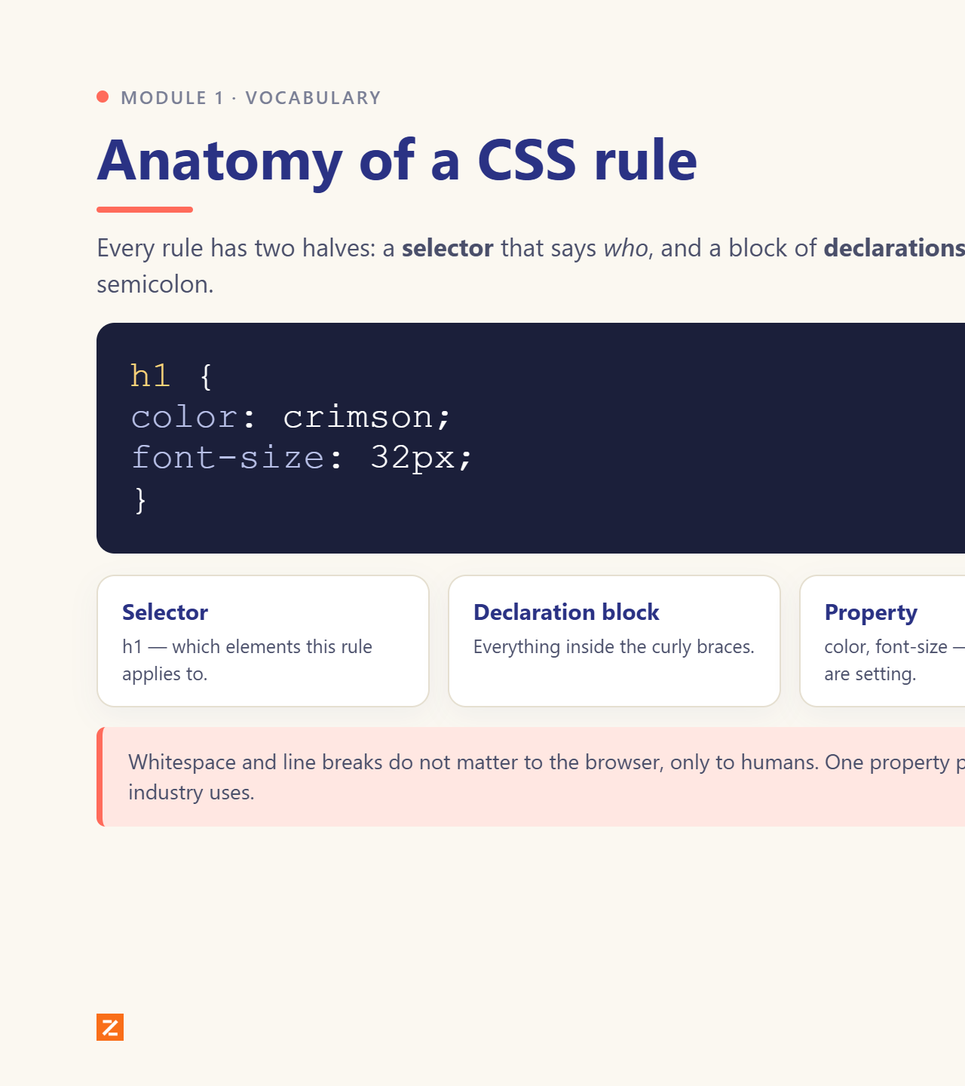
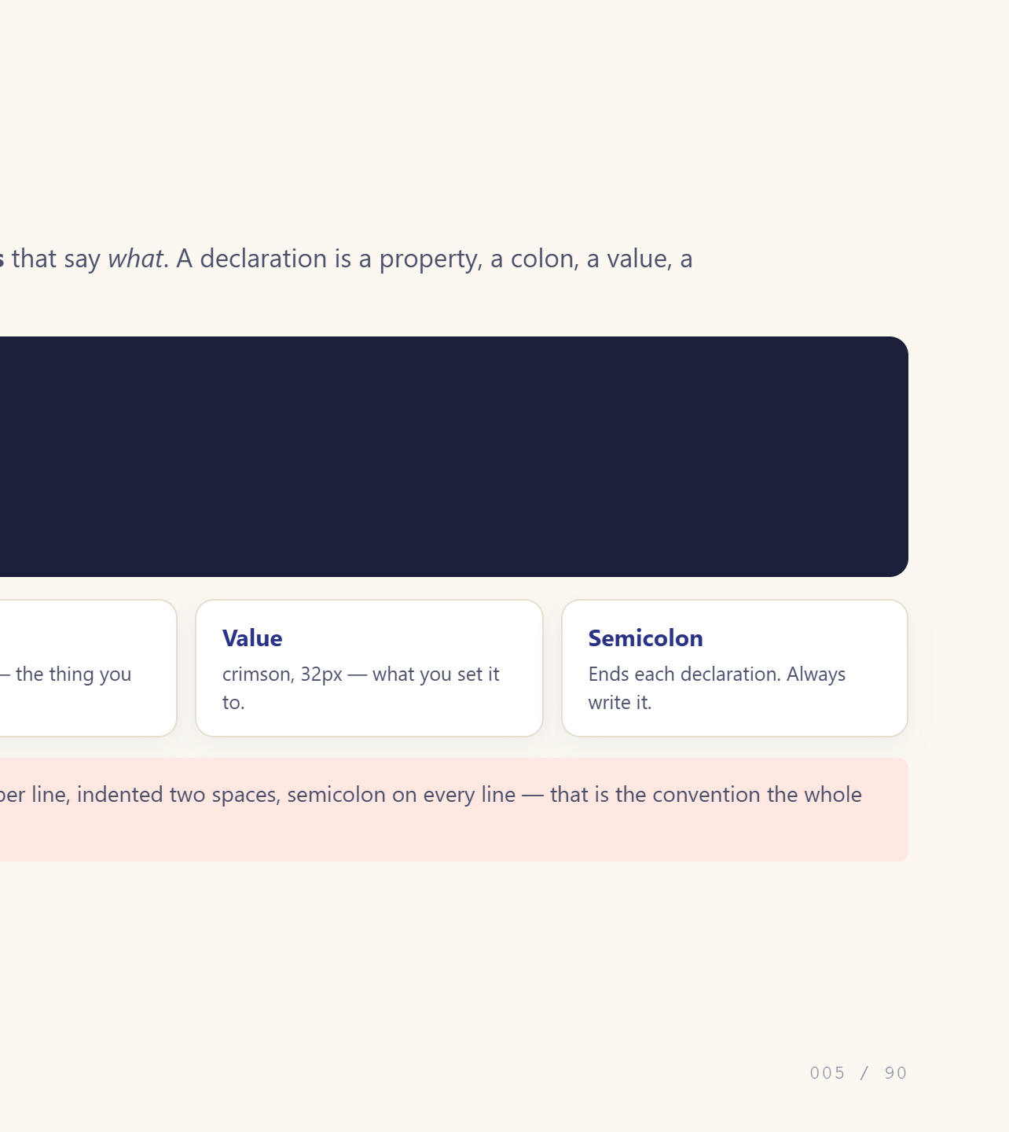
Notes:
Name every part out loud. They will hear these words 200 times.

Slide 6
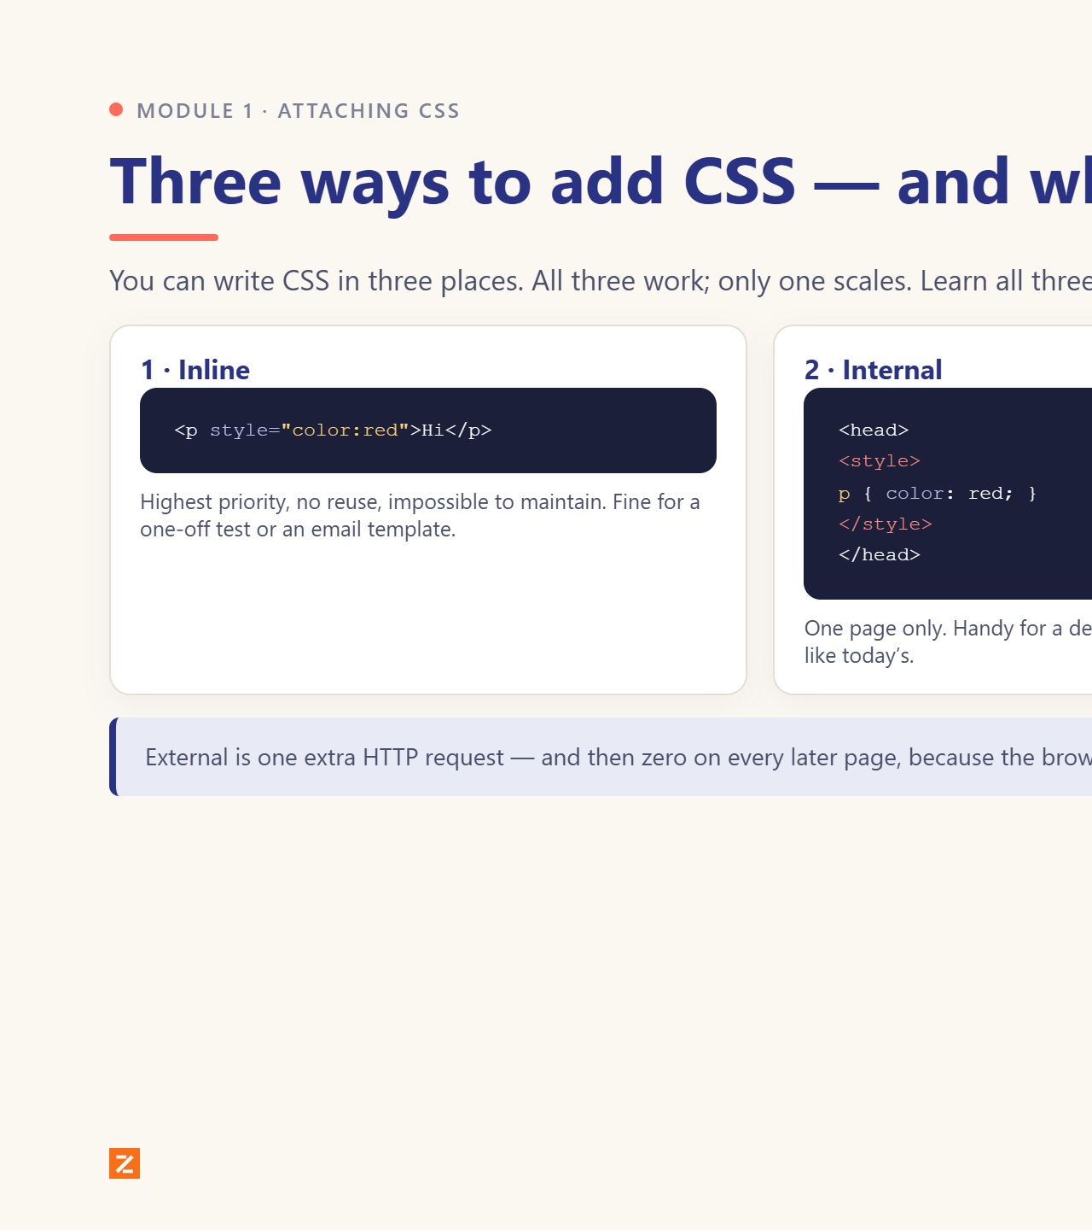
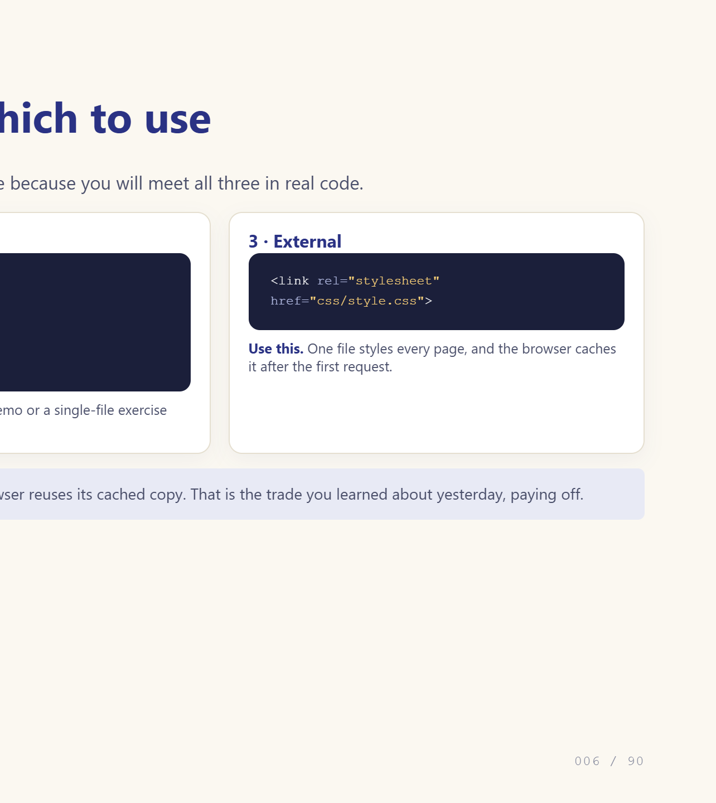
Notes:
Show all three, then say: use external.

Slide 7
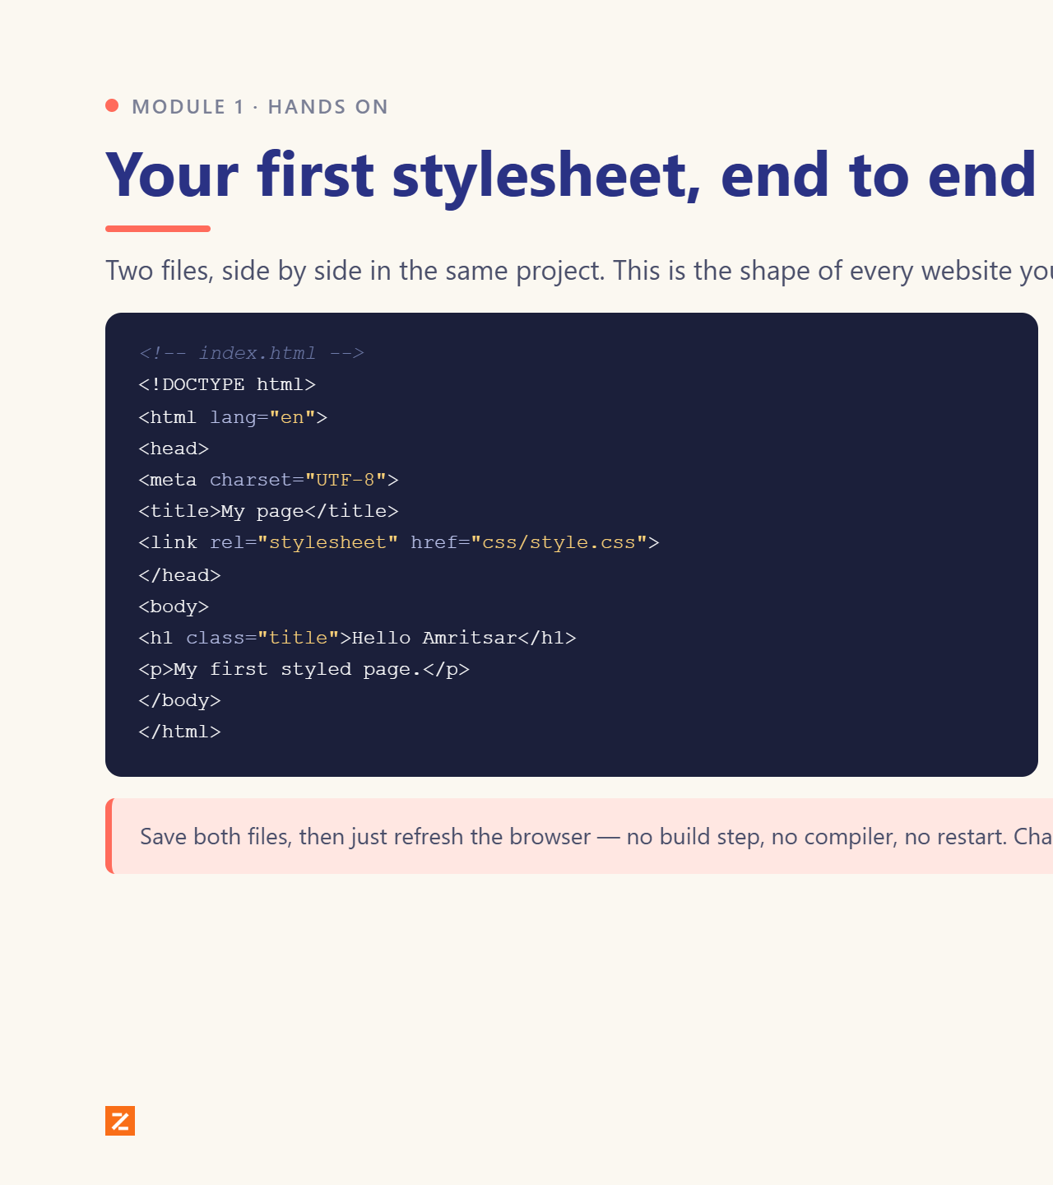
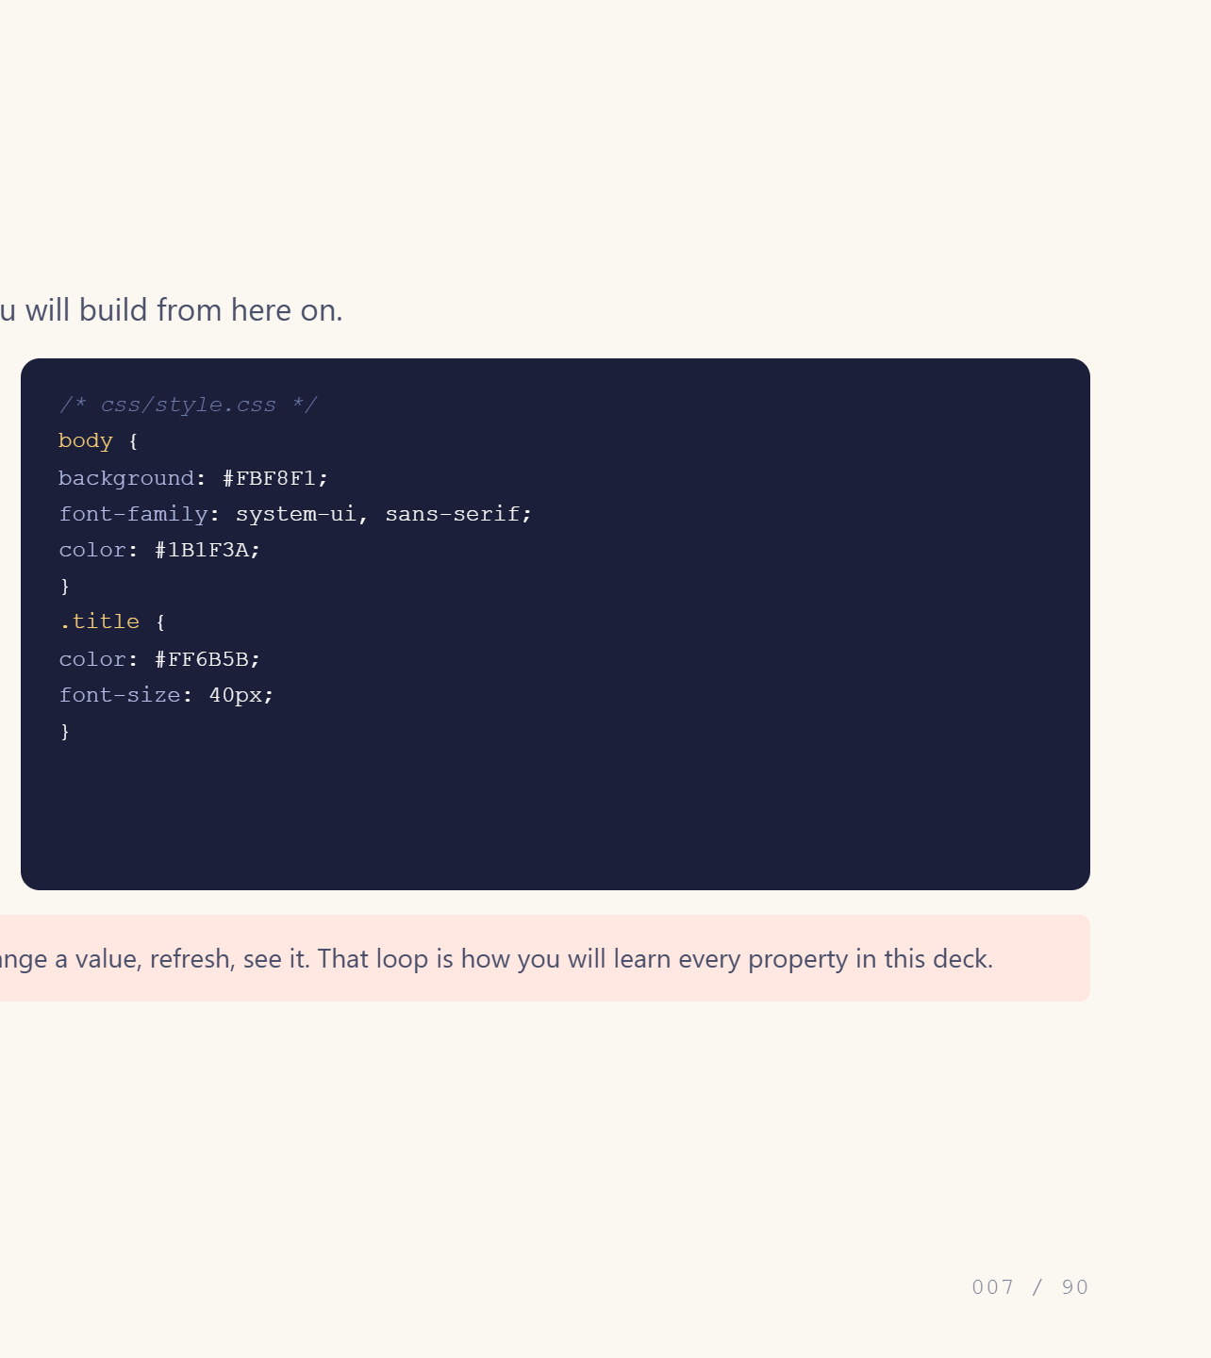
Notes:
Have them type this exact file.

Slide 8
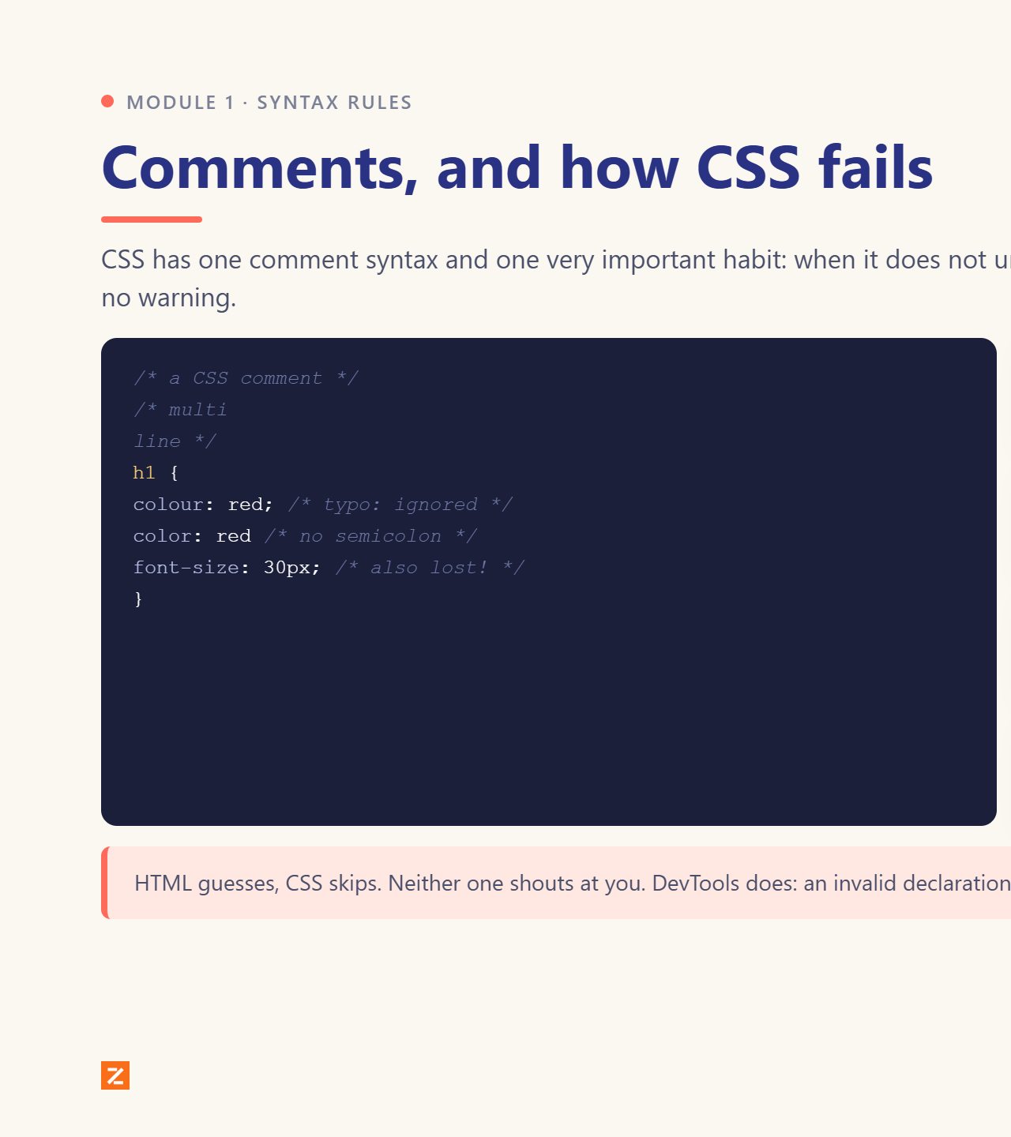
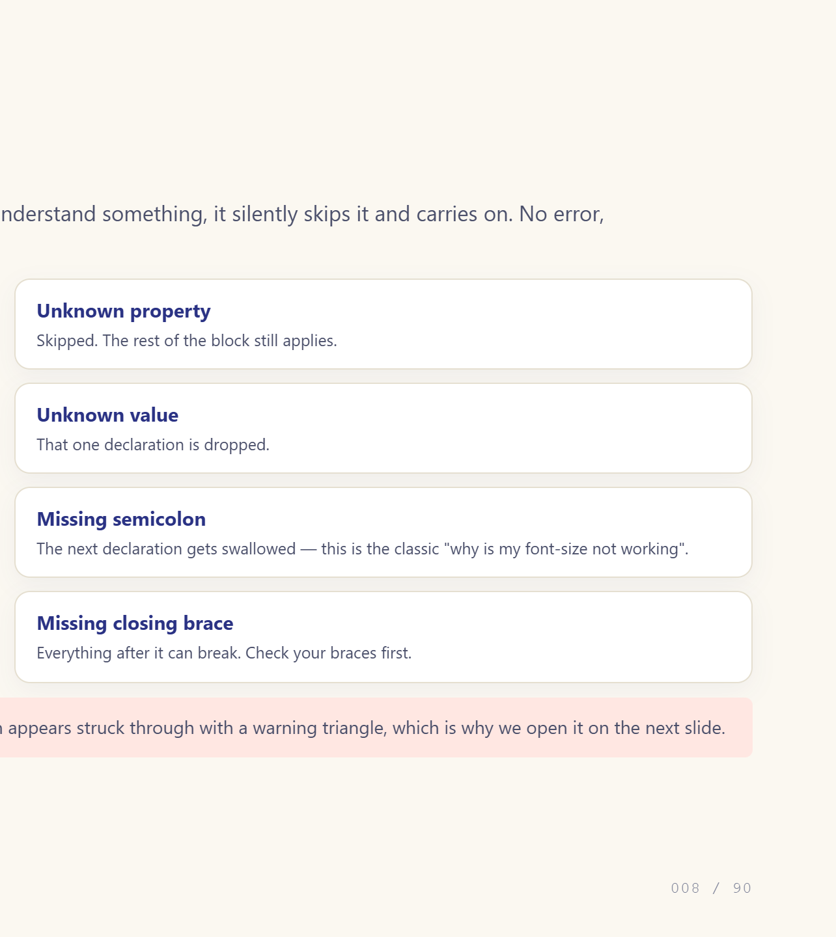
Notes:
Broken syntax fails silently: the big one.

Slide 9
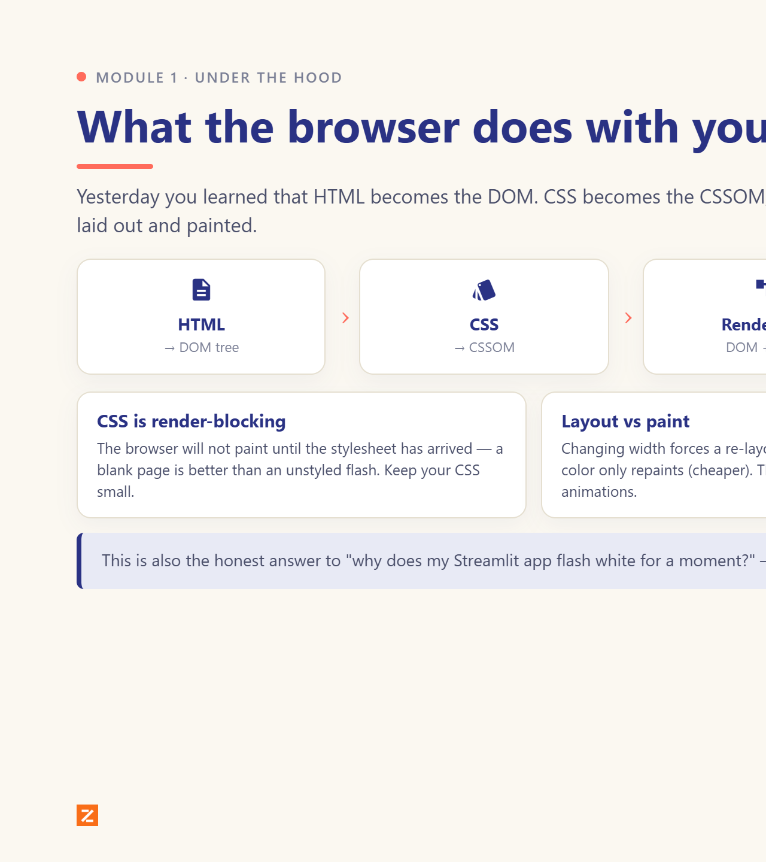
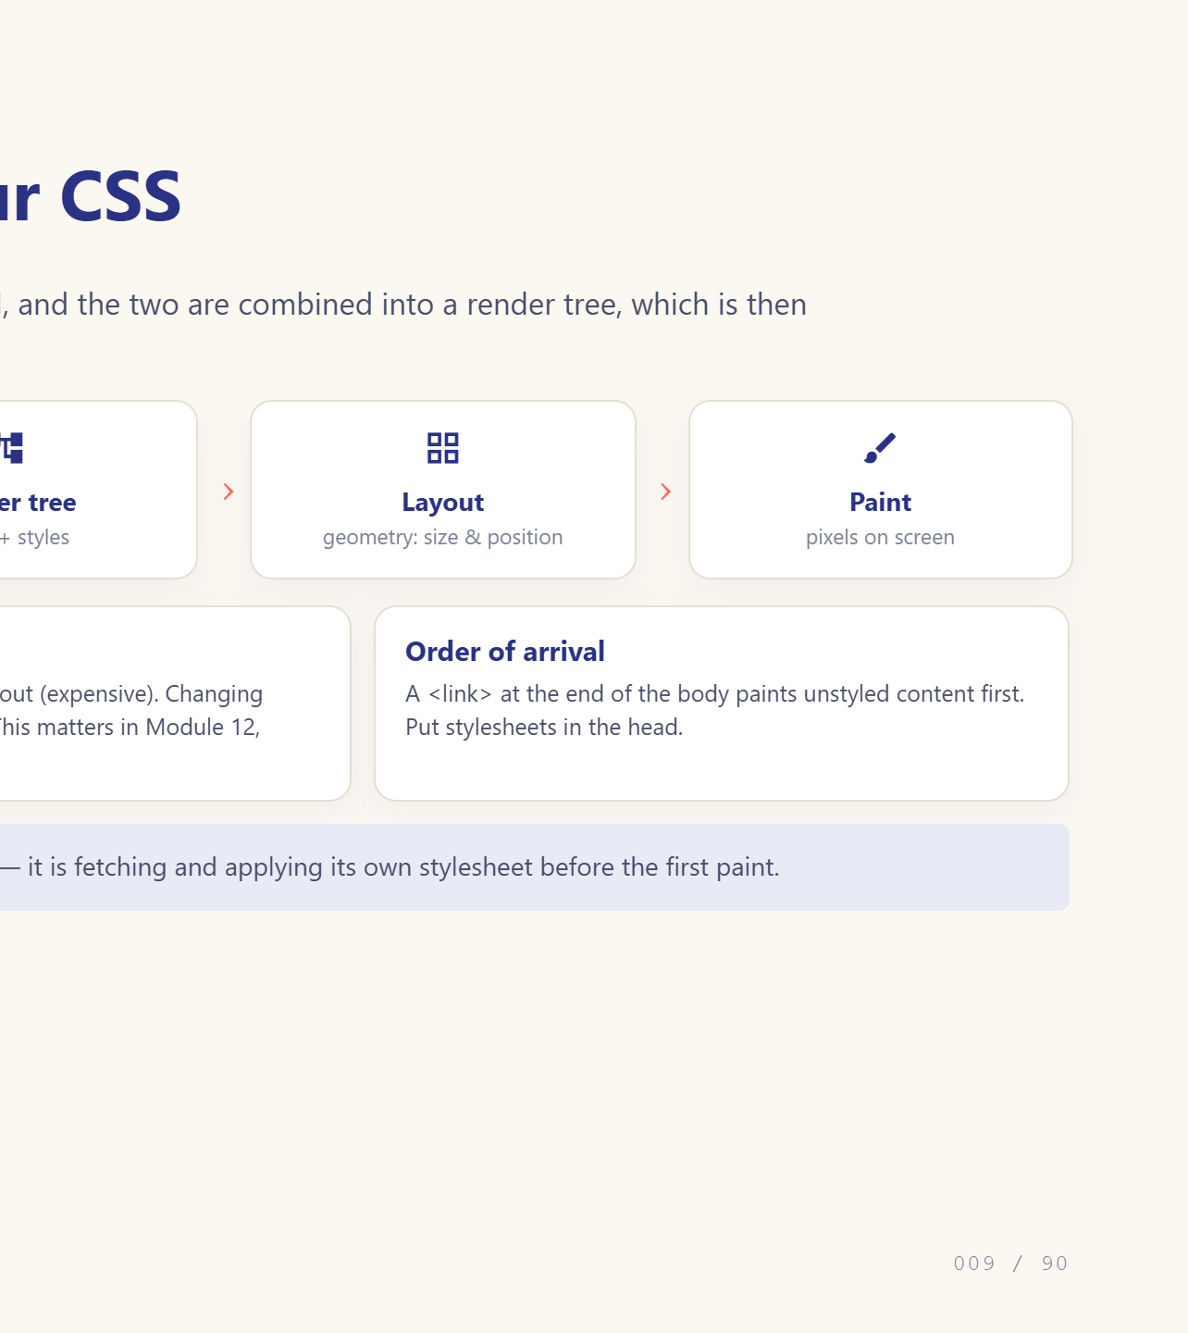
Notes:
This explains why CSS blocks the first paint.

Slide 10
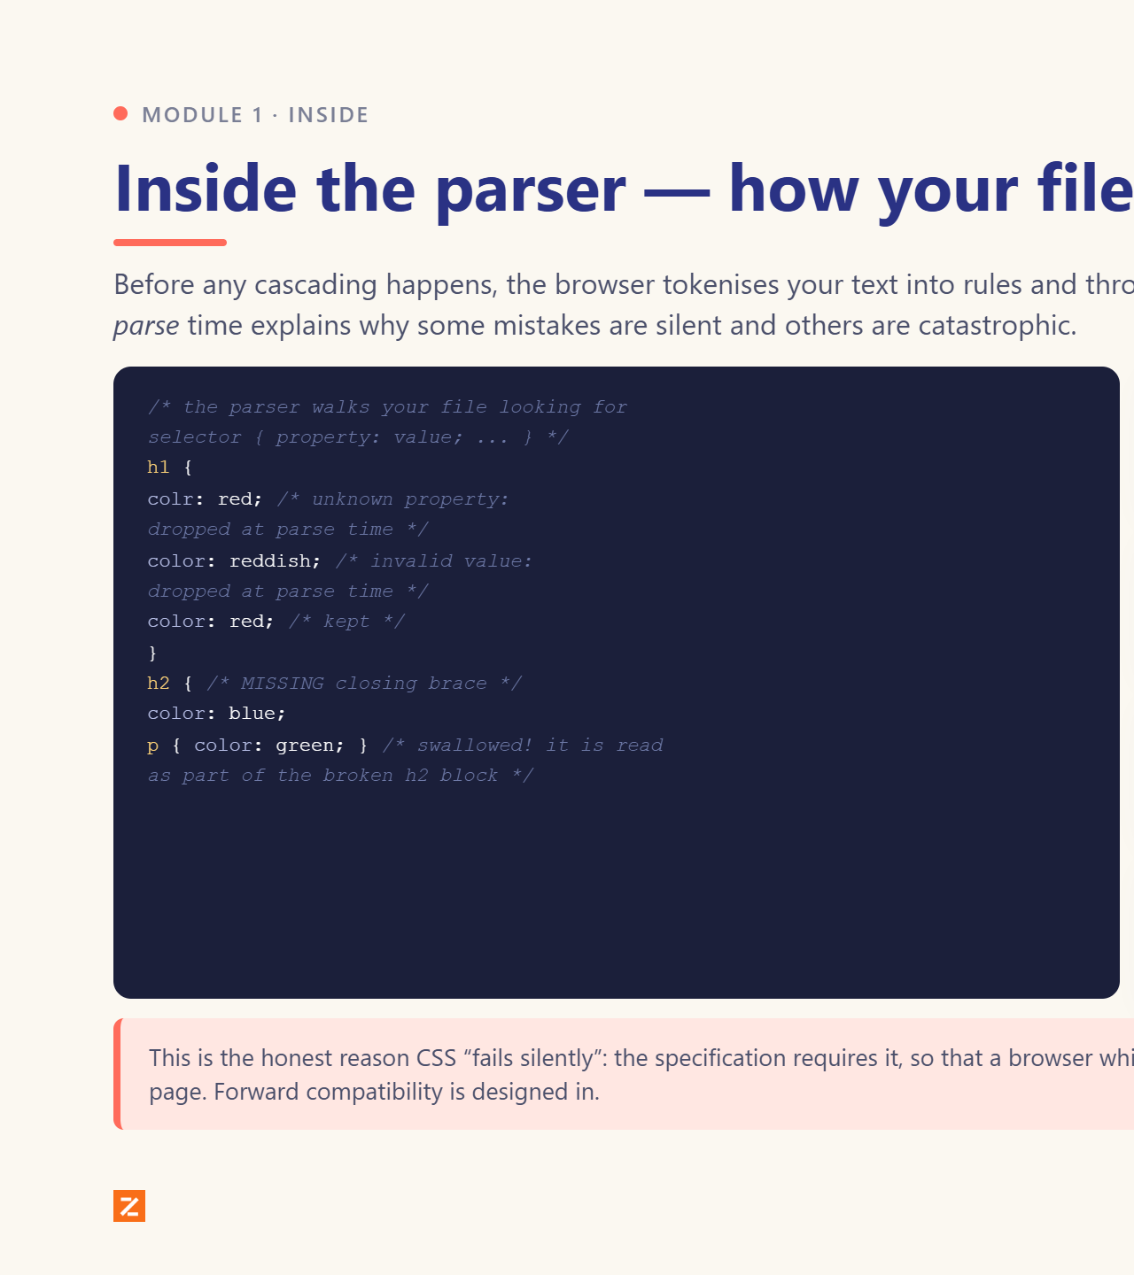
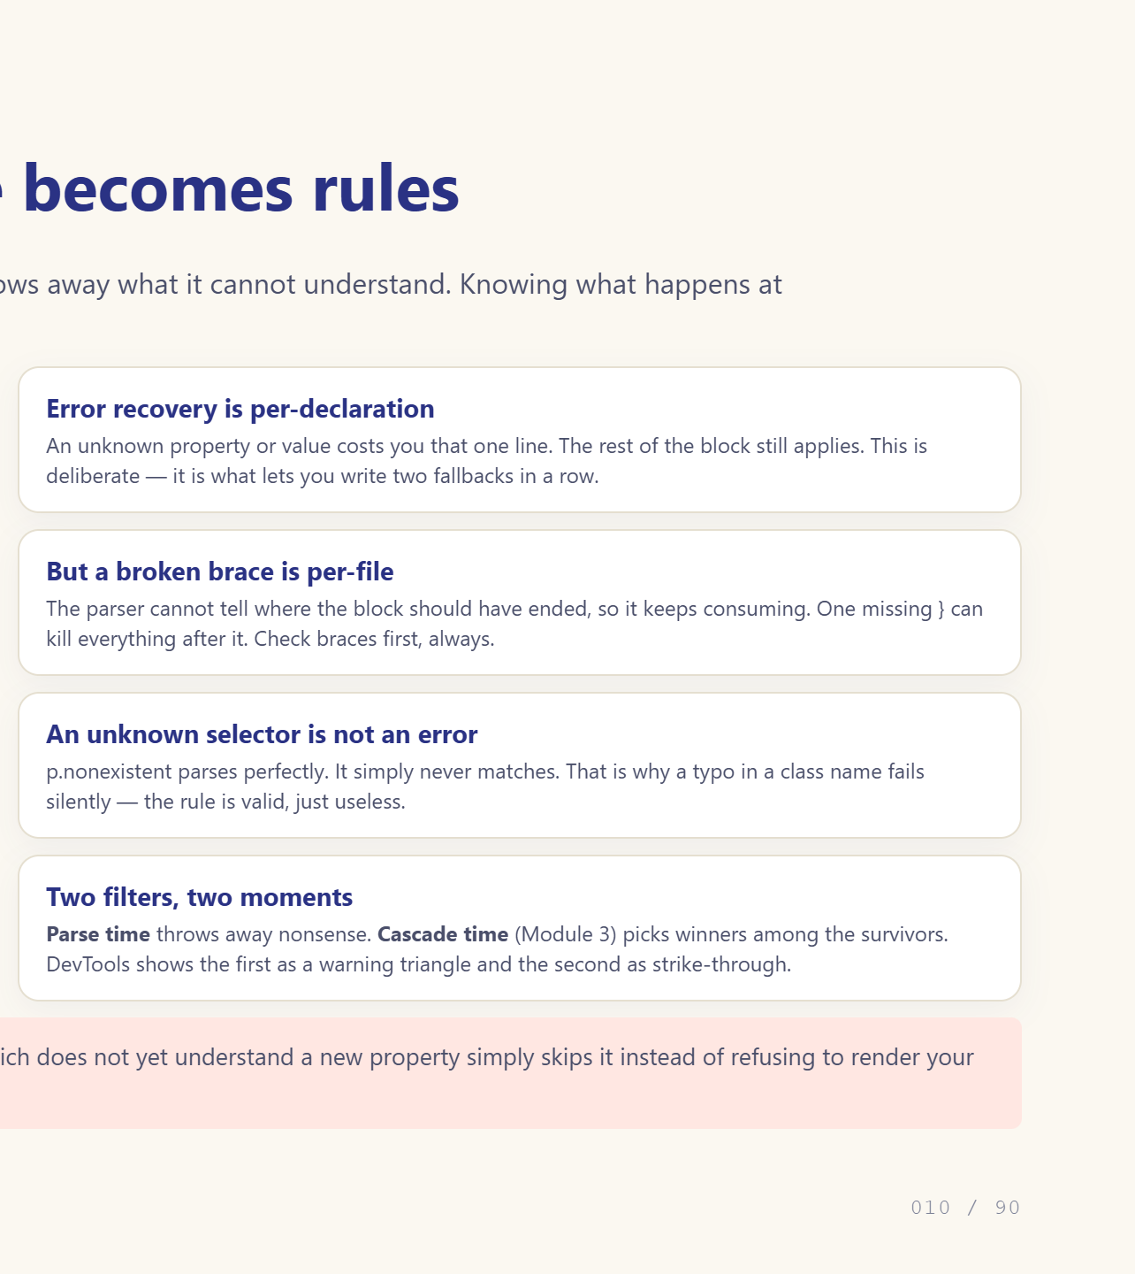
Notes:
Parse-time vs cascade-time: two different filters.

Slide 11
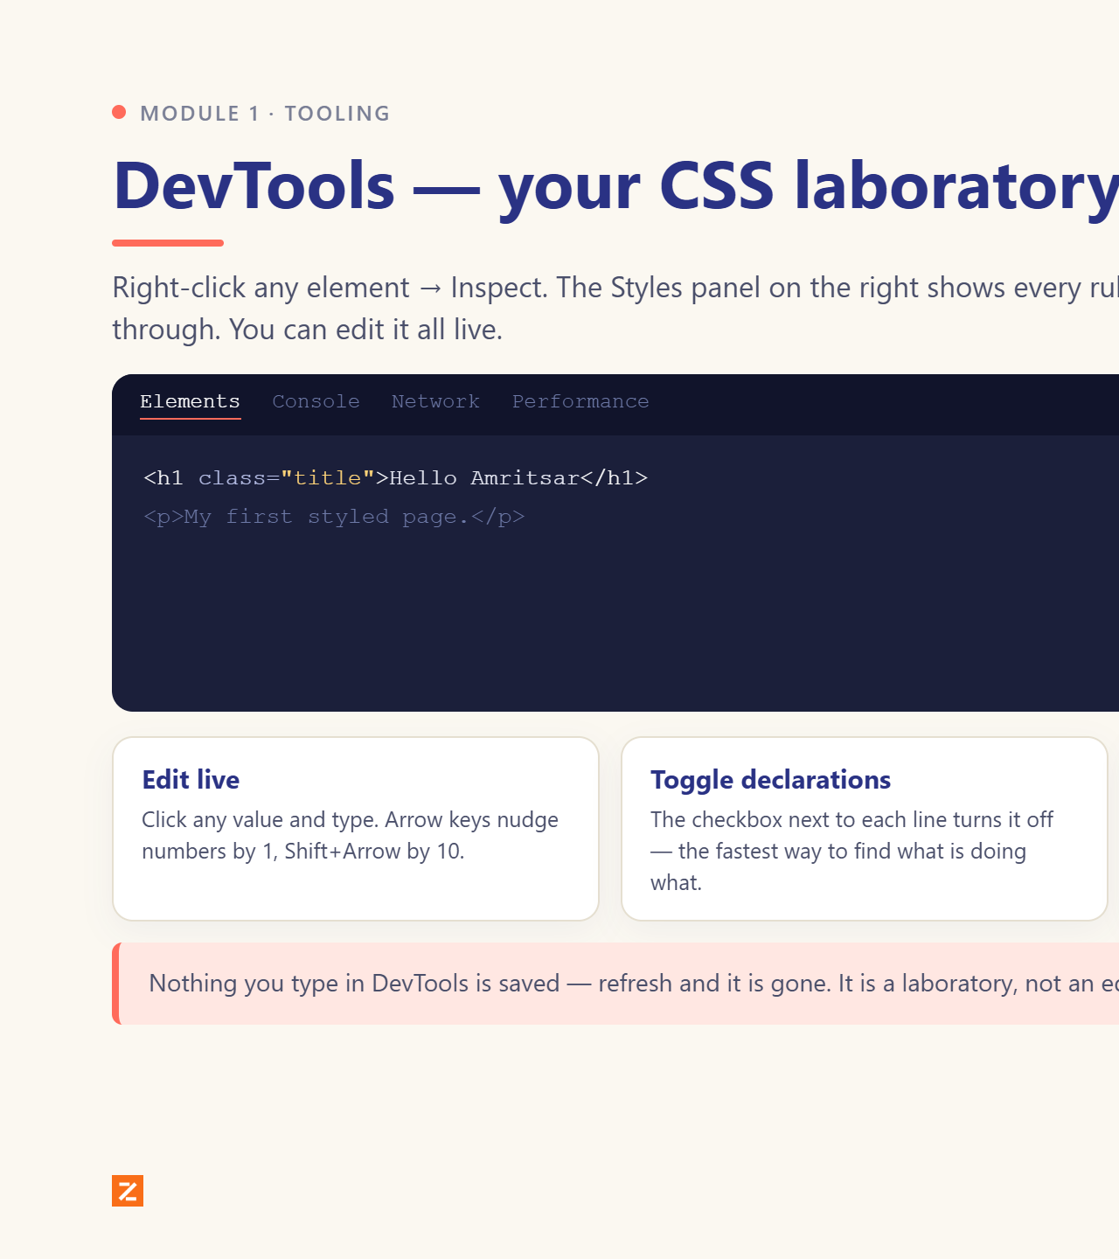
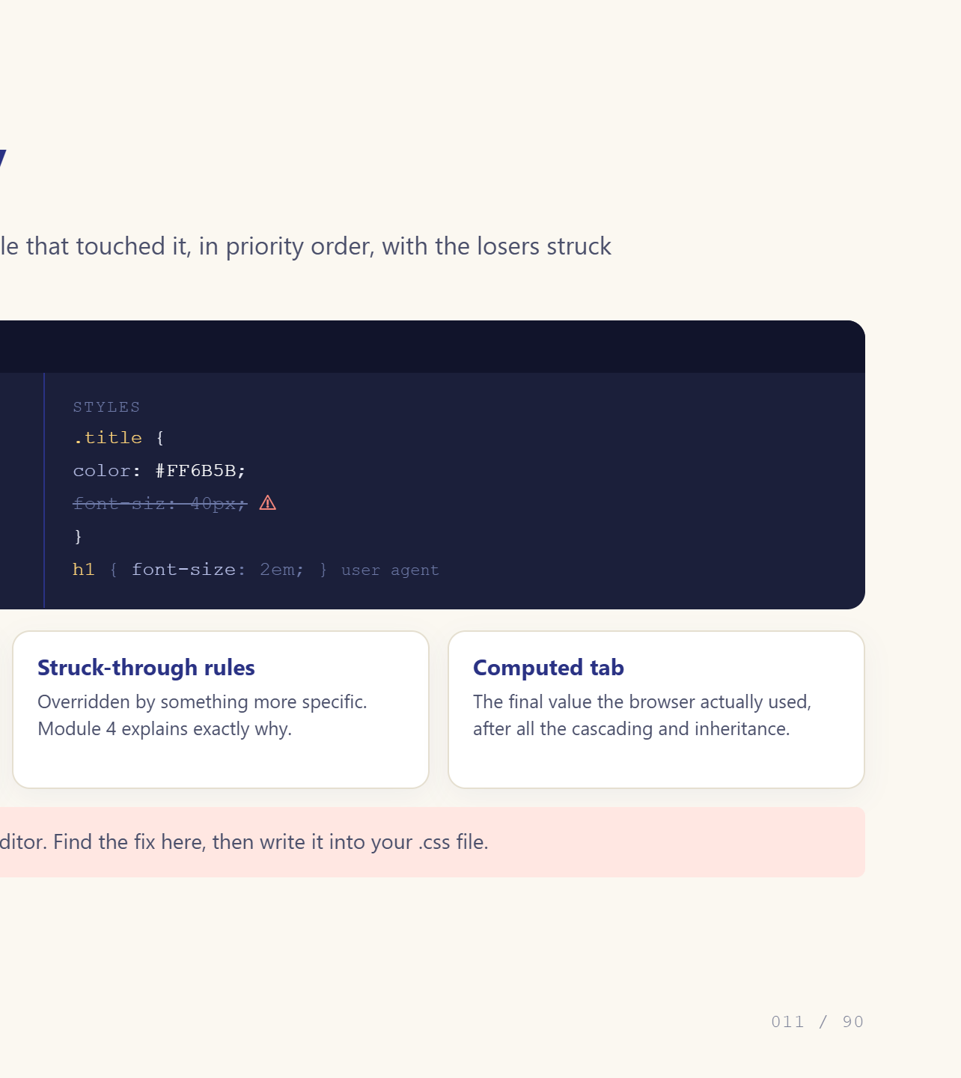
Notes:
Do this live. It is the single most useful skill today.

Slide 12
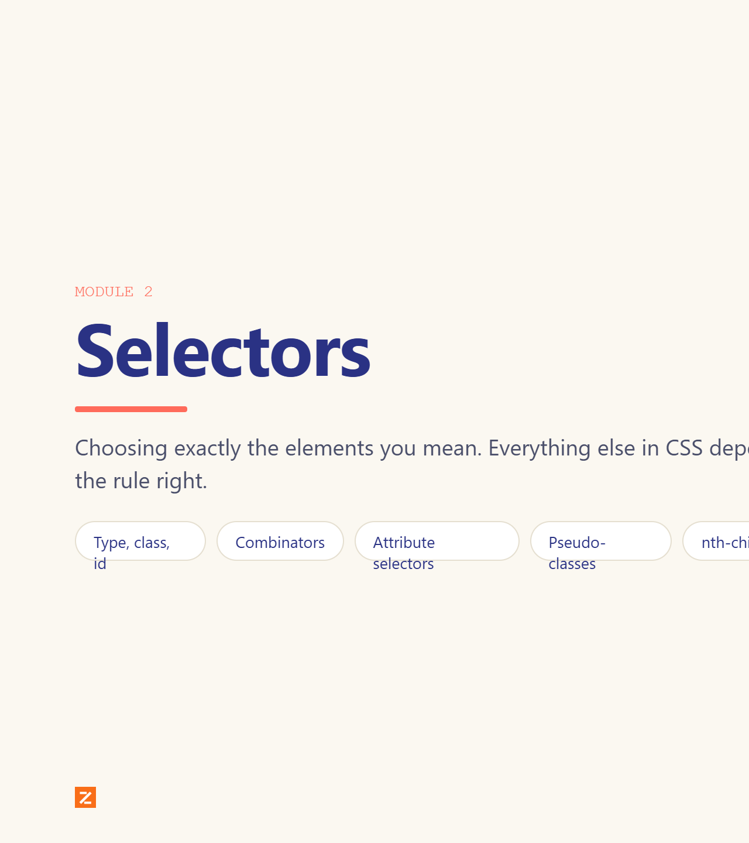
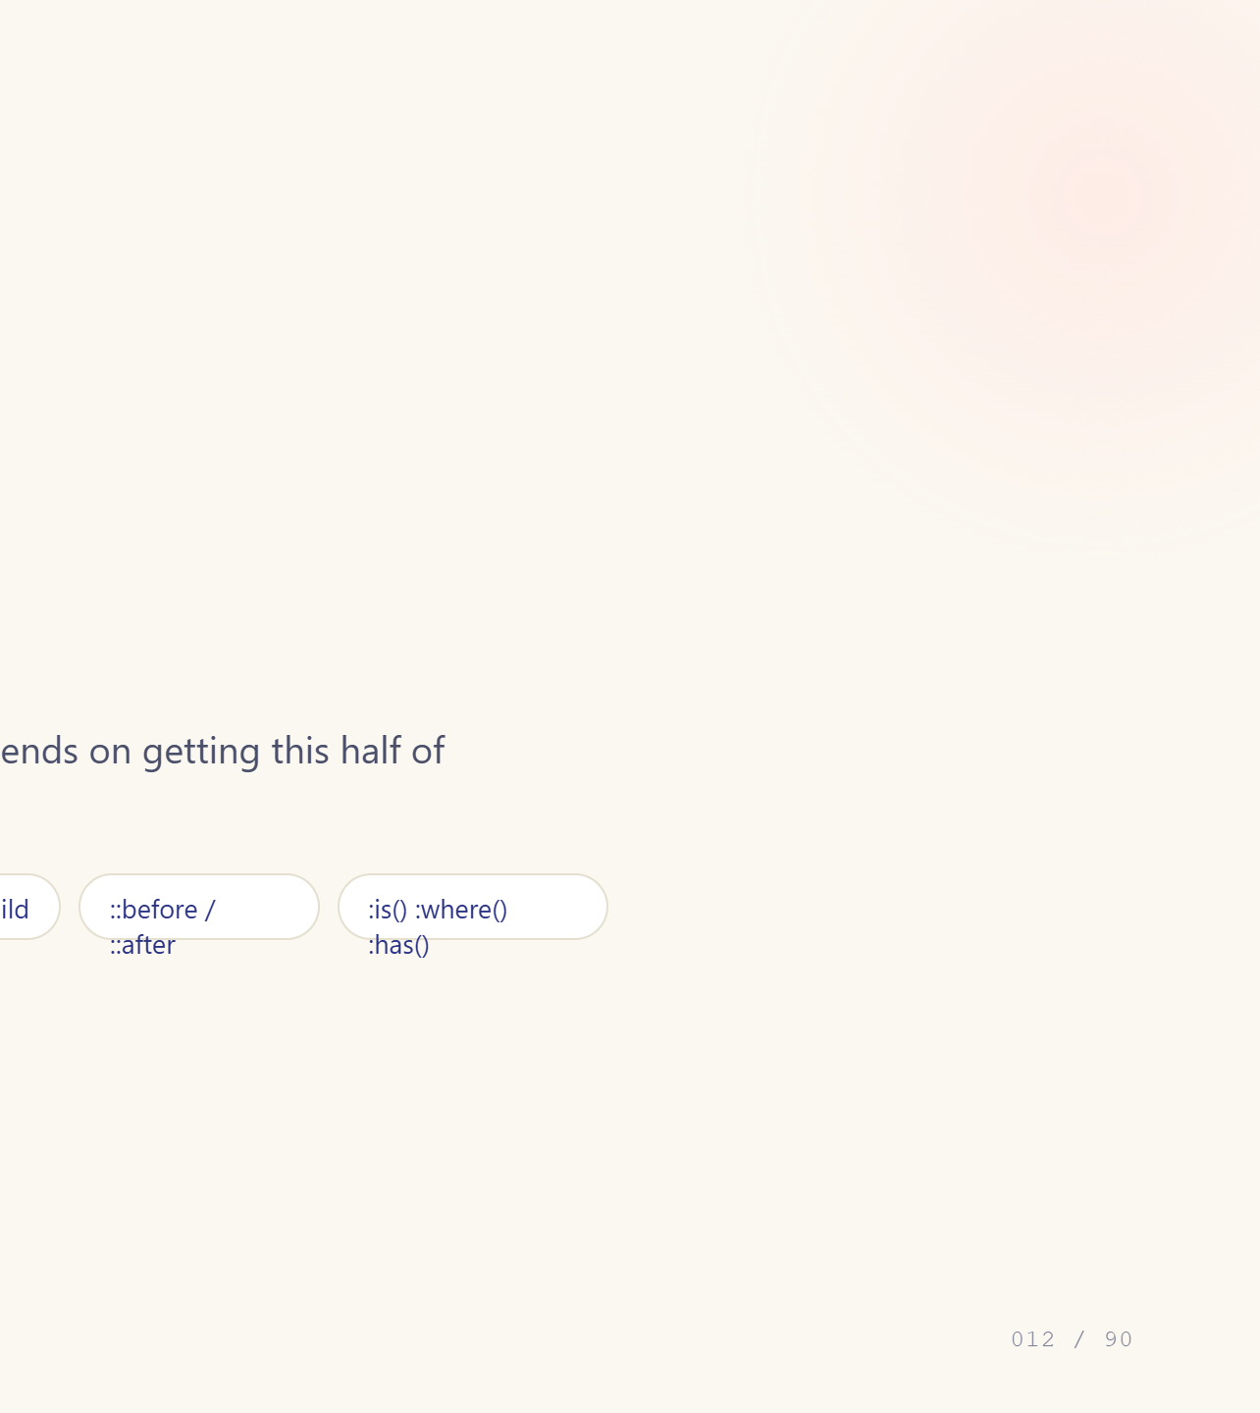
Notes:
Module divider. Say what changes in this module.

Slide 13
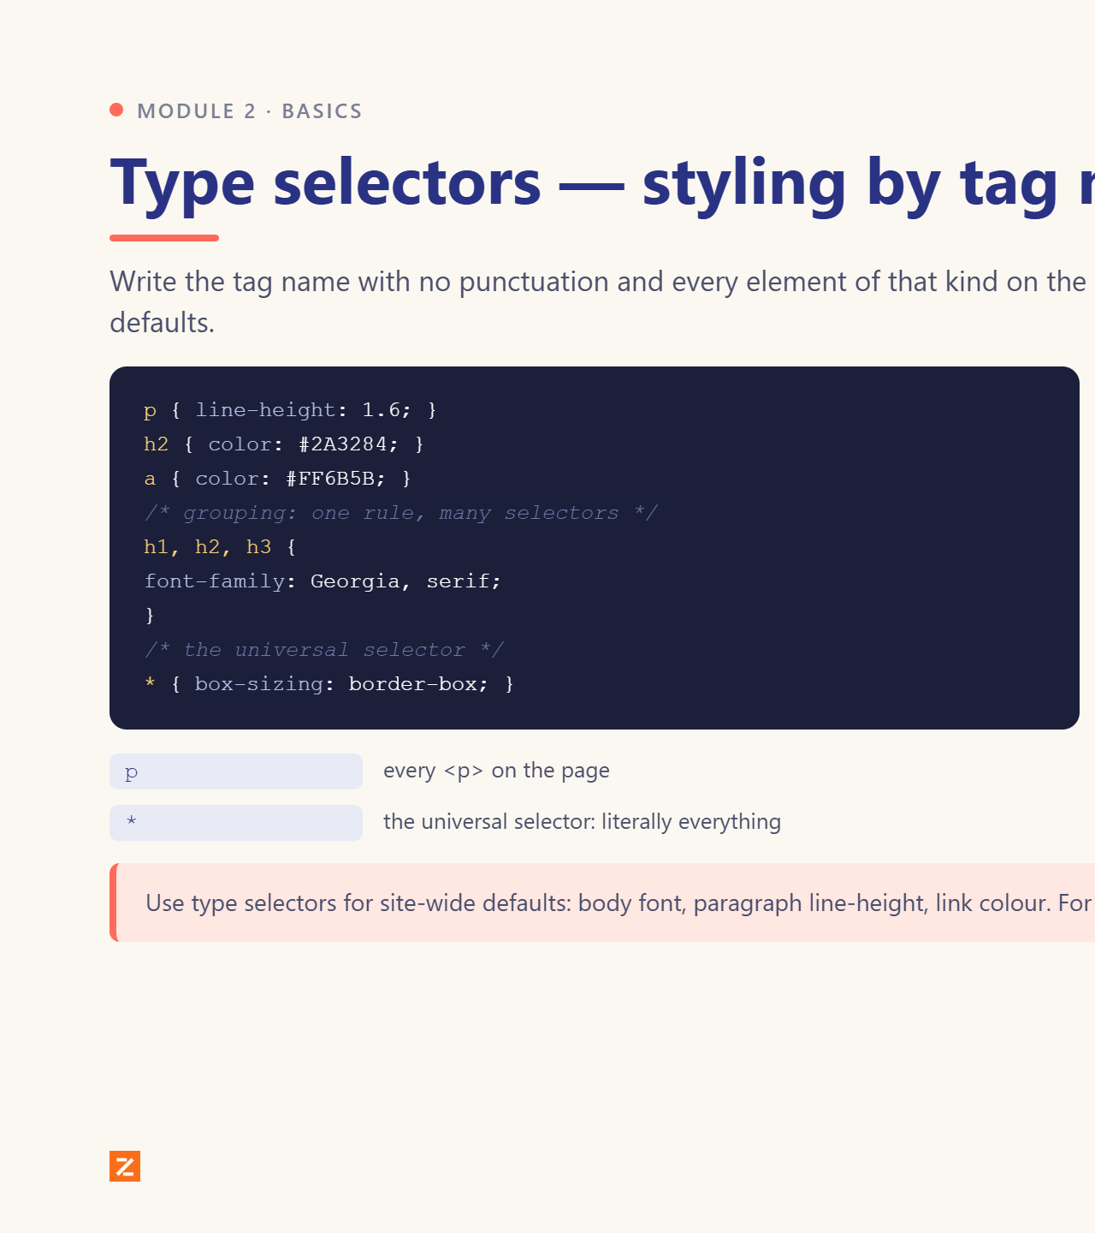
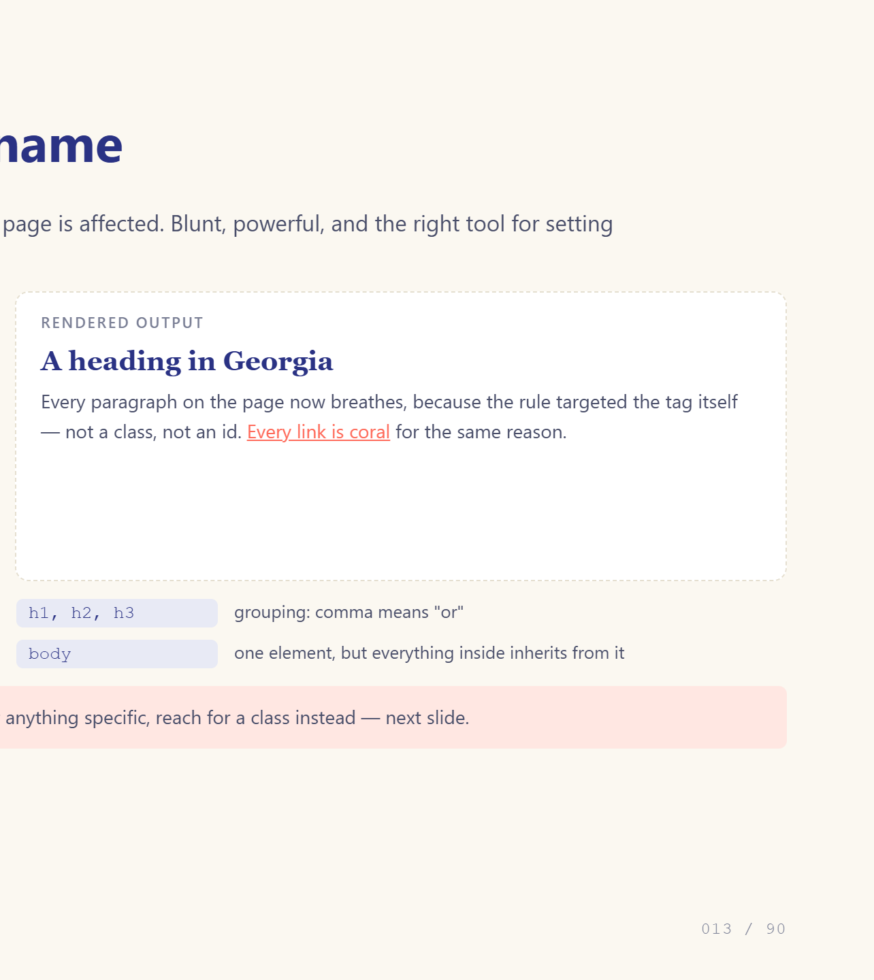
Notes:
Start with the bluntest tool.

Slide 14
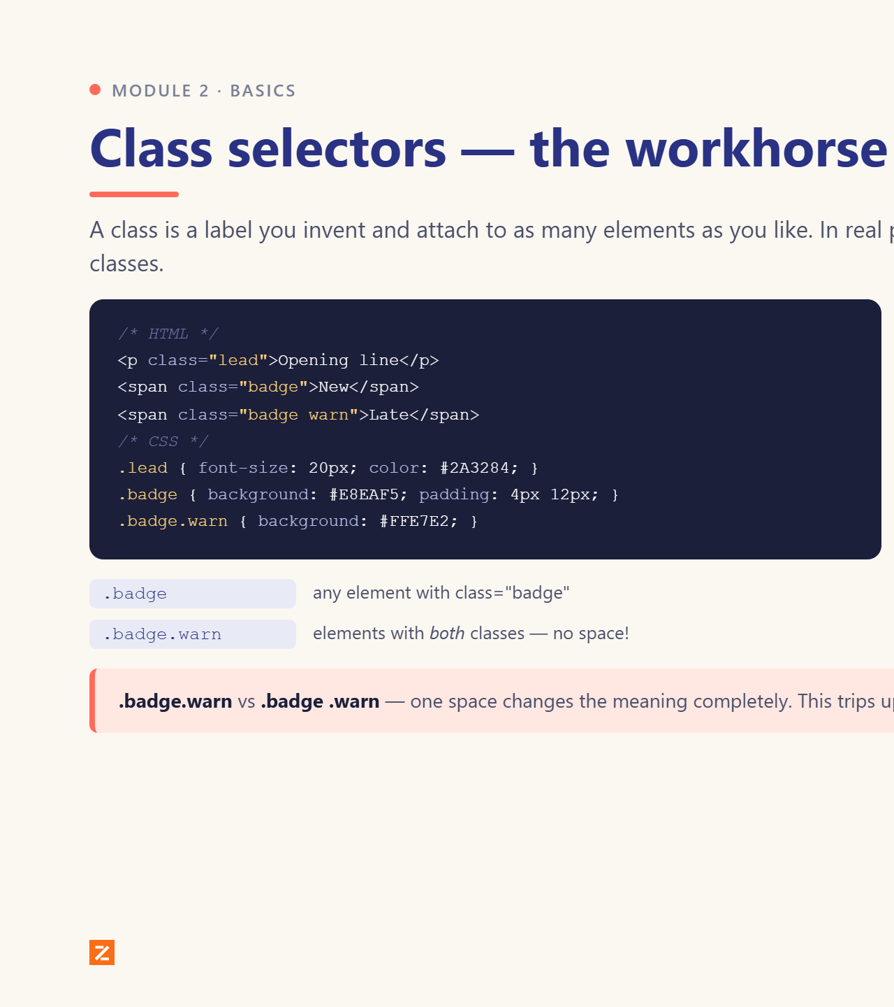
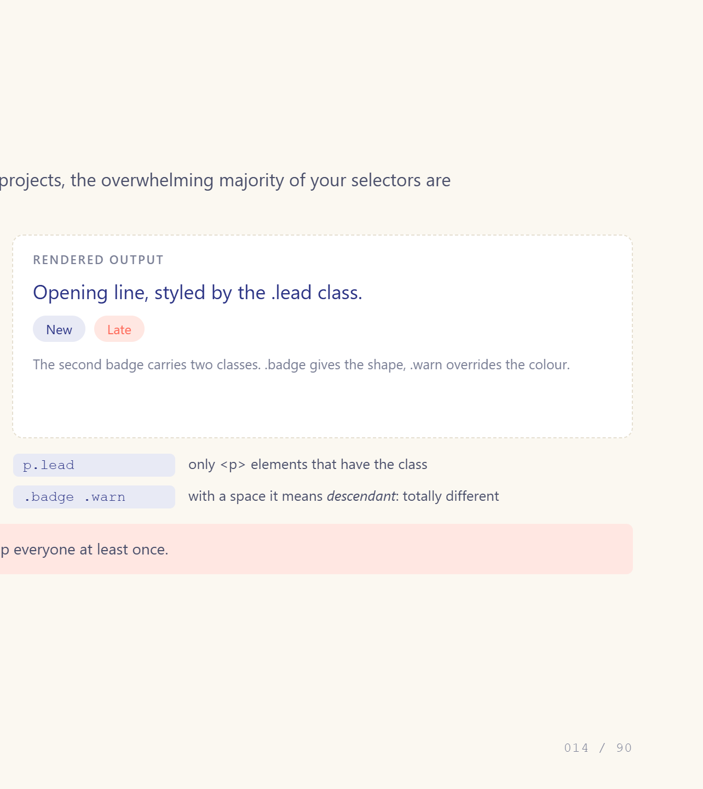
Notes:
Classes are 90% of real-world CSS.

Slide 15
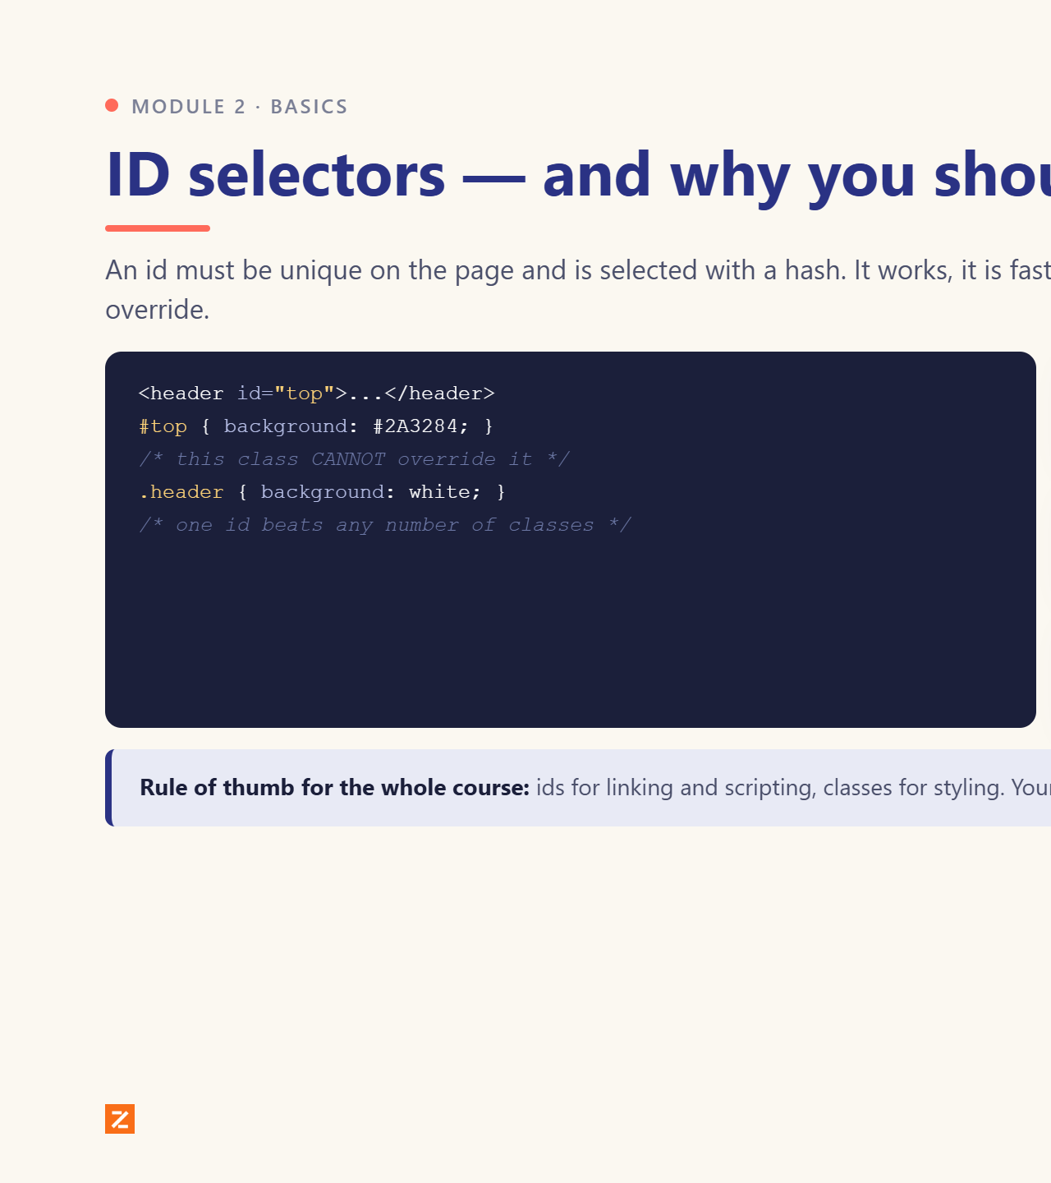
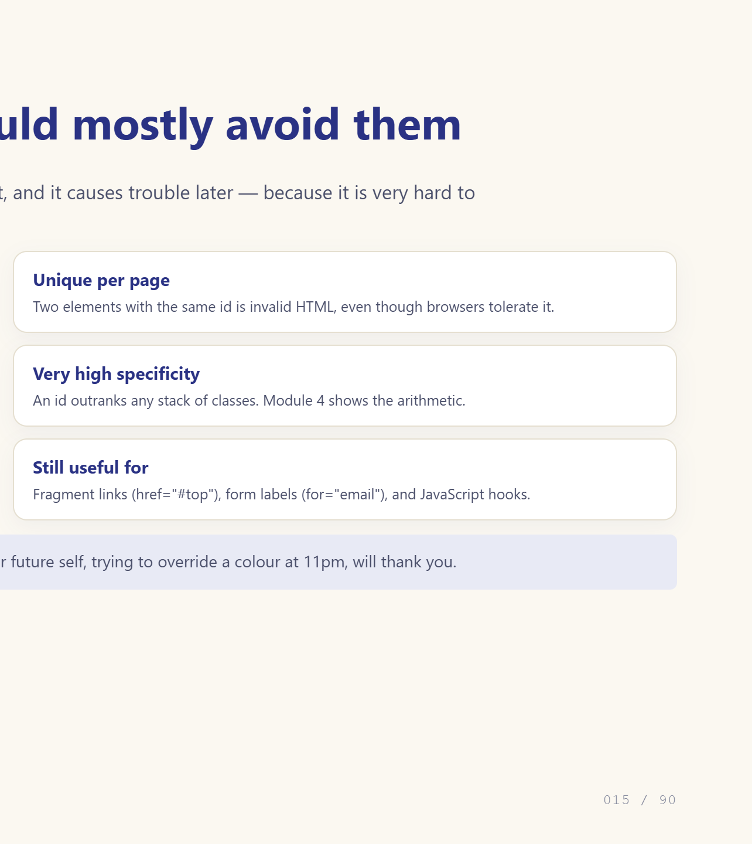
Notes:
Teach it, then tell them to avoid it.

Slide 16
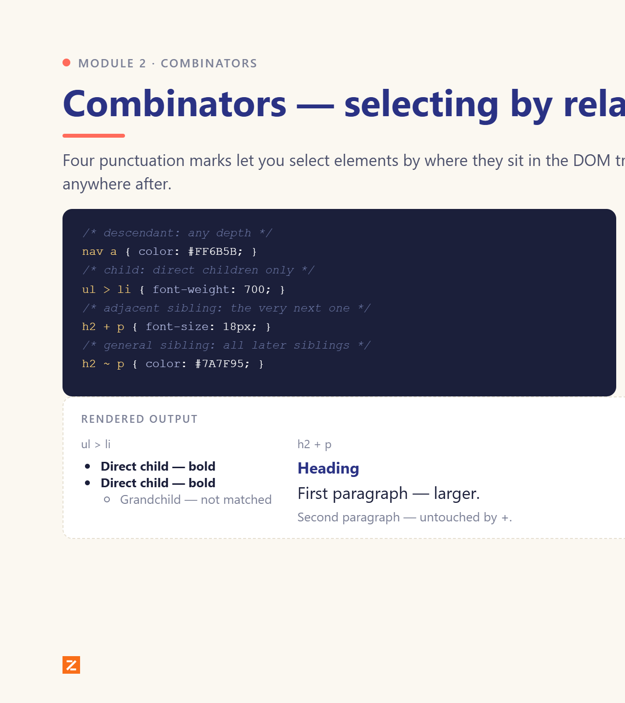
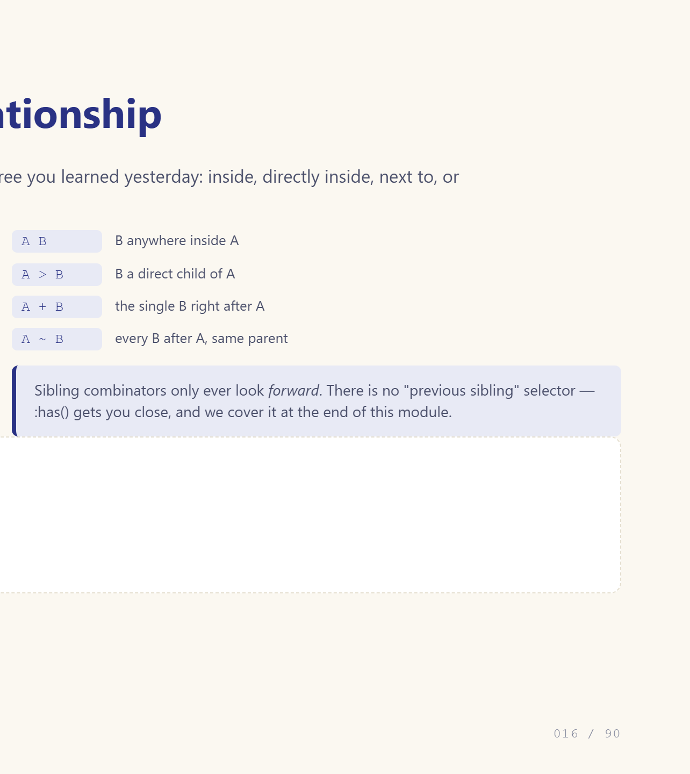
Notes:
Draw the family tree on the board.

Slide 17
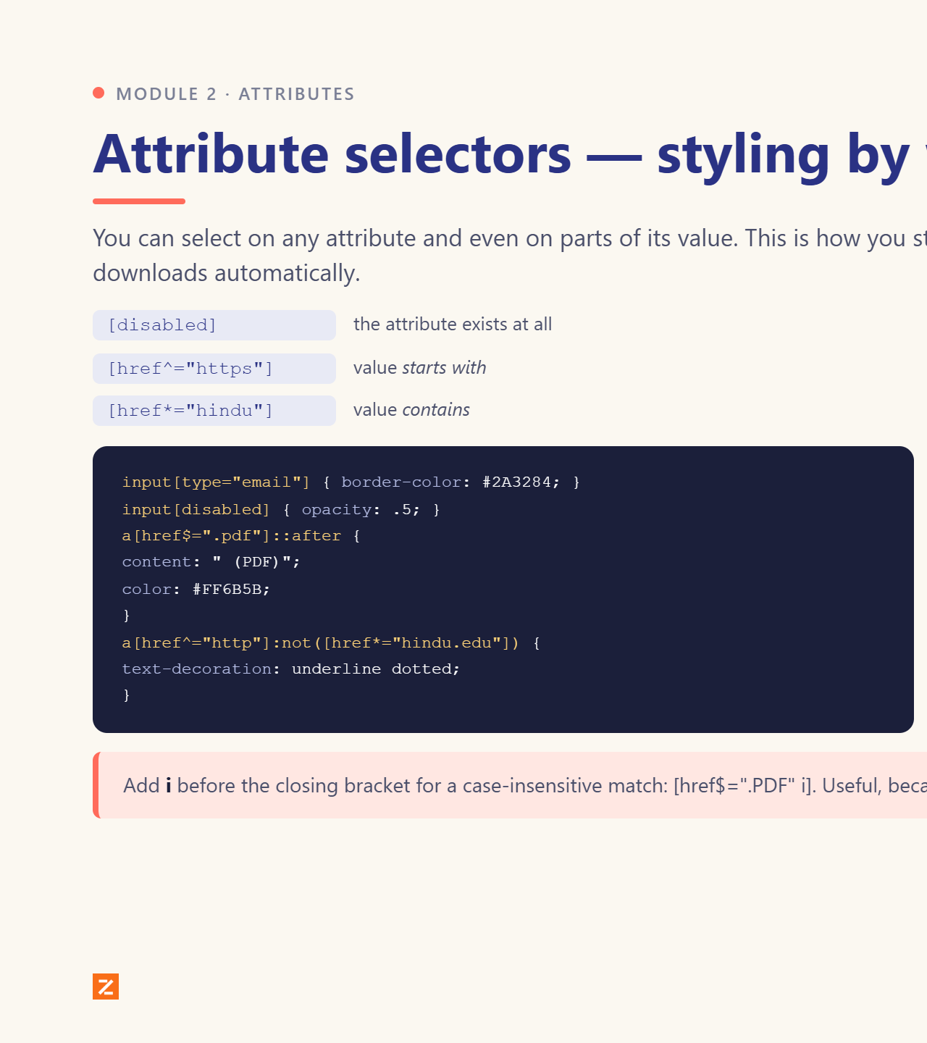
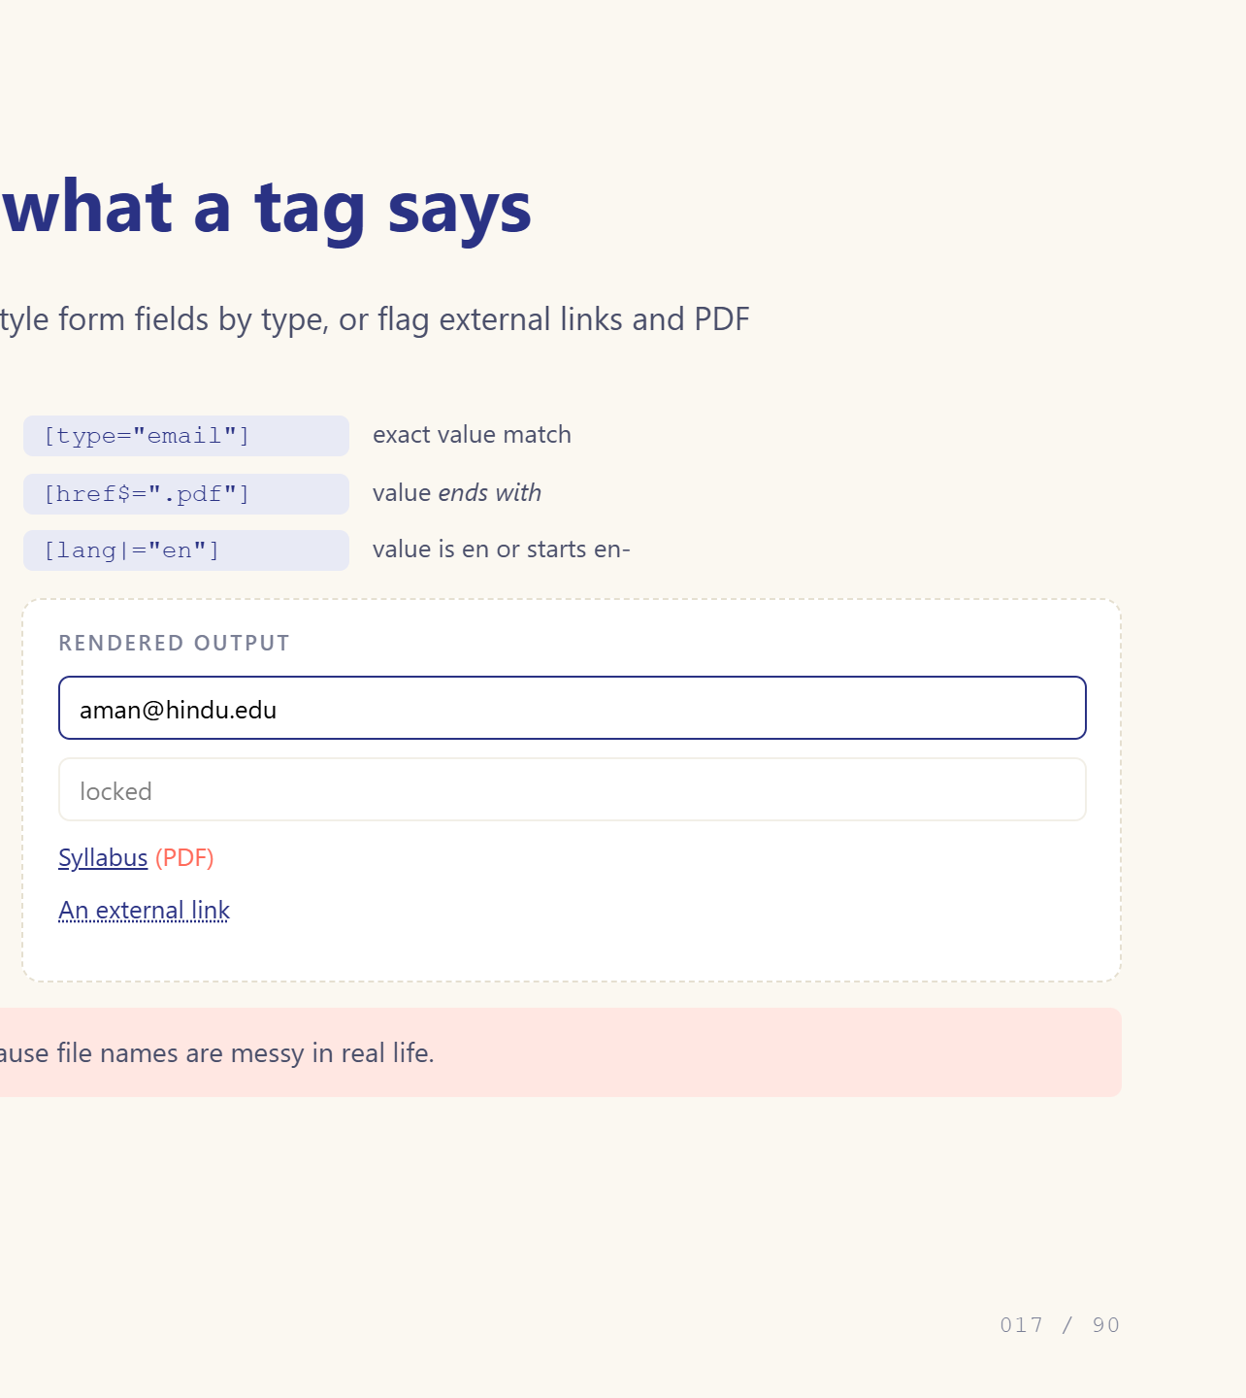
Notes:
Great for forms and links.

Slide 18

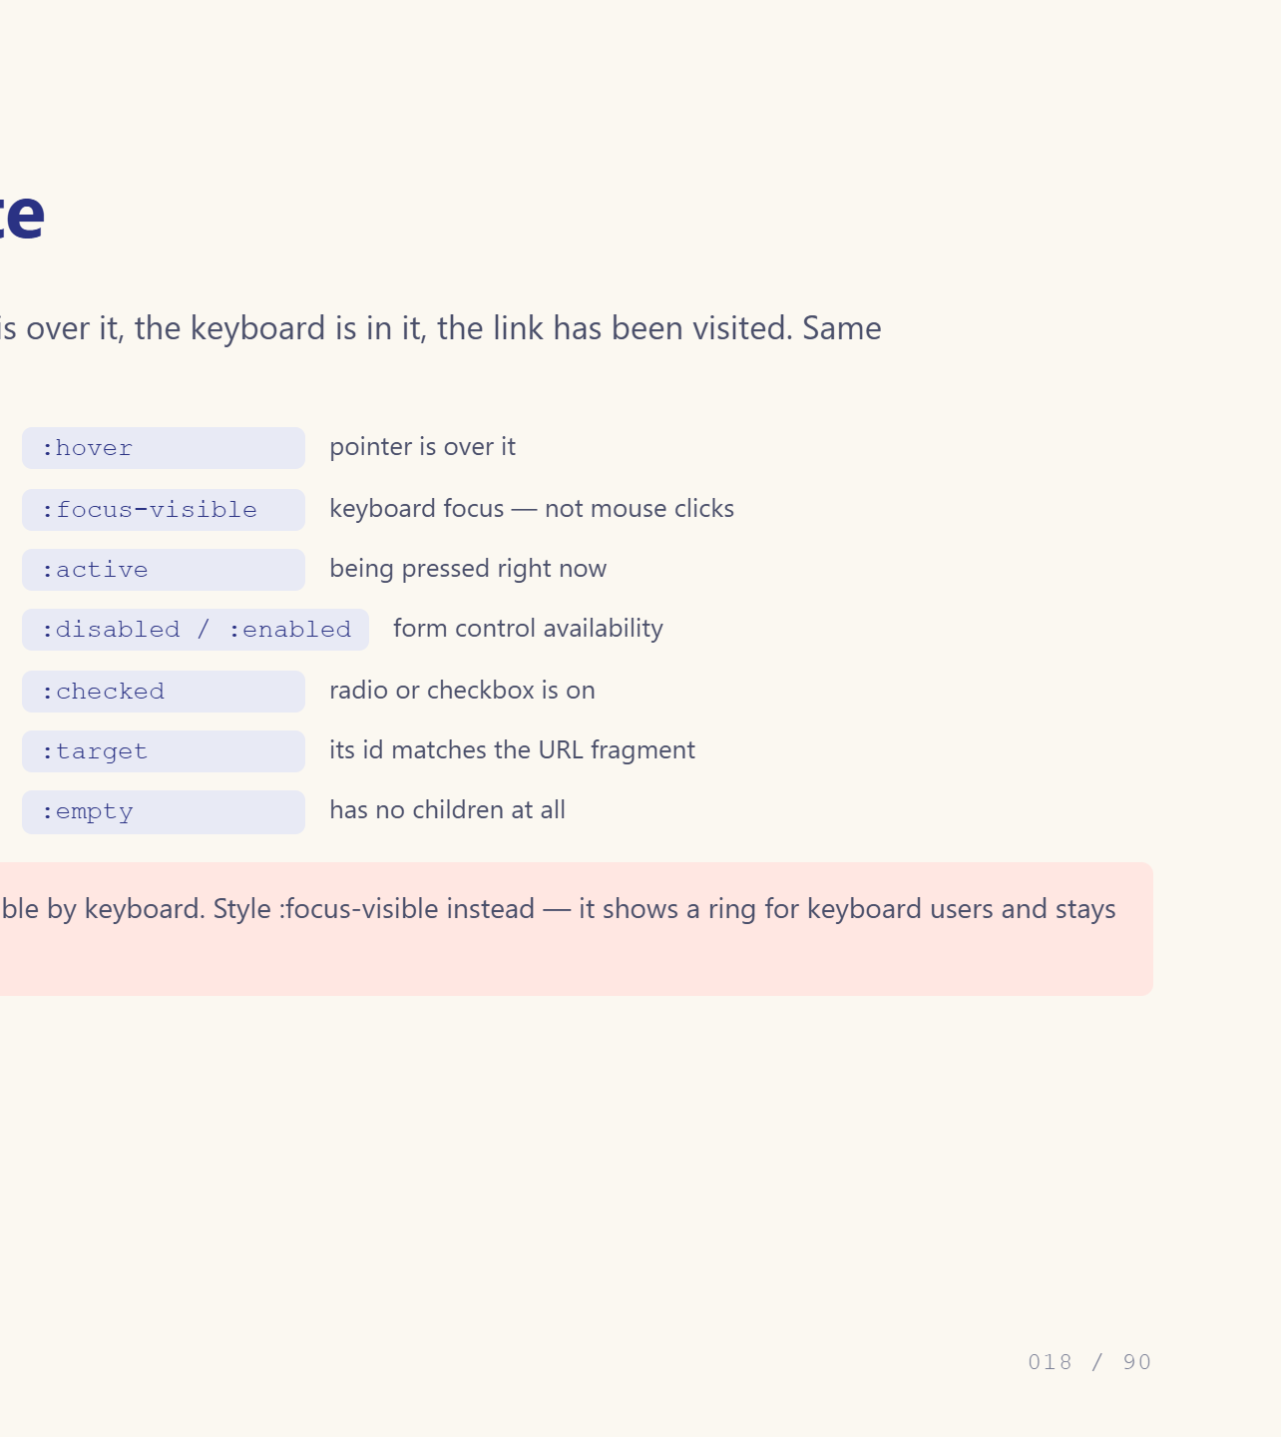
Notes:
hover and focus are non-negotiable.

Slide 19
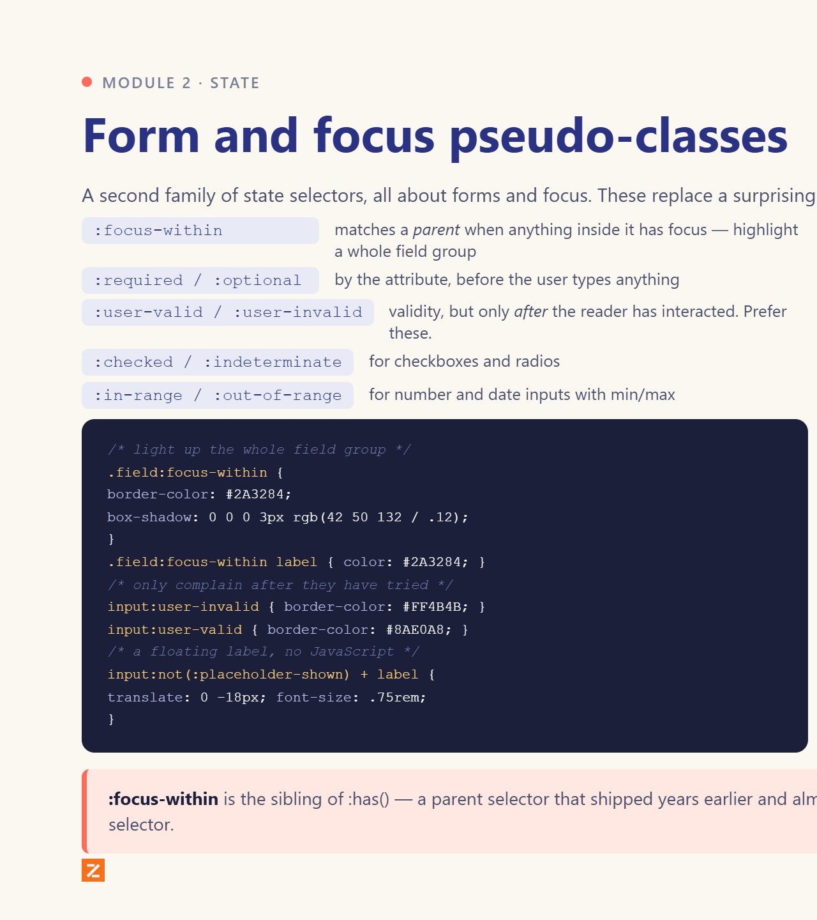
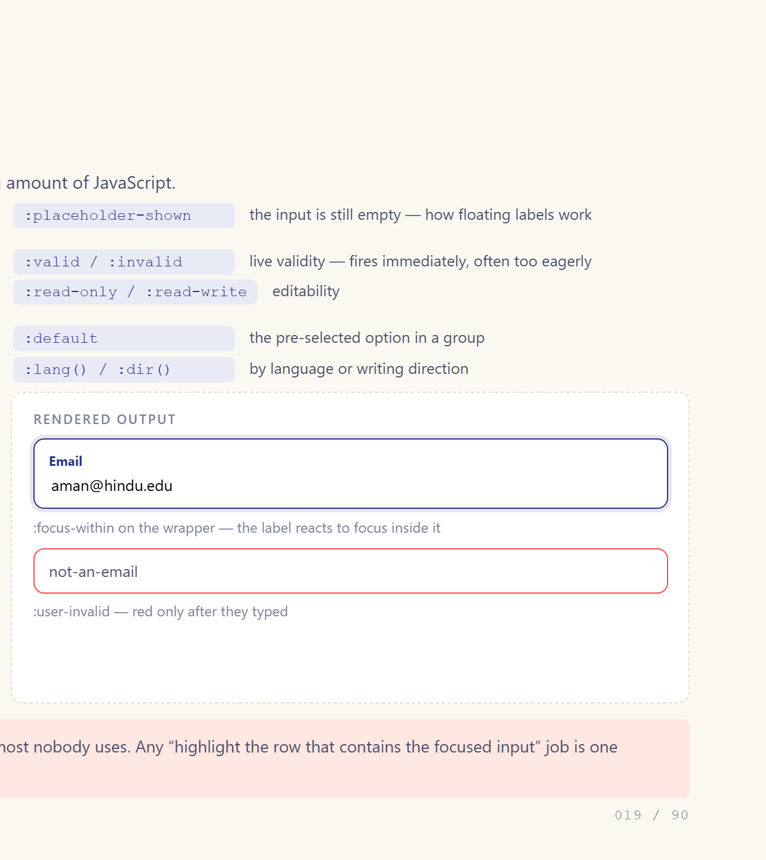
Notes:
focus-within is the one they will use most.

Slide 20
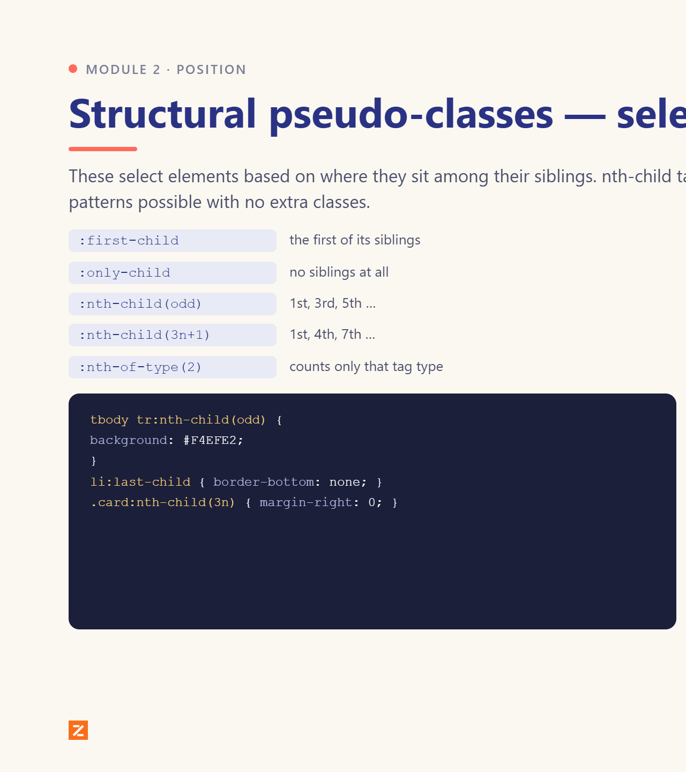
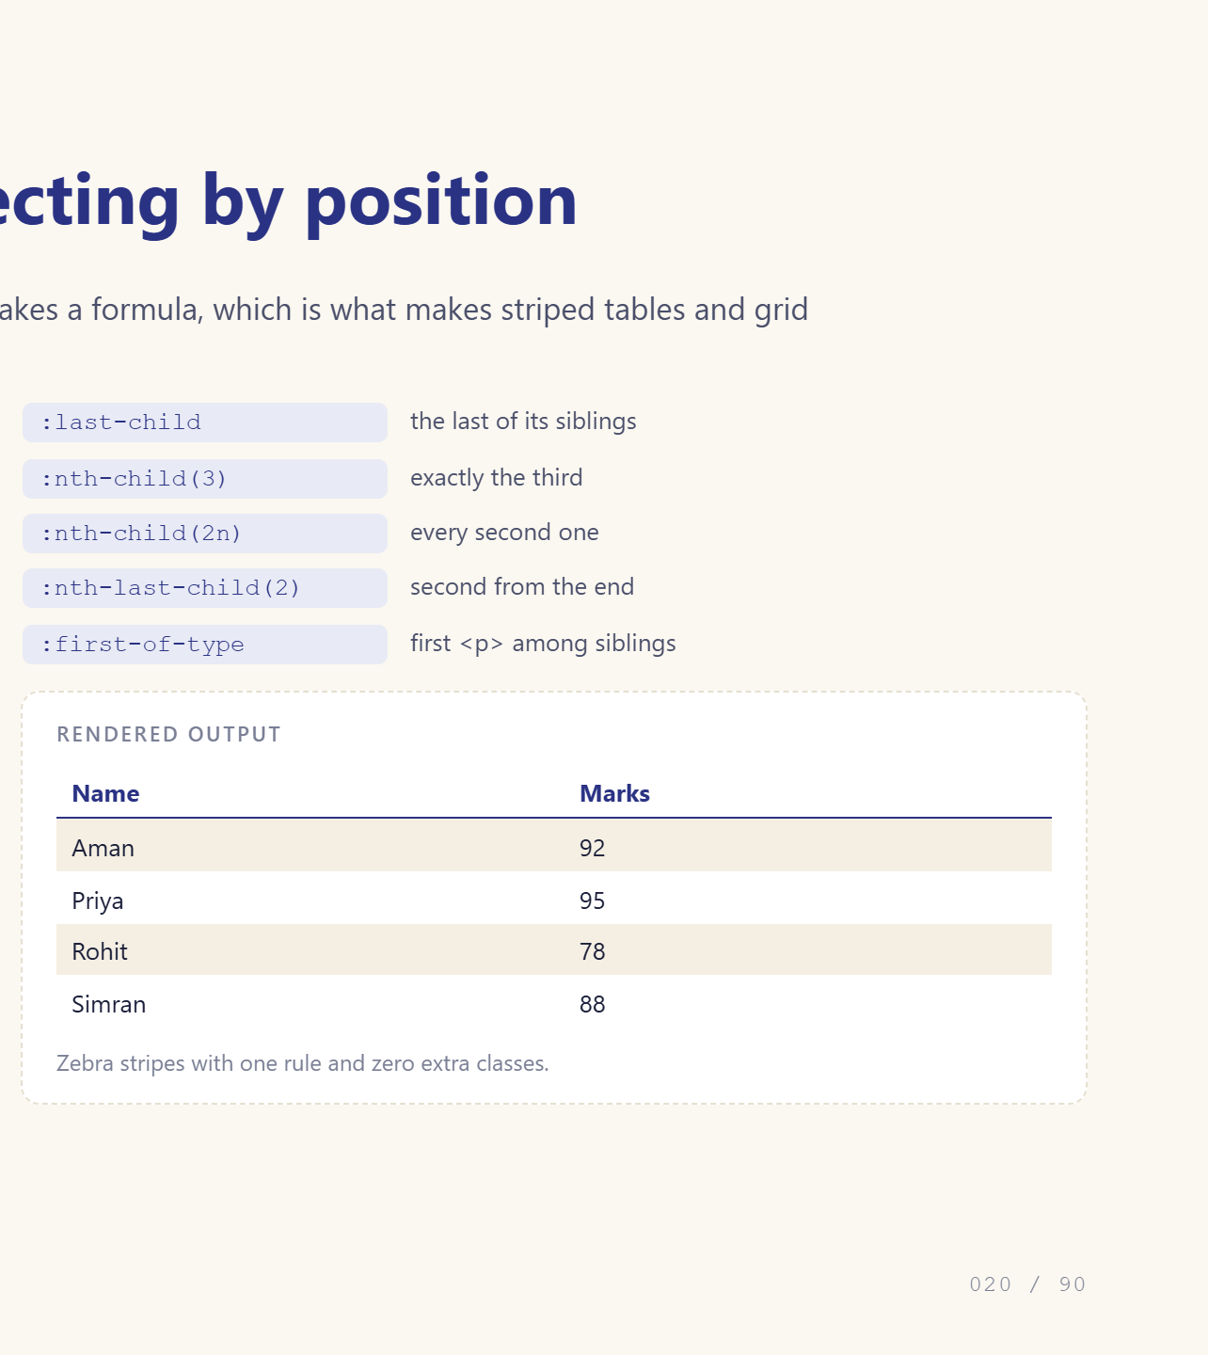
Notes:
Explain 2n+1 slowly.

Slide 21
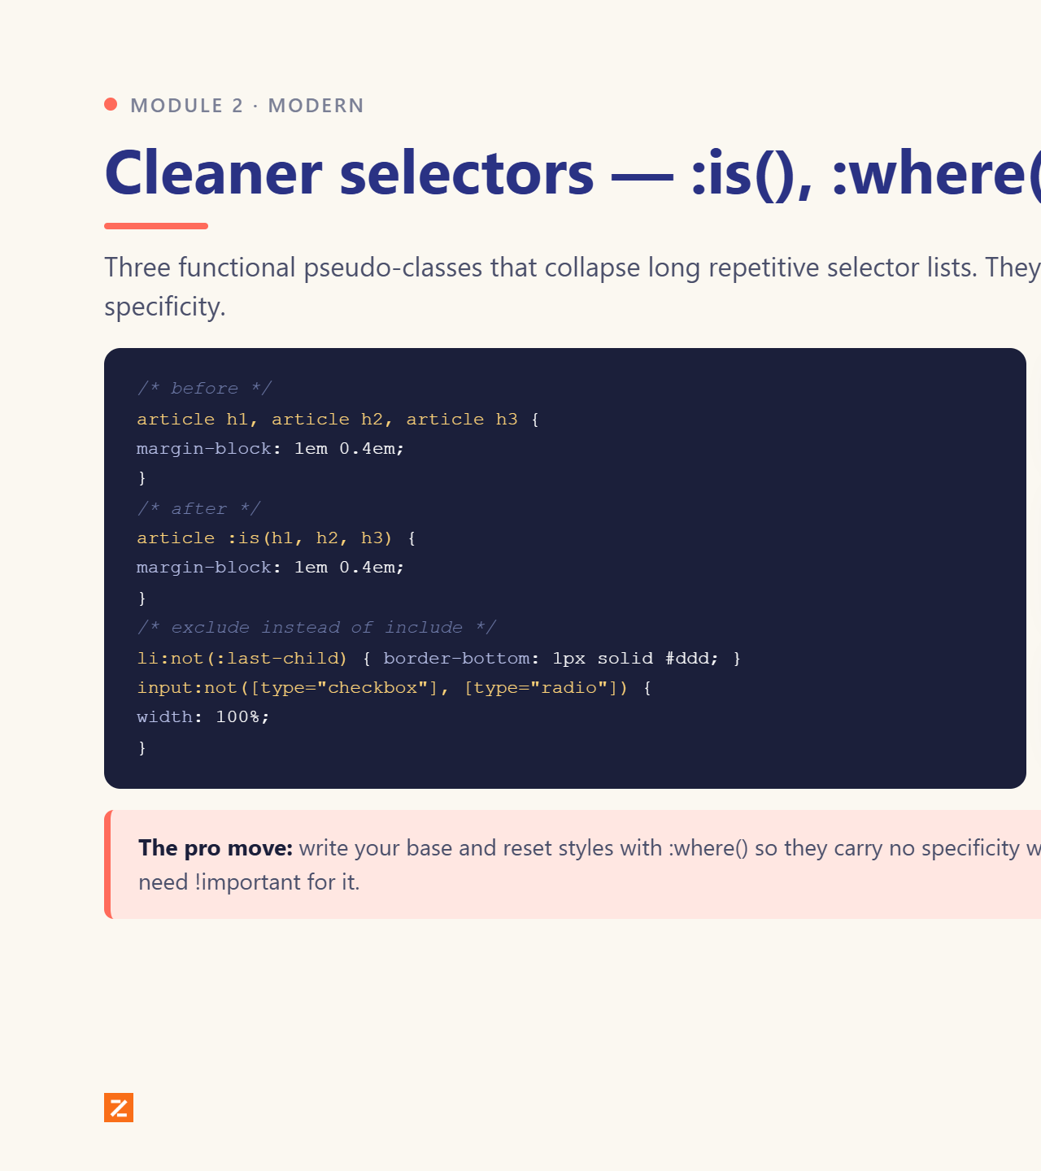
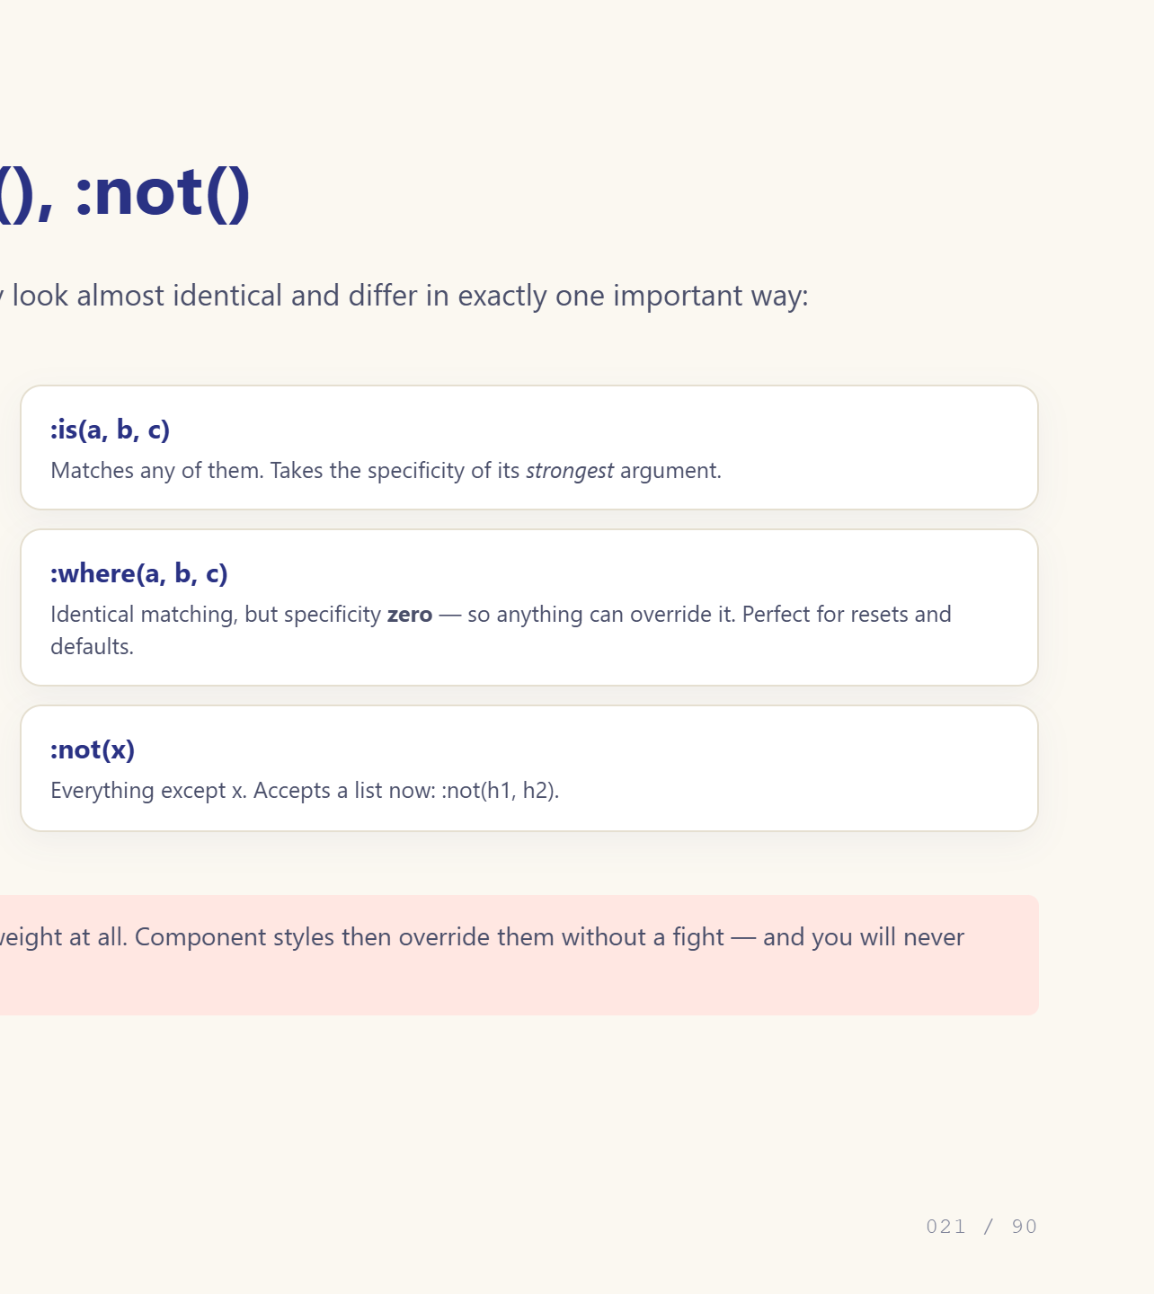
Notes:
Emphasise the specificity difference.

Slide 22
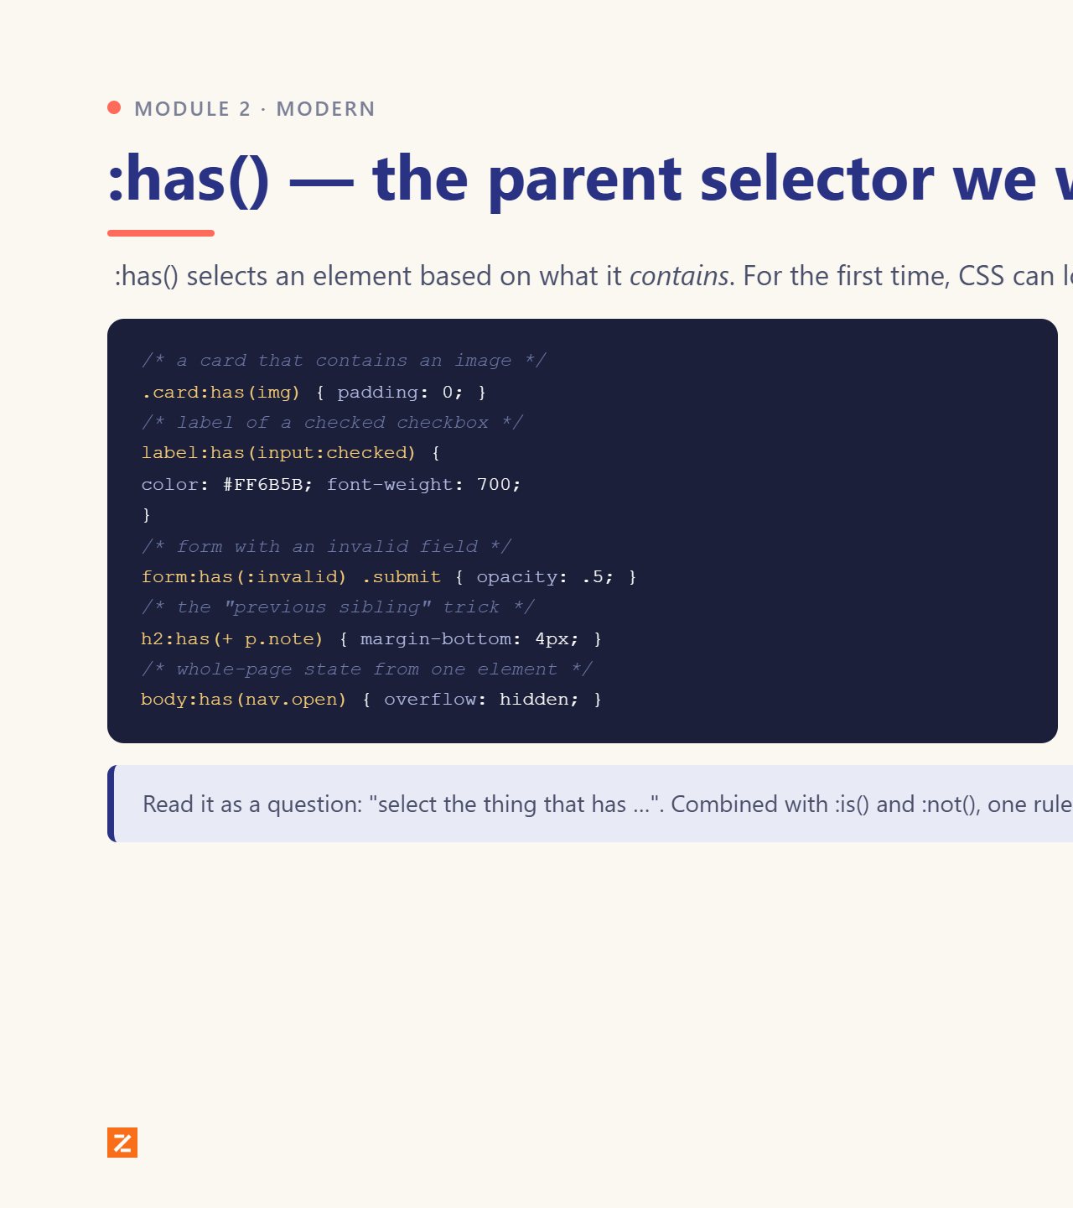
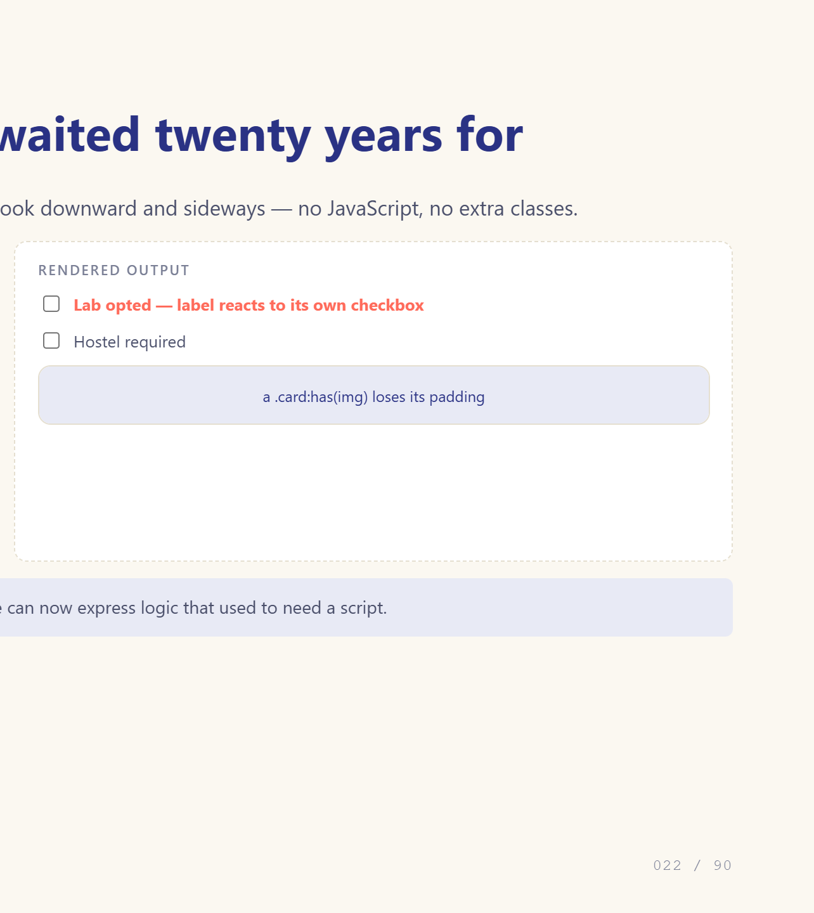
Notes:
The one that changes how you write CSS.

Slide 23
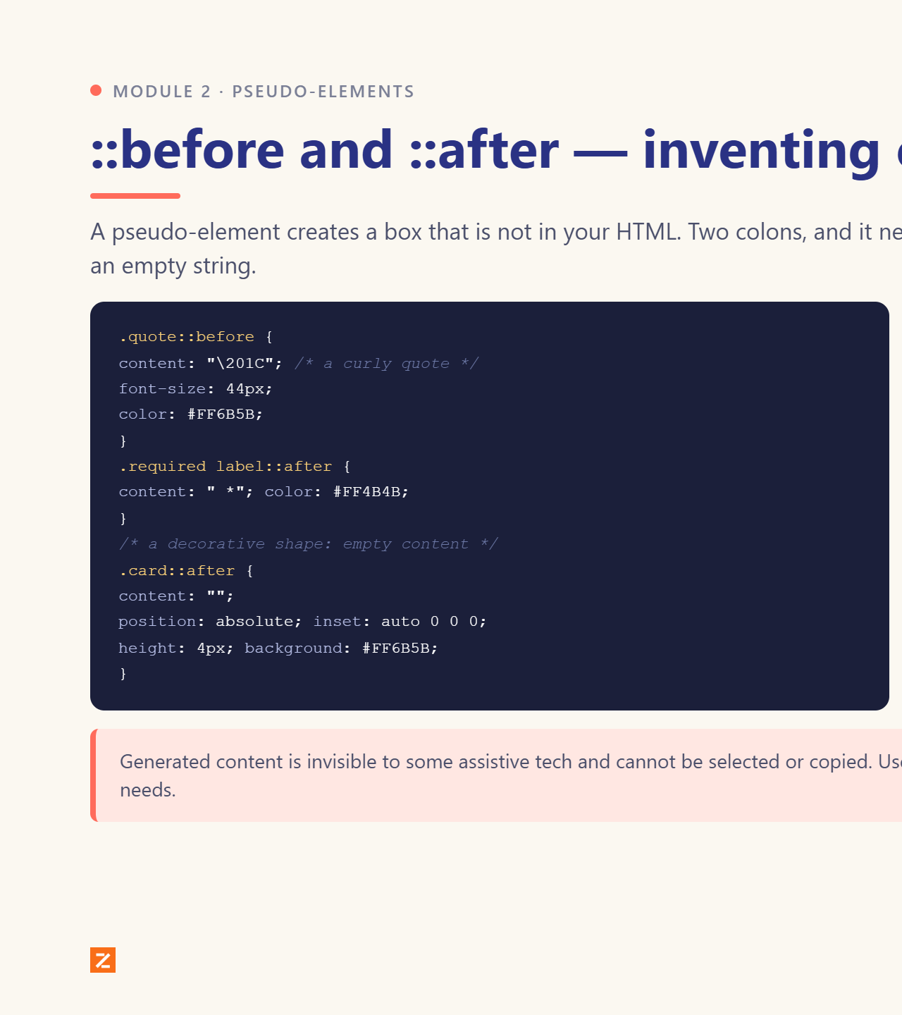
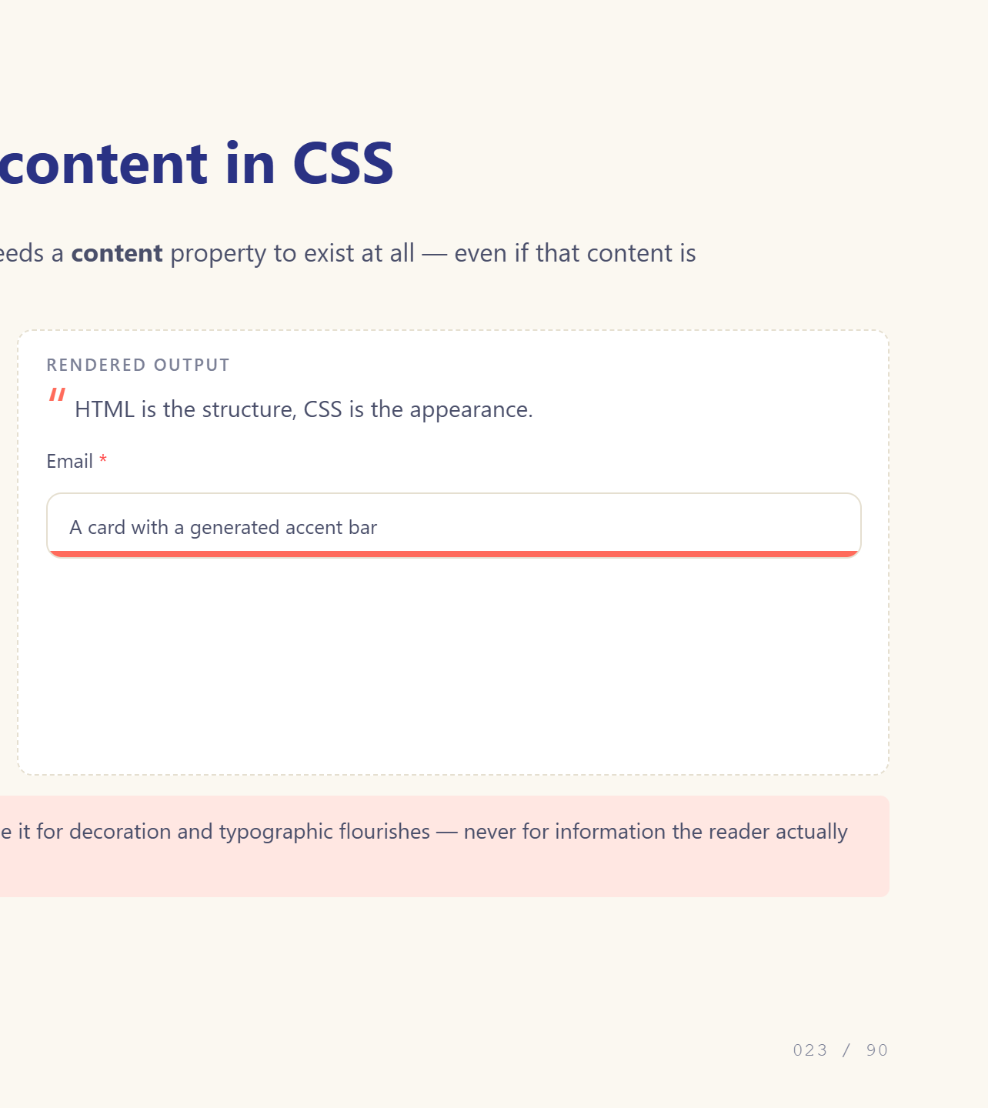
Notes:
Two colons, and content is required.

Slide 24
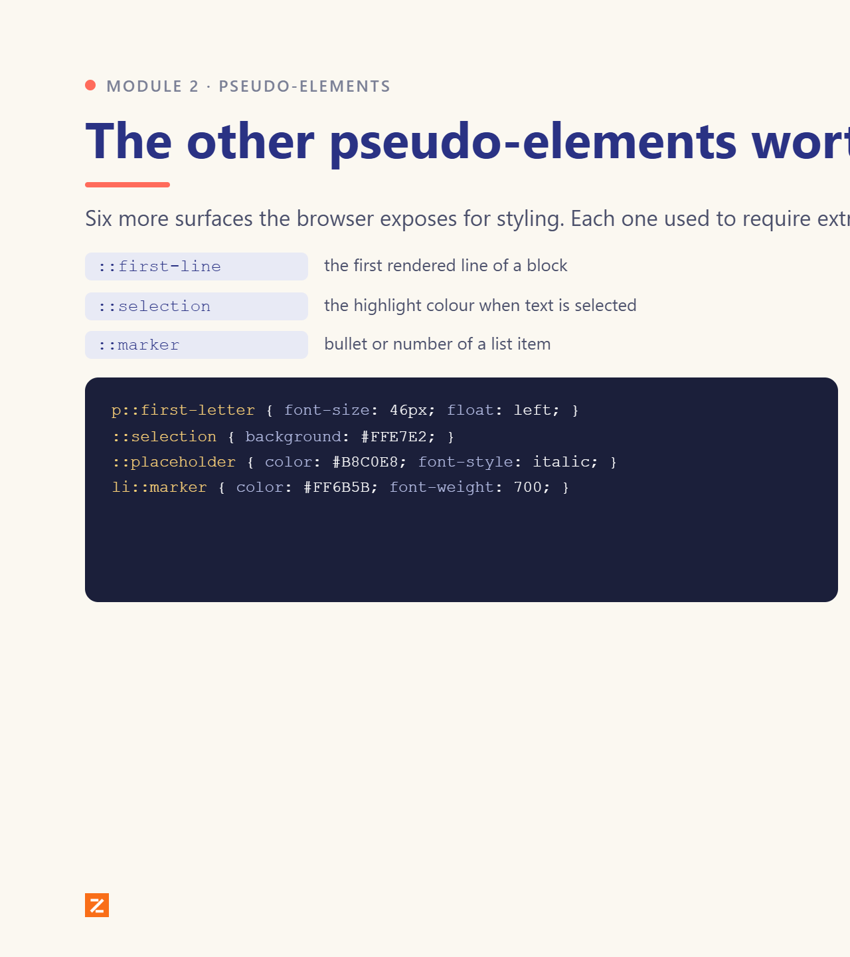
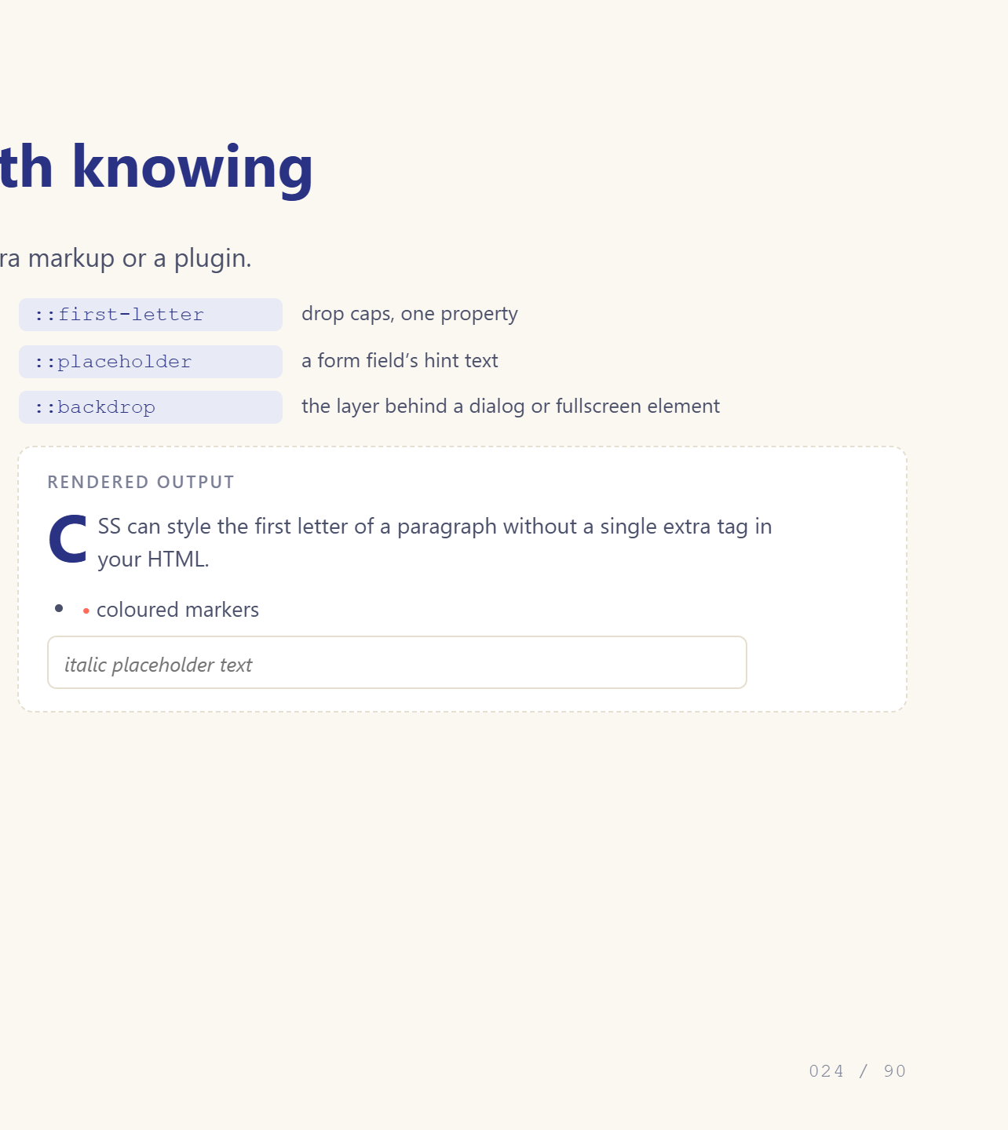
Notes:
::marker and ::placeholder are instantly useful.

Slide 25
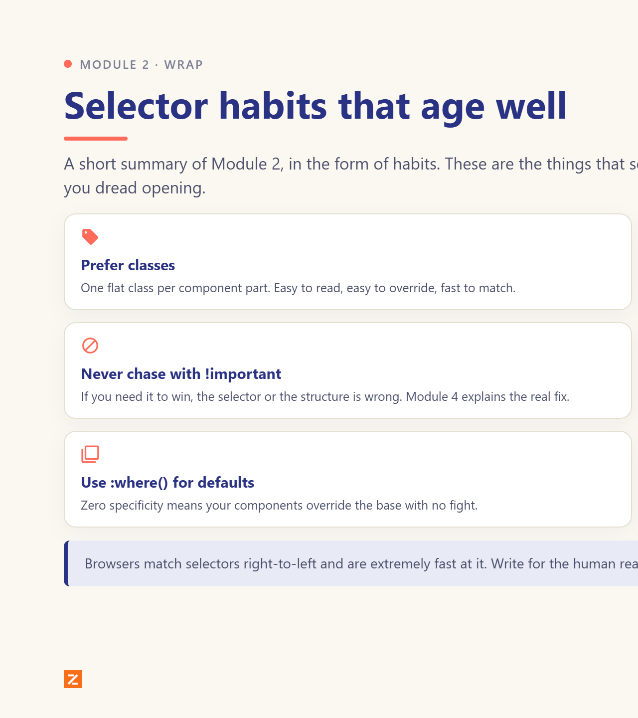
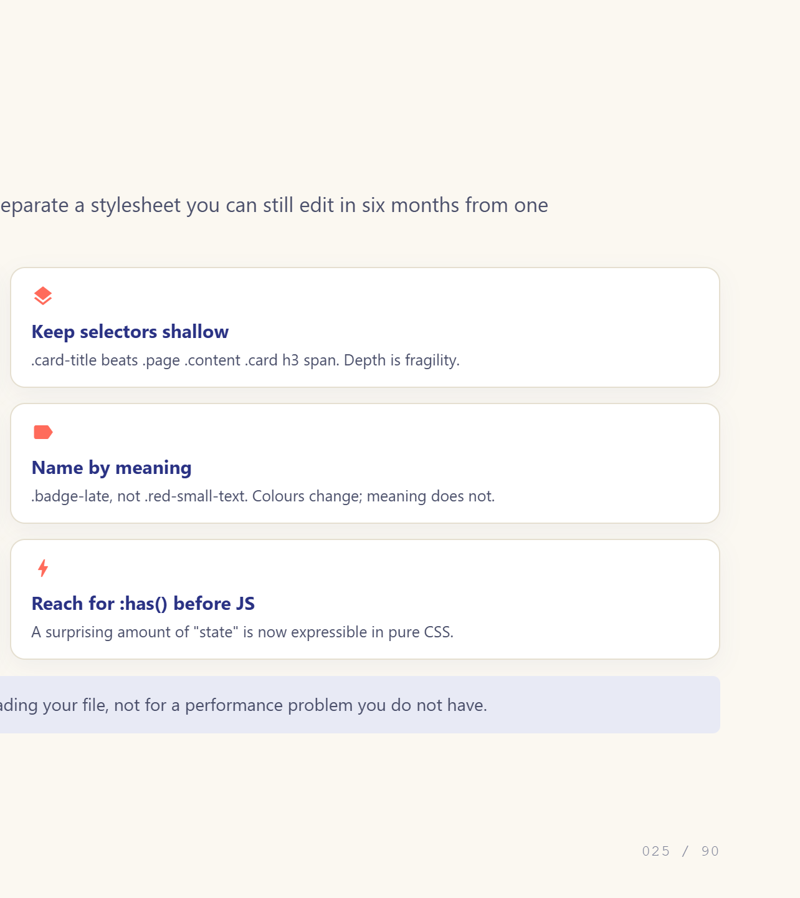
Notes:
Reassure: readability beats micro-optimisation.

Slide 26
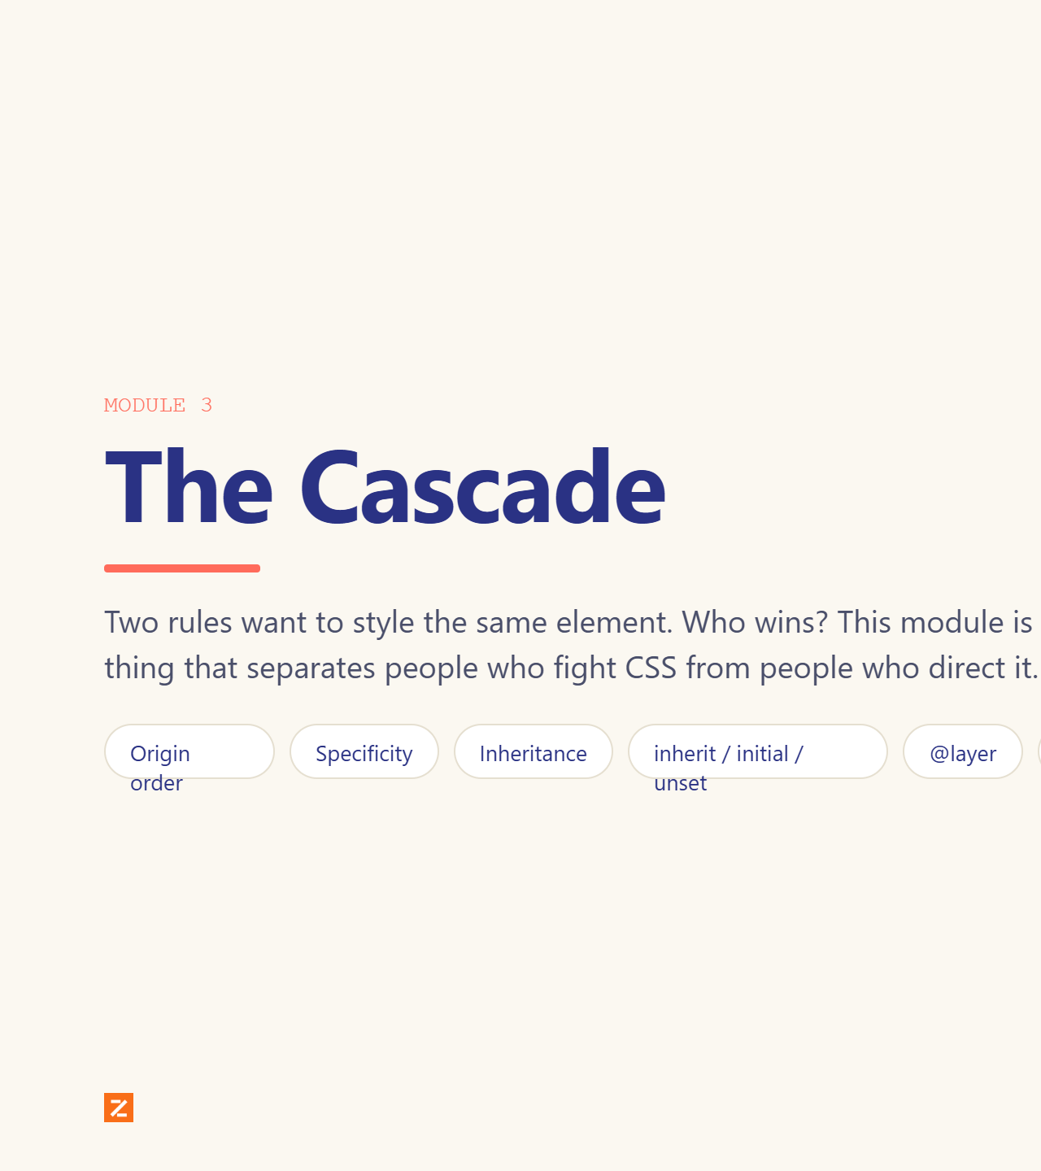

Notes:
Module divider.

Slide 27


Notes:
Four questions, in this order. Most conflicts end at question 3.

Slide 28


Notes:
Teach the three-number score. Make them count out loud.

Slide 29


Notes:
Do it as a show of hands before revealing.

Slide 30


Notes:
Explain why border does not inherit.

Slide 31


Notes:
Four keywords, one slide, saves hours.

Slide 32


Notes:
This is the modern answer to specificity wars.

Slide 33


Notes:
Give them the two legitimate uses, then move on.

Slide 34


Notes:
The complete list, including animations.

Slide 35


Notes:
Practical recipe for

Slide 36


Notes:
Module divider.

Slide 37


Notes:
px is the only absolute unit you will use on screen.

Slide 38


Notes:
The single most useful distinction in CSS sizing.

Slide 39


Notes:
dvh is the fix for the mobile address-bar bug.

Slide 40


Notes:
ch for measure, lh for rhythm.

Slide 41


Notes:
Four ways to say the same red.

Slide 42


Notes:
oklch is the professional default now.

Slide 43


Notes:
Gradients are images, not colours.

Slide 44


Notes:
env() is the notch fix nobody knows.

Slide 45


Notes:
clamp() is the one they will use forever.

Slide 46
Notes:
Module divider.

Slide 47
Notes:
Point at the four layers in DevTools too.

Slide 48
Notes:
The one-line fix everyone applies first.

Slide 49
Notes:
Shorthand order: clockwise from top.

Slide 50
Notes:
border-radius has eight values if you want them.

Slide 51
Notes:
auto is the classic centring trick.

Slide 52
Notes:
The weirdest default in CSS. Name it, then give the fixes.

Slide 53
Notes:
min-height vs height matters for real content.

Slide 54
Notes:
The over-constrained equation explains auto margins.

Slide 55
Notes:
Half of all positioning bugs are this.

Slide 56
Notes:
outline does not affect layout: that is the point.

Slide 57
Notes:
Module divider.

Slide 58
Notes:
system-ui is free and instant.

Slide 59
Notes:
font-display: swap prevents invisible text.

Slide 60
Notes:
Give them the 1.25 ratio and let them go.

Slide 61
Notes:
font shorthand is easy to get wrong.

Slide 62
Notes:
1.5 for body, 1.1 for display.

Slide 63
Notes:
text-decoration has real options now.

Slide 64
Notes:
Counters are how numbered headings work.

Slide 65
Notes:
Yesterday they built tables. Today they make them readable.

Slide 66
Notes:
Real newspaper columns, five declarations.

Slide 67
Notes:
The mysterious gap under an image lives here.

Slide 68
Notes:
text-wrap: balance is a free win on every heading.

Slide 69
Notes:
One file, infinite weights.

Slide 70
Notes:
Module divider.

Slide 71
Notes:
Order in the shorthand is forgiving; teach longhand first.

Slide 72
Notes:
Comma-separated: first is on top.

Slide 73
Notes:
Two properties beginners meet and nobody teaches.

Slide 74
Notes:
Filters apply to the whole element, children included.

Slide 75
Notes:
This is frosted glass. One line.

Slide 76
Notes:
Same modes as Photoshop layers.

Slide 77
Notes:
Shapes without image files.

Slide 78
Notes:
Masks use an image’s alpha; clip-path uses geometry.

Slide 79
Notes:
Module divider.

Slide 80
Notes:
Everything else is a deviation from this.

Slide 81
Notes:
Three ways to hide, three different meanings.

Slide 82
Notes:
static and relative first, then the others.

Slide 83
Notes:
Containing block is the concept to nail.

Slide 84
Notes:
sticky needs a threshold and a scrolling ancestor.

Slide 85
Notes:
Stacking contexts are the real lesson here.

Slide 86
Notes:
Historical, but you will meet it.

Slide 87
Notes:
No more padding-top: 56.25% hacks.

Slide 88
Notes:
The actual painting algorithm, in order.

Slide 89
Notes:
Small properties, disproportionate effect on feel.

Slide 90
Notes:
Six ways. Grid place-items is the answer now.

