Slide 1
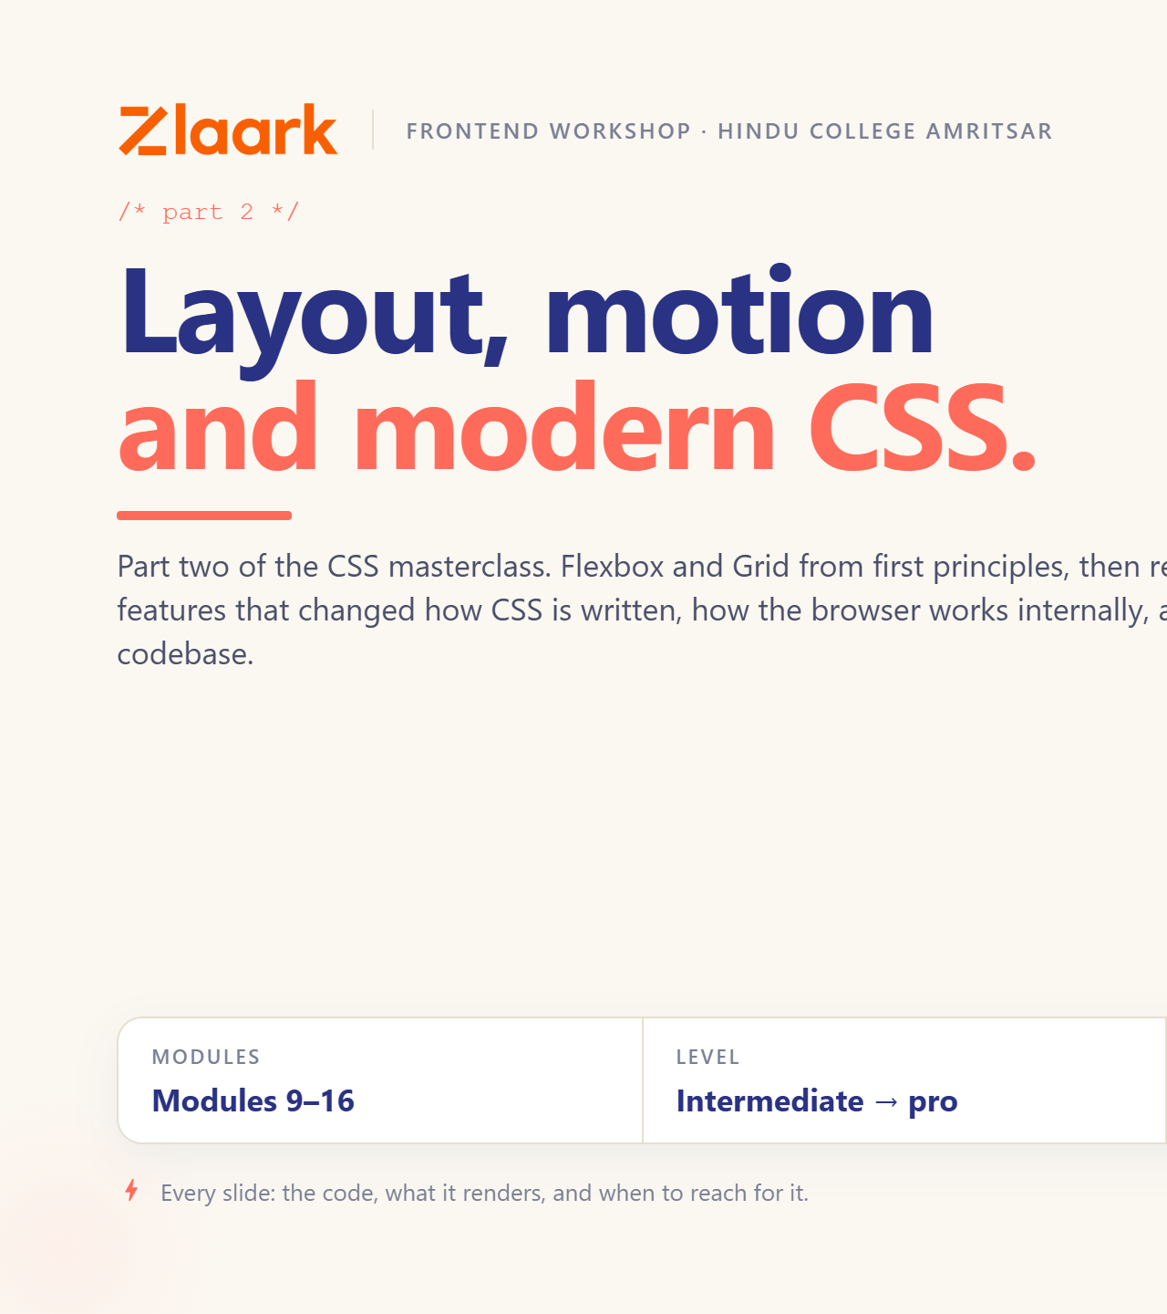
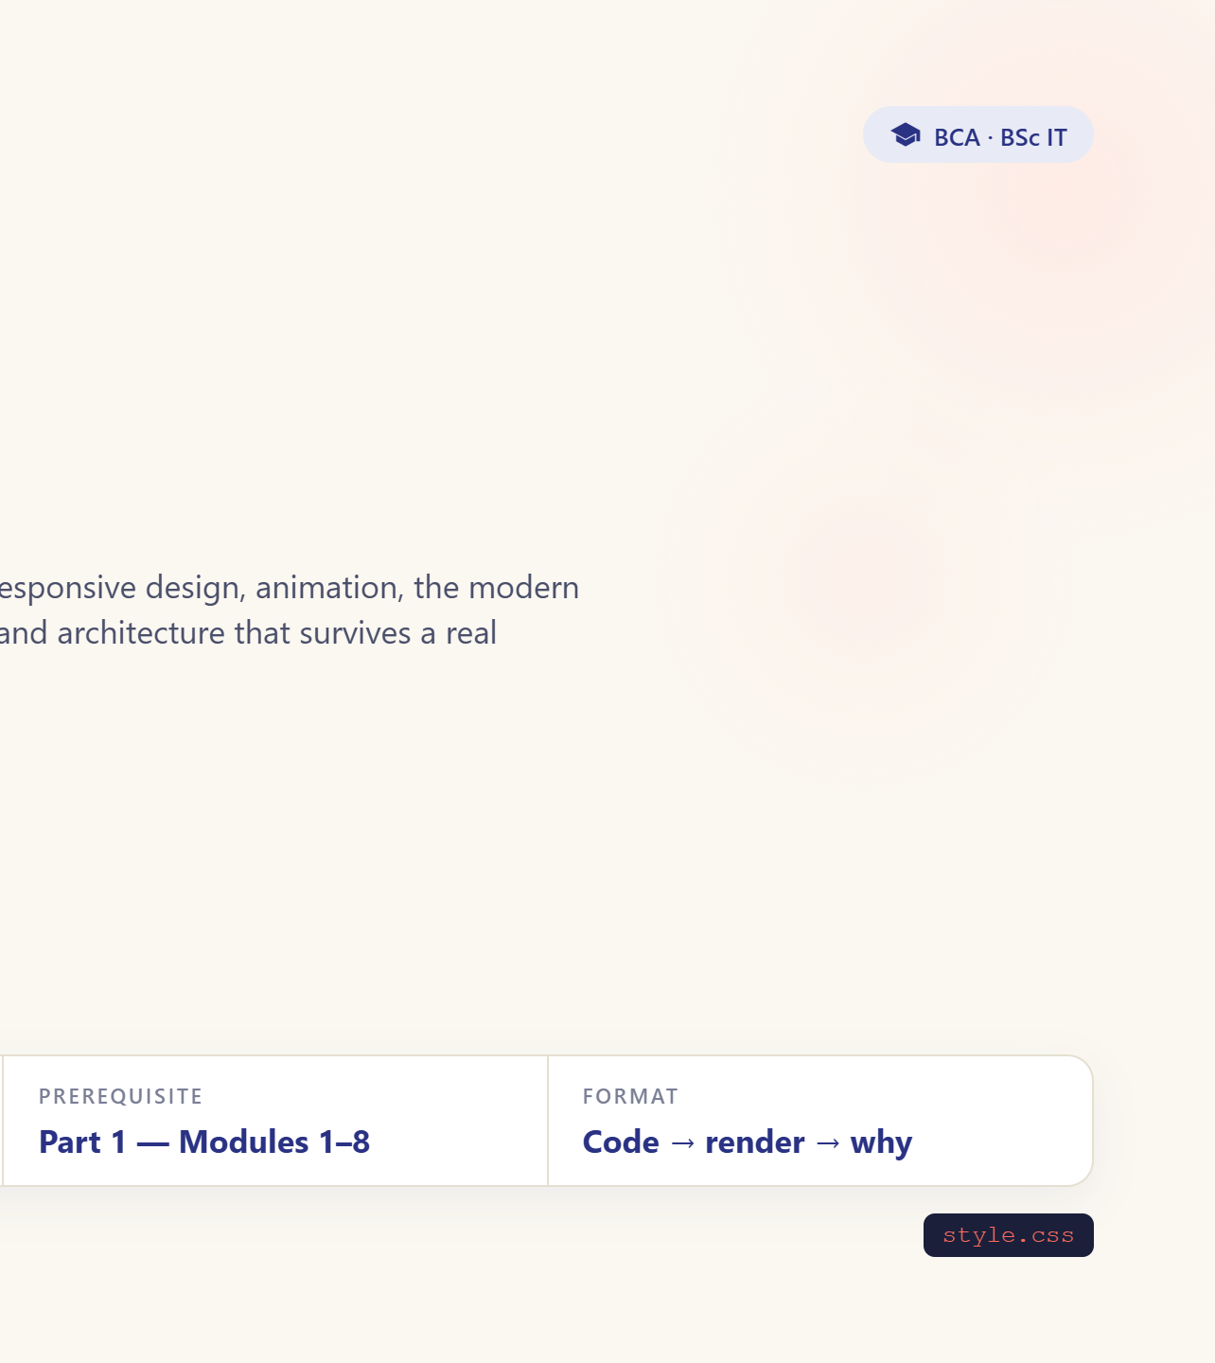
Notes:
Welcome to Day 2. Yesterday: structure. Today: everything you can see.

Slide 2
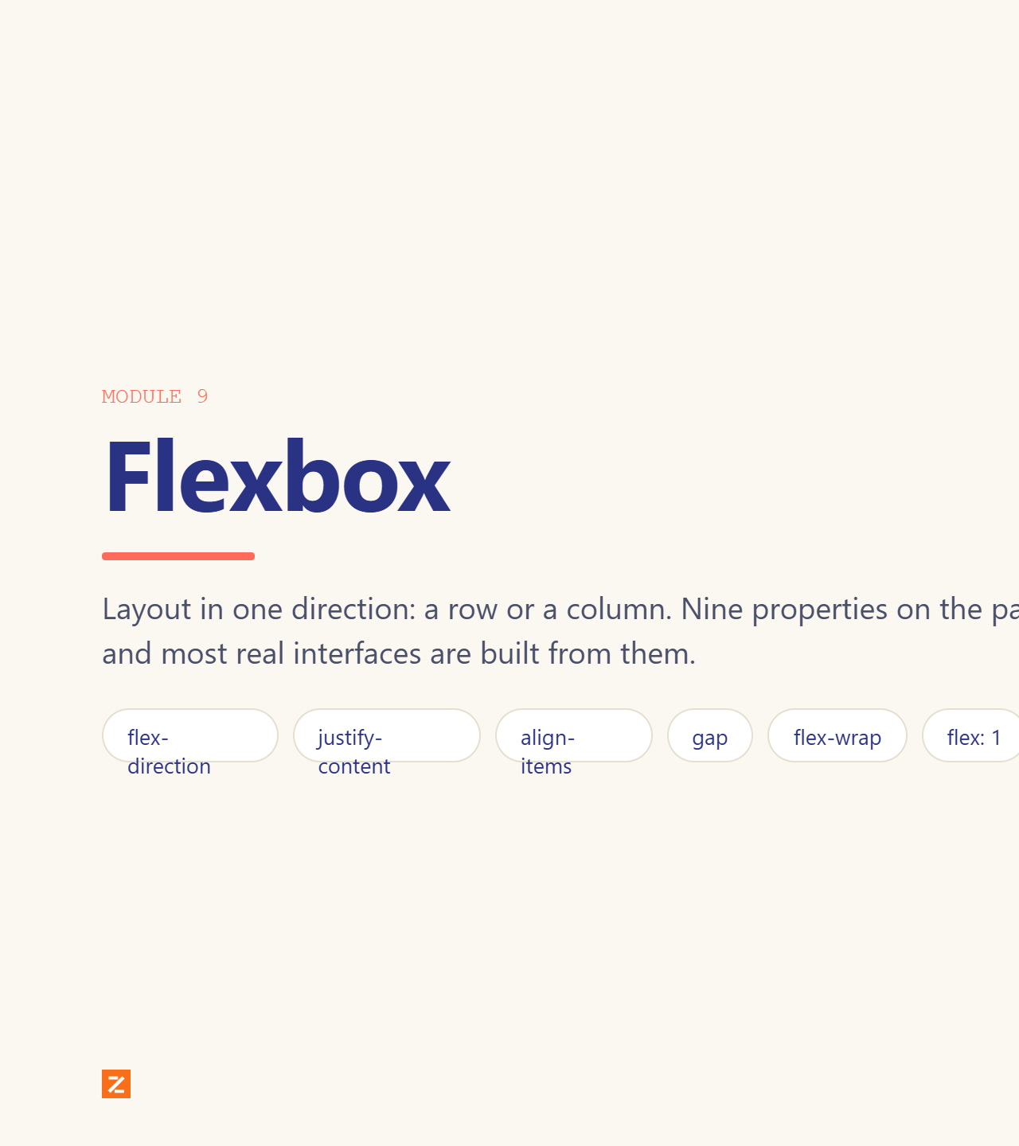
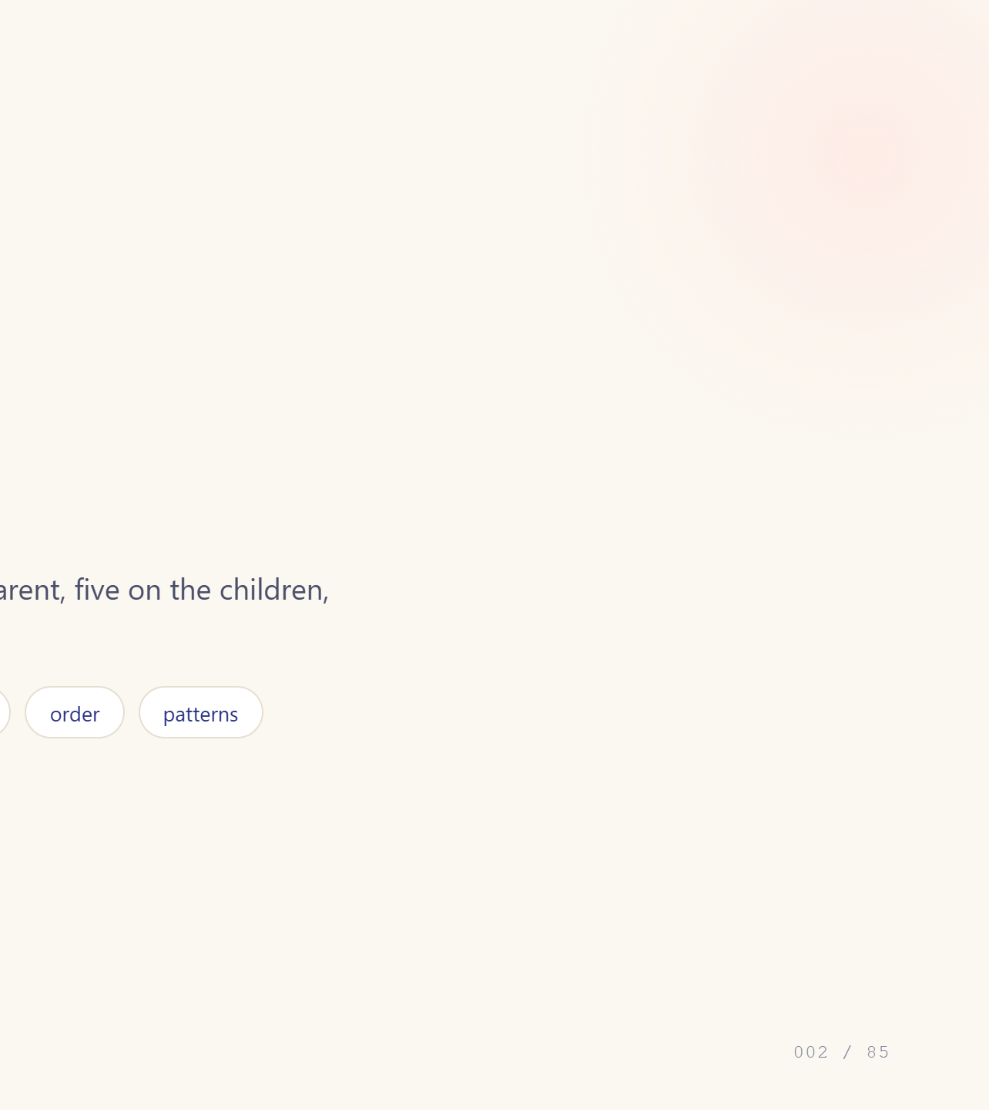
Notes:
Module divider.

Slide 3
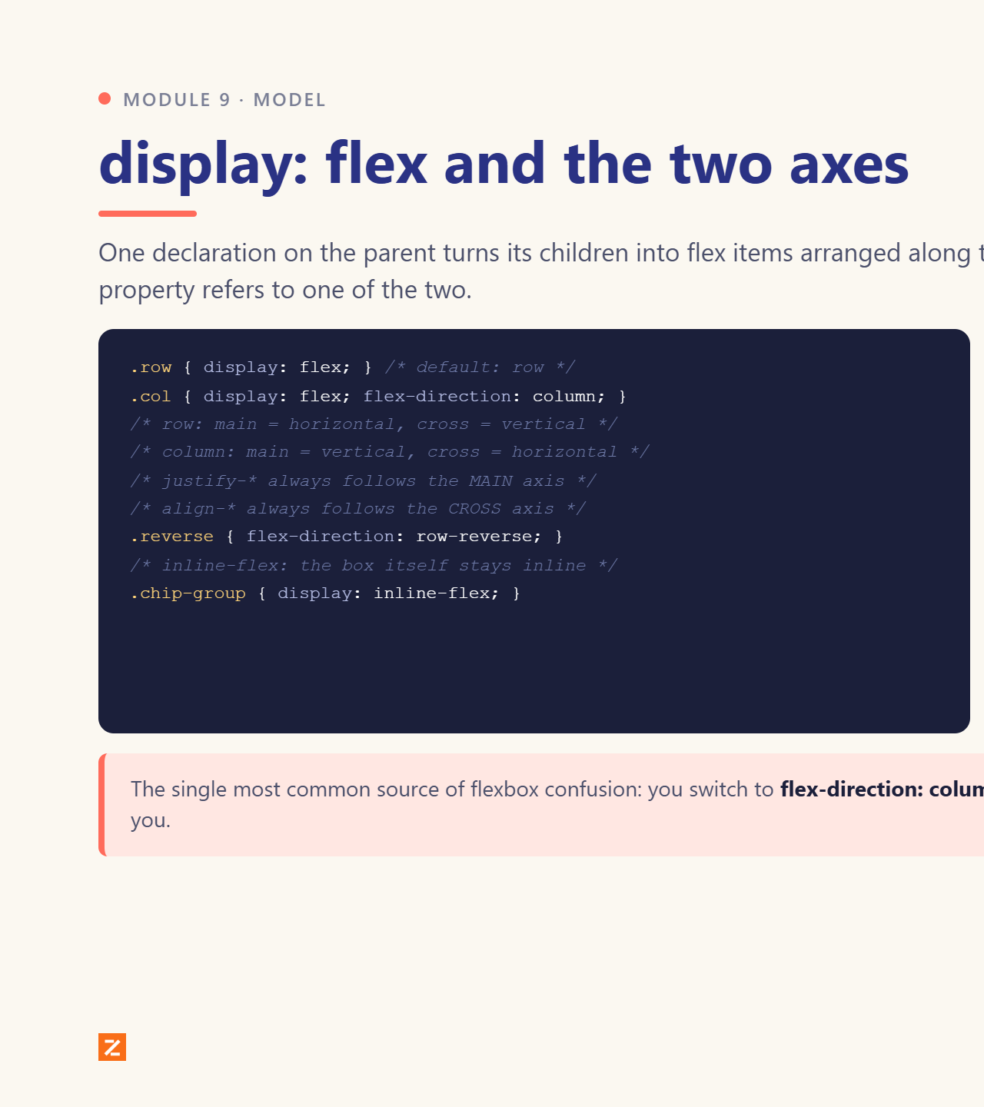
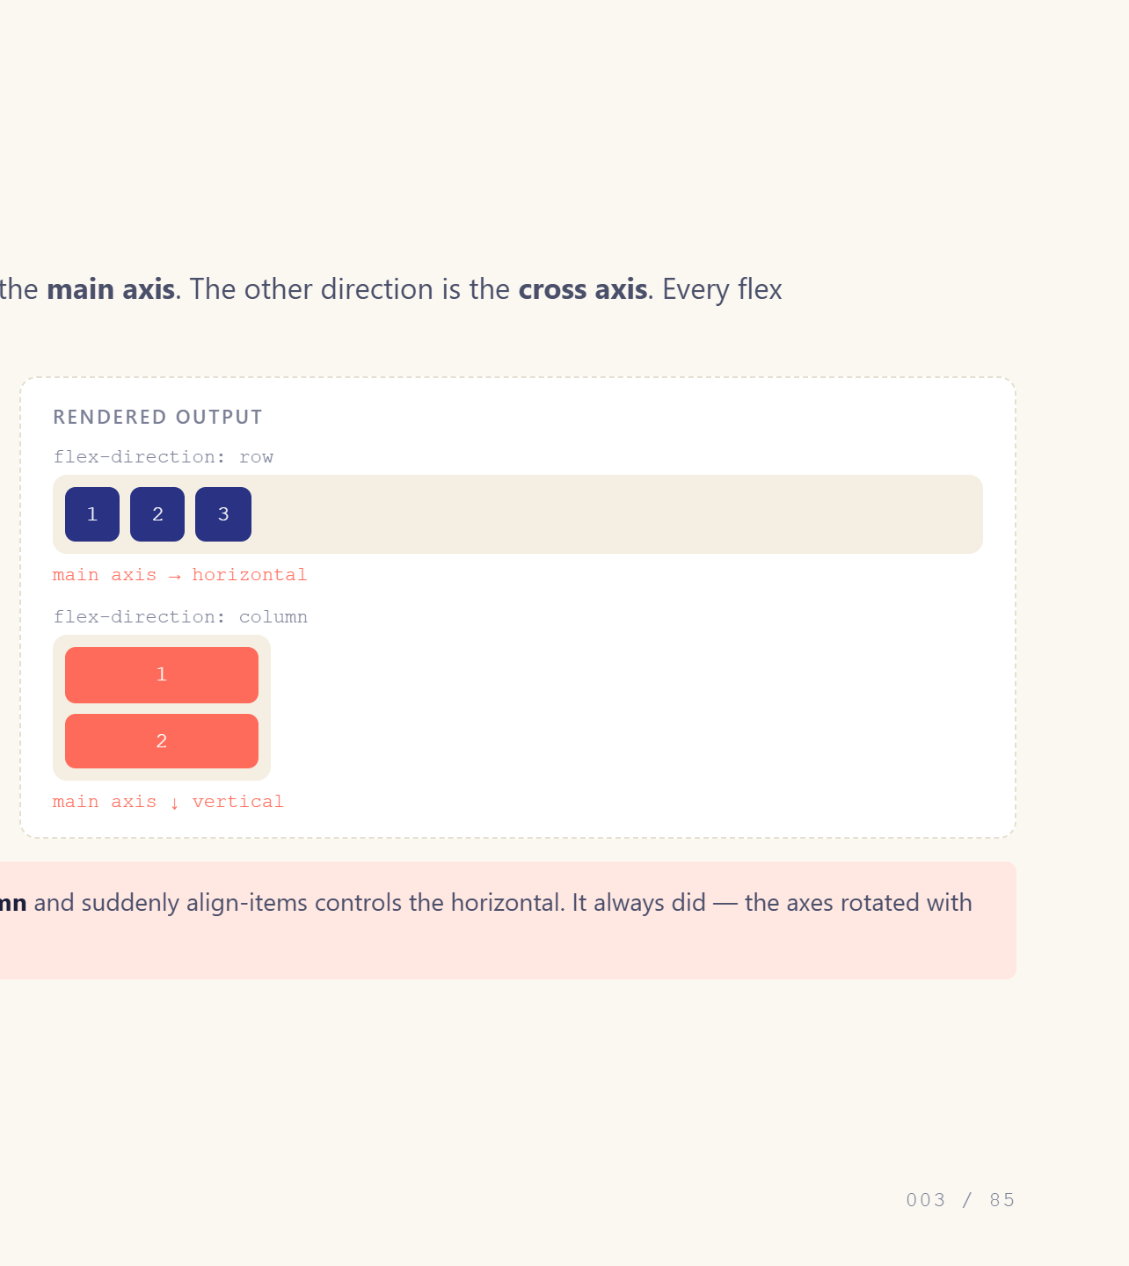
Notes:
Main axis vs cross axis is the whole mental model.

Slide 4
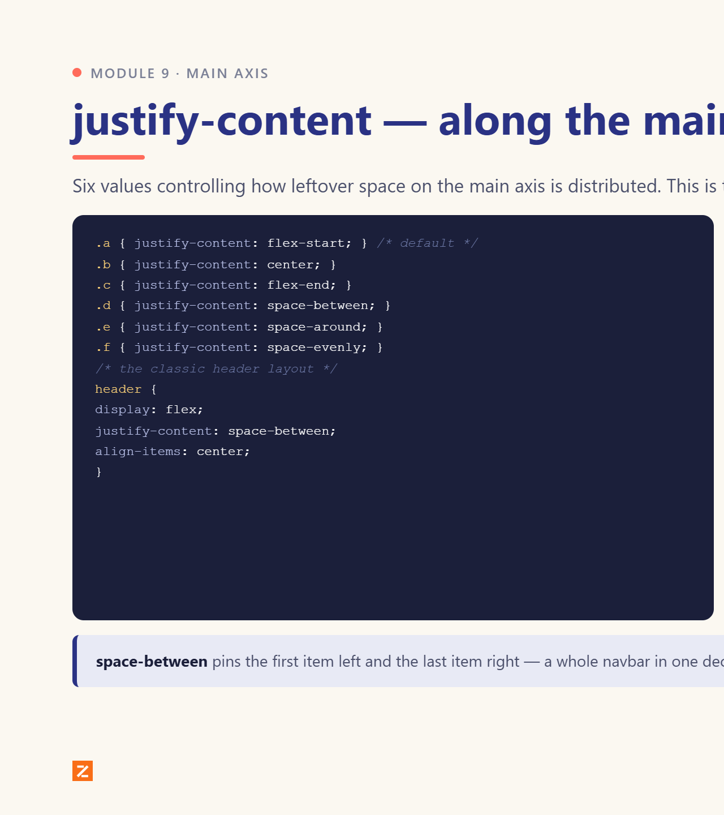
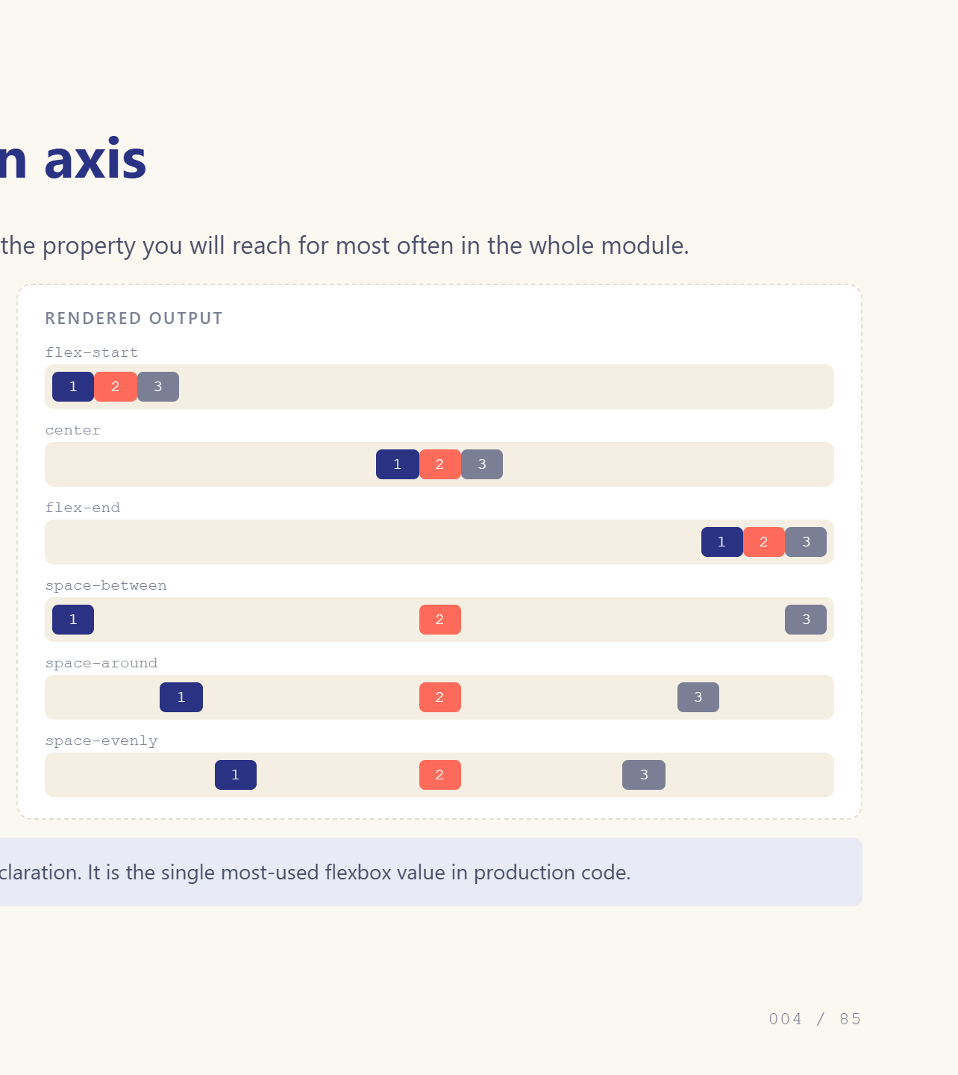
Notes:
Space-between is the workhorse.

Slide 5
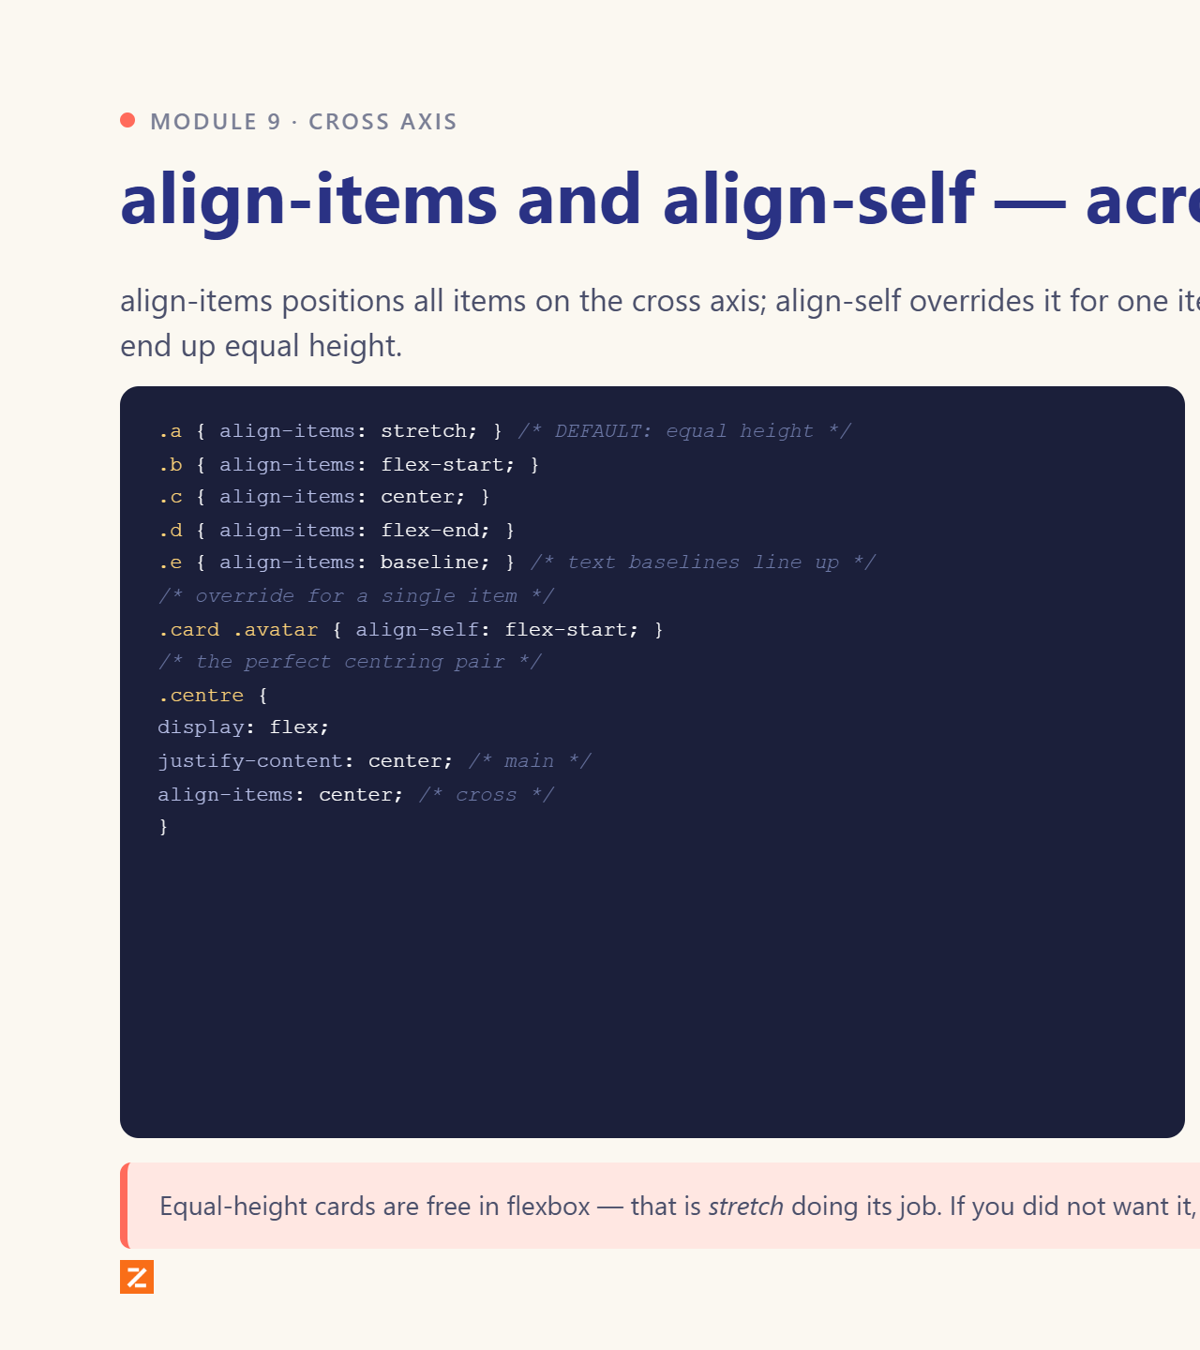
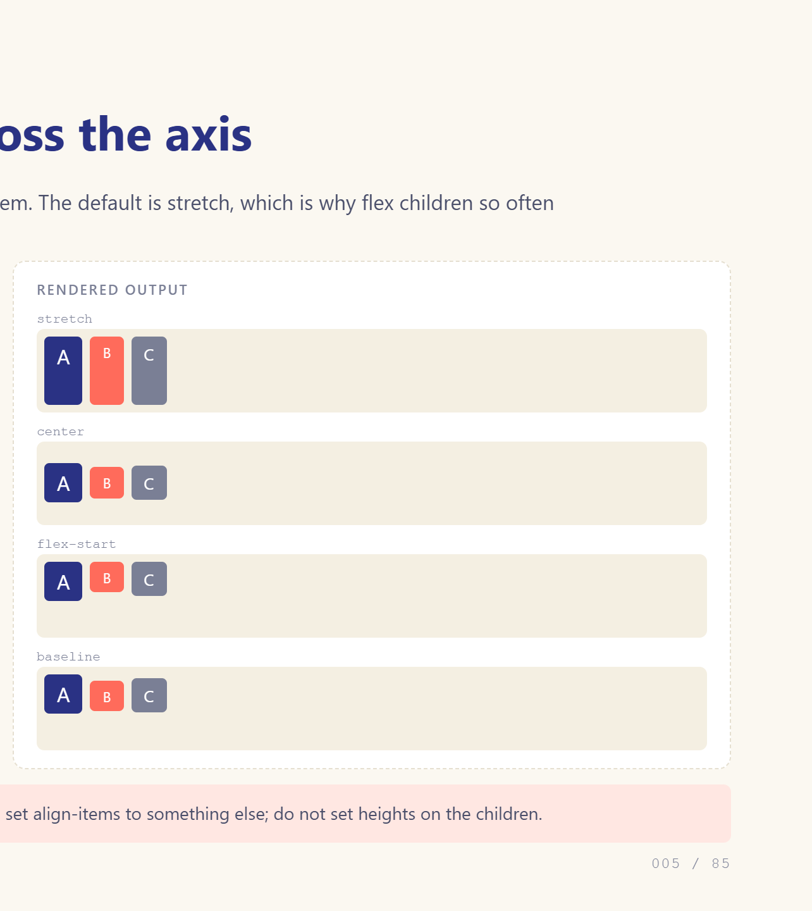
Notes:
stretch is the default and surprises people.

Slide 6
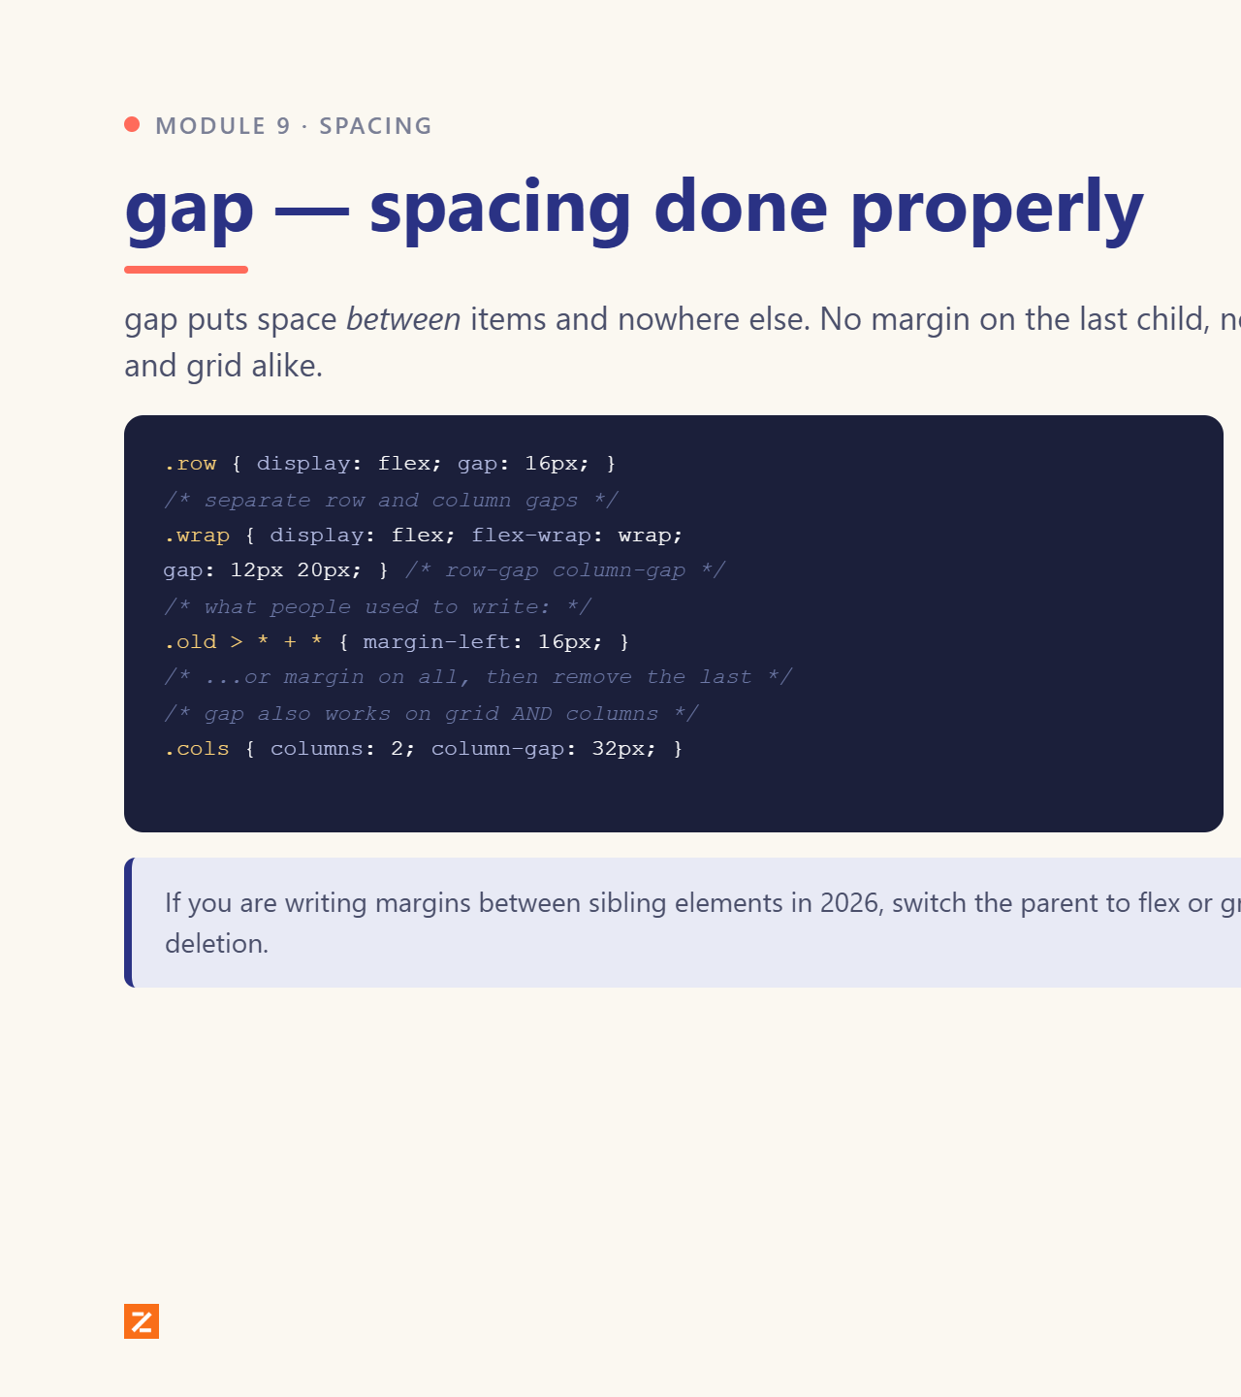
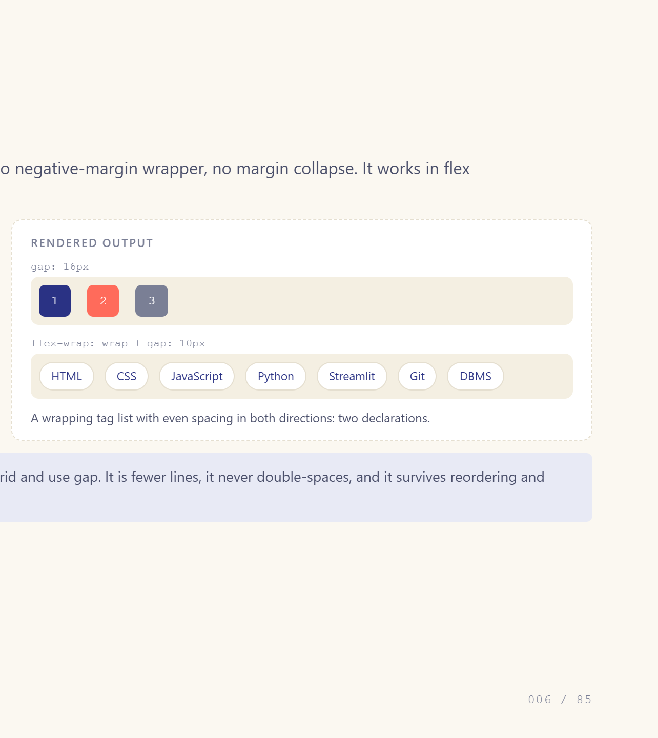
Notes:
gap replaced margin hacks entirely.

Slide 7
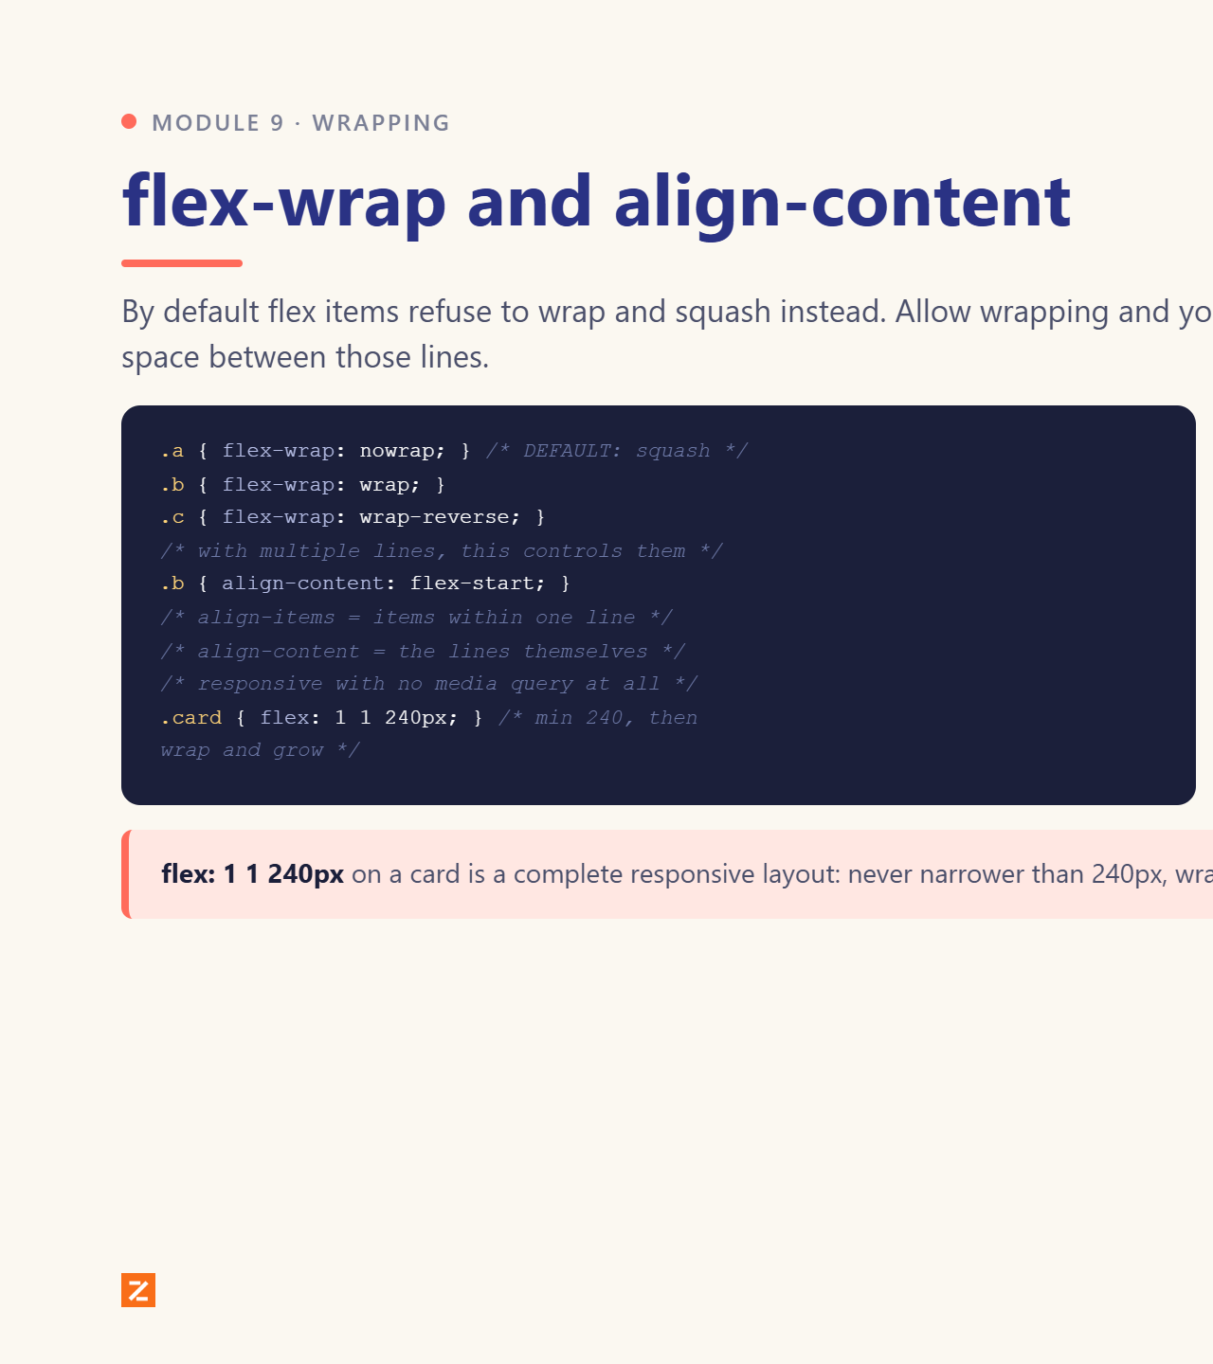
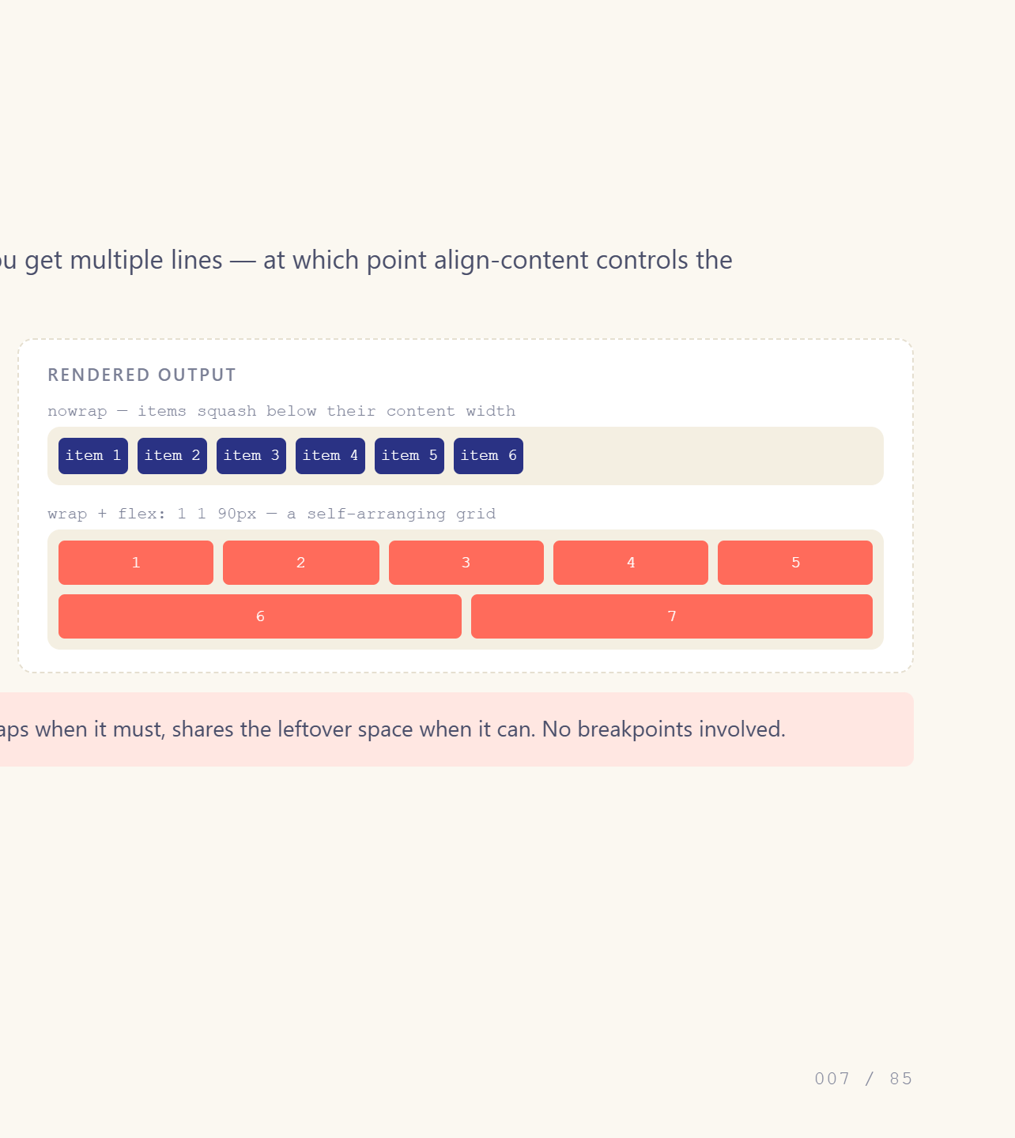
Notes:
Nowrap is the default and causes squashing.

Slide 8
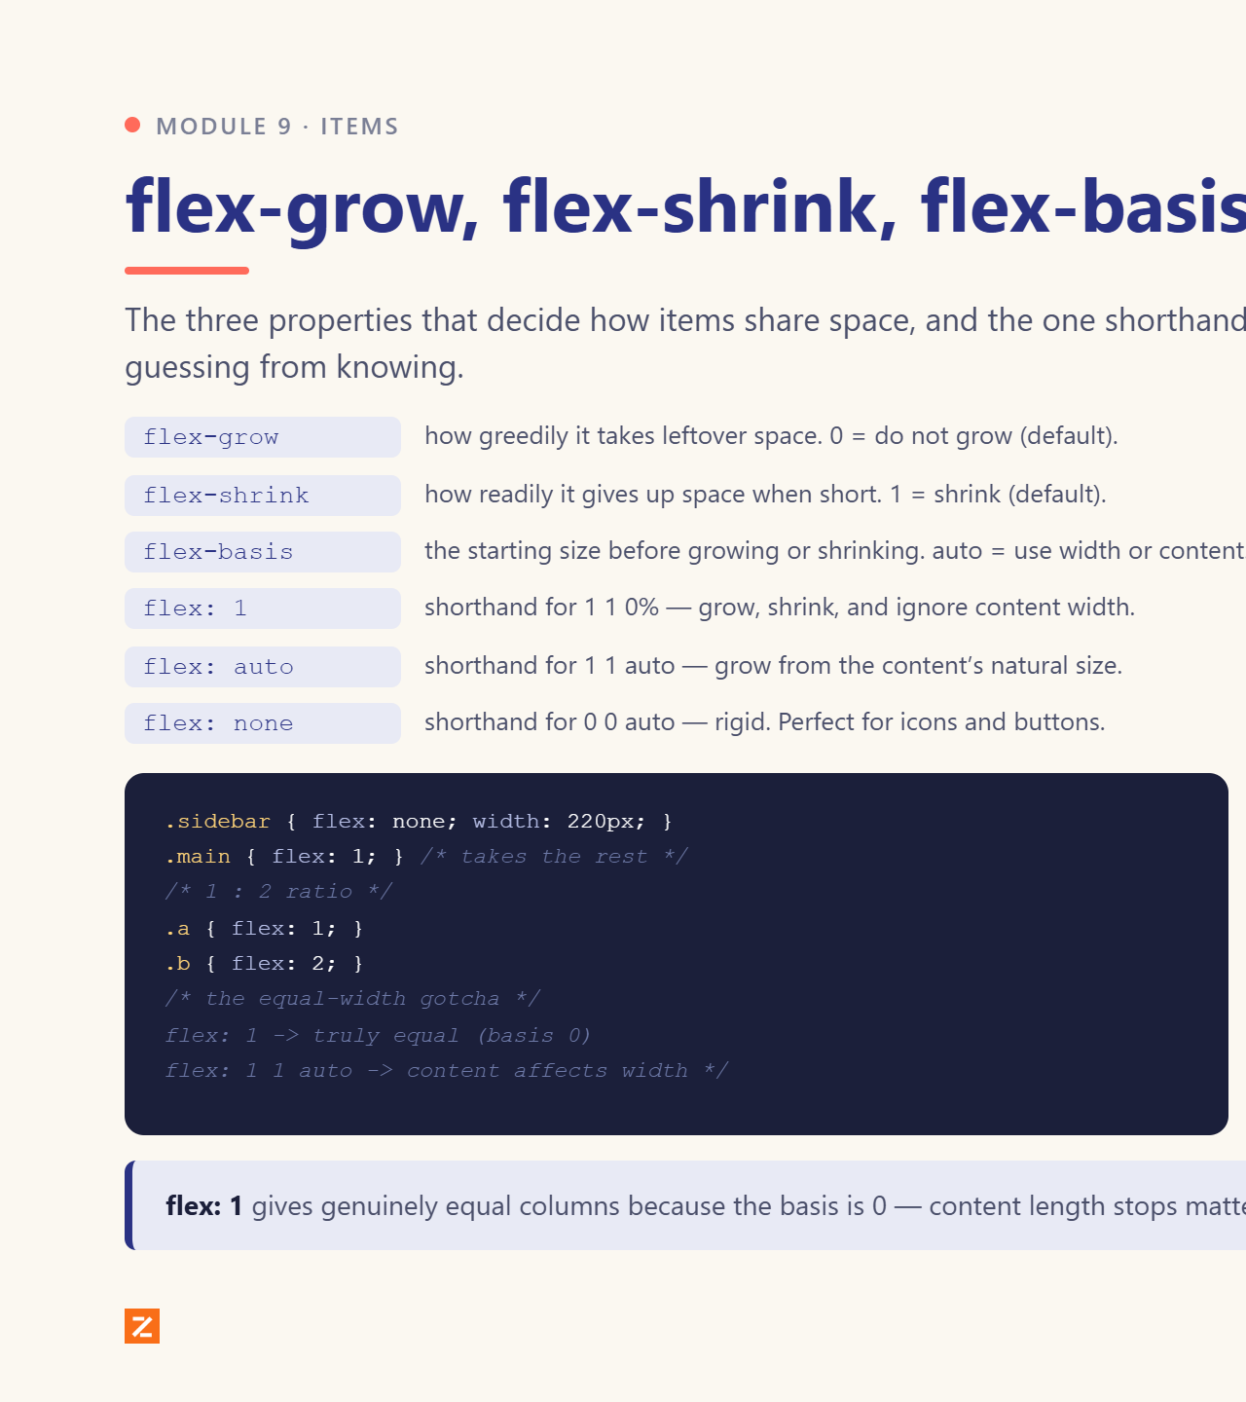
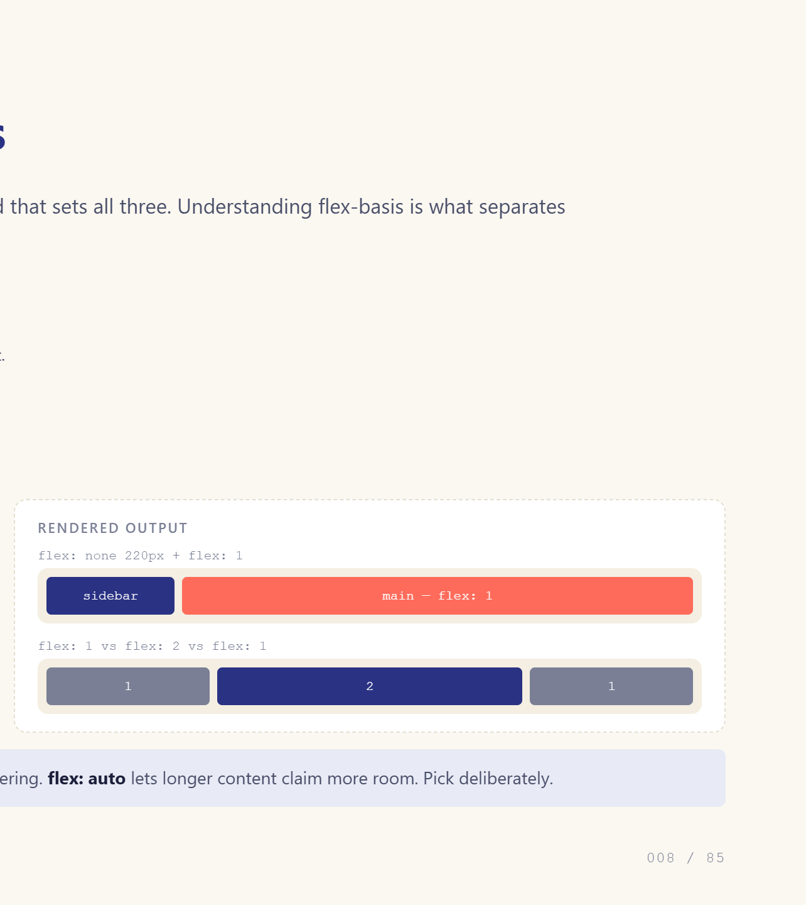
Notes:
flex: 1 is three values in disguise.

Slide 9
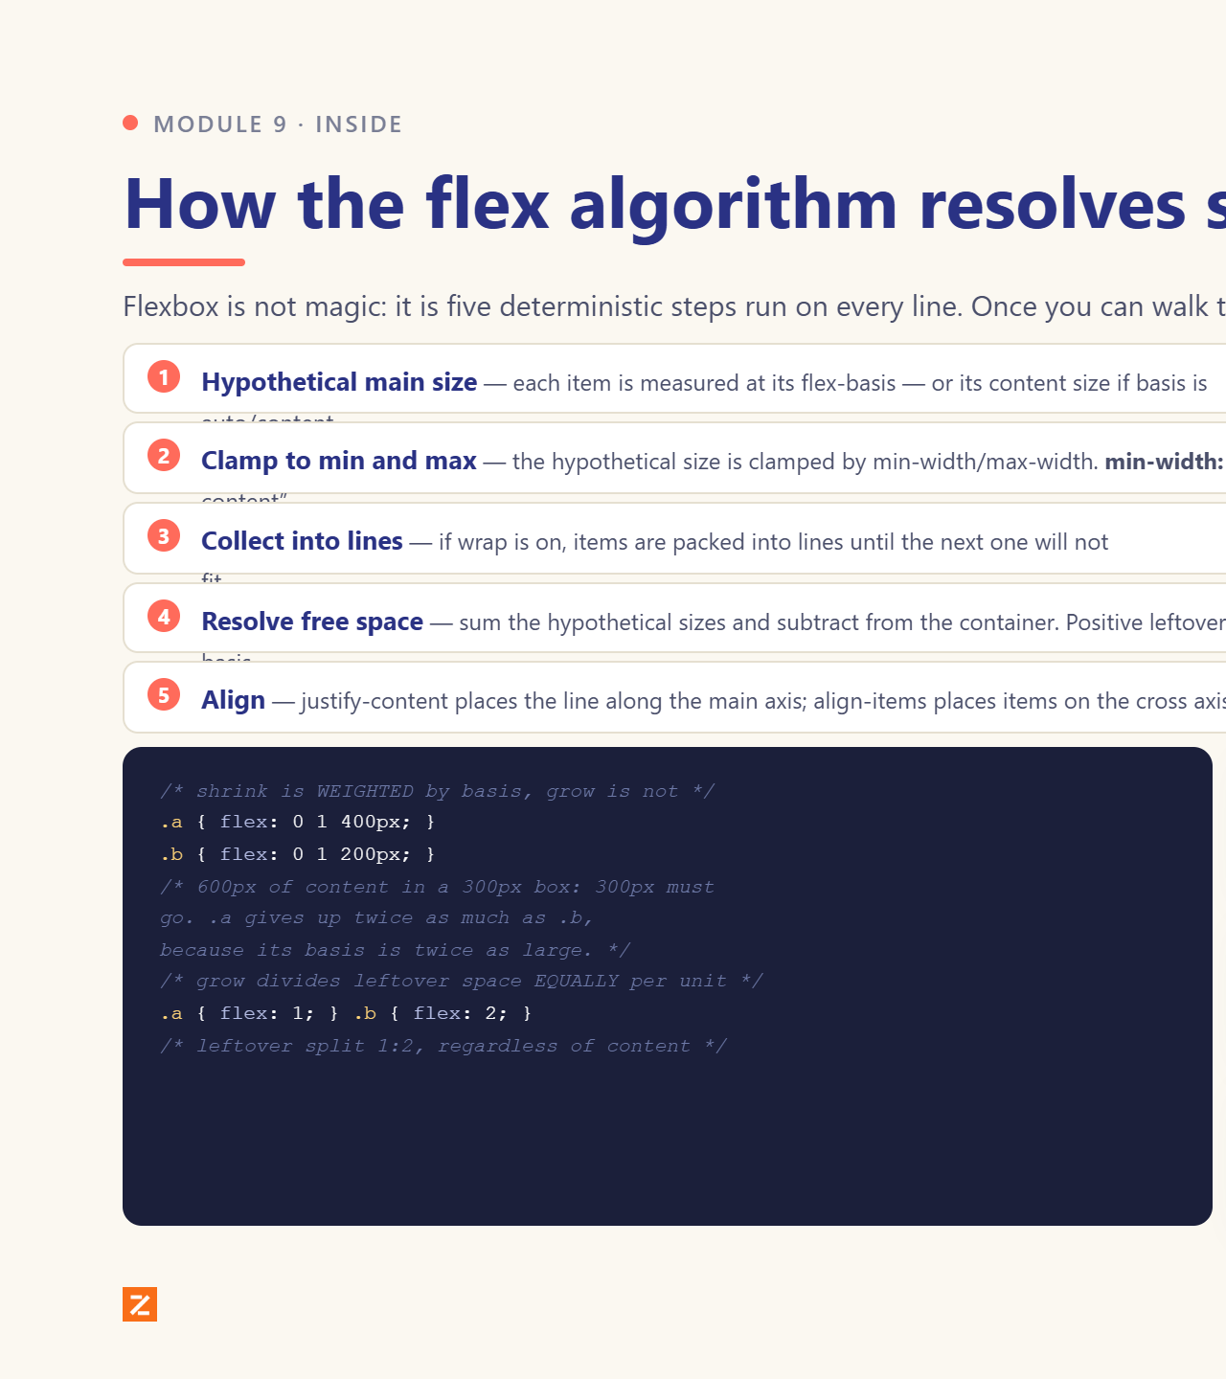
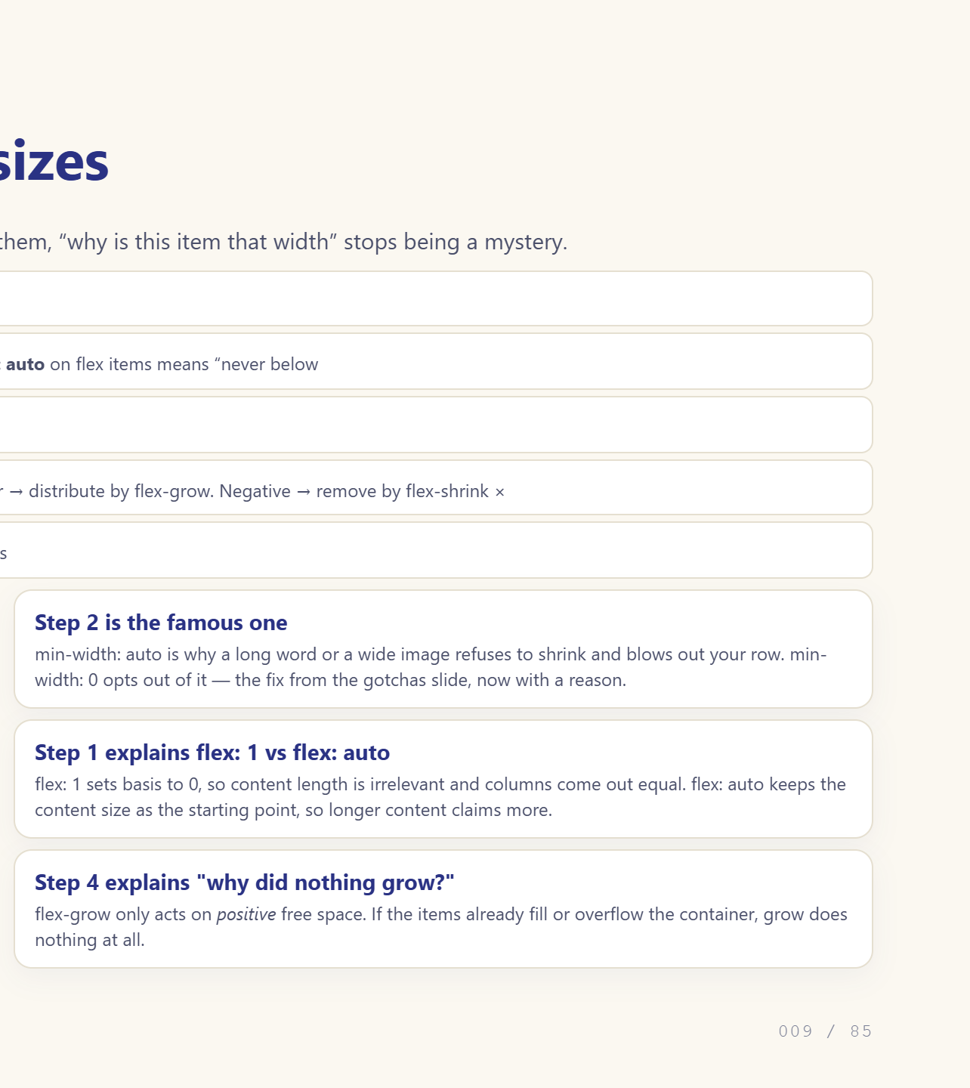
Notes:
Walk the five steps. This is the slide that ends flex guessing.

Slide 10
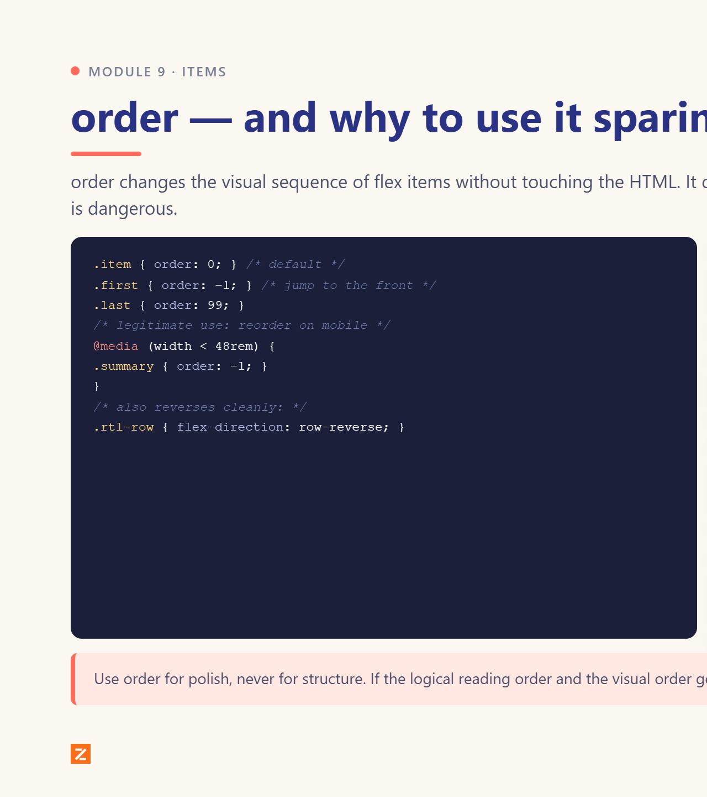
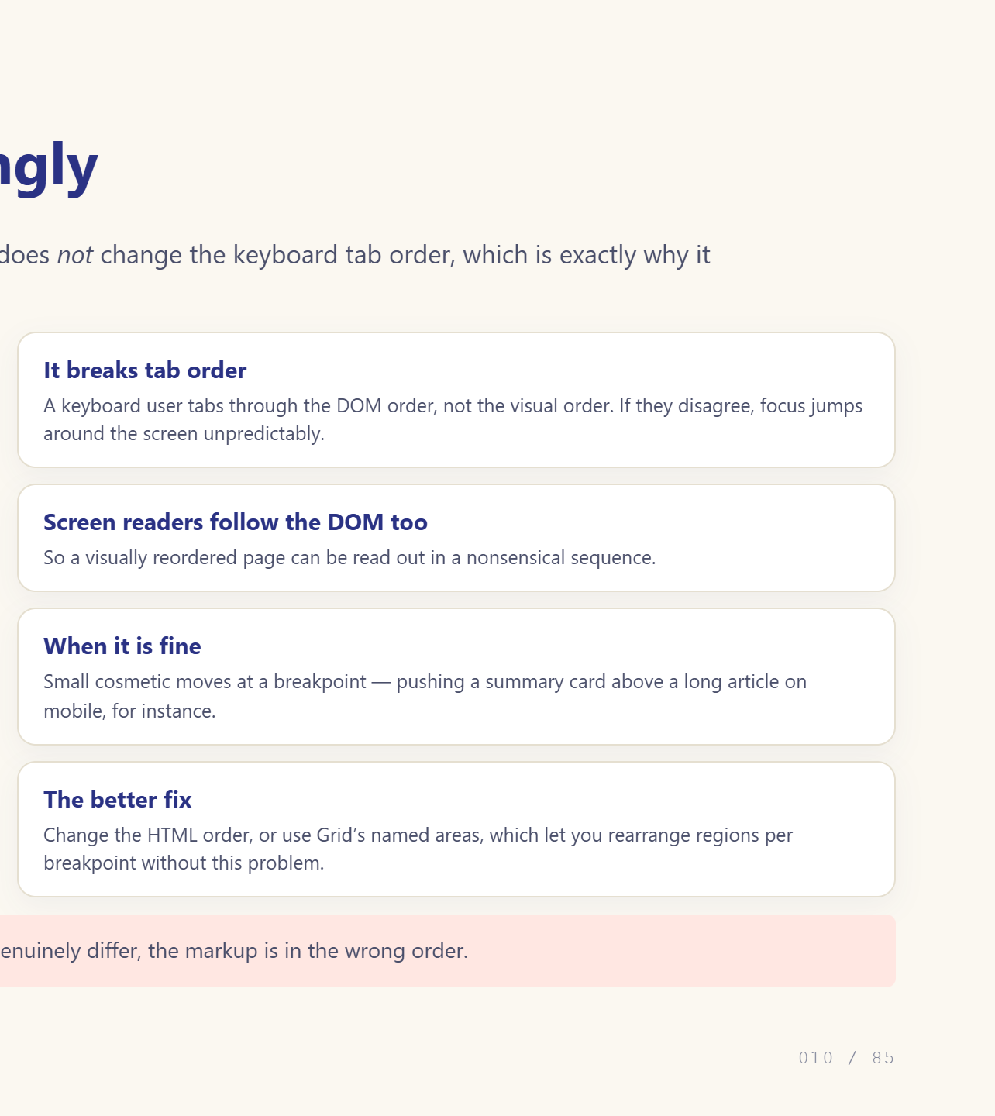
Notes:
Visual order only. Tab order does not change.

Slide 11
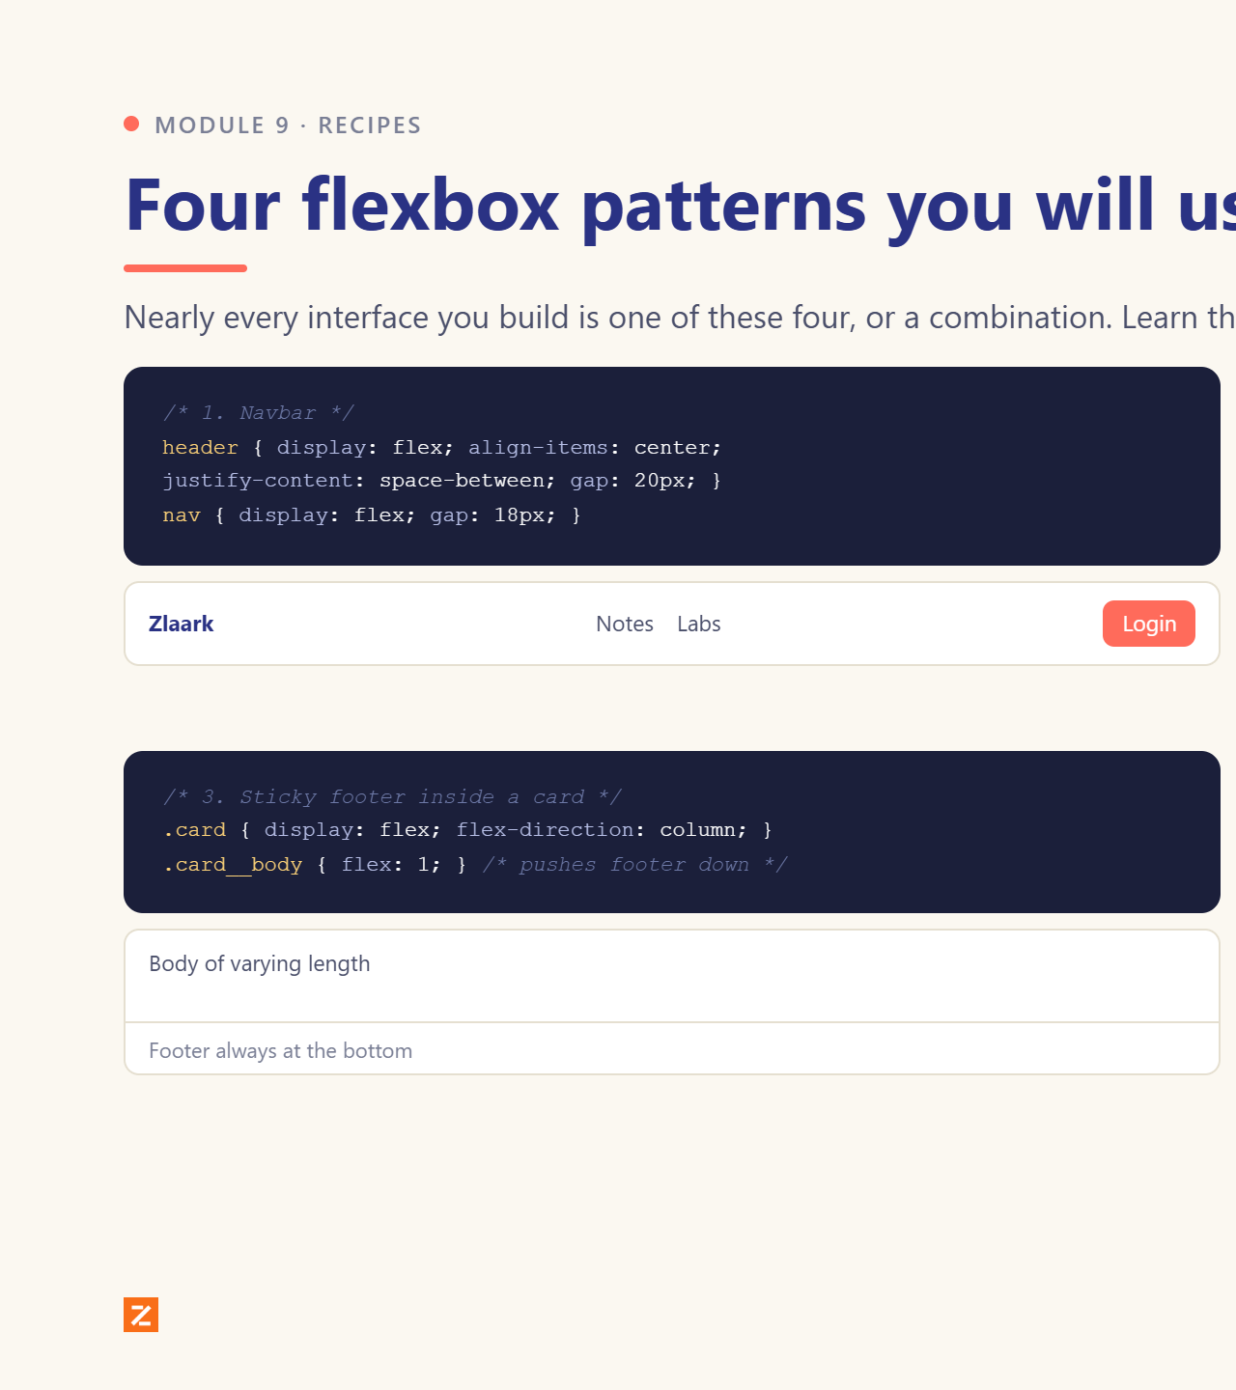
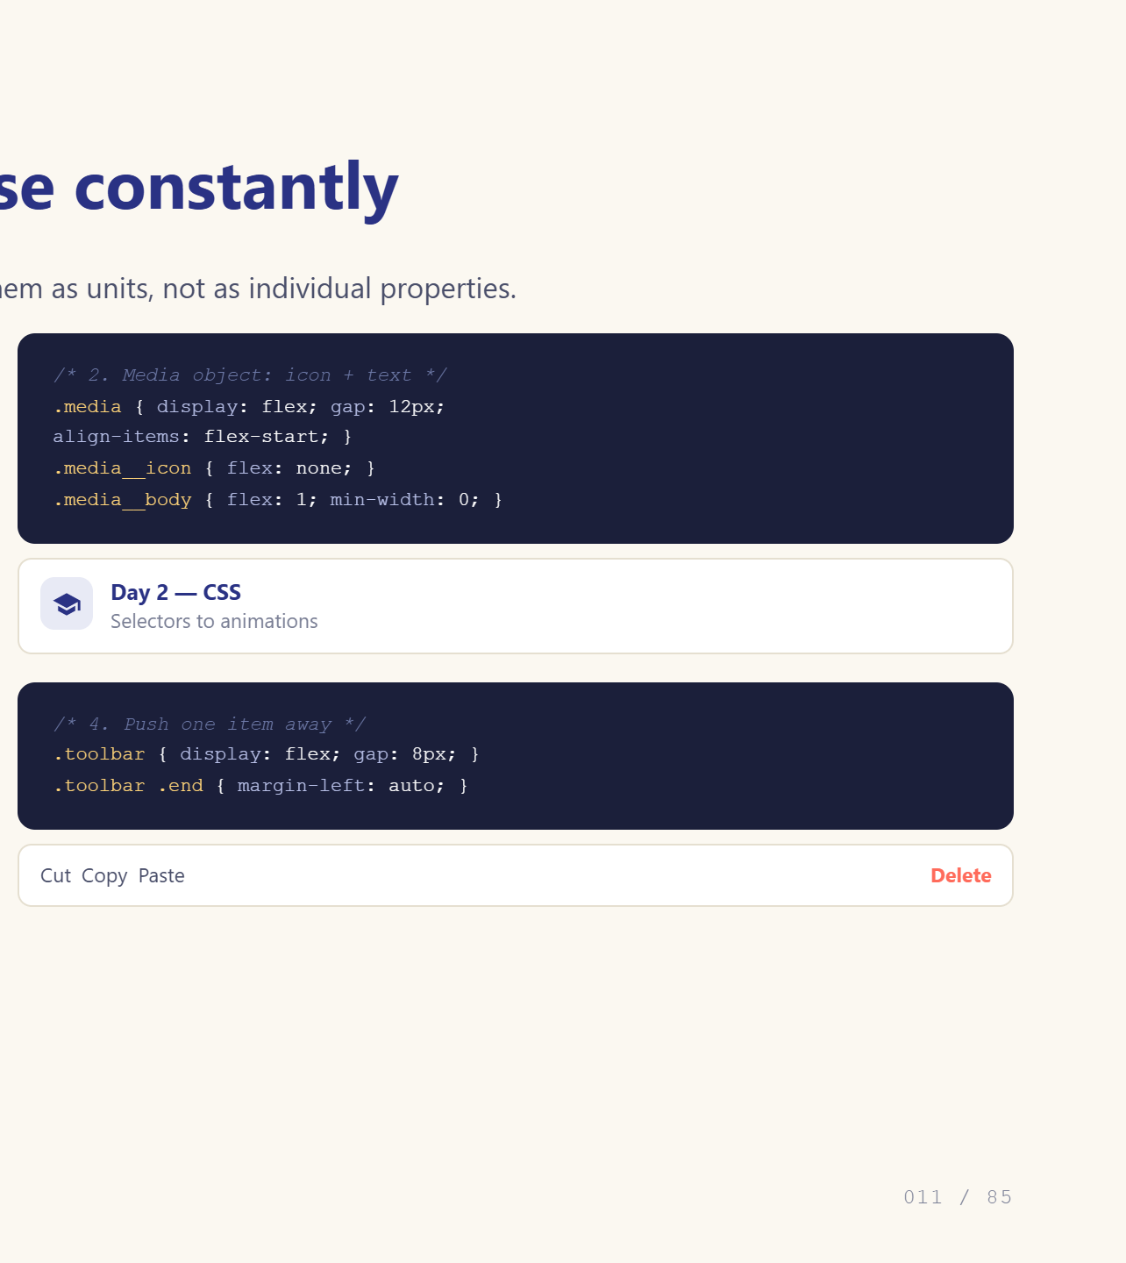
Notes:
These four cover most real UI.

Slide 12
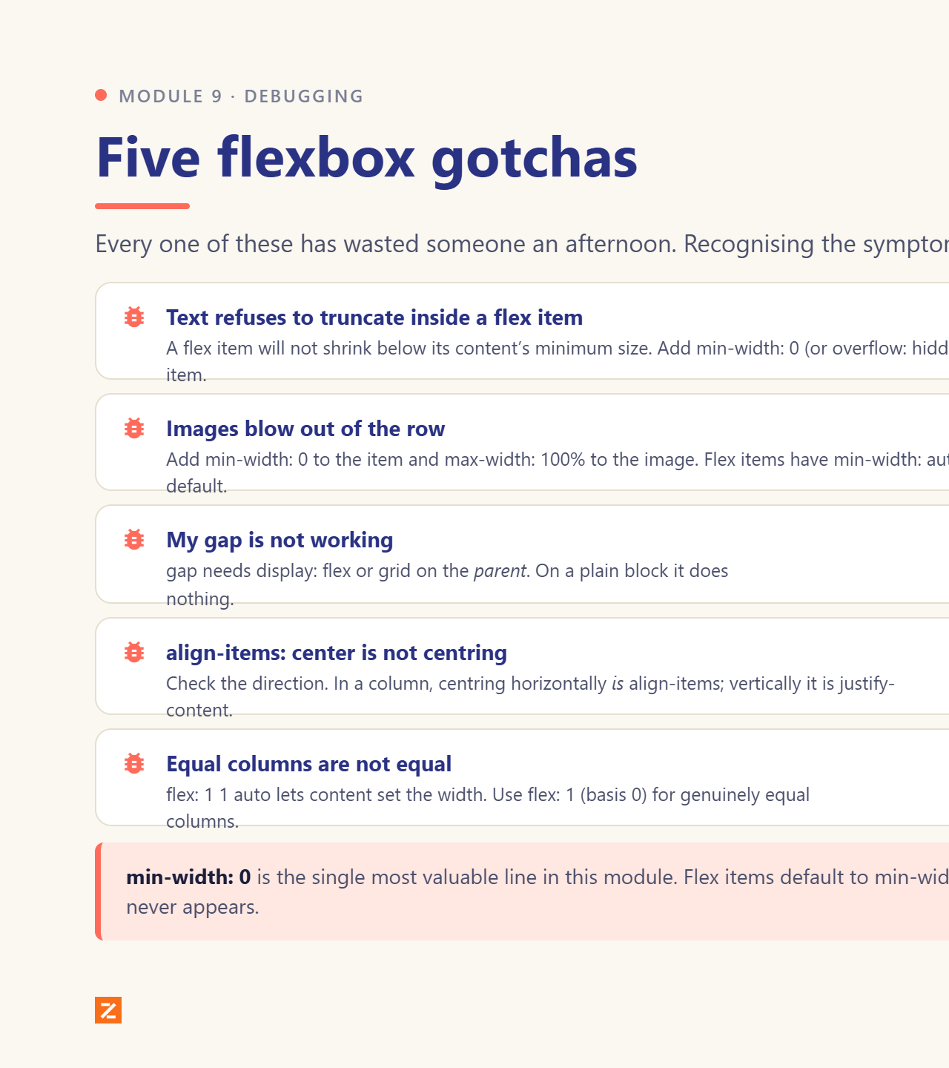
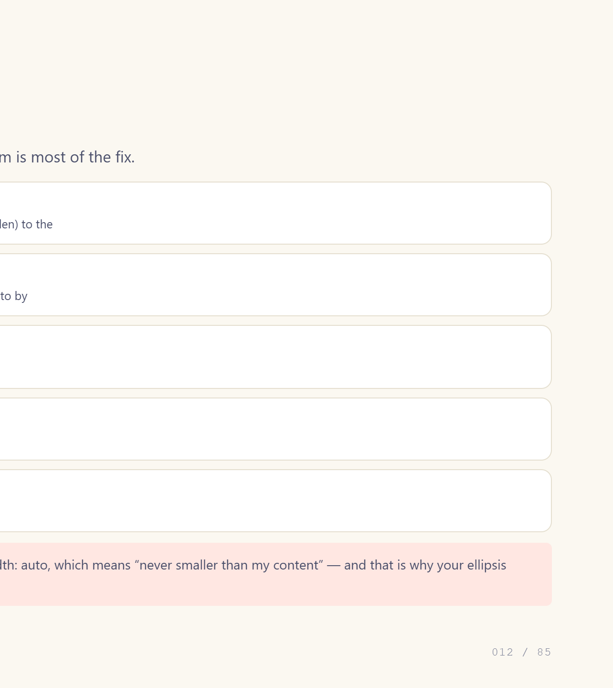
Notes:
min-width: 0 is the fix nobody guesses.

Slide 13
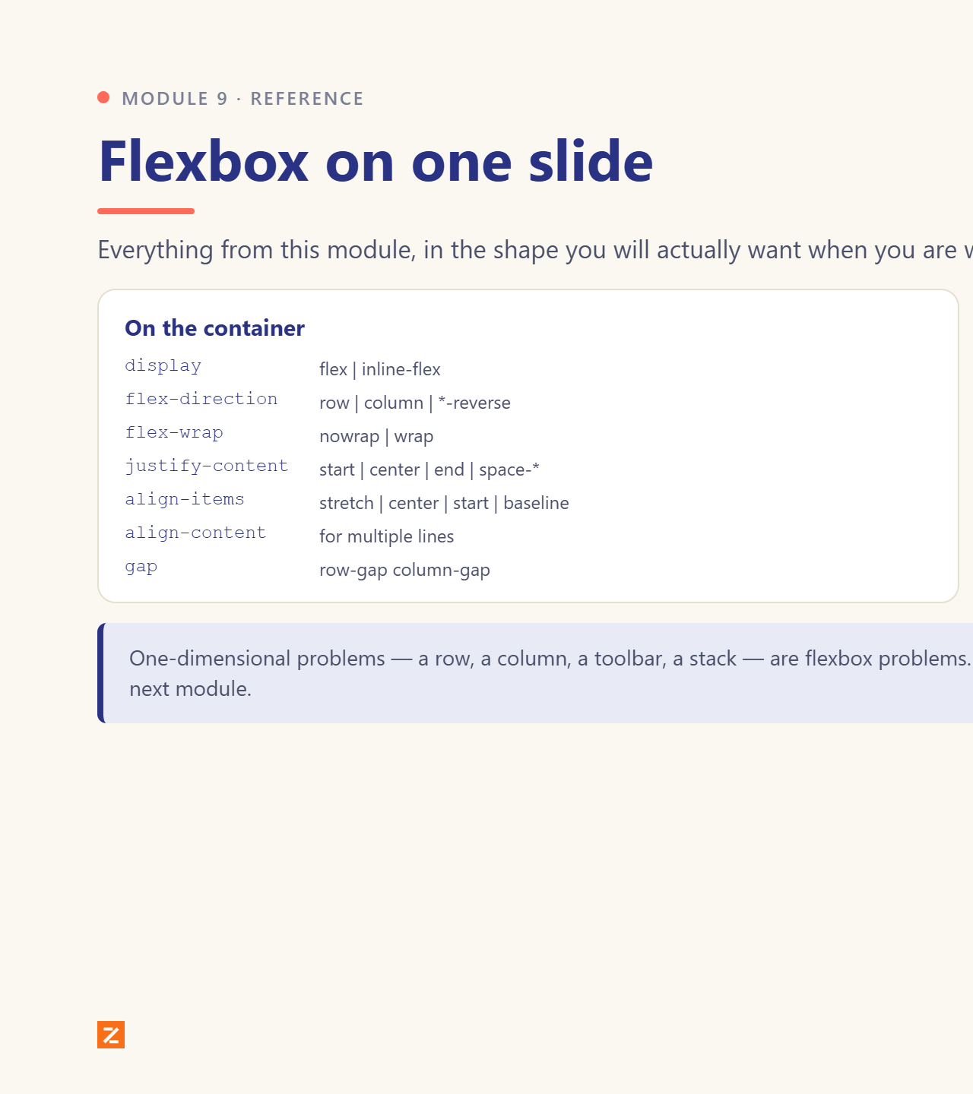
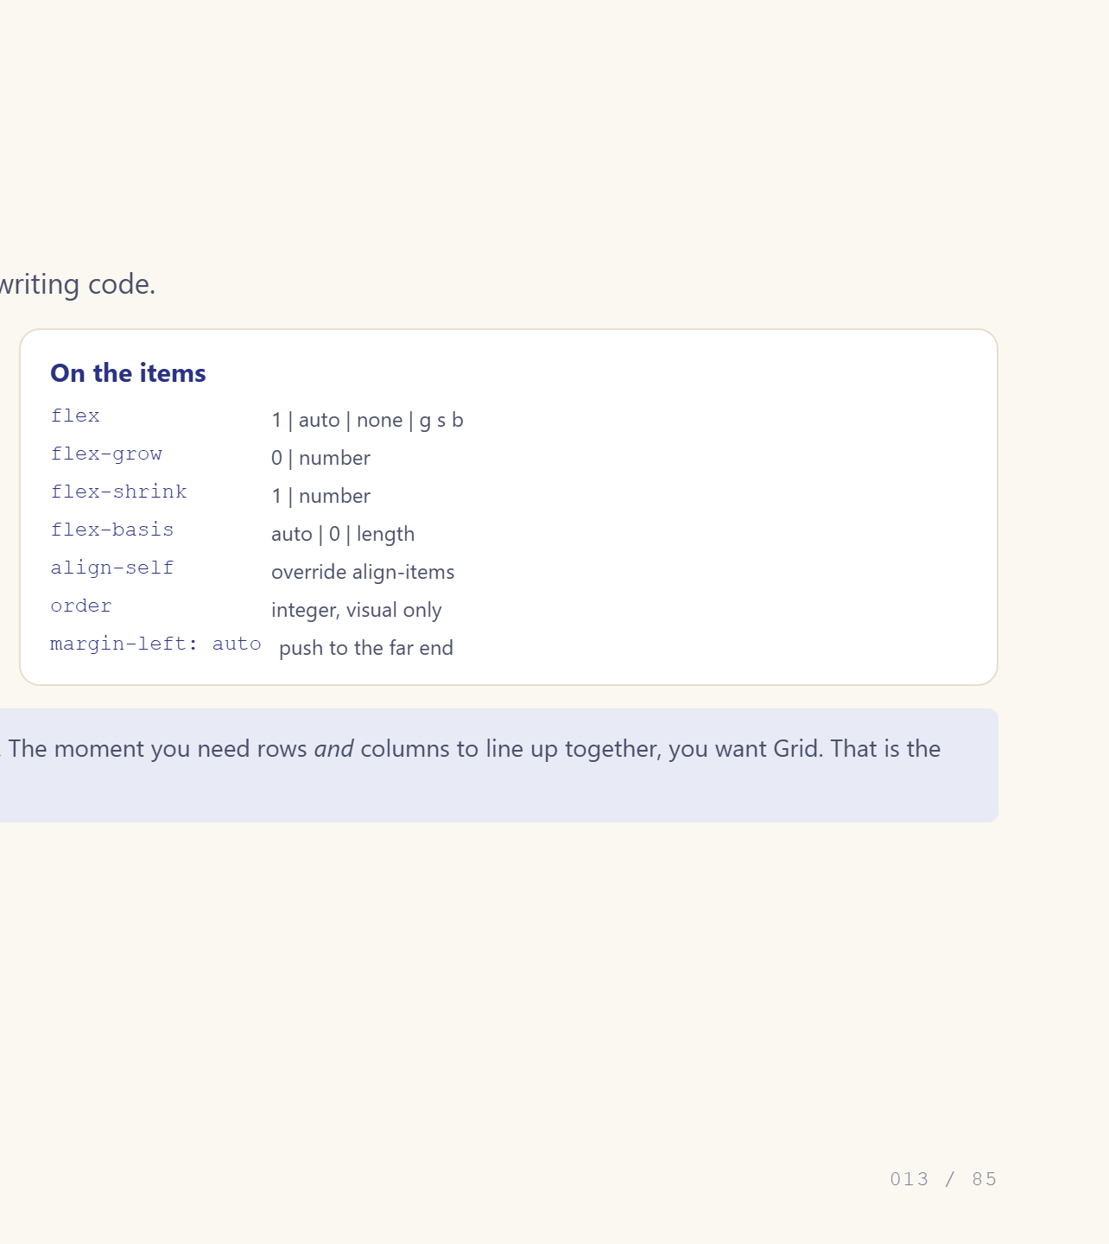
Notes:
Photograph this slide.

Slide 14
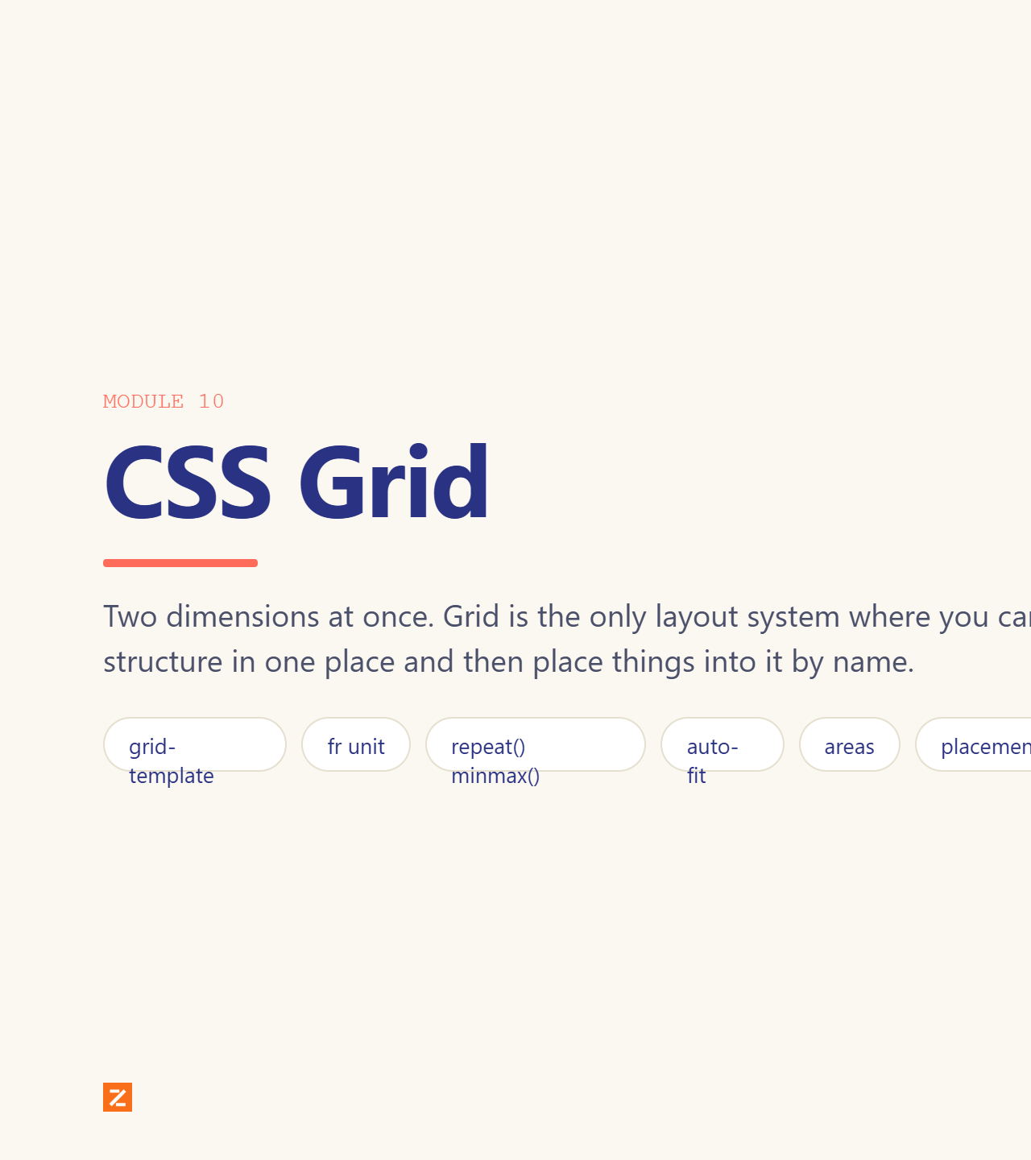
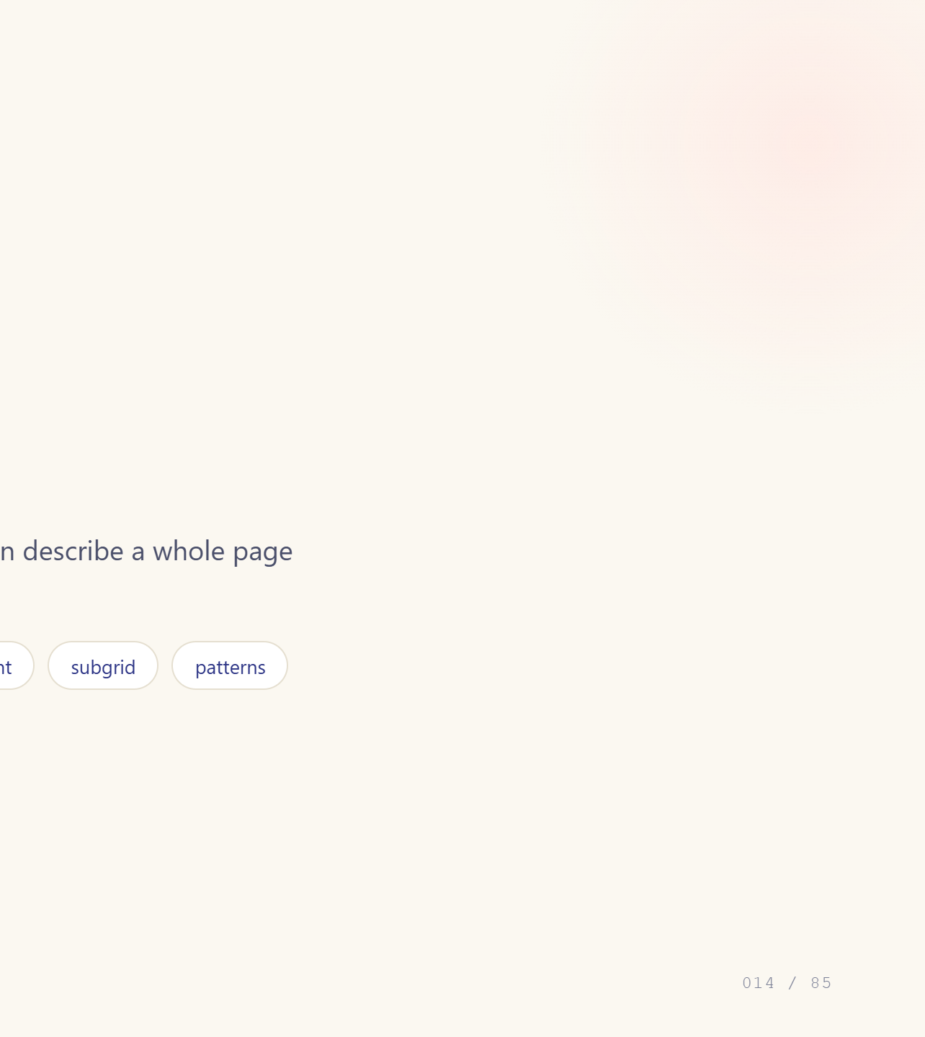
Notes:
Module divider.

Slide 15
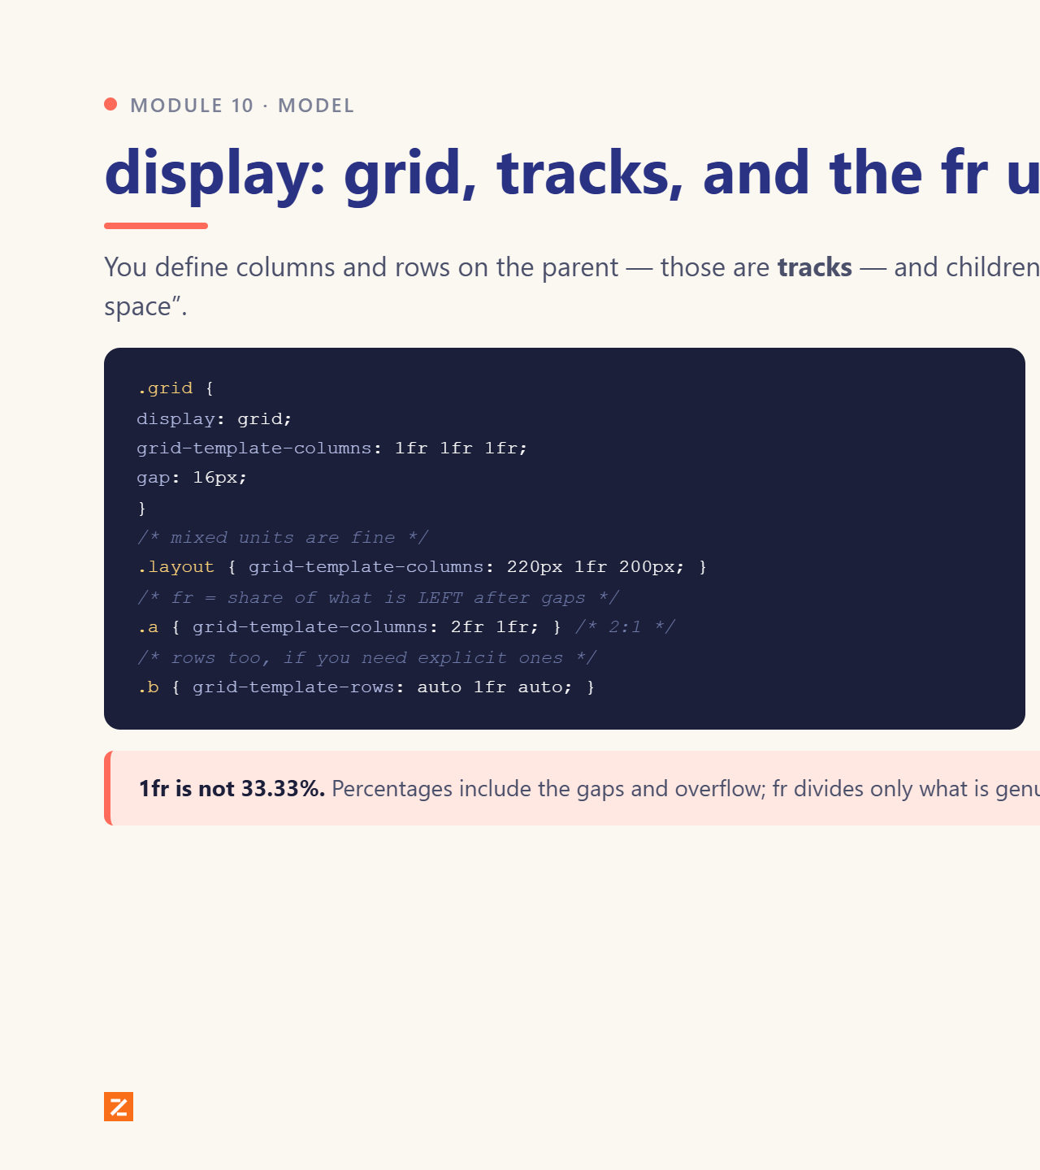
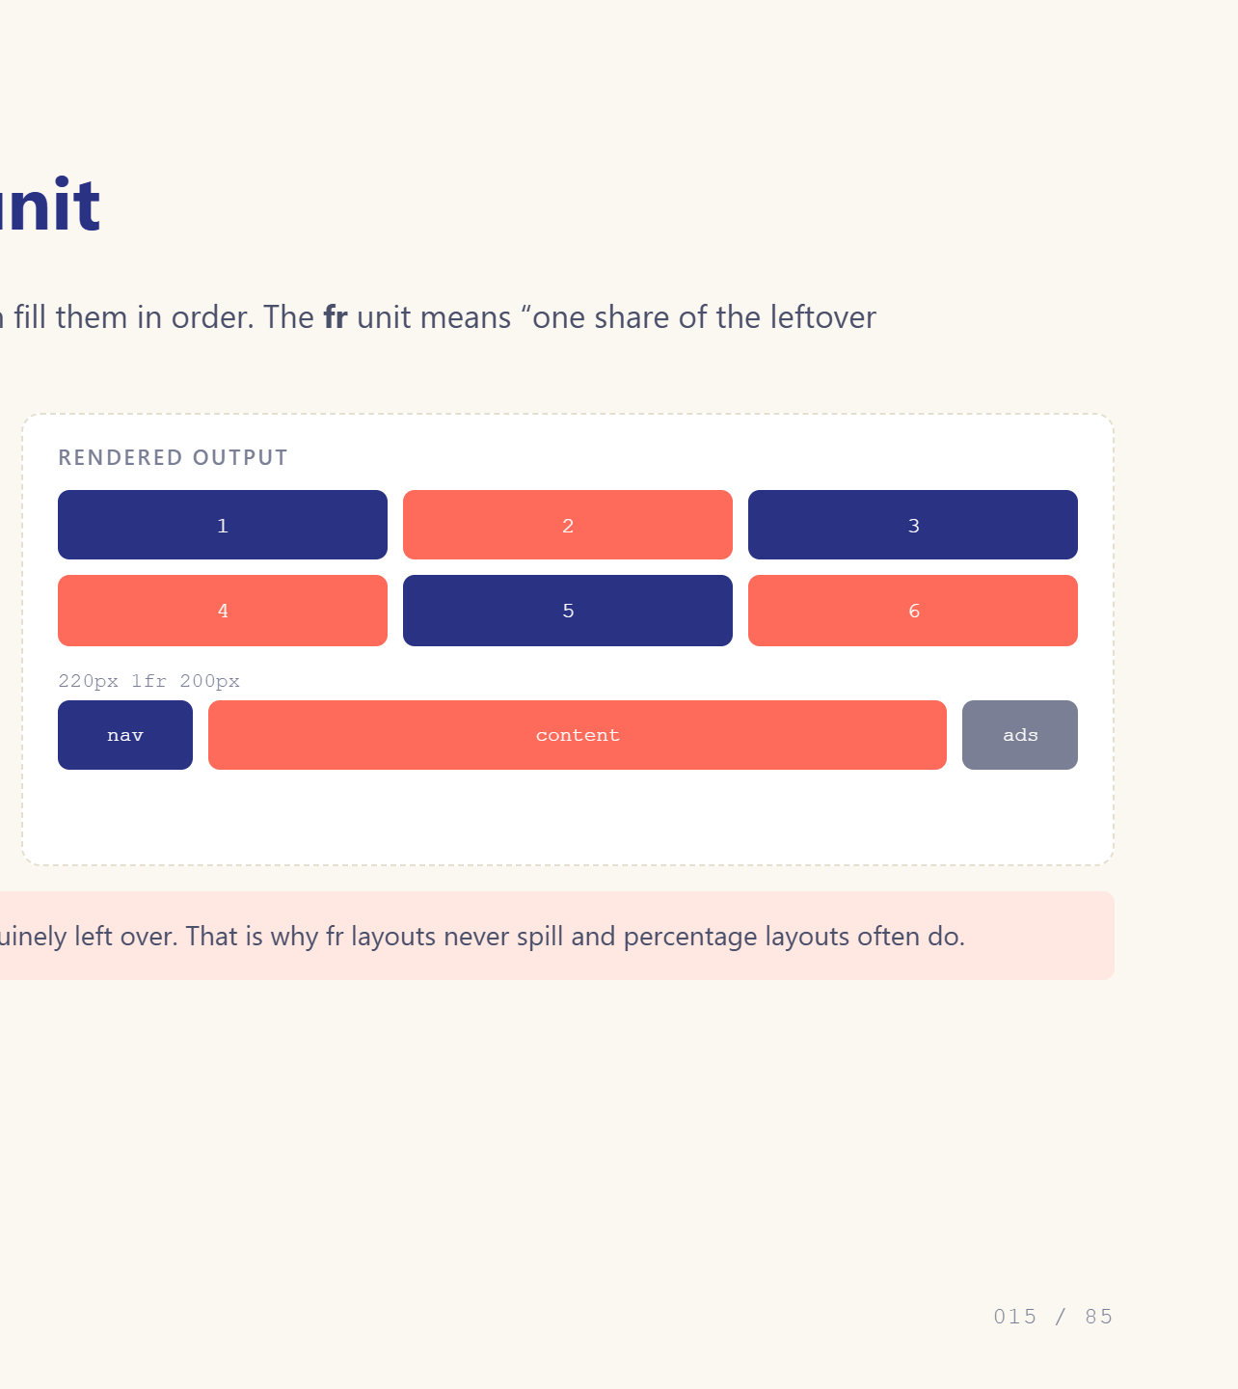
Notes:
fr is the unit that makes grid click.

Slide 16
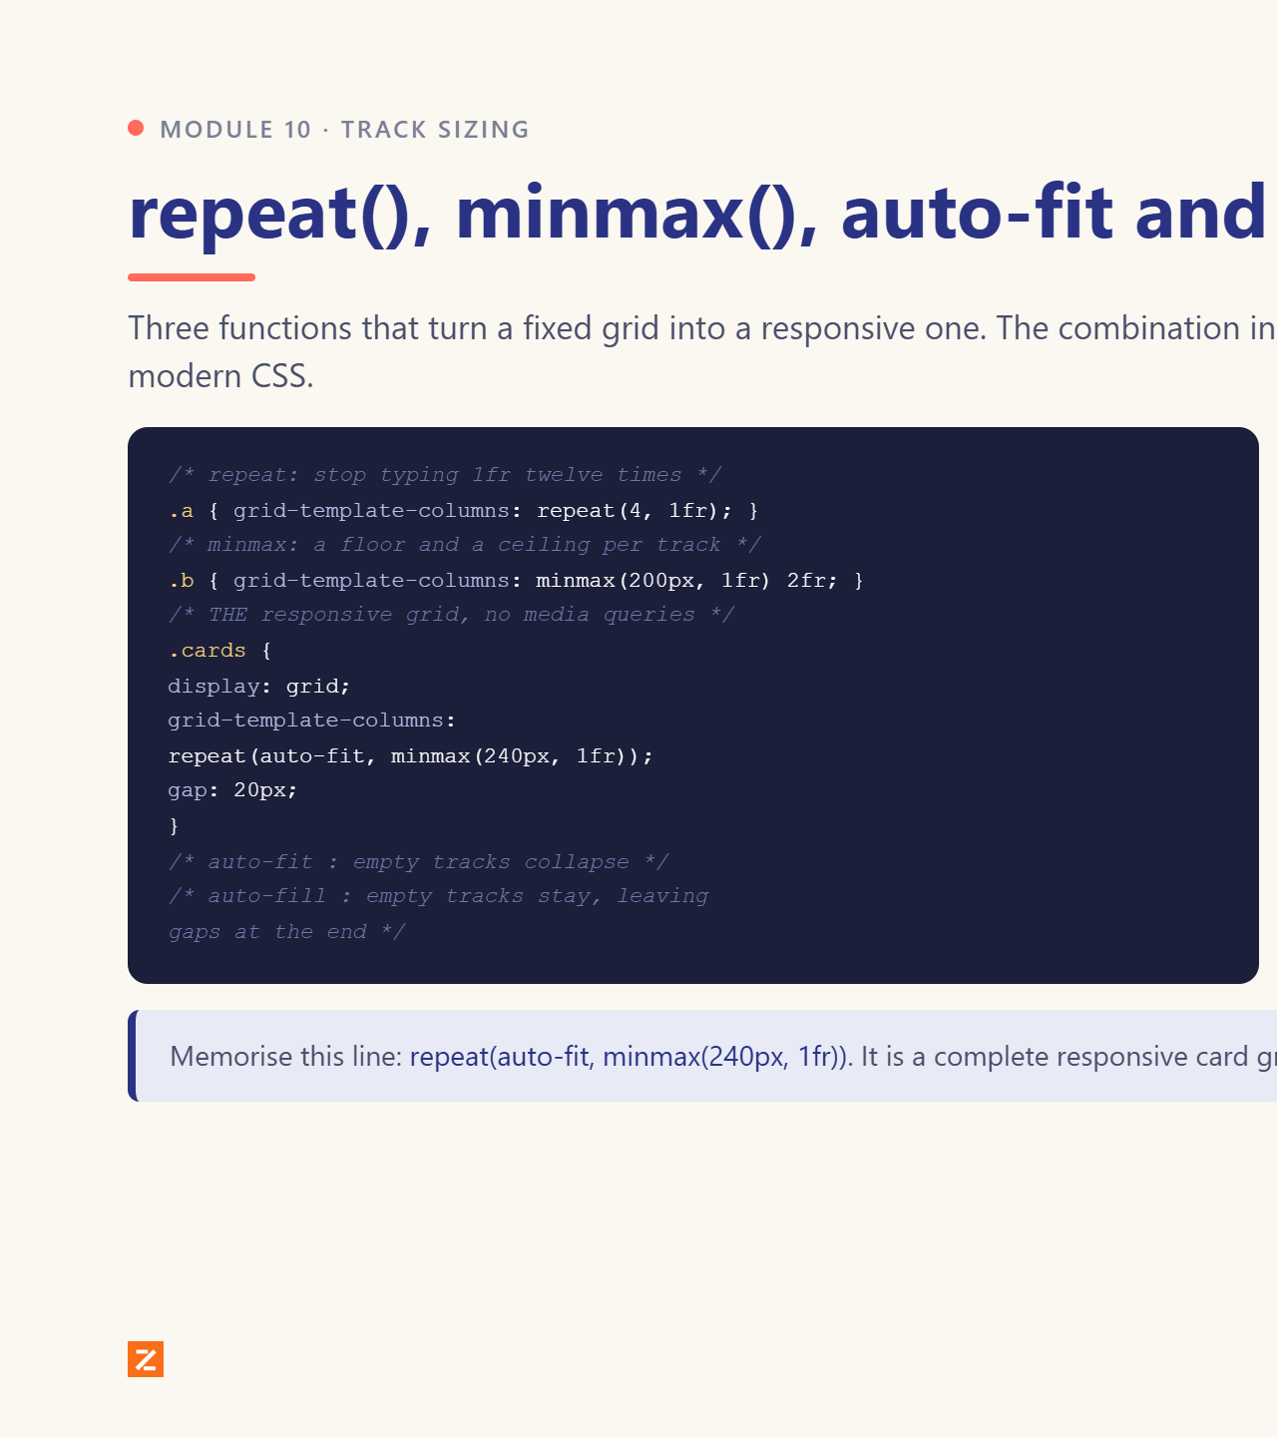
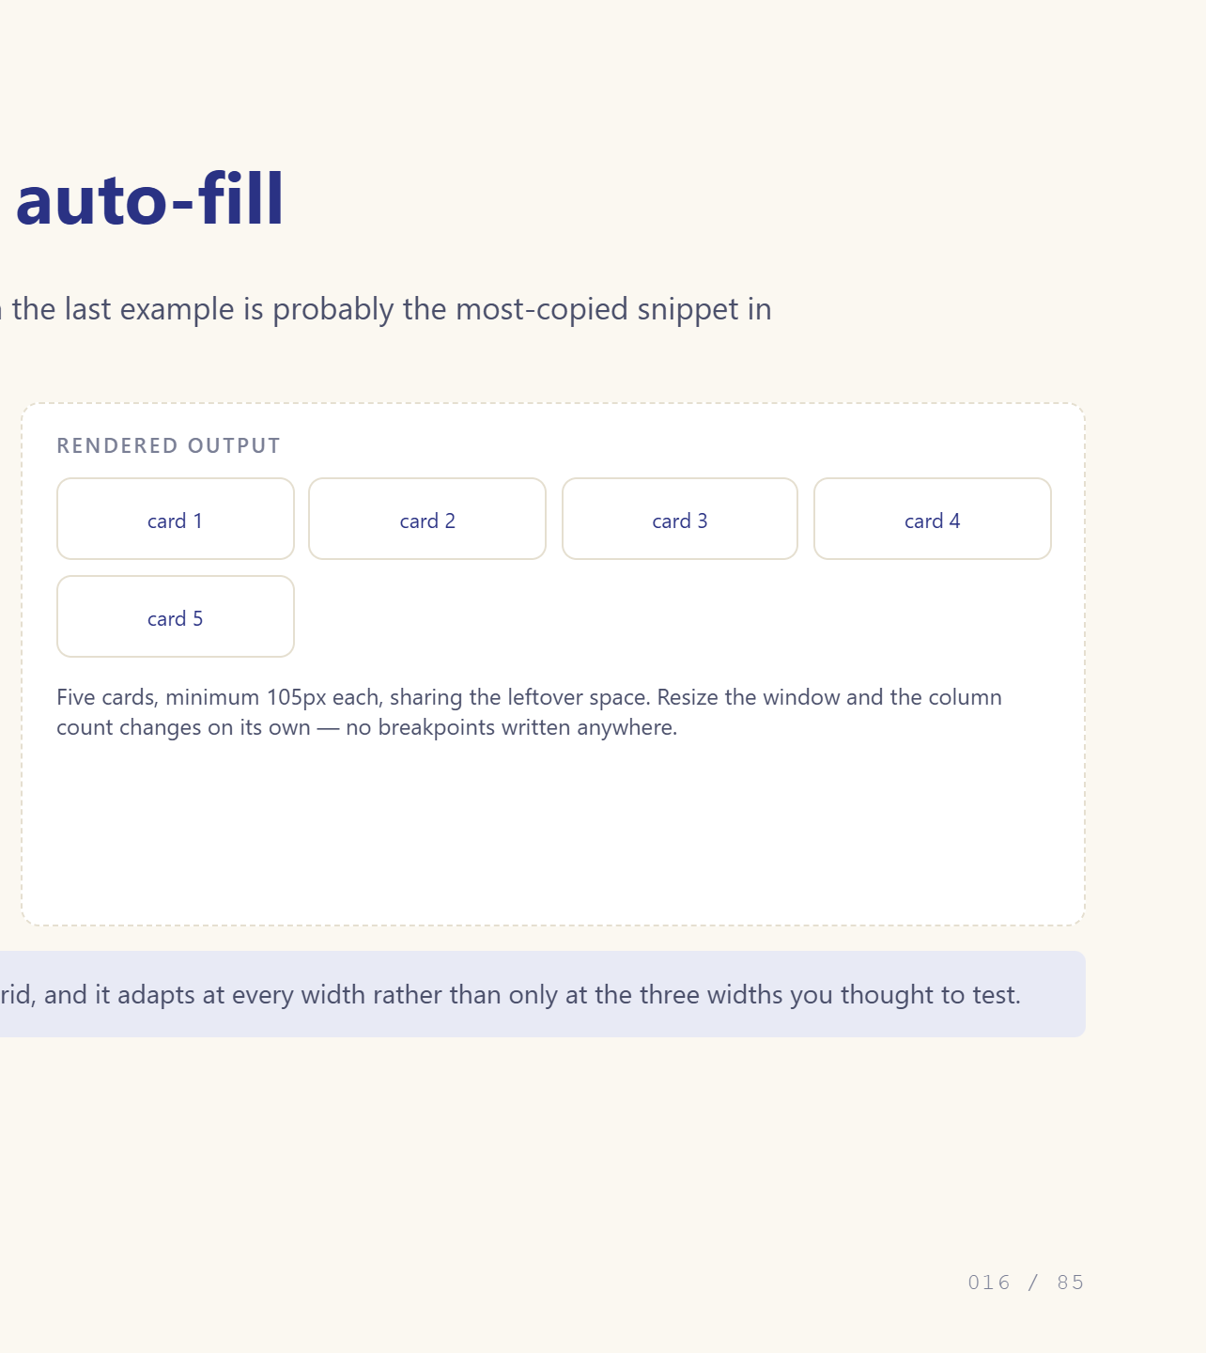
Notes:
auto-fit + minmax is the famous one-liner.

Slide 17
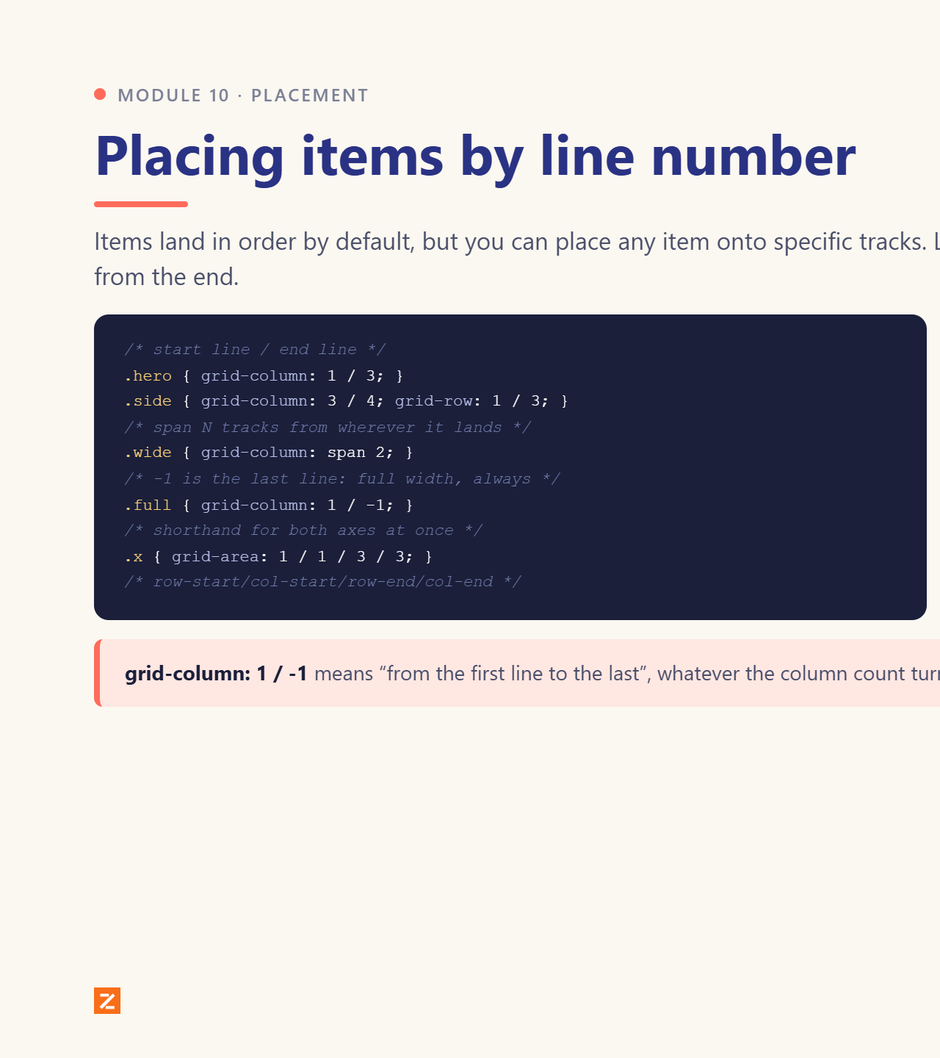
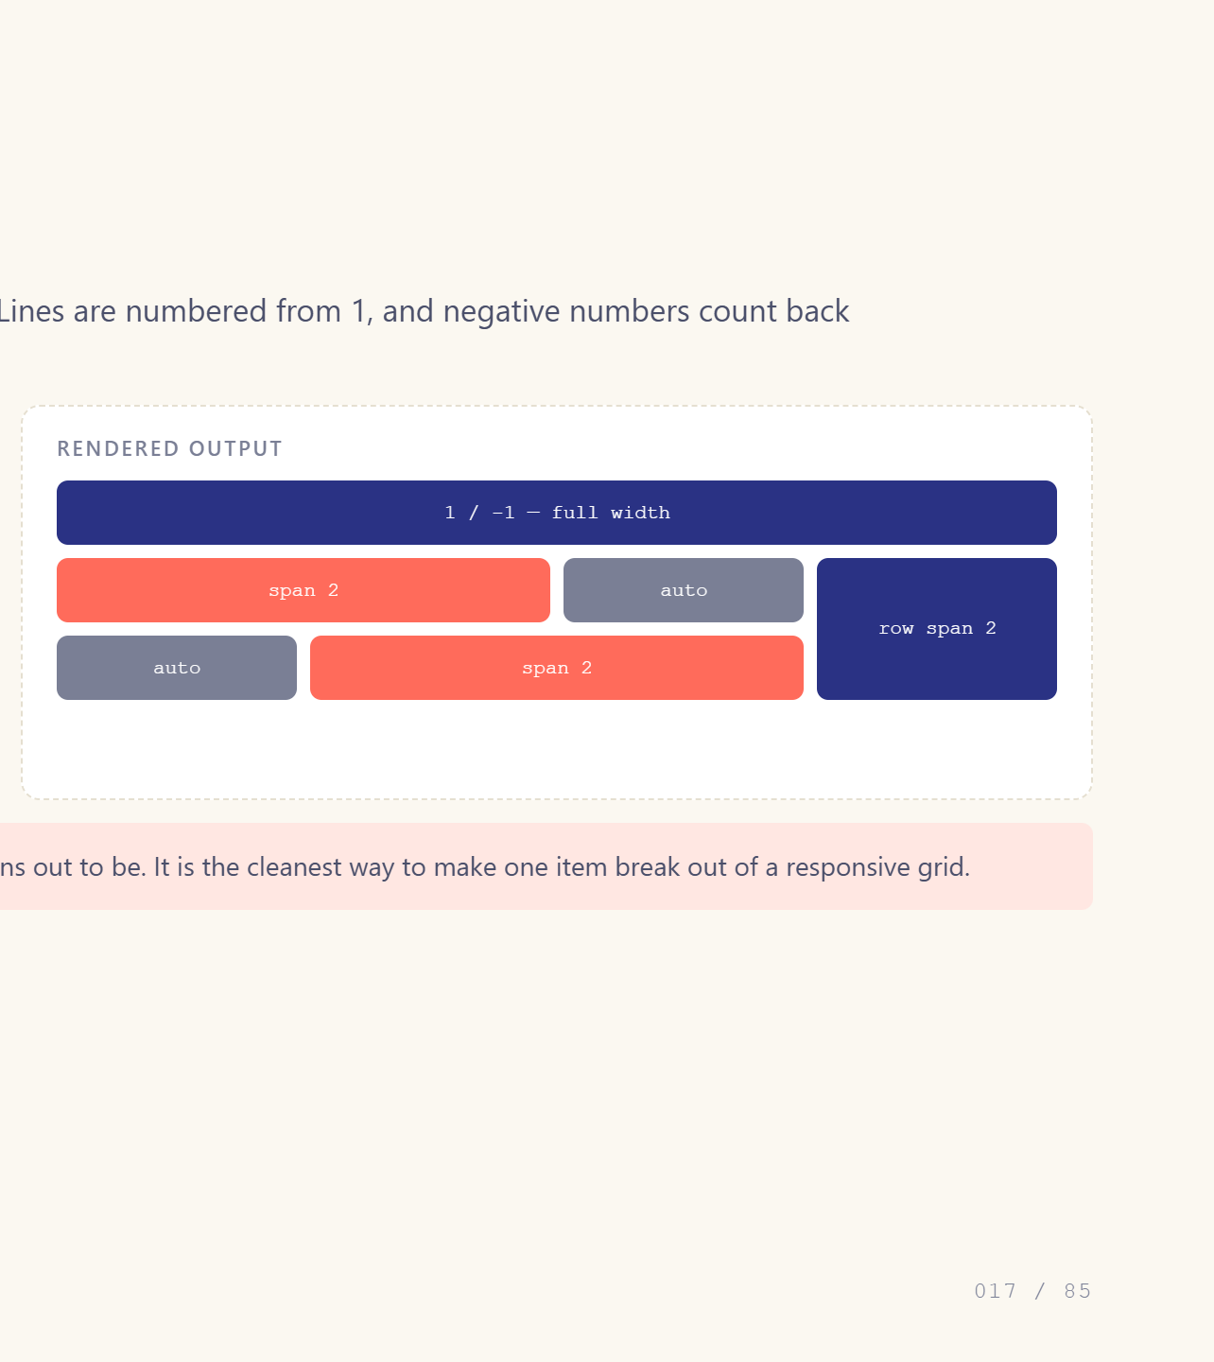
Notes:
Grid lines are numbered from 1, including the last edge.

Slide 18
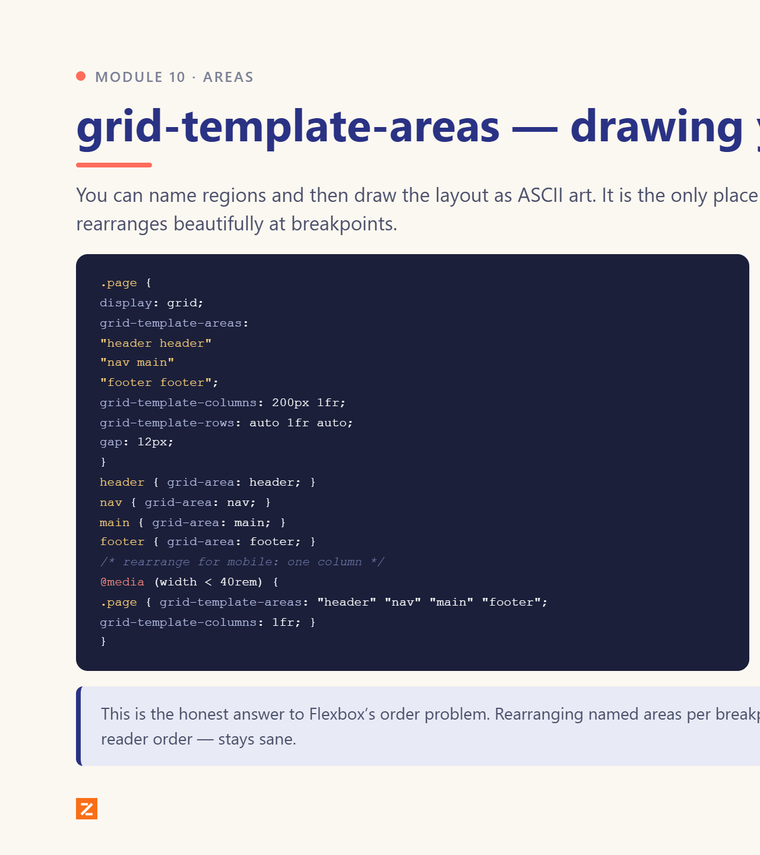
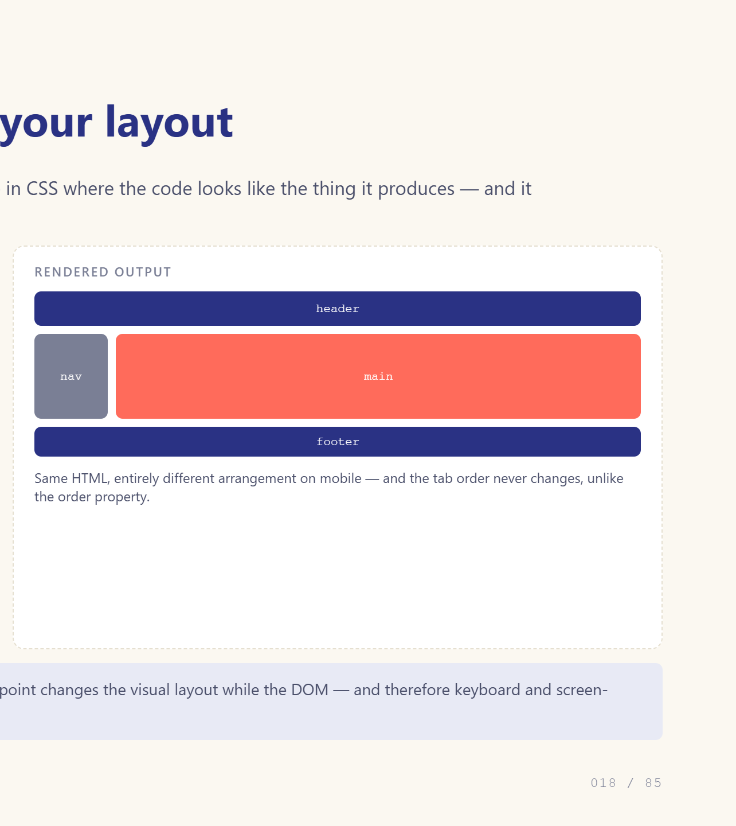
Notes:
This is the slide that sells Grid.

Slide 19
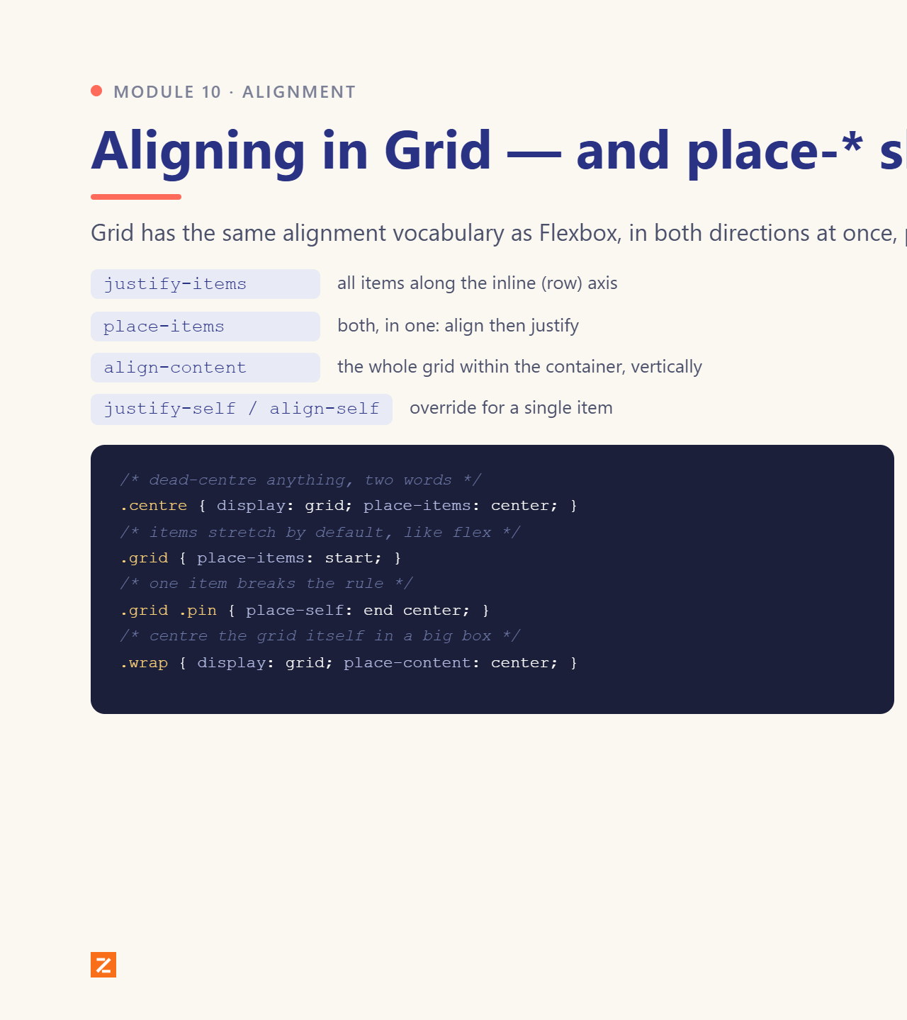
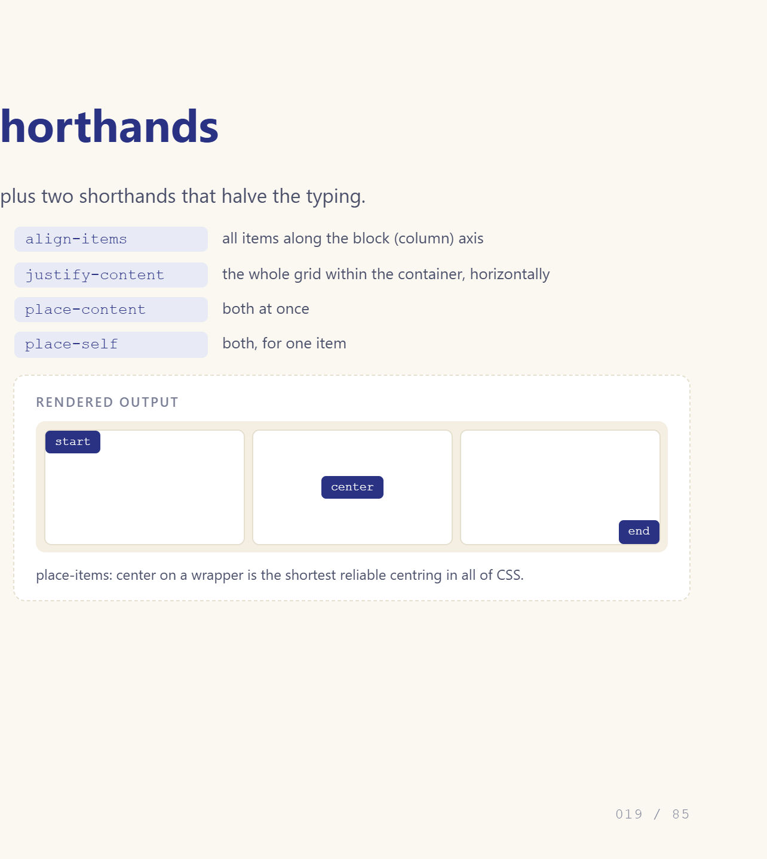
Notes:
Six properties, two shorthands.

Slide 20
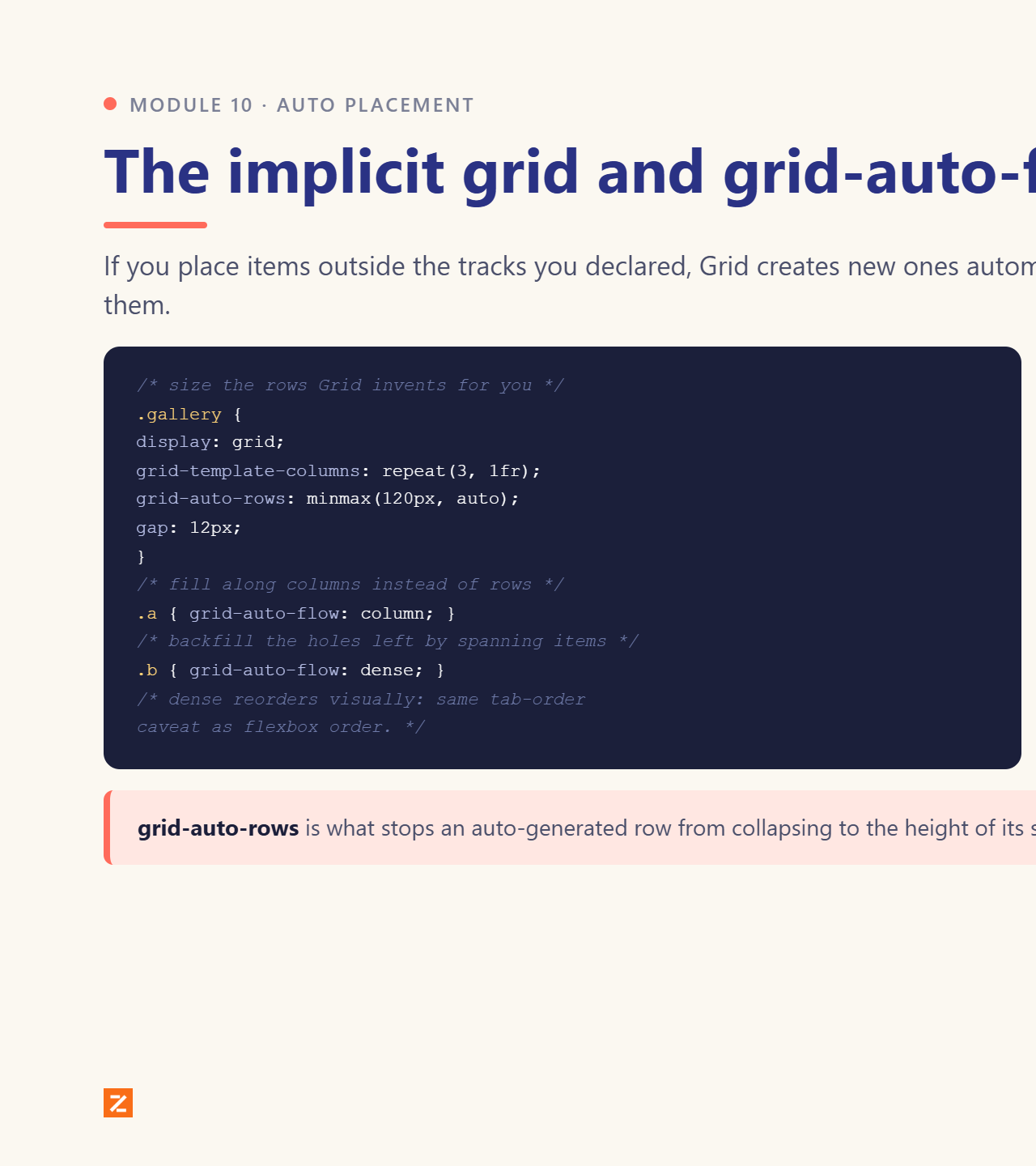
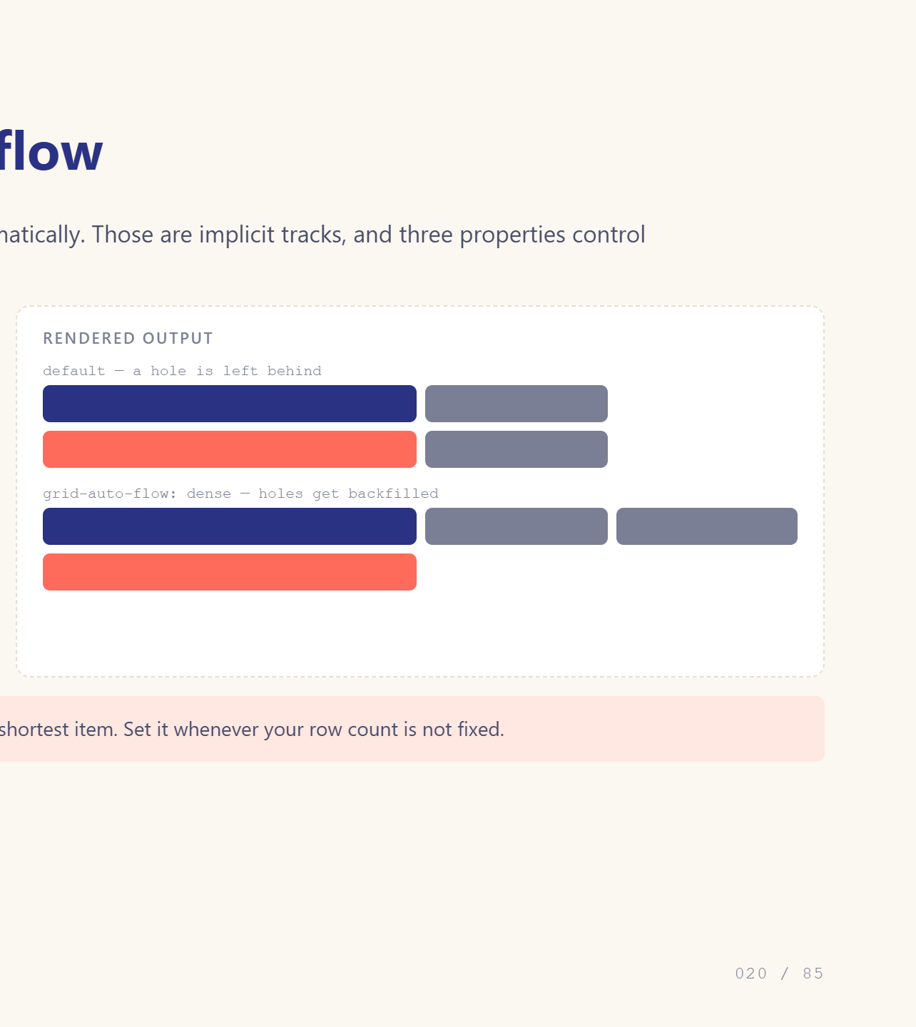
Notes:
auto-flow dense fills the holes.

Slide 21
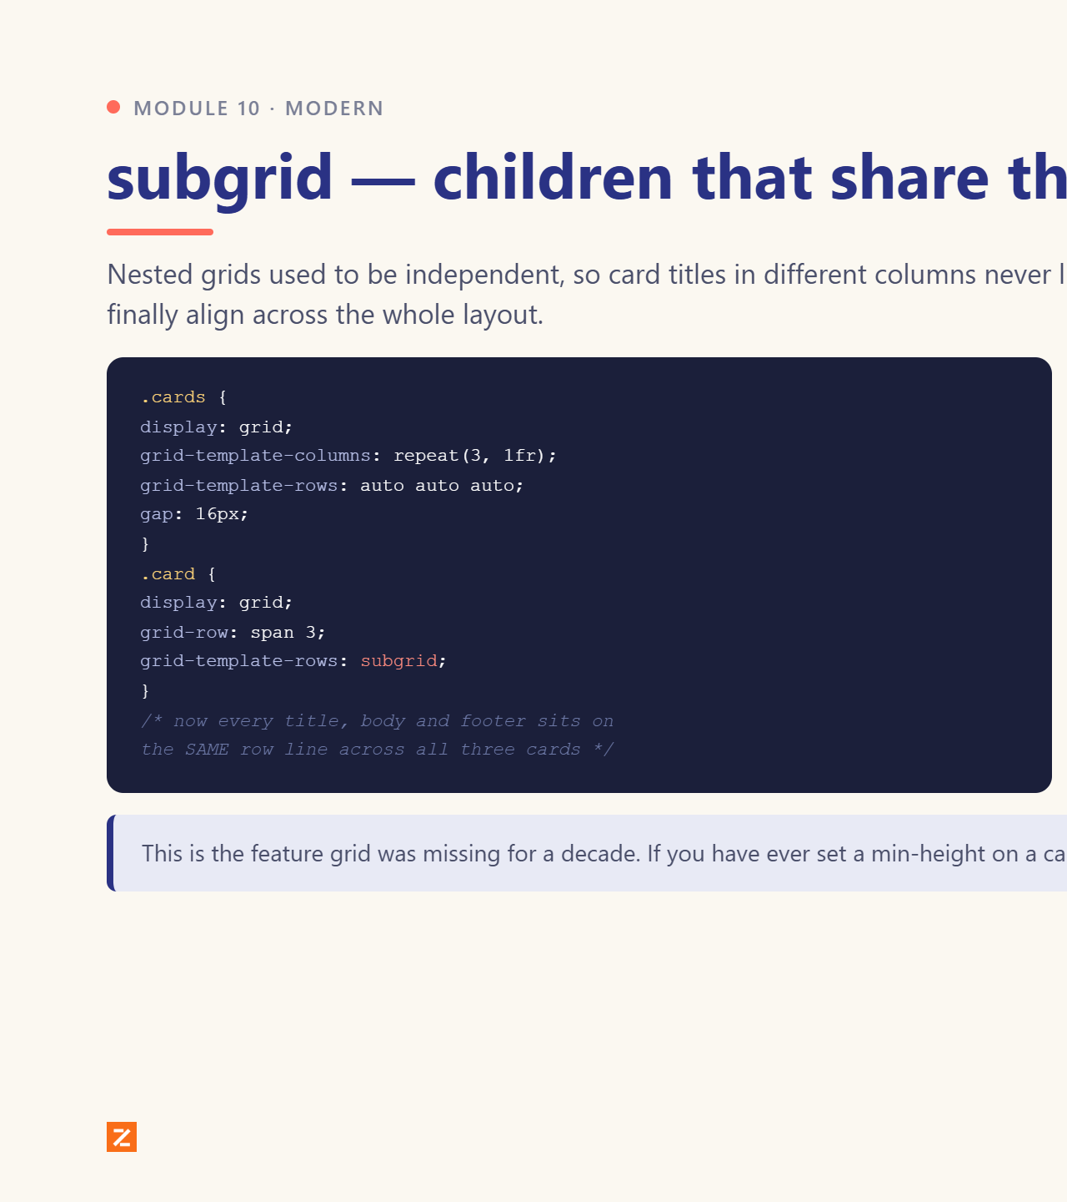
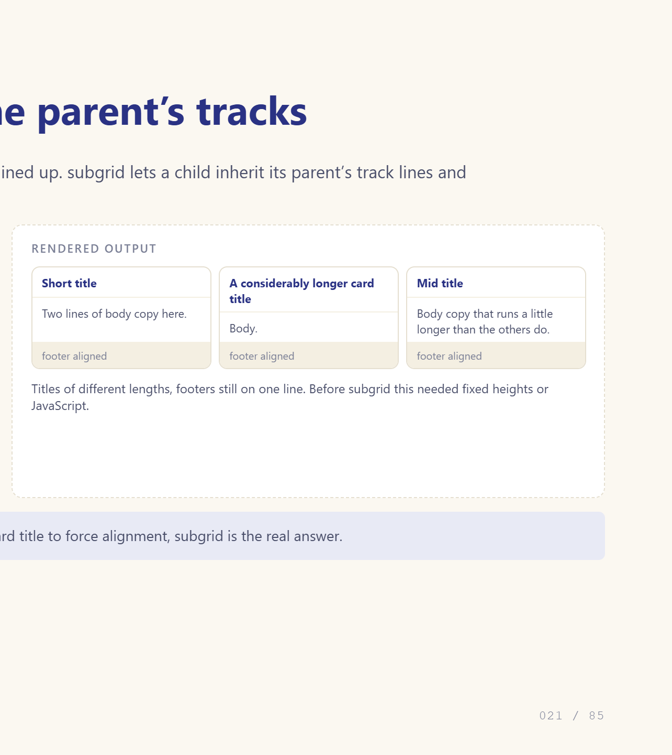
Notes:
The newest big grid feature.

Slide 22
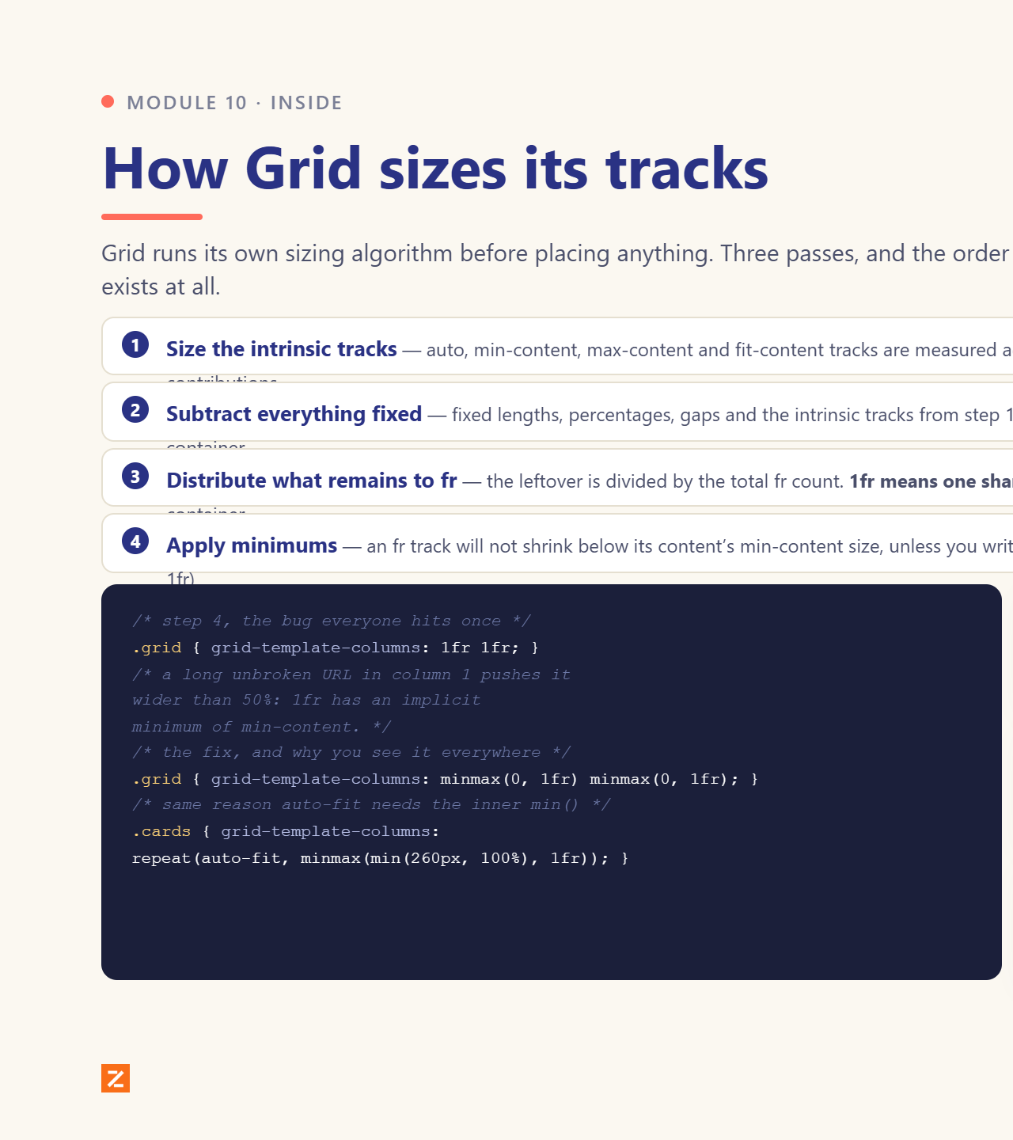
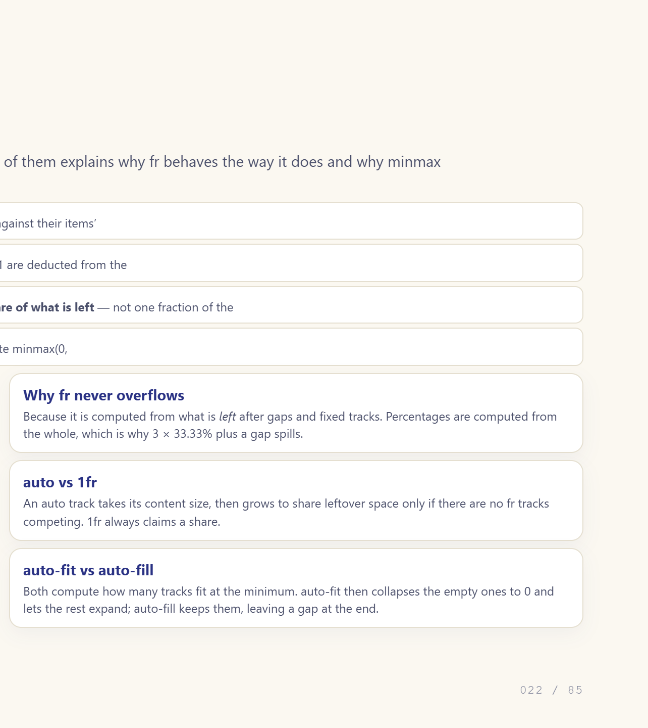
Notes:
fr is a leftover distribution, not a fraction of the whole.

Slide 23
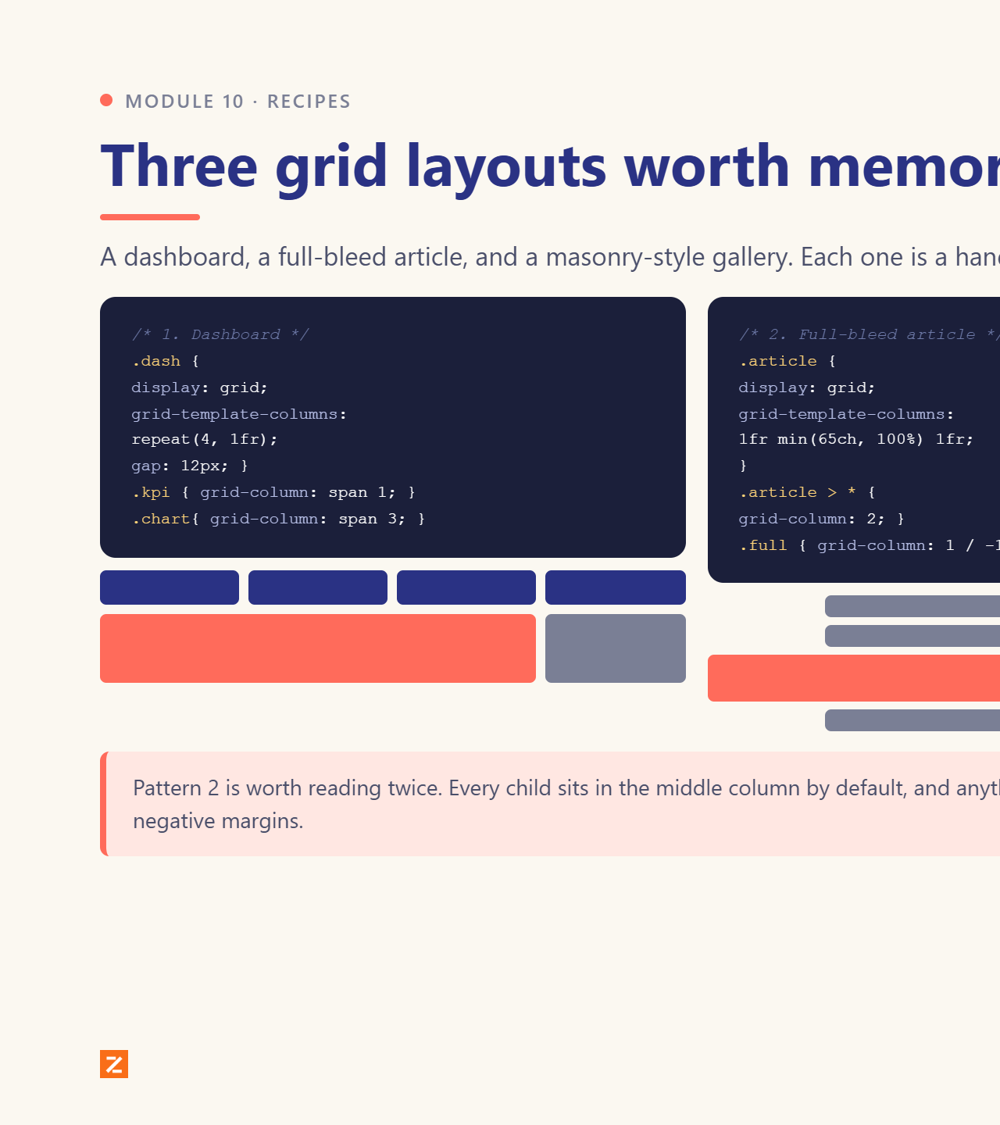
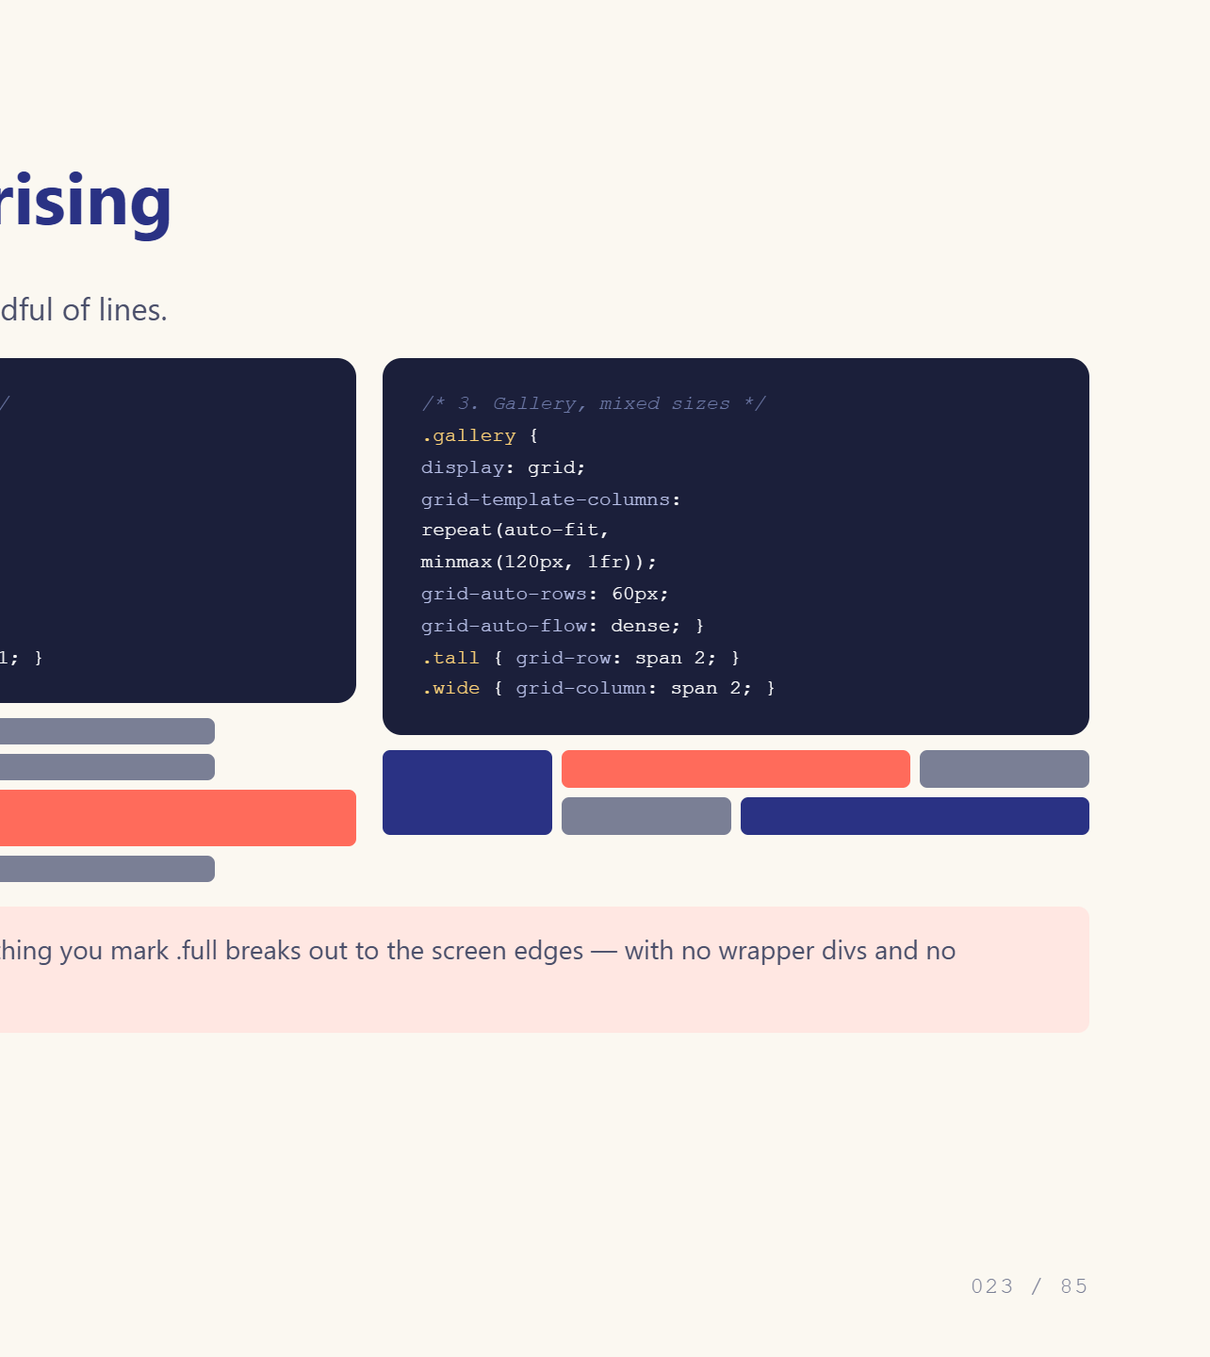
Notes:
Three layouts, three snippets.

Slide 24
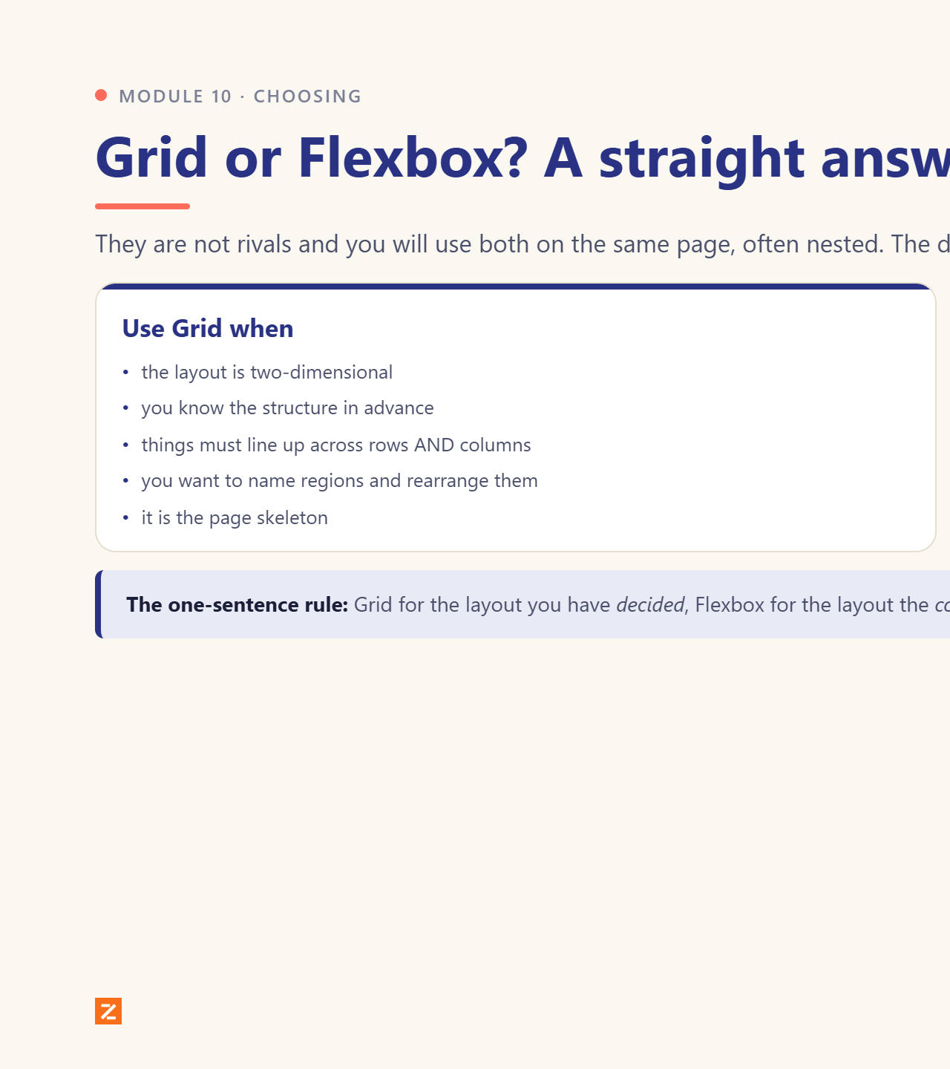
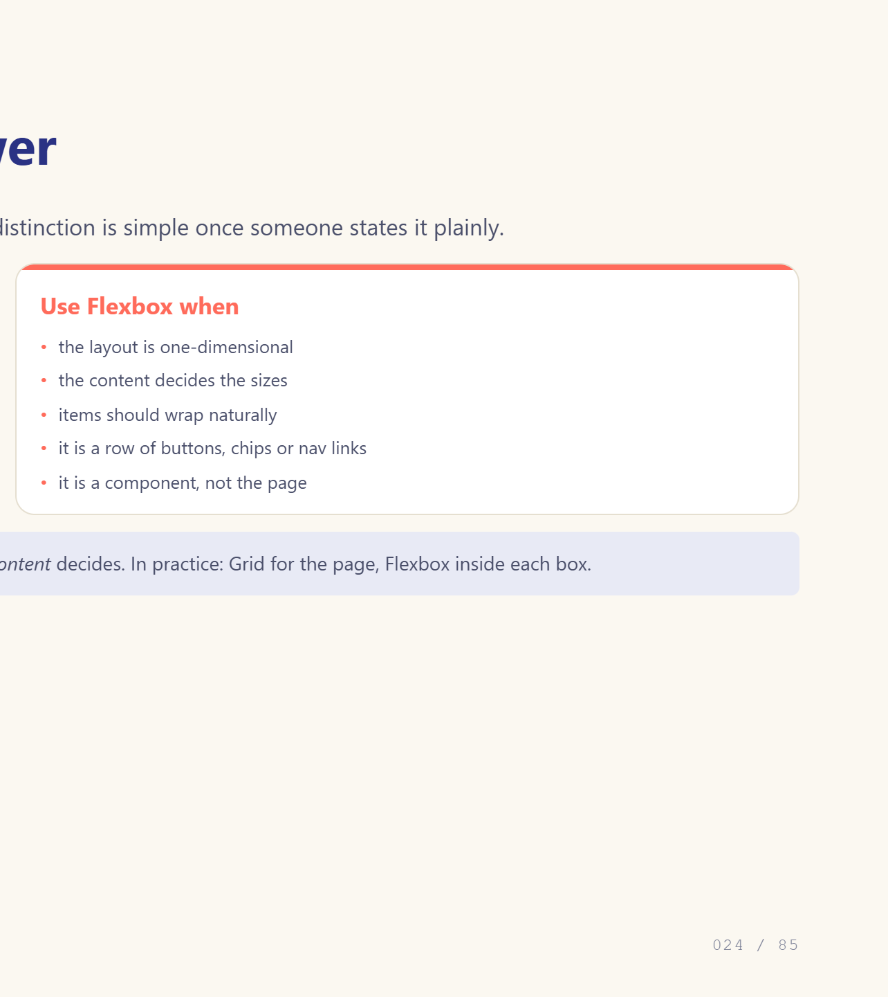
Notes:
Give them the one-sentence rule.

Slide 25
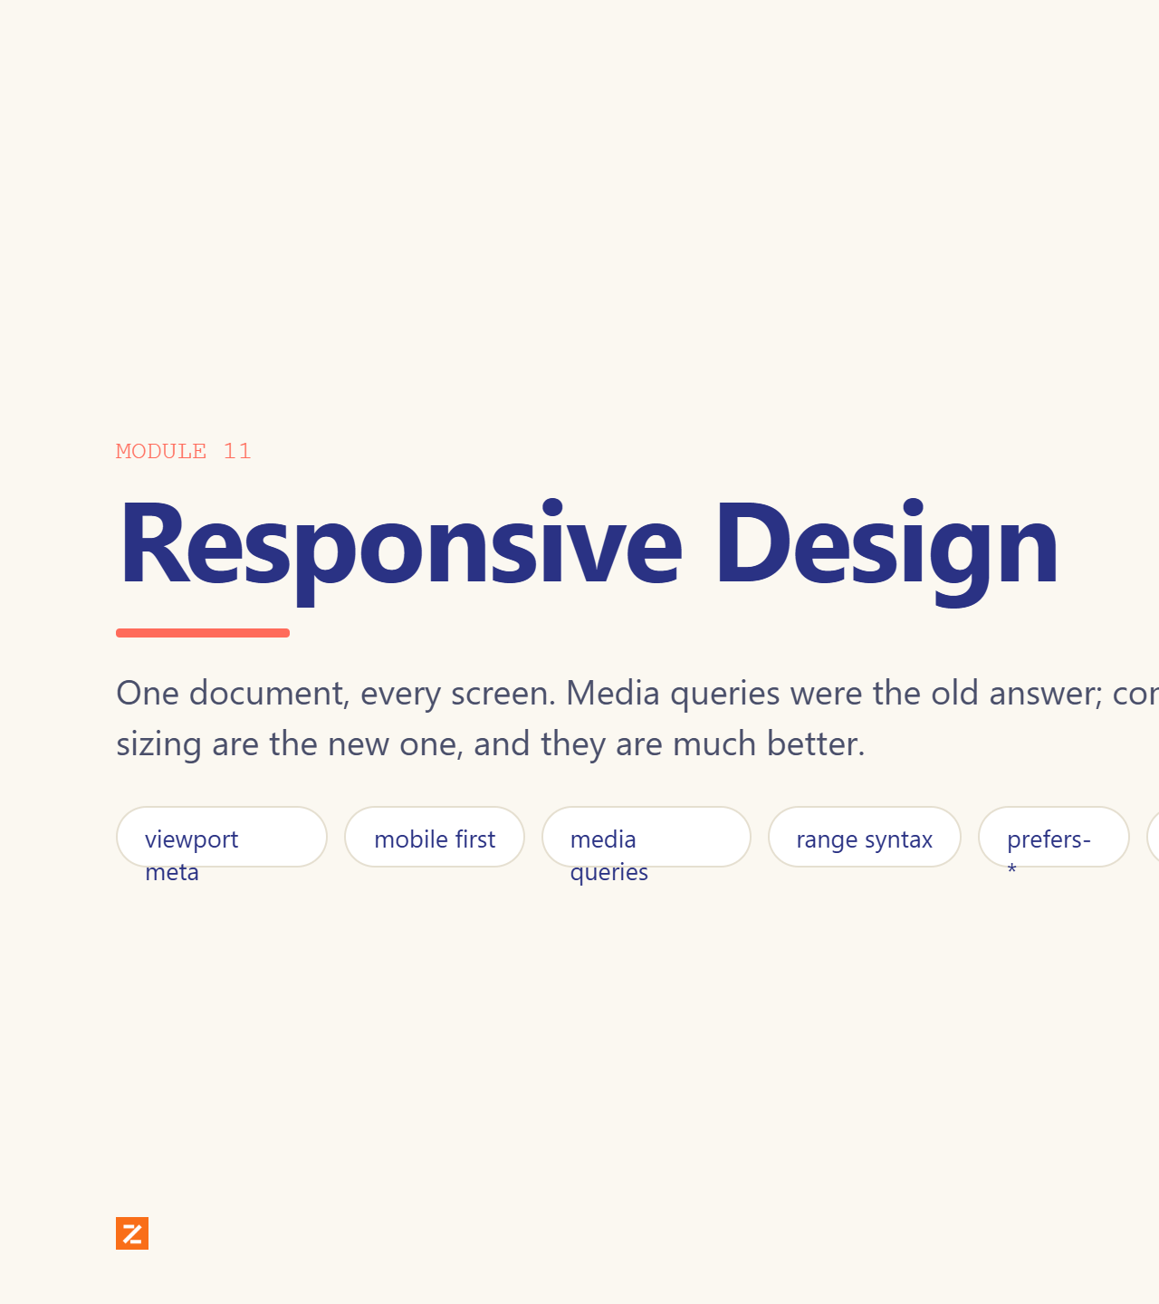
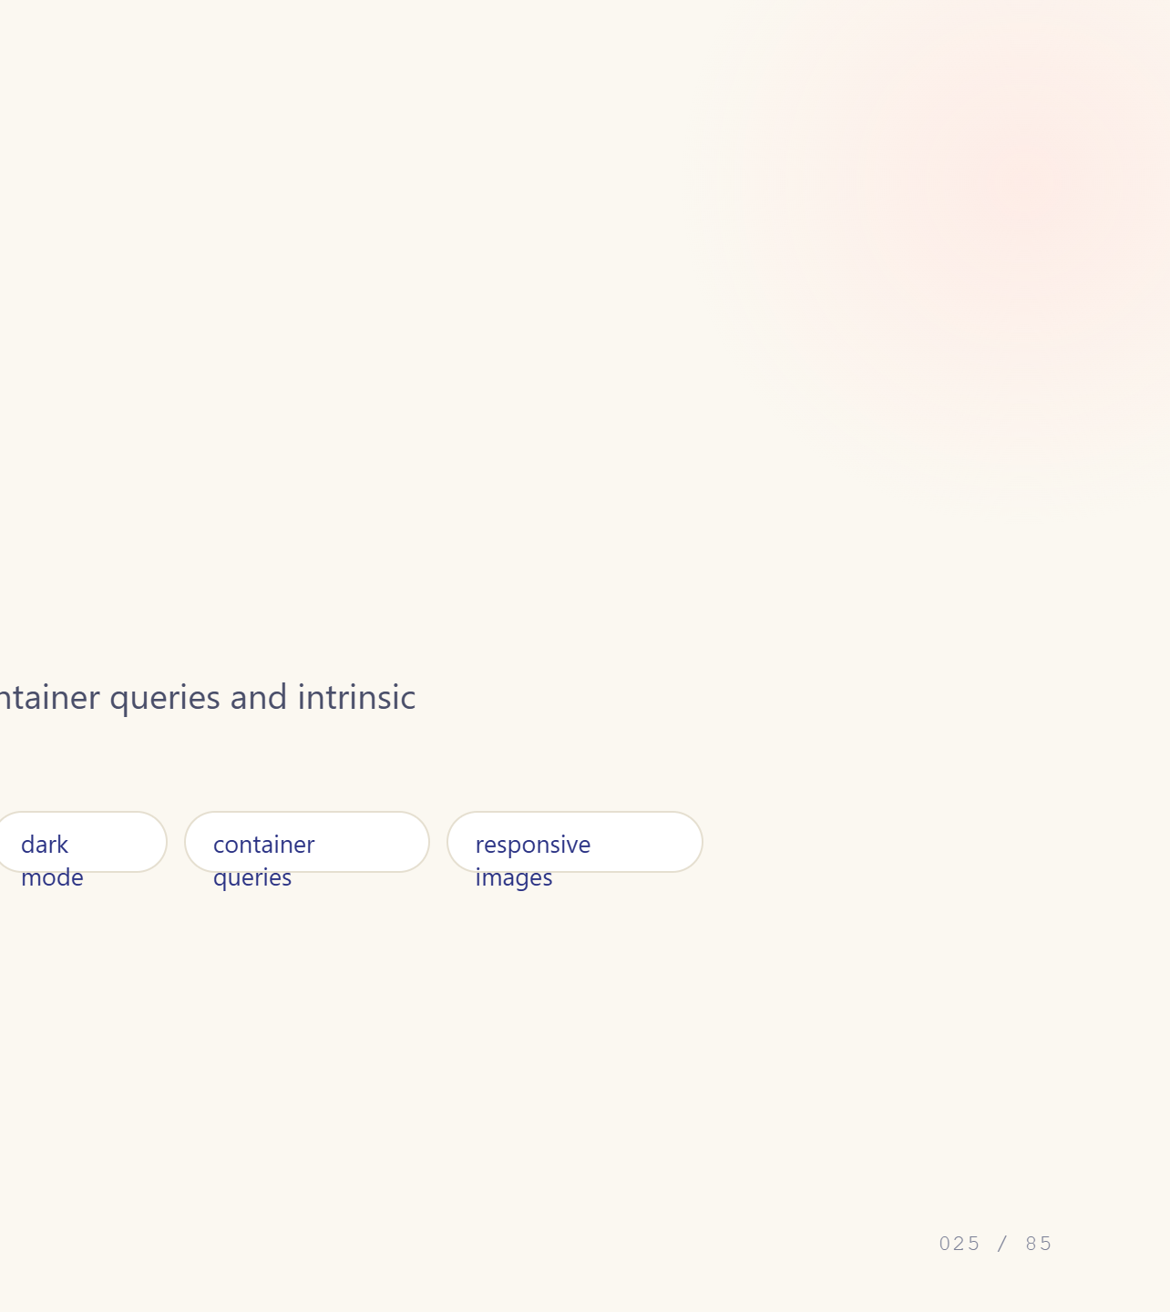
Notes:
Module divider.

Slide 26


Notes:
Without this, mobile lies about its width.

Slide 27


Notes:
Min-width queries, not max-width.

Slide 28


Notes:
Range syntax is much easier to read.

Slide 29


Notes:
Respecting these is free accessibility.

Slide 30


Notes:
The genuinely new idea in responsive CSS.

Slide 31


Notes:
Newer, and worth knowing exists.

Slide 32


Notes:
srcset saves real bandwidth.

Slide 33


Notes:
The goal: fewer breakpoints, not more.

Slide 34


Notes:
The details that separate a site from an app.

Slide 35


Notes:
Test list they can actually run.

Slide 36


Notes:
Module divider.

Slide 37


Notes:
Four parts: property, duration, easing, delay.

Slide 38


Notes:
Easing is what makes motion feel designed.

Slide 39


Notes:
Transforms are cheap. Layout properties are not.

Slide 40


Notes:
perspective is what makes 3D read as 3D.

Slide 41


Notes:
Transitions need a trigger; animations do not.

Slide 42


Notes:
fill-mode and direction are the two to remember.

Slide 43


Notes:
Staggering is what makes motion feel designed.

Slide 44


Notes:
Timeline tied to scroll position, no JS.

Slide 45


Notes:
Animating between two states of the DOM.

Slide 46
Notes:
Two properties are cheap. Everything else is not.

Slide 47
Notes:
This is why transform and opacity are special.

Slide 48
Notes:
Close the module with judgement, not syntax.

Slide 49
Notes:
Module divider.

Slide 50
Notes:
Variables that live in the cascade — that is the key difference.

Slide 51
Notes:
This is the pattern for every design system.

Slide 52
Notes:
Typed variables unlock animating gradients.

Slide 53
Notes:
Invalid at computed-value time is a real gotcha.

Slide 54
Notes:
Native nesting, no build step.

Slide 55
Notes:
Feature detection, in CSS.

Slide 56
Notes:
One set of properties for every writing direction.

Slide 57
Notes:
Carousels with no JavaScript.

Slide 58
Notes:
Tooltips and menus without a positioning library.

Slide 59
Notes:
appearance: none is the doorway.

Slide 60
Notes:
Round out with the small useful things.

Slide 61
Notes:
What to actually adopt tomorrow.

Slide 62
Notes:
Module divider.

Slide 63
Notes:
Deeper than module 1. Name each stage.

Slide 64
Notes:
This is the slide that explains inherit and em.

Slide 65
Notes:
BFC is the hidden concept behind three earlier gotchas.

Slide 66
Notes:
This is why module 12 said transform and opacity.

Slide 67
Notes:
Right-to-left genuinely surprises people.

Slide 68
Notes:
Show the Rendering panel live if you can.

Slide 69
Notes:
Module divider.

Slide 70
Notes:
BEM in one slide.

Slide 71
Notes:
Present both fairly.

Slide 72
Notes:
A modern reset, annotated.

Slide 73
Notes:
ITCSS-lite plus layers.

Slide 74
Notes:
Practical DevTools tricks.

Slide 75
Notes:
Where Sass still earns its place.

Slide 76
Notes:
Concrete numbers, not vibes.

Slide 77
Notes:
Nobody teaches this and everyone needs it.

Slide 78
Notes:
Module divider.

Slide 79
Notes:
The bridge back. Show it live.

Slide 80
Notes:
Config first, CSS second.

Slide 81
Notes:
This is Day 4. Set expectations now.

Slide 82
Notes:
Three sizes, pick two.

Slide 83
Notes:
Fast oral quiz on the vocabulary.

Slide 84
Notes:
Preview Day 3 and Day 4.

Slide 85
Notes:
Take questions. Remind them: laptops tomorrow, two practice tasks.

