Slide 1

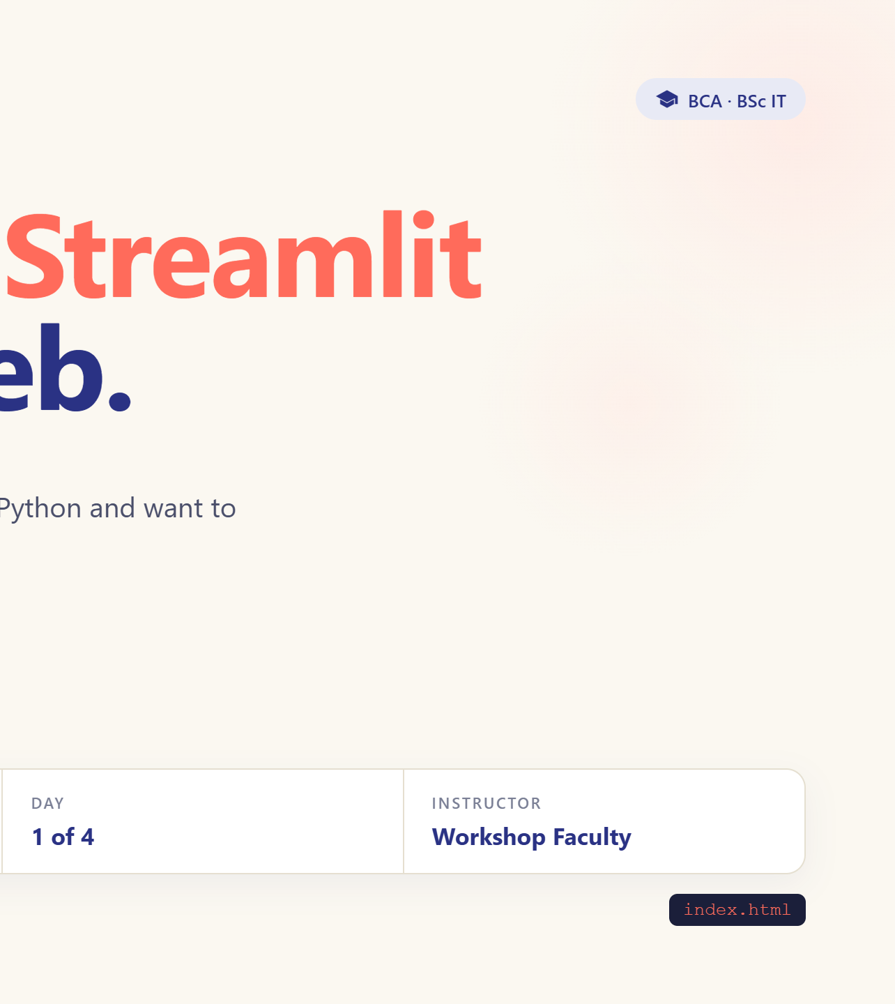
Notes:
Welcome. Ask who has built a Streamlit app. Today we open the bonnet.

Slide 2
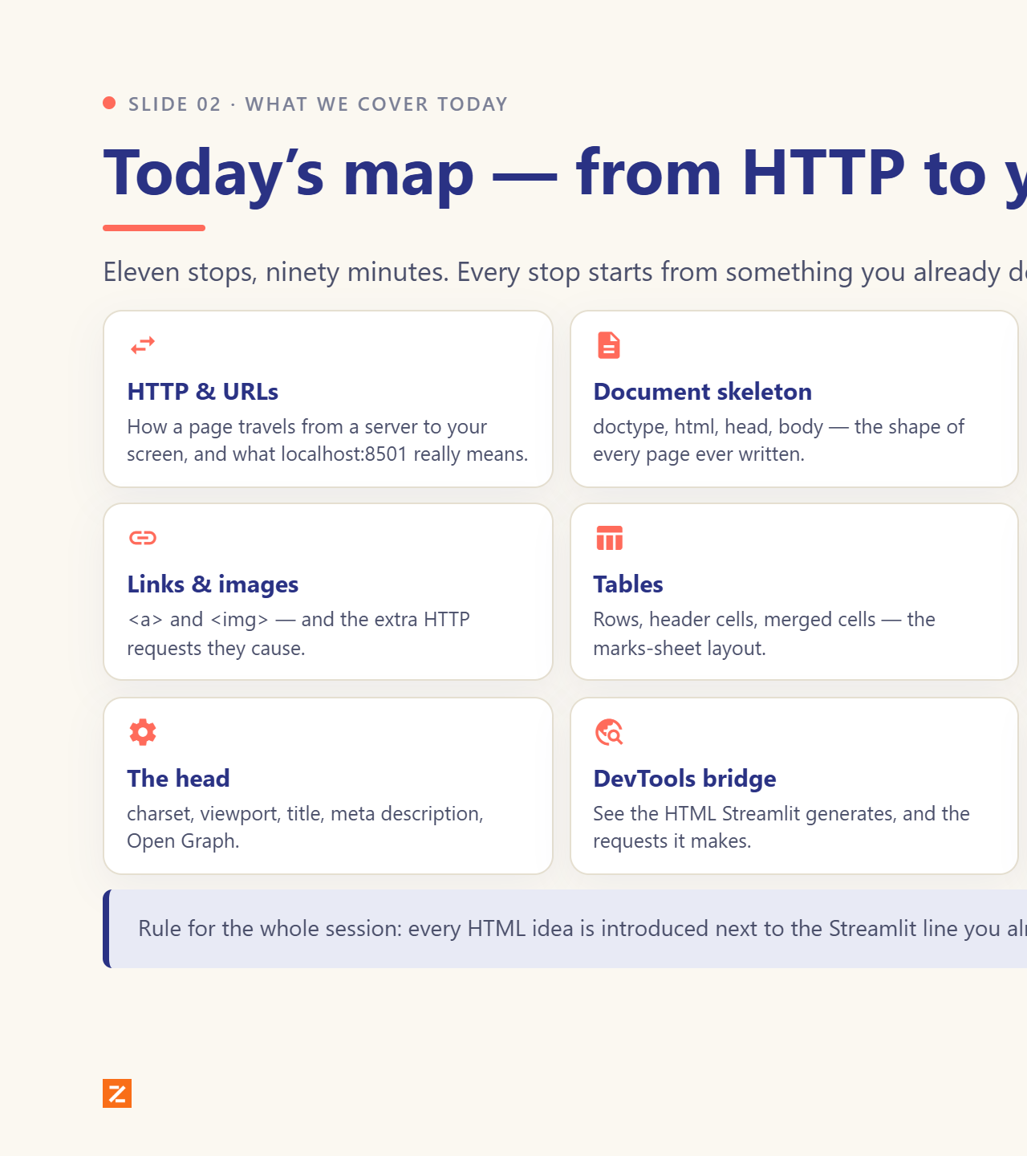
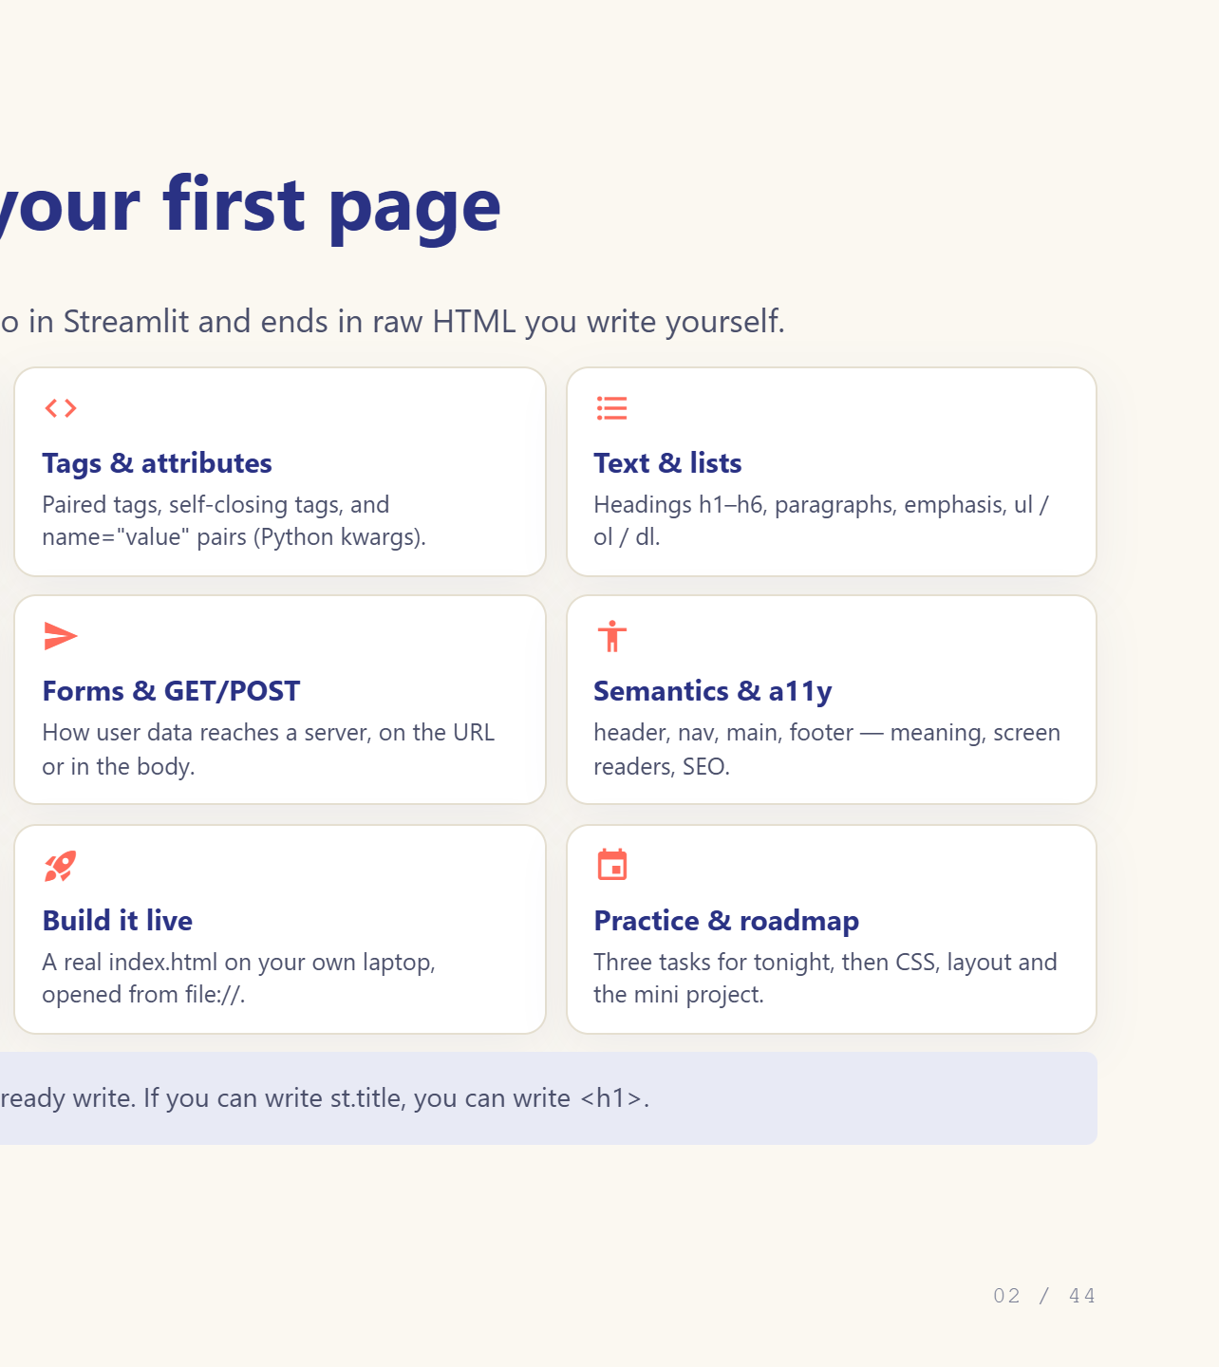
Notes:
Set the map for the session. 90 minutes, eleven stops.

Slide 3
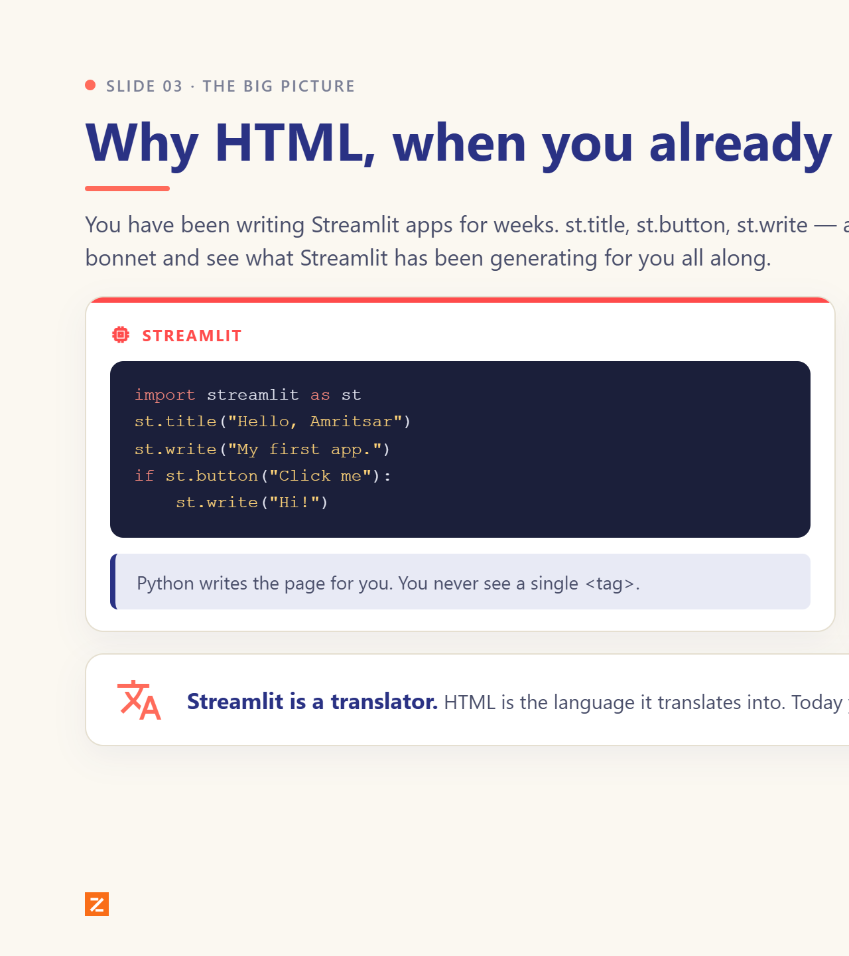
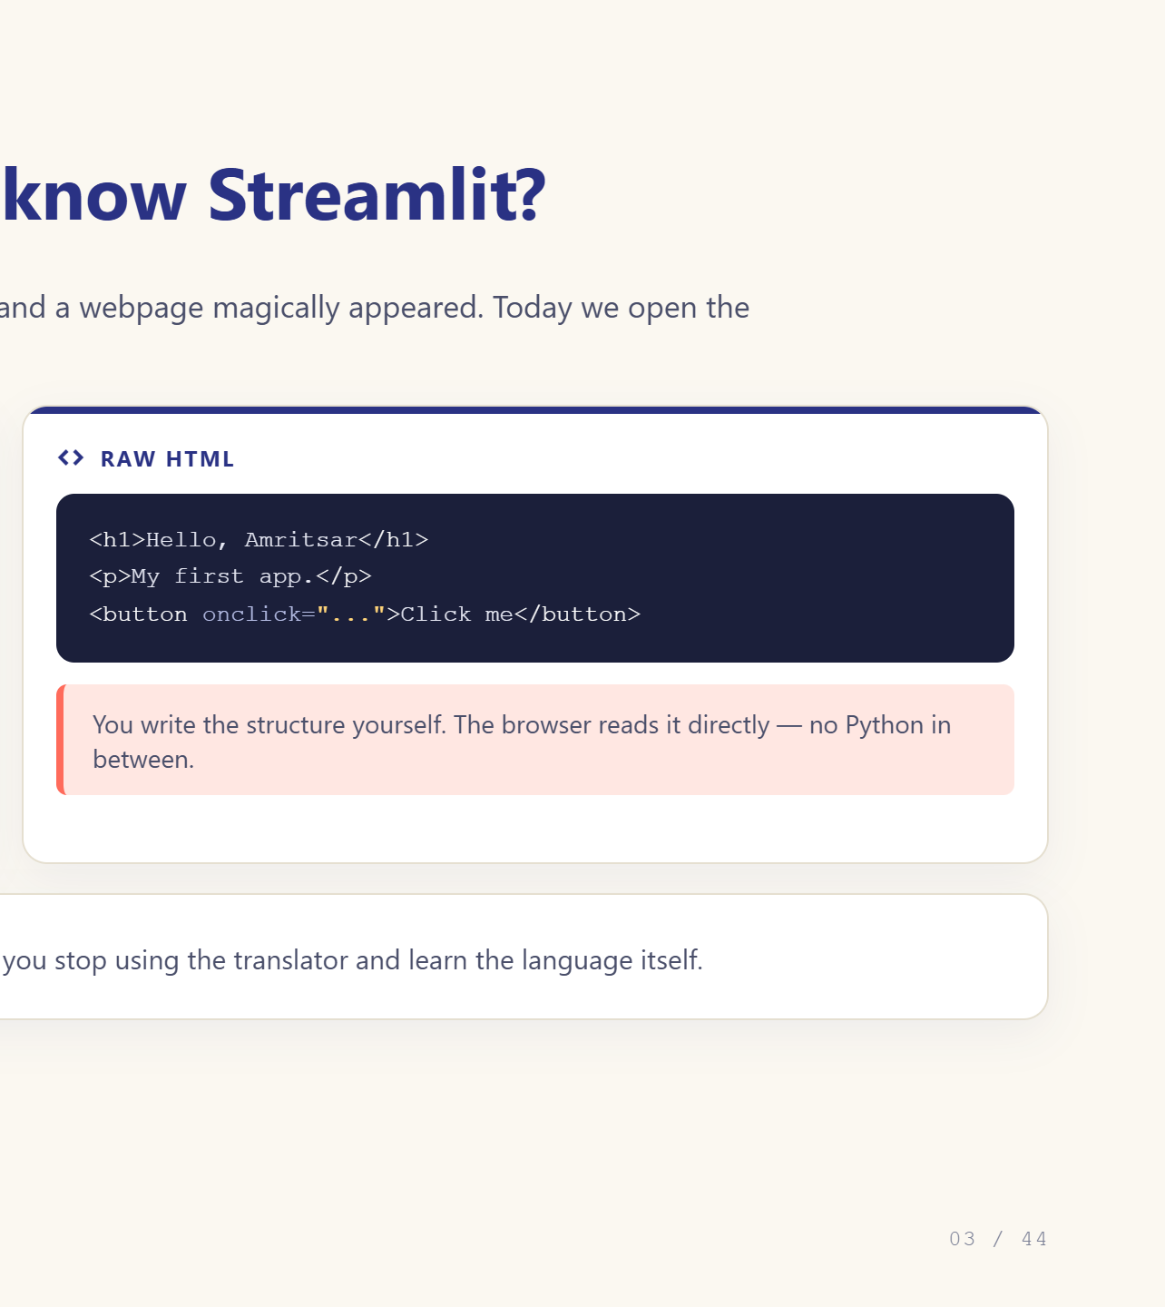
Notes:
Streamlit is a translator. Today we learn the language it translates into.

Slide 4
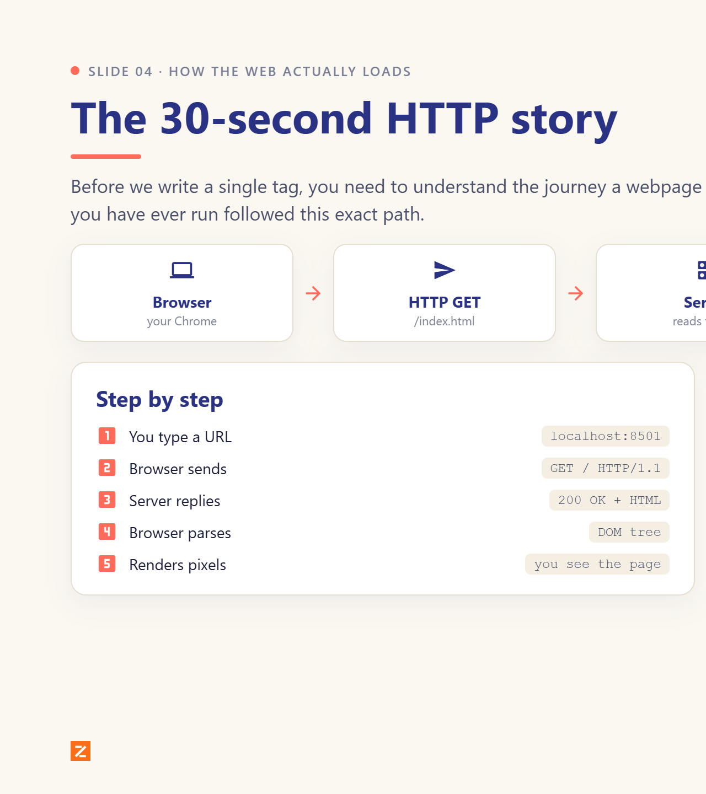
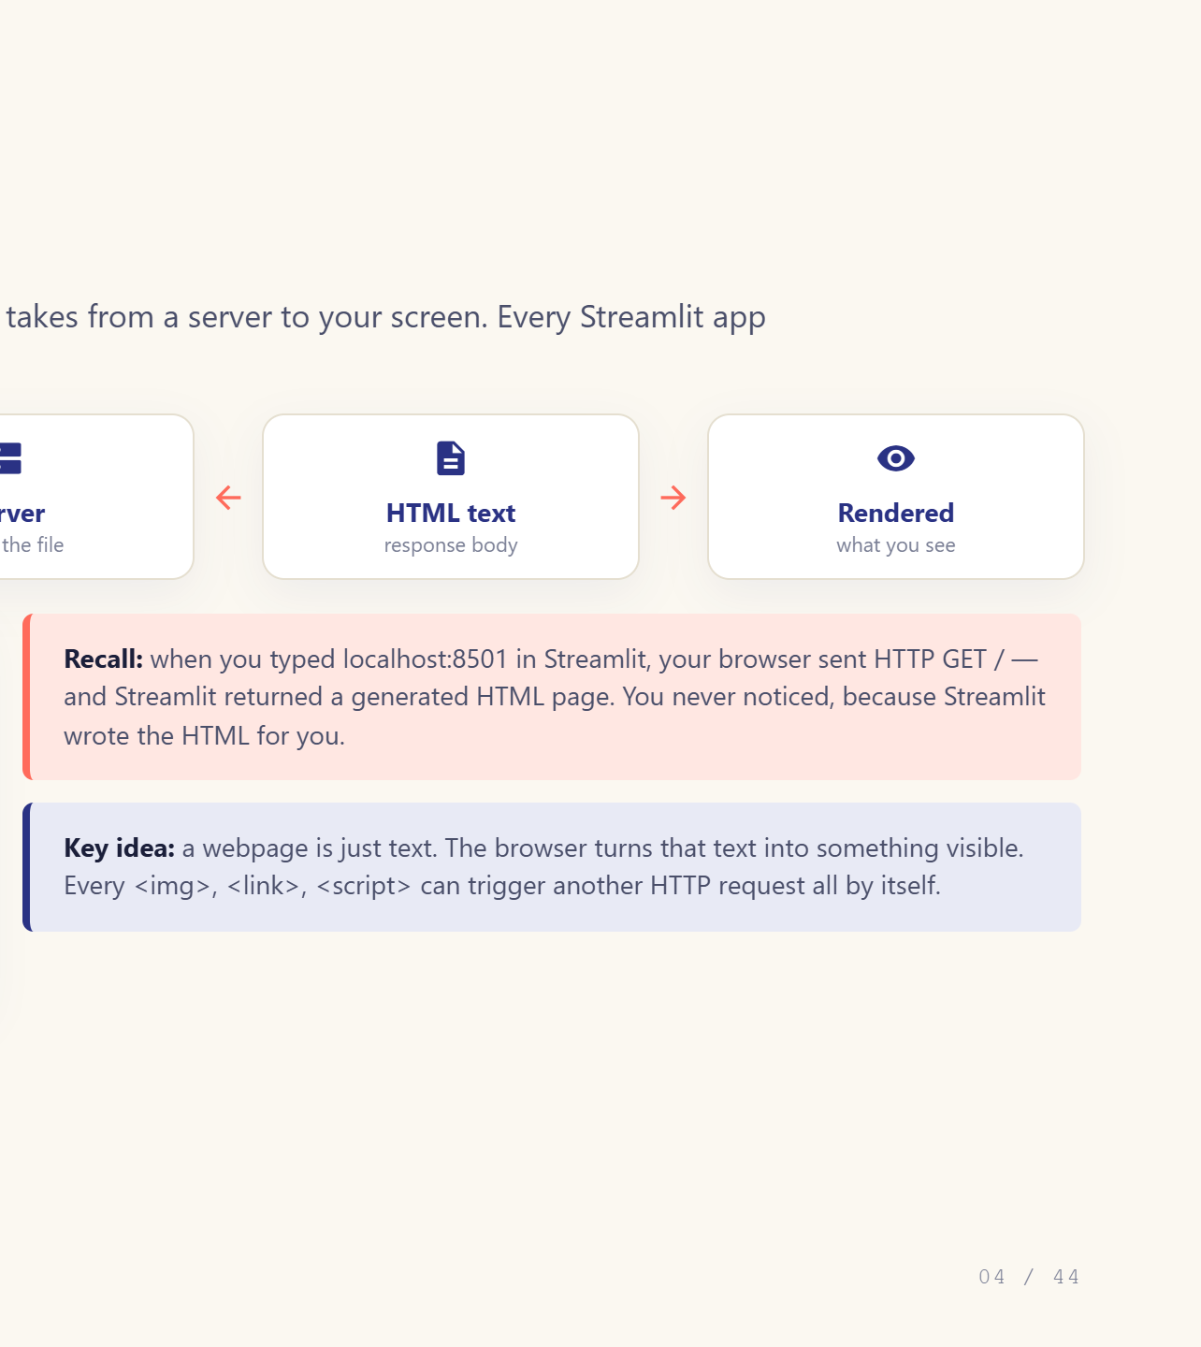
Notes:
Walk the five nodes. Tie back to localhost:8501.

Slide 5
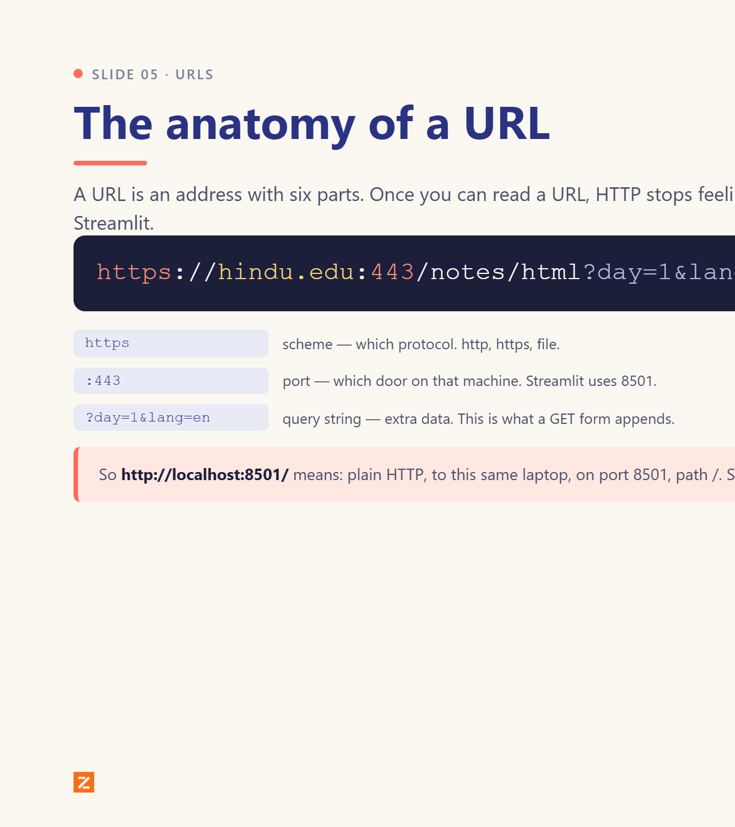
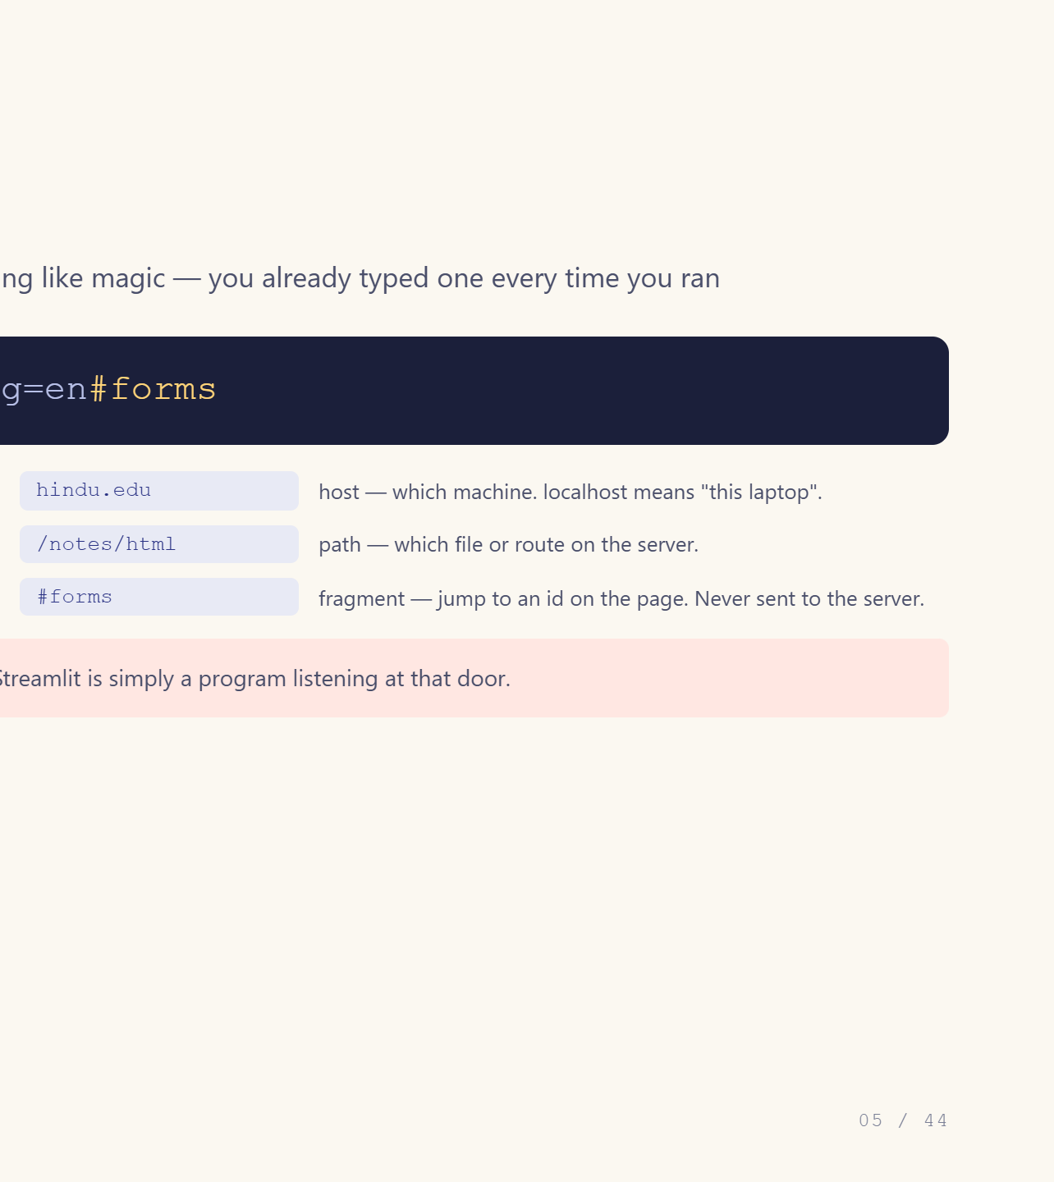
Notes:
Break the URL apart on the board. Ask what 8501 is.

Slide 6
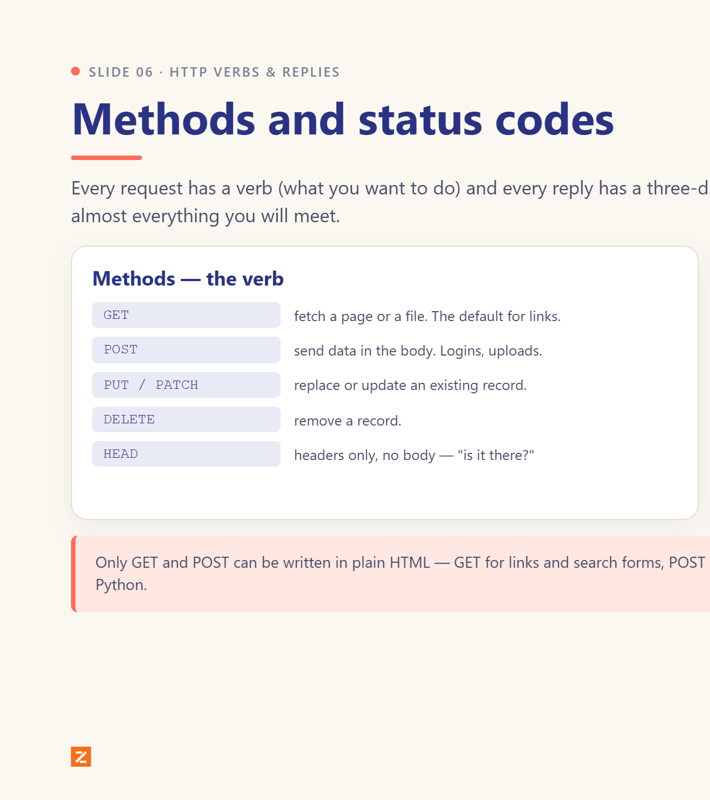
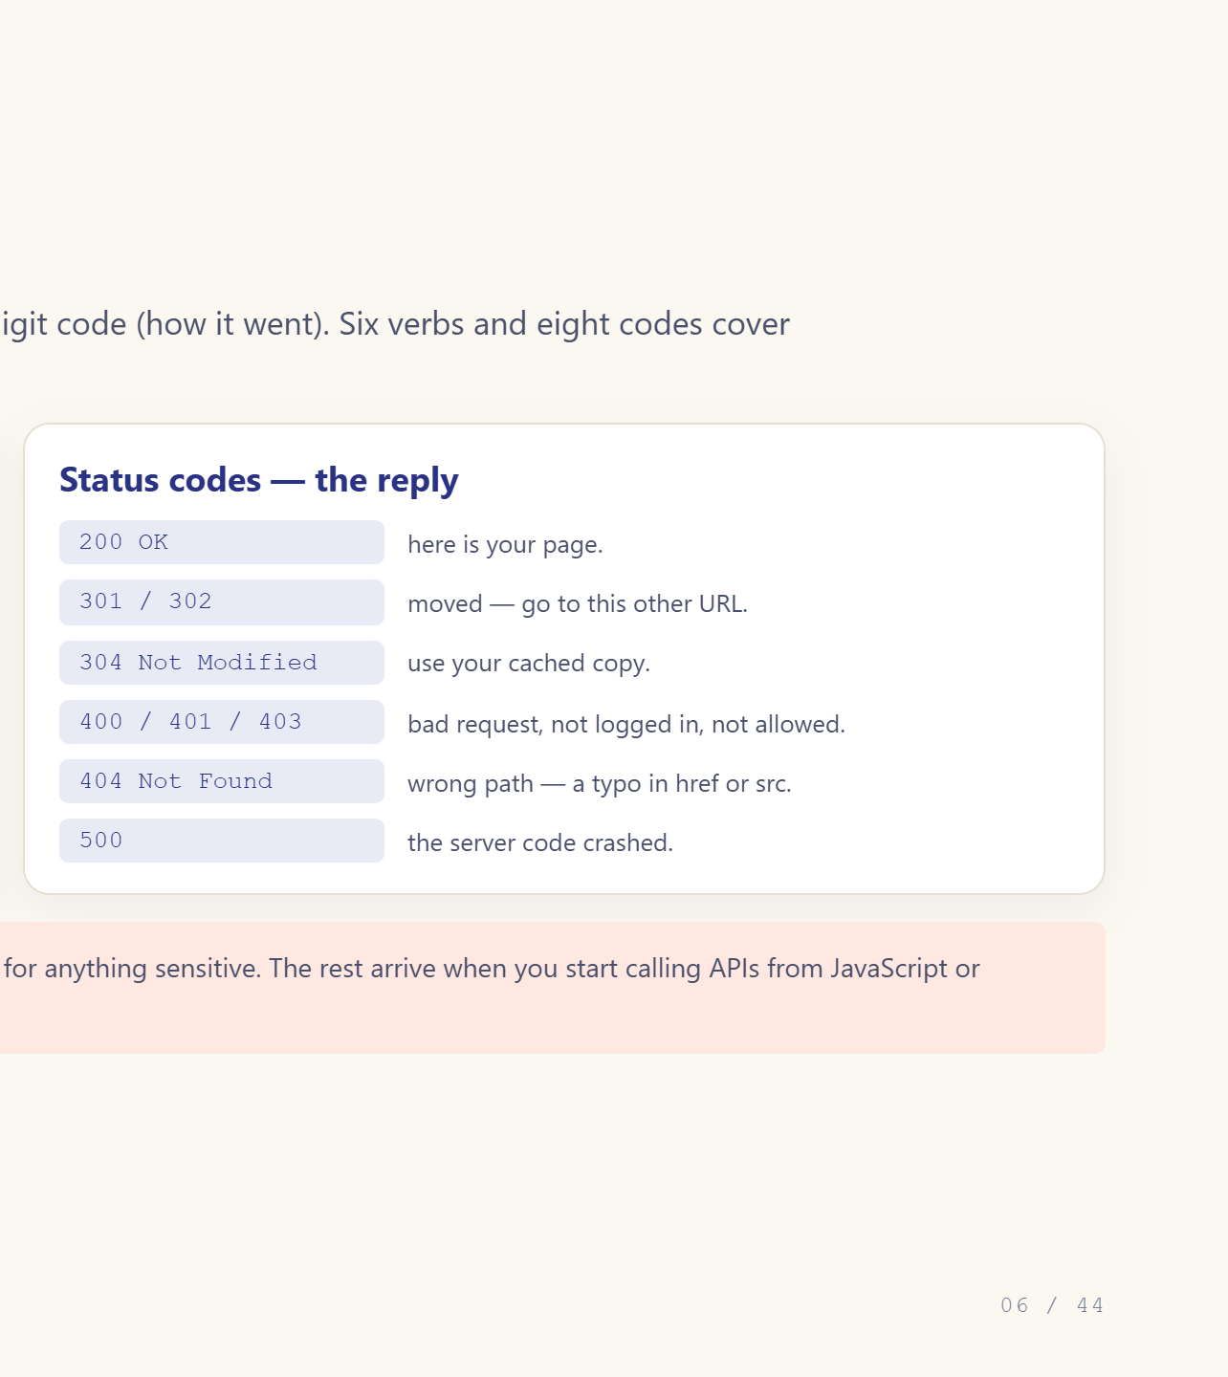
Notes:
404 and 200 are the two they will meet most.

Slide 7
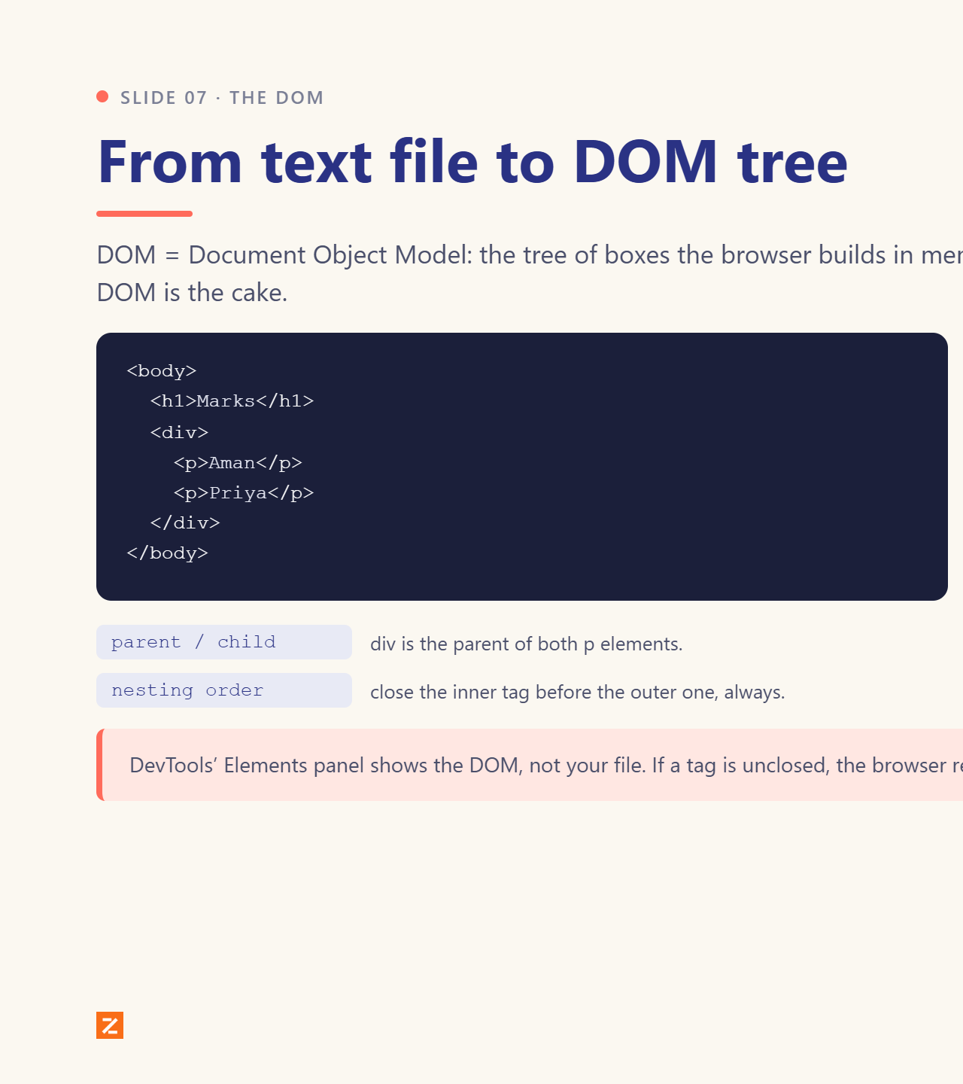
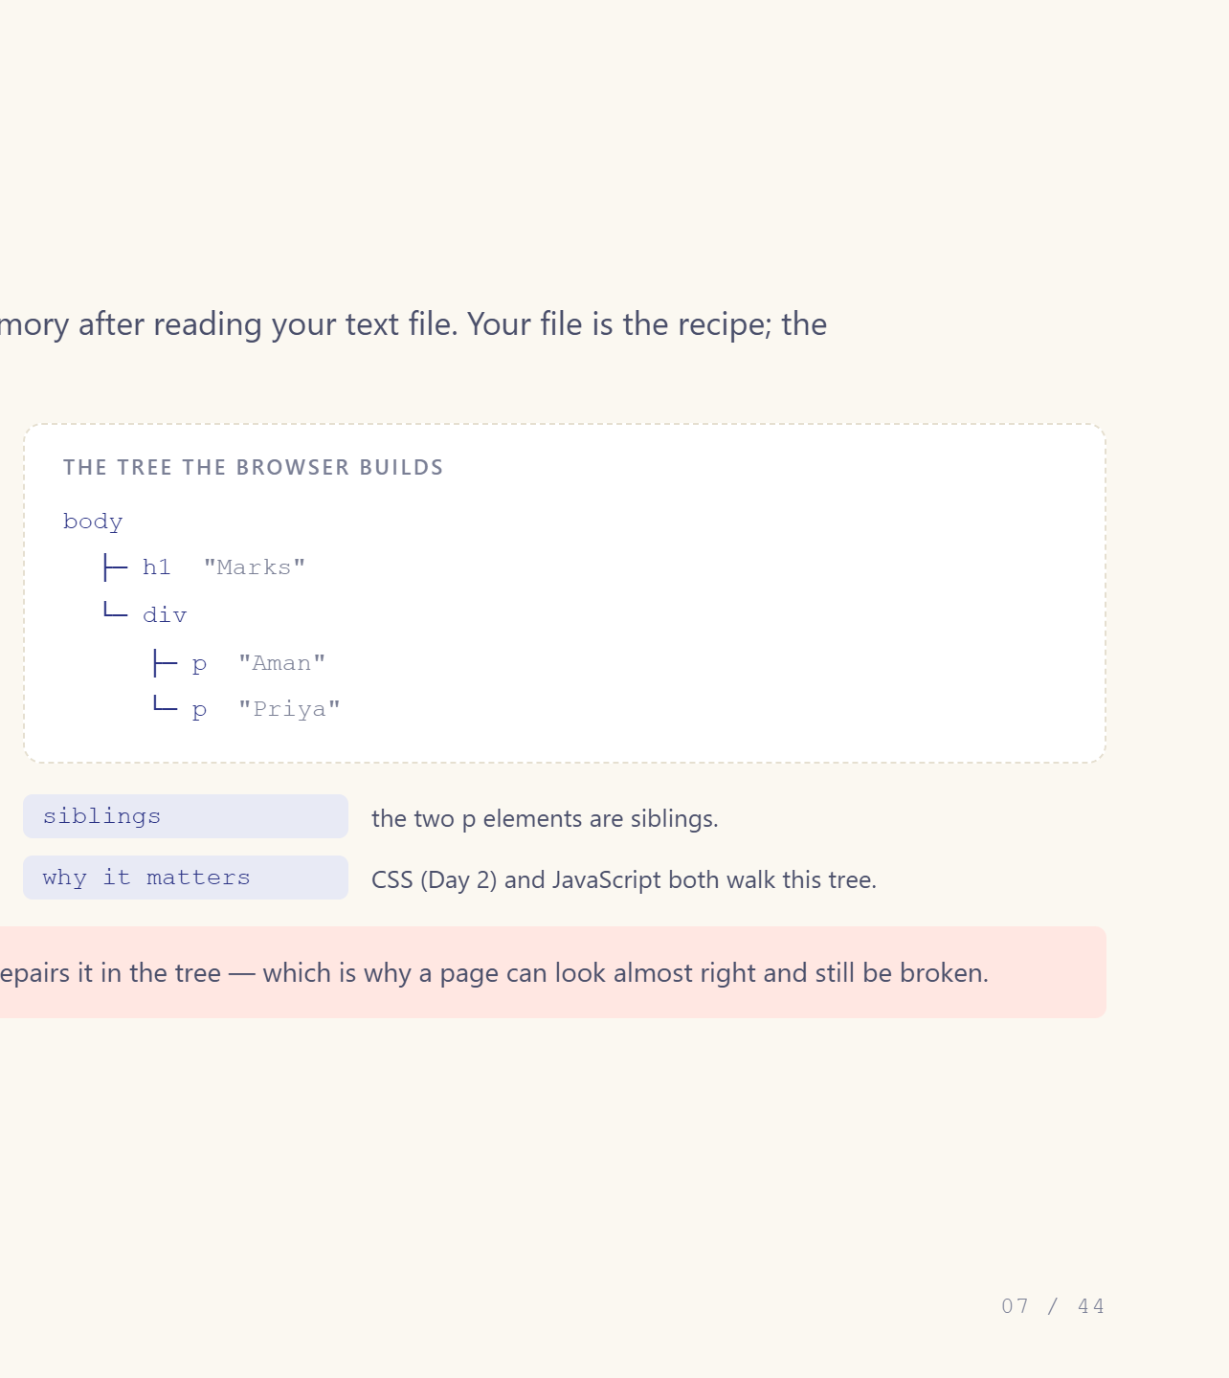
Notes:
DevTools shows the DOM, not your file.

Slide 8
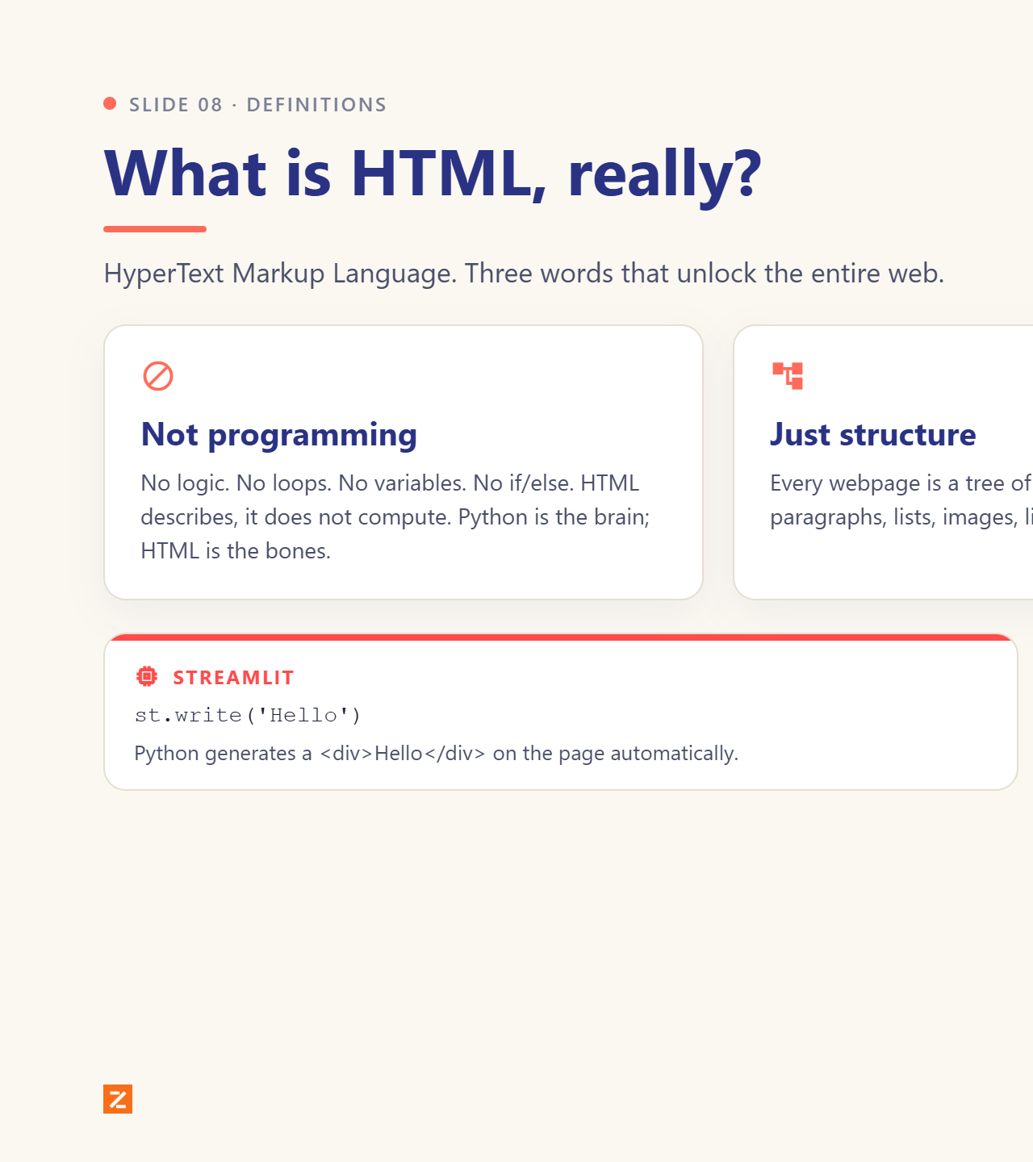
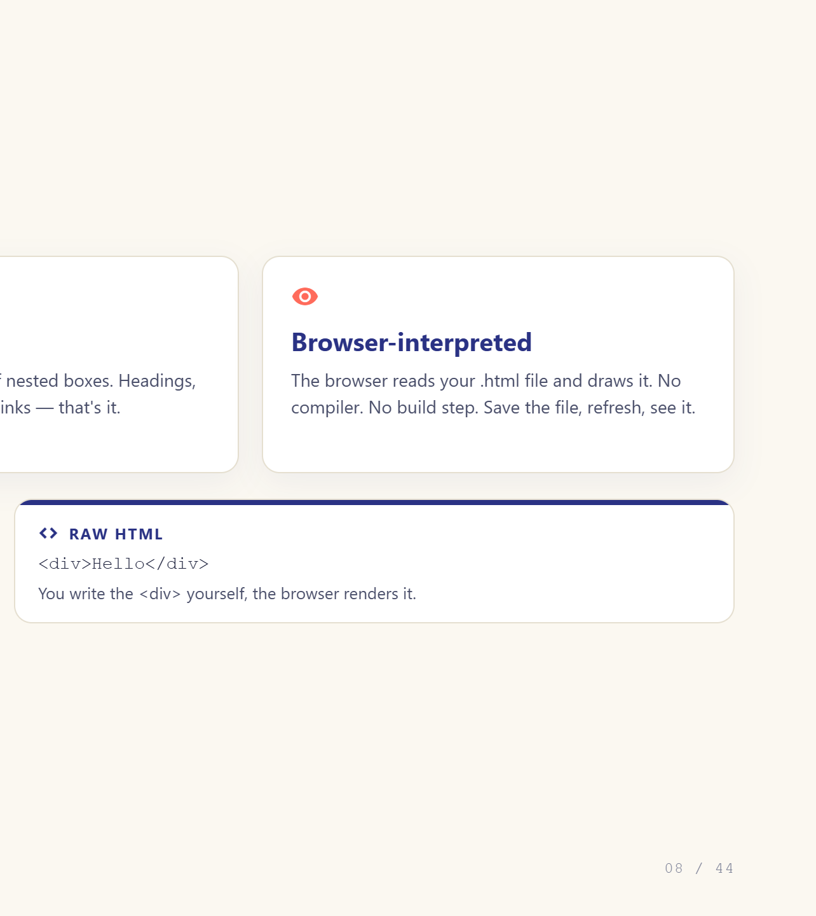
Notes:
HTML describes, it does not compute.

Slide 9
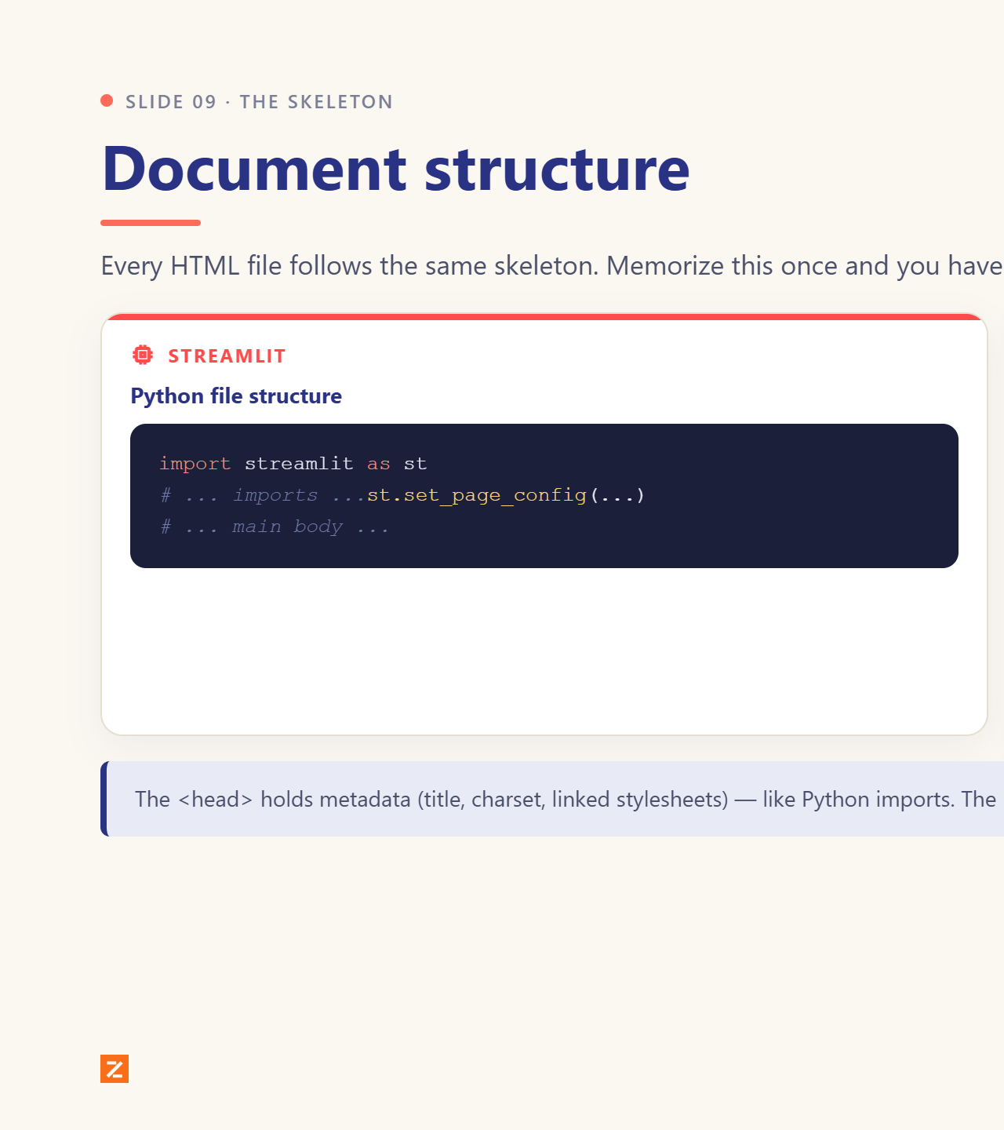
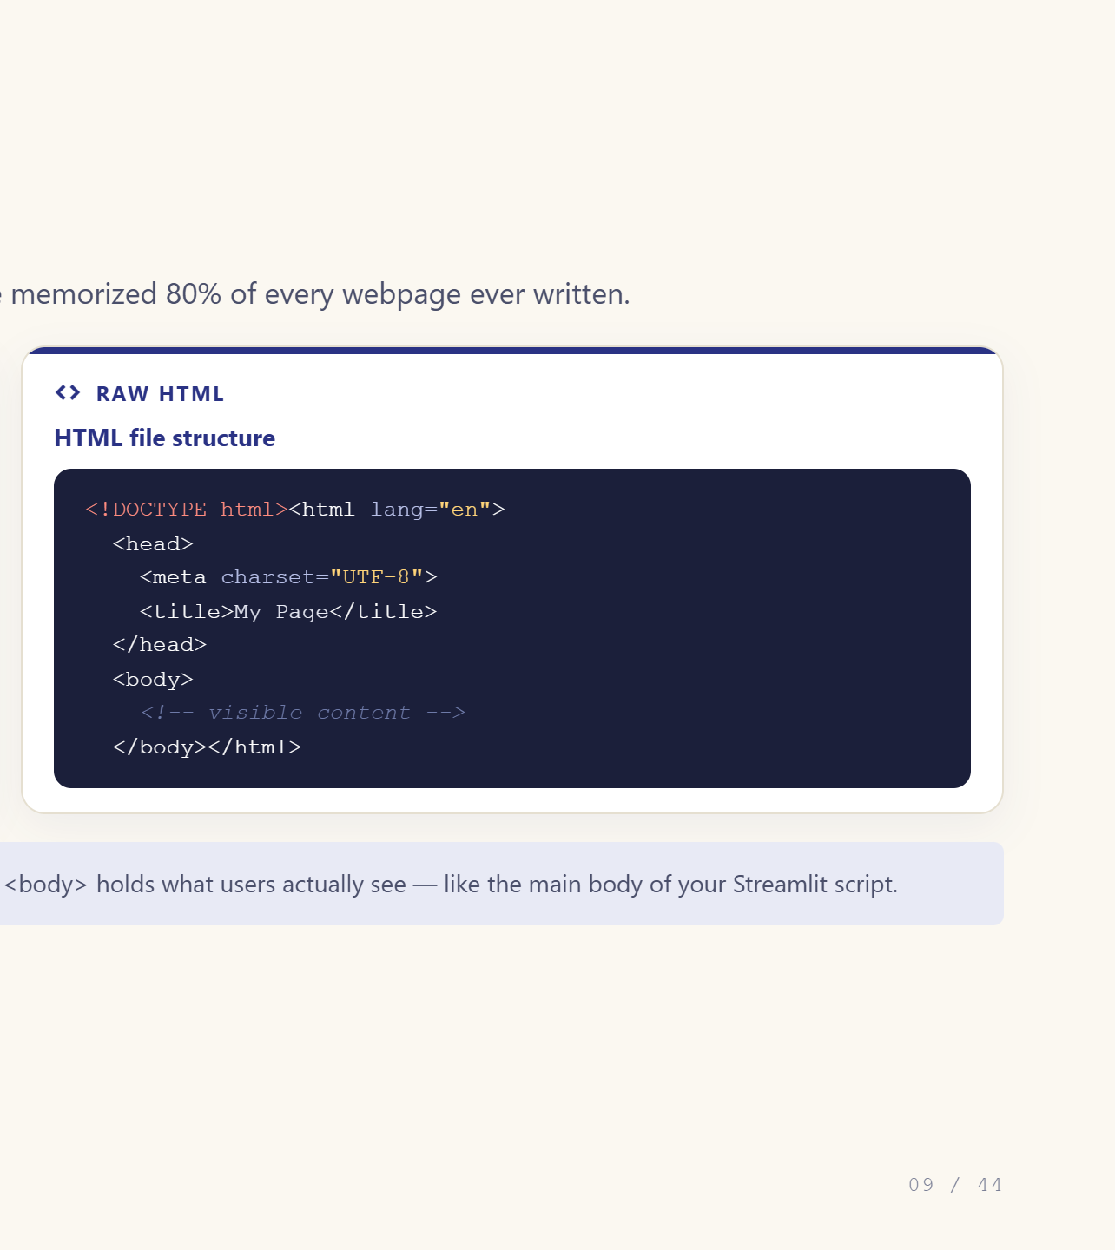
Notes:
Memorise the skeleton once.

Slide 10
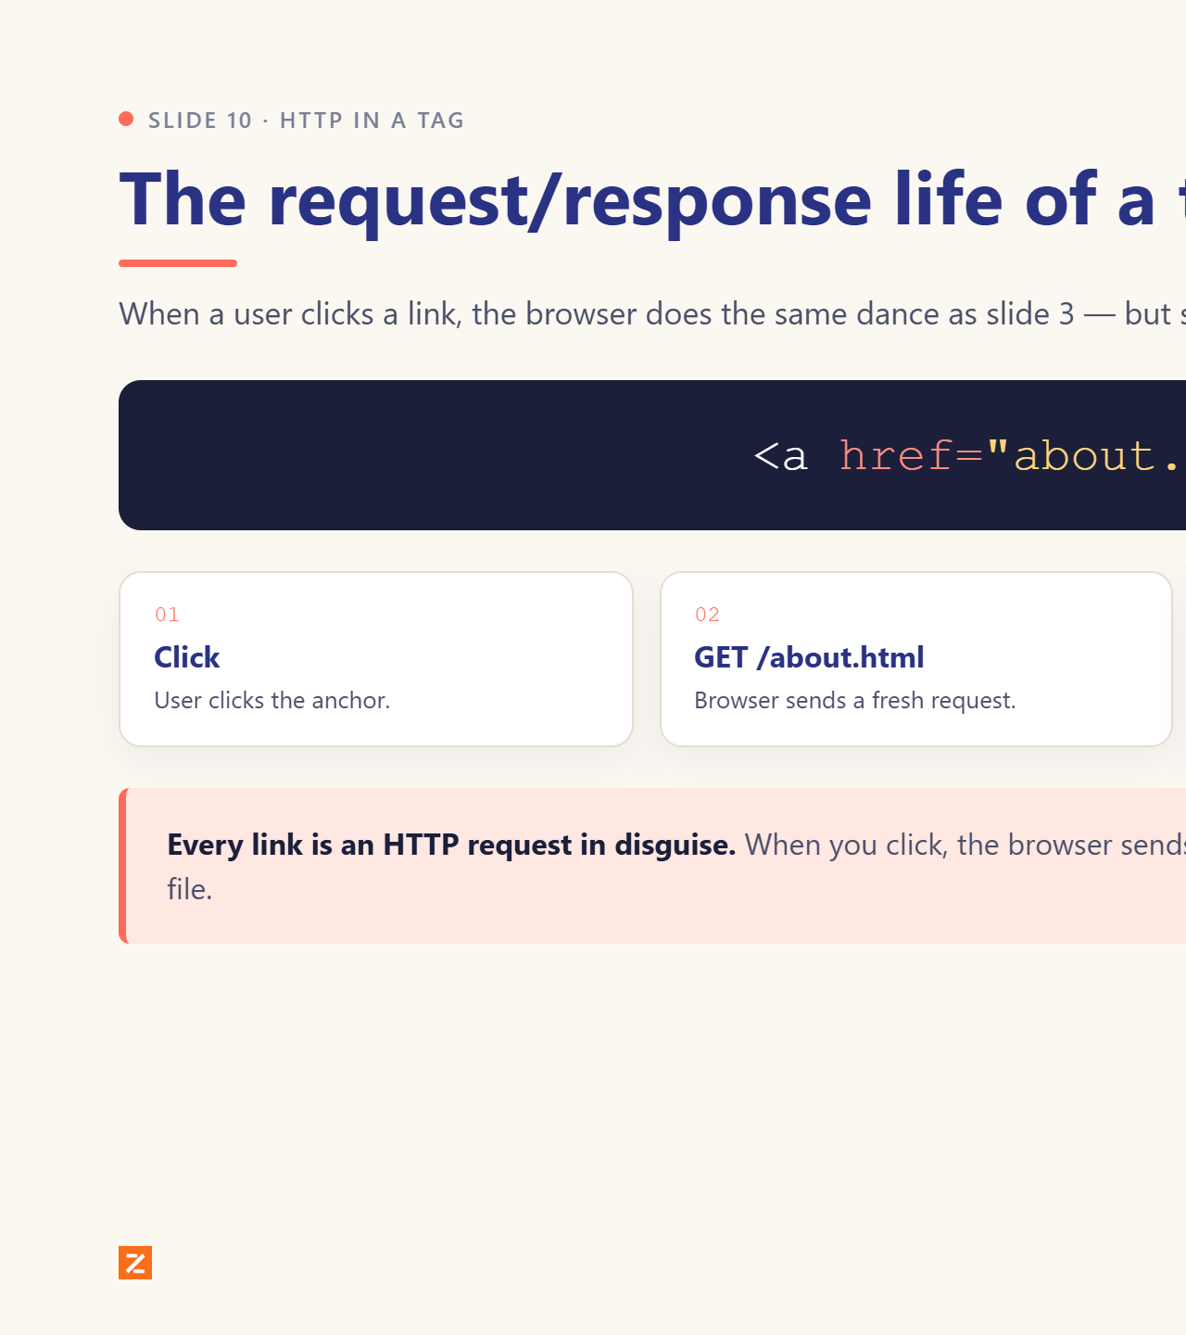
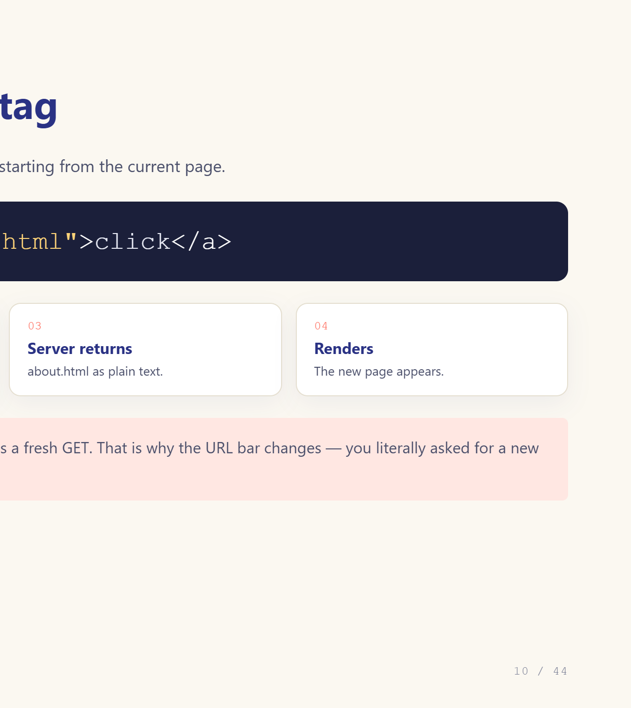
Notes:
Every link is an HTTP request in disguise.

Slide 11
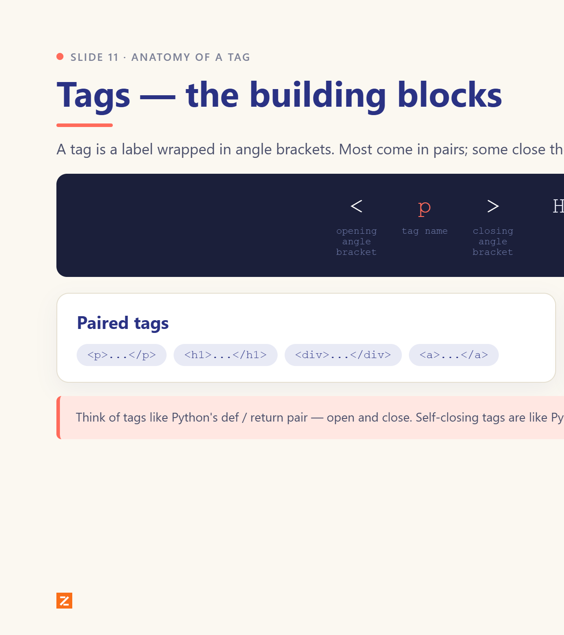
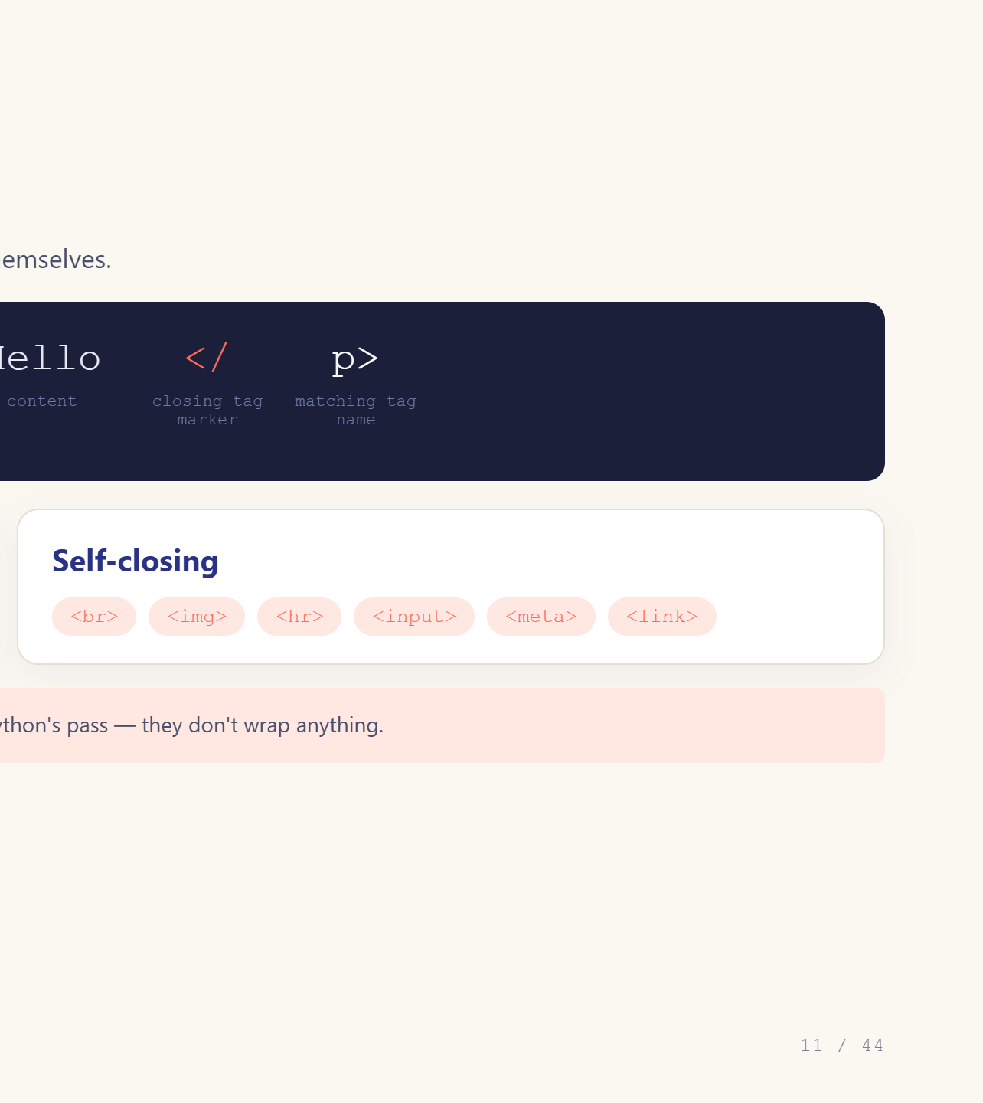
Notes:
Open and close, like def and return.

Slide 12
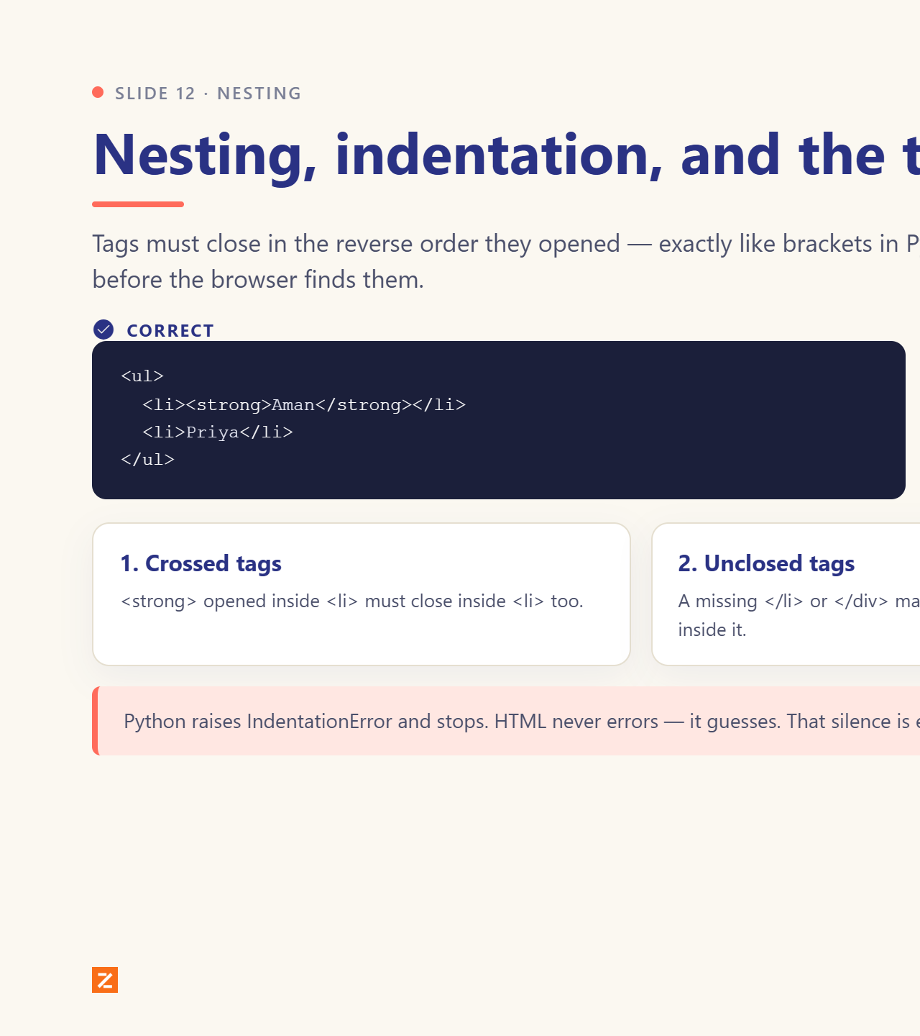
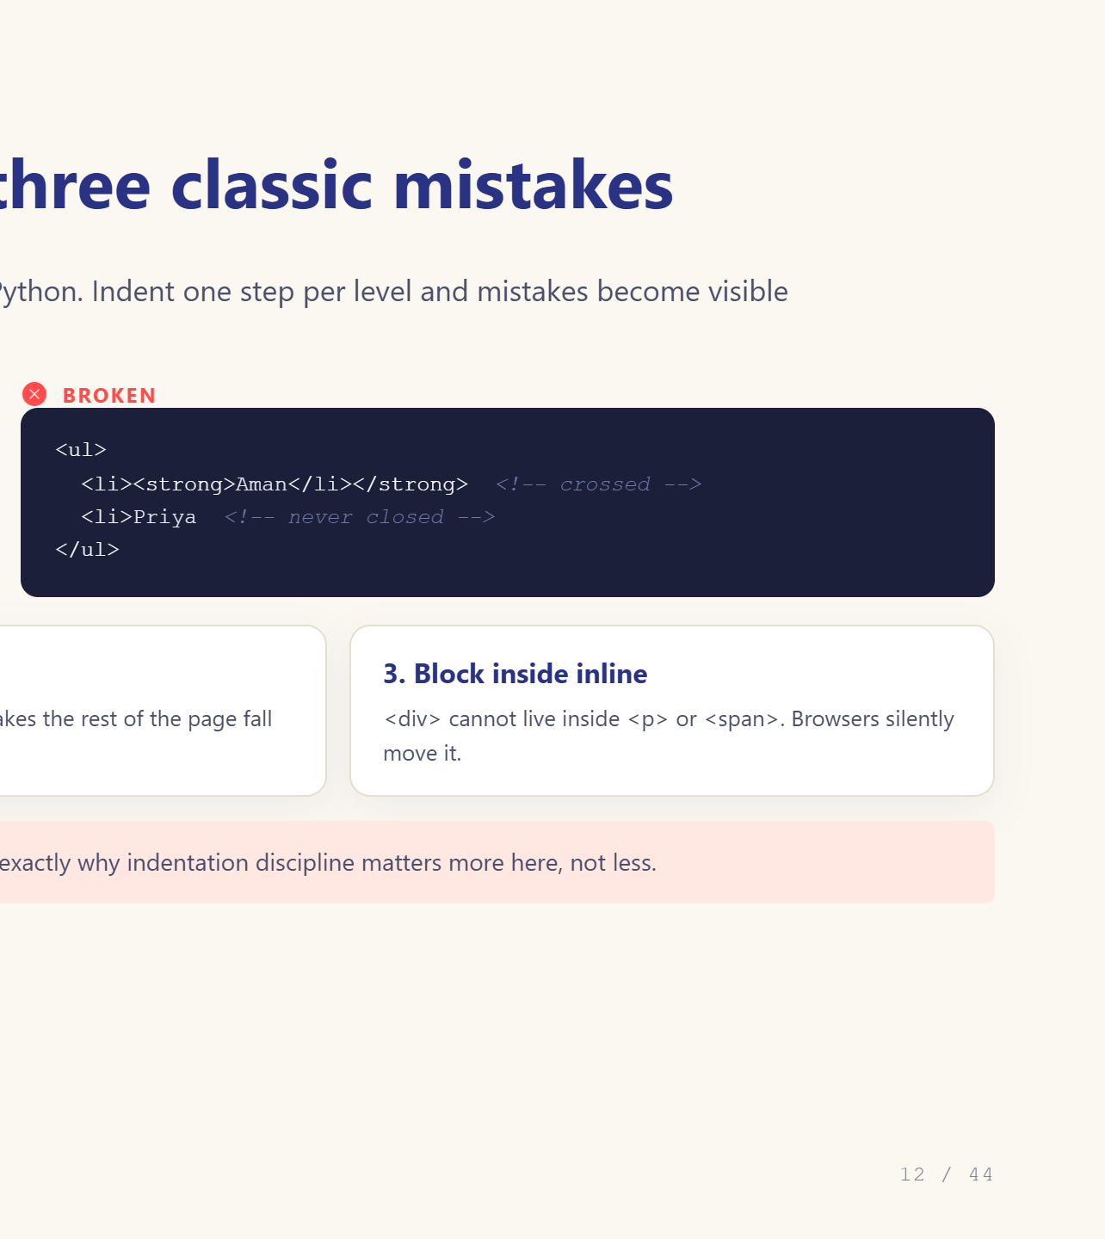
Notes:
Show the three classic mistakes.

Slide 13
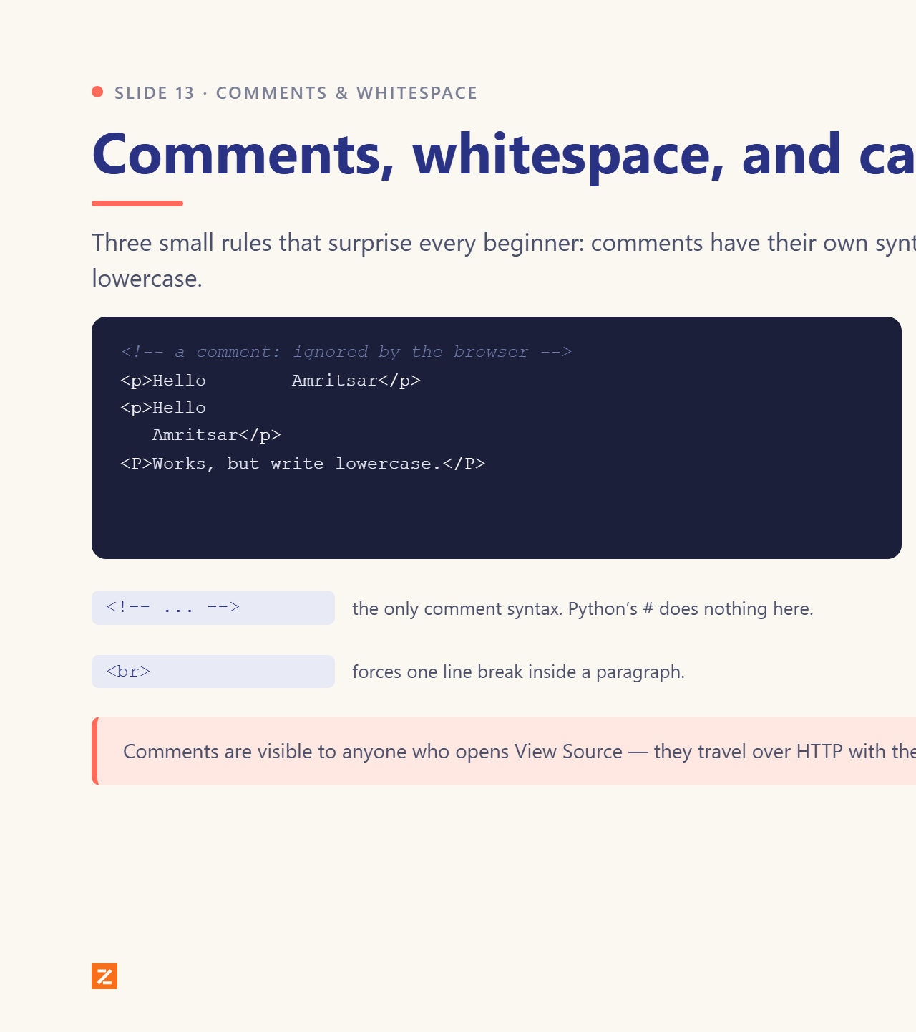
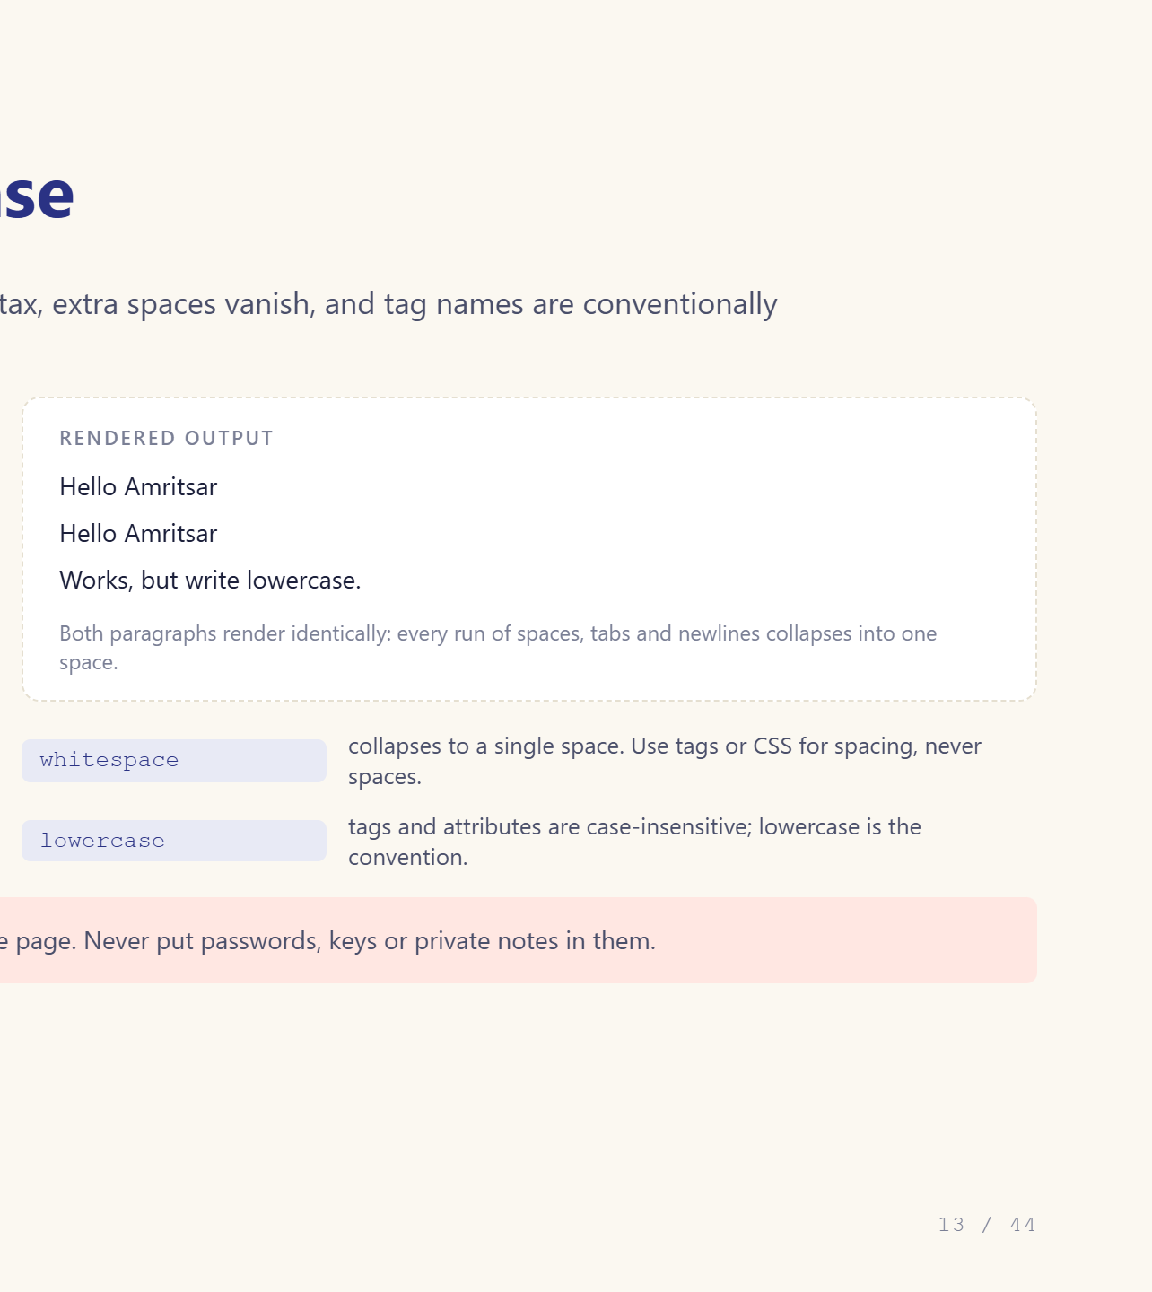
Notes:
Whitespace collapses. Show the two-space demo.

Slide 14
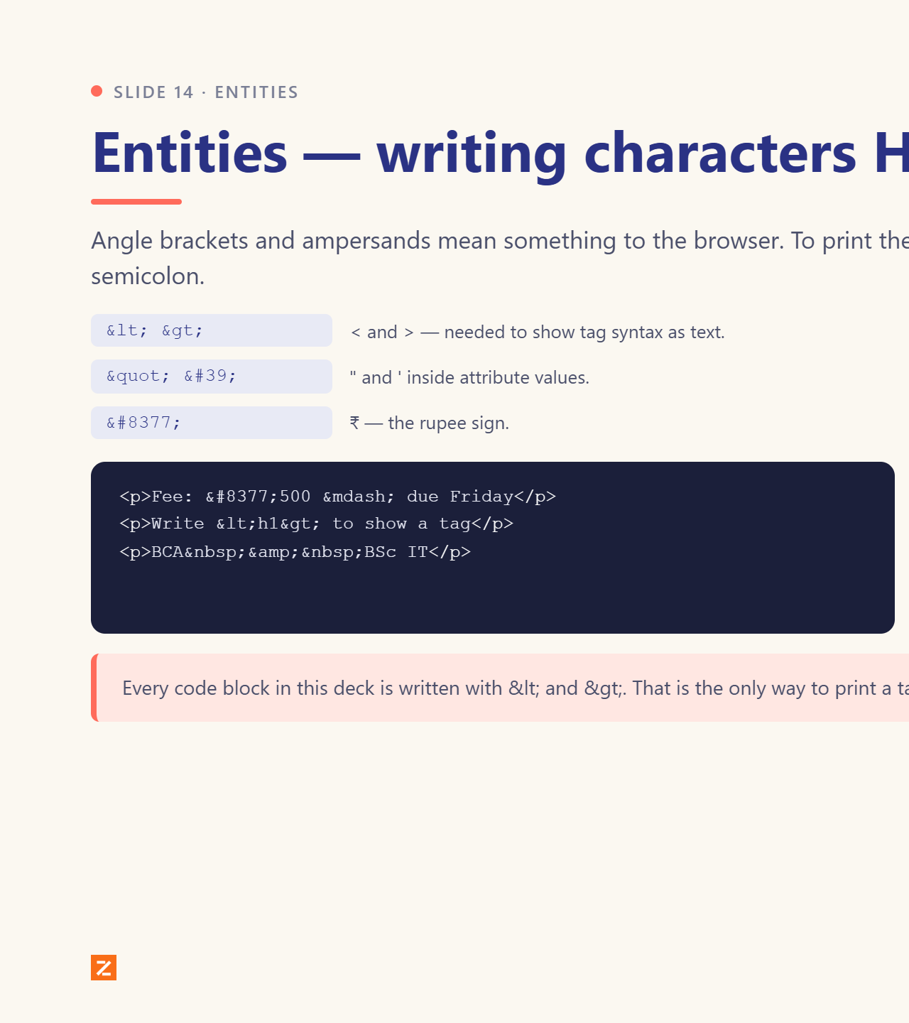
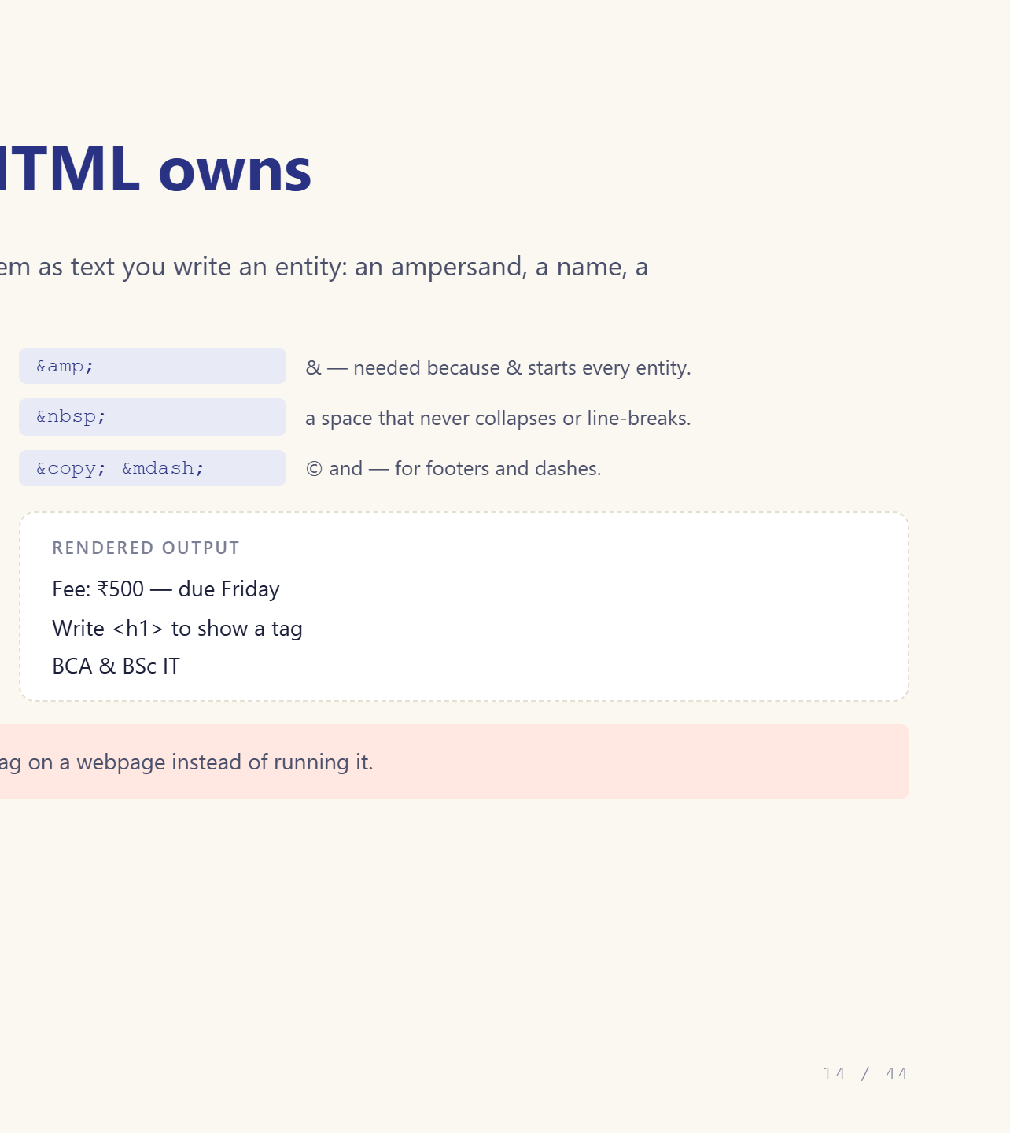
Notes:
Rupee sign and the four must-knows.

Slide 15
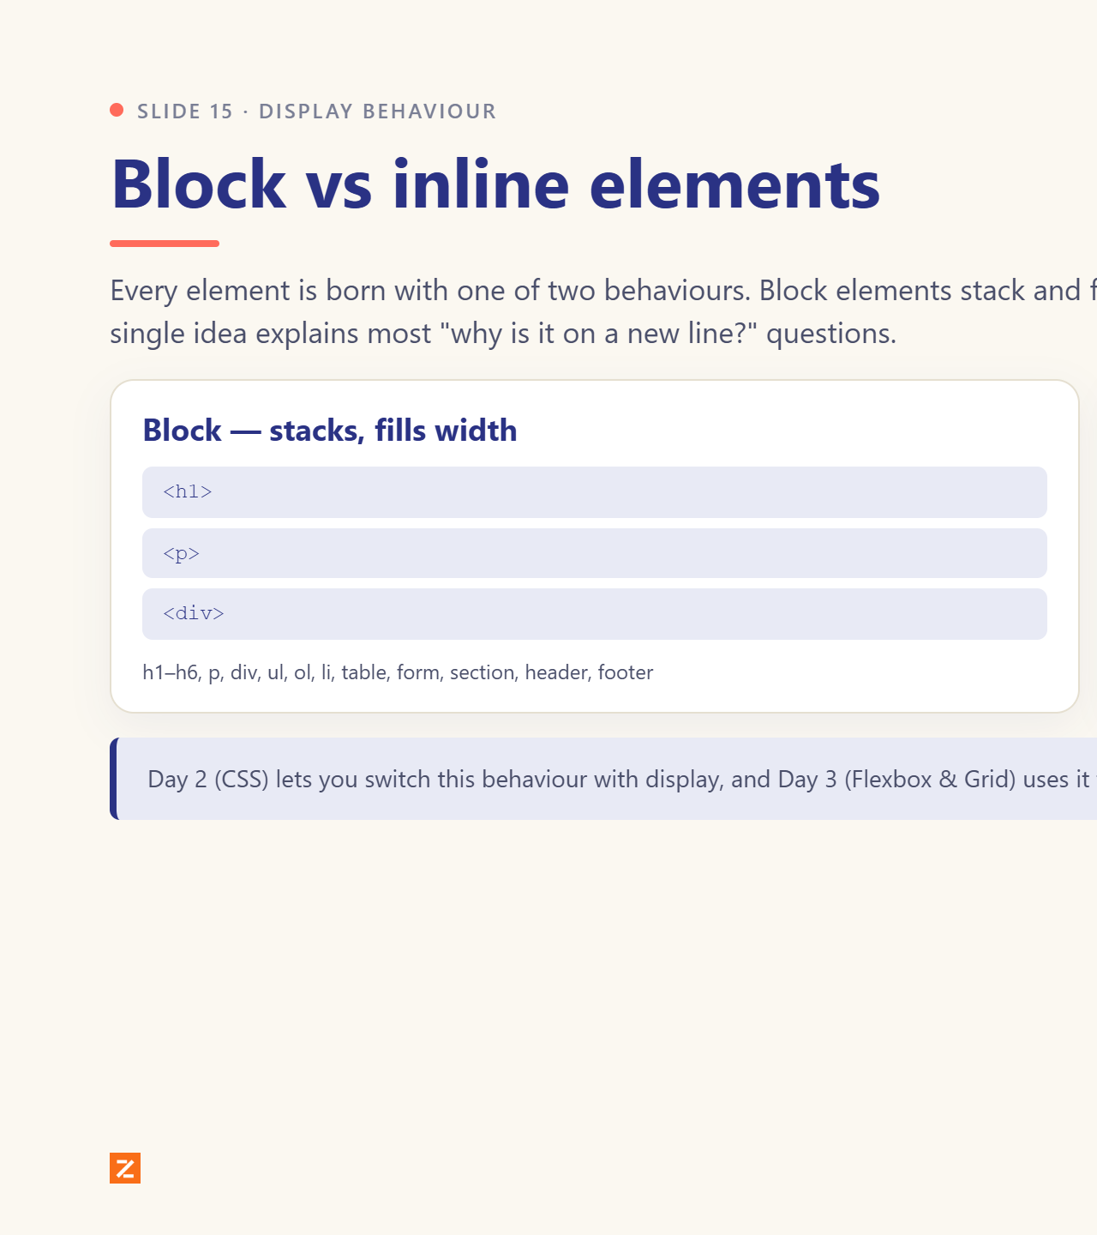
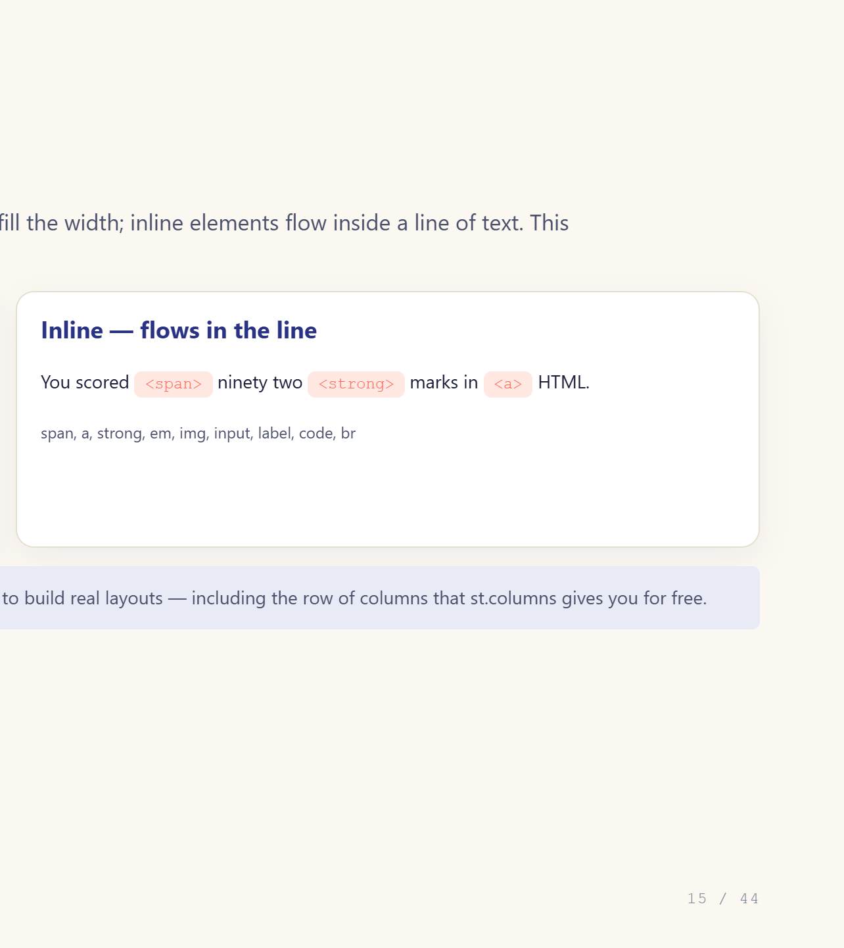
Notes:
This is the seed of Day 2 and Day 3.

Slide 16
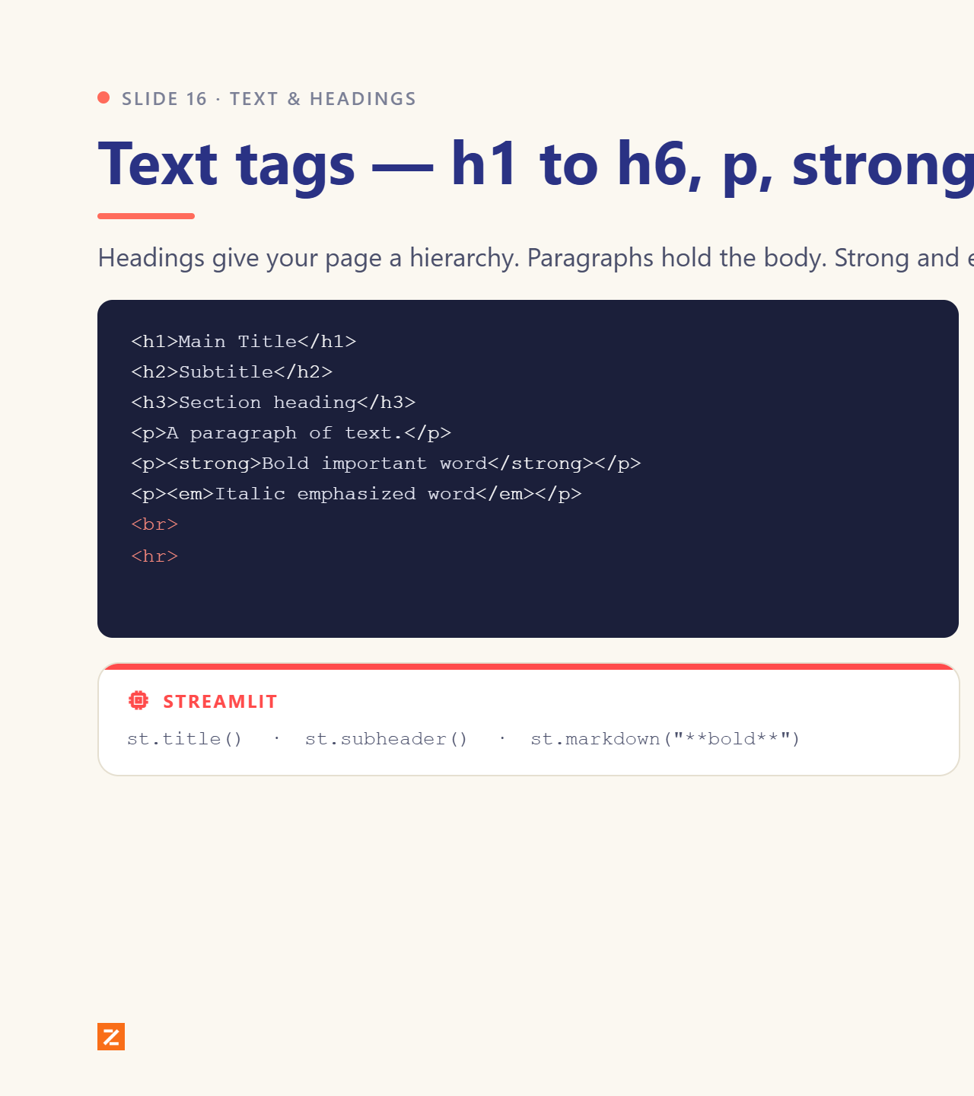
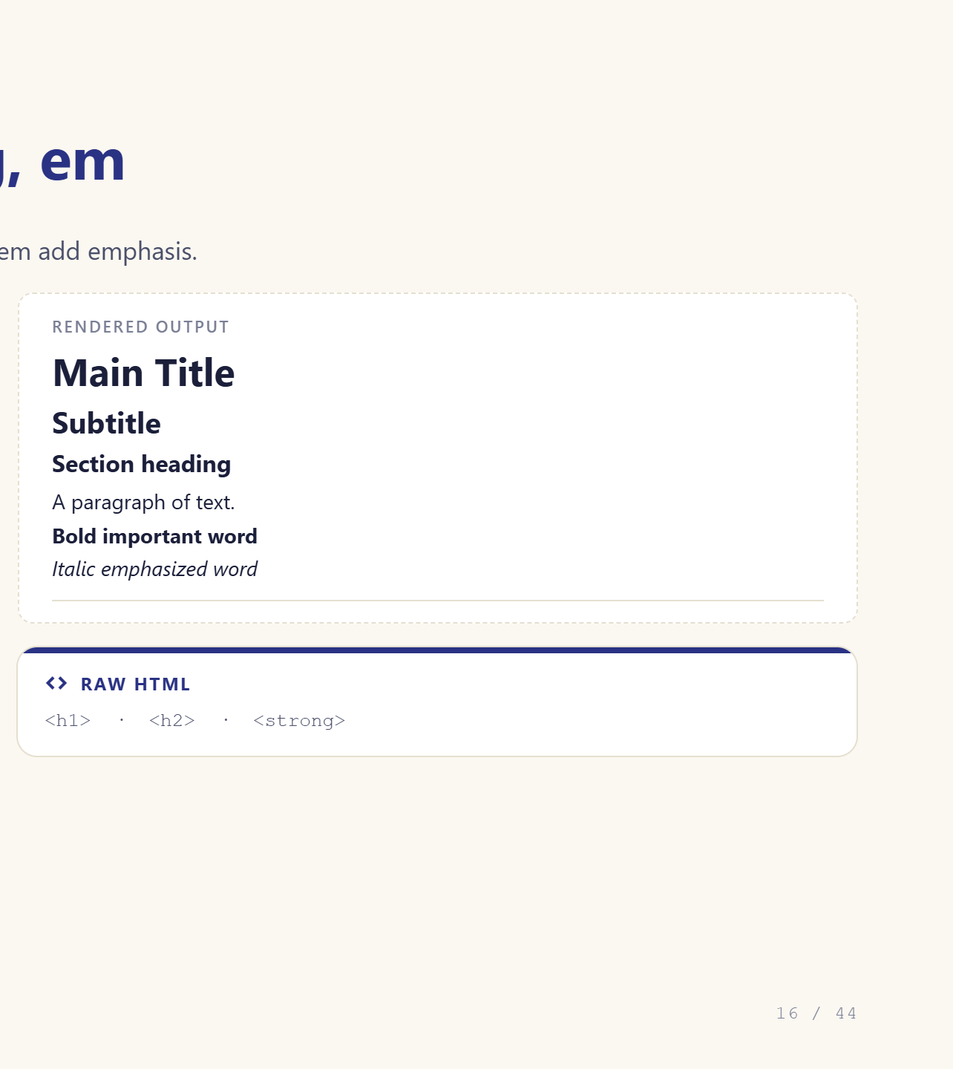
Notes:
Show code left, rendered right.

Slide 17
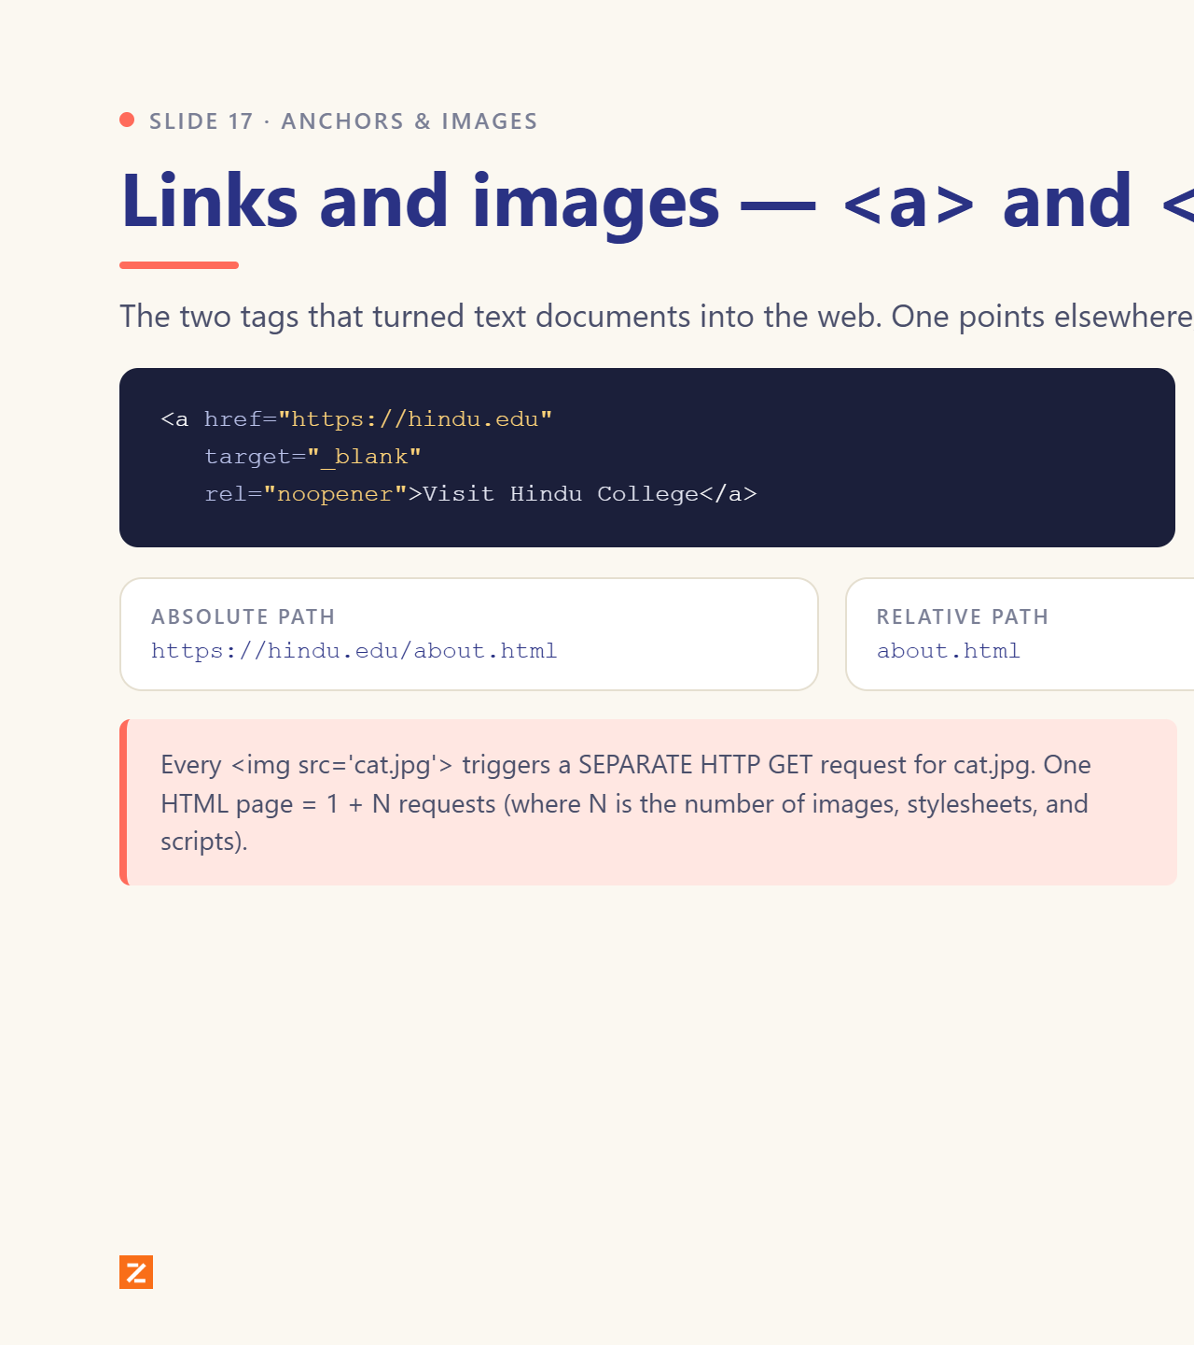
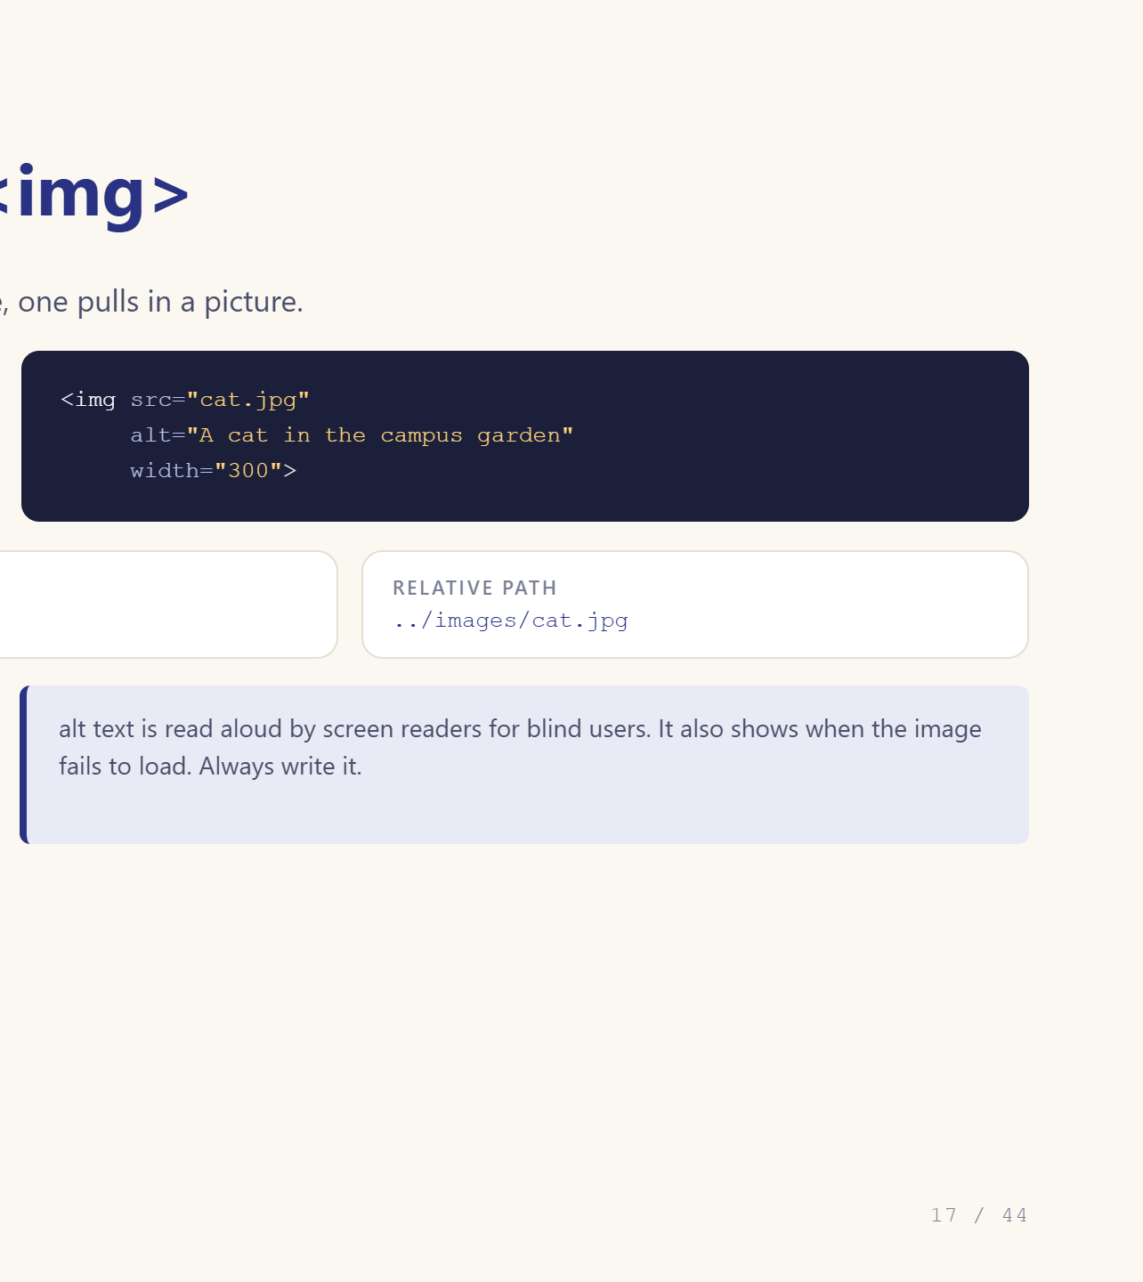
Notes:
1 + N requests. Always write alt text.

Slide 18
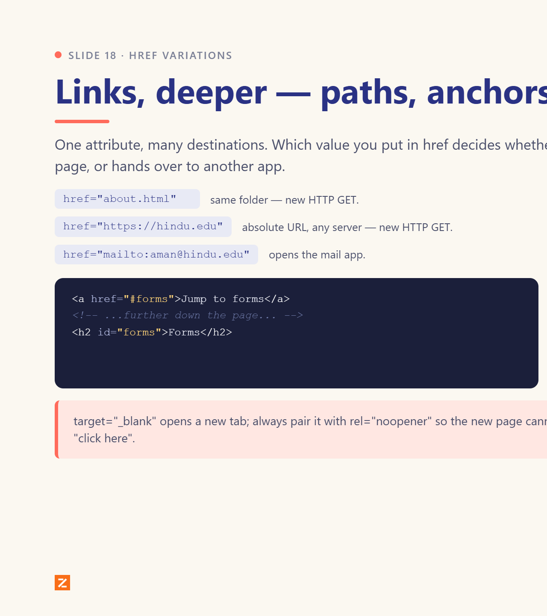
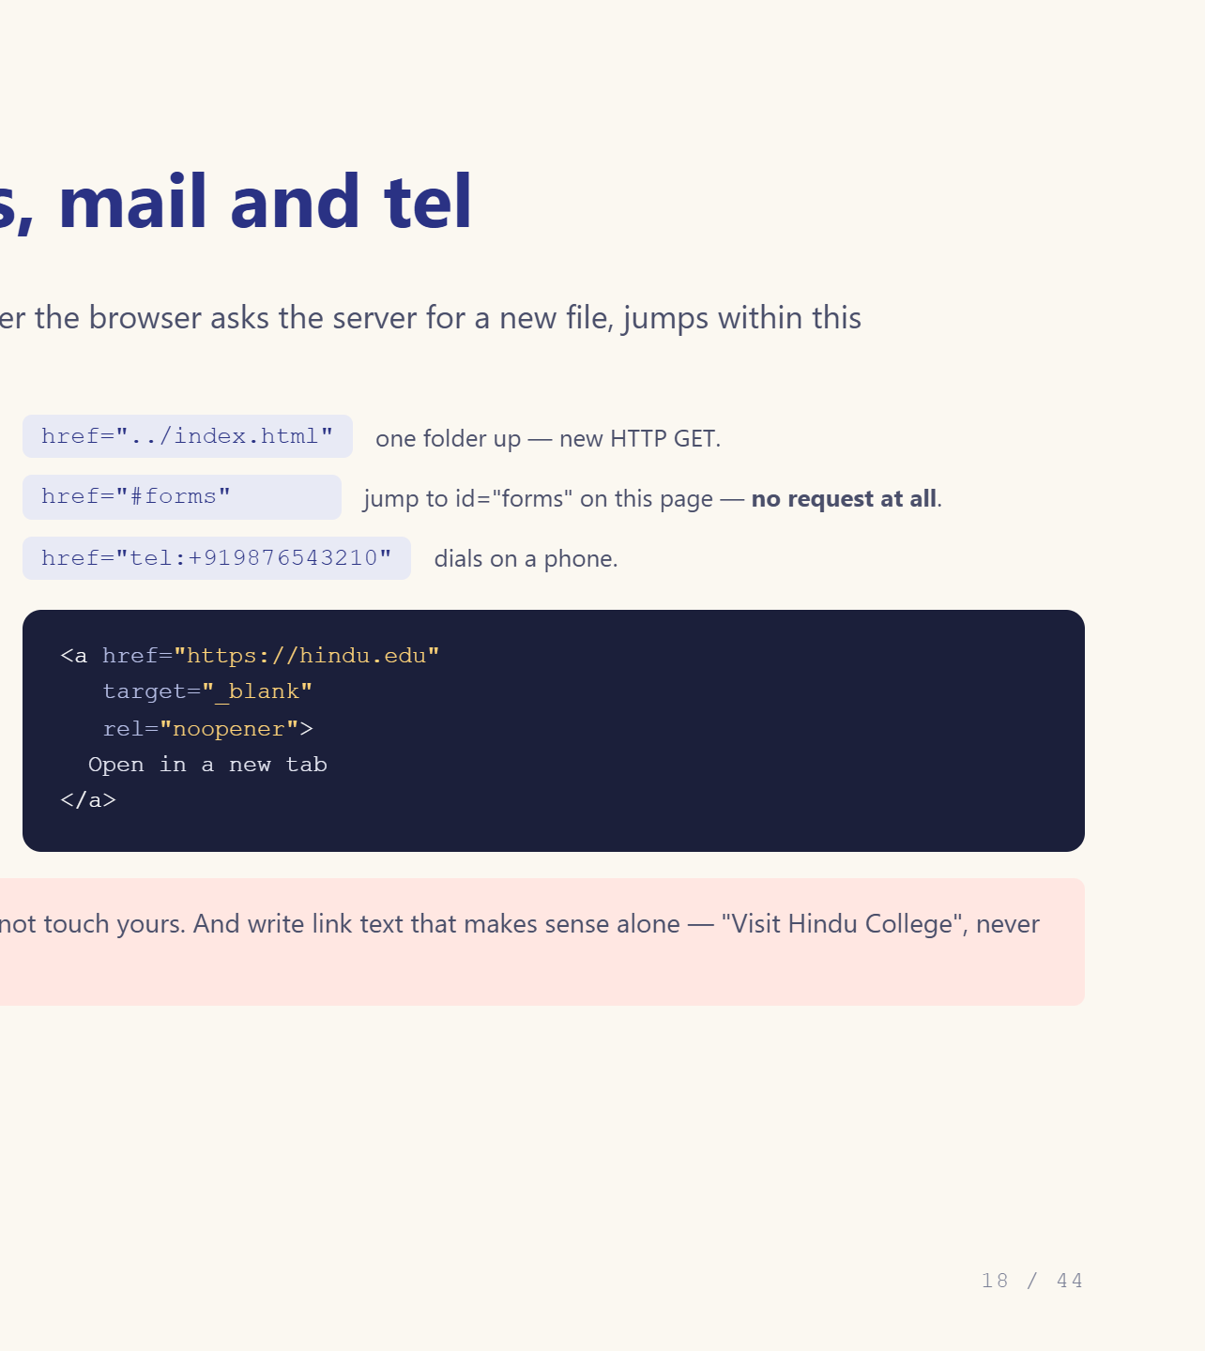
Notes:
Fragment links cost no request — good demo.

Slide 19
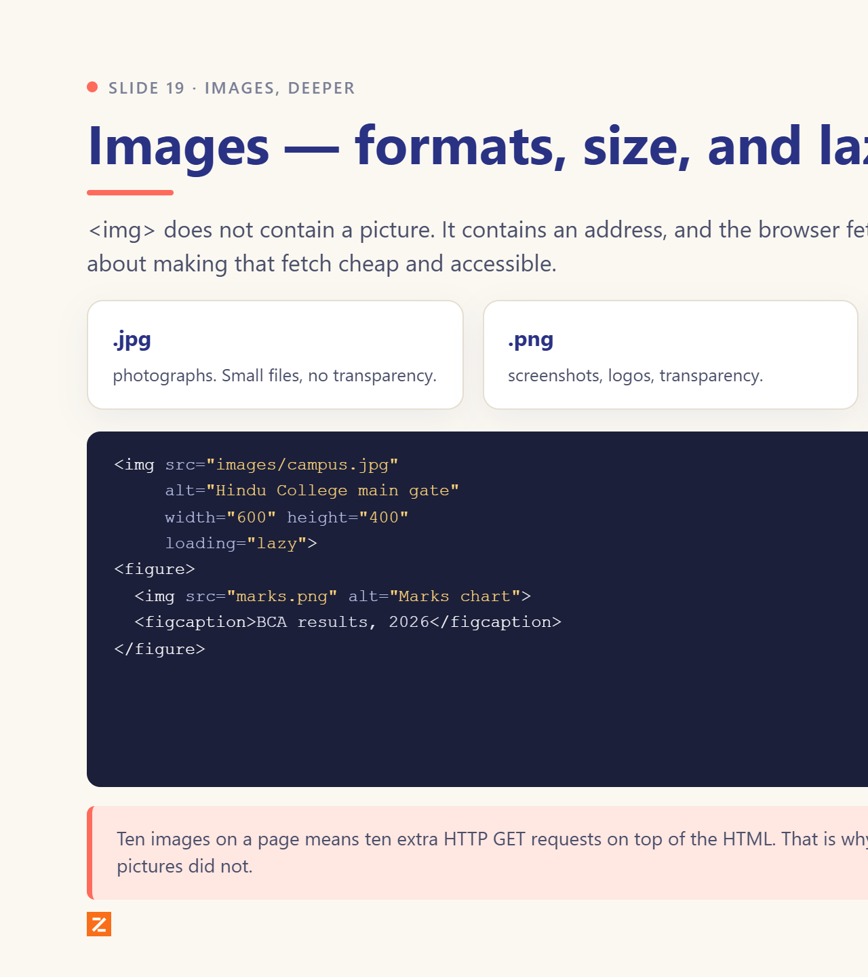
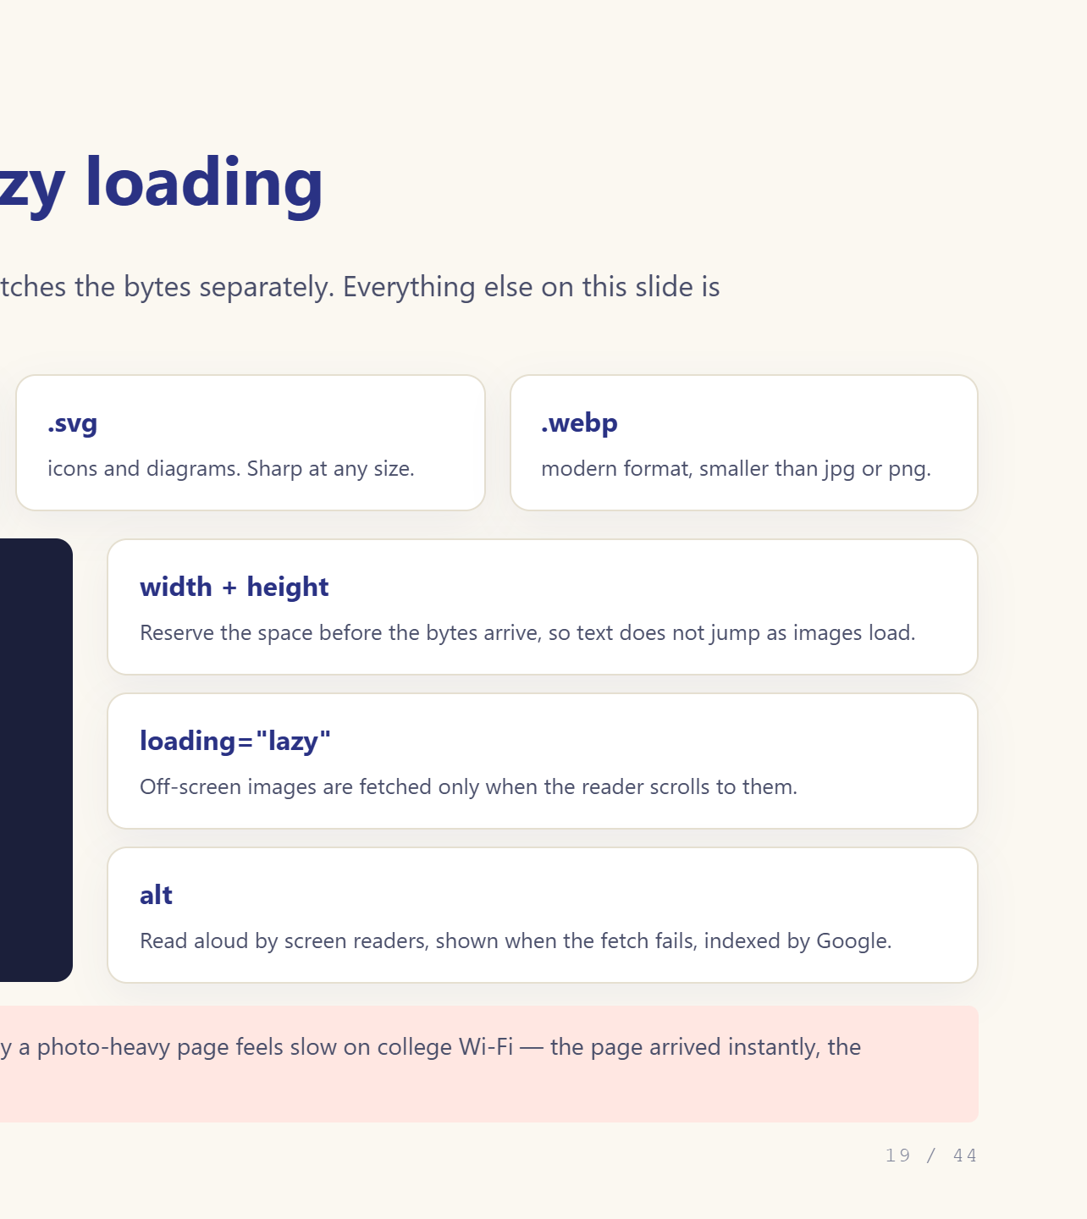
Notes:
Set width and height to stop layout jumping.

Slide 20
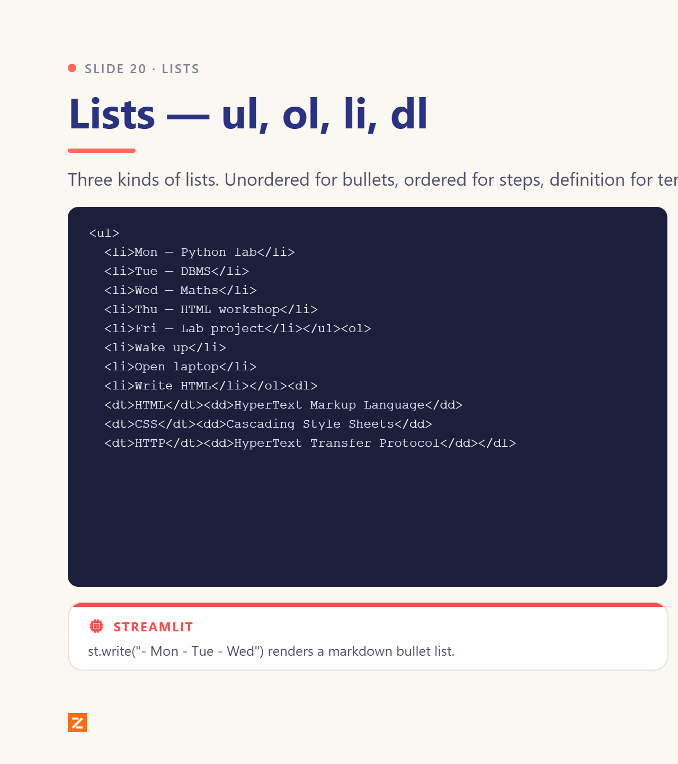
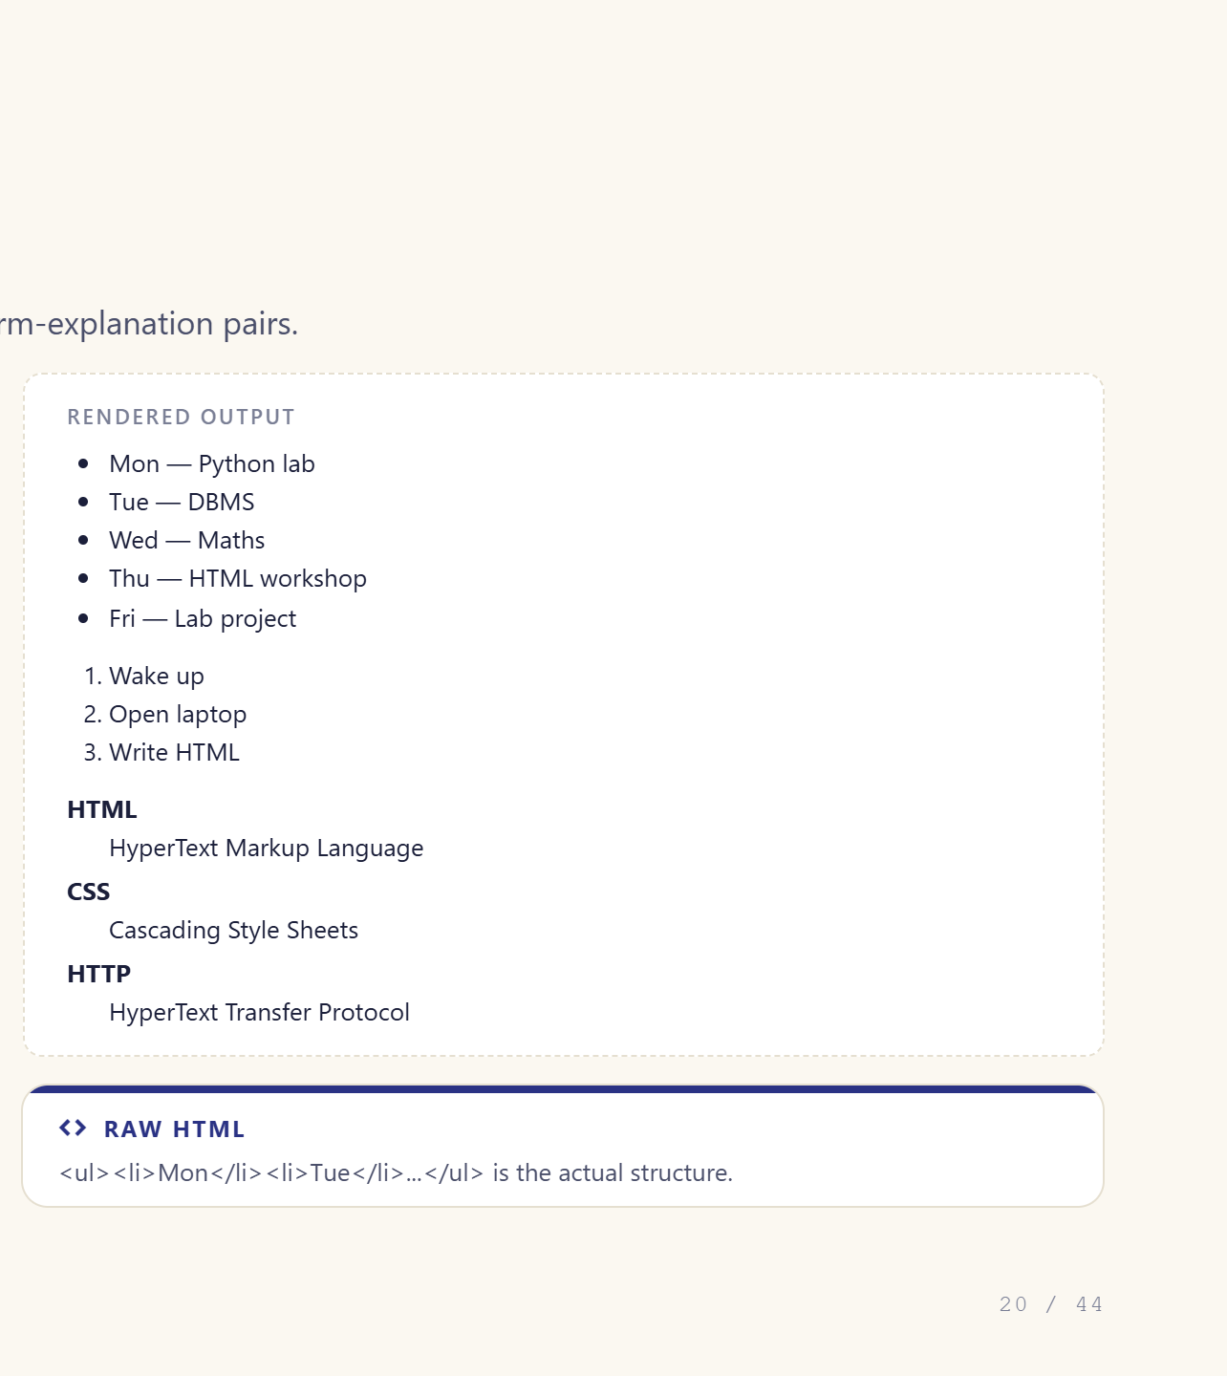
Notes:
Timetable example, ask the class to read their own week.

Slide 21
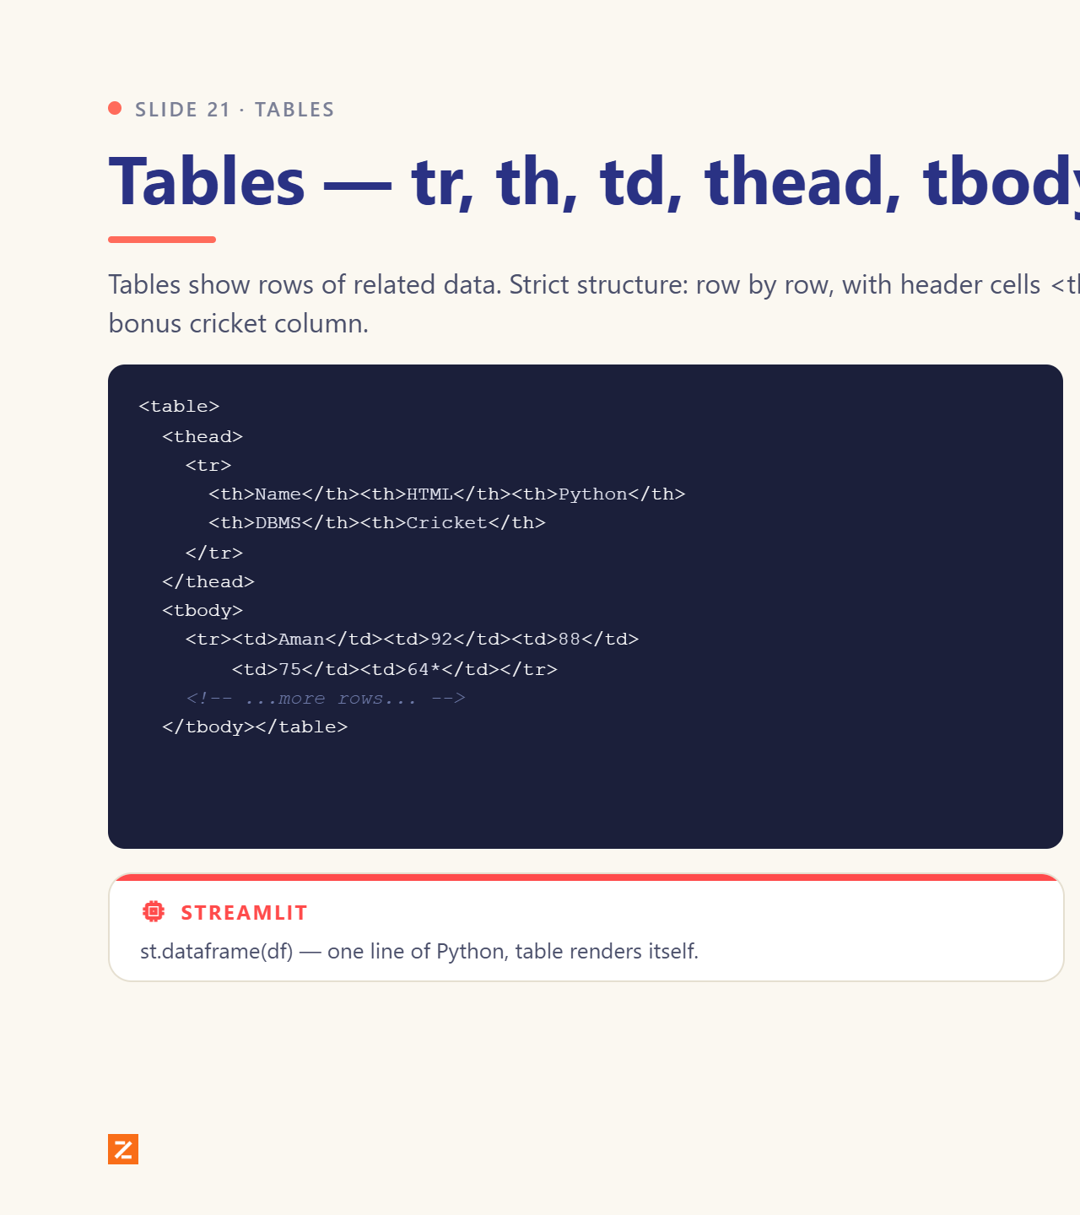
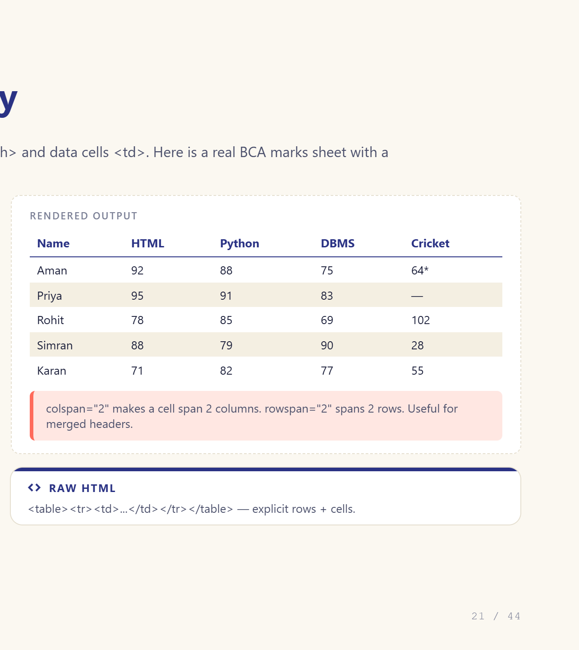
Notes:
Marks sheet with a cricket column. 64* means not out.

Slide 22
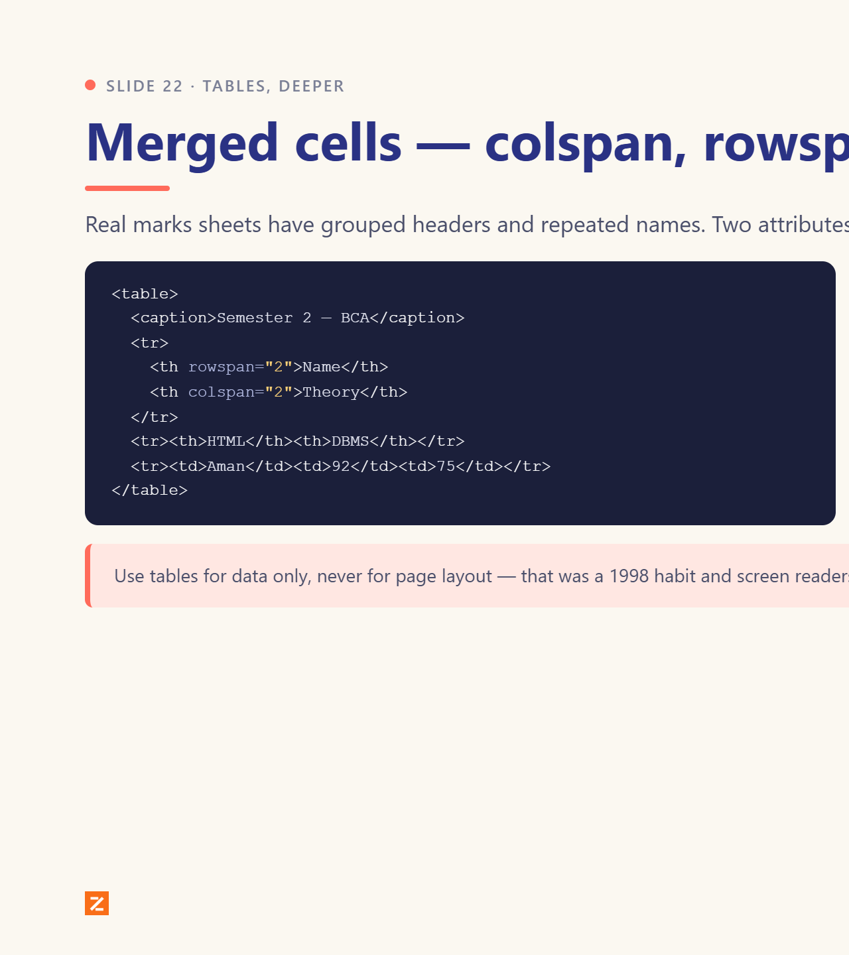
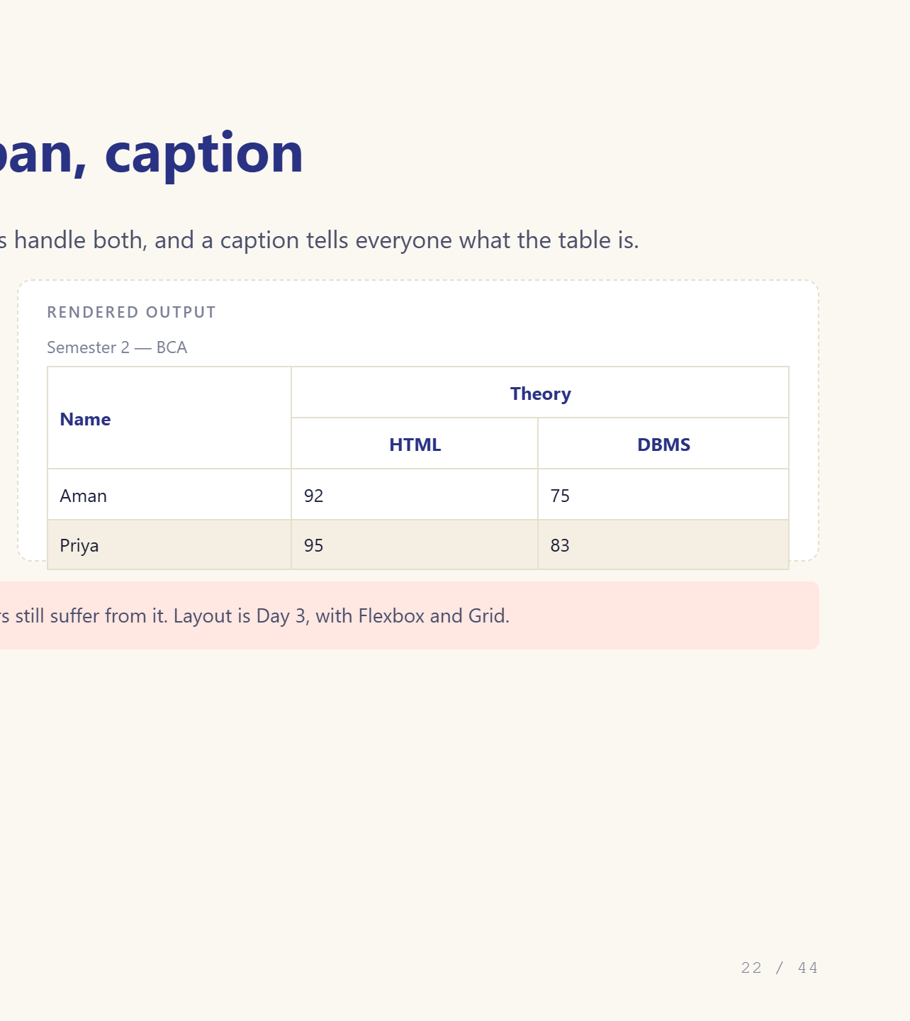
Notes:
colspan and rowspan on the board.

Slide 23
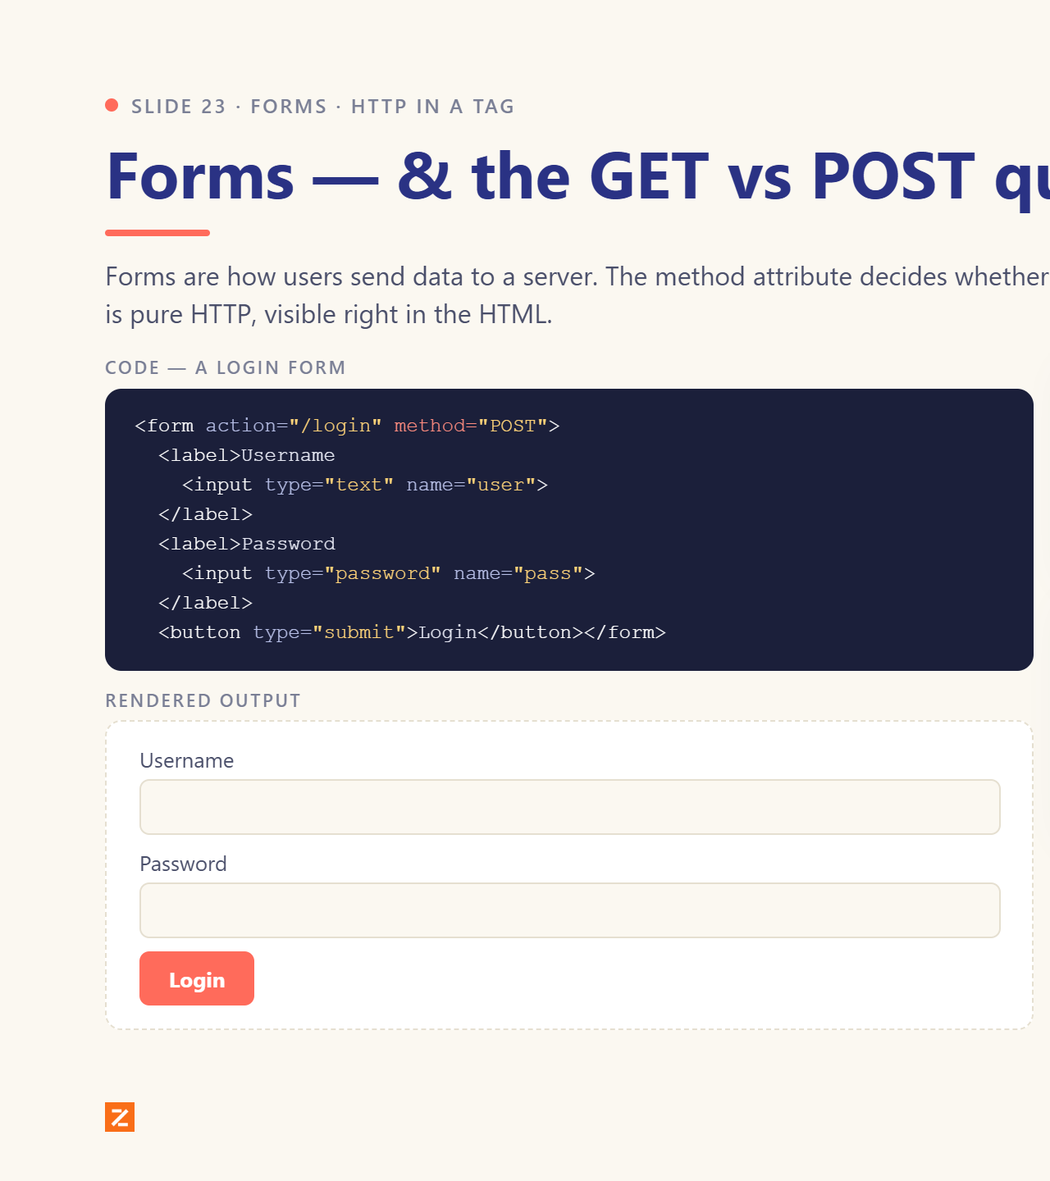
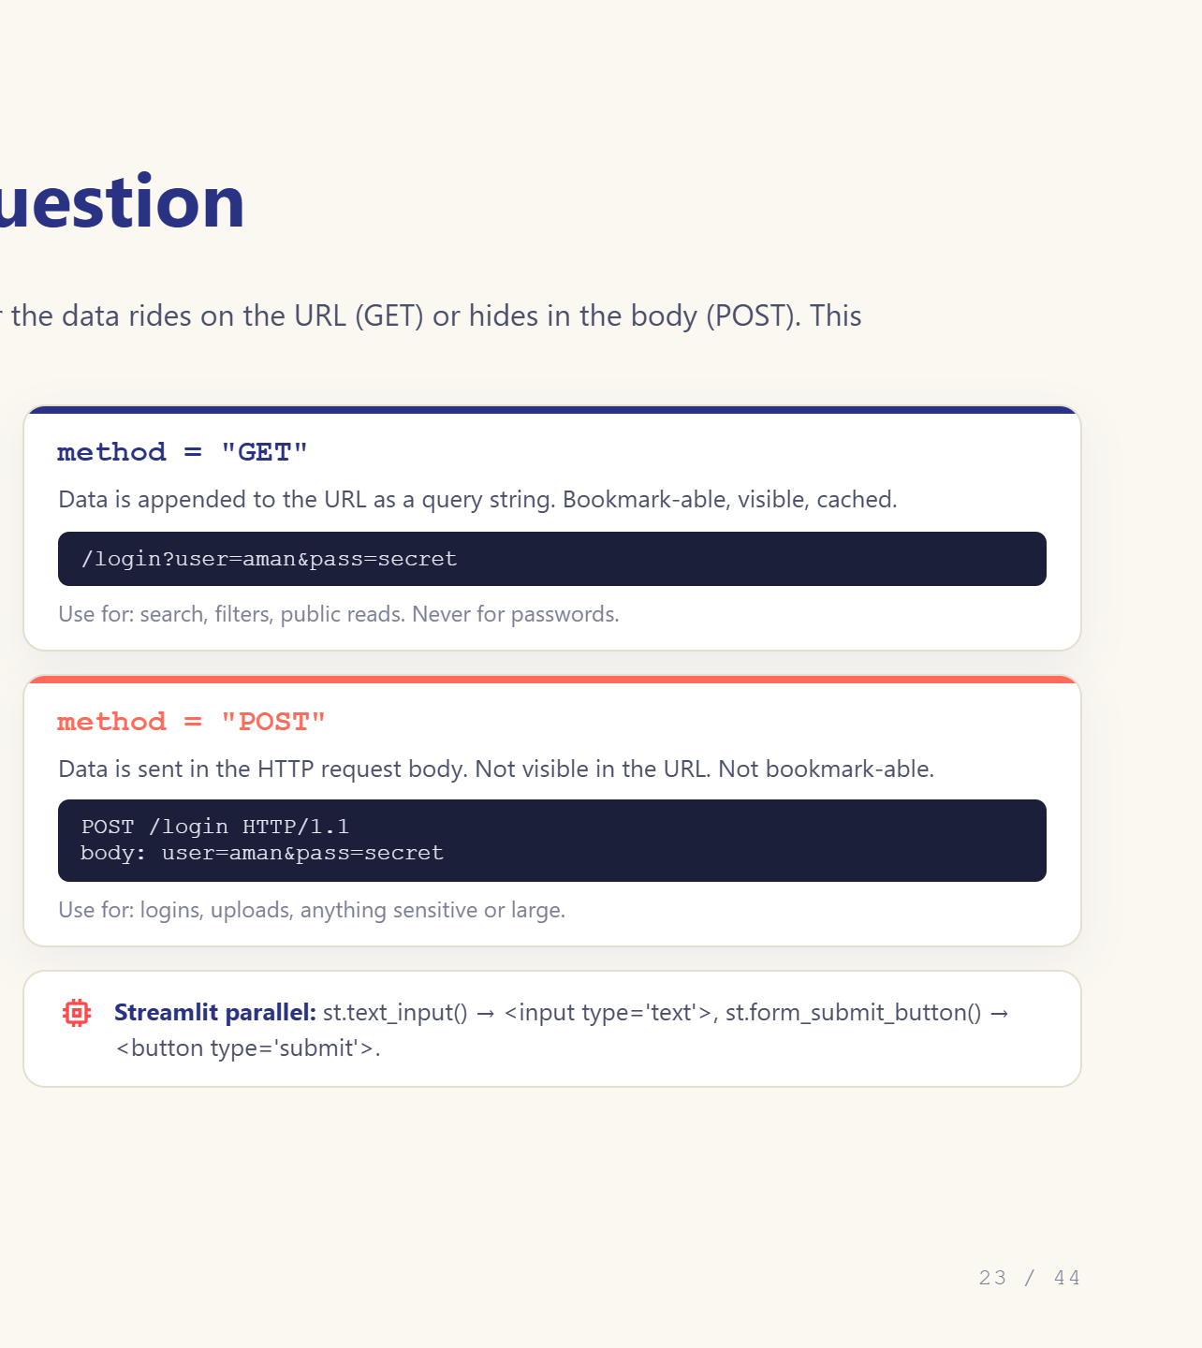
Notes:
Critical slide. Never send passwords over GET.

Slide 24
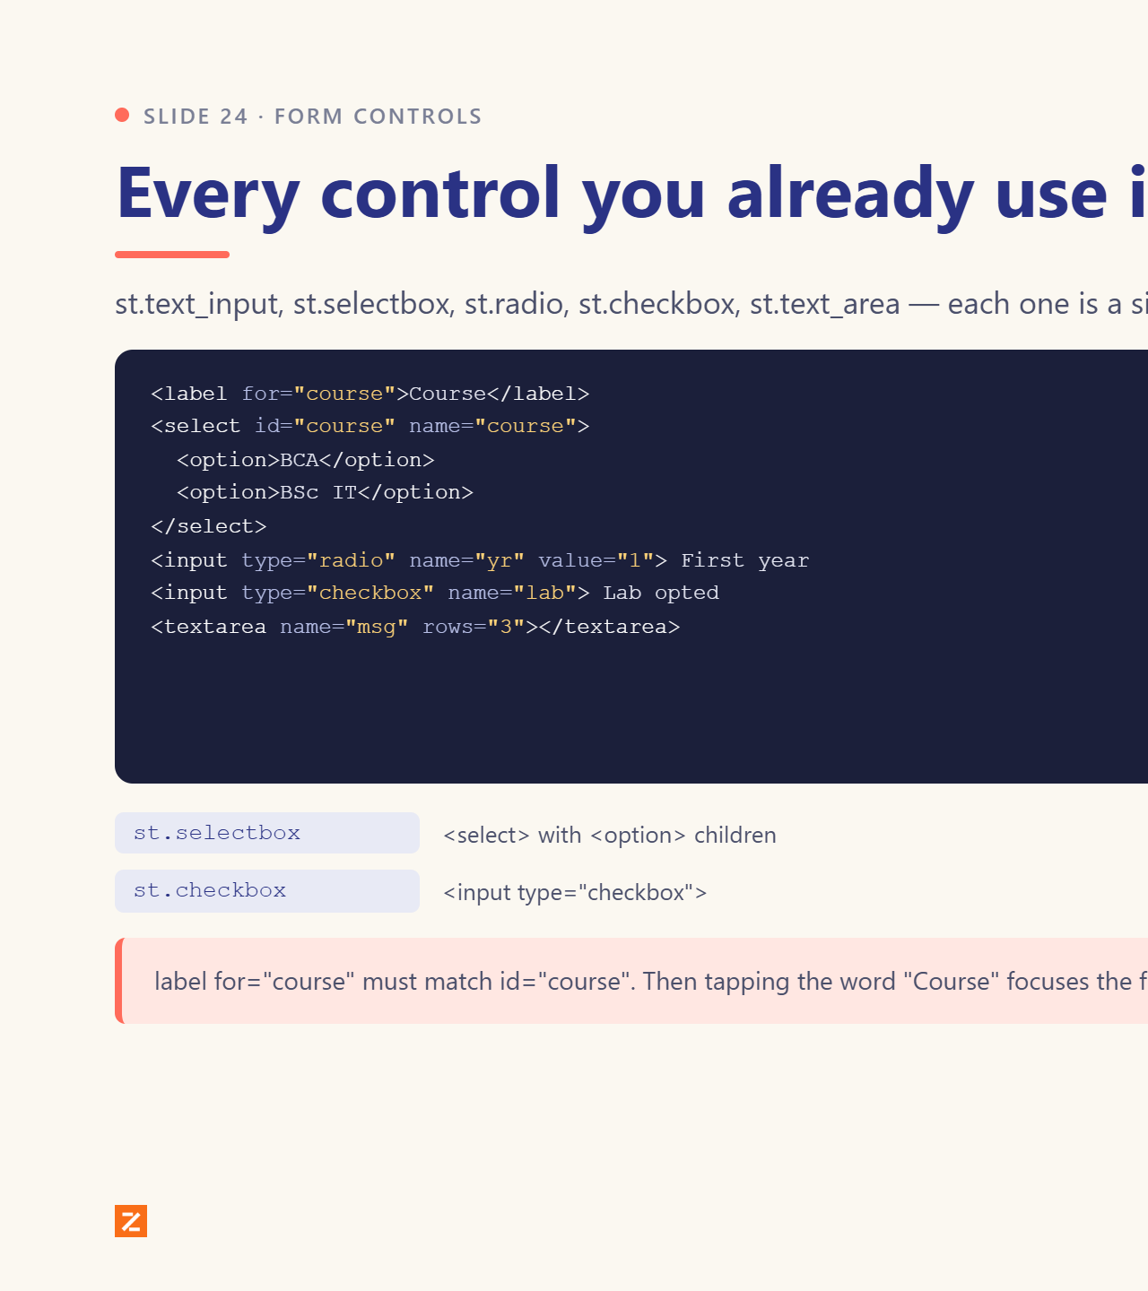
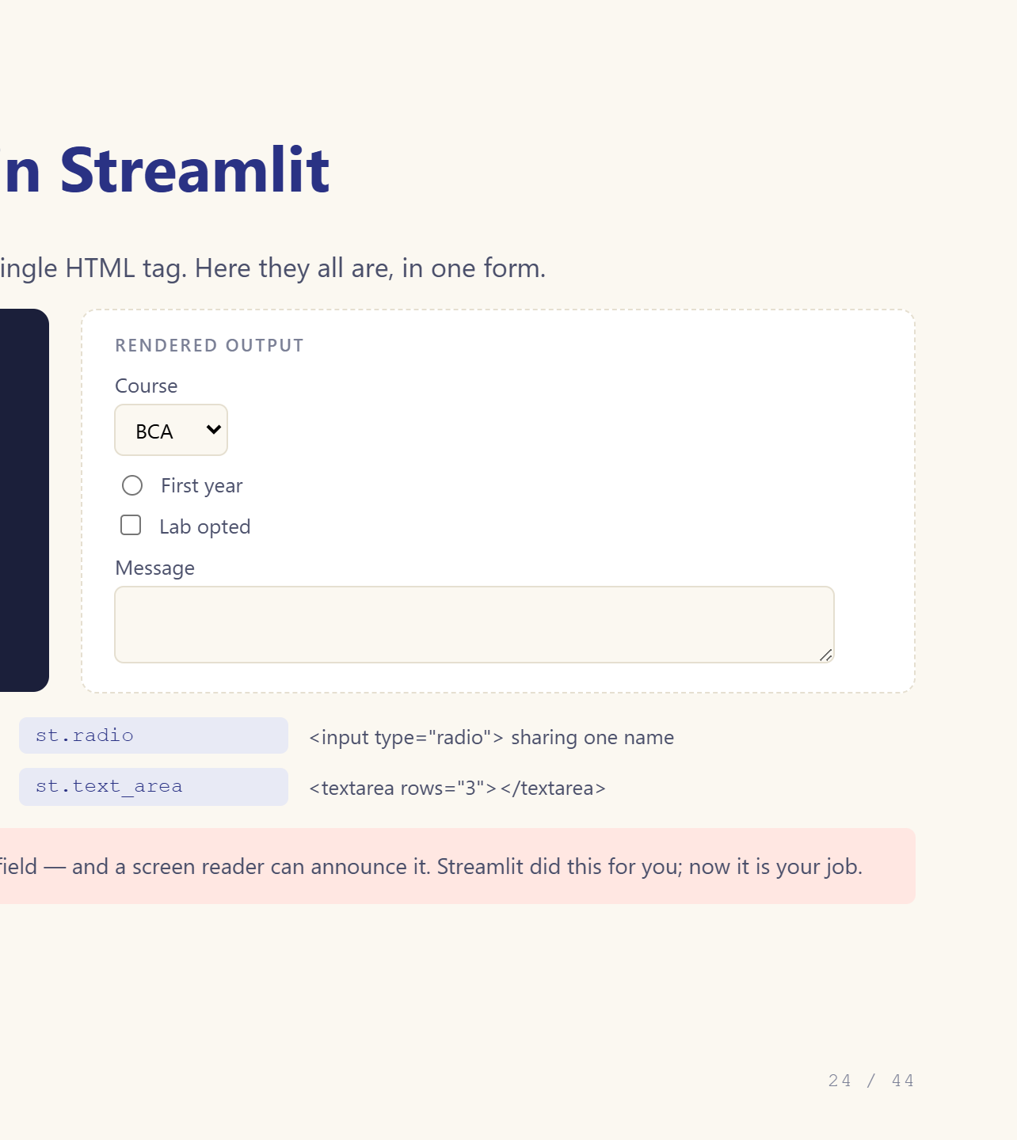
Notes:
Let them name each control they know from Streamlit.

Slide 25
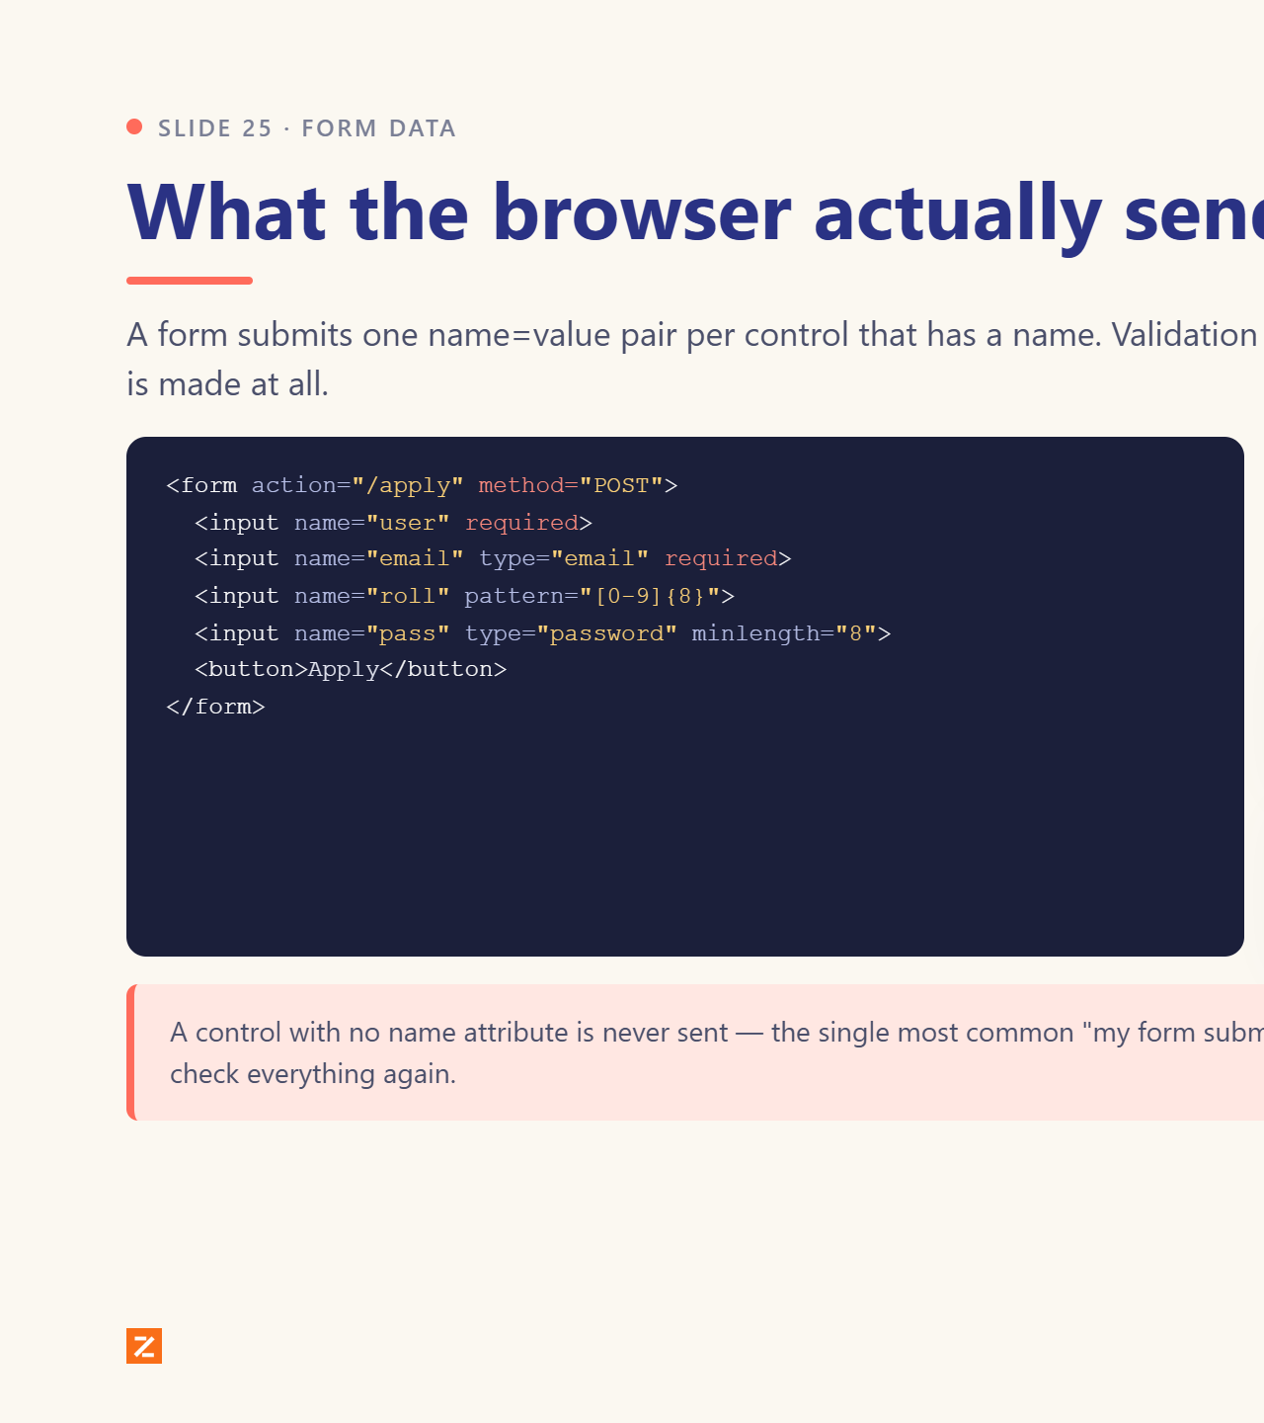
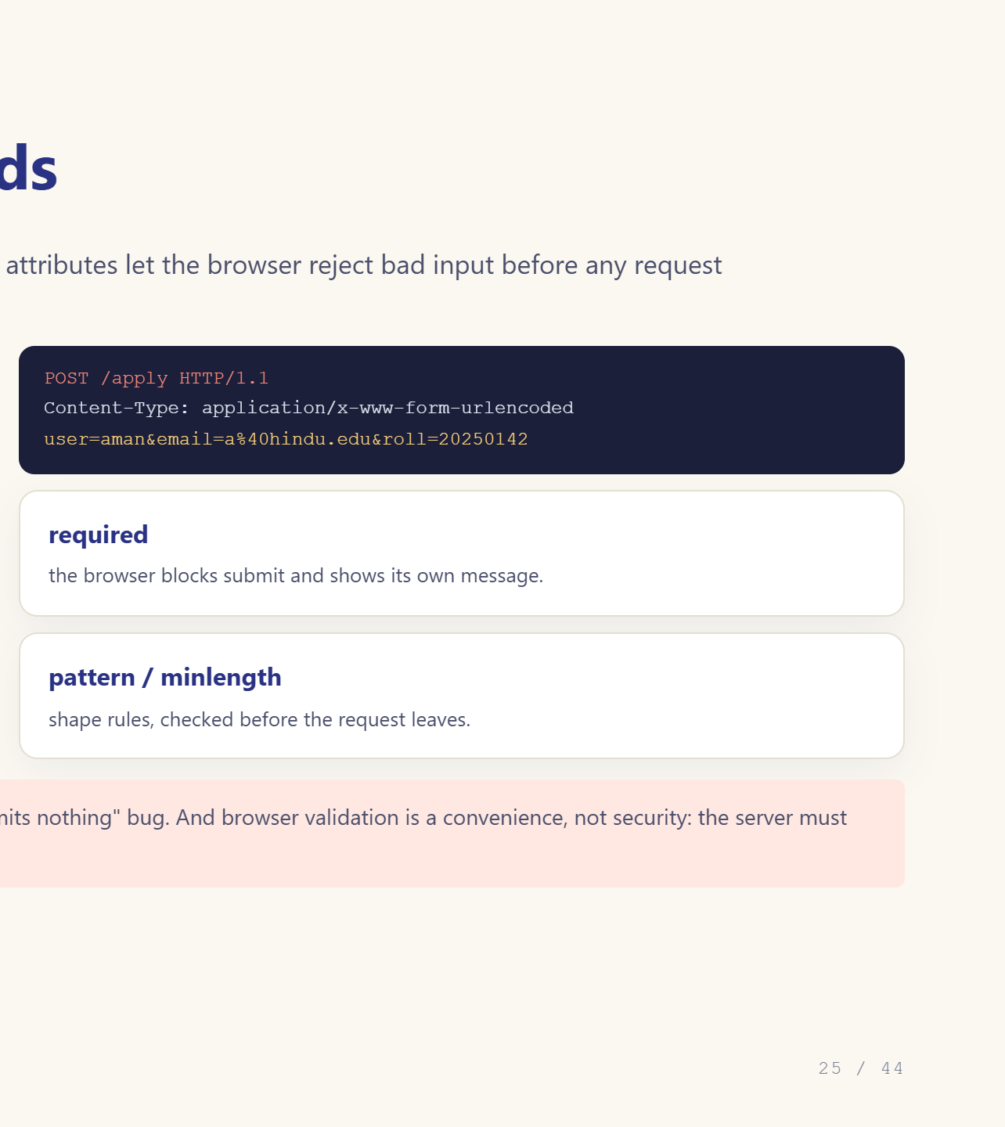
Notes:
Show name=value pairs. Missing name = missing data.

Slide 26
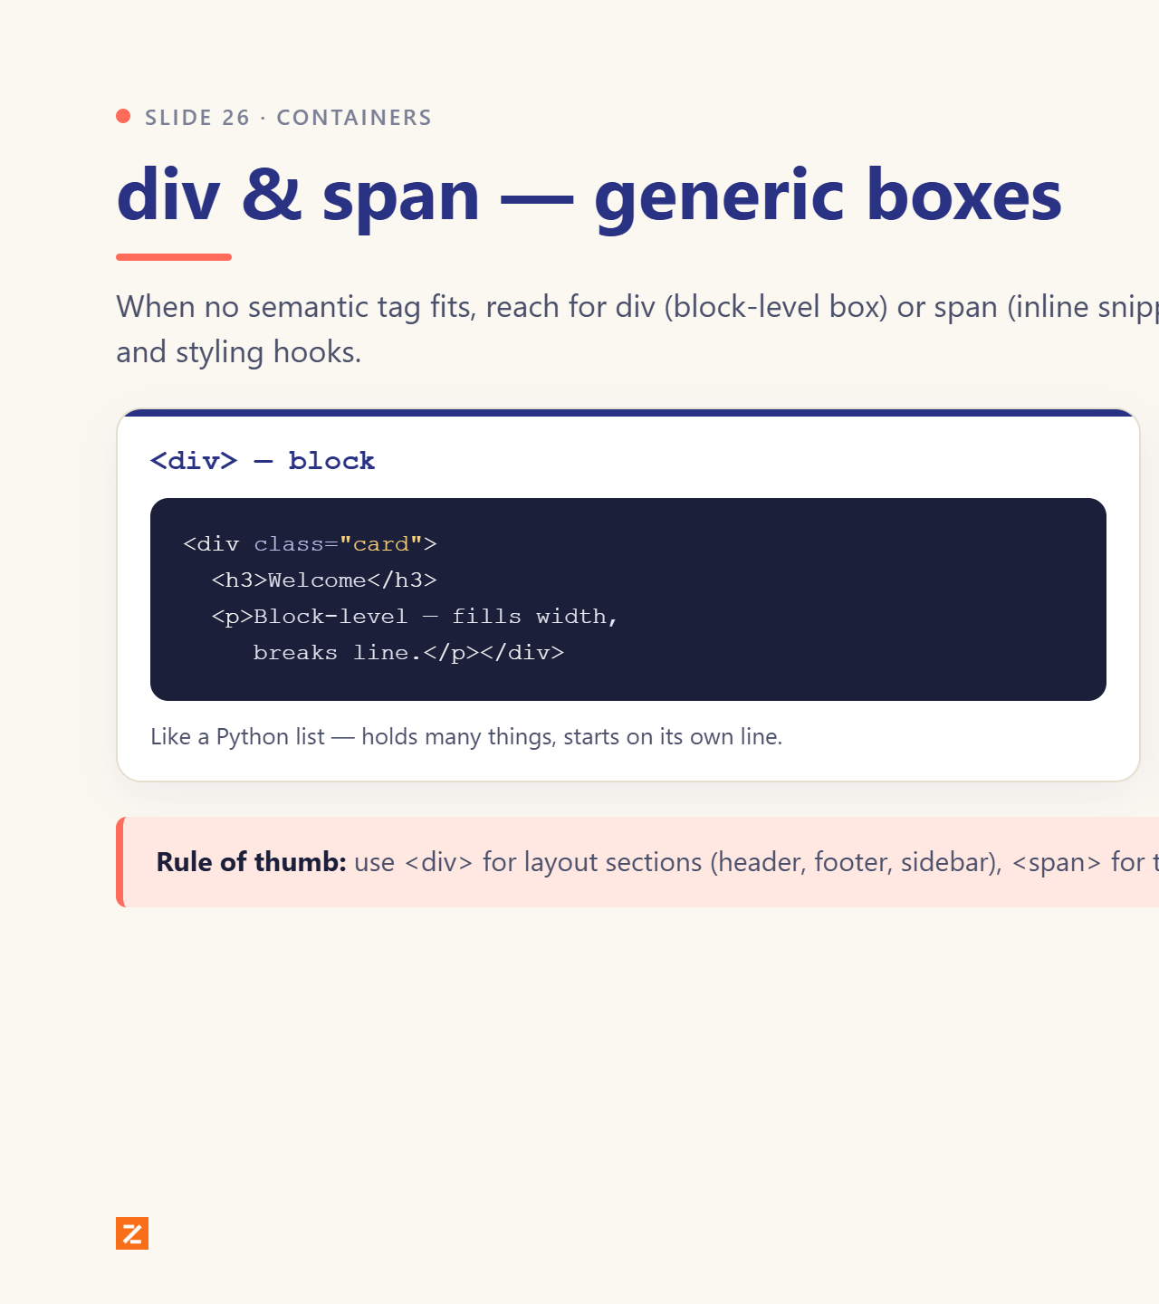

Notes:
div for sections, span for words.

Slide 27


Notes:
Semantics change meaning, not looks.

Slide 28


Notes:
Same mental model as Python kwargs.

Slide 29


Notes:
Each src is another GET. Lazy-load.

Slide 30


Notes:
st.date_input, st.slider, st.color_picker parallels.

Slide 31


Notes:
These decide the WhatsApp link preview.

Slide 32


Notes:
Tomorrow’s file gets linked here.

Slide 33


Notes:
Folders now save pain in the mini project.

Slide 34


Notes:
Run http.server live if time allows.

Slide 35


Notes:
One student in every classroom needs this.

Slide 36


Notes:
The aha slide. Do this live on localhost:8501.

Slide 37


Notes:
Open the Network tab on localhost:8501 live.

Slide 38


Notes:
This is the Day 4 hook.

Slide 39


Notes:
Do it with them, three minutes.

Slide 40


Notes:
Read them out; ask who has hit each one.

Slide 41


Notes:
Fast oral quiz: point at a term, ask for the meaning.

Slide 42


Notes:
Pick at least two. Bring them tomorrow.

Slide 43


Notes:
Preview Day 2 to Day 4. Bring laptops.

Slide 44


Notes:
Take questions. Remind them: laptops tomorrow.

