Slide 1



TKSMJ
Making scientific research accessible using AI and Big data
INTRODUCTION
WHY WE?
PROBLEM STATEMENT
LIMITATIONS
APPROACH
DEMONSTRATION
Kanisha Shah(19bce253)
Stuti Patel(19bce269)
Taha Firoz(19bce271)
Jurin Vachchani(19bce286)
Meet Vora(19bce299)

Slide 2
#1 Netflix for Researchers
PROBLEM STATEMENT
WHY WE?
DEMONSTRATION
APPROACH
LIMITATIONS
INTRODUCTION

Slide 3
Research says that around 1.8 million research papers are published every year.
The more papers there are, the more difficult it is for users to navigate through each one to find the content they want. Even if the content matches, users are not able to find the papers which are most popular among other readers.
Hence in order to make searching more intuitive for users, we propose an algorithm that takes into account the ratings given by different users for papers and the citations of papers and hence generates promising results with reduced search time for best papers.
WHY WE?
DEMONSTRATION
APPROACH
INTRODUCTION
LIMITATIONS
PROBLEM STATEMENT

Slide 4
Query Based Searching
The user enters his query in the search field and using TF-IDF similarity, research papers are ranked and displayed to the user. The similarity is based on the content and title of papers with the query.
WHY WE?
DEMONSTRATION
APPROACH
LIMITATIONS
PROBLEM STATEMENT
INTRODUCTION

Slide 5
Field Recommendation (Trending Fields)
The field recommendation uses K-nearest neighbors to recommend the user a trending field like Data Science, Machine Learning.
The algorithm treats the existing users and new users differently. - Fields displayed to new users are based on the trending fields, trending fields are calculated by taking the average of ratings given by existing users.
Fields displayed to existing users are based on the ratings given by their closest neighbors also taking into account user's ratings.
Finally, the fields having the highest rating and citations are given more preference and displayed to users.
WHY WE?
DEMONSTRATION
APPROACH
LIMITATIONS
PROBLEM STATEMENT
INTRODUCTION

Slide 6
Paper Recommendation (Trending Papers)
The paper recommendation also uses the same approach as the above algorithm.
In this case, the citations are given less preference, and ratings of other users for individual papers are given more preference.
So the user is being suggested papers based on what his neighbors or like-minded users are reading and enjoying.
Finally, the user is being asked to enter his feedback (rating : 0 to 5) on the current paper he read and is later updated in the database.
WHY WE?
DEMONSTRATION
APPROACH
LIMITATIONS
PROBLEM STATEMENT
INTRODUCTION

Slide 7
Decreased search time.
Showing papers based on similar interest.
Showing trending fields based.
User friendliness UI.
Context based Searching.
DEMONSTRATION
WHY WE?
LIMITATIONS
PROBLEM STATEMENT
INTRODUCTION
APPROACH

Slide 8
The limitation, this algorithm might face is as the research papers increase in our database the algorithm becomes lazy ("lazy learning") as it will compute the similarity with all the vectors (users) again and the searching might take longer time than usual.
We plan to shift to Deep Learning models like VAE (Variational autoencoders) as the data increases.
DEMONSTRATION
LIMITATIONS
PROBLEM STATEMENT
INTRODUCTION
WHY WE?
APPROACH

Slide 9
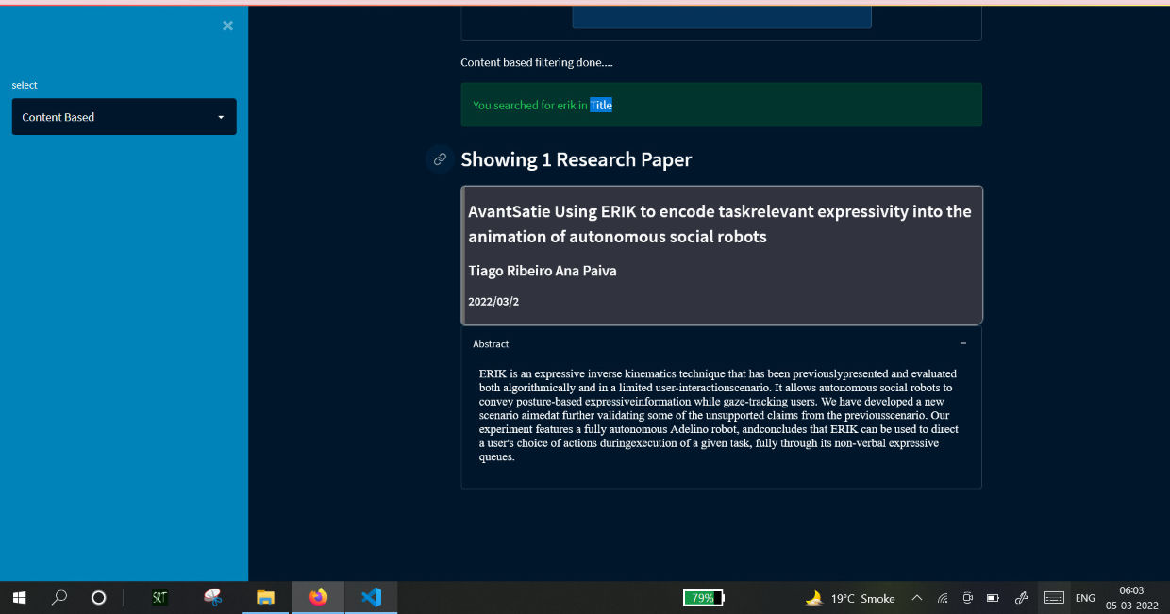
DEMONSTRATION
PROBLEM STATEMENT
LIMITATIONS
INTRODUCTION
WHY WE?
APPROACH

Slide 10
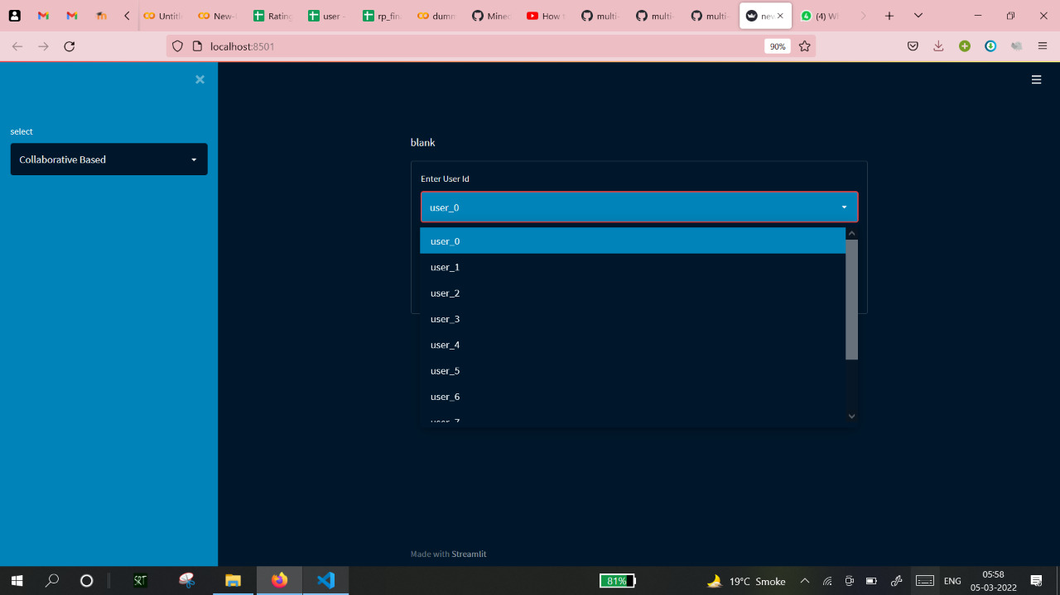
DEMONSTRATION
PROBLEM STATEMENT
LIMITATIONS
INTRODUCTION
WHY WE?
APPROACH

Slide 11
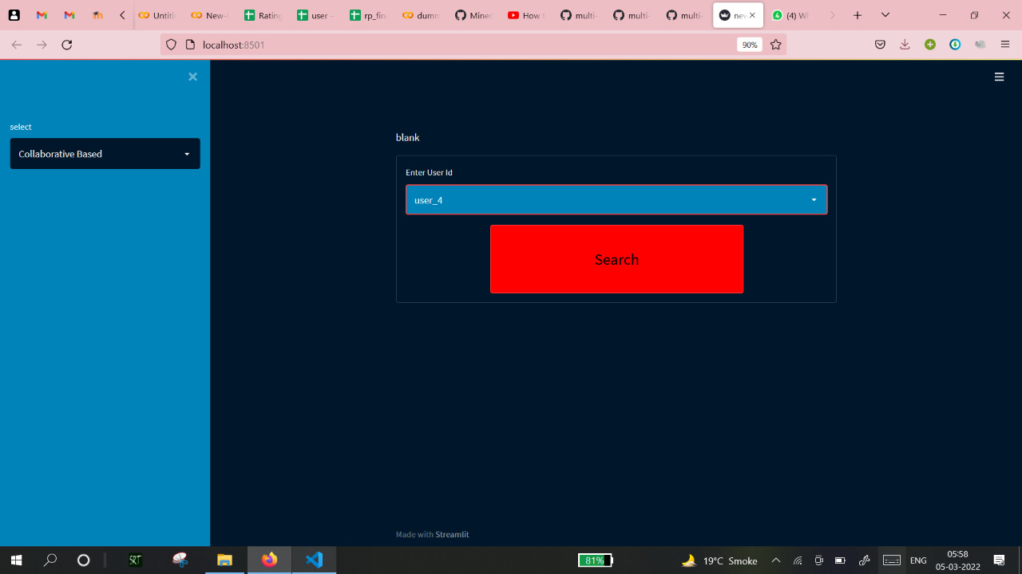
DEMONSTRATION
PROBLEM STATEMENT
LIMITATIONS
INTRODUCTION
WHY WE?
APPROACH

Slide 12
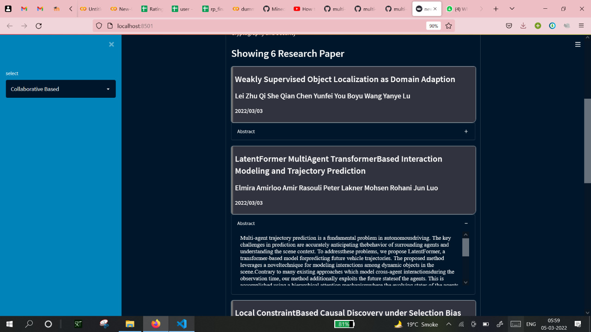
DEMONSTRATION
PROBLEM STATEMENT
LIMITATIONS
INTRODUCTION
WHY WE?
APPROACH

Slide 13
REFERENCES
https://arxiv.org/
https://www.analyticsvidhya.com/blog/2020/11/create-your-own-movie-movie-recommendation-system/
https://techvidvan.com/tutorials/movie-recommendation-system-python-machine-learning/

