Slide 1



Water Quality Prediction
By: Kanisha Ravindra Sharma AICTE Student ID: STU6767d1d4f23fc1734857172
GitHub: https://github.com/KanishaSharma11/Edunet-AICTE-Internship/tree/main

Slide 2

Learning Objectives
Understand the impact of various water parameters on quality.
Learn how to preprocess real-world environmental datasets.
Implement and evaluate a Random Forest Regressor model.
Gain insights into model performance through regression metrics.
Build an intelligent system for proactive water quality monitoring.
GOAL
Source :
www.freepik.com/

Slide 3
Tools and Technology used
Languages: Python
Libraries and Frameworks:
Pandas, NumPy, Scikit-learn – for data handling and model training
Streamlit – for interactive web-based user interface
Flask – for backend
Joblib, Pickle – for model saving and loading
Environment:
Jupyter Notebook – for experimentation and development
app.py – for deployment using Streamlit or Flask
Algorithm:
Random Forest Regressor – used for water quality prediction

Slide 4
Methodology
Loaded the dataset: Imported waterQualityDataset.csv Cleaned the Data: Handled missing values and removed or treated outliers to ensure quality input.
Selected Features: Dropped redundant or highly correlated features to prevent overfitting.Split the Data.
Trained the Model: Implemented a Random Forest Regressor to capture complex relationships.
Evaluated the Model: Used R², MAE, and RMSE to assess predictive accuracy.
Prepared for Deployment: Serialized the model using Pickle/Joblib, and integrated it using Streamlit and Flask.

Slide 5
Problem Statement:
With increasing pollution and climate impact on freshwater sources, there is an urgent need for intelligent, real-time systems that can analyze water quality and predict contamination risk before it becomes a threat. This project aims to build a machine learning-based prediction model that empowers communities, researchers, and authorities to monitor water safety, prevent waterborne diseases, and promote sustainable water management through data-driven insights.

Slide 6
Solution:
To tackle the challenge of predicting water quality intelligently and in real time, we developed a machine learning-based system that analyzes chemical properties of water to assess its safety.
The dataset, containing physicochemical parameters like pH, hardness, and solids, was preprocessed with cleaning, normalization, and feature selection.
A Random Forest Regressor was trained to capture complex, nonlinear patterns and deliver robust predictions.
Model performance was evaluated using R² score, Mean Absolute Error, and Root Mean Squared Error, ensuring accuracy and generalization.
Key influencing features were identified through feature importance analysis, enhancing interpretability.
The trained model was serialized using Pickle and Joblib, and integrated into an interactive web interface built with Streamlit and Flask, enabling real-time predictions.
This system provides a scalable, user-friendly, and cost-effective tool for researchers, environmentalists, and policy-makers to make proactive decisions and prevent water contamination-related risks.

Slide 7
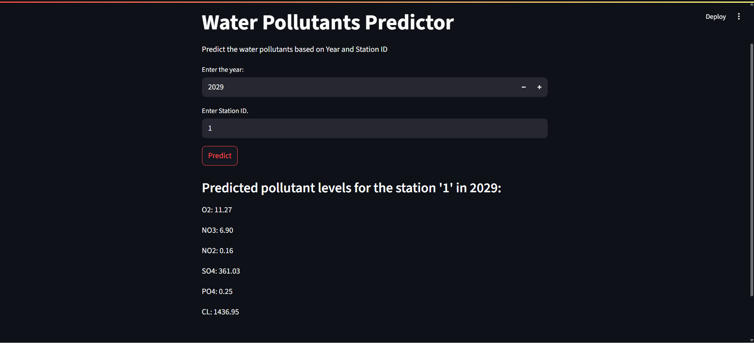
Screenshot of Output:

Slide 8
Conclusion:
The project successfully demonstrates how machine learning, specifically Random Forest Regressor, can be leveraged to predict water quality with high accuracy.
Through data preprocessing, analysis, and model evaluation, we identified the most influential factors affecting water quality.
The integration of the trained model into a Streamlit and Flask-based web application ensures real-time accessibility and usability.
This system offers a scalable, low-cost, and intelligent solution to support environmental monitoring, early intervention, and public health safety.
With further improvements and live sensor integration, this project has the potential to become part of smart water management systems used by governments and communities.

