Slide 1
MismatchAnalyzer
Renault Nissan Technology & Business Centre India
A presentation on the AI-Driven
Image Difference Analyzer
Presented by,
Kanishk Mishra

Slide 2
Problem Statements
Renault Nissan Technology & Business Centre India
Version V01:
Leverage AI to calculate mismatch % between two cluster screenshots
Input: Cluster image dataset & HTML comparison report
Output:
  Categorized analysis report (4 status groups)
  Spreadsheet with % differences from multiple models
  OCR-extracted text from selected images
Version V02:
Use LLM to describe differences in natural language
Highlight differences between two images
Output:
  Analysis report + LLM review
  Highlighted diff image
Version V2.1:
Fine-tune a multimodal model on comparison images + target outputs

Slide 3
My Approach
Renault Nissan Technology & Business Centre India
For V01:
Do a pixelwise comparison
  Issue? – Too sensitive
Check size difference
Go for the head – Neural Networks
  Use ViT to get the embedding vectors of both the images.
  Calculate the cosine similarity (dissimilarity)
  Set thresholds for all the statuses (OK, NOK, Investigate & Faulty)
Small image issue!
  Use a GAN to enlarge and enhance images
Use an OCR to extract text when required.
For V02:
Try with API of a cloud based MLLM – better performance
  Engineer prompts to include images and req instructions
Use Pillow to create the highlighted diff image
Use CV to find minute differences and send with the prompt

Slide 4
Models & Metrics Used
Renault Nissan Technology & Business Centre India
Scale mismatch computation
Pixel mismatch computation
CLIP from OpenAI - for perceptual variation
  Coupled with torch’s cosine similarity computation
Segment wise CLIP mismatch computation
EasyOCR – for text extraction
Real-ESRGAN – for image enhancement
Mistral (Ollama) via API – for difference review

Slide 5
V01 Comparison & Status Logic
Renault Nissan Technology & Business Centre India
If images are not comparable → Status = Faulty (e.g., different sizes)
If overall CLIP mismatch > NOK threshold → Status = NOK
If CLIP mismatch > Investigate threshold:
  If only one segment is very different (striking difference) → NOK
  Else → Investigate
If CLIP mismatch ≤ Investigate threshold:
  If one striking segment is found → NOK
  Else if segment mismatch > NOK threshold → Investigate
  Else if segment mismatch > Investigate threshold → Investigate
  Else → OK

Slide 6


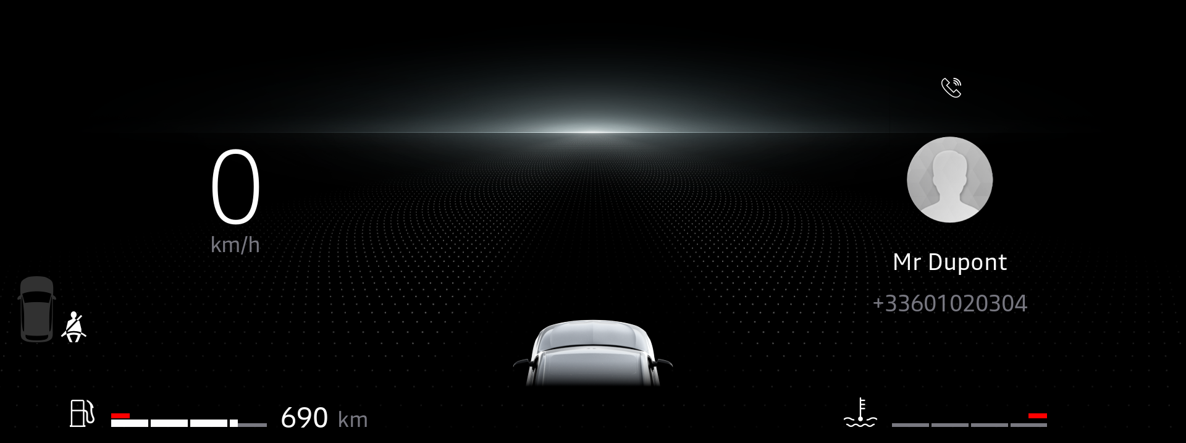

Sample OK Cases
Renault Nissan Technology & Business Centre India
CLIP mismatch = 0.02 | Scale mismatch = 0 | Max Segment mismatch = 0.06
CLIP mismatch = 0 | Scale mismatch = 0 | Max Segment mismatch = 0

Slide 7
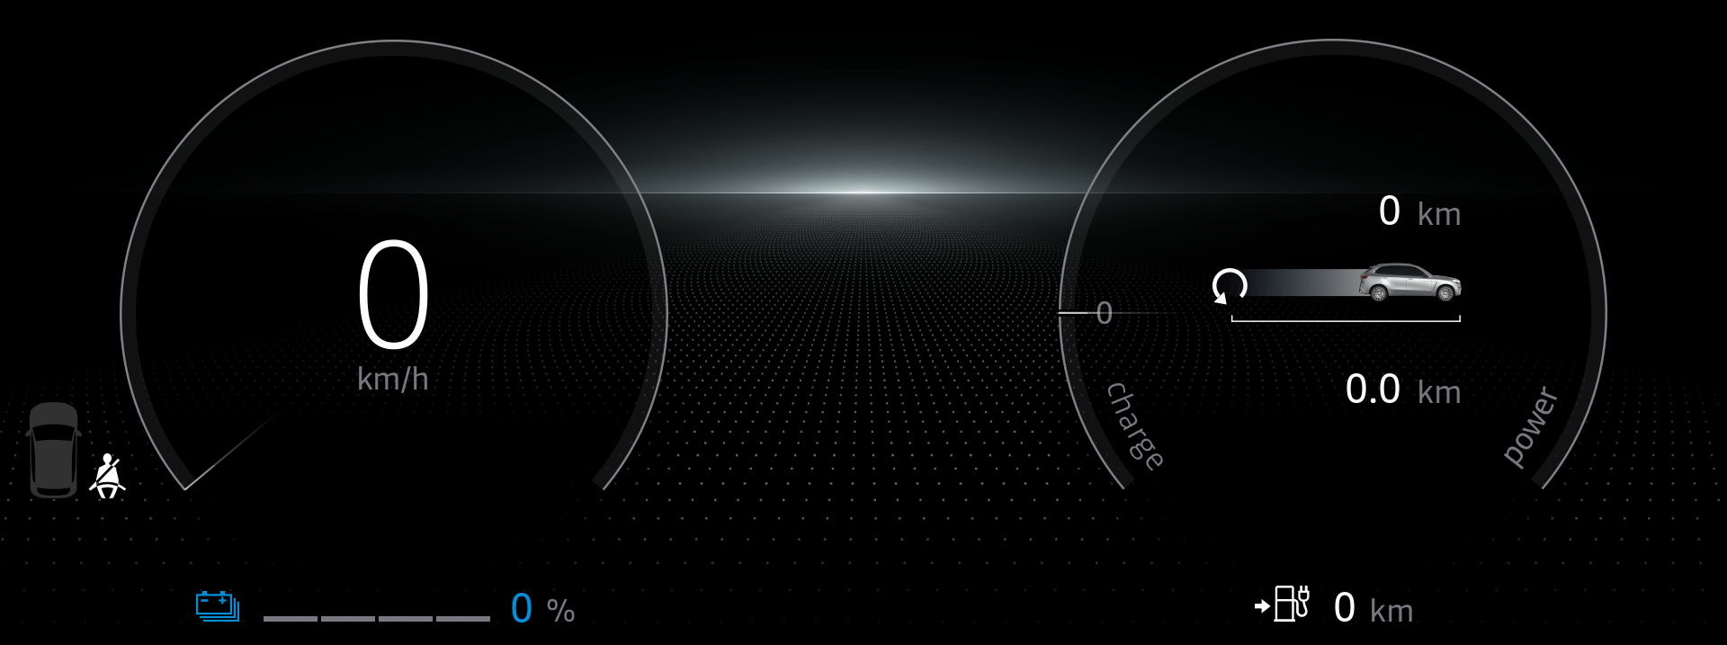
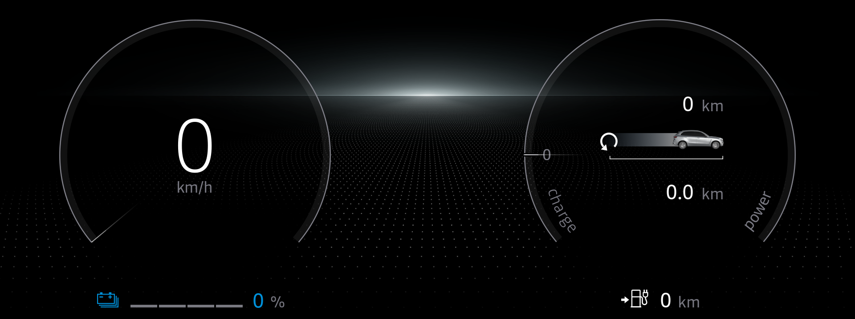
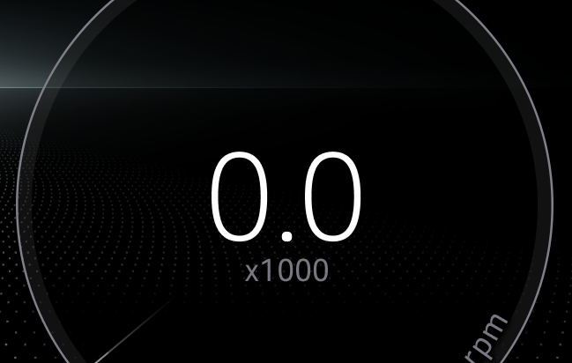
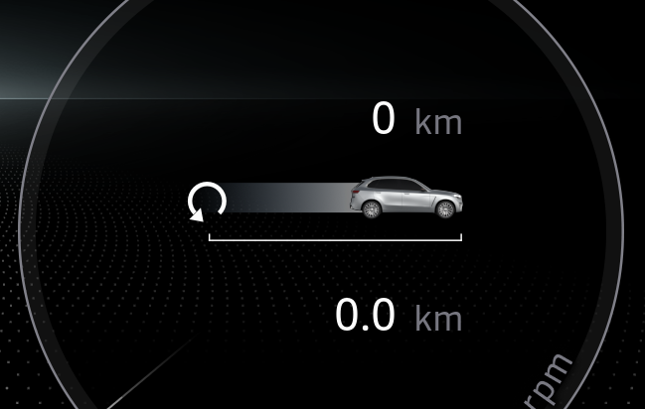
Sample NOK Cases
Renault Nissan Technology & Business Centre India
CLIP mismatch = 0 | Scale mismatch = 0 | Max Segment mismatch = 11.24
CLIP mismatch = 9.63 | Scale mismatch = 0 | Max Segment mismatch = 9.32

Slide 8
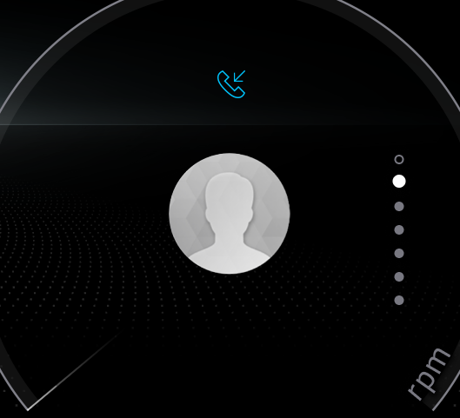
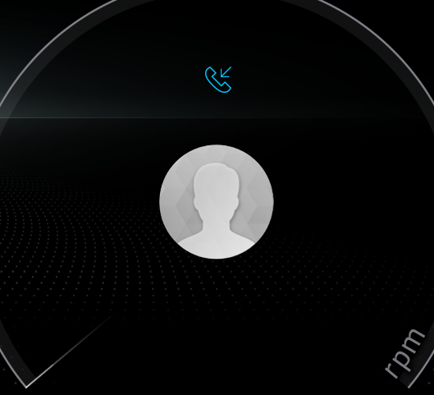
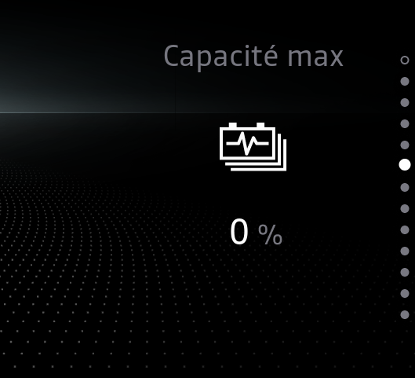
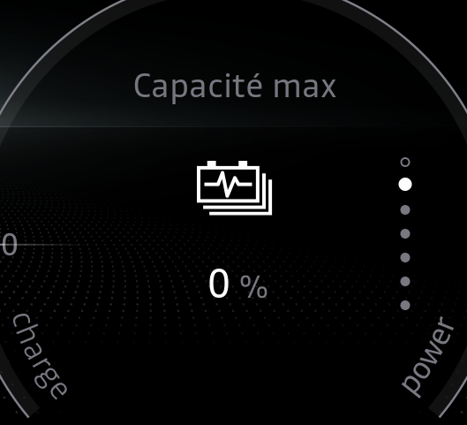
Sample Investigate Cases
Renault Nissan Technology & Business Centre India
CLIP mismatch = 0.5 | Scale mismatch = 0 | Max Segment mismatch = 3.45
CLIP mismatch = 5.47 | Scale mismatch = 0 | Max Segment mismatch = 9.5

Slide 9


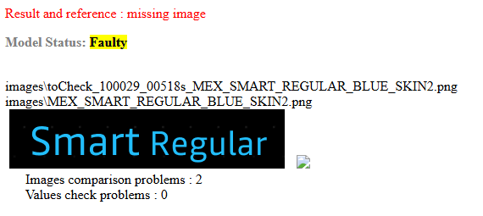
Sample Faulty Cases
Renault Nissan Technology & Business Centre India
CLIP mismatch = NA | Scale mismatch = 8.8 | Max Segment mismatch = NA
Image is missing!
CLIP mismatch = NA | Scale mismatch = NA | Max Segment mismatch = NA

Slide 10
V01 Analysis Summary over C1AREG_10i
Renault Nissan Technology & Business Centre India
Status | Count
OK | 2967
NOK | 753
Investigate | 912
Faulty | 367

Slide 11
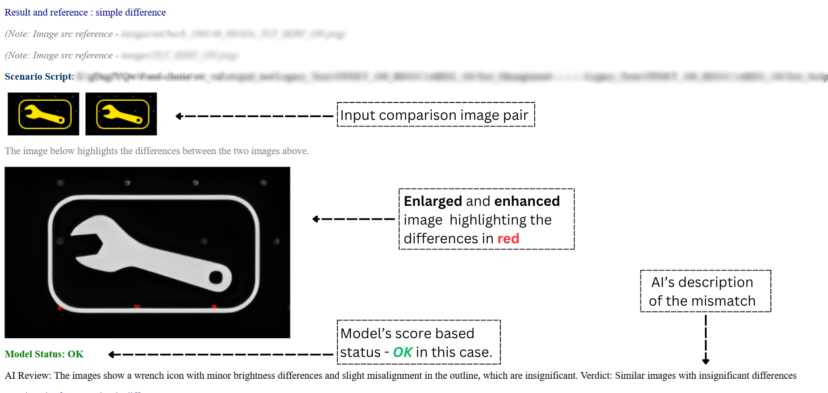
Sample V02 Final Analysis Report
Renault Nissan Technology & Business Centre India

Slide 12
Challenges Faced
Renault Nissan Technology & Business Centre India
GPU unavailability - Unresolved
Low CLIP MM% on large images
  Implemented Resolution: Segment compared large images and take the argmax CLIP MM%
Low CLIP MM% on very small images
  Implemented Resolution: Enhanced them using GAN
Low CLIP MM% on text variations
  Implemented Resolution: Added a text recognition model to compare textual content
Executable file’s size issue due to model weights - Unresolved

Slide 13
Conclusion
Renault Nissan Technology & Business Centre India
CLIP and Mistral have been the most reliable local and cloud-based models so far.
A hybrid analysis approach can be considered to avoid sending confidential data to cloud-based models.
However, relying solely on an online MLLM is currently the most efficient option.
A fully offline/local solution is storage-intensive and resource-draining, but it's the best choice for data privacy.
Fine-tuning and prompt engineering are the recommended paths forward; training a model from scratch would be inefficient.

Slide 14
Scope
Renault Nissan Technology & Business Centre India
Additional models like VGG16 can be explored.
The bootstrap technique can be used to fine-tune a secondary model by generating scores from our current models and using them as input for training.
Individual percentage scores from different methods can be aggregated using a suitable technique.
These scores can also be converted into percentiles for better comparability.
If the hybrid approach is approved, fine-tuning Mistral via API using the difference image and expected description can be done.
If the offline approach is accepted, Mistral’s models like Pixtral can be downloaded and fine-tuned.
Project can be scaled to detect mistakes in a screenshot without the expected image.

Slide 15
Thankyou
Renault Nissan Technology & Business Centre India

