Slide 1
Mismatch%Calculator
Renault Nissan Technology & Business Centre India
A presentation on the AI analysis
of the Global Test Report
Presented by,
Kanishk

Slide 2
Statuses and Meanings
Renault Nissan Technology & Business Centre India
Threshold meanings:
clip_threshold_investigate: CLIP mismatch percentage above which status becomes 'Investigate'.
'Investigate' refers to image pairs with noticeable but not severe differences (ideally between 3–8%).
clip_threshold_nok: CLIP mismatch percentage above which status becomes 'NOK'.
NOK' refers to image pairs with significant mismatches (ideally greater than 8%).
segment_threshold_investigate: Segment-wise max mismatch percentage above which status becomes 'Investigate'.
The images are divided into smaller segments for detailed (tell-tale level) comparison.
This threshold applies to the highest mismatch observed among those segments (ideally between 3–8%).
segment_threshold_nok: Segment-wise max mismatch percentage above which status becomes 'NOK'.
Indicates major differences at the segment level (ideally greater than 8%).
Ideal threshold values: Investigate = 3%, NOK = 8–10%

Slide 3


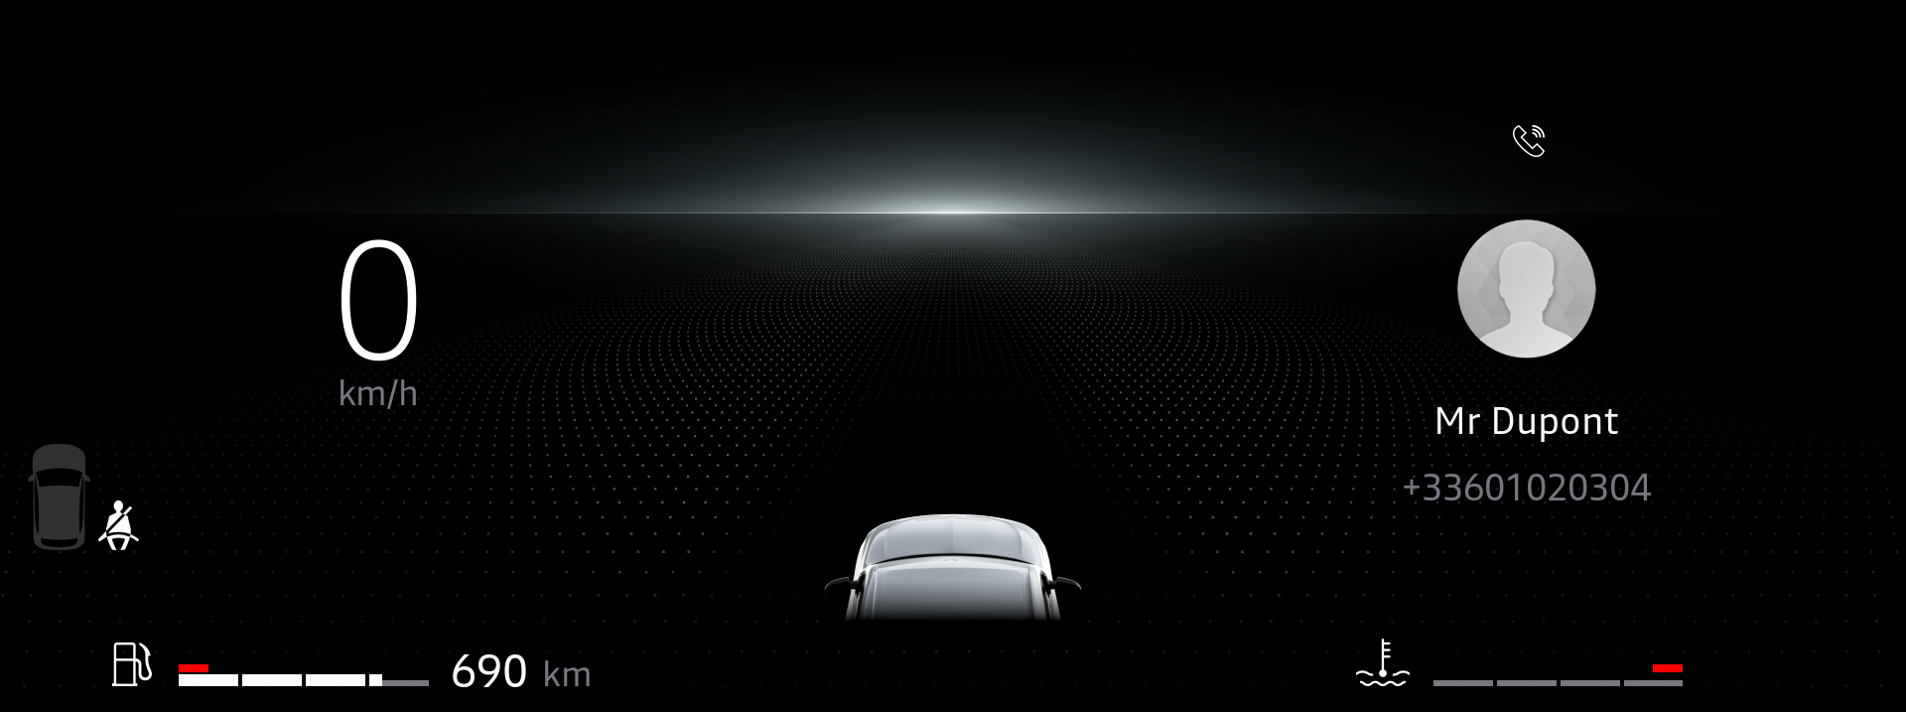

Sample OK Cases
Renault Nissan Technology & Business Centre India
CLIP mismatch = 0.02 | Scale mismatch = 0 | Max Segment mismatch = 0.06
CLIP mismatch = 0 | Scale mismatch = 0 | Max Segment mismatch = 0

Slide 4
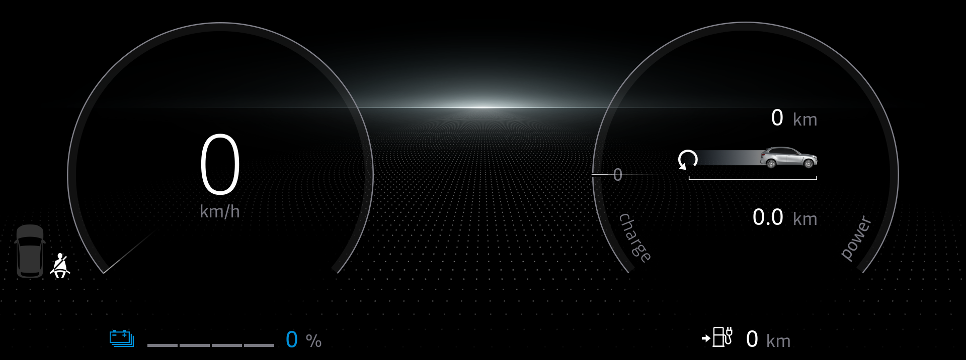
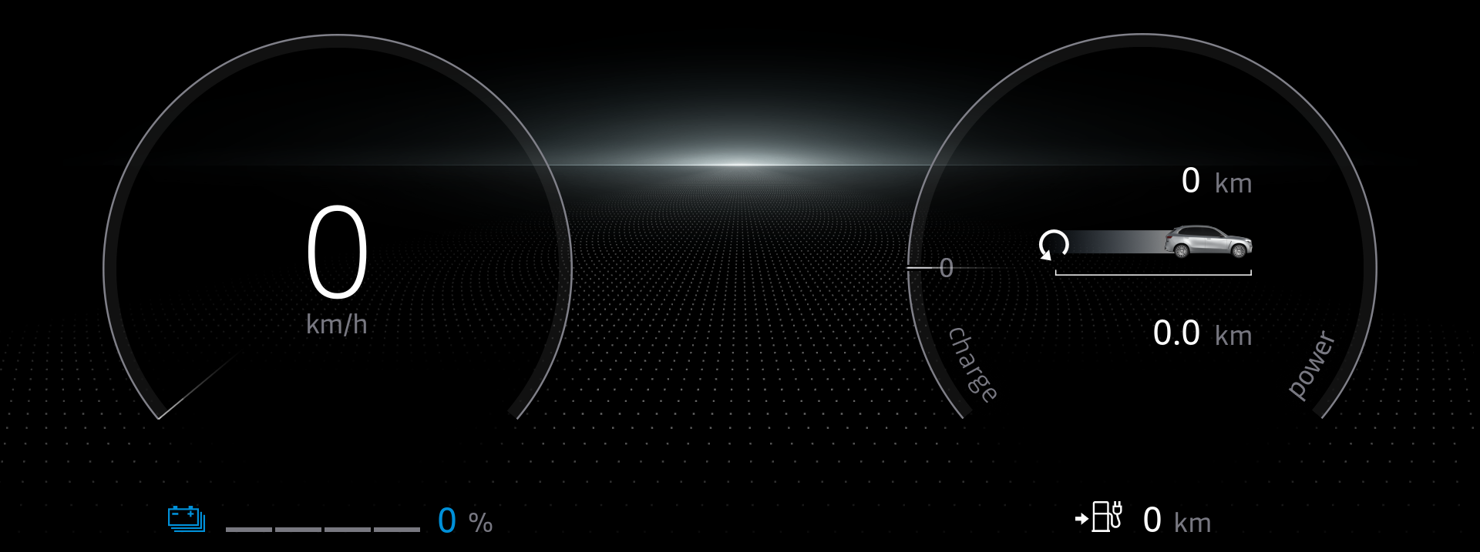
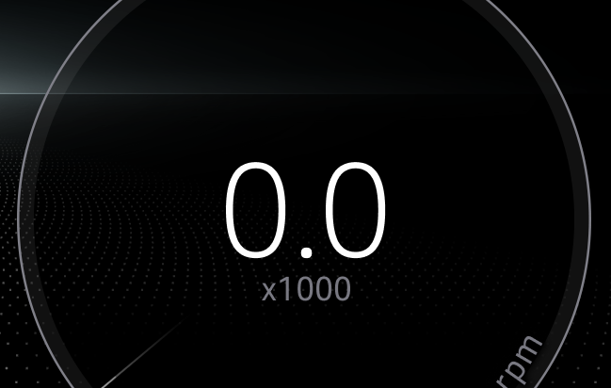
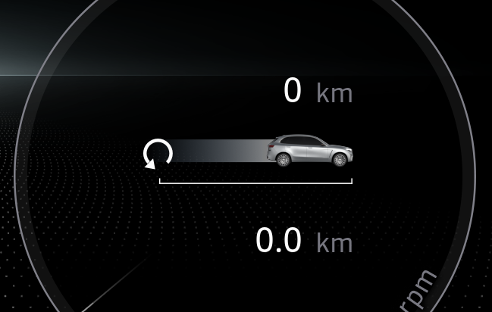
Sample NOK Cases
Renault Nissan Technology & Business Centre India
CLIP mismatch = 0 | Scale mismatch = 0 | Max Segment mismatch = 11.24
CLIP mismatch = 9.63 | Scale mismatch = 0 | Max Segment mismatch = 9.32

Slide 5
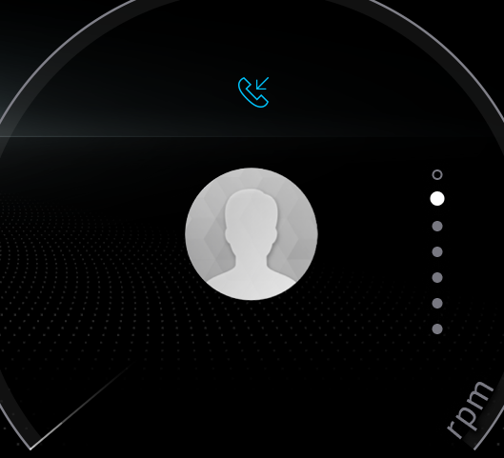
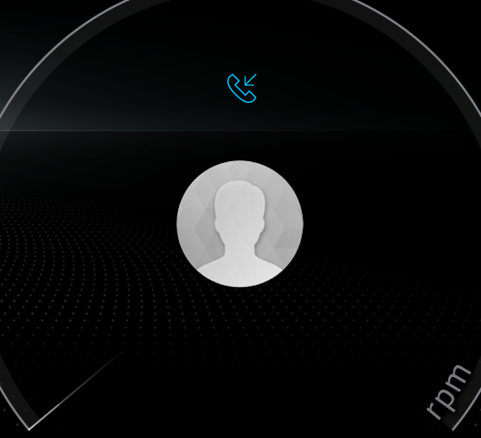
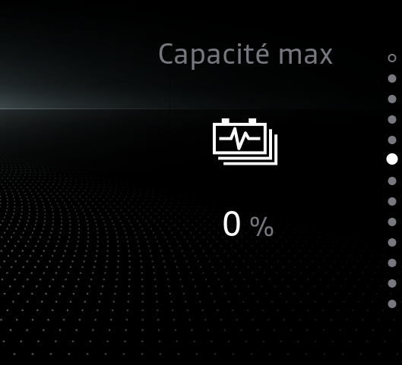
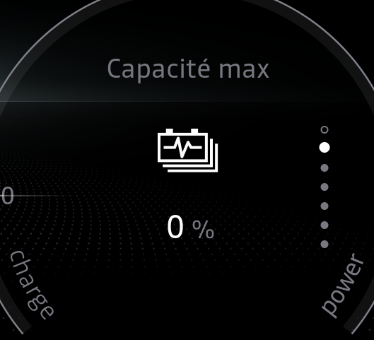
Sample Investigate Cases
Renault Nissan Technology & Business Centre India
CLIP mismatch = 0.5 | Scale mismatch = 0 | Max Segment mismatch = 3.45
CLIP mismatch = 5.47 | Scale mismatch = 0 | Max Segment mismatch = 9.5

Slide 6


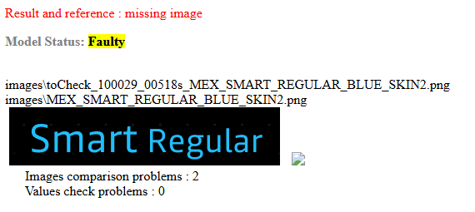
Sample Faulty Cases
Renault Nissan Technology & Business Centre India
CLIP mismatch = NA | Scale mismatch = 8.8 | Max Segment mismatch = NA
Image is missing!
CLIP mismatch = NA | Scale mismatch = NA | Max Segment mismatch = NA

Slide 7
Comparison & Status Logic
Renault Nissan Technology & Business Centre India
If images are not comparable → Status = Faulty (e.g., different sizes)
If overall CLIP mismatch > NOK threshold → Status = NOK
If CLIP mismatch > Investigate threshold:
If only one segment is very different (striking difference) → NOK
Else → Investigate
If CLIP mismatch ≤ Investigate threshold:
If one striking segment is found → NOK
Else if segment mismatch > NOK threshold → Investigate
Else if segment mismatch > Investigate threshold → Investigate
Else → OK

Slide 8
Analysis Summary over C1AREG_10i
Renault Nissan Technology & Business Centre India
Status | Count
OK | 2967
NOK | 753
Investigate | 912
Faulty | 367

Slide 9
Thankyou
Renault Nissan Technology & Business Centre India

