Slide 1
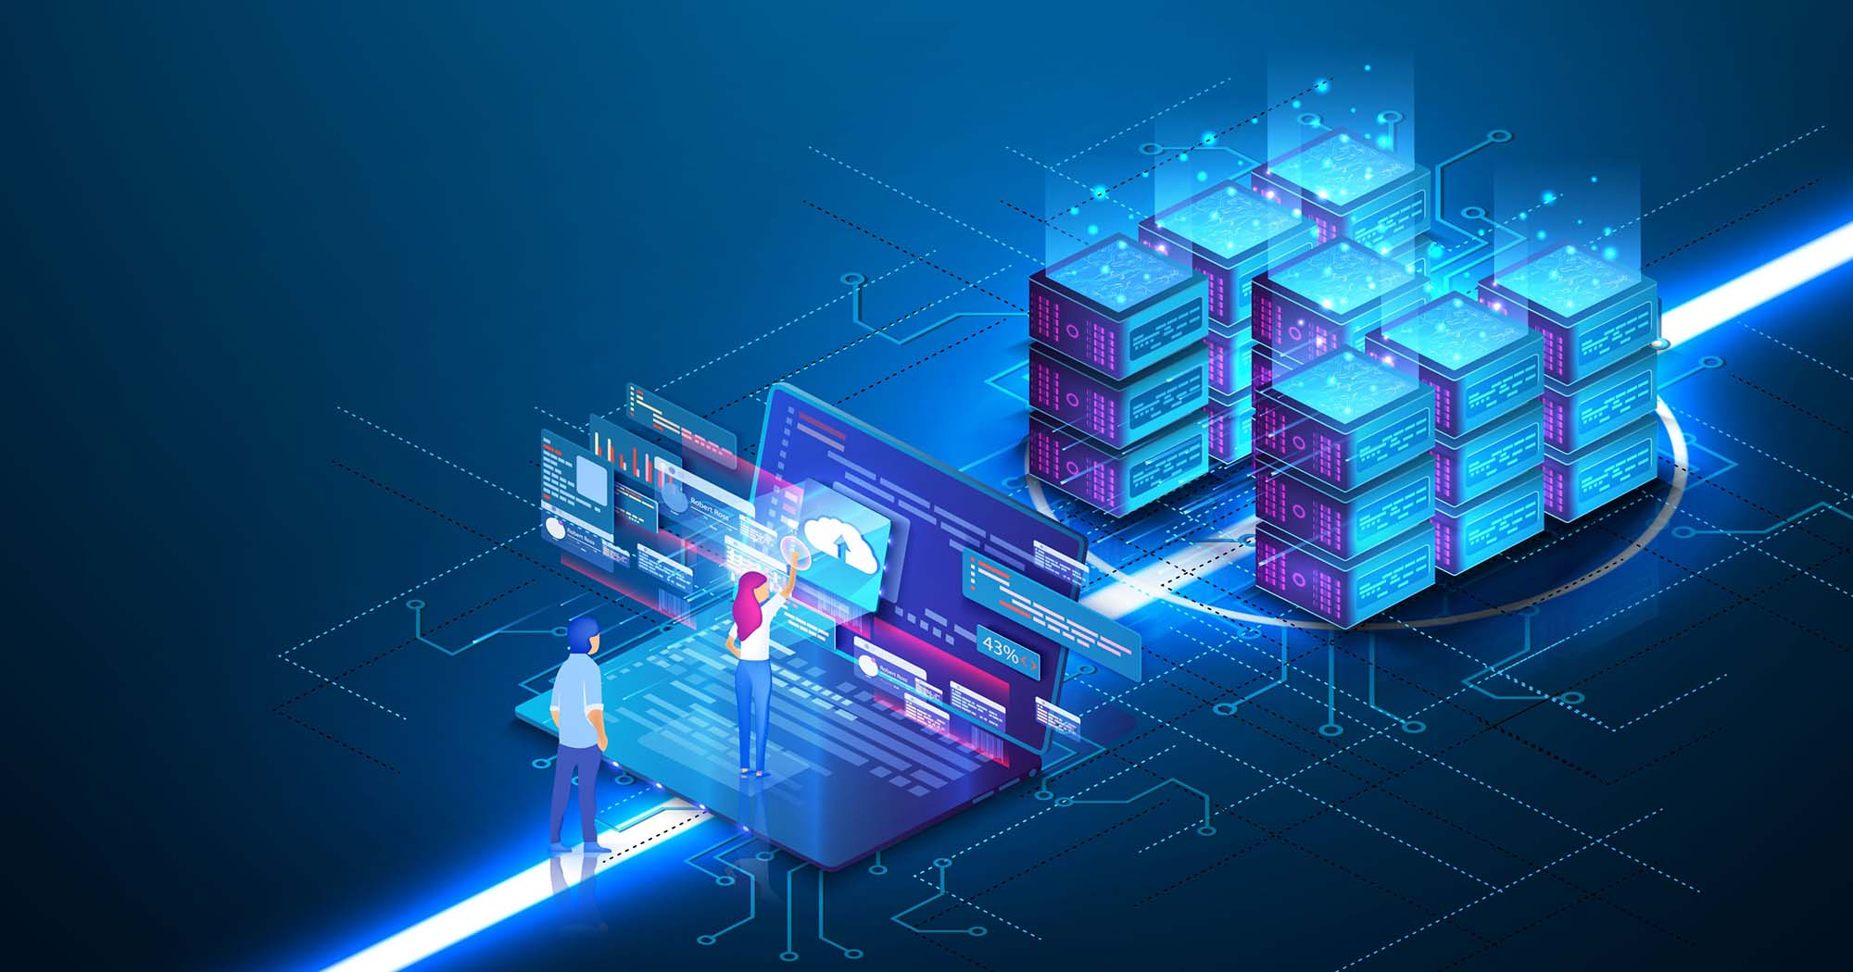
DOCKER: An Introduction to Containerization​
Presented By:​
Riya Khandelwal​
​

Slide 2
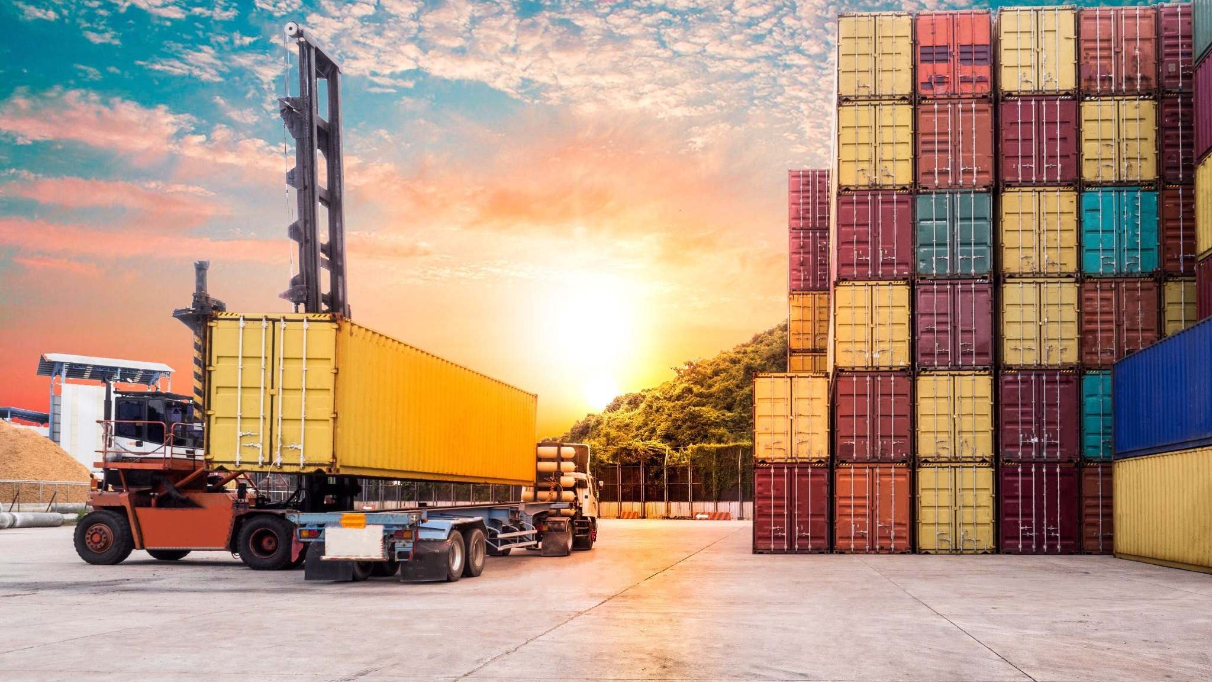
AGENDA
Docker
Containerization
Pre-Docker Challenges
Transition to Docker
Components
Comparison with VMs
Docker Architecture
How to Dockerize
Docker Compose
Port Mapping
Docker Networking
Volume Mounting
Advantages

Slide 3

It is an open-source platform that enables developers to automate the deployment, scaling, and management of applications using containerization.
It provides ability to run an application in an isolated environment.
By taking advantage of Docker's methodologies, we can significantly reduce the delay between writing code and running it in production.

Slide 4

Containerization
It is a software deployment method that packages an application's code, along with its dependencies, into a single, portable unit called a container​
Can be easily shared
Enables applications to run consistently across diverse computing environments​

Slide 5
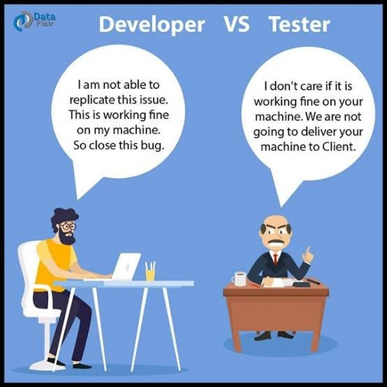
PRE- DOCKER CHALLENGES
Environment Inconsistencies
Resource Overhead with Virtual Machines (VMs)
Deployment Complexity
Lack of Isolation

Slide 6

Transition to Docker
Consistent Environments
Efficient Resource Usage
Streamlined Deployment
Enhanced Isolation and Security

Slide 7
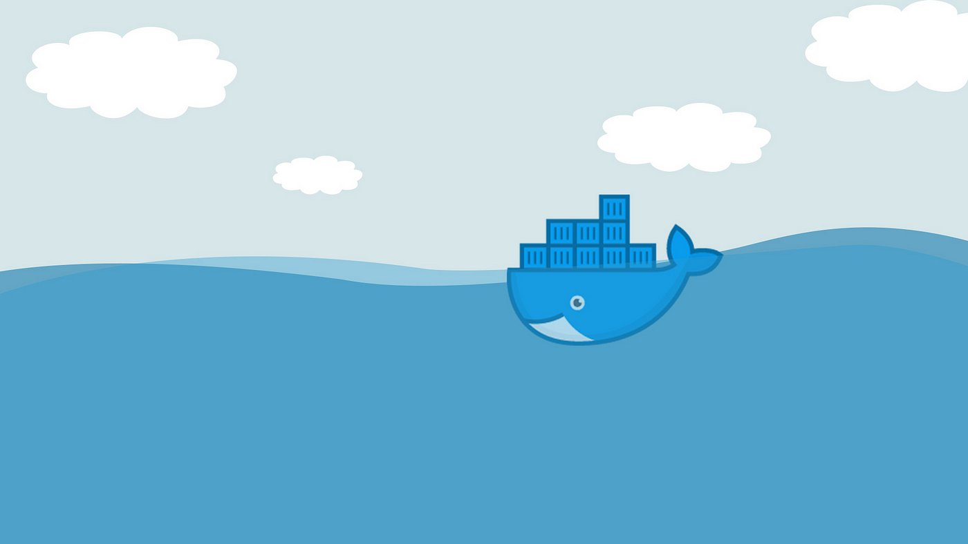
COMPONENTS
Daemon:
Docker daemon runs on the host O.S.
It is responsible for running containers to manage docker services.
Docker daemon can communicate with other daemons.
Image:
Single file with all dependencies and configuration required to run a program/container.
Container:
It is a runnable instance of an image

Slide 8
Dockerfile:
It is a script like file that defines the steps to create a Docker Image
Registry:
It manages and stores the docker images.
Client
Docker user can interact with docker daemon through a client (CLI)
Docker client uses commands and rest API to communicate with the docker daemon.
Host:
Docker host is used to provide an environment to execute and run applications.
It contains the docker daemon, images, containers, networks, and storage.

Slide 9
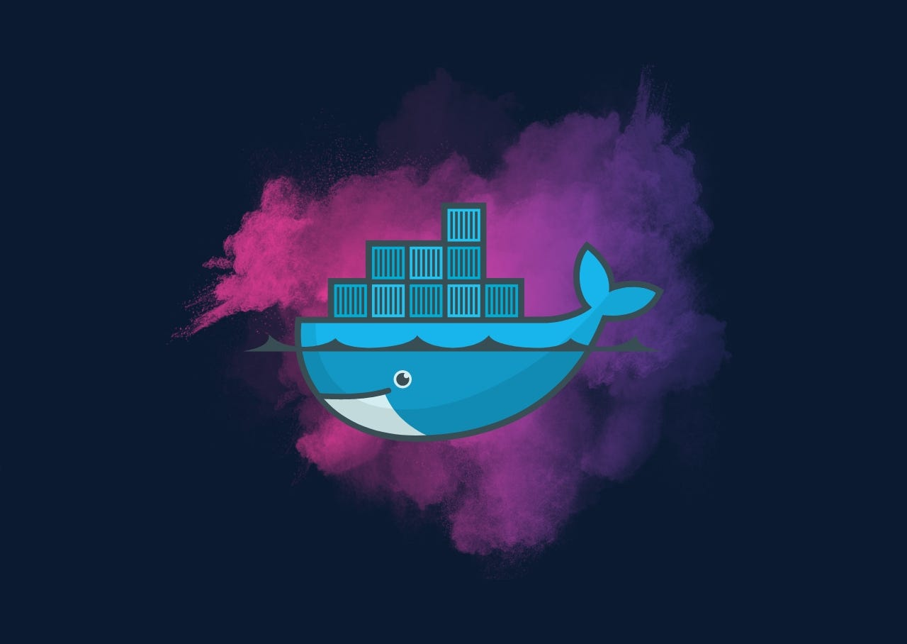
Components
Daemon:
Docker daemon runs on the host O.S.
It is responsible for running containers to manage docker services.
Docker daemon can communicate with other daemons.
Image:
Single file with all dependencies and configuration required to run a program/container.
Container:
It is a runnable instance of an image
Dockerfile:
It is a script like file that defines the steps to create a Docker Image

Slide 10
Components
Registry:
It manages and stores the docker images.
Client
Docker user can interact with docker daemon through a client (CLI)
Docker client uses commands and rest API to communicate with the docker daemon.
Host:
Docker host is used to provide an environment to execute and run applications.
It contains the docker daemon, images, containers, networks, and storage.

Slide 11
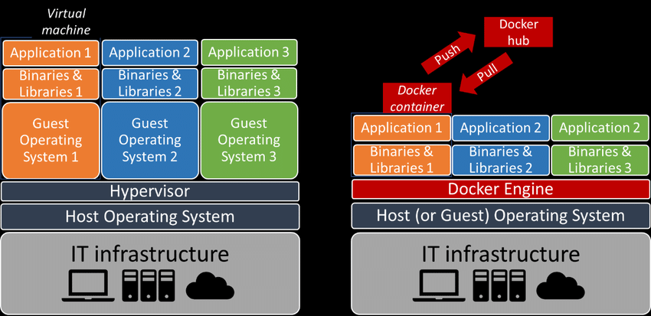
COMPARISON WITH VIRTUAL MACHINES

Slide 13
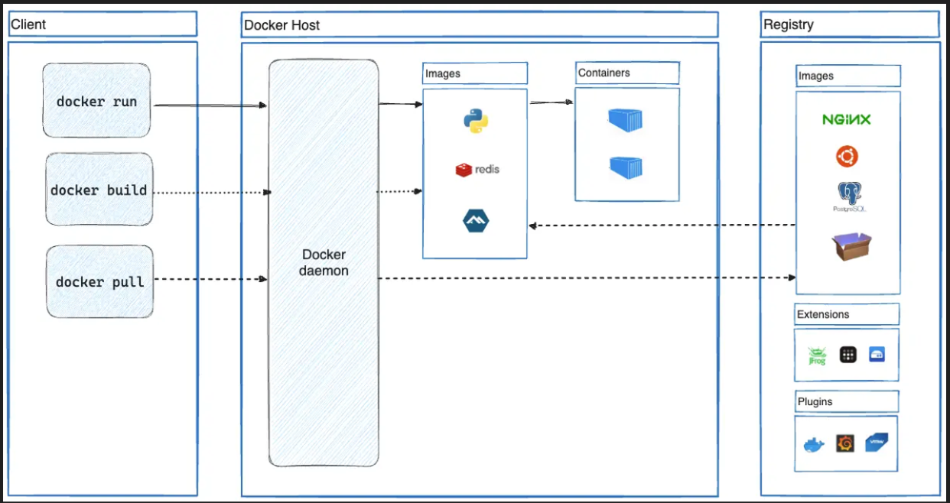
DOCKER ARCHITECTURE​

Slide 14
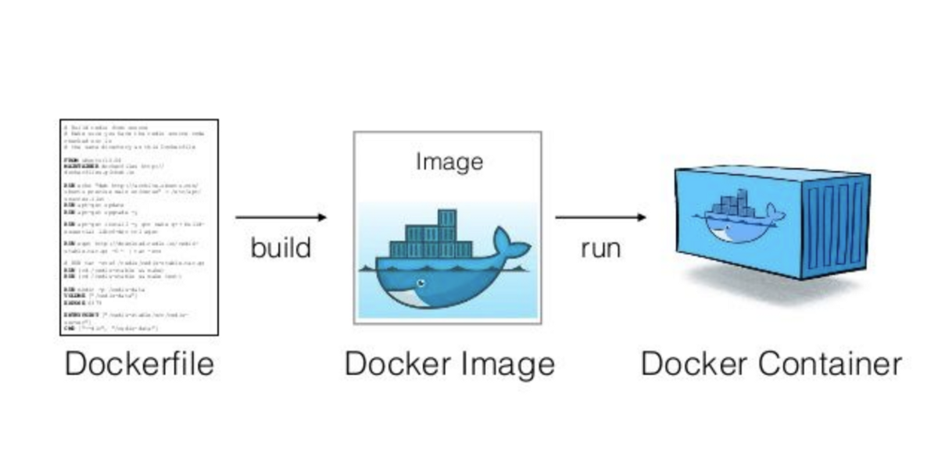
HOW TO DOCKERIZE
It is the process of converting an application to run within a Docker container.

Slide 15
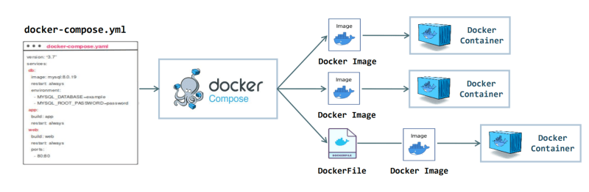
DOCKER COMPOSE​
It is a tool for defining and running multi-container Docker applications.​
Simplifies the management of multi-container Docker applications by defining them in a single YAML file.​

Slide 16
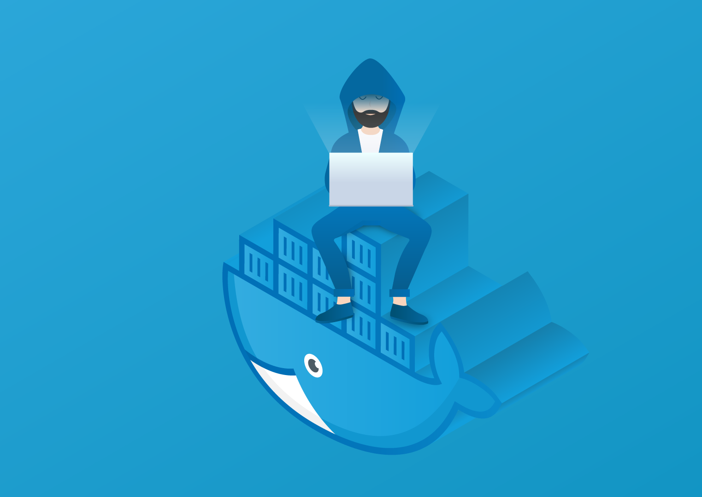
COMMANDS
Start Services: docker-compose up (creates and starts containers defined in the docker-compose.yml file)
Stop Services: docker-compose down (Stops and removes containers, networks, and volumes defined in the docker-compose.yml file.)
List Containers: docker-compose ps (Lists the status of the services defined in the docker-compose.yml file.)

Slide 17
PORT MAPPING
Port mapping in Docker is the process of mapping a port on the host machine to a port in the container. This is essential for accessing applications running inside containers from outside the Docker host.
Command Syntax:
docker run -p [HOST_PORT]:[CONTAINER_PORT] [IMAGE]
Example: Forwarding Port 3000
docker run -p 3000:3000 [IMAGE]
Accessing the Containerized Application
After setting up port forwarding, any request sent to port 3000 on the host machine is automatically forwarded to port 3000 in the container.
URL:
http://[HOST_IP]:3000.

Slide 18
DOCKER NETWORK
It refers to the ability for containers to connect to and communicate with each other, or to non-Docker workloads.
Type of Networks:
Bridge: The default network driver.
Host: Remove network isolation between the container and the Docker host, and use the host's networking directly.
None: Completely isolate a container from the host and other containers.
Custom Network:
It is a user-defined network that allows containers to communicate with each other using a specified network driver.
It provide better control over how containers interact and can enhance network security and performance by isolating containers into specific network segments.

Slide 19
DOCKER NETWORK
Commands:
List Networks: docker network ls
Inspect a Network: docker network inspect <network_name>
Create a Network: docker network create <network_name>
Connect a Container to a Network: docker network connect <network_name> <container_name>
Disconnect a Container from a Network: docker network disconnect <network_name> <container_name>
Remove a Network: docker network rm <network_name>
Docker Run Command with Network Option: docker run -it --network=<network_name> <image_name>
Ping command: ping <container_name>

Slide 20
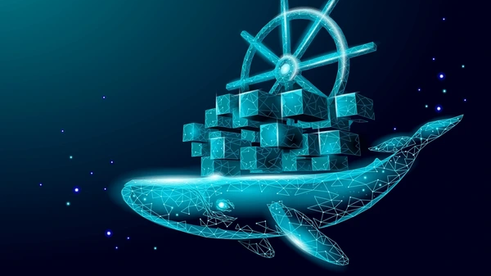
VOLUME MOUNTING
It refers to the process of linking a directory or file from the host machine to a container. This allows data to persist outside the lifecycle of the container, and facilitates data sharing between the host and the container or between multiple containers.​
When containers are destroyed there memory is also destroyed, so to prevent this we have Volume Mounting ​
Means mount Volume in docker which is a type of permanent memory​

Slide 21
ADVANTAGES
Isolation
Scalability
Agility
Portability
Performance
Docker applications perform exactly as they did when deployed
Docker containers are totally independent of each other
Containers are faster to create and start quickly.
New containers can be quickly created if the applications demand for it
The containers help to make the development process more agile and responsive

Slide 22

THANK YOU

Slide 23
Simplified Configuration: Docker simplifies application configuration by allowing you to define everything in a Dockerfile. This makes it easy to replicate environments and share configurations.
Faster Deployment: Docker containers start almost instantly compared to VMs, significantly speeding up deployment and reducing downtime.
Version Control and Rollbacks :Docker allows you to version control your containers and roll back to previous versions if something goes wrong, providing better control over application updates.
Isolation and Security:Docker provides isolation for applications, preventing conflicts between different software running on the same host. This enhances security by containing potential vulnerabilities within specific containers.

Slide 24
Real World Example

Slide 25
Docker run -it ubuntu
Docker start name_of_image
Docker stop name_of_image
Docker exec –it name_of_image
Docker exec container_name command

Slide 26
Use Case

Slide 27
Port Mapping
Port mapping in Docker is the process of mapping a port on the host machine to a port in the container. This is essential for accessing applications running inside containers from outside the Docker host.
docker run -p [HOST_PORT]:[CONTAINER_PORT] [IMAGE]
Forwarding Port 3000
docker run -p 3000:3000 [IMAGE]
Accessing the Containerized Application
After setting up port forwarding, any request sent to port 3000 on the host machine is automatically forwarded to port 3000 in the container.
http://[HOST_IP]:3000.

Slide 28
Data Management
Volumes and bind mounts

Slide 29
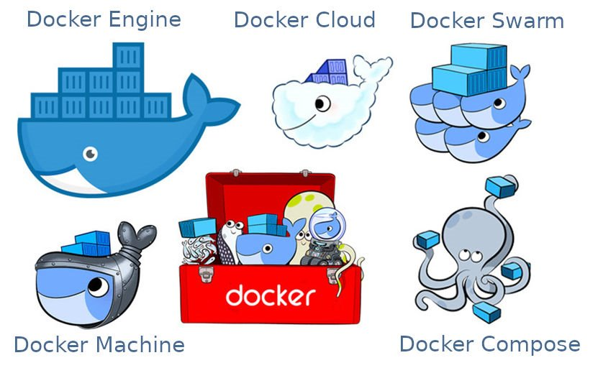
Main Components of Docker :
1. Docker Daemon / Engine
2. Docker Client
1. Docker Daemon / Engine
2. Docker Client
3. Docker Host
4. Docker Hub / Registry
5. Docker Images
3. Docker Host
4. Docker Hub / Registry
5. Docker Images
5. Docker Images are templates of project
Container are Running Instance of Image

Slide 30
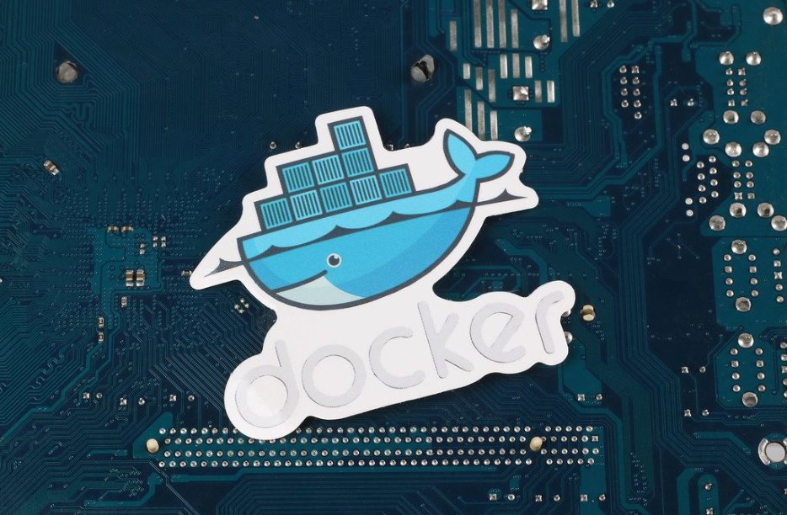

Slide 31
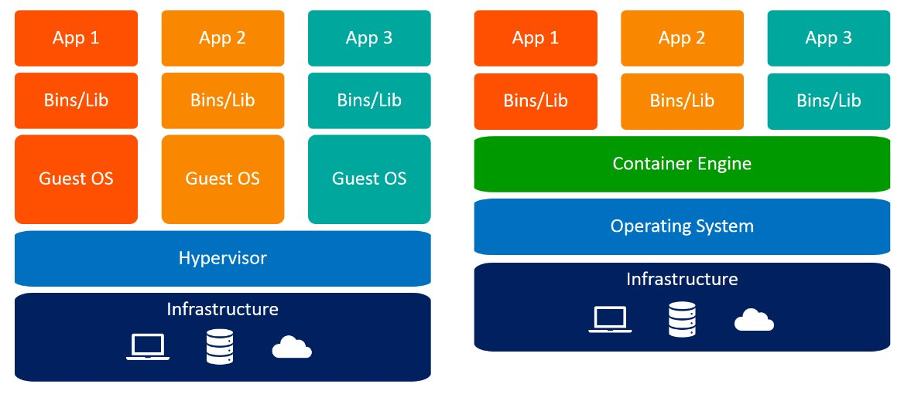
Comparison with Virtual Machines

Slide 32
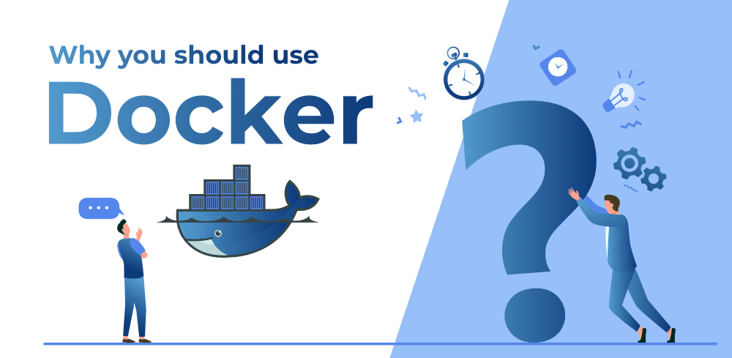

Slide 33
Components
Registry:
It manages and stores the docker images.
Client
Docker user can interact with docker daemon through a client (CLI)
Docker client uses commands and rest API to communicate with the docker daemon.
Host:
Docker host is used to provide an environment to execute and run applications.
It contains the docker daemon, images, containers, networks, and storage.

Slide 34
How to Dockerize
It is the process of converting an application to run within a Docker container.

Slide 35
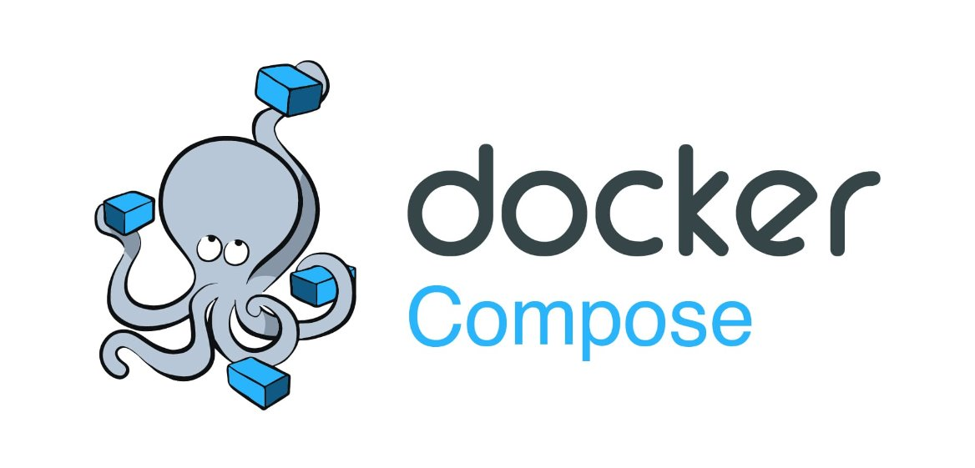
ThePhoto by PhotoAuthor is licensed under CCYYSA.

Slide 36
Port Mapping
Port mapping in Docker is the process of mapping a port on the host machine to a port in the container. This is essential for accessing applications running inside containers from outside the Docker host.
docker run -p [HOST_PORT]:[CONTAINER_PORT] [IMAGE]
Forwarding Port 3000
docker run -p 3000:3000 [IMAGE]
Accessing the Containerized Application
After setting up port forwarding, any request sent to port 3000 on the host machine is automatically forwarded to port 3000 in the container.
http://[HOST_IP]:3000.

Slide 37
Custom Network
Docker network create –d bridge custom_net
So our own network named custom_net is made from this command
Containers on same network can communicate with each other
Using ping container2_name
We can ping ṭhrough IP address or through name

Slide 38
Docker Compose
It is a tool for defining and running multi-container Docker applications.
Simplifies the management of multi-container Docker applications by defining them in a single YAML file.

Slide 39
Docker Networking
Bridge Mode:
Host Mode: No need of port mapping as host machine and docker container are on same server
None: network address is not available
Docker run –it --network=none <image_name>
WE CAN CREATE our own custom network also using docker

Slide 40

Volume Mounting
It refers to the process of linking a directory or file from the host machine to a container. This allows data to persist outside the lifecycle of the container, and facilitates data sharing between the host and the container or between multiple containers.
When containers are destroyed there memory is also destroyed, so to prevent this we have Volume Mounting
Means mount Volume in docker which is a type of permanent memory

