Slide 1
Presentation Title
Presentation Subtitle

Slide 2
Accessibility Guidelines
Use unique slide titles.
Use clear and accurate link text that tells the user where the link takes them.
Add alt-text to images.
Use the accessibility checker to review your presentation.

Slide 3
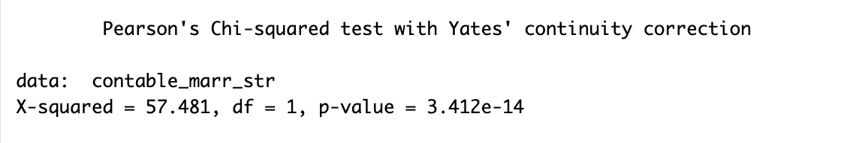
4. Are there any biological or social factors that explain the gender differences in stroke risk?
Null hypothesis: ever_married and stroke variables are independent
Alternative hypothesis: ever_married and stroke variables are not independent

Slide 4
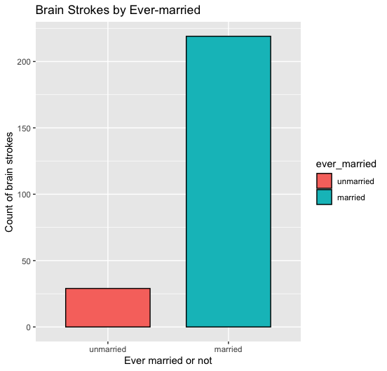
Bar plot of ever-married or not of people with a stroke

Slide 5
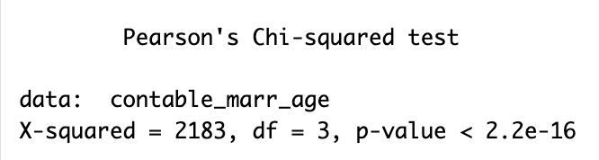
Chi-squared test between ever-married and age period
Null hypothesis: ever_married and age are independent
Alternative hypothesis: ever_married and age are not independent

Slide 6
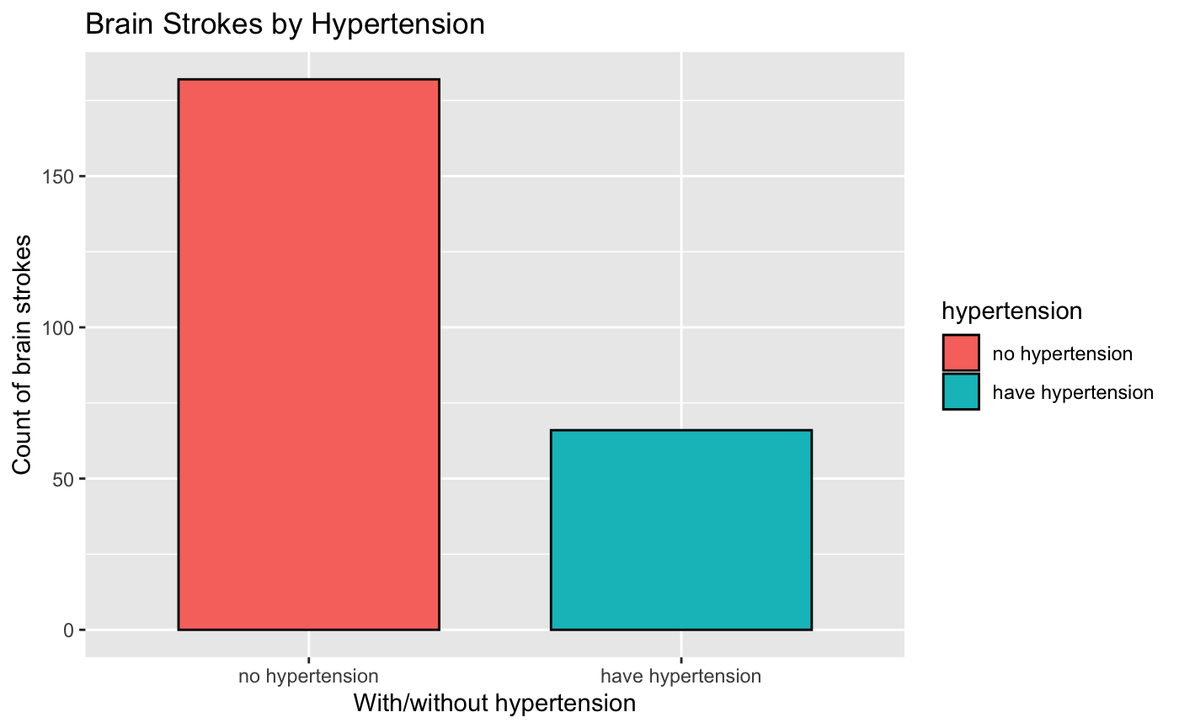
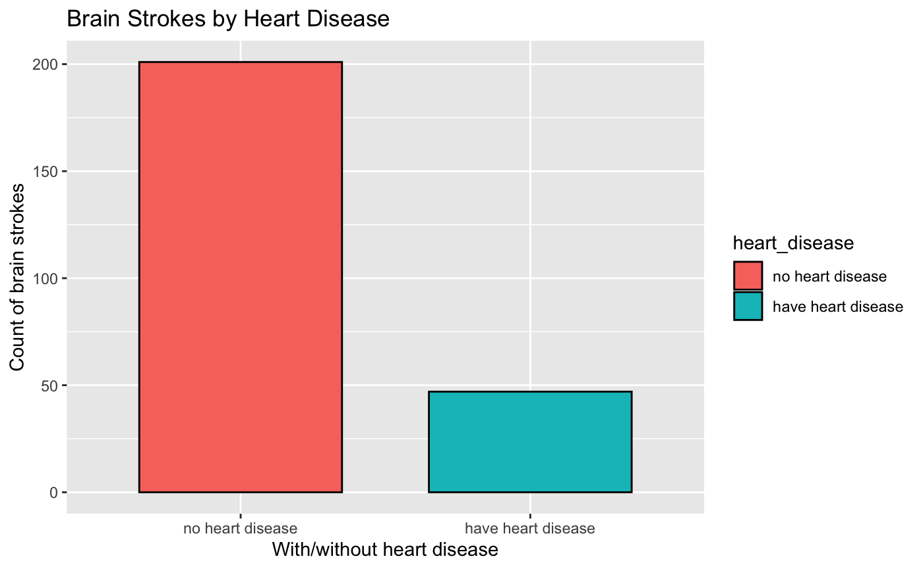
5. What is the strength of the association between hypertension, heart disease, and brain stroke?

Slide 7
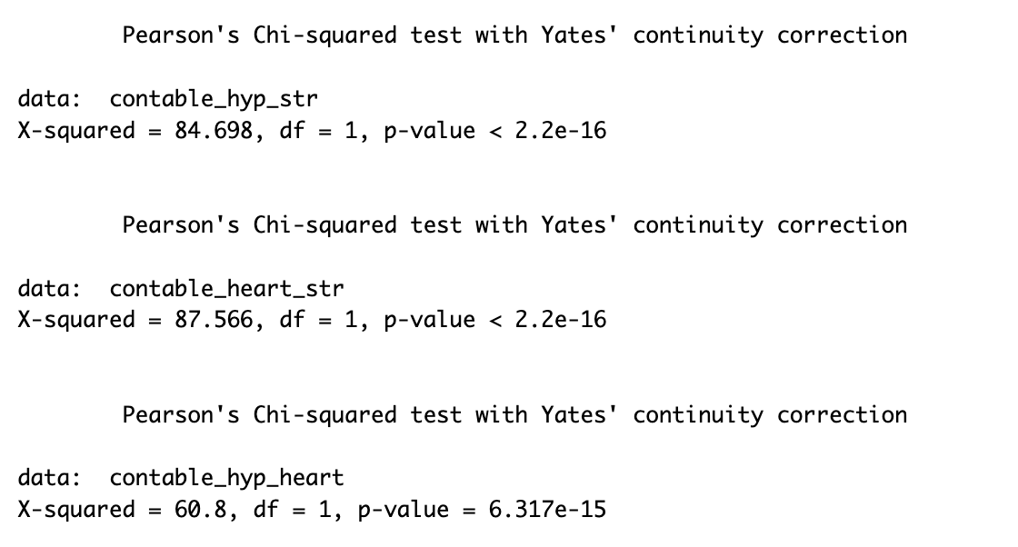
hypertension vs stroke
heart disease vs stroke
hypertension vs heart disease

