Slide 1


Team Details
  Team name: SUVS
  Team leader name: Utkarsh Sahay
  Problem Statement: Smart Resource Allocation [Open Innovation]

Slide 2
Brief about your solution
The Solar Analyzer is an innovative solution designed to promote sustainable development by enabling efficient use of solar energy. It analyzes a given area to determine how many solar panels can be optimally installed based on available space, orientation, and layout.
The system further estimates potential energy generation and calculates expected monthly profit, helping users understand both environmental and economic benefits. It also considers factors such as sunlight availability, panel efficiency, and local conditions to provide more accurate predictions.
Additionally, the Solar Analyzer:
Helps in reducing carbon footprint by encouraging clean energy adoption
Assists users in making cost-effective and informed investment decisions
Provides a scalable solution suitable for homes, industries, and commercial spaces
Saves time by automating calculations that would otherwise require technical expertise
Supports government and sustainability initiatives by promoting renewable energy usage
Overall, the Solar Analyzer acts as a smart decision-making tool that bridges the gap between sustainability and profitability, making solar energy more accessible and practical for everyone.

Slide 3
Opportunities
  How different is it from any of the other existing ideas?
  How will it be able to solve the problem?
  USP of the proposed solution
  Our Solar Analyzer is different because it not only estimates energy generation but also calculates how many panels can actually fit in a given area and predicts monthly profit. Unlike basic tools, it combines space optimization + financial analysis, making it a complete decision-making solution rather than just a calculator.
  It solves the problem by analyzing available space, sunlight, and panel efficiency to determine optimal panel placement, estimate energy output, and calculate monthly profit helping users make quick and informed solar investment decisions.
  Combines space optimization and profit prediction in one simple tool, helping users know exactly how many panels they can install and how much they can earn.

Slide 4
List of features offered by the solution
Calculates maximum number of solar panels for a given area
Suggests optimal panel placement/layout
Estimates energy generation (daily/monthly)
Predicts monthly profit and cost savings
Considers sunlight, location, and panel efficiency
User-friendly interface for easy input and results
Suitable for homes, businesses, and large spaces
Quick and automated analysis for decision-making
Weather and seasonal impact analysis
Energy usage vs generation comparison
Environmental impact (CO₂ reduction) estimation
Cost estimation for installation and maintenance

Slide 5
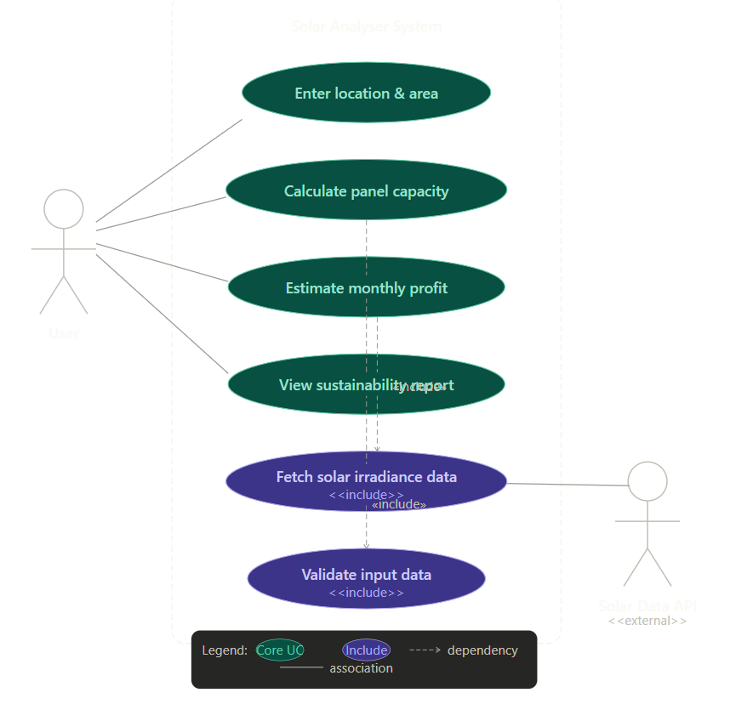
Process flow diagram or Use-case diagram

Slide 6
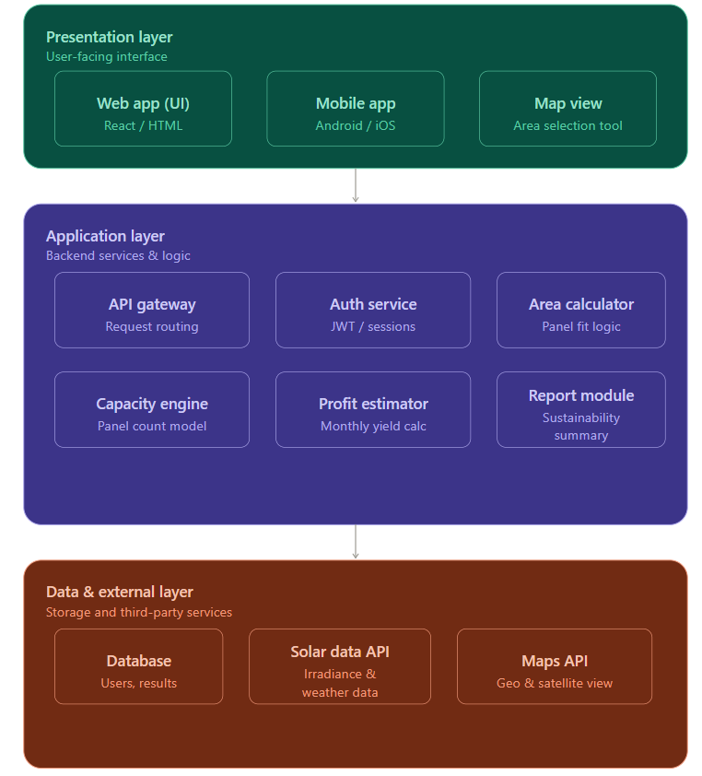
Architecture diagram of the proposed solution

Slide 7
Technologies to be used in the solution
Frontend: HTML, CSS, JavaScript (or React for better UI)
Backend: Node.js / Python (Flask or Django)
Database: MySQL / MongoDB
Data Analysis: Python (NumPy, Pandas)
Solar Calculations: Custom algorithms for energy & profit estimation
APIs: Weather API (for sunlight data), Maps API (for location analysis)
Visualization: Charts using Chart.js / Matplotlib
Deployment: Cloud platforms like AWS / Firebase / Heroku

Slide 8
Estimated implementation cost (optional)
Development Cost: ₹0 – ₹5,000 (if self-developed using free tools)
Software & Tools: Mostly free (open-source frameworks, libraries)
APIs (Weather/Maps): Free tier available (₹0 – ₹2,000 if scaled)
Hosting/Deployment: ₹0 – ₹3,000 per year (Firebase/AWS basic plans)
Maintenance Cost: Minimal (₹1,000 – ₹2,000 annually)
Total Estimated Cost: ₹0 – ₹10,000 (for a basic working prototype)

Slide 9

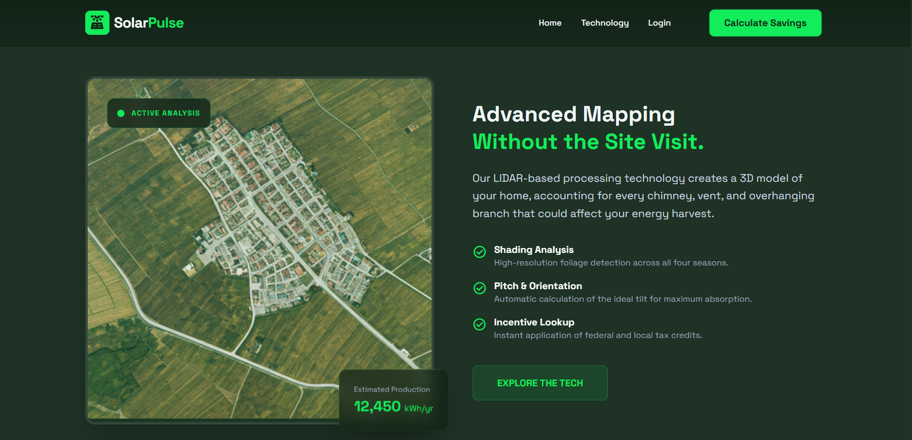

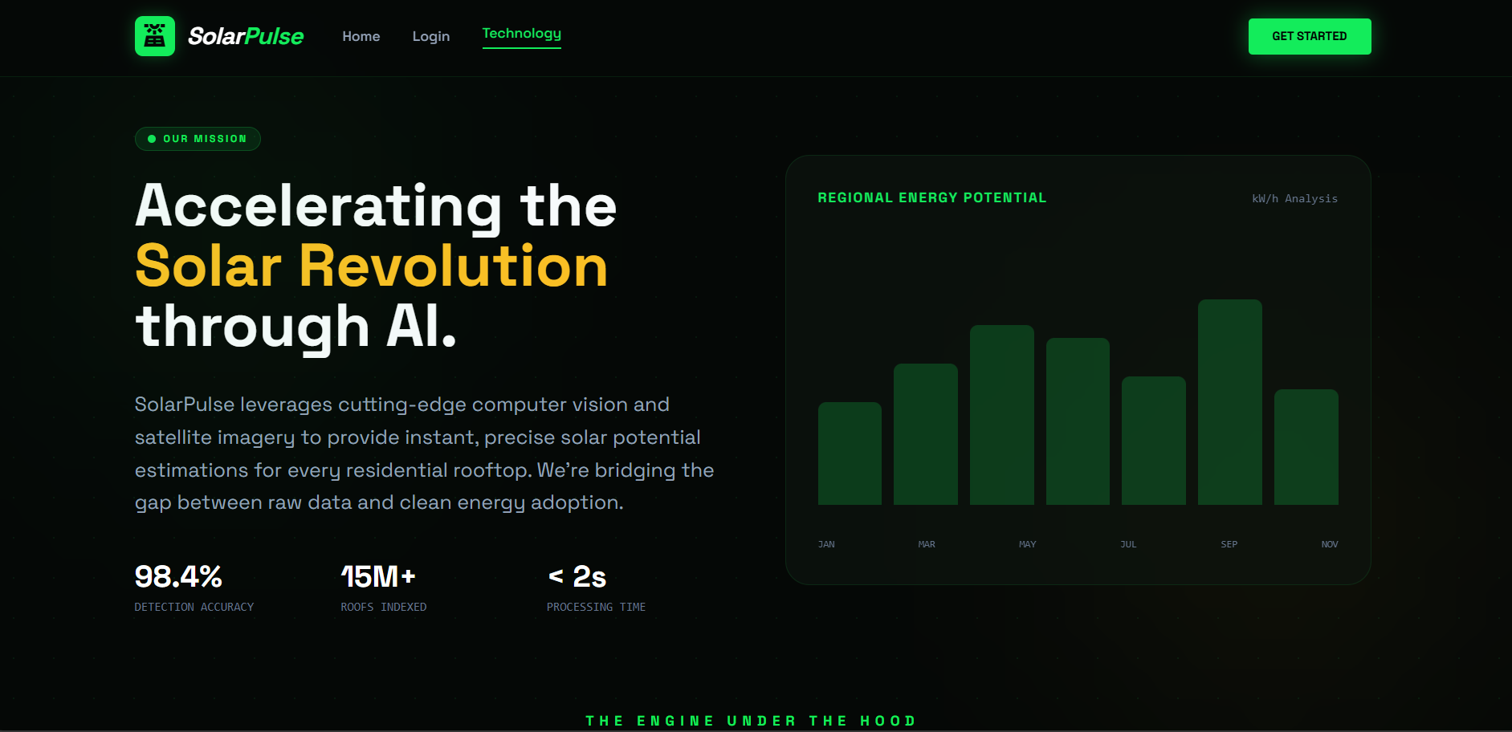
Snapshots of the MVP

Slide 10
Additional Details/Future Development (if any)
While Solar Pulse currently provides high-accuracy personal solar estimations, our roadmap aims to transition the platform into an industry-grade enterprise solution. We are planning to integrate high-resolution LIDAR data and Google Earth Engine to enable automated, coordinate-based rooftop identification without the need for manual image uploads. Future iterations will feature 3D geometric mesh modeling to calculate the precise pitch and azimuth of roof planes, alongside a comprehensive Battery ROI Engine for simulating storage feasibility. Furthermore, we intend to implement AI-driven obstacle detection (for AC units and vents) and a Carbon Credit Dashboard, transforming the tool from a calculator into a complete end-to-end consultancy platform for commercial renewable energy transitions.

Slide 11
Provide links to your:
GitHub Public Repository
Demo Video Link (3 Minutes)
MVP Link
Working Prototype Link
https://github.com/UtkarshSahay123/US-INFOTECH-PROJECT-Solar-Anaylzer
https://youtu.be/JscwEGL_Dv8
3. https://us-infotech-project-solar-anaylzer.vercel.app/
4. https://us-infotech-project-solar-anaylzer.vercel.app/

Slide 12


