Slide 1







Garbage Management System Using IoT

Slide 2

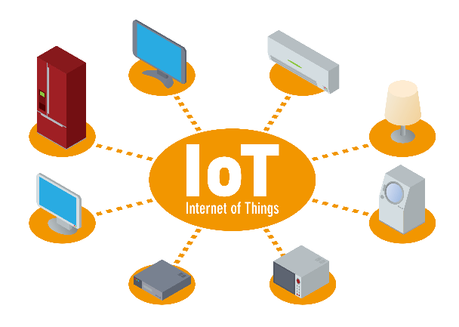
The Internet of Things (IoT) is a system of interrelated computing devices, mechanical and digital machines, objects, animals or people that are provided with unique identifiers and the ability to transfer data over a network without requiring human-to-human or human-to-computer interaction.
INTRODUCTION
CONCEPT OF IOT

Slide 3

Garbage Management and Collection in Cities, Town and Villages is a major concern and emerging problem in Smart City paradigm. Also lack of proper resource distribution in the process of Garbage collection is great risk to sanitation, cleanliness and health.
PROBLEM STATEMENT

Slide 4
The project “ Garbage Management System Using IoT ” is a very innovative system which will help to keep the cities clean. The system monitors the garbage bins and informs about the level of garbage collected in the garbage bins.This system built on a platform which was based Wi-Fi module (ESP8266) board which was interfaced with a ultrasonic sensor.
PROPOSED SOLUTION

Slide 5
TECHNOLOGIES
The Firebase Realtime Database is a cloud-hosted database. Data is stored as JSON and synchronized in Realtime to every connected client. When you build cross-platform apps with our iOS, Android, and JavaScript SDKs, all of “your clients share one Realtime Database instance and automatically receive updates with the newest data. Instead

Slide 6
TECHNOLOGIES
Android Studio is the official integrated development environment (IDE) for Android application development. It is based on the IntelliJ IDEA, a Java integrated development environment for software, and incorporates its code editing and developer tools.

Slide 7
TECHNOLOGIES
To connect to the internet in Iphones make use of a prebuilt platform called Blynk app. “After the user installs the Blynk app on the iOS platform, an account to be created in the app to access its services. The services are enabled for the signed users.

Slide 8
TECHNOLOGIES
WordPress is a free and open-source content management system based on PHP & MySQL. Features include a plugin architecture and a template system. To make a prototype web interface I have used WordPress system

Slide 9

BENEFITS
The garbage will be collected on time-to-time basis.
There would not be any bad smell around the bin.
Real time garbage levels to collect the garbage.
Saving on fuel consumption, thus reducing the threat to the environment
The solution offers you the means to have less trucks on the road for less time

Slide 10
CONCLUSION
Monitoring the fullness of bins through the use of sensors, it is possible to achieve a more efficient system than the current existing. Our idea of “Garbage Management System Using IoT”, mainly concentrates on Monitoring the waste management, providing a smart technology for waste system, avoiding human intervention, reducing human time and effort and which results in healthy and waste ridden environment.

