Slide 1
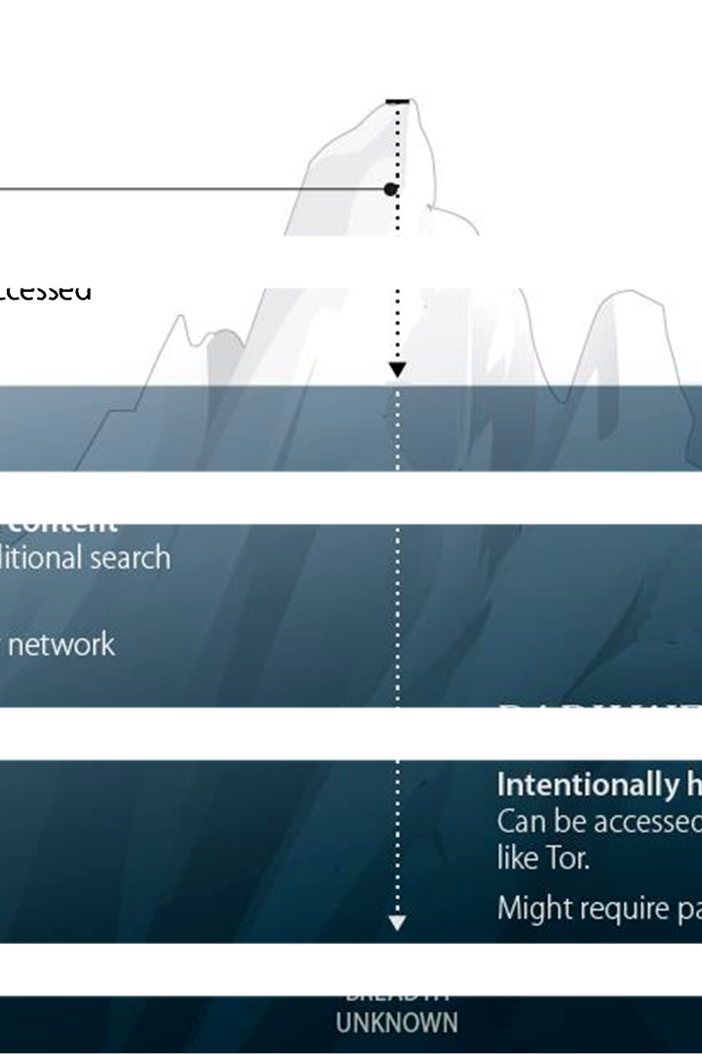

TEAM - CPC
Dark Web Monitoring System
In this presentation, we will delve into the concept of a dark web monitoring system, focusing on the development of a dark web crawler. This system is designed to provide insights into the hidden corners of the internet, enabling proactive security measures.

Slide 2
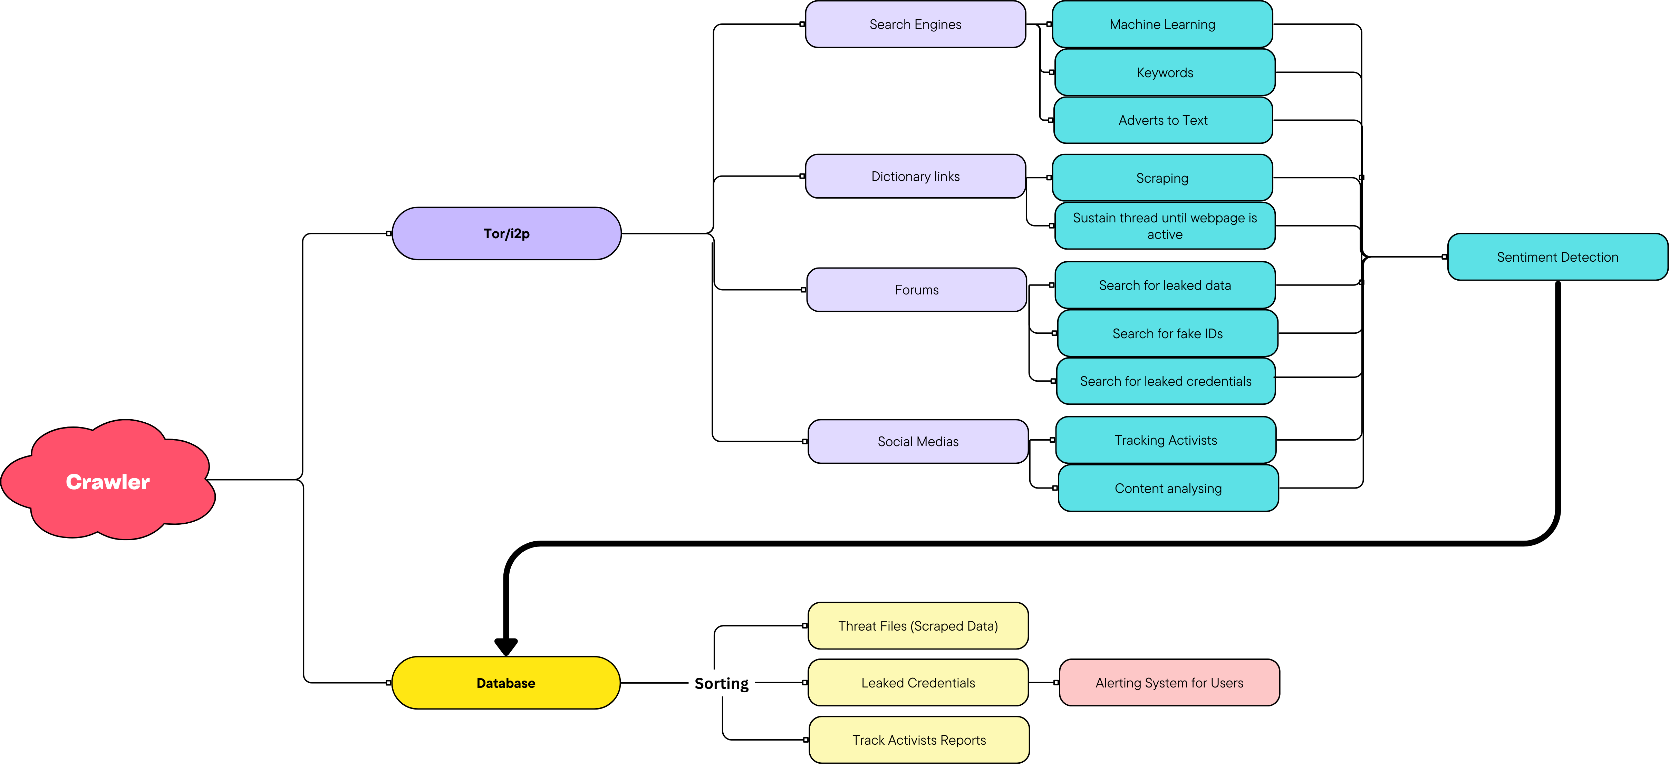

Slide 3
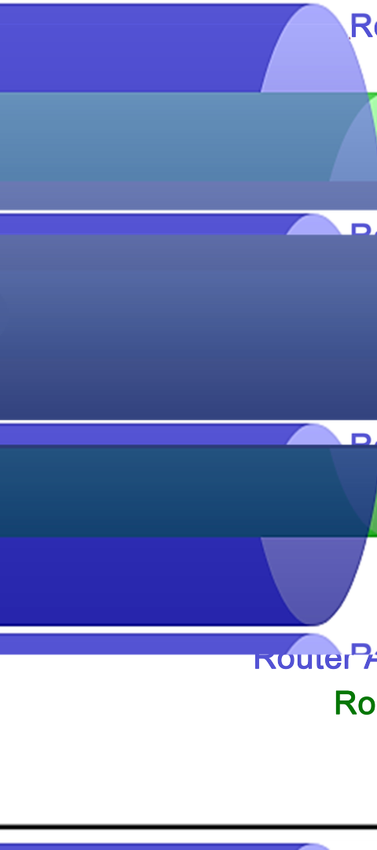
Purpose and Importance of Dark Web Monitoring
1
Proactive Security Measures
2
Insight into Illicit Activities
Dark web monitoring is crucial for identifying potential threats and vulnerabilities before they impact businesses and individuals.
It aids in understanding and tracking illegal trade, fraud, and other criminal activities occurring in the hidden layers of the internet.
3
Protecting Sensitive Data
By monitoring the dark web, organizations can safeguard their sensitive information and prevent data breaches.

Slide 4
Command Line Dark Web Monitor Features:
The overall project is a command line tool which will be compatible to run on servers with customisable kernels for less operating cost.
Sentiment Detection (NLP):
Utilizes NLP for sentiment analysis within the dark web content.
Web Archives (Onion Websites , i2p):
Scrapes and archives data from onion/i2p websites.
Asynchronous Programming:
Implements asynchronous operations for efficiency.
Interactive CLI for Tor Control:
CLI for seamless control over Tor utilities.
Customizable Thread Interactive Kernel:
Flexible code supports customizable thread interactive kernel.
Separate Storage of Onion Links:
Stores onion links in dedicated storage.
Scheduled Re-Search for Occasional Websites:
Periodically re-searches and updates URLs of occasionally online websites.

Slide 5

Key Features and Functionalities of the System
CLI for seamless control over Tor utilities.
TOR as well I2P networks are involved.
Asynchronous programming
& emotion analysis through (NLP)

Slide 6

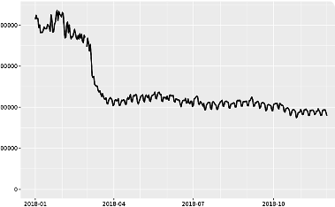
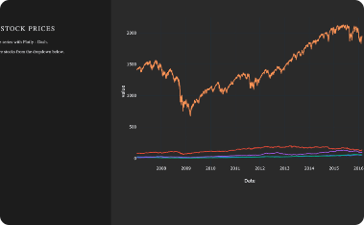
Key-features of the Dark Web Crawler
Cost Efficiency and Future Scalability:
Web Archives for Seamless Data Preservation:
Enhanced Anonymity with Tor IP Utility:
Our solution is designed with cost efficiency in mind, leveraging advanced servers and a specialized kernel optimized for handling threads. This not only reduces operational costs but also ensures efficient performance, paving the way for future scalability as the cause grows.
Our Tor IP utility stands as a cornerstone for anonymity, offering a suite of features that are both user-friendly and instrumental in keeping your online activities discreet. By harnessing this utility, users can navigate the digital landscape with confidence, assured of their privacy and security.
The incorporation of robust web archiving features ensures the seamless preservation of historical web records. By maintaining data in its original format, our solution guarantees an authentic user experience while meeting regulatory conditions for the preservation of reliable and unaltered copies.

Slide 7

Conclusion and Future Enhancements
Optimized System Architecture for Maximum Efficiency:
Our project is strategically designed to operate seamlessly across three parallel systems, each tailored to deliver optimal performance in key areas:
1
High-Performance Scraping Server:
A dedicated server boasting exceptional CPU performance is employed for the efficient and rapid scraping of data. This ensures a streamlined data acquisition process, maximizing the overall efficiency of the system.
2
Robust Database Infrastructure:
At the core of our architecture lies a powerful database, meticulously designed to handle and store extensive web archives. This infrastructure guarantees not only the reliability of data storage but also facilitates seamless retrieval and analysis, meeting the highest standards of archival precision.
3
GPU-Enhanced NLP Processing System:
The third system is equipped with a high-powered GPU, specifically chosen for its prowess in executing Natural Language Processing (NLP) tasks. This computational powerhouse enhances the speed and precision of NLP algorithms, empowering the system to extract valuable insights from the gathered data efficiently.

Slide 8
4. ALERTING MECHANISM : In our project, meticulously scrutinized data is identified for potential leaks across networks and securely stored in a centralized dump. This forms the basis for an advanced alert system, enabling users to promptly check the status of their credentials and take swift action in case of compromise. Our streamlined processes ensure robust security measures for proactive defense against potential threats.

