Slide 1
PARTS & SERVICE BUSINESS CASE
Growth Strategy
& Revenue Roadmap
Data-backed recommendations to capture $49M in untapped market opportunity
$103M
52.5%
$49M
7,859
Total Market
Opportunity
Current
POPS-C
Untapped
Revenue Gap
Customers
Analyzed

Slide 2
EXECUTIVE SUMMARY
What the data tells us — and what to do about it
⚠ $49M Revenue Gap Identified
🎯 DIM Segment = Single Biggest Lever
Only 52.5% of the $103M total market opportunity is being captured. 5,807 customers have zero recorded sales despite measurable opportunity.
6,479 'Do It Myself' customers hold $67.8M in untapped opportunity at just 13.5% POPS-C. Converting even half unlocks $30M+.
📍 3 Cities Drive 65% of the Gap
🔧 Labor & Hydraulics Are the Priority Categories
Ankara ($18.2M), Izmir ($7.7M) and Istanbul ($6.2M) together account for $32.1M of the $49M gap. Concentrate resources here first.
Labor: $19.2M gap at 37% POPS-C. Hydraulics: $9.7M gap at 31% POPS-C. Two categories alone = 59% of all parts/service gap.
📊 Analysis based on 10,165 PTOS records merged with Equipment Fleet & Sales Channel data across 9 Turkish regions.

Slide 3
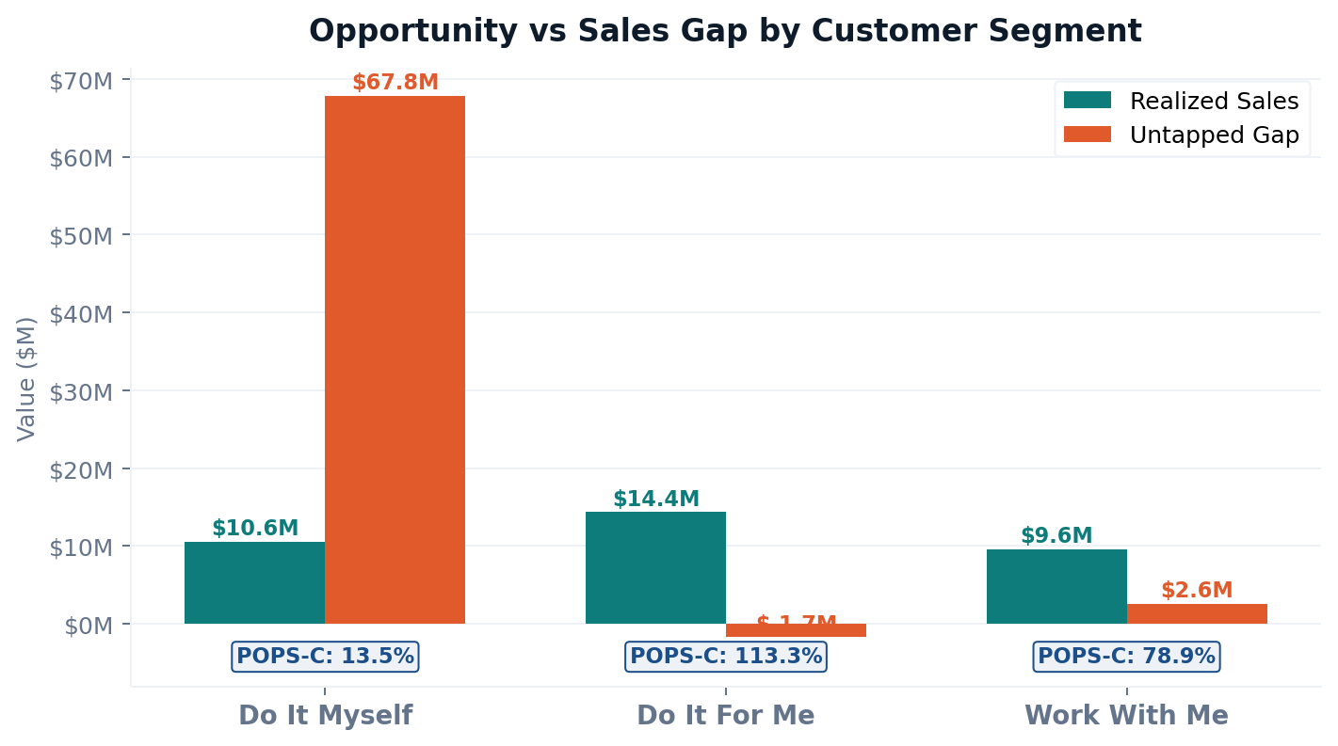
CUSTOMER SEGMENT ANALYSIS — Opportunity vs. Sales Gap
SEGMENT BREAKDOWN
Do It Myself
6,479 customers • POPS-C: 13.5%
Gap: $67.8M — Highest urgency
Work With Me
162 customers • POPS-C: 78.9%
Gap: $2.6M — Retain & upsell
Do It For Me
328 customers • POPS-C: 113.3%
Gap: Exceeded — Monitor only
⚡ DIM segment alone holds 69% of all untapped revenue. Converting from 13.5% → 25% POPS-C adds $9M annually.

Slide 4
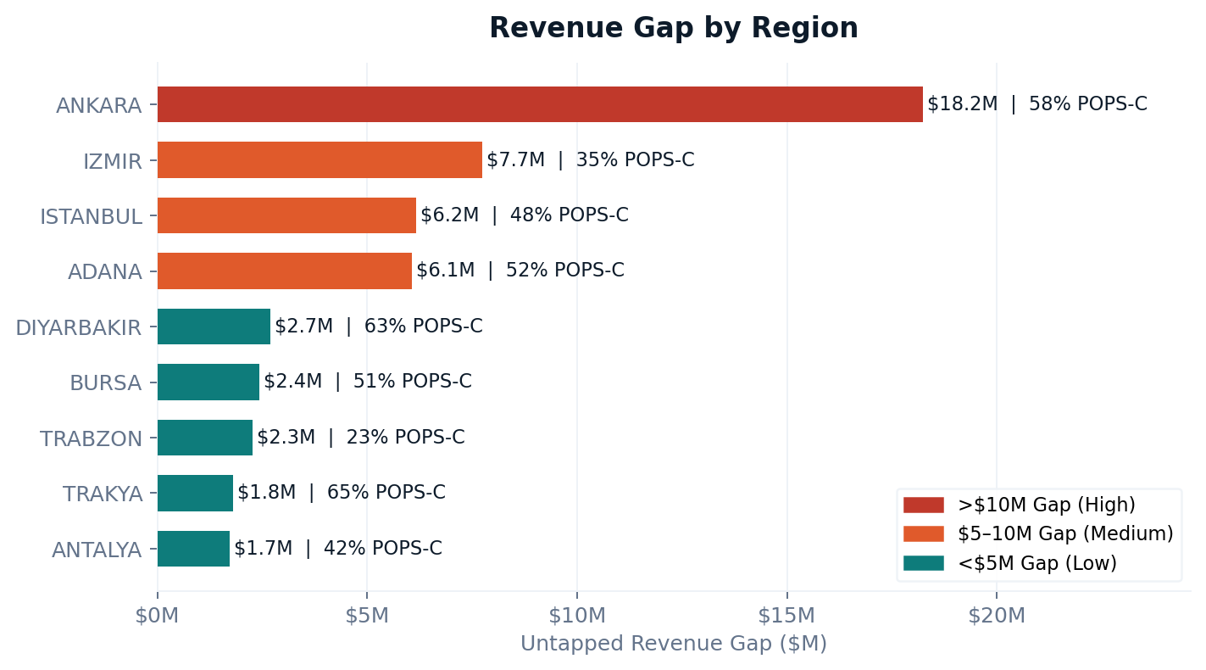
GEOGRAPHIC ANALYSIS — Revenue Gap by Region
REGIONAL PRIORITIES
Ankara
HIGH
Gap: $18.2M | POPS-C: 58%
Izmir
HIGH
Gap: $7.7M | POPS-C: 35.5%
Istanbul
HIGH
Gap: $6.2M | POPS-C: 48.4%
Adana
MED
Gap: $6.1M | POPS-C: 51.7%
Trabzon
MED
Gap: $2.3M | POPS-C: 22.8%
📍 Ankara + Izmir + Istanbul = $32M of the $49M total gap. Deploy top performers and increase visit frequency here first.

Slide 5
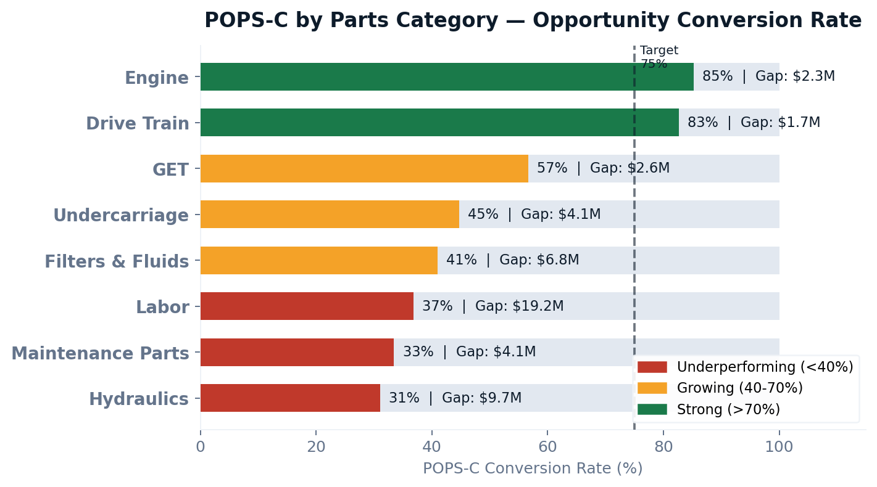
PARTS CATEGORY PERFORMANCE — POPS-C Conversion by Category
KEY FINDINGS
🔴 Labor: Largest $19.2M gap at only 37% conversion — upsell services at every parts transaction.
🔴 Hydraulics: $9.7M gap at 31% — launch targeted diagnostic campaign for DIM customers.
🟡 Filters & Fluids: $6.8M gap at 41% — bundle with maintenance kits to lift conversion.
🟡 Undercarriage: $4.1M gap at 45% — focus on customers with 3+ machines for bulk deals.
🟢 Engine & Drive Train are strong converters (83-85%) — protect these relationships and expand wallet share.
🎯 Labor + Hydraulics alone = $28.9M in recoverable revenue. Targeted campaigns in both categories could add $8–12M within 12 months.

Slide 6
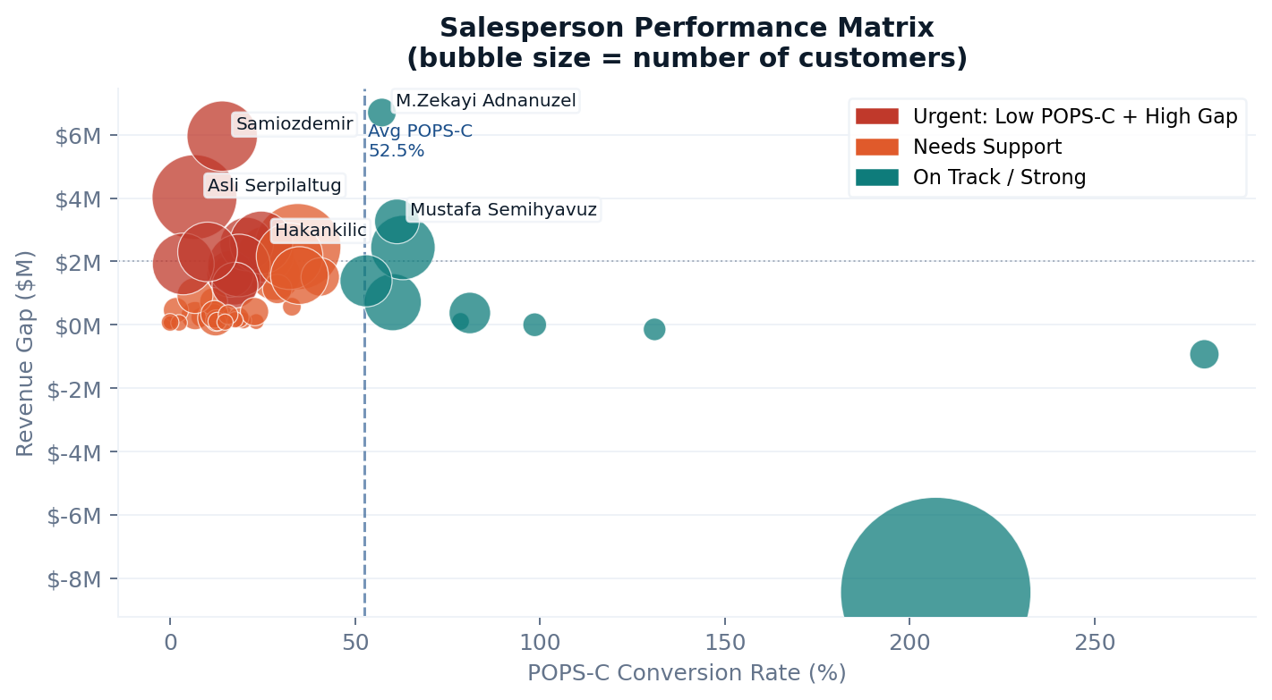
SALESPERSON PERFORMANCE MATRIX — POPS-C vs. Revenue Gap
TOP 5 BY UNTAPPED GAP
M.Z. Adnanuzel
Account Planning
Gap: $6.7M | POPS-C: 57.3%
Sami Ozdemir
Urgent Coaching
Gap: $5.9M | POPS-C: 14.1%
Asli Altug
Urgent Coaching
Gap: $4.0M | POPS-C: 6.6%
M.S. Yavuz
Account Planning
Gap: $3.3M | POPS-C: 61.4%
Hakan Kilic
Focused Support
Gap: $2.6M | POPS-C: 24.6%
💡 3 reps with <15% POPS-C manage 1,220+ customers and $14M+ in combined gap — immediate coaching intervention required.

Slide 7
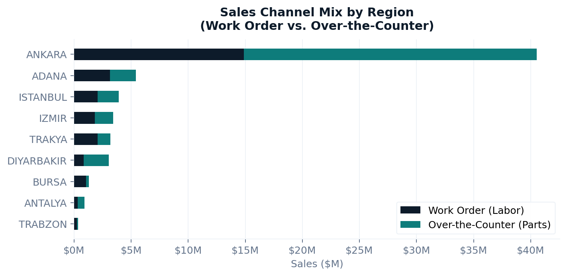
SALES CHANNEL ANALYSIS — Work Order vs. Over-the-Counter
CHANNEL INSIGHTS
Work Order Sales
$26.4M (42.6%)
Over-the-Counter
$35.6M (57.4%)
Strategic Implication:
OTC dominance signals customers prefer buying parts independently — reinforcing the DIM conversion challenge. Labor (Work Order) growth is the highest-margin opportunity.
Channel Action: Bundle work orders with parts purchases. Every OTC sale is an opportunity to upsell a service visit.
🔧 Raising WO share from 43% → 55% of total sales would add ~$7.4M in higher-margin labor revenue at current sales volumes.

Slide 8
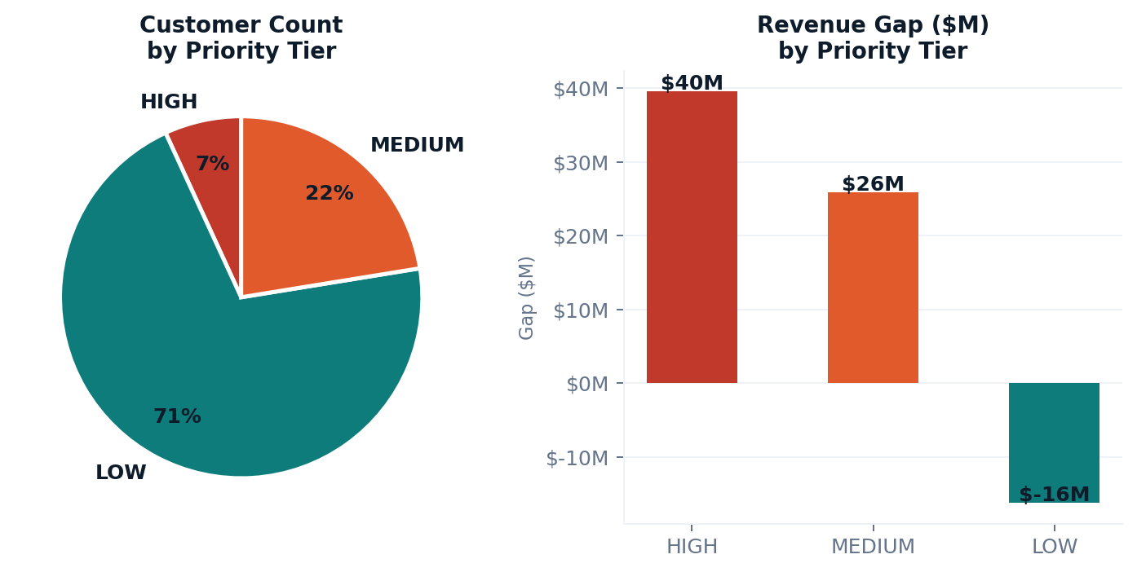
CUSTOMER PRIORITY TARGETING — Where to Focus Sales Resources
HIGH Priority
1,550 customers
Opportunity: $51.4M
Opp >$20K, POPS-C <30%. Immediate rep visit, diagnosis, tailored offer.
MEDIUM Priority
2,012 customers
Opportunity: Targeted Outreach
Opp >$5K, POPS-C <60%. Structured account plans, quarterly reviews.
LOW Priority
6,603 customers
Opportunity: Digital Outreach
Smaller accounts. Use automated campaigns, self-service portals.
⚡ Allocate 70% of sales rep time to the 1,550 HIGH-priority accounts — they hold $51.4M of the $49M total gap.

Slide 9
STRATEGIC RECOMMENDATIONS
Activate the DIM Segment
Close Hydraulics & Labor Gap
⏱ 0–90 days • Target: +$9M ↑ Chart 1
⏱ 30–120 days • Target: +$7M ↑ Chart 3
01
→ Identify top 500 DIM customers by opportunity size
02
→ Launch Hydraulics diagnostics for all DIM machine owners
→ Deploy maintenance bundles + first-service-visit incentives
→ Introduce preventive maintenance labor contracts
→ Assign dedicated rep to each account with >$20K opportunity
→ Train reps: upsell one work order per OTC transaction
→ Target: DIM POPS-C 13.5% → 25% = +$9M revenue
→ Labor 37%→50% = +$4M; Hydraulics 31%→45% = +$2M
Geographic Focus: Ankara & Izmir
Sales Force & Channel Enablement
⏱ 30–60 days • Target: +$5M ↑ Chart 2
⏱ Ongoing • Target: +$3M ↑ Charts 4 & 5
03
→ Ankara ($18.2M gap): Assign top performers, 2× call frequency
04
→ Introduce POPS-C as primary KPI in monthly rep reviews
→ Izmir (35.5% POPS-C, $12M market): Deploy dedicated team
→ Pair Asli Altug, Sami Ozdemir (6–14% POPS-C) with top mentors
→ Istanbul (48.4% POPS-C): Structured key account planning
→ Segment all 3,196 untagged customers to unlock hidden opportunity
→ Explore mobile service units for underserved districts
→ Bundle WO + OTC: lift WO mix from 43%→55% for margin growth
Combined impact of all 4 recommendations: +$15–24M in additional annual parts & service revenue within 12 months.

Slide 10
ADDITIONAL DATA NEEDED & FURTHER ANALYSES TO CONFIRM FINDINGS
Data We Still Need
Further Analyses to Validate
📊 Visit Frequency / CRM Activity
📈 Cohort / Vintage Analysis
Correlate rep call cadence with POPS-C to identify if low POPS-C is a contact or a product issue.
Track POPS-C over customer tenure. Do newer customers convert better? Are legacy DIM customers recoverable?
📅 Multi-Year Trend Data
Identify growing vs. declining accounts. Current analysis is single-year snapshot only.
🤖 Churn Prediction Model
Identify DIFM/WWM customers at risk of reverting to DIM using historical behavioral signals.
💰 Margin by Category
Reprioritize gap categories by gross margin, not just revenue, to maximize profit impact.
🗺 Geo-Spatial Clustering
🏭 Machine Age & Model
Map customer locations to optimize rep territory routing and identify underserved zones.
Predict parts demand windows. Older machines = higher maintenance need = proactive outreach trigger.
📦 Basket / Cross-Sell Analysis
🌐 Competitor Intelligence
Which parts are bought together? Build bundles to increase average order value per transaction.
Izmir (35.5% POPS-C) may indicate competitor pricing pressure. Price benchmarking needed.
📋 Lost Order Reasons
🔍 Opportunity Algorithm Audit
Survey customers who buy 0 labor — is it price, convenience, or capability?
Structural/Other shows >100% POPS-C — likely a model calibration issue. Audit inputs for accuracy.
With CRM + margin + trend data, POPS-C improvement targets can be validated to ±5% precision and tailored by machine type and region.

Slide 11
THE BOTTOM LINE
$49 million is sitting on the table.
The data is clear: structured targeting of the DIM segment, closing the
Hydraulics and Labor gaps, focusing geographic resources on Ankara and Izmir,
and empowering underperforming sales reps can realistically capture
$15–24M of that opportunity within the next 12 months.
01. Target DIM Segment
02. Labor & Hydraulics
03. Ankara + Izmir Push
04. Enable Sales Force
+$9M
+$7M
+$5M
+$3M

