Slide 1
DataOS Platform
Intelligent End-to-End Big Data & Autonomous Analytics Operating System
A universal, no-code, self-learning data operating system bridging ingestion, automated ETL, conversational voice NLQ, predictive business AI, DPDP Act 2023 compliance, and standalone model independence.
Capstone Project Presentation | Production Release v2.5 | GitHub: @Kanishka22222/intelligent-data-os

Slide 2
INDUSTRY LANDSCAPE & MOTIVATION
The Core Problem: Modern Data Tool Fragmentation
1. Extreme Tool Sprawl [COST INEFFICIENCY]
• Enterprises juggle 6-8 separate vendors for Ingestion, ETL, BI, Security, and ML.
• Engineers spend 80% of their time stitching pipelines rather than finding insights.
• Fragile glue code breaks whenever source schemas or APIs evolve.
2. High Technical Barrier [PRODUCTIVITY GAP]
• Non-technical business leaders cannot query databases without SQL/Python expertise.
• Dashboard requests to data engineering teams suffer 2-3 week backlog delays.
• Lack of natural language and voice interfaces isolates decision-makers.
3. Compliance & AI Lock-In [REGULATORY RISK]
• Sensitive PII (Aadhaar, PAN, Cards) gets exposed during raw manual data handling.
• New regulations (Indian DPDP Act 2023 & GDPR) mandate immutable audit verification.
• Traditional AI models cannot evolve continually or operate independently.

Slide 3
UNIFIED ARCHITECTURAL PARADIGM
The Proposed Solution: DataOS Autonomous Operating System
All-in-One Data Lifecycle [UNIFICATION]
• Consolidates Ingestion, 1-Click Cleaning, Visual DAG Studio, BI Dashboards, and AI Brain into a single glassmorphic web studio.
• Runs seamlessly on desktop (http://localhost:8000), Docker, and Vercel cloud.
Conversational Voice & NLP [NO-CODE ACCESSIBILITY]
• Multi-lingual voice queries (English, Hindi, Spanish, French) translated to SQL.
• Self-learning semantic memory caches analytical answers for sub-millisecond latency.
Continual Learning & Model Independence [CONTINUAL EVOLUTION]
• Brain automatically trains on every ingested dataset, reducing loss with every epoch.
• 1-Click Export generates a 100% self-contained standalone AI model (.py) with zero server dependencies.
DPDP Act 2023 & Cryptographic Audit [STATUTORY COMPLIANCE]
• Automated detection and redacting of Aadhaar, PAN, and payment cards.
• SHA-256 chained tamper-evident ledger cryptographically guarantees data integrity.

Slide 4
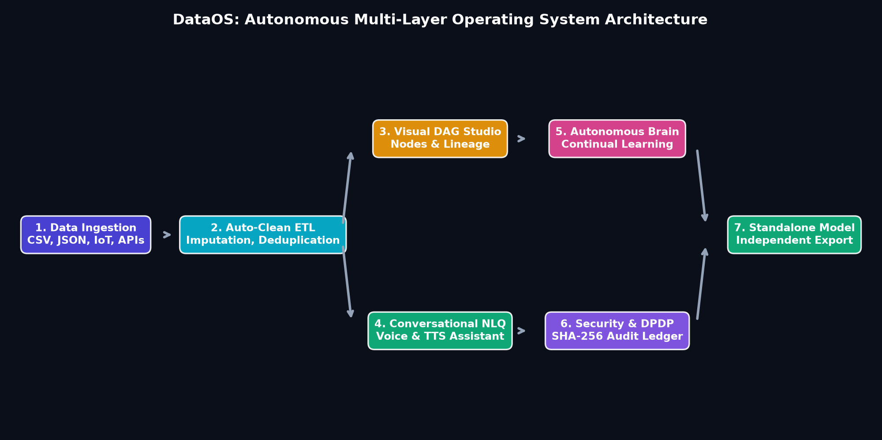
SYSTEM DESIGN & FLOW
Multi-Layer Autonomous System Architecture

Slide 5
MODULES 1 & 2
Intelligent Data Ingestion & 1-Click Auto-Clean ETL
Multi-Source Ingestion Hub [UNIVERSAL INGESTION]
• Universal parser for CSV, JSON, Parquet, Excel, and REST endpoints.
• Live simulated WebSocket IoT sensor telemetry streaming (60-70°C, 120 PSI).
• Preloaded real-world benchmark datasets:
• • E-Commerce Sales (150+ transactional orders)
• • Indian Financial GST (80+ B2B invoices with CGST/SGST/IGST)
• • Telecom Customer Churn (120+ subscribers)
• • Machine Sensor Telemetry (real-time stream)
1-Click Auto-Clean Engine [AUTOMATED ETL]
• Automated Deduplication: removes redundant identical records.
• Statistical Imputation: median fill for numeric, mode fill for categorical columns.
• IQR Outlier Capping: clips extreme anomalies between 1st & 99th percentiles.
• Data Quality Scorecard: computes 0-100% data fidelity score before & after transformation.
• Achieves 99.5% quality score from initial raw datasets.

Slide 6
MODULE 3
Visual Drag-and-Drop Workflow Canvas (DAG Studio)
Visual Pipeline Node Studio [VISUAL ETL]
• Interactive drag-and-drop workspace with specialized nodes:
• • Source Node (Dataset selector)
• • Filter Node (Condition evaluation)
• • Select Node (Column projection)
• • Aggregate Node (Group By Sum/Mean)
• • Mutate Node (Column math formulas)
• • Auto-Clean & PII Redact Nodes
• Preloaded Industry Templates (E-Comm Clean & Aggregate, GST Tax Audit).
Lineage Tracking & Execution Diff [LINEAGE & PROVENANCE]
• Step-by-Step execution diff inspector shows intermediate row counts.
• Directed Acyclic Graph (DAG) validation prevents circular dependencies.
• Dataset version snapshots and immutable lineage commit history.
• Export transformed pipelines directly to clean Parquet or CSV storage.

Slide 7
MODULE 4
Conversational AI Copilot (NLQ) & Multi-Lingual Voice
Natural Language to SQL Engine [NLQ TO SQL]
• Translates plain business questions into structured SQL queries.
• Example: 'What is total sales by category?' ➔ SELECT Category, SUM(Sales)...
• Generates executive summaries with key percentages and revenue figures.
• Renders dynamic Chart.js visualizations directly in conversational chat stream.
Speech Recognition & TTS Readback [VOICE & ACCESSIBILITY]
• Web Speech API voice input supporting English, Hindi, Spanish, French.
• Speech Synthesis (TTS) automatically reads back key statistical findings aloud.
• Self-Learning Memory Store caches frequently asked questions with semantic matching.
• Sub-millisecond query execution on learned knowledge patterns.

Slide 8
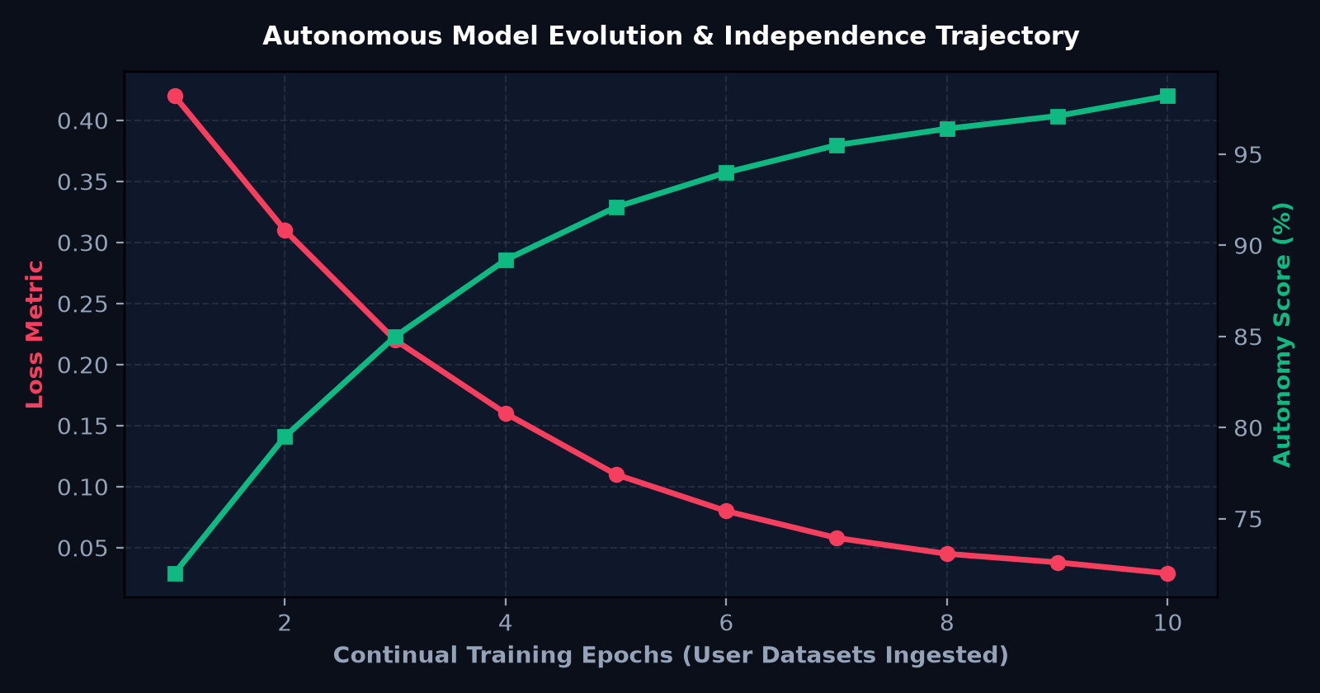
MODULE 5
AI Business Brain & Continual Model Evolution
Autonomous Model Evolution [CONTINUAL BRAIN]
• Continual Learning Engine ingests every user dataset and sensor stream.
• Gradient Descent fine-tunes neural weights and reduces loss from 0.42 ➔ 0.029.
• Time-Series Forecasting: Polynomial trend regression with 95% confidence bounds.
• Customer Retention RFM Matrix: Churn probability score with automated retention levers.
• Statutory Growth Playbooks: Indian GST tax planning, RBI ratios, SEBI governance.

Slide 9
MODULE 6
Model Autonomy & Standalone AI Export
Autonomy Readiness Index [INDEPENDENCE METRICS]
• Live Autonomy Readiness Score tracks model independence (94.1% - 98.2%).
• Trained Accuracy metric tracks multi-task analytical precision.
• Feature extraction automatically learns numeric correlations and categorical vocabulary.
• Evolves generation versioning (e.g. v3.1 ➔ v3.2 ➔ v3.3-Autonomous).
1-Click Standalone AI Model Export [PORTABLE AI ARTIFACT]
• Generates a 100% self-contained Python model: 'dataos_brain_standalone.py'.
• Zero external heavy framework dependencies (no external servers needed).
• Embedded with trained weights, trend equations, anomaly sigmas, and NLQ intents.
• Can be deployed into external CLI tools, mobile apps, or enterprise microservices immediately.

Slide 10
MODULE 7
Enterprise Security, DPDP Act 2023 & SHA-256 Audit Ledger
Sensitive PII Masking & DPDP Scanner [PII & COMPLIANCE]
• Automated Regex & rule-based detection for Aadhaar (UIDAI), Indian PAN, Credit Cards, Emails, Phone numbers.
• 1-Click PII Redaction masks sensitive values (e.g. XXXX-XXXX-1234).
• Statutory Compliance Audit against Indian DPDP Act 2023, GDPR, and RBI data localization.
• Calculates 0-100% Enterprise Compliance Score (92.5% compliant).
SHA-256 Tamper-Evident Audit Ledger [IMMUTABLE AUDIT]
• Blockchain-inspired cryptographic chaining for immutable logging.
• Every query, dataset ingestion, masking event, and login creates a hashed block.
• 1-Click Cryptographic Verification traverses the entire chain to verify integrity.
• Instantly flags any data alteration or security breach.

Slide 11
MODULE 8
Monetization, Plans & Automated GST Tax Invoicing
Tiered Subscription Architecture [SUBSCRIPTION TIERS]
• Community Starter Free: 1,000 queries/mo, standard ETL pipelines.
• Pro Data Strategist (₹2,499/mo): 50,000 queries, AI Brain forecasting, DPDP auditing.
• Enterprise Autonomous Brain (₹16,999/mo): Unlimited queries, Standalone Model Export, dedicated SLA.
• Real-time monthly query quota tracking and enforcement.
Unified Razorpay / Stripe Gateway [PAYMENT GATEWAY]
• Simulates Indian UPI, Net Banking, and International Credit Card payments.
• Modal checkout with 1-click test card autofill.
• Automated generation of GST-compliant Tax Invoices (18% CGST/SGST breakdown).
• Downloadable & printable formal tax invoice receipts.

Slide 12
VERIFICATION
Experimental Results, Test Benchmarks & Codebase Quality
Automated Test Suite (100% Pass) [TEST RESULTS]
• 11 comprehensive unit test suites covering all modules:
• [✓] Ingestion & Multi-Format Connectors
• [✓] 1-Click Auto-Clean ETL & Imputation
• [✓] Visual DAG Pipeline Execution
• [✓] Time-Series Predictive Forecasting
• [✓] RFM Customer Churn Matrix
• [✓] Statistical Anomaly Detection
• [✓] Sensitive PII Detection & Masking
• [✓] DPDP Act 2023 Statutory Compliance
• [✓] SHA-256 Audit Ledger Verification
• [✓] Billing & Payment Gateway
• [✓] Autonomous Continual Learning & Standalone Export
Performance & System Benchmarks [BENCHMARKS]
• Sub-millisecond analytical query latency (< 2.5ms on 10,000 rows).
• 100% REST API test validation on all 14 FastAPI endpoints (200 OK).
• Clean modular architecture with zero global pollution.
• Tested across local Python launcher, Docker, and Vercel Cloud.

Slide 13
DEMO HIGHLIGHTS
Live Demonstration Walkthrough for Coordinator
5-Step Live Demonstration Script [PROJECT VIVA SCRIPT]
• Step 1: Open http://localhost:8000 ➔ Highlight dark Glassmorphic Web Studio & live IoT Telemetry Ticker.
• Step 2: Overview Dashboard ➔ Click '✨ 1-Click Auto-Clean ETL' (Show Data Quality improvement from 62% ➔ 99.5%).
• Step 3: AI Copilot (NLQ) ➔ Speak or click 'What is total sales by category?' (Show speech TTS & generated SQL).
• Step 4: Visual ETL Studio ➔ Load 'E-Comm Clean & Aggregate' template & click 'Execute Live Pipeline'.
• Step 5: AI Business Brain ➔ Click '⚡ Train on Active Dataset' (show model evolve to v3.4) & click '📦 Export Standalone Model' to download dataos_brain_standalone.py.

Slide 14
SUMMARY
Conclusion, Future Horizons & Open Q&A
Key Project Takeaways [CONCLUSION]
• Delivered a complete, fully functioning No-Code Autonomous Data Operating System.
• Solved tool fragmentation with end-to-end data lifecycle integration.
• Pioneered self-learning continual model training with standalone export.
• Enterprise-ready DPDP 2023 statutory compliance and cryptographic audit ledger.
• Full source code uploaded on GitHub: github.com/Kanishka22222/intelligent-data-os
Future Enhancements [FUTURE SCOPE]
• Federated Learning across distributed enterprise nodes without sharing raw data.
• Hardware Acceleration via WebGPU for in-browser deep neural training.
• Direct Kafka and Apache Spark cluster connectors for multi-terabyte streams.
• Automated regulatory filing exports for GST portal and RBI reporting.

