Slide 1



Tennis
View in Power BI
Last data refresh:
18/09/2022 20:18:26 UTC
Downloaded at:
18/09/2022 20:19:33 UTC

Slide 2
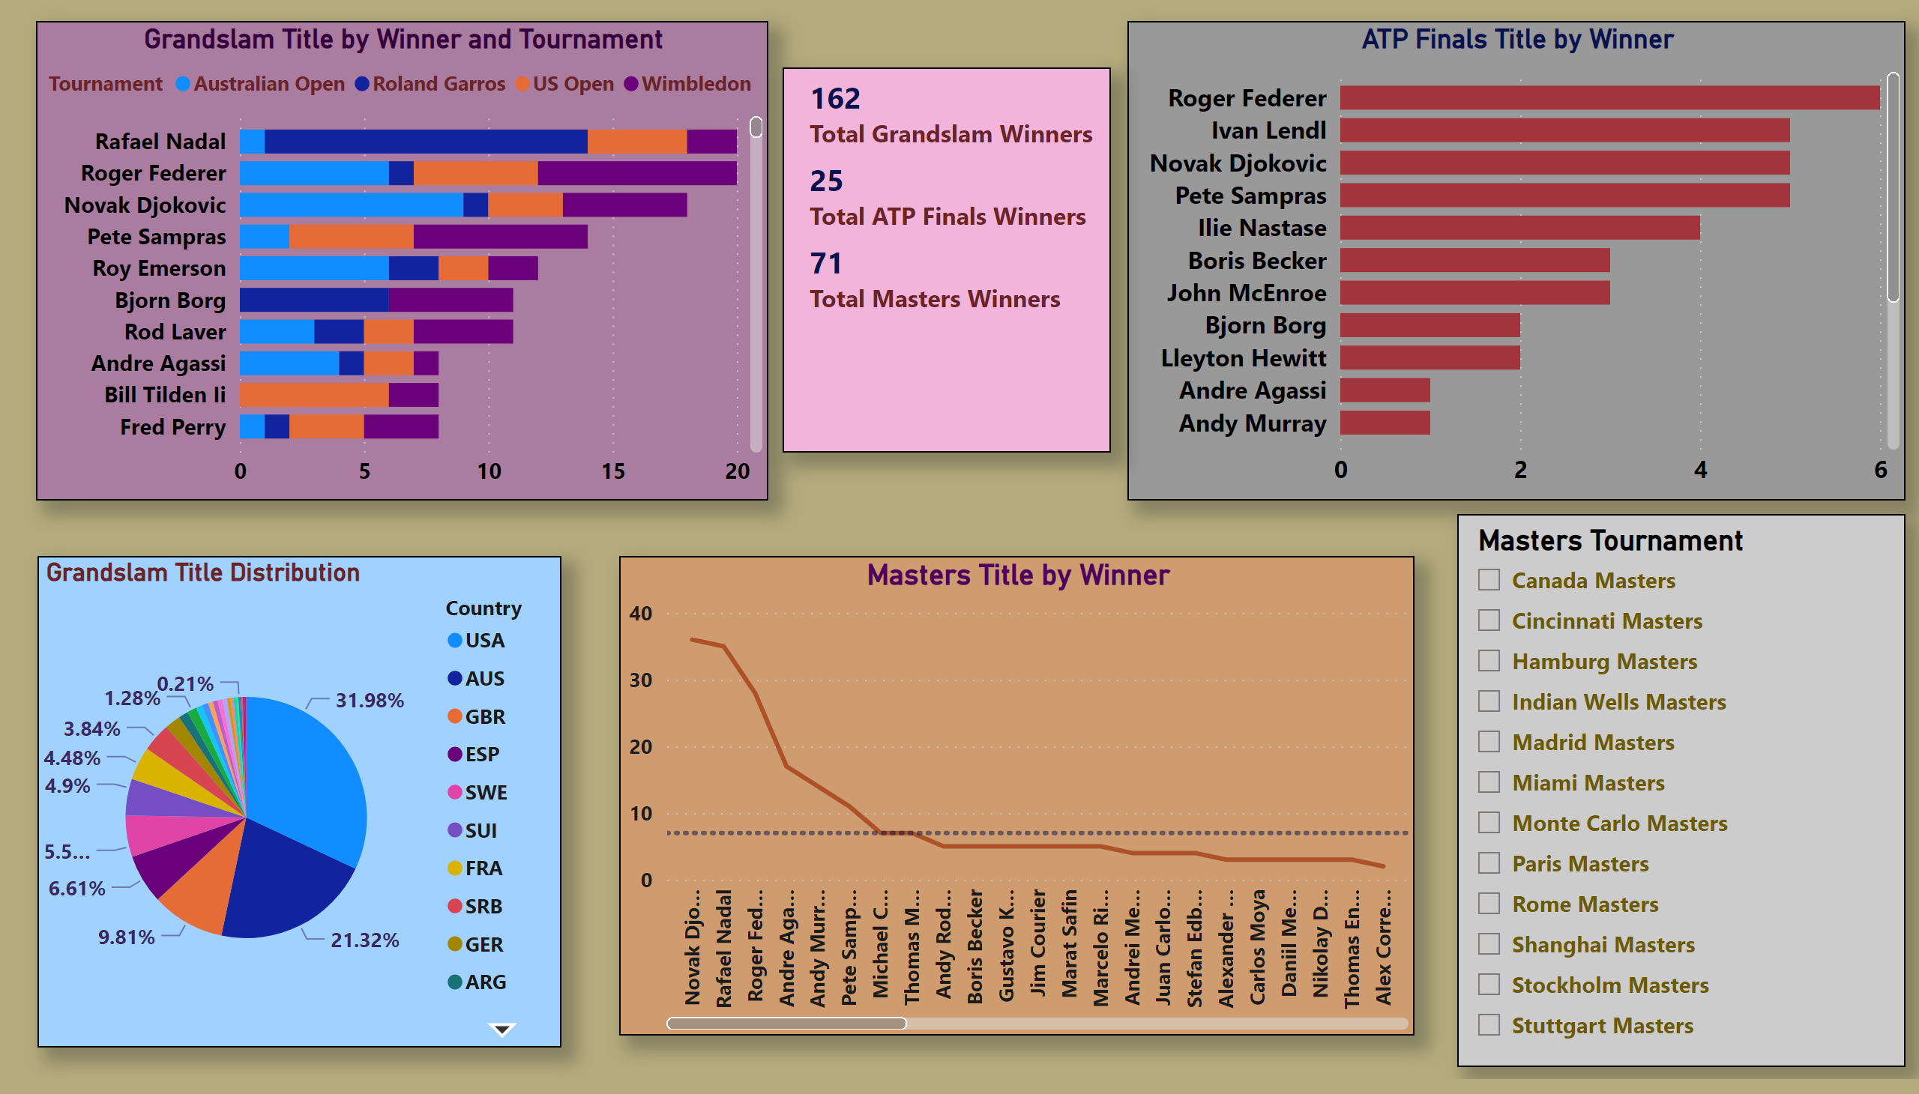
Tennis Big Title
Notes:
slicer
No alt text provided
Grandslam Title Distribution
No alt text provided
multiRowCard
No alt text provided
lineChart
No alt text provided
barChart
No alt text provided
barChart
No alt text provided

