Slide 1



Coronavirus
View in Power BI
Last data refresh:
18/09/2022 19:30:18 UTC
Downloaded at:
18/09/2022 20:12:43 UTC

Slide 2
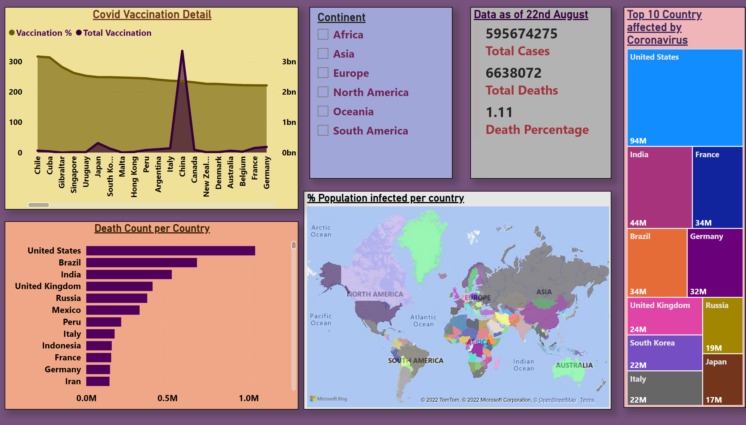
Coronavirus Details
Notes:
Data as of 22nd August
No alt text provided
Top 10 Country affected by Coronavirus
No alt text provided
Covid Vaccination Detail
No alt text provided
slicer
No alt text provided
% Population infected per country
No alt text provided
Death Count per Country
No alt text provided

