Slide 1

Project Title -
[Student Name
College Name- ]
AICTE STU ID : (its available in your offer letter)

Slide 2

PROBLEM STATEMENT
(Agricultural activities are influenced by seasonal variations in environmental conditions, farming practices, resource availability and market conditions. As a result, agricultural performance may differ from one season to another. However, raw agricultural data does not clearly explain how agricultural performance changes across seasons or what patterns can be observed in different seasonal conditions. The problem is to analyze the given agricultural dataset and investigate seasonal differences in agricultural performance by identifying meaningful patterns, trends, relationships and variations within the available data.

Slide 3
Project Description
This project analyzes 4,000 farm records across 8 Indian states, 8 crops, and 3 cropping seasons (Kharif, Rabi, Zaid) to understand how agricultural performance varies seasonally. The dataset includes environmental conditions (rainfall, temperature, soil), input usage (fertilizer, irrigation, pesticides), and financial outcomes (yield, cost, revenue, profit). After cleaning and feature engineering (profit margin, ROI, water-use efficiency), the analysis applies statistical hypothesis testing (ANOVA, Kruskal-Wallis, Tukey HSD, Chi-square) to confirm whether seasonal differences are statistically significant, followed by correlation analysis, K-Means clustering to segment farm performance archetypes, and a Random Forest model to rank the key drivers of profitability. The goal is to move beyond descriptive charts to evidence-based, statistically validated conclusions that can support seasonal agricultural planning.

Slide 4

WHO ARE THE END USERS?
Agricultural policy makers and state agriculture departments (seasonal planning, subsidy targeting)
Farmers and farmer cooperatives (crop-season selection, irrigation choice)
Agri-lending institutions and insurers (season-wise risk assessment)
Agricultural extension officers (targeted advisory for underperforming farm clusters)
Researchers and agri-tech companies (data-driven crop planning tools)

Slide 5

Technology Used
Python, Pandas, NumPy, Matplotlib, Seaborn, SciPy, Statsmodels (ANOVA/Tukey HSD), Scikit-learn (K-Means, PCA, Random Forest), Jupyter Notebook.

Slide 6
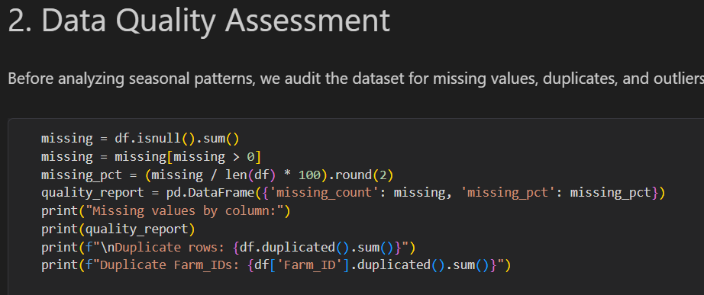
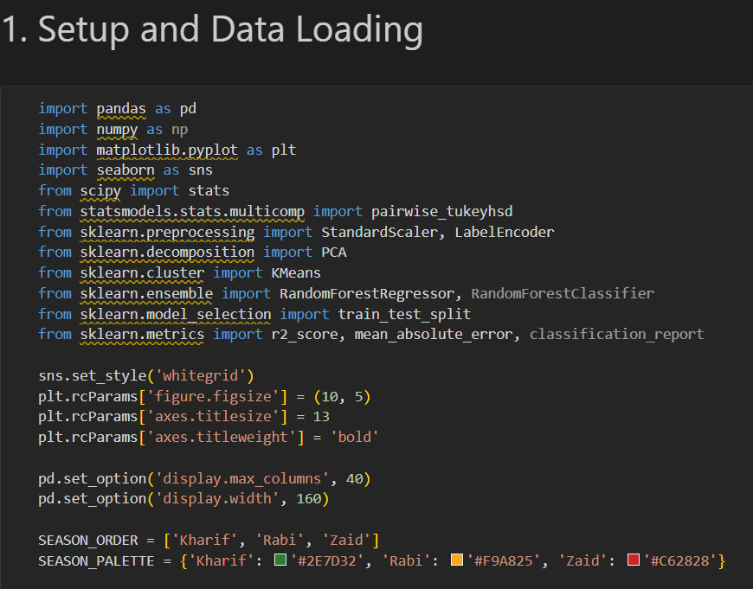
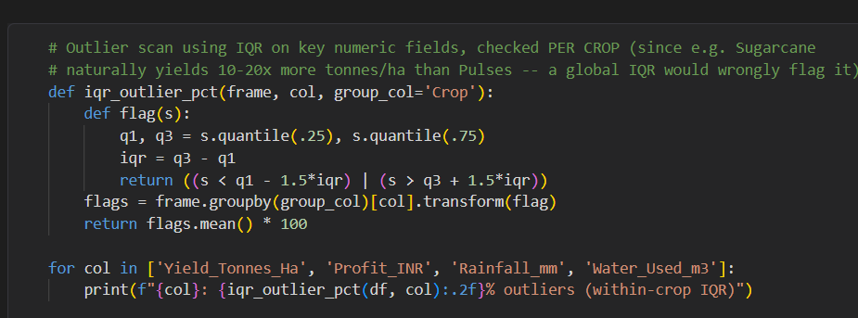
RESULTS

Slide 7
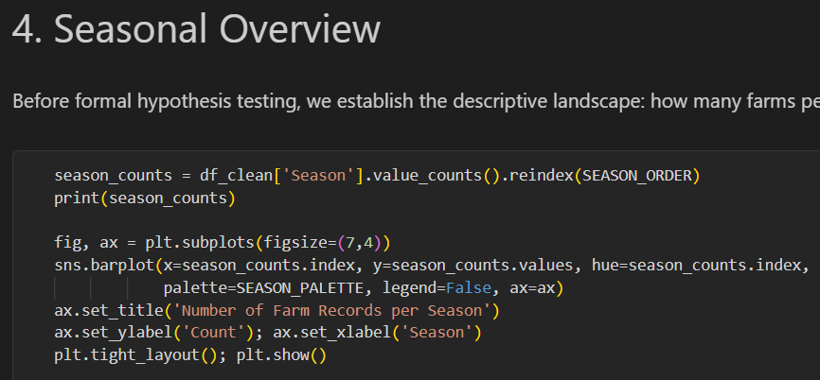
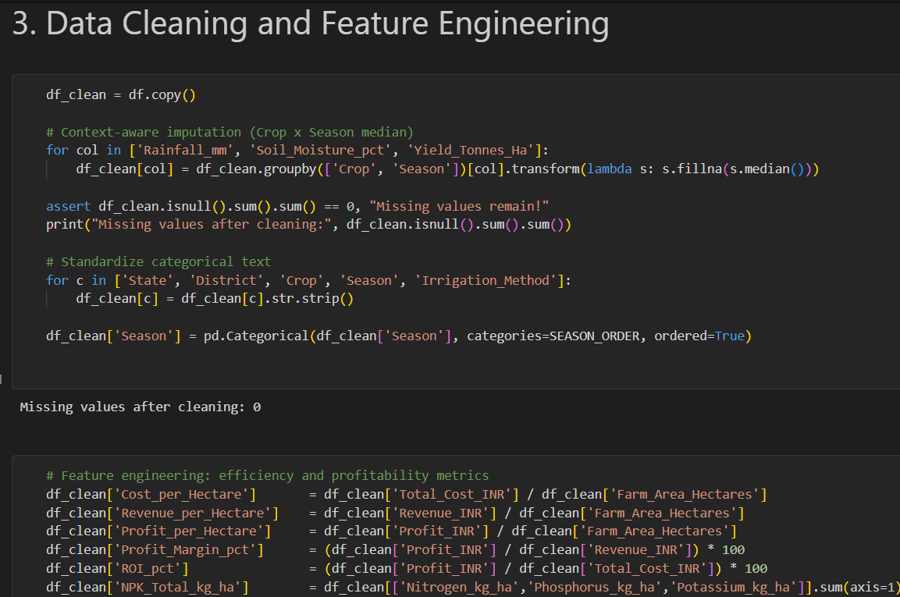
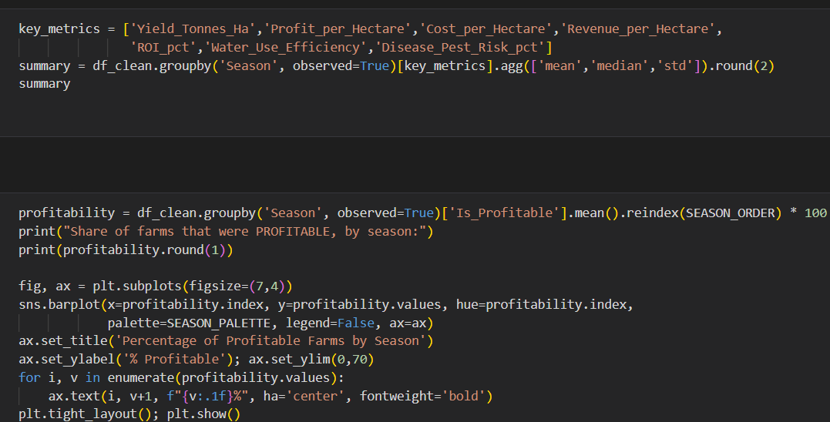
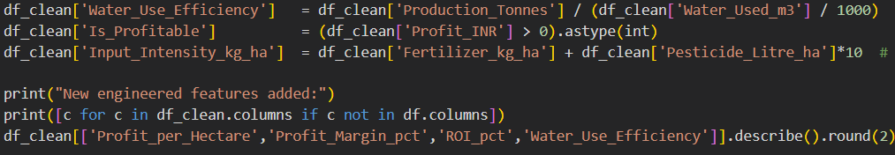
RESULTS
[Add screen shots of your code ]

Slide 8
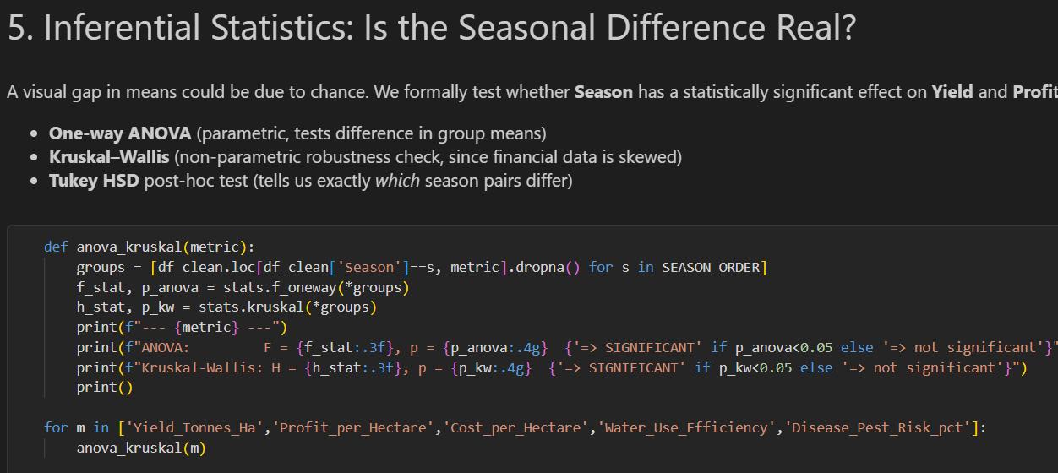
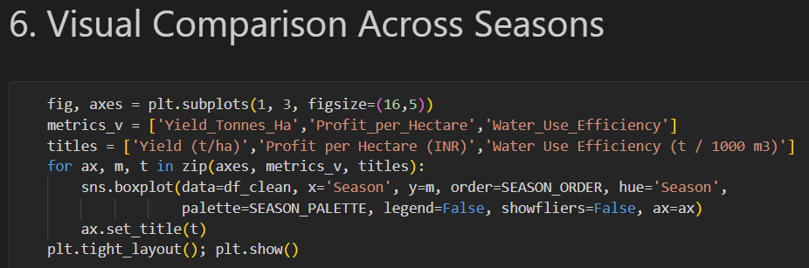
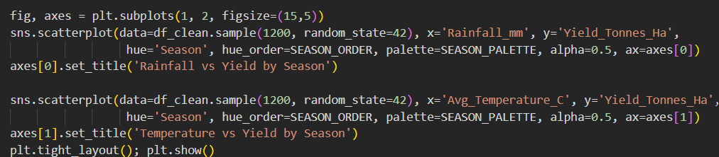
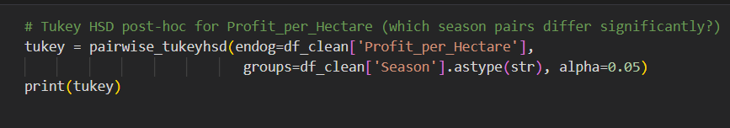
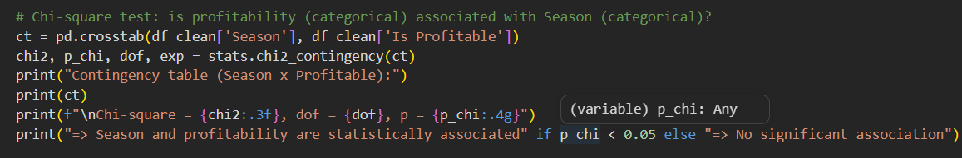
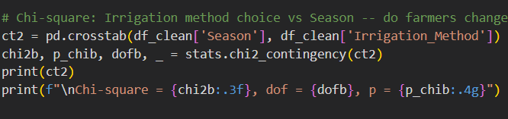
RESULTS
[Add screen shots of your code ]

Slide 9
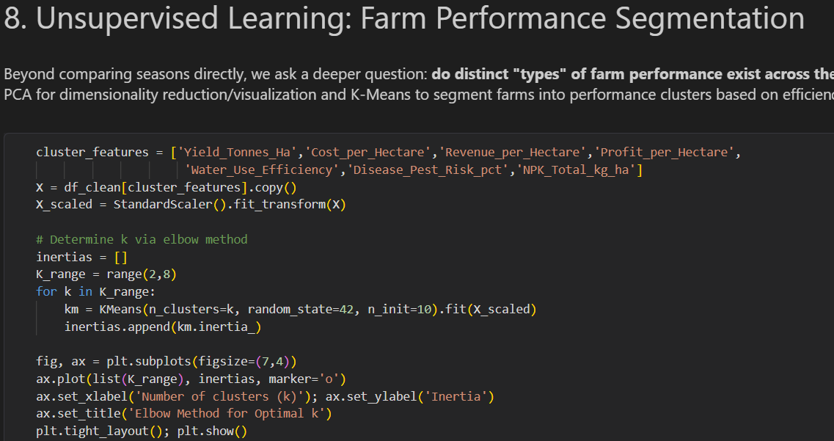
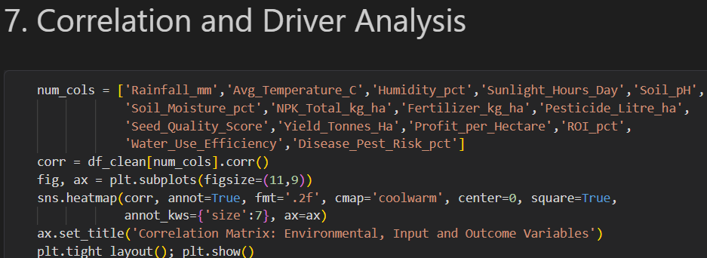
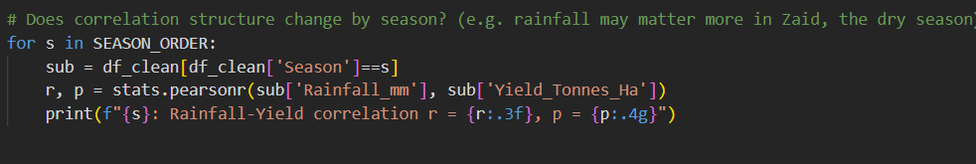
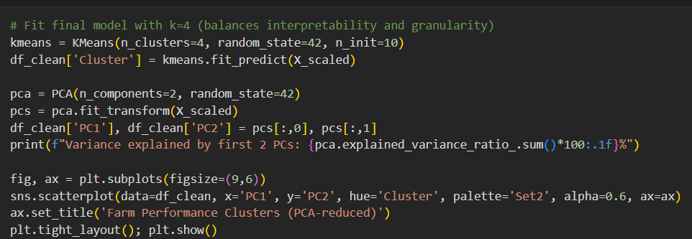
RESULTS
[Add screen shots of your code ]

Slide 10
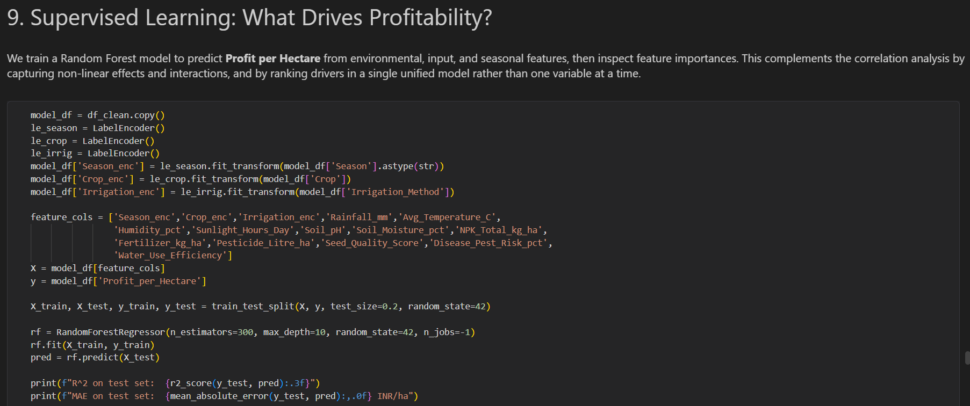
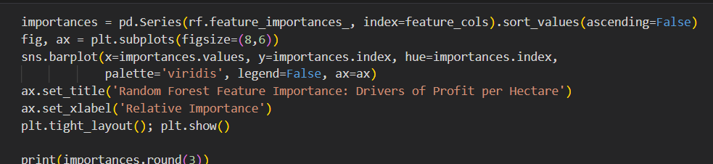
RESULTS
[Add screen shots of your code ]

Slide 11
Future scope
Extend to multi-year longitudinal data to study year-over-year seasonal trends, not just a single-cycle snapshot
Incorporate real-time weather/market-price feeds for predictive (not just descriptive) seasonal planning
Build a farmer-facing dashboard recommending optimal crop-season-irrigation combinations by region
Test causal methods (e.g., controlled experiments) to move from correlation to causation on key drivers

Slide 12
GitHub Link
https://github.com/Kanishka345/Seasonal-Agriculture-Performance-Analysis.git

Slide 13

VOIS Course completion certificate - Course name- Data Visualization

Slide 14
Thank you
.
.

