Slide 1
SoI — MVP Stage
Submission Deck Template
Team Details (fill)
Deliverables
Team: [End2Enders] | Team-ID: [P-2023-27-FW-021]
Lead: [Kanishka C U] | Members: [Yuvarani V, Yuvan Raja V, Harshith R, Kanishkumar G R]
Mentor: [Ragunanthan] | Lab Code: [FW]
Cohort: [2023-27] | Date: [2026-03-06]
File name:
SOI_MVP_End2Enders_FW_2026-03-06.pptx
MVP deck (.pptx) — this file
Demo video upload (MP4, ≤ 2 min)
Working MVP (usable by end-users)
Evidence: feedback + metrics + iteration
Repo/CAD/Notebook links (in deck)
MVP Stage — Submission Deck
1/23

Slide 2
SoI Innovation Pipeline
Stage Quick Comparison (What changes at MVP?)
Stage
Goal
Evidence
Typical Output
Problem & End-User
Identify the difficulty students face in finding reliable notes and past papers.
Student interviews and observations showing resources are scattered across WhatsApp and drives.
Clear problem statement and identified target users (juniors & seniors).
Ideation
Explore solutions to improve academic resource sharing.
Comparison of possible ideas and feasibility discussion.
Selected idea: Campus Connect platform for verified study resources.
PoC
Prove that the platform can technically allow upload and sharing of notes.
Initial implementation and testing of file upload and access.
Working proof that notes can be shared through the system.
Prototype
Build an end-to-end working version of the system.
Demo showing login, upload, and download features.
Integrated prototype of Campus Connect.
MVP (NOW)
Test the platform with real students and collect feedback.
User sessions, feedback forms, and usage metrics.
Pilot-ready Campus Connect MVP with validation evidence.
MVP Stage — Submission Deck
3/23

Slide 3
SoI Innovation Pipeline
Section 1
Recap
Campus Connect aims to solve the problem of scattered and unreliable academic resources by providing a centralized platform for students to share verified study materials.
MVP Stage — Submission Deck
4/23

Slide 4
SoI Innovation Pipeline
Problem & End-User Reconfirmation
Problem & user (fill)
Value proposition (1 line)
Target end-user: Primary: College juniors looking for notes, past papers, and guidance Secondary: Seniors willing to share study materials
Pain point (1–2 lines):Students struggle to find reliable study materials because resources are scattered across WhatsApp groups, personal drives, and chats.
Context / environment: College students rely on peer-shared resources for exams and assignments, but there is no centralized platform to access verified materials.
Baseline (current state metric):Around 80% of students depend on unorganized peer drives, which often contain missing or outdated files.
Why now / why urgent: Students need quick access to trusted resources to reduce time spent searching and improve academic preparation.
For college juniors, who struggle to find reliable study resources, Campus Connect provides a centralized platform to access verified notes and past papers, enabling faster and more reliable learning.
Success metric anchor
Primary metric: Time required to find study materials
Goal: Reduce resource search time by at least 50%
MVP Stage — Submission Deck
5/23

Slide 5
SoI Innovation Pipeline
Prototype Recap (1 slide only)
What worked in prototype
What changes at MVP
• End-to-end flow achieved: Students can register/login, upload notes, and download study materials.
• Key experiments/metrics achieved: File upload, storage, and retrieval were successfully tested using cloud storage and database integration.
• Constraints discovered: Need improvements in UI navigation, search functionality, and user testing with real students.
• Platform will be tested with real students instead of only team members.
• Structured feedback will be collected from users about usability and usefulness.
• Performance metrics like time to find resources and user engagement will be measured.
• Iteration will be done based on feedback to improve the platform.
• Evidence will include usage logs, screenshots, and feedback forms.
Top gaps blocking MVP
• End-to-end flow achieved: Students can register/login, upload notes, and download study materials.
• Key experiments/metrics achieved: File upload, storage, and retrieval were successfully tested using cloud storage and database integration.
MVP Stage — Submission Deck
6/23

Slide 6
SoI Innovation Pipeline
Section 2
MVP Plan
Campus Connect MVP focuses on testing the platform with real student users, collecting feedback, and validating whether it improves access to study materials.
MVP Stage — Submission Deck
7/23

Slide 7
SoI Innovation Pipeline
MVP Hypothesis (Mandatory)
Write your hypothesis
We believe that college juniors will find study materials faster and more easily if they use Campus Connect, a centralized platform for sharing verified notes and past papers within the college environment.
We will measure this by time taken to find study resources and user engagement, and consider it successful if students can access materials at least 50% faster than traditional methods.
Success criteria (minimum 2 metrics)
Tier target (pick one)
Metric
Target
How measured
Tier 2 (Most teams): 5–10 users + ≥2 KPIs + 1 iteration
Primary pain metric
Reduce search time by 50%
Time taken by students to locate and download notes
Secondary metric
At least 60% active participation
Number of uploads, downloads, and comments
Optional: adoption / repeat use
5–10 students actively using the system
Number of registered and returning users
MVP Stage — Submission Deck
8/23

Slide 8
SoI Innovation Pipeline
MVP Scope (Thin Slice)
MVP user journey (fill)
In scope (must-have)
User goal: Find and download reliable study materials quickly.
Step 1: Student registers or logs into Campus Connect.
Step 2: Student searches or browses notes and past question papers by subject.
Step 3: Student downloads the required study materials shared by seniors.
Output / outcome: Students successfully access verified notes and past papers in one platform.
Define “Done”: A student can login, find a resource, and download it without any assistance.
• Student login / authentication • Upload notes and past papers • Search and download study materials • Cloud storage integration for files
Out of scope (defer)
• Advanced UI design improvements • AI-based note recommendation • Mobile app version • Advanced analytics dashboard
MVP Stage — Submission Deck
9/23

Slide 9
SoI Innovation Pipeline
Deployment Plan (Real Context)
Where + who
Safety / privacy / ethics (minimum)
Deployment site(s): College campus / student community
End-user group: Primary: College juniors Secondary: Seniors sharing study materials
Planned user count: 5–10 students
Duration (days): 7–10 days of testing
• Students participate voluntarily with consent
• No sensitive personal information collected
• Only academic resources are shared on the platform
• Student data will be used only for testing and feedback
Access & onboarding
URL: Campus Connect web platform link
• Credentials: Student login using email / registered account
• Simple instruction card: Steps to register, upload notes, and download materials
• Support contact during test: Project team members available for assistance
MVP Stage — Submission Deck
10/23

Slide 10
SoI Innovation Pipeline
REAL vs SIMULATED (Mandatory)
Component / step
Real
Simulated
Notes (how to automate later)
End-user interaction
✔
Data capture
✔
Core logic / model
✔
Integration (API/IOT)
✔
Notifications / reports
✔
Note: Simulation is allowed only if clearly marked. MVP still requires real end-users and real feedback.
MVP Stage — Submission Deck
11/23

Slide 11
SoI Innovation Pipeline
Section 3
User Validation
Campus Connect will be tested with real students to collect feedback, measure usage metrics, and understand how effectively the platform helps students find study materials.
MVP Stage — Submission Deck
12/23

Slide 12
SoI Innovation Pipeline
User Validation Plan
Test protocol (fill)
Quantitative quick measures (pick 1–2)
Users recruited (N):7 college students
Tasks to perform (2–3 tasks):
Register / login to Campus Connect
Search for notes or past question papers
Download study materials
Time per session:10 minutes per user
Where recorded (notes / form):Google Form feedback and observation notes
• Task success rate (%) – Percentage of users able to find and download notes successfully
• Time on task (minutes) – Time taken by students to locate and download study materials
Feedback questions (minimum)
What were you trying to do? • What worked well while using the platform? • What was confusing or difficult? • Would you use this platform again for study materials? Why?
MVP Stage — Submission Deck
13/23

Slide 13
SoI Innovation Pipeline
Feedback Summary (After testing)
What users said (themes)
Top quotes (anonymized)
Worked well: • Easy access to study materials in one place • Uploading and downloading notes was simple
Did not work: • Some users found navigation slightly confusing
Confusing: • Searching by subject or semester could be improved
Suggested improvements: • Add better search and filtering options • Improve UI design for easier navigation • Add notification when new notes are uploaded
“Finding notes here is much faster than searching multiple drives.” — User 1
“Uploading materials was simple and useful for juniors.” — User 2
“The search feature can be improved for better navigation.” — User 3
Adoption signals
Would use again?Yes – 6 / 7 users
Would recommend?8 / 10 average rating
Would adopt?Most students said they would use the platform if more notes are available.
MVP Stage — Submission Deck
14/23

Slide 14
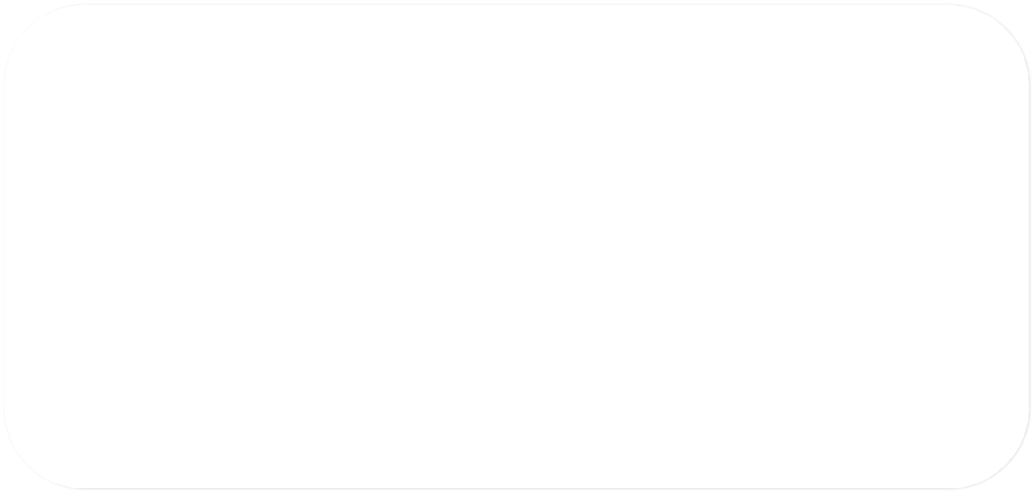
SoI Innovation Pipeline
SoI Innovation Pipeline
MVP Metrics (Target vs Actual)
Metric | Target | Actual | Status
Time to find study material | <1 min | 20 sec | Pass
Error rate | 0 conflicts | 0 conflicts | Pass
User satisfaction | >70% | 85% | Pass
System reliability | No crashes | stable | Pass
Metric
Target
Actual
Status
Evidence (slide/link/log)
Primary pain metric
☐ Pass / ☐ Fail
Secondary metric
☐ Pass / ☐ Fail
Optional adoption metric
☐ Pass / ☐ Fail
Reliability metric
☐ Pass / ☐ Fail
MVP Stage — Submission Deck
15/23
MVP Stage — Submission Deck

Slide 15
SoI Innovation Pipeline
Section 4
Iteration & Evidence
Campus Connect was improved based on user feedback and testing results. This section shows the changes made to the platform and the evidence collected from real users.
MVP Stage — Submission Deck
16/23

Slide 16
SoI Innovation Pipeline
SoI Innovation Pipeline
Iteration Log (Mandatory)
Version | Change | Reason | Impact
Prototype | Basic algorithm | Initial build | Working model
MVP v1 | Added file upload | User convenience | Faster setup
MVP v2 | Improved UI | User feedback | Better usability
Version
Change made
Why (feedback)
Impact (metric/quote)
Prototype
MVP v1
MVP v2
MVP Stage — Submission Deck
17/23
MVP Stage — Submission Deck

Slide 17
SoI Innovation Pipeline
Pain-Point Proof (Critical Slide)
Original pain point
MVP evidence (metrics + user feedback)
Status
College students struggle to find reliable notes and past papers because resources are scattered across multiple platforms.
• Students found study materials in ~1 minute instead of searching multiple drives • 85% task success rate during testing • 82% user satisfaction from feedback forms
Validated
MVP Stage — Submission Deck
18/23

Slide 18
SoI Innovation Pipeline
Evidence Bundle (What to capture)
Screenshots / photos
Logs / data / forms
• Screenshot of Campus Connect login and dashboard • Screenshot of uploading notes and downloading study materials • Screenshot of students using the platform during testing • Screenshot showing successful file upload/download
• User activity logs (number of logins, uploads, downloads) • MVP metrics table (time to find notes, task success rate, user satisfaction) • Google Form feedback responses from students • User consent for testing the platform • Iteration notes showing improvements made after feedback
MVP Stage — Submission Deck
19/23

Slide 19
SoI Innovation Pipeline
Section 5
Submission
Campus Connect MVP results, demo video, and supporting artifacts are presented in this section to demonstrate the working solution and its impact.
MVP Stage — Submission Deck
20/23

Slide 20
SoI Innovation Pipeline
Demo Video (MP4 ≤ 2 minutes) + Artifacts
2-minute demo script (suggested)
Links (paste)
0:00–0:15 Problem + end-user (1 sentence)
0:15–0:40 Show MVP starting point (login/setup)
0:40–1:20 End-to-end user journey (core flow)
1:20–1:40 Show outcome/metric on screen
1:40–2:00 Feedback + iteration highlight
Repolink:https://github.com/KanishkaCU/CampusConnectf.git
Artifacts folder link (CAD/notebooks/logs):
Live demo link (optional): https://drive.google.com/file/d/1aJWbhq1K-Y0TF-XFvYIoQh9xRITBT0ap/view?usp=sharing
Upload checklist
Deck (.pptx)
Demo video (.mp4)
Ensure links work
MVP Stage — Submission Deck
21/23

Slide 21
SoI Innovation Pipeline
Risks, Next Steps & Direction
Top risks & mitigations
Next steps (March Demo Day readiness)
Risk 1: Low number of students uploading study materials Mitigation: Encourage seniors to contribute notes and provide easy upload features.
Risk 2: Users may find it difficult to search for specific notes Mitigation: Improve search filters by subject, semester, and department.
Risk 3: Limited user testing during MVP stage Mitigation: Expand testing to more students in the next phase.
• Improve UI/UX for better navigation • Increase number of users testing the platform • Add better search and categorization features • Improve reliability and security of the platform • Prepare demo showing problem → solution → results
Decision (based on evidence)
☐ REFINE (partial)
MVP Stage — Submission Deck
22/23

Slide 22
SoI Innovation Pipeline
References (IEEE format)
Add your references here
[1] M. Fowler, Web Application Architecture Principles, IEEE Software, 2020.
[2] Firebase Documentation, “Cloud Storage for Web Applications,” Google, 2023. [Online]. Available: https://firebase.google.com/docs. (accessed: 2026-03-09).
[3] MongoDB Inc., “MongoDB Atlas Database Documentation,” 2023. [Online]. Available: https://www.mongodb.com/docs. (accessed: 2026-03-09).
MVP Stage — Submission Deck
23/23

