Slide 1
COMP262 - NLP & Recommender System
Sentiment Analysis Model
Phase #1
GROUP 05
PROJECT
KANISHKA DHIR
KAUSHALKUMAR PANDYA
MAHPARA RADMY
MANIPAL SIDHU
RONALD SAENZ

Slide 2
1
Dataset Info
2
Dataset Exploration
3
Dataset Pre-processing
AGENDA
4
Sentiment Analysis
5
Model Comparison
6
Conclusion

Slide 3

Dataset Info
Amazon Review Data: Gift Cards
Dataset Source: U.C.R. Project, 2018
Type: 5-core subset
image - images that users post after they have received the product
11
reviewerID - ID of the reviewer, e.g. A2SUAM1J3GNN3B
1
asin - ID of the product, e.g. 0000013714 (Amazon Standard Identification number)
2
reviewerName - name of the reviewer
3
vote - helpful votes of the review
4
style - a dictionary of the product metadata, e.g., "Format" is "Hardcover"
5
reviewText - text of the review
6
overall - rating of the product
7
summary - summary of the review
8
unixReviewTime - time of the review
9
reviewTime - time of the review (raw)
10

Slide 4
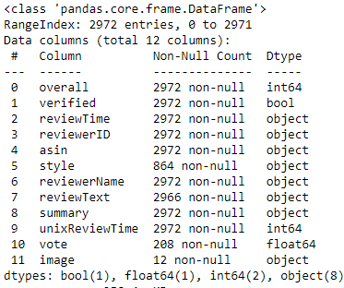
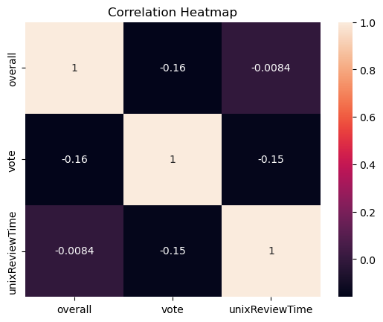
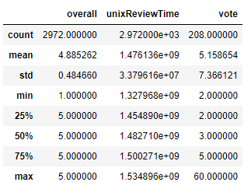
2. Dataset Exploration
The dataset has reviews from 2972 entries with 12 columns
On average, products have a high rating of 4.88 out of 5
Review ratings have little to no relation with the time of the review or the number of votes it received

Slide 5
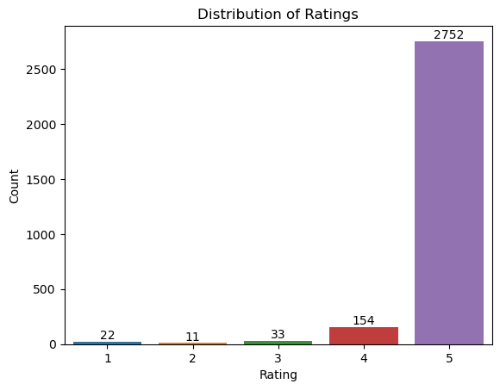
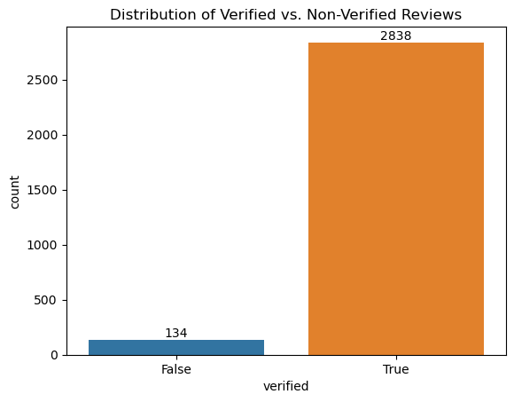
Distribution of Ratings:
5 stars: 2,752 reviews
4 stars: 154 reviews
3 stars: 33 reviews
2 stars: 11 reviews
1 star: 22 reviews
Verified vs. Non-Verified Reviews:
True: 2,838 reviews
False: 134 reviews

Slide 6
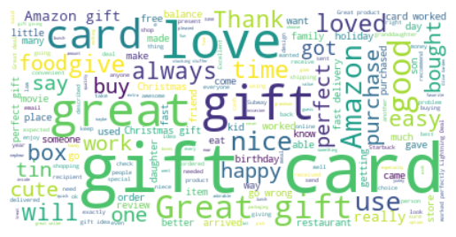
Word Cloud (before pre-processing)

Slide 7
Dataset Pre-processing(Basic)
03
Removed all Non-Verified records. There are total 134 non verified reviews.
1
Dropped unwanted columns as following: 'verified', 'reviewerID', 'asin', 'reviewerName', 'reviewTime', 'style', 'unixReviewTime', 'vote' and 'image'
2
Dropped duplicates. There are 892 duplicates found.
3
Labeled the data based on the value of “rating of the product” i.e., as follows:
4
Ratings 4,5: Positive
Rating 3: Neutral
Ratings 1,2: Negative
Merge 'reviewText' and 'summary' column into new 'text' column
5

Slide 8
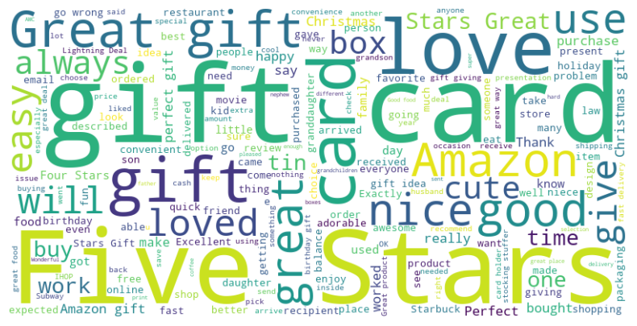
Word Cloud (after basic pre-processing)

Slide 9
Dataset Pre-processing for TextBlob
Removing Stop Words, Special Characters, Digits, Trailing Whitespaces, Punctuations and URLs
Using NLTK, Tokenizing the text
After tokenization, join the tokens back into a coherent text
Expanding the contractions
TextBlob itself converts the text into lowercase and does the lemmatization on it.*

Slide 10
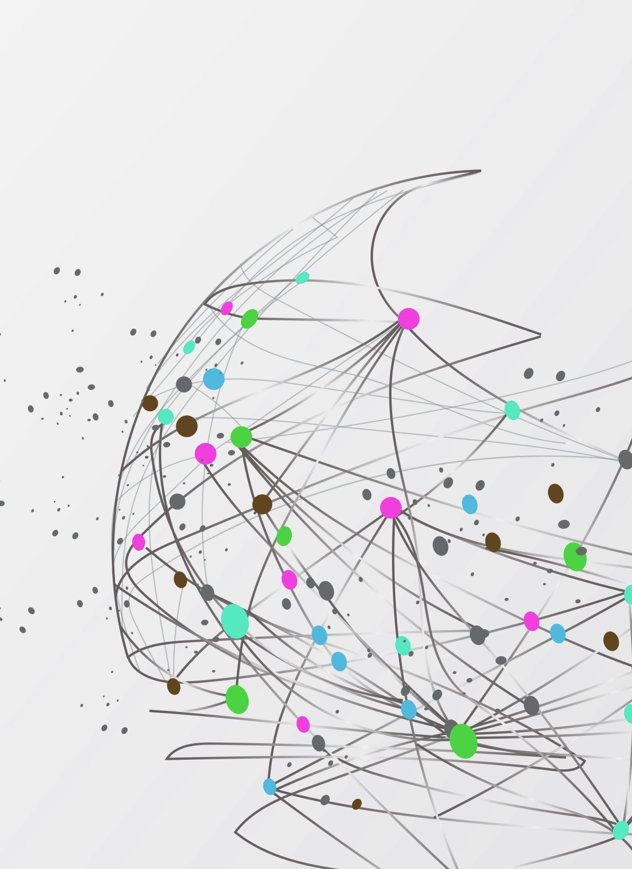
Dataset Pre-processing for VADER (Valence Aware Dictionary and Sentiment Reasoner)
No pre-processing required as VADER is specifically designed for analyzing sentiments for social media posts. It is well-suited for processing short and informal textual data. It can effectively analyze the sentiment intensity and polarity of the text. The VADER sentiment lexicon is sensitive both the polarity and the intensity of sentiments expressed in social media contexts

Slide 11
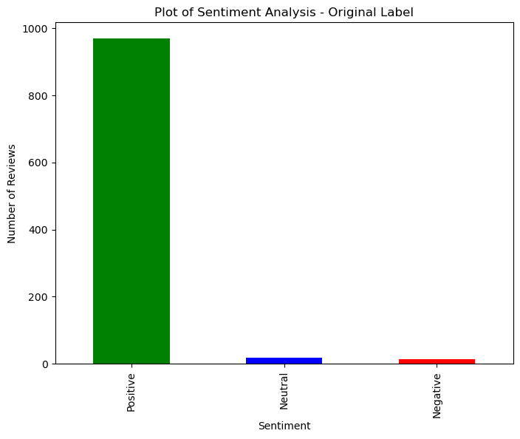
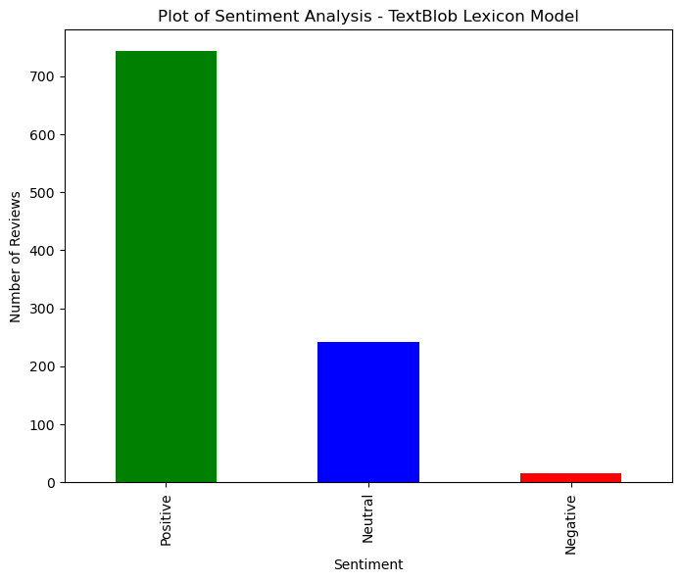
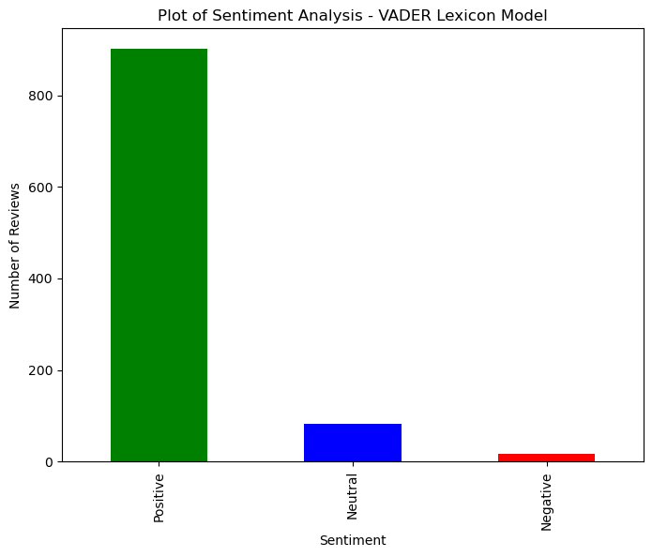
4. Sentiment Analysis
Original Label Rating:
Positive: 969 reviews
Neutral: 18 reviews
Negative : 13 reviews
TextBlob Label Rating:
Positive: 743 reviews
Neutral: 242 reviews
Negative : 15 reviews
VADER Label Rating:
Positive: 901 reviews
Neutral: 83 reviews
Negative : 16 reviews

Slide 12
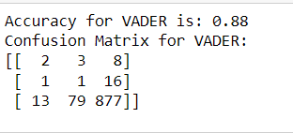
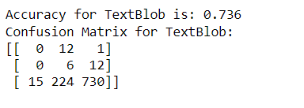
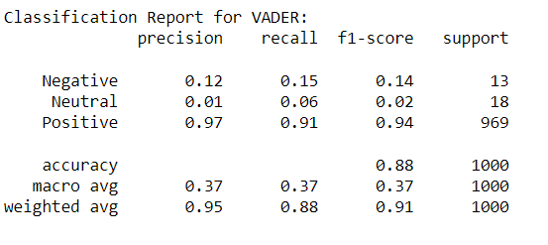
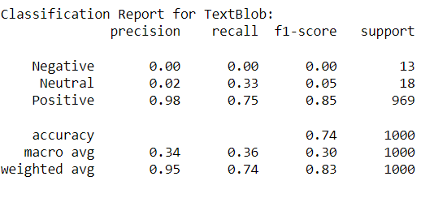
5. Model Comparison
VADER:
TextBlob:

Slide 13

Conclusion
When comparing the sentiment analysis capabilities of VADER and TextBlob, VADER clearly emerges as the superior model. It consistently outperforms TextBlob across key metrics, particularly in accuracy and in identifying positive sentiments. While both models have their merits, for tasks demanding higher precision and recall, VADER appears to be the more reliable choice.
Notes:
Databricks Lakehouse is at the forefront of the data management revolution. It offers an integrated solution for data engineering, science, and business analytics.
It uses the latest in cloud technology, data storage, and analyzing data.
But in a rapidly evolving tech landscape, it's crucial to remember that no platform operates in isolation. Competition is fierce, and adaptability is key.
As data becomes central to business strategies, platforms like Databricks are essential. Embrace the power of data, stay agile, and be ready for what the future holds. It's a journey of promise and potential.

Slide 14
References
COMP262 - NLP & Recommender System
Project, U. C. R. (n.d.). Amazon Review Data (2018). https://nijianmo.github.io/amazon/index.html
Tutorial: Quickstart - TextBlob 0.16.0 documentation. (n.d.). https://textblob.readthedocs.io/en/dev/quickstart.html
Cjhutto. (n.d.). CJHUTTO/Vadersentiment: Vader sentiment analysis. GitHub. https://github.com/cjhutto/vaderSentiment
Vader sentiment analysis: A complete guide, algo trading and more. Quantitative Finance & Algo Trading Blog by QuantInsti. https://blog.quantinsti.com/vader-sentiment/
Todi, M. (2019, September 23). Sentiment analysis using the vader library. Medium. https://medium.com/analytics-vidhya/sentiment-analysis-using-the-vader-library-a91a888e4afd
PROJECT
GROUP 05

Slide 15
Thank You

