Slide 1
COMP262 - NLP & Recommender System
Sentiment Analysis Model
Phase #2
GROUP 05
PROJECT
KANISHKA DHIR
MAHPARA RADMY
MANIPAL SIDHU
RONALD SAENZ

Slide 2
1
Recap – Phase #1
2
Dataset Pre-processing
3
ML Models Declaration & Results
AGENDA
4
Lexicon Vs ML Models
5
Recommender systems - State-of-the-Art
6
Conclusion

Slide 3
1. Recap – Phase #1
Key Insights
VADER's Closer Alignment: VADER's sentiment labeling was more closely aligned with the original label distribution, particularly in identifying positive reviews.
Insight: One of the main reasons for VADER's superior performance is its training on external datasets, including Amazon reviews.
Transition to Phase 2
From Lexicon to Machine Learning: Building on the insights from Phase 1, we are employing Machine Learning techniques for deeper sentiment analysis.
Goal: Enhance accuracy and depth in understanding customer sentiments.

Slide 4
Dataset Pre-processing(Basic)
02
Removed all Non-Verified records. There are total 134 non verified reviews.
1
Dropped unwanted columns as following: 'verified', 'reviewerID', 'asin', 'reviewerName', 'reviewTime', 'style', 'unixReviewTime', 'vote' and 'image'
2
Dropped duplicates. There are 892 duplicates found.
3
Labeled the data based on the value of “rating of the product” i.e., as follows:
4
Ratings 4,5: Positive
Rating 3: Neutral
Ratings 1,2: Negative
Merge 'reviewText' and 'summary' column into new 'text' column
5

Slide 5
Pre-processing Cont.
Lexicon Approach Sampling:
Out of 1,946, selected a subset of 200 reviews for Lexicon-based Sentiment Analysis.
ML Model Preparation
Reserved remaining 1,746 reviews for Machine Learning models.
Training Set: 70% of 1,746 reviews, focusing on model training and optimization.
Testing Set: Remaining 30% of the data, used to evaluate model performance.
Final Dataset Shapes:
Training Data(ML)
Reviews (X): 1,222 samples
Overall Rating (y): 1,222 samples
Testing Data(ML)
Reviews (X): 524 samples
Overall Rating (y): 524 samples

Slide 6
Pre-processing for TextBlob & VADER
Removing Stop Words, Special Characters, Digits, Trailing Whitespaces, Punctuations and URLs
Using NLTK, Tokenizing the text
After tokenization, join the tokens back into a coherent text
Expanding the contractions
TextBlob itself converts the text into lowercase and does the lemmatization on it.*
VADER has built-in basic pre-processing features, but we manually removed URLs as this is not done automatically.*

Slide 7
Pre-processing for ML Models
Removing Stop Words, Special Characters, Digits, Trailing Whitespaces, Punctuations and URLs
Using NLTK, Tokenizing the text and lemmatization
After tokenization & lemmatization, join the lemmatized tokens back into a coherent text
Expanding the contractions
Used TF-IDF for feature extraction

Slide 8
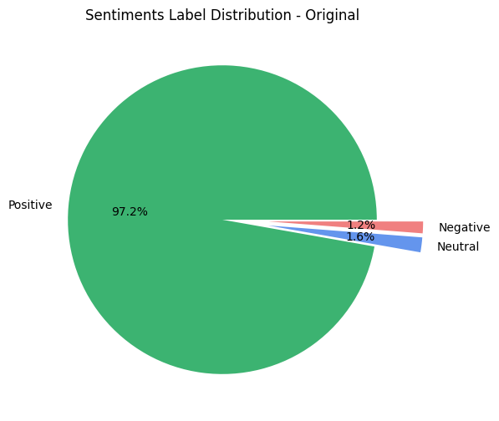
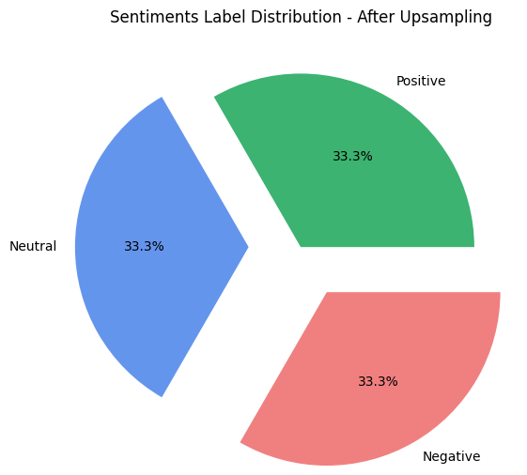
Pre-processing Cont.
{'Positive': 1188, 'Neutral': 19, 'Negative': 15}
{'Positive': 1188, 'Neutral': 1188, 'Negative': 1188}

Slide 9
3. ML Models Declaration
Logistic Regression (Model 1):
Model: LogisticRegression
Key Parameter: class_weight="balanced"
Max Iterations: 500
Support Vector Machine (SVM) (Model 2):
Model: SVC
Key Parameter: class_weight='balanced'
Max Iterations: 10,000
Naive Bayes (Model 3):
Model: MultinomialNB
Default Parameters
Gradient Boosting (Model 4):
Model: GradientBoostingClassifier
Default Parameters

Slide 10
ML Models Result
Model | Accuracy | Precision | Recall | F1 | Confusion Matrix
Logistic Regression | 0.9828 | 0.9830 | 0.9828 | 0.9826 | [[5 0 1] [1 4 3] [2 2 506]]
Support Vector Machine (SVM) | 0.9771 | 0.9704 | 0.9771 | 0.9713 | [[1 0 5] [1 2 5] [0 1 509]]
Naive Bayes | 0.9466 | 0.9679 | 0.9466 | 0.9558 | [[3 0 3] [1 4 3] [8 13 489]]
Gradient Boosting | 0.9733 | 0.9714 | 0.9733 | 0.9716 | [[4 0 2] [0 2 6] [4 2 504]]

Slide 11
Lexicon Models VS ML Models
Model Type | Model | Accuracy | Precision | Recall | F1 | Confusion Matrix
Lexicon Model | TextBlob | 0.685 | 0.9567 | 0.685 | 0.7950 | [[2 0 0] [0 0 3] [5 55 135]]
Lexicon Model | Vader | 0.885 | 0.9588 | 0.885 | 0.9204 | [[0 2 0] [0 0 3] [2 16 177]]
Machine Learning Model | Logistic Regression | 0.990 | 0.9901 | 0.990 | 0.9887 | [[1 0 1] [0 2 1] [0 0 195]]
Machine Learning Model | Support Vector Machine (SVM) | 0.985 | 0.9852 | 0.985 | 0.9817 | [[1 0 1] [0 1 2] [0 0 195]]

Slide 12
Recommender systems based on user reviews: the state of the art
Section 4.2- In this section, we survey approaches that aim to infer a user’s overall preference for a product based on the opinions s/he expresses in the review, which can act as a virtual rating (also called an inferred rating, opinion rating, or text-based rating) for a CF system.”
Section 4.3.3 - virtual ratings are the overall opinions inferred from reviews.
Section 4.3.3 - opinion post-filtering, in which ratings and overall opinions are first used independently to train two prediction models, and then a linear combination of the two models is realized to obtain the final rating prediction
Leveraged our two most performant machine learning models—SVM and Logistic Regression
Used the same 1746 pre-processed reviews to train SVM and Logistic Regression on ratings and review text.
Performed text representation of TF-IDF to represent each review as a vector of word frequencies.
To train the models on balanced data, employed RandomOverSampler which gives 1112 reviews for each rating from 1 to 5.

Slide 13
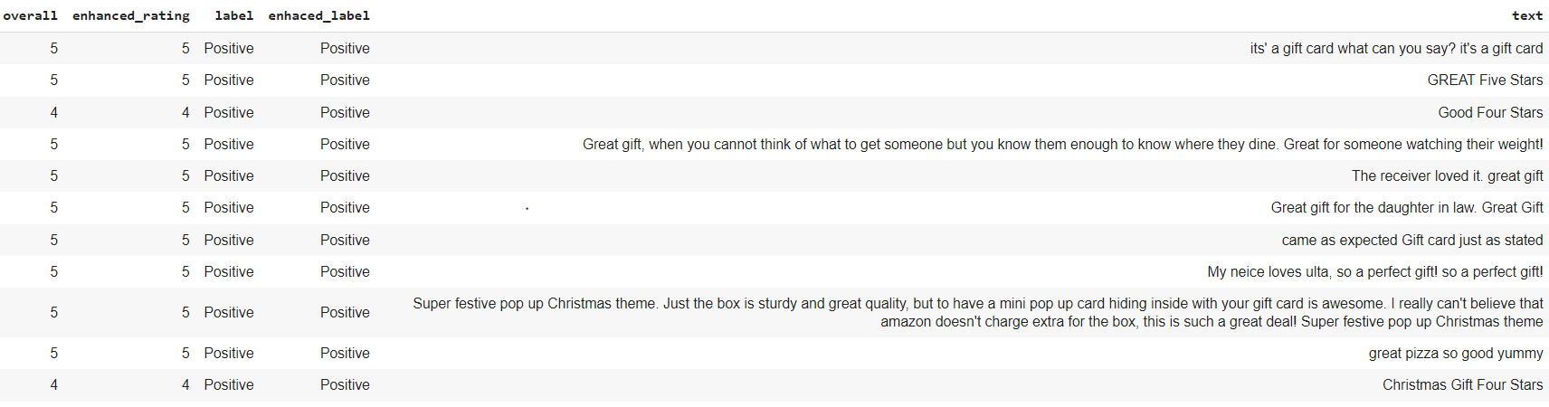
Enhancing Ratings
Dataset | Mean Square Error Value
Testing Data | 0.215
Subset of 200 reviews | 0.153
Linear combination is calculated using -
enhanced_rating = (svm_weight * inferred_rating_svm) + (gb_weight * inferred_rating_gb)
The best weights found were 0.4 for SVM and 0.6 for Logistic Regression

Slide 14

Conclusion
According to our experiment, Machine Learning models performs better than Lexicon approach, giving us better accuracy on sentiment analysis on 200 reviews subset.
Secondly, we have enhanced the ratings using the Machine Learning approach which gave us good Mean Square Error Value of 0.15 on the 200 reviews subset.
Notes:
Databricks Lakehouse is at the forefront of the data management revolution. It offers an integrated solution for data engineering, science, and business analytics.
It uses the latest in cloud technology, data storage, and analyzing data.
But in a rapidly evolving tech landscape, it's crucial to remember that no platform operates in isolation. Competition is fierce, and adaptability is key.
As data becomes central to business strategies, platforms like Databricks are essential. Embrace the power of data, stay agile, and be ready for what the future holds. It's a journey of promise and potential.

Slide 15
References
COMP262 - NLP & Recommender System
Project, U. C. R. (n.d.). Amazon Review Data (2018). https://nijianmo.github.io/amazon/index.html
Chen, L., Chen, G., & Wang, F. (2015). Recommender systems based on user reviews: the state of the art. User Modeling and User-Adapted Interaction, 25(2), 99–154. https://doi.org/10.1007/s11257-015-9155-5
PROJECT
GROUP 05

Slide 16
Thank You

