Slide 1
NAKAL PROJECT
Submitted By:-KANISHKA DHIR
CSE 2K15
Uni Roll No:15110169

Slide 2
JAVA
Object oriented language
Platform independent
Compiled and Interpreted
Robust
Secure
Portable
Simple
Multi-threaded
Architectural Neutral

Slide 3
INTRODUCTION TO PROJECT
Aims at automating all the work regarding handling the nakals generated in DC office .
This software creates a system to automate the services which would be more flexible than the earlier system.
This project is meant to reduce the workload and complexities that the owners have to face during the handling the people and the nakals from pattwari.

Slide 4
LIMITATIONS OF EXISTING SYSTEM
Current manual system
No security of data
No fixed number of days for delivery
Search whole register in case of enquiry
Manual calculation of fare takes a lot of time and error.
Full flexibility over records.
Full flexibility over the entire balance of the record
Change according to needs

Slide 5
ADVANTAGES OF PROEJCT
Automated generation of nakals
Fixed delivery date
Feel of security for customer as no one else can take his nakal.
Operator can have the balance of his daily record-how many applied today for nakal, how many nakals status is ready to deliver and how many are delivered today.
There is transparency for the income either as in initial fee or the total fee.
Helps authority manage his employees properly as they cannot change anything in this software.
Allows the operator to have a backup for his data in case his system is crashed.

Slide 6
FRONT END
JAVAFX:- JavaFX is a Java library used to build Rich Internet Applications. The applications written using this library can run consistently across multiple platforms. JavaFX provides a rich set of graphics and media API’s and it leverages the modern Graphical Processing Unit through hardware accelerated graphics.
JDBC:- The JDBC is a set of the database access classes. The term JDBC stands for "Java database Connectivity" and it was developed by Javasoft. The JDBC API makes it possible to do these things :-
Establish a connection with a database or access tabular data source.
Send SQL statements and process the results.

Slide 7
BACK END
JAVA:- Java is an object-oriented programming language with a built-in application programming interface (API) that can handle graphics and user interfaces and that can be used to create applications or applets. Java applications are typically compiled to byte code that can run only on Java virtual machine(JVM) regardless of computer architecture.
MYSQL:- It is used for:
Querying a database by editing the SQL statement
Querying a database with a program.
Defining the data organization.
Administrating data.
Accessing multiple data server.
Managing transaction.

Slide 8
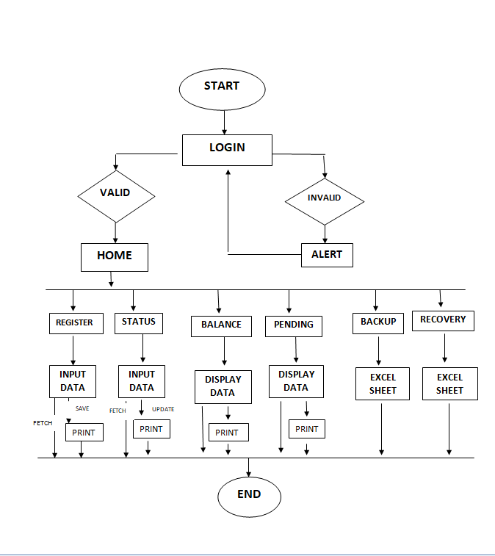
BLOCK DIAGRAM

Slide 9
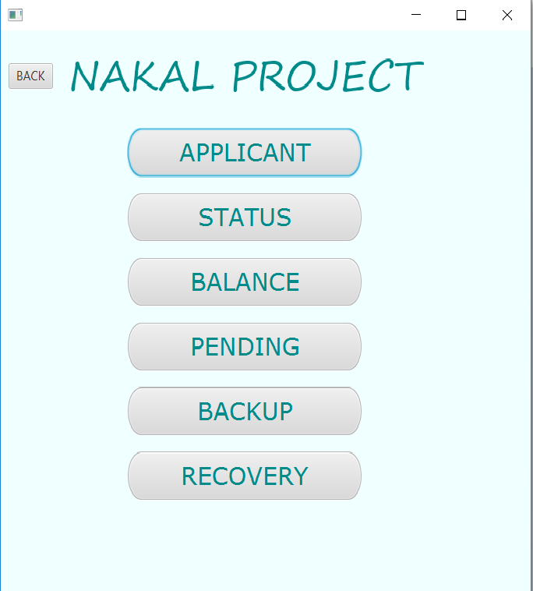
MODULES
Customer registration
Set Status
Check Balance
Check Pending
Take Backup
Recover

Slide 10
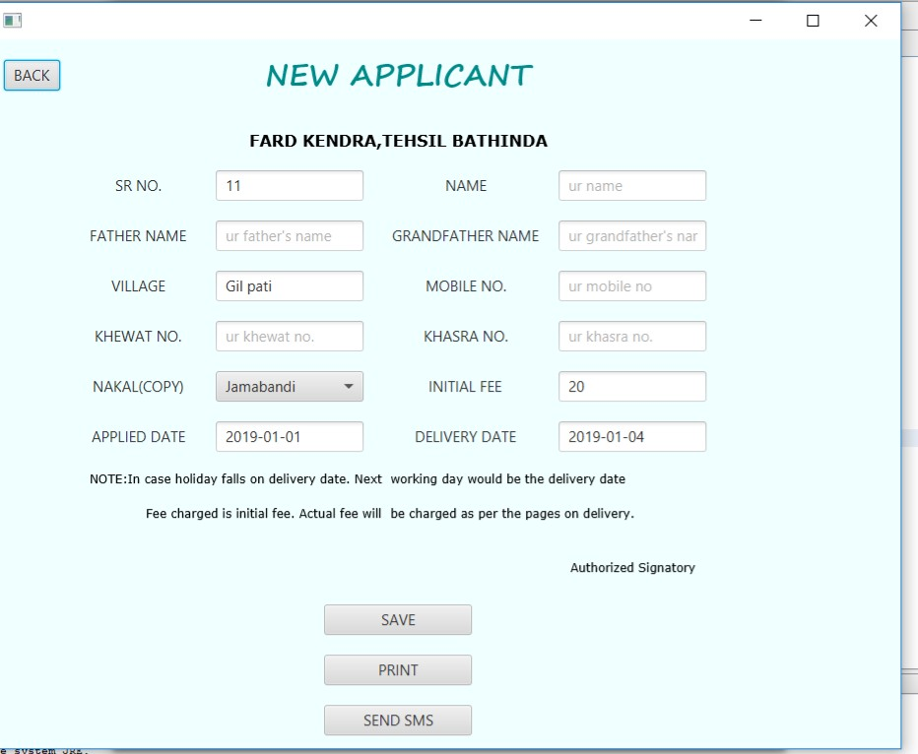
CUSTOMER REGISTRATION
Operator will store the necessary information of every customer in their database which can be used for further communication with the customer. Each customer is given an auto-generated id.

Slide 11
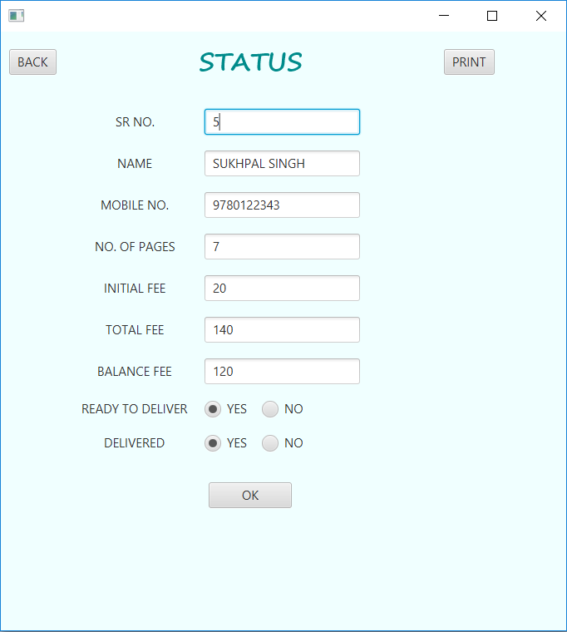
STATUS REPORT
Operator can change the status of the nakal received for a particular person as the nakal comes from pattwari and when the person collects the nakal in hand from the operator

Slide 12
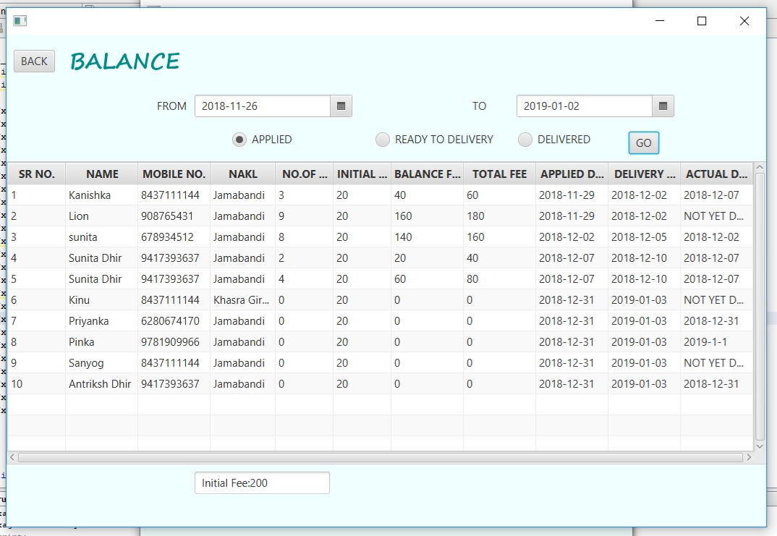
CHECK BALANCE
Operator can check the balance from a particular date to another to check the number of nakals applied, ready to deliver and those delivered with confirming the amount he has deposit.

Slide 13
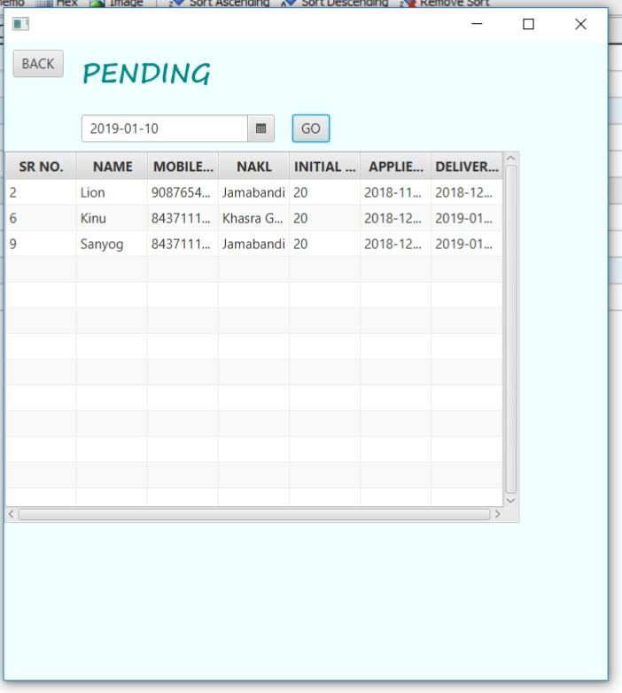
CHECK PENDING
Operator can check the nakals pending with the pattwari,so he can have a record of nakals whose delivery date has been expired.

Slide 14
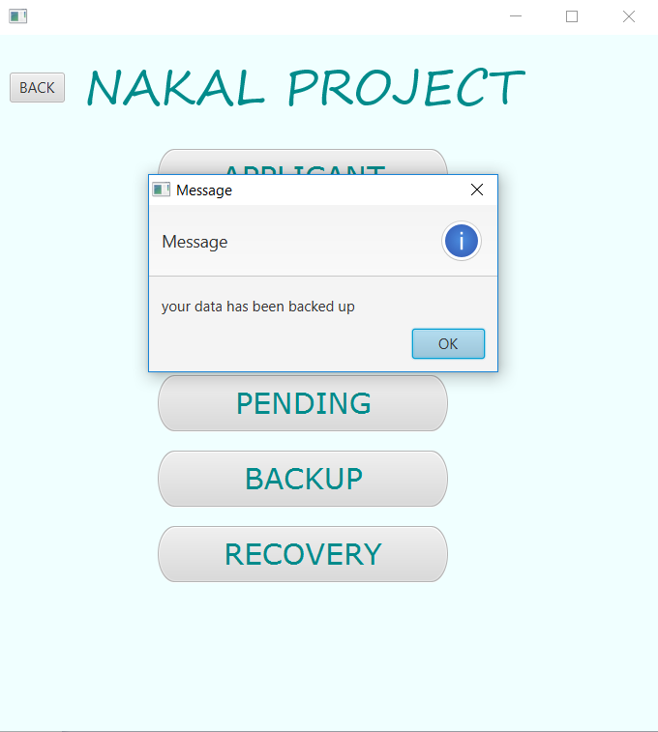
BACKUP
The operator can transfer all the records to an excel sheet created where his exe file is kept so that if any time his system goes down, his data is kept secure.

Slide 15

RECOVERY
In this module, operator can retrieve all the records of previous customers from the backup file to his database when his system becomes active again.

Slide 16
THANK YOU!!

