Slide 1

Traffic Collision Group4 Sec002 - COMP 247
By Group 4:-
Vikas Bhargav Trivedi
Kanishka Dhir
Chitra Hajra Roy

Slide 2
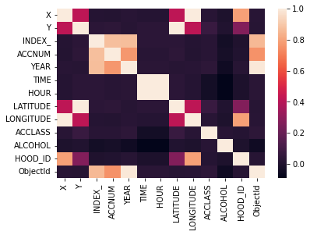
Data Exploration Correlation Graph

Slide 3
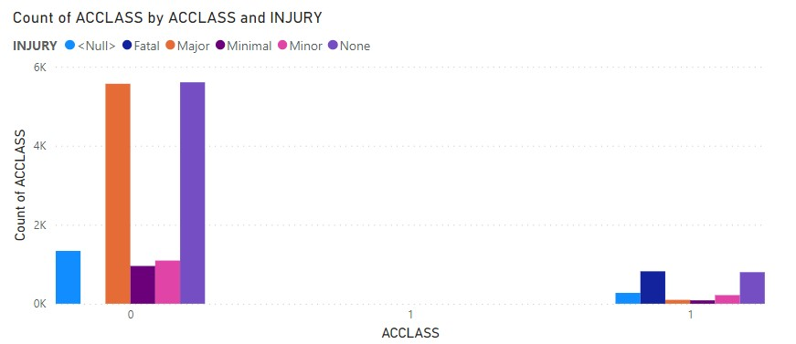
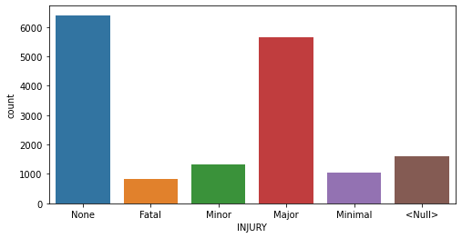
Data Exploration: Injury Column
Most of Fatal Accidents have occurred when the Injury is Fatal and no fatal injury has resulted in non-fatal outcome.

Slide 4
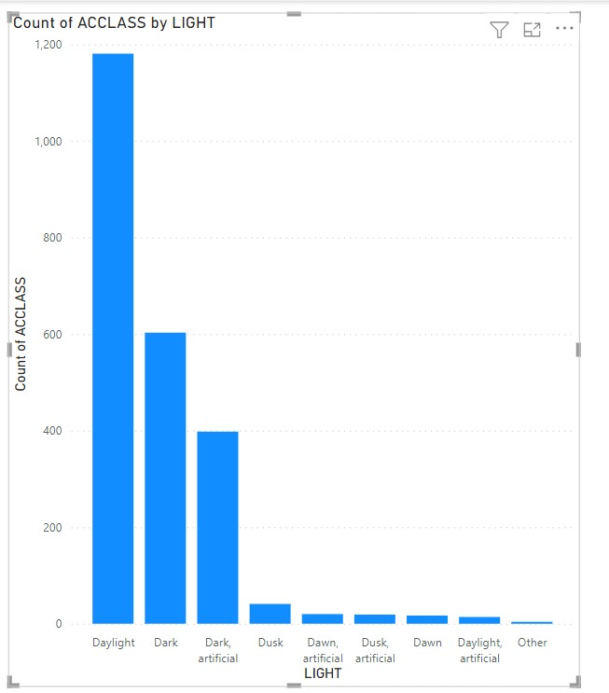
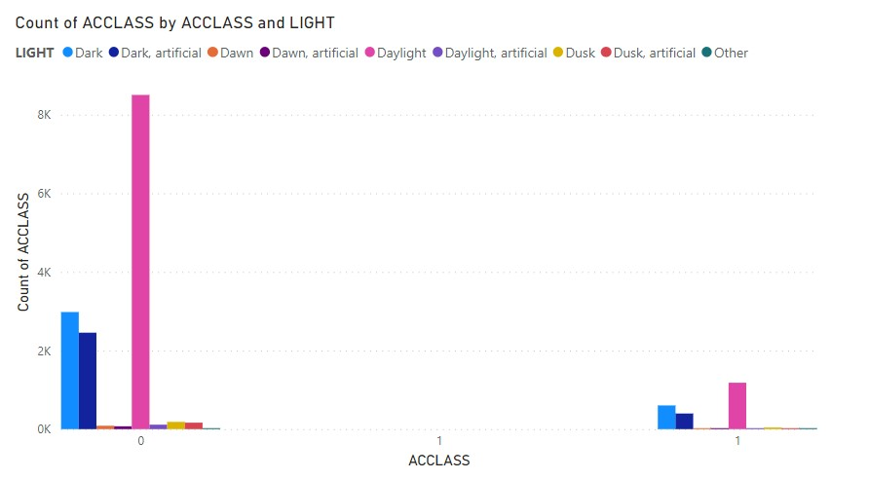
Data Exploration: Light Column Most of accidents have taken place during daylight.

Slide 5
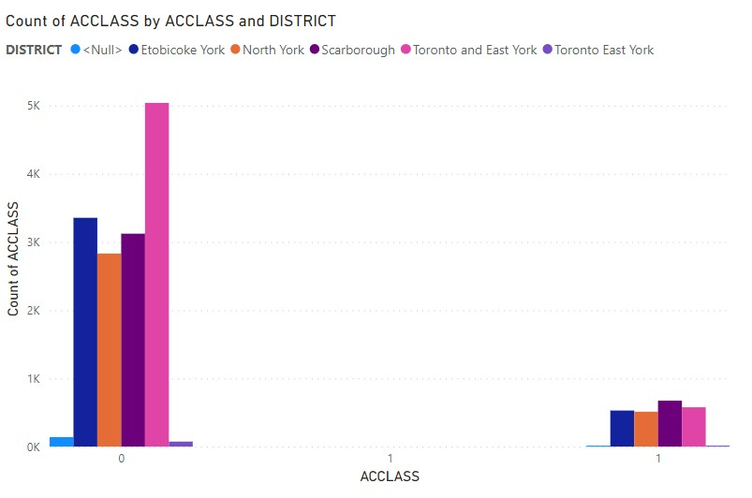
Data Exploration: District Column
Highest Number of Fatal accidents have occurred in Scarborough District and highest number of non-Fatal accidents have occurred in Toronto and East York.

Slide 6
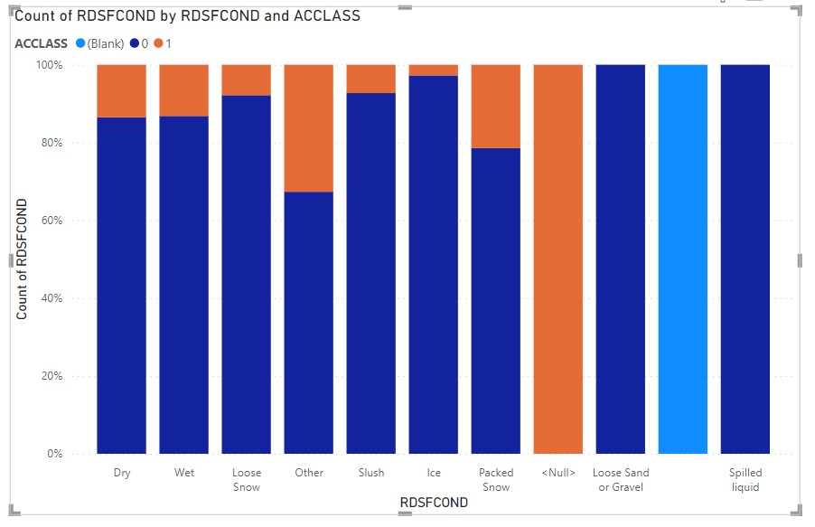
Data Exploration: Roads Condition Column
Many of the accidents resulting in fatality took place when road condition was other.

Slide 7
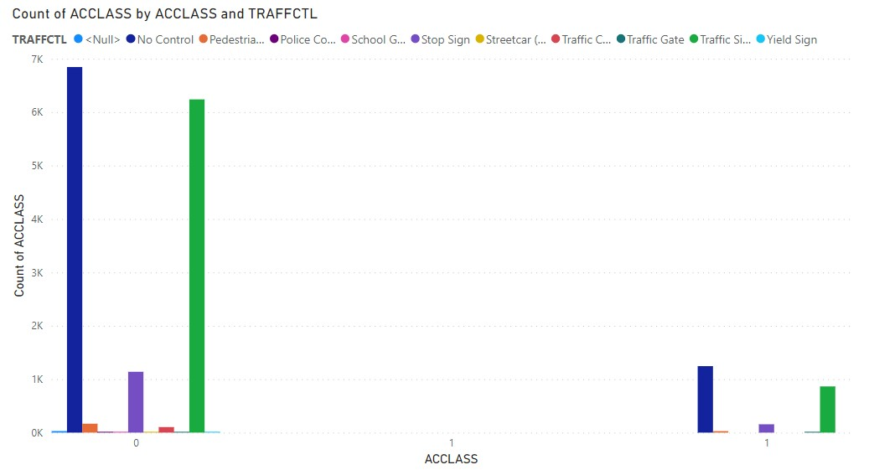
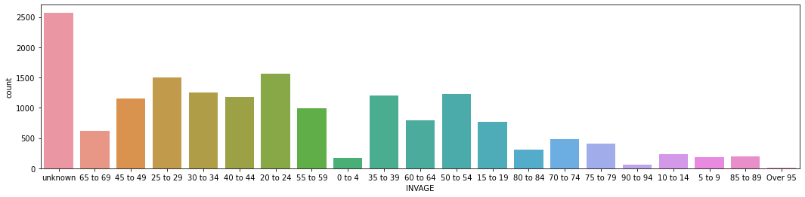
Data Exploration: Traffctl and Invage Columns

Slide 8
Feature Selection and Data Modelling:
Replaced the null, unknown and Unknown with np.nan in dataset
Calculated the missing values per column and dropped the columns with highest number of nulls and unique values.
Fitting and transforming the Simple Imputer on dataset for missing entries.
Applied Standard Scaler on the numerical features in a pipeline.
Applied OneHotEncoder on the categorical features in a pipeline.
Applied ColumnTransformer for both the pipelines.

Slide 9
Columns after preprocessing:
["X", "Y", "YEAR", "HOUR", "ROAD_CLASS", "DISTRICT", "LATITUDE", "LONGITUDE", "LOCCOORD", "ACCLOC", "TRAFFCTL", "VISIBILITY", "LIGHT", "RDSFCOND", "IMPACTYPE", "INVTYPE", "INVAGE", "INJURY", "INITDIR", "VEHTYPE", "MANOEUVER", "DRIVACT", "DRIVCOND", "AUTOMOBILE", "AG_DRIV", "POLICE_DIVISION", "HOOD_ID"]}

Slide 10
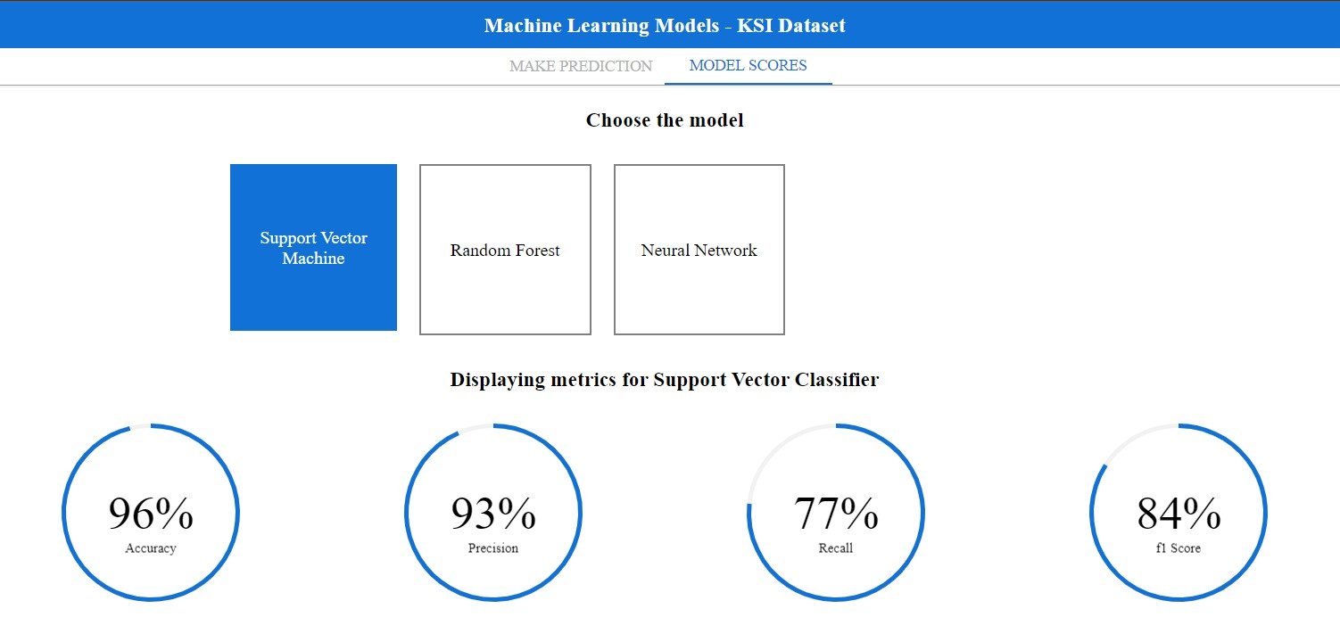
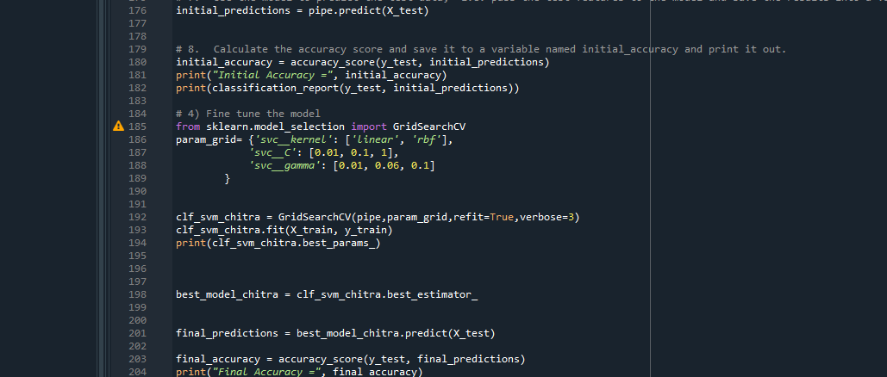
Support Vector Machine

Slide 11
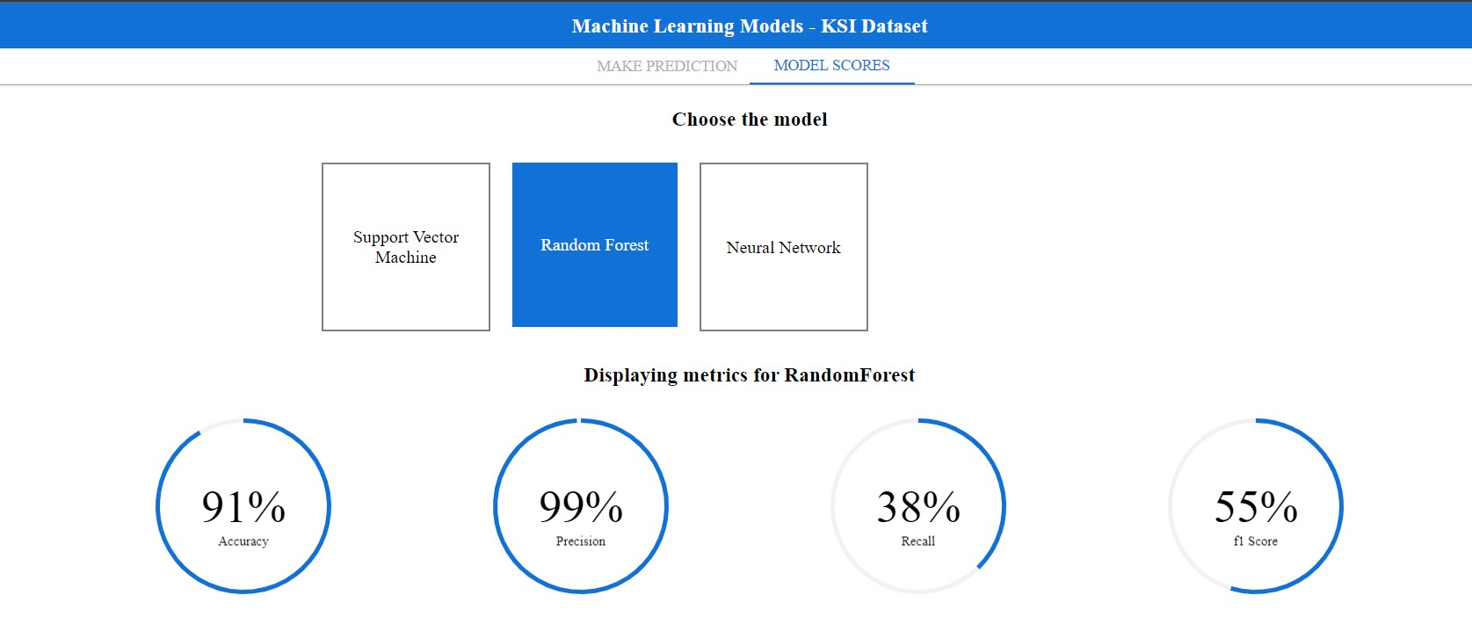
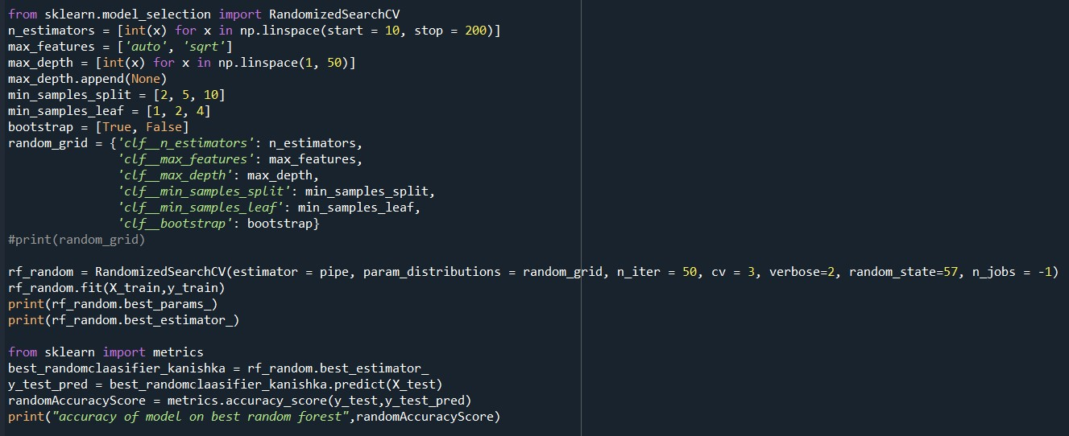
Random Forest

Slide 12
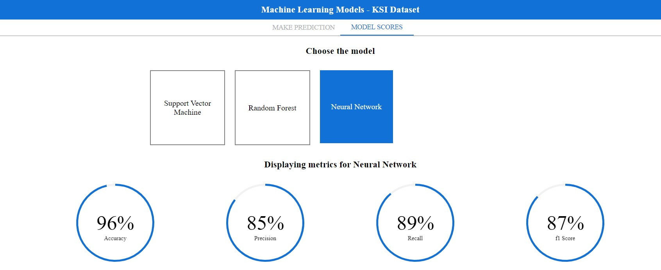
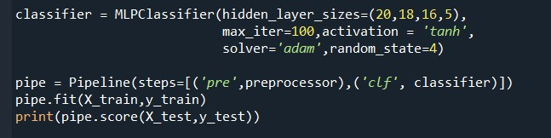
Neural Network

Slide 13
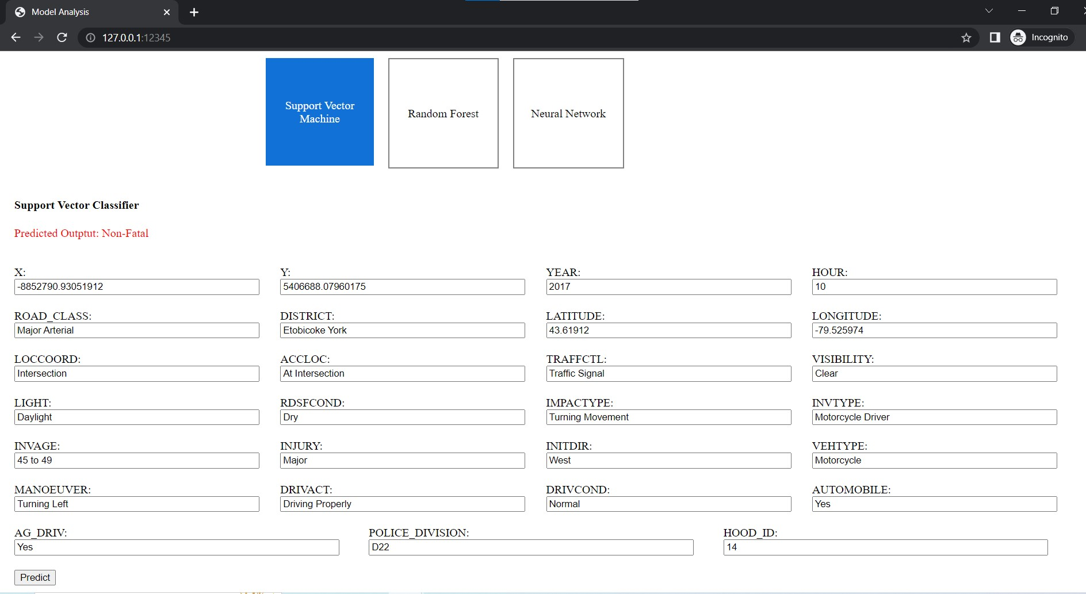
Front End
Used Javascript, Jquery ,HTML and CSS to develop the front end.

Slide 14
Live Demonstration

