Slide 1

ERROR HANDLING DURING FILE OPERATIONS
Pranjal Tiwari
076
&
Ansh Sharma
078
BCA – III EB

Slide 2


Topics to be covered
File Handling
Introduction to error handling
Need
Methods
Examples
PYQs & MCQs

Slide 3

What is File Handling?
File handling is used to store data permanently in a computer. Using file handling we can store our data in secondary memory (Hard disk).
How to perform the File Handling
For performing file handling we need to follow the following steps:-
STEP 1-Naming a file
STEP 2-Opening a file
STEP 3-Writing data into the file
STEP 4-Reading data from the file
STEP 5-Closing a file.

Slide 4

Introduction
Errors are the problems that occur in the program due to an illegal operation performed by the user. Error Handling is the process of handling errors and exceptions such that the normal execution of the system is not affected .

Slide 5

error handling in file
Error handling is a process to handle the errors in a file . We perform error handling so, the normal flow of program can be maintained even after getting errors.

Slide 6

need of error handling
The following are the common problems that lead to errors during file operations:
When trying to open a file for reading might not exist.
When trying to read from a file beyond its total number of characters.
When trying to perform a read operation from a file that has opened in write mode
When trying to perform a write operation on a file that has opened in reading mode.
When trying to operate on a file that has not been opened.

Slide 7



Methods for handling errors

Slide 8
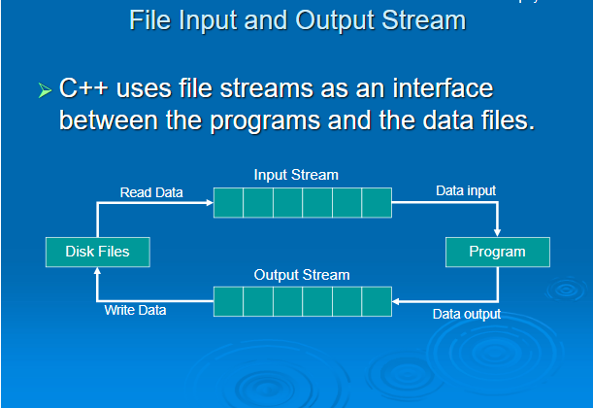
The C++ programming language provides several built-in functions to handle errors during file operations.

Slide 9
Built-in functions
The following are the built-in functions to handle file errors:
int bad()
int fail()
int good()
int eof()
clear()

Slide 10

1. int bad()
It returns a non-zero (true) value if an invalid operation is attempted or an unrecoverable error has occurred. Returns zero if it may be possible to recover from any other error reported and continue operations.

Slide 11
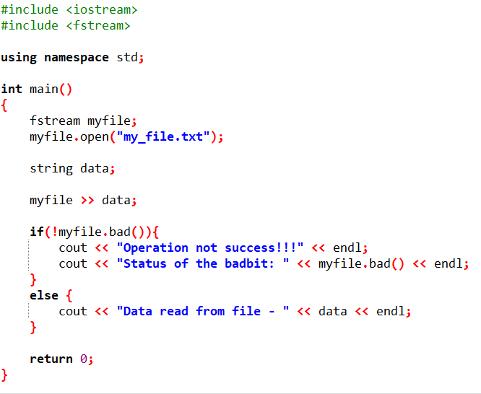
Example for
int bad()
11

Slide 12
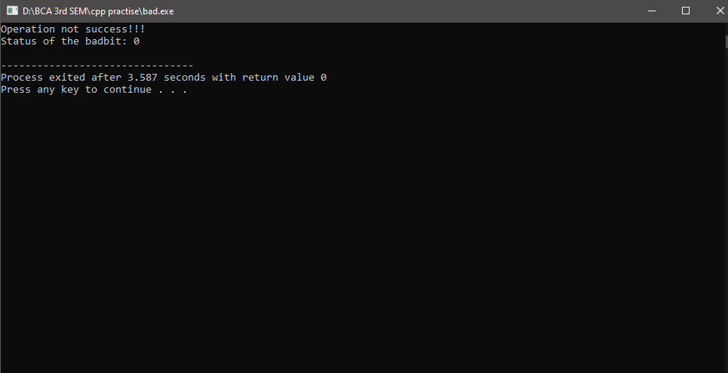
Output

Slide 13

2. int fail()
The fail( ) function returns a non-zero value when an input or output operation has failed.

Slide 14
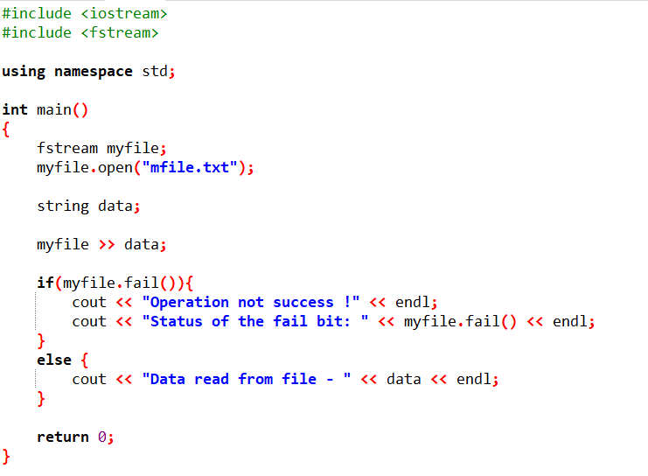
Example for
int fail()
11

Slide 15
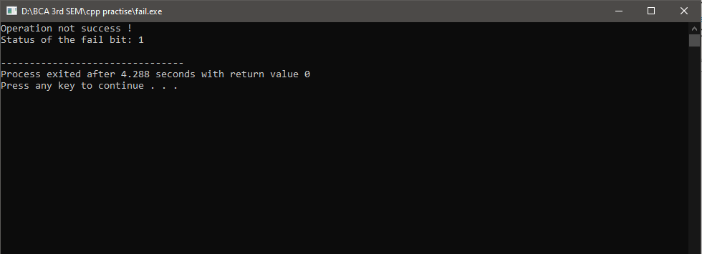
Output

Slide 16


3. int good( )
The good() function returns a non-zero(true) value when no error has occurred otherwise return zero(false).

Slide 17
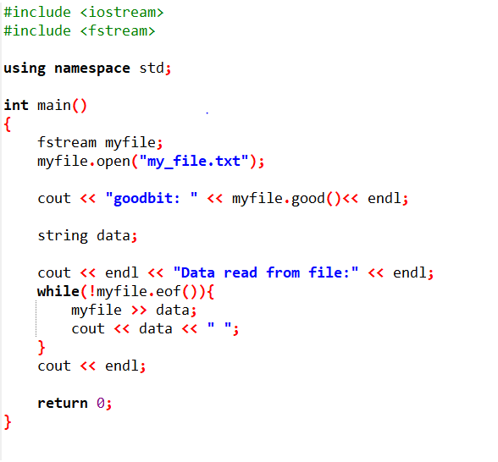
Example for
int good()

Slide 18
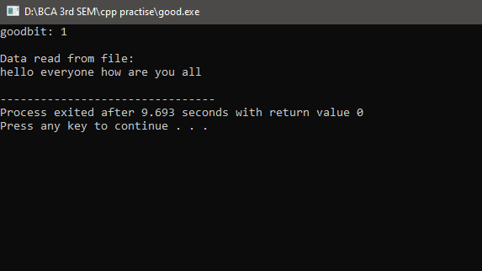
Output

Slide 19

4. int eof( )
The eof( ) function returns a non-zero (true) value when end-of-file is encountered while reading; otherwise returns zero (false).

Slide 20
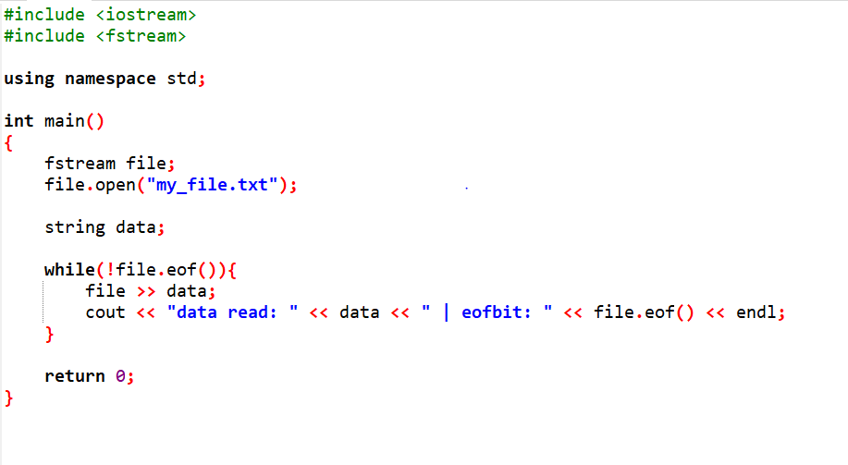
Example for
int eof()
11

Slide 21
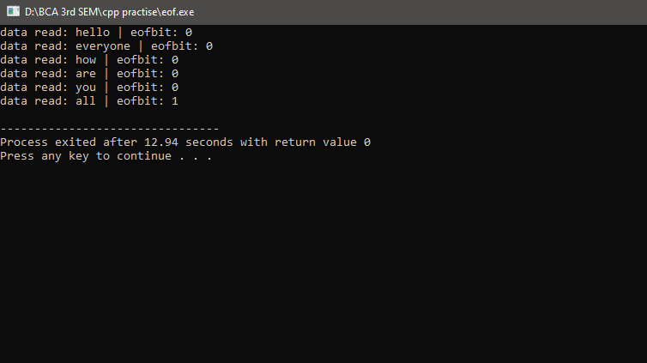
Output

Slide 22

5. int clear( )
The clear( ) function is used to reset the error state so that further operations can be attempted.

Slide 23
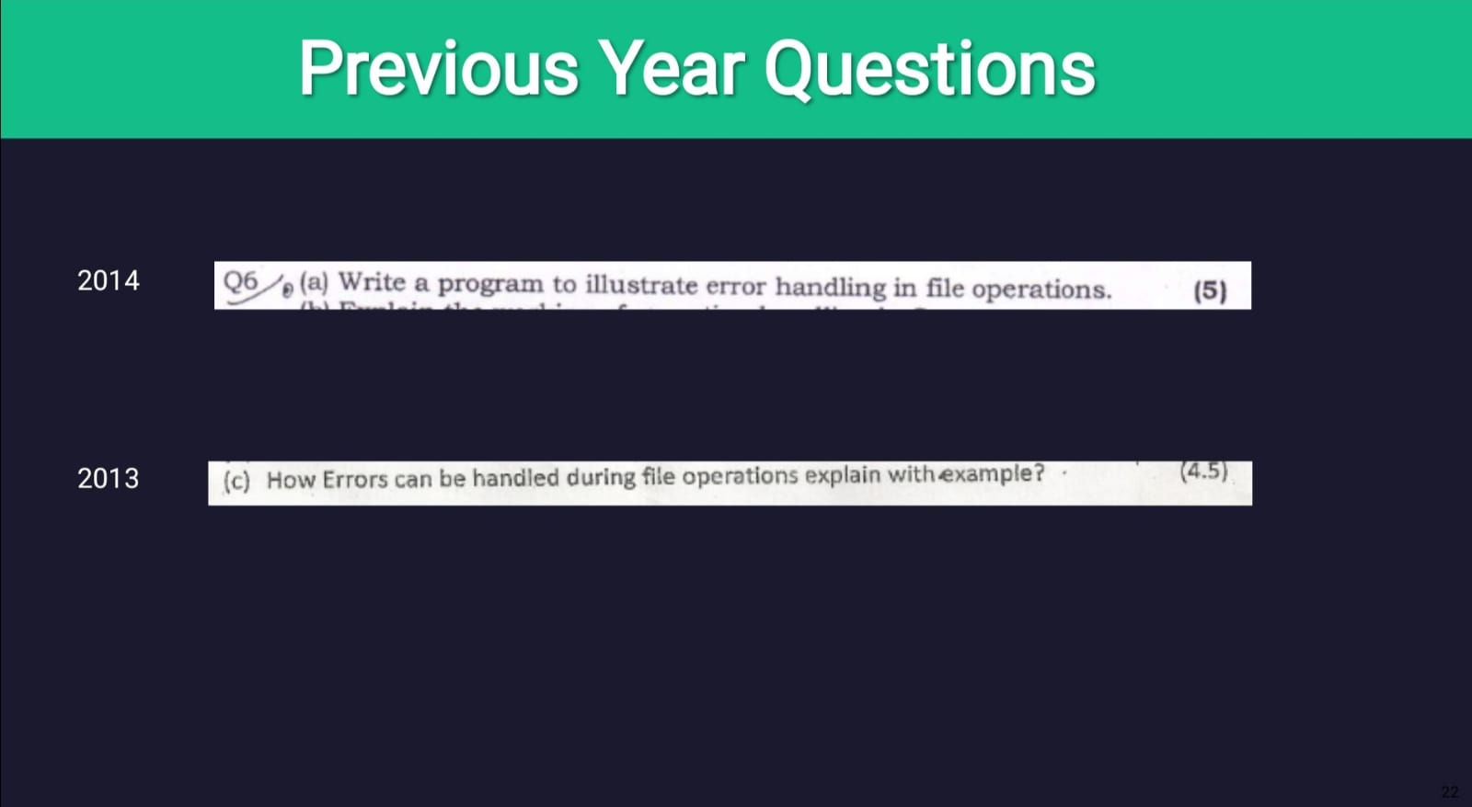

Slide 24

Q & A Session

Slide 25

MCQs
Q.1 What is an error?
A state that helps ongoing work
Problem that stops ongoing work
Used for faster execution
Something that make the work easier
Answer - 2

Slide 26

Q.2 C++ supports built-in functions for handling errors.
True
False
Answer -1

Slide 27

Q.3 How many built-in functions are there for handling errors.
Two
Seven
Three
Five
Answer -4

Slide 28

Q.4 good() function returns a _______ value when no error has occurred.
zero
string
non-zero
none
Answer -3

Slide 29

Q.5 fail( ) function returns a ______ value when an input or output operation has failed.
zero
string
None
non-zero
Answer -4

Slide 30


Thank you
Pranjal Tiwari
07629802021
&
Ansh Sharma
07829802021
BCA-III EB
C++ Presentation

