Slide 1
Sheikh Kamal It Training &
Incubation Center Project
APTIS Writing

Slide 2
Word-level writing (Part 1)
In the first part, you have joined a club, course or activity and must answer a series of 5 text messages from other members of the club, course or activity. There is no extended writing in this part (no sentence writing), just individual words. You should spend no more than 2 minutes on this part.

Slide 3
Preparation
Since the emphasis in this task is on the
accurate completion of a form, the most
important things to focus on using a capital letter
if needed and spelling.
Common errors are to write in all capital letters
and to write the month as a number instead of
Word.

Slide 4
Short text writing (Part 2)
This part is again about form filling, but this time you need to write in sentences. You should spend no more than 3 minutes on this part.

Slide 5
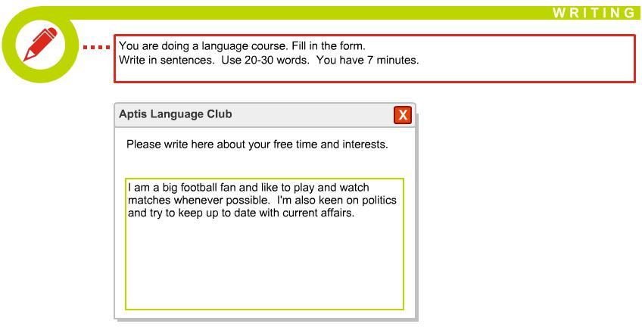

Slide 6
Three written parts of the text, all of which require responses (Part 3)
In this part, you will have a social network-type interaction. You will receive three questions and need to respond. You should spend no more than 9 minutes on this part.

Slide 7
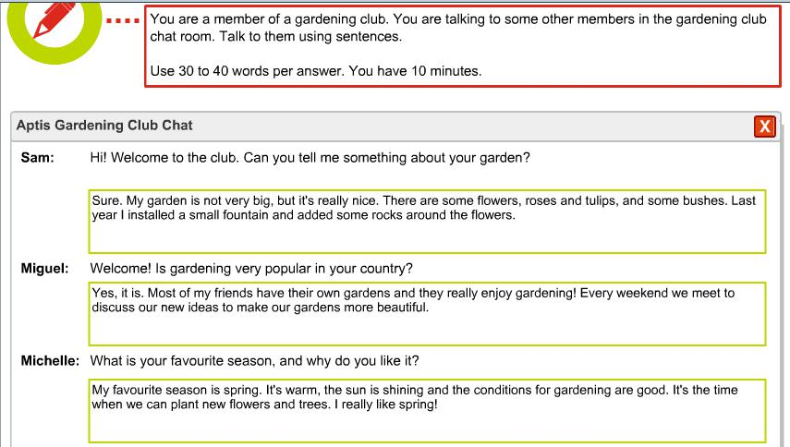

Slide 8
Formal and informal writing (Part 4)
This part requires that you write an informal email to a friend and a more formal email to an unknown person. Both emails are in reaction to information about a change. You should spend no more than 15 minutes on this part.

Slide 9
Preparation
Differentiate your two messages. One should clearly be an informal email to a friend or close family member, while the second should clearly be a formal email to a company.
You are also assessed on how broadly and accurately you can write so use a wide range of vocabulary, grammar and cohesive devices.

Slide 10
LAYOUT A Dear Sir, I am writing to you because I am unable to pay next month’s rent which is due on Saturday. Unfortunately, the other day I lost my wallet, and there was a large amount of money inside. I have, therefore, had to write to my parents to ask them to send me some money urgently. As soon as it arrives, I will immediately notify you and arrange to pay by cash or cheque. I hope that this does not cause you much inconvenience. There are also some problems with the flat that I wish to bring to your attention. First, the cold tap in the bathroom will not turn off properly, and the water is dripping constantly. This will need to be fixed quickly because it is wasting water. Second, one of the back burners on the top of the oven does not work at all. I’m sorry that I cannot pay the rent on time, and trust that you will understand. Yours sincerely Jane Citizen

Slide 11
LAYOUT B Dear Sir, I am writing to you because I am unable to pay next month’s rent which is due on Saturday. Unfortunately, the other day I lost my wallet, and there was a large amount of money inside. I have, therefore, had to write to my parents to ask them to send me some money urgently. As soon as it arrives, I will immediately notify you and arrange to pay by cash or cheque. I hope that this does not cause you much inconvenience. There are also some problems with the flat that I wish to bring to your attention. First, the cold tap in the bathroom will not turn off properly, and the water is dripping constantly. This will need to be fixed quickly because it is wasting water. Second, one of the back burners on the top of the oven does not work at all. I’m sorry that I cannot pay the rent on time, and trust that you will understand. Yours sincerely Jane Citizen

Slide 12
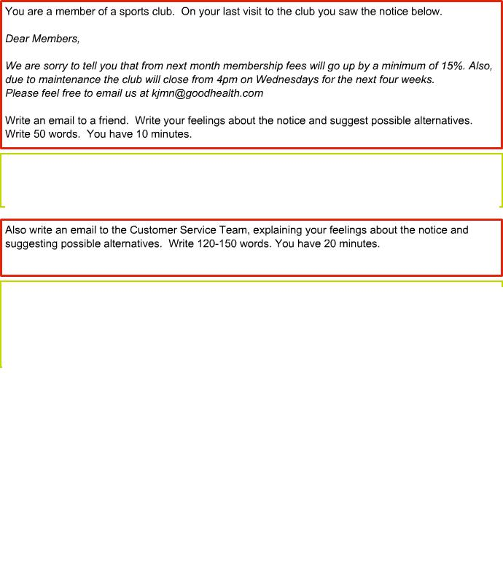
Hey Rasel, what do you think about the fee increase at the sports club? I can’t believe they will increase the fees and close early. If you ask me, the gym should offer a discount if they plan to close early. I just signed up and already a fee increase! Not happy!!
Sakib
Dear concerned,
I am writing to complain about the fee increase to take effect from next month and your plan to close early on Wednesdays.
I have been a member for only three months and feel it is unacceptable to increase the fee so soon after signing up while also closing early on Wednesdays, which is one of the days when I like to go to the sports club and meet my personal trainer.
I think you should rethink the fee increase if you are withdrawing services. One alternative is to implement the fee increase after you have completed the maintenance. Another alternative is to complete the maintenance after the gym is closed at 10pm.
Hope to hear back from you if my recommendations are acceptable. If not, I will have to look for another sports club for my membership.
Regards,
Sakib

Slide 13
The most common mistakes are the following:
• Not answering the questions or going off topic. Read the question and understand what you are required to do.
• Writing too much but with poor grammar, spelling and punctuation. Keep to the word count and focus on accuracy.
• Not capitalizing months, cities, countries and names.

Slide 14


