Slide 1

Blood Bank Management

Slide 2
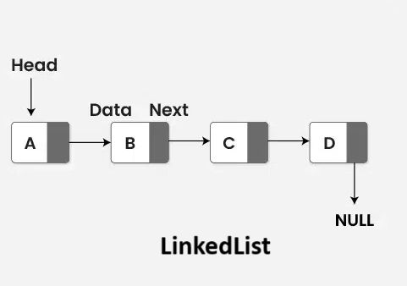

Linked List & Queue
Linked List — Dynamic Storage
Nodes: Donor*, Patient*, Blood* heads
Each node holds data + pointer to next
Functions: addDonor(), deleteDonor(), showDonors()
New node becomes head — no fixed size limits
Queue — FIFO Request System
Pointers: frontReq / rearReq
Functions: enqueueRequest(), dequeueRequest()
Oldest emergency request processed first

Slide 3

Stack, Arrays & File Handling
Stack — Donation History (LIFO)
Pointer: topDonation
Functions: pushDonation(), showDonationHistory()
Most recent donation always surfaces first
Arrays & Strings — Identity Data
Stores blood groups, names, CNIC, phone
Custom functions: strEqual(), strLen(), toUpperCase()
Validates input without library dependencies
File Handling — Persistence
Writes to donor.txt and patient.txt
Data survives program termination
Loaded at startup for session continuity

Slide 4




Function Mapping & System Flow
User Layer
Menu Interface
Donor / Patient / Nurse / Manager
Role-based menus route actions
DSA Layer
File Storage
Linked List · Queue · Stack
Persistence via .txt files
Function
DSA Used
addDonor(), deleteDonor()
Linked List
enqueueRequest(), dequeueRequest()
Queue
pushDonation(), showDonationHistory()
Stack

Slide 5


Main Menu & Secure Access
The application's main menu provides tailored access based on user roles:
Patient
Request blood, view status.
Access Decision
Grant, Retry, or Block
Donor
Validate against directory
Register, schedule donations.
Check Credentials
Nurse
Enter Credentials
Input username and password
Manage inventory, process requests.
Start Login
Manager
Begin user authentication
Oversee all operations, reports.
Secure Login Protocol
A strict 3-attempt limit is enforced. Exceeding this limit will block the account to prevent unauthorized access and maintain system integrity.
Both Manager and Nurse roles require authentication to access sensitive functionalities. Each login attempt is validated against stored credentials.

Slide 6

Patient Menu
1. Register Patient
2. Show Blood Compatibility
3. Display Blood Inventory
4. Show Current Patient Details
5. Request Blood
6. Exit back to main menu

Slide 7

Donor Menu
Access the main functionalities available to donors within the system:
01
02
Register Donor
Show Current Donor Details
03
04
Check Blood Compatibility
Wants to donate blood
05
Exit (Back to Main Menu)

Slide 8

Nurse Menu & Authentication
Login Credentials:
Username: nurse
Password: 123
Show Donors
Show Patients
Add Donor
Remove Donor
Search Donor
Add Patient
Remove Patient
Search Patient
Show Inventory
Exit

Slide 9

Manager Menu & Authentication
Login Credentials:
Username: manager
Password: 123
Manager Menu
Show Donors
Show Patients
Add Donor
Remove Donor
Search Donor by ID
Add Patient
Remove Patient
Search Patient by ID
Show Inventory
Add Blood Units
Remove Blood Units
Show Blood Requests
Process Next Request
Show Donation History
Exit

Slide 10

Time Complexity Analysis
Complexity Analysis
Linked List Insert
Linked List Search
Queue Enqueue
→ O(1)
→ O(n)
→ O(1)
Queue Dequeue
Stack Push
→ O(1)
→ O(1)

Slide 11
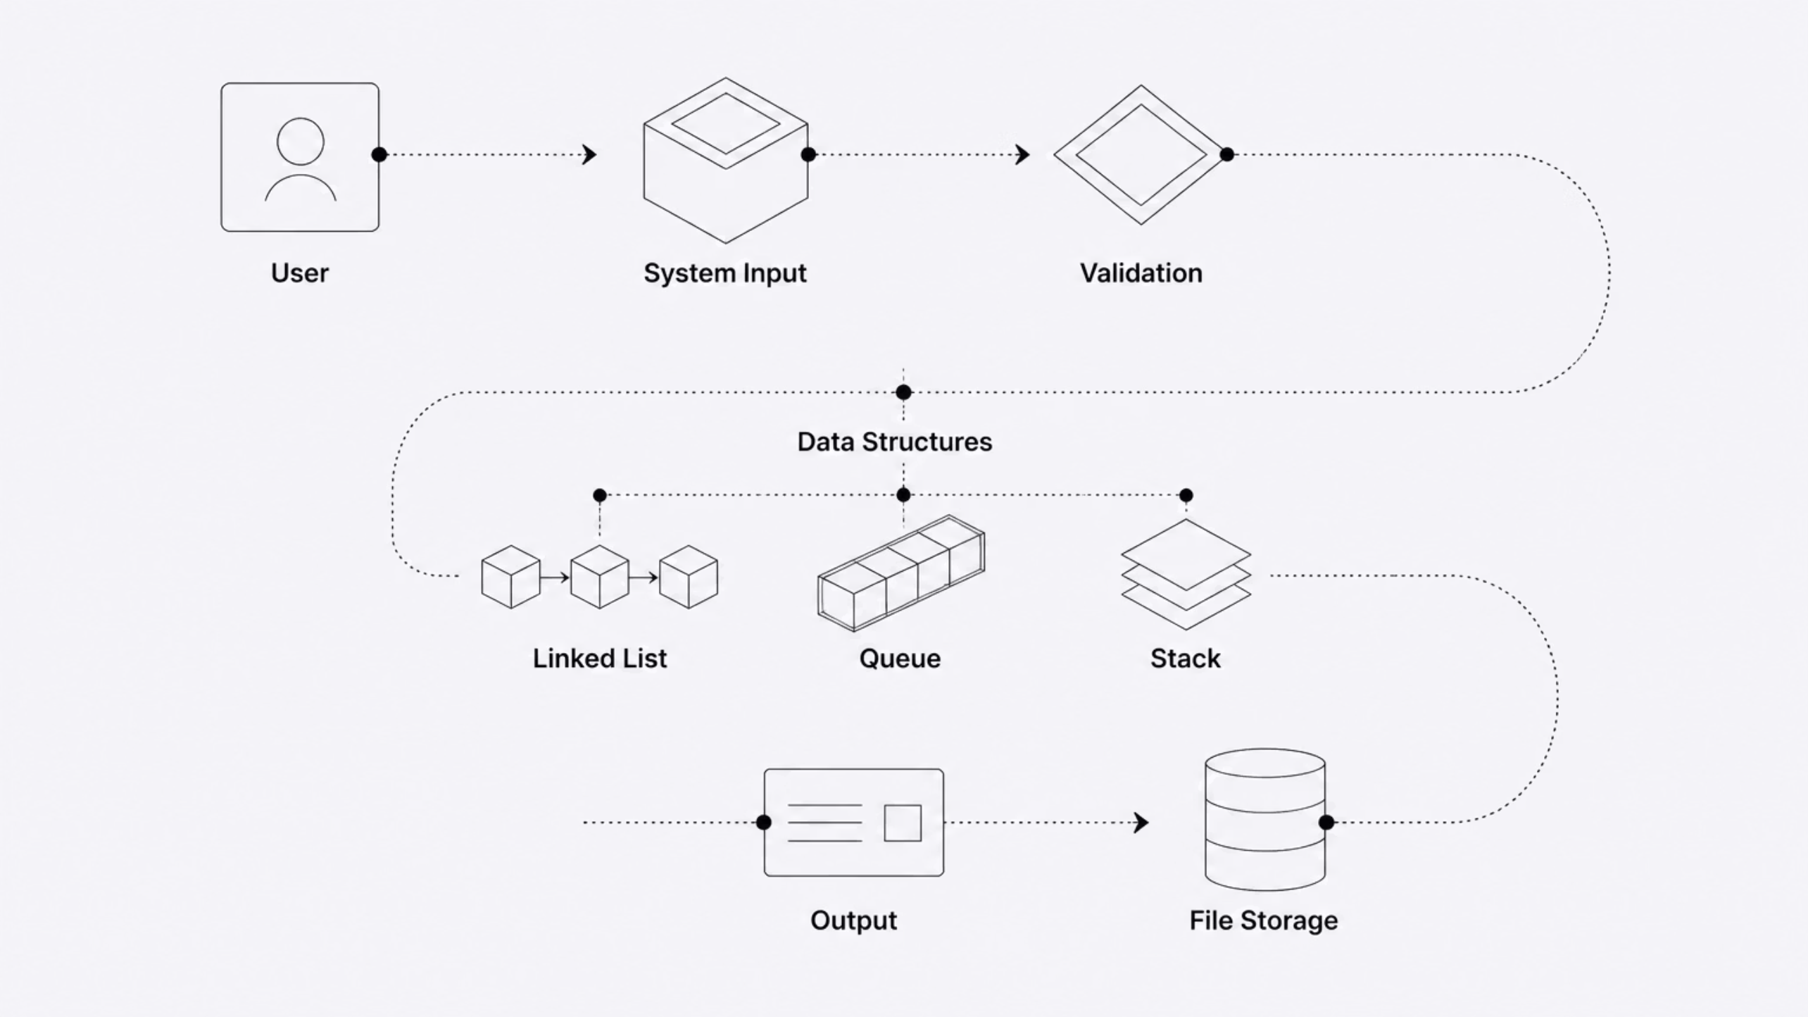
Data Flow Diagram

Slide 12
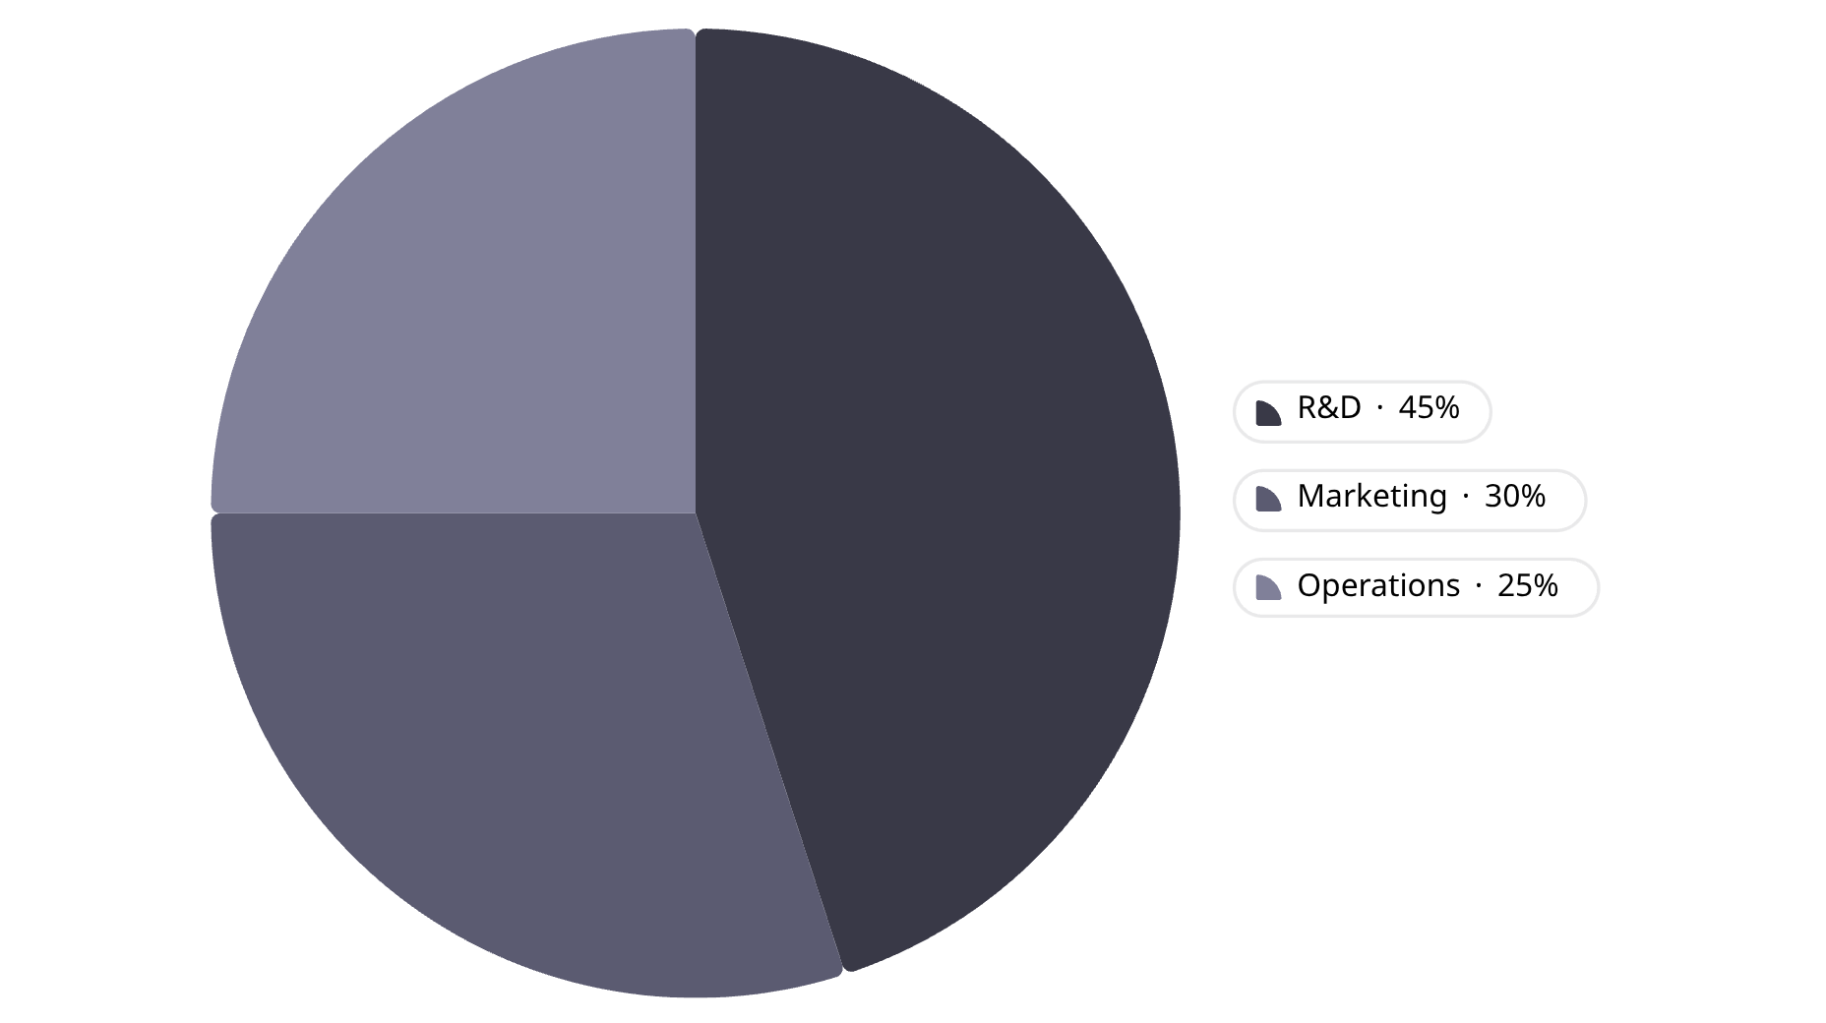
Conclusion
Each data structure solves a specific problem — together they form a coherent, scalable blood bank system.
Linked List
Dynamic donor, patient & inventory management
Queue
Fair, ordered emergency request processing
Stack
Instant access to recent donation history
File I/O
Data persistence across sessions
Removing any structure degrades the system — fixed arrays cause overflow, no queue loses request order, no stack hides recent activity, no file I/O wipes all data on exit.

