Slide 1

OCT Retinal Disease Classification Using Graph Neural Networks
Submitted By
Submitted To
Kaniz Fatema Tuli
Dr. Raihan Ul Islam
Associate Professor
Department of Computer Science & Engineering
ID: 2023-1-60-192
Jannatul Ferdous Shanta
Focus Area
ID: 2022-3-60-167
Multi-class retinal disease classification from Optical Coherence Tomography (OCT) images using Graph Neural Networks, with explainability via SHAP and LIME.
Abira Ahsan
ID: 2023-2-60-127

Slide 2


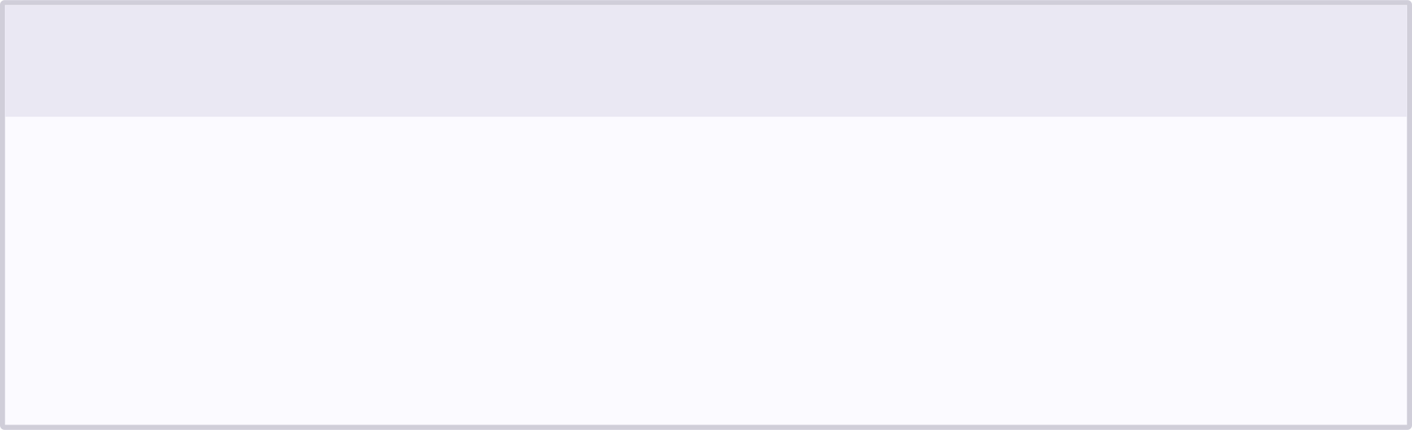


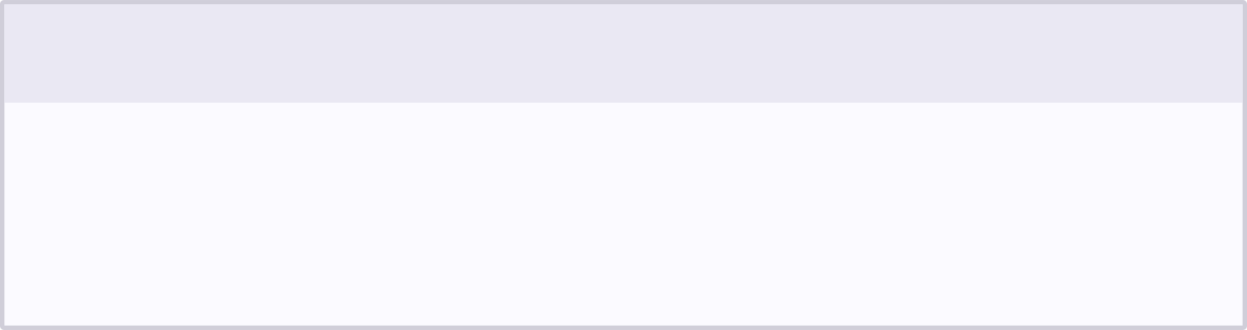
Research Objectives
This study establishes a complete end-to-end pipeline for retinal disease classification, benchmarking classical machine learning approaches against a novel Graph Neural Network architecture designed to preserve spatial retinal structure.
Build a Complete Pipeline
Benchmark Baselines vs. GNN
Construct a full retinal disease classification pipeline using the OCTDL dataset, from raw OCT images through feature extraction to final prediction.
Compare multiple machine learning baselines — including SVM, XGBoost, LightGBM, MLP, and 1D CNN — against the proposed Graph Neural Network architecture.
Preserve Spatial Information
Explain Model Decisions
Improve classification performance by retaining the spatial structure of retinal tissue, which is lost in conventional feature-vector approaches.
Apply Explainable AI techniques — specifically SHAP and LIME — to interpret and validate model predictions in a clinically meaningful way.
02

Slide 3
DATASET
Dataset Information
Dataset | OCTDL — Optical Coherence Tomography Dataset
Source | Kaggle
Problem Type | Multi-class Image Classification
Classes (7) | AMD, DME, ERM, NO, RAO, RVO, VID
2,063
1,444
Total Images
Training (70%)
309
310
Validation (15%)
Test (15%)
Why Subject-Level Split?
✓
One patient's images never appear in multiple sets.
AMD
DME
ERM
NO
RAO
✓
Prevents data leakage across train / val / test.
RVO
VID
✓
Ensures a fair, unbiased evaluation.
SEVEN DISEASE CLASSES
Imbalance note
NO and AMD have the most samples; RAO and RVO are the most under-represented classes.
03

Slide 4
TASK 1 · DATA UNDERSTANDING
Exploratory Data Analysis & Research Gap
EDA SCOPE
RELATED WORK (2022–2026)
Cleaning & corrupted-image removal
Duplicate checking
VGG16 | 98.7% Accuracy
Graph-Fused CNN + ViT | 99.8% Accuracy
GCN + U-Net | Dice 0.850
Explainable Graph Model | 61.8% ISNT alignment
Hybrid CNN-ViT | Better than pure ViT
Class distribution analysis
Image resolution (width/height) stats
Sample visualization
Train / val / test verification
Key Findings
•
Seven retinal disease categories in the dataset.
Research Gap
•
Images are RGB OCT scans.
—
Loss of spatial retinal information
•
Dataset is imbalanced overall.
—
Naive feature fusion
•
NO and AMD have more samples.
—
Poor robustness across imaging devices
•
RAO and RVO contain the fewest samples.
—
Limited integration of clinical metadata
04

Slide 5

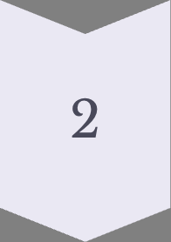
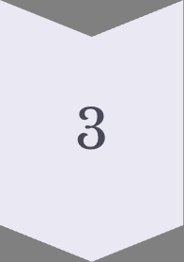
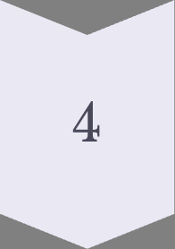
Task 2: Baseline Models
Models Tested
Linear & Kernel
Preprocessing Pipeline
Logistic Regression
SVM (RBF kernel)
k-Nearest Neighbors
Subject-Level Split
Patient IDs kept separate across all folds
to prevent leakage.
Tree-Based
ResNet-50 Feature Extraction
Decision Tree
Random Forest
Gradient Boosting
XGBoost
LightGBM
Deep features extracted from pretrained ResNet-50 as input representations.
Scaling & Feature Selection
StandardScaler normalization, Variance Threshold filtering, and Mutual Information selection applied.
Neural
MLP (Multi-Layer Perceptron)
1D CNN
Class Balancing
Class-weight balancing applied to all models; SMOTE oversampling applied specifically for k-NN.
Macro-F1 was chosen as the primary metric to give equal importance to rare disease classes regardless of class frequency.
05

Slide 6

Task 2-Baseline Performance Results
Top-performing baselines ranked by Macro-F1. SVM (RBF) emerged as the strongest baseline and the
model to beat for the proposed GNN.
BASELINE PERFORMANCE (TOP 5)
Model | Accuracy | Macro-F1 | ROC-AUC | Time (s)
SVM ⭐ | 0.7845 | 0.6049 | 0.9151 | 4.10
XGBoost | 0.7744 | 0.5981 | 0.8807 | 6.75
Gradient Boosting | 0.7644 | 0.5866 | 0.8567 | 180.46
LightGBM | 0.7669 | 0.5772 | 0.8861 | 4.76
MLP | 0.7619 | 0.5794 | 0.8803 | 1.15
Model to Beat: SVM achieved the highest Macro-F1 (0.6049), making it the strongest baseline. Macro-
F1 was chosen as the primary metric because it gives equal importance to rare classes. SVM (RBF) was the
strongest classical baseline. The proposed GNN was designed to outperform it.
06

Slide 7
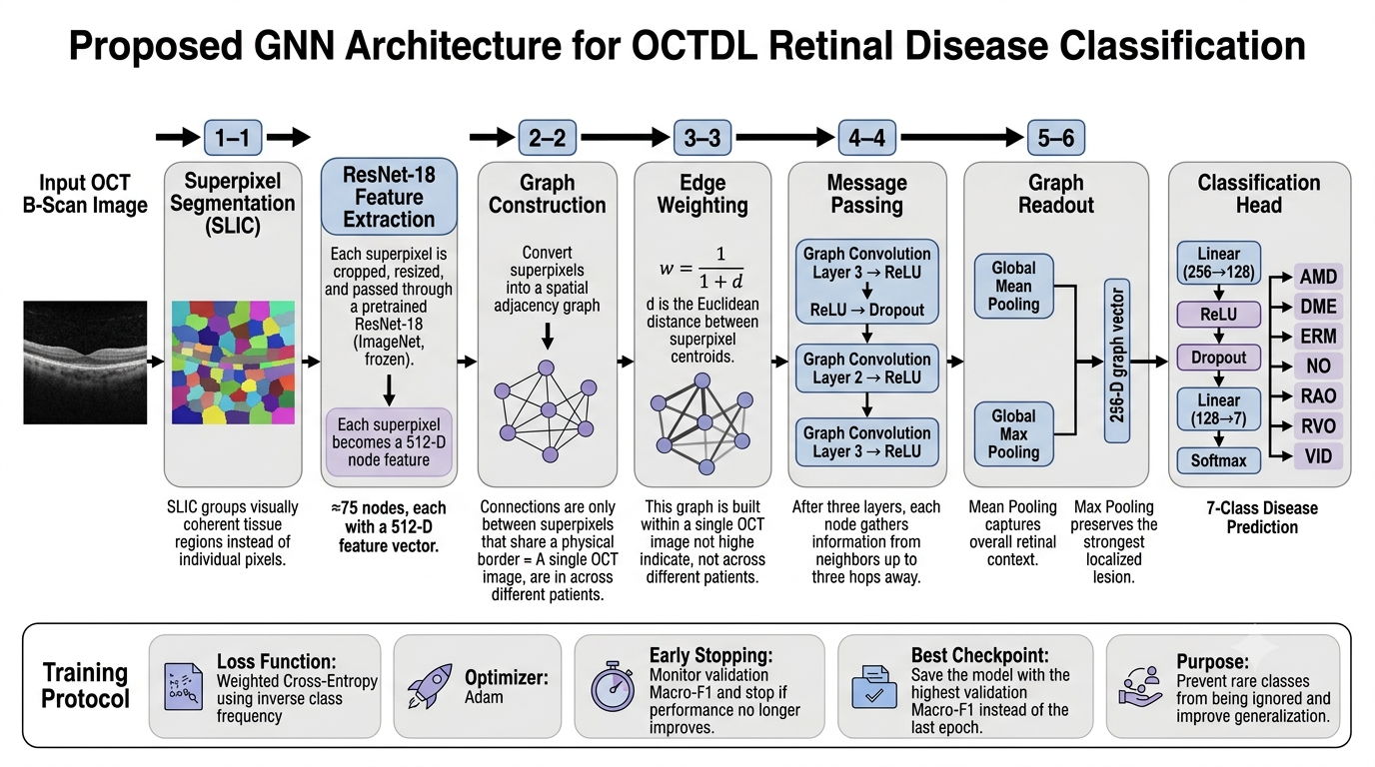
TASK 2 · Architecture of our work
Best Baseline: SVM
07

Slide 8

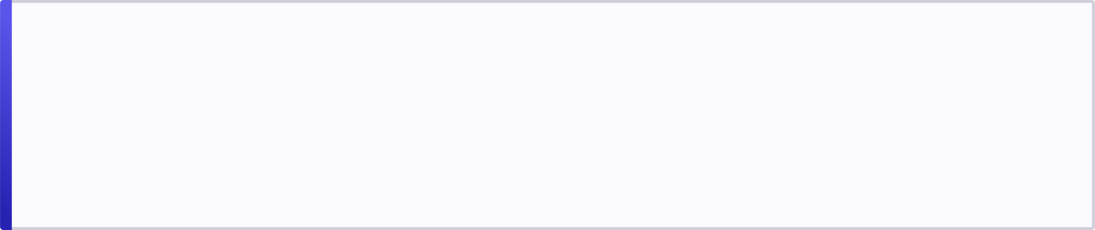


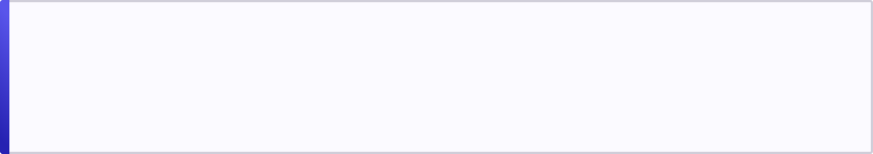

Why Graph Neural Networks?
GNN Architectural Advantages
Limitations of Baseline Approaches
1. Superpixel Graph Construction
Spatial Information Lost
Each OCT image is converted into a graph of ~75 superpixels, preserving the spatial arrangement of retinal tissue regions.
Every OCT image is flattened into a single feature vector. The spatial location of retinal lesions — critical for distinguishing AMD from DME — is entirely discarded after global pooling.
2. Spatial Adjacency Edges
Neighboring tissue regions are connected using spatial adjacency, encoding the anatomical relationships between retinal layers.
Indistinguishable Lesion Positions
Two lesions in different retinal regions produce similar representations after pooling, making it impossible for the model to reason about where pathology occurs.
3. Message Passing
Each region learns from nearby healthy and diseased tissues through iterative message passing, enabling context-aware classification.
1D-CNN Structural Blindness
4. Mean + Max Pooling
The 1D-CNN captures only a single scan line at a time, missing the full 2D retinal structure that defines disease morphology.
Dual pooling captures both overall tissue context (mean) and localized lesion signals (max), improving detection of AMD, DME, and ERM.
08

Slide 9
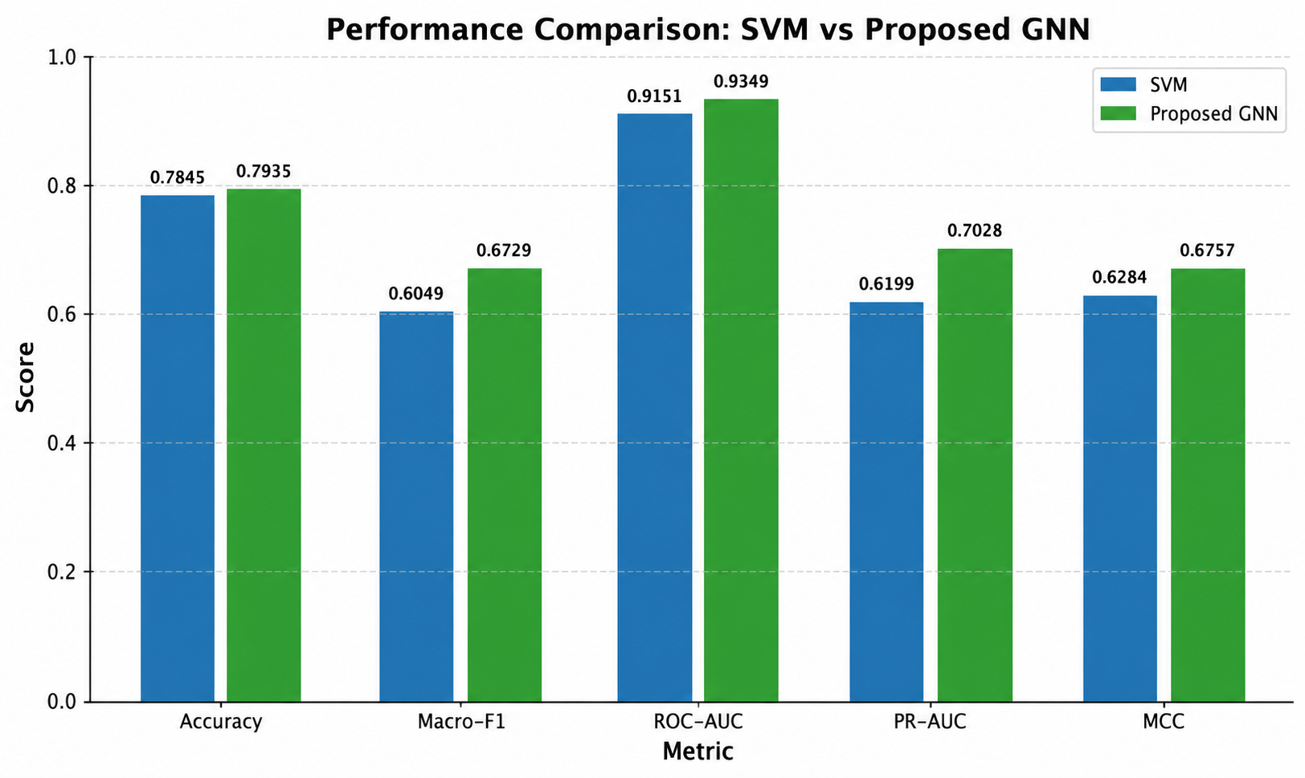
Task-2 RESULTS
GNN Results Vs Baseline Performance Comparison
IMPROVEMENT OVER BEST
BASELINE (SVM)
Metric | SVM | Proposed GNN
Accuracy | 0.7845 | 0.7935
Macro-F1 | 0.6049 | 0.6729
ROC-AUC | 0.9151 | 0.9349
PR-AUC | 0.6199 | 0.7028
MCC | 0.6284 | 0.6757
09

Slide 10
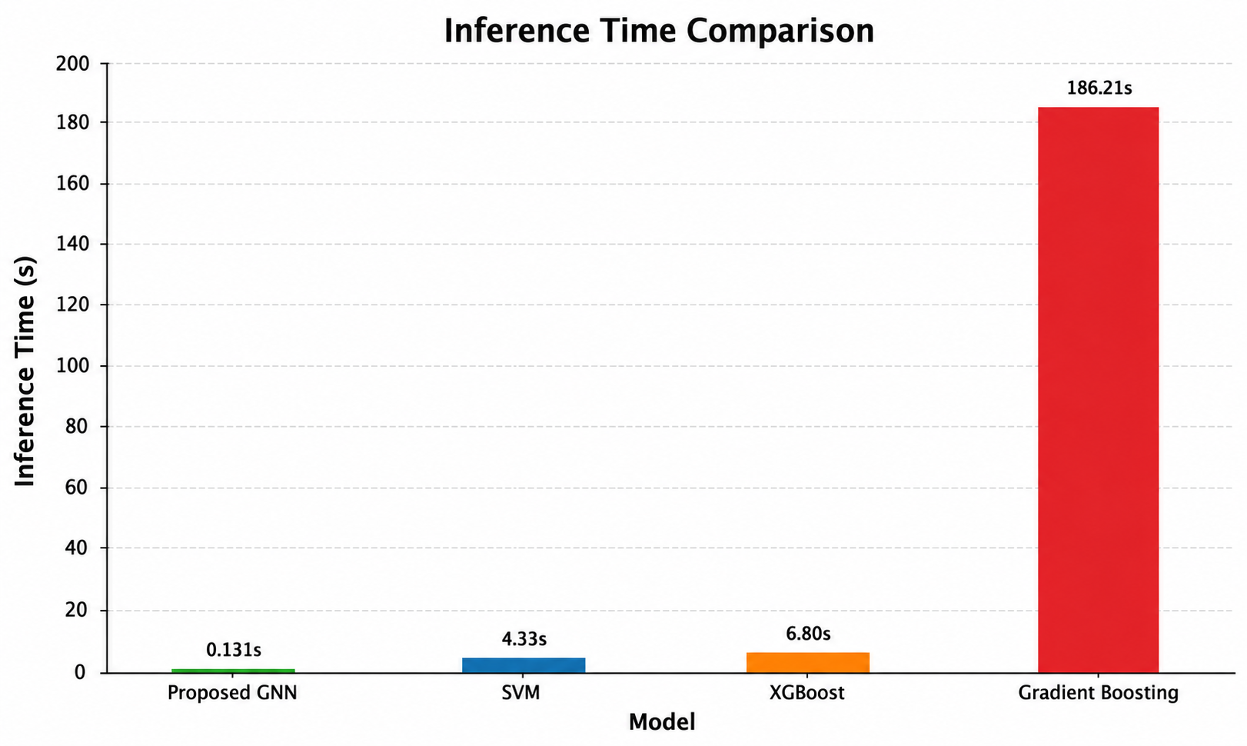
Task-2 RESULTS
GNN Results Vs Baseline Performance Comparison
Why Did It Improve?
1
Preserved Spatial Structure
Retinal layout is retained through graph message passing rather than flattened.
2
Region-Level Reasoning
Predictions draw on localized superpixel regions, not just global features.
3
Neighborhood Information
Message passing lets nearby regions inform each other's representation.
4
Localized Lesion Handling
Better sensitivity to small, spatially concentrated pathological patterns.
10

Slide 11
TASK 3 · MODEL DEVELOPMENT
Ablation Study & Model Improvement
KEY FINDINGS
64→128 hidden units + 2→3 GCN layers gave the largest lift (0.386 → 0.539).
Starting from the initial GCN (A0), we changed one or two components at a time under a fixed dataset, patient-level split, and early-stopping protocol — using validation Macro-F1 for selection while keeping the test set untouched.
Distance-weighted edges pushed performance further (0.539 → 0.608).
Run | Main Change | Val F1 | Test Macro-F1
A0 | Initial GCN | 0.506 | 0.386
A1 | Larger GCN + Regularization | 0.685 | 0.539
A2 | Distance-weighted edges | 0.684 | 0.608
A3 | Global Fusion (Final Model) | 0.712 | 0.531
A4 | k-NN Graph | 0.588 | 0.511
A5 | GAT | 0.658 | 0.579
A6 | GraphSAGE | 0.572 | 0.502
A7 | Adam Optimizer | 0.669 | 0.583
A8 | No LR Scheduler | 0.400 | 0.400
Spatial adjacency beat k-NN graph construction.
GCN outperformed both GAT and GraphSAGE on this dataset.
AdamW + ReduceLROnPlateau was most stable; removing the scheduler caused the biggest drop (0.712 → 0.400).
Final Selection: A3 chosen for highest validation Macro-F1 (0.712).
11

Slide 12
TASK 3 · MODEL DEVELOPMENT
Model | Accuracy | Macro-F1
Logistic Regression | 0.774 | 0.513
Gradient Boosting | 0.771 | 0.504
SVM (RBF) | 0.742 | 0.401
Random Forest | 0.720 | 0.404
Improved CNN ⭐ | 0.787 | 0.524
Final Performance: Fair, Leakage-Free Comparison
EVALUATION PROTOCOL
Same patient-grouped split for every model.
Test set untouched until the final model was selected.
Classical ML: ResNet-50 (ImageNet) features → StandardScaler → SMOTE → classifier.
Macro-F1 by Model
Improved CNN trained end-to-end under the same protocol.
Best Baseline The Improved CNN became the strongest classical baseline.
12

Slide 13
TASK 3 · MODEL DEVELOPMENT
Final Model Comparison
Accuracy & Macro-F1
Model | Accuracy | Macro-F1
Best Baseline (Improved CNN) | 0.787 | 0.524
First GNN (A0) | 0.697 | 0.281
Final GNN (A3) ⭐ | 0.803 | 0.531
0.281 → 0.531
+0.007
Macro-F1 improvement,
first GNN → Final GNN
Macro-F1 vs. best
baseline (Improved CNN)
The optimized GNN improved Macro-F1 from 0.281 to 0.531 vs. the first GNN, and edged out the strongest baseline — while preserving a fair, leakage-free evaluation.
13

Slide 14
TASK 3 · MODEL VALIDATION
Cross-Validation & Significance Testing
WHY CROSS-VALIDATION?
CROSS-VALIDATION SETUP
A single train/test split can favor one model by chance. We used 5-fold StratifiedGroupKFold to check whether the Final GNN consistently outperformed the best baseline — with patient IDs kept separate across folds to prevent leakage.
5 patient-grouped folds (1,749 images / 697 patients for train + validation).
Both models retrained from scratch on every fold.
Fold 1
Fold 2
Fold 3
Fold 4
Fold 5
Class-weighted loss across all folds.
AdamW optimizer with learning-rate scheduling.
Patients grouped and rotated across 5 folds — never split within a patient.
Early stopping on validation Macro-F1.
14

Slide 15
TASK 3 · MODEL VALIDATION
Mean Performance Across 5 Folds
Macro-F1 (Mean ± SD)
Model | Accuracy | Balanced Acc. | Macro-F1
Best Baseline (Improved CNN) | 0.786 ± 0.052 | 0.677 ± 0.085 | 0.617 ± 0.104
Final GNN (A3) | 0.771 ± 0.068 | 0.624 ± 0.044 | 0.619 ± 0.066
+0.002
⚠ Fold-to-fold variation (±0.066–0.104) is much larger than the +0.002 gap between models.
Mean Macro-F1 advantage (GNN vs. baseline)
The Final GNN reached the highest average Macro-F1 (0.619) — a marginal edge over the baseline's 0.617 — but the gap is small next to natural fold variation, so a formal significance test is needed before claiming an advantage.
15
17

Slide 16
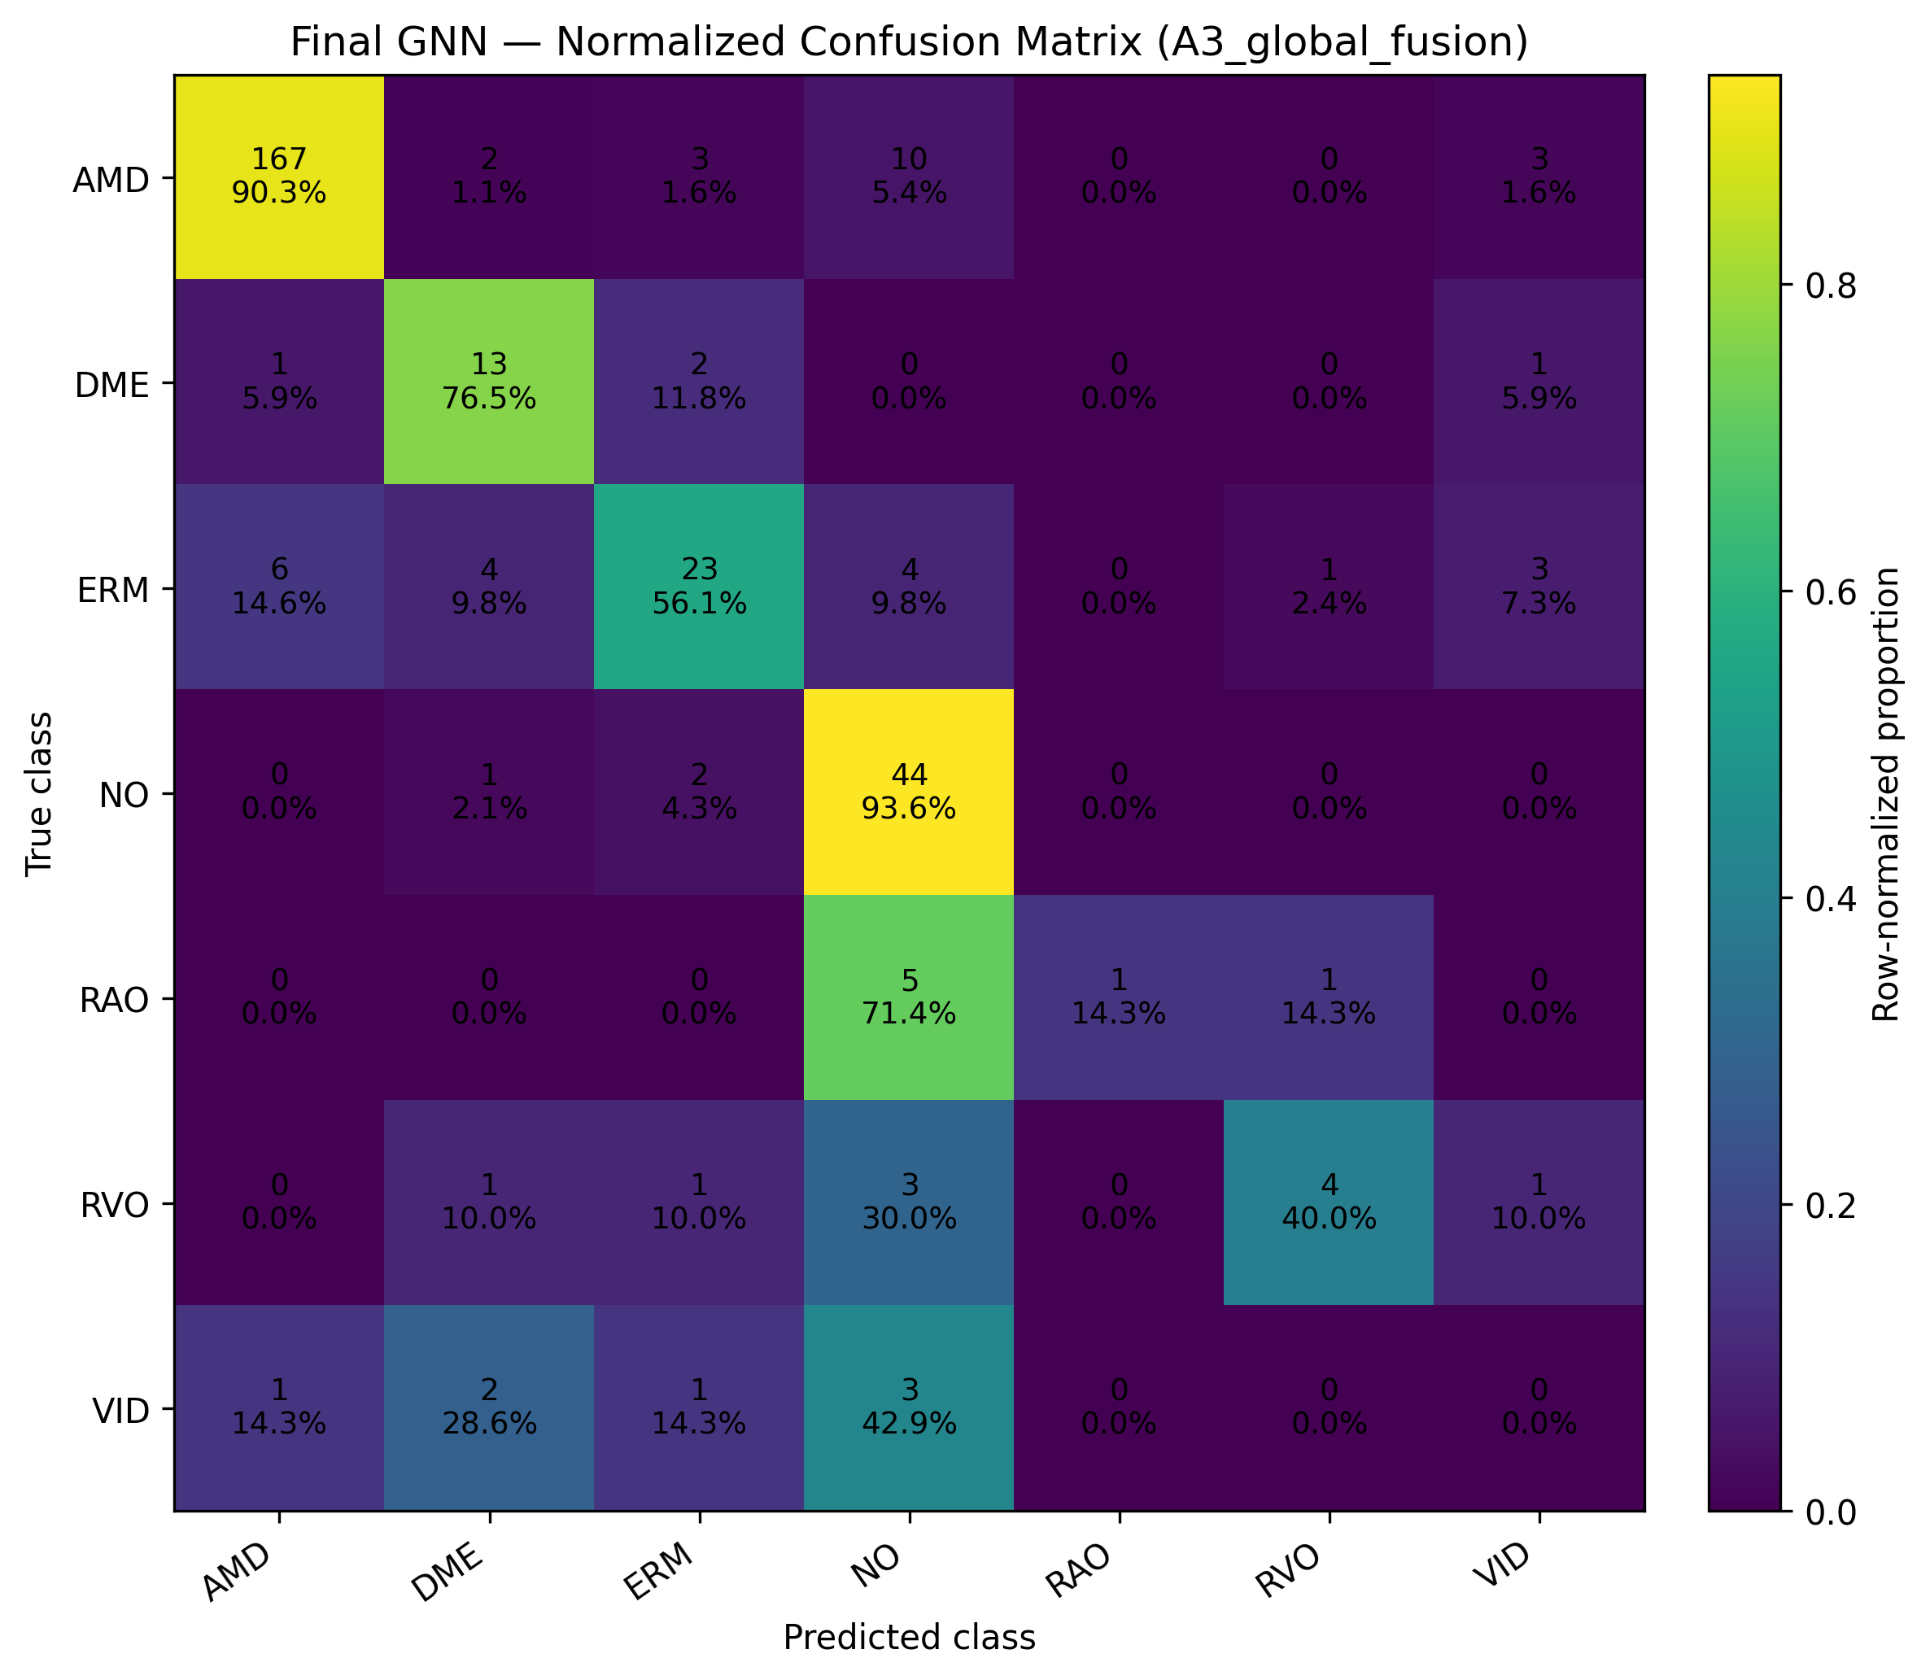
Final GNN Confusion matrix
16

Slide 17
TASK 3 · MODEL VALIDATION
Statistical Significance Testing
We tested whether the Final GNN's improvement over the Improved CNN baseline was real or due to chance, using two tests for two evaluation settings.
PRIMARY · Wilcoxon Signed-Rank (5-Fold CV)
SECONDARY · Exact McNemar (Held-out Test Set)
Baseline-only Correct | 12
GNN-only Correct | 17
Discordant Pairs | 29
Statistic | 12.0
p-value | 0.4583
Statistic | 7.0
p-value | 1.0000
Significance Level (α) | 0.05
Result: Not Significant
Result: Not Significant
Mean Macro-F1 Final GNN: 0.6194 · Improved CNN: 0.6175
McNemar used only for the shared held-out test set.
Both tests reach the same conclusion: although the Final GNN scored slightly higher, the improvement is not statistically significant at α = 0.05.
17
18

Slide 18
TASK 3 · DIAGNOSTICS
Final Model Diagnostics
Per-Class Performance — Final GNN
KEY FINDINGS
AMD achieved the best performance (F1 = 0.928).
NO was also classified accurately (F1 = 0.759).
Rare classes — RAO, RVO, VID — showed weaker performance due to limited training samples.
VID was the most challenging class, with no correct predictions on the test set.
Class imbalance remains the model's core limitation for rare retinal conditions.
18

Slide 19
TASK 3 · DIAGNOSTICS
Explainability (SHAP + LIME)
LIME and SHAP were used to understand why the Final GNN made its predictions — explanations were generated for the highest-confidence correct prediction (RAO) and the highest-confidence wrong prediction (RVO → NO).
LIME
SHAP
Highlights the important superpixels that influenced each prediction.
Shows each region's positive and negative contribution to the prediction.
Correct RAO prediction: focus centered on abnormal retinal regions.
Confirmed the same important regions identified by LIME.
Wrong RVO prediction: overemphasized normal-looking tissue.
Revealed the misclassified RVO image received weak evidence for its true class.
Key Takeaway: SHAP and LIME made the Final GNN's decisions more interpretable by showing which retinal regions influenced both correct and incorrect predictions.
19
20

Slide 20
LOOKING AHEAD
Future Work
1
Rare-Class Recognition
2
Broader Explainability
3
Generalization
Focus on RAO, RVO, and VID, which have limited test samples and drive performance variability.
Evaluate LIME and SHAP across many samples from all disease classes, not just one correct/incorrect case.
Validate the Final GNN on external datasets and different imaging devices / settings.
4
Graph Design
5
Robustness to Imbalance
6
Broader Validation
Explore alternative graph-construction and GNN strategies to improve spatial representation.
Investigate methods that reduce sensitivity to class imbalance for underrepresented diseases.
Use larger, more diverse datasets for more reliable estimates of model performance.
These directions follow directly from the report's limitations and discussion — particularly its emphasis on rare classes, broader explainability, and external / device generalization.
20

Slide 21
A Competitive, Interpretable Approach
TASK 3 · SUMMARY
Conclusion
80.3%
Built a patient-grouped, leakage-free evaluation pipeline for multi-class OCT disease classification.
Test accuracy — Final GNN (A3)
The Final GNN (A3) performed competitively against the Improved CNN baseline.
Ablation analysis showed the value of regularization, distance-weighted spatial edges, global-image fusion, AdamW, and LR scheduling.
0.531
Test Macro-F1, vs. 0.524 baseline
LIME and SHAP provided interpretable visual explanations for both correct and incorrect predictions.
The main remaining challenge is reliable classification of rare disease classes — RAO, RVO, and VID.
0.619 vs 0.617
5-fold CV Macro-F1 — not statistically significant
The proposed GNN is best characterized as a competitive and interpretable approach — rather than a statistically proven improvement over the baseline.
21
22

Slide 22
Thank You

