Slide 1

Heart Disease Prediction Project
Using Machine Learning to Predict Cardiovascular Risk Based on Health Features
by Kankana Mondal
AI-ML Using Python Project

Slide 2

Project Problem
Cardiovascular Health Challenge
Heart disease is a major global health concern requiring early detection. The dataset includes key medical and lifestyle features such as Age, Gender, Cholesterol, Diabetes, Smoking, Family History, Obesity, Chest Pain Type, Exercise Hours, and more. The goal is to analyze these factors and train a Logistic Regression model to classify patients into Heart Disease or No Heart Disease. This helps demonstrate how machine learning can support medical decision-making and risk assessment.
Early Detection
Identify at-risk individuals before symptoms appear
Preventive Care
Enable proactive healthcare decisions and interventions
Risk Analysis
Understand key factors contributing to heart disease

Slide 3



Data Preprocessing Pipeline
Data Cleaning
Handled missing values and removed duplicate rows to ensure data integrity
Feature Engineering
Converted categorical variables and created BMI ranges for better risk grouping
Normalization
Scaled numerical values and removed outliers for optimal model performance

Slide 4
Model Creation Process
Performance Evaluation
Accuracy, Confusion Matrix, ROC/AUC analysis
Logistic Regression
Simple, interpretable model for binary classification
Data Split
80% training data, 20% testing data for validation

Slide 5
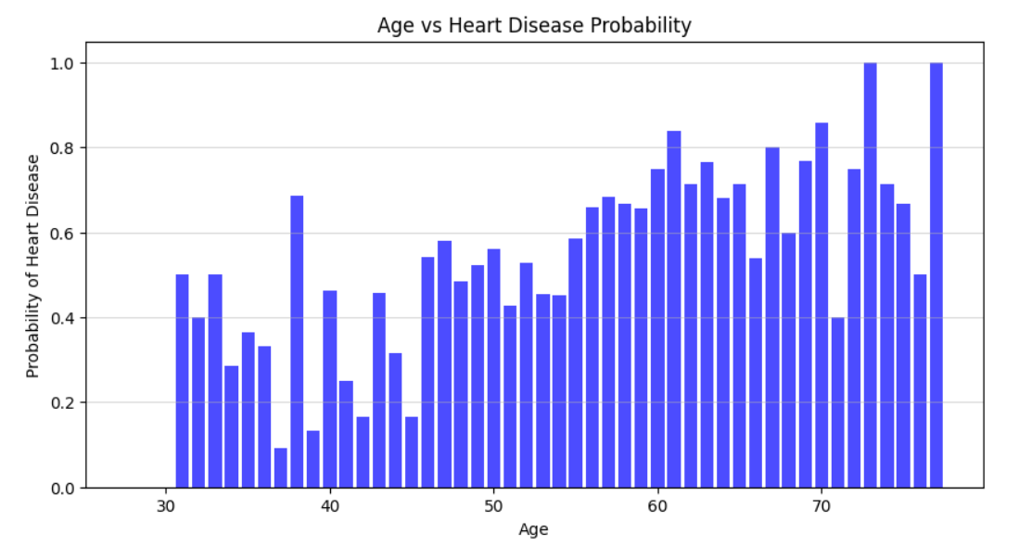
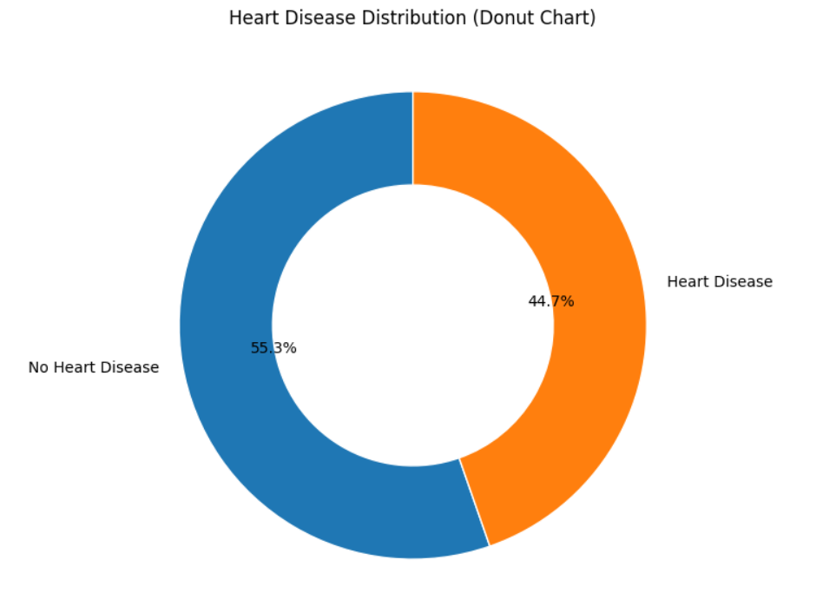
Data Visualizations & Insights
Bar Chart of Heart Disease Probability by Age
Proportion of Heart Disease vs No Heart Disease — Donut Chart

Slide 6
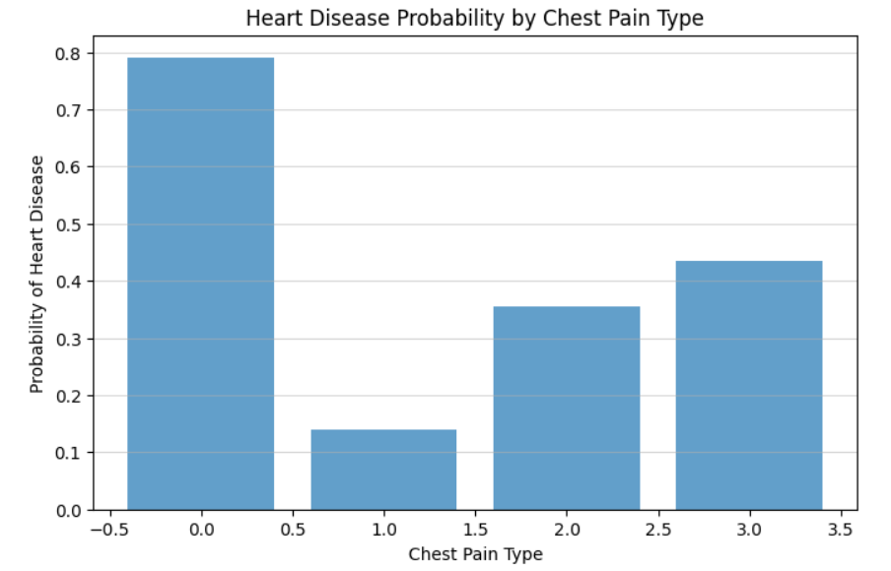
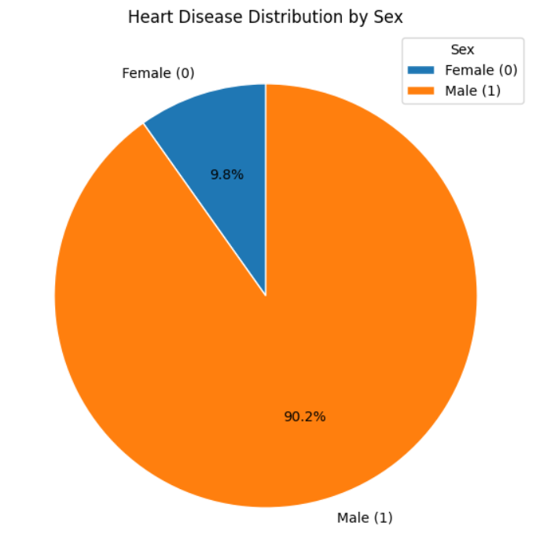
Data Visualizations & Insights
Chest Pain Type vs Predicted Heart Disease Probability — Bar Chart
Proportion of Heart Disease Cases by Sex
— Pie Chart

Slide 7
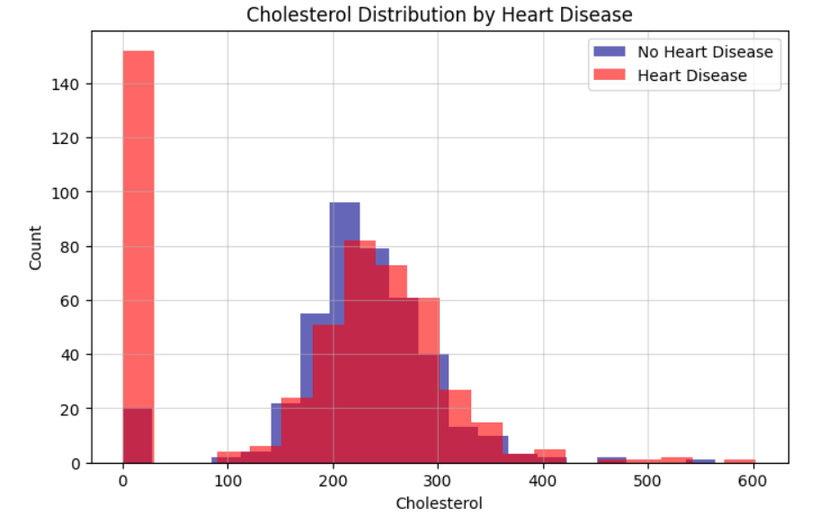
Data Visualizations & Insights
Comparison of Cholesterol Distributions Across Heart Disease Classes — Histogram Plot

Slide 8
Project Conclusions
Successful Prediction
Key Risk Factors
Future Improvements
Machine learning model achieved good accuracy in predicting heart disease risk using health features
Age, BMI, and blood pressure emerged as the most influential predictors of cardiovascular risk
Enhanced accuracy possible with more data and advanced models for better clinical decision support
Comparison of Cholesterol Distributions Across Heart Disease Classes — Histogram Plot

Slide 9
THANK YOU…

