Slide 1

Department of Computer Science and Engineering
191CS161A – Mini Project Work
Face Recognition and Alerting System using Python
Team Members:
Girishun Kumar R- 113119UG03027
Kishore M - 113119UG03050
Guided by:
Ms.V.Vijayashanthi.,M.tech(IT),
Asst.Professor,
Dept of CSE.
Batch No: 10
Date : 27.06.2022

Slide 2
Outline of the Presentation
Objective
Abstract
Existing System
Disadvantage
Literature Survey
Proposed System
Advantage
Architecture Diagram
Software and Hardware Requirement
Algorithm
Modules
Conclusion and Future Enhancement
Reference
2

Slide 3
Objective
The major objectives of the project are as follows:
We are proposing an Information Security Strategy.
To identify the intruder using a machine learning algorithm.
Image processing techniques are performed on this image and feature values are extracted.
It detects and analyzes faces.
Converting it to an image, to find a match.
If the face doesn’t match with our data, alert through whatsapp.
Online monitoring.
3

Slide 4
Abstract
Security has become an important factor. Intruders have become prominent factors for all the data/property theft. The basic idea in this paper is to identify the intruder and alert owner/administrator in different possible ways. This paper discusses different ways such as “WhatsApp message” and “intruder’s image to owner’s/administrator’s WhatsApp” to alert owner/administrator. For identifying the intruder, machine learning algorithm is used. A camera placed at the locality is trained such that it can identify the familiar people and it is “on” all the time. Whenever an unknown/unidentified person comes to the vicinity of the camera, all the above-said features get activated and the owner gets alerted.
4

Slide 5
Existing System
In the existing system by using a CCTV camera, it records the video that can be viewed through a smartphone, tablet, or computer from anywhere over the internet.
It captures the footage of the respective location and stores it in a sd card that can be viewed whenever needed.
Loaded with some essential features only.
5

Slide 6
Disadvantages
It can’t stop the theft.
It doesn’t alert the property owner or anyone immediately.
It is only used to identify the criminals only after notifying them of theft, burglary, or any other illegal or criminal activities.
6

Slide 7
Literature Survey
1. Computer Vision with the OpenCV Library, O’Reilly Publication.
“This library is useful for practitioners, and is an excellent tool for those entering the field: it is a set of computer vision algorithms that work as advertised.” -William T. Freeman, Computer Science and Artificial Intelligence Laboratory, Massachusetts Institute of Technology.
Learning OpenCV puts you in the middle of the rapidly expanding field of computer vision. Written by the creators of the free open source OpenCV library, this book introduces you to computer vision and demonstrates how you can quickly build applications that enable computers to "see" and make decisions based on that data.
7

Slide 8
2. M.A. Turk and A.P. Pentland, "Face Recognition Using Eigenfaces", IEEE Conf. on Computer Vision and Pattern Recognition, pp. 586-591, 1991.
An approach to the detection and identification of human faces is presented, and a working, near-real-time face recognition system which tracks a subject's head and then recognizes the person by comparing characteristics of the face to those of known individuals is described. This approach treats face recognition as a two-dimensional recognition problem, taking advantage of the fact that faces are normally upright and thus may be described by a small set of 2-D characteristic views. Face images are projected onto a feature space ('face space') that best encodes the variation among known face images. The face space is defined by the 'eigenfaces', which are the eigenvectors of the set of faces; they do not necessarily correspond to isolated features such as eyes, ears, and noses. The framework provides the ability to learn to recognize new faces in an unsupervised manner.
8

Slide 9
3. Kruti Goyal, Kartikey Agarwal, Rishi Kumar “Face detection and tracking: Using OpenCV”
An application for tracking and detecting faces in videos and in cameras which can be used for multipurpose activities. The intention of the paper is deep study of face detection using an open CV. A tabular comparison is performed in order to understand the algorithms in an easier manner. It talks about various algorithms like Adaboost, Haar cascades. This paper aims to help in understanding the best prerequisites for face detection.
9

Slide 10
Proposed system
In the proposed system, initially the face of the users is detected. (registering to our database)
After detection the faces are analyzed and trained to get more accurate data of the users.
When the collection of users' face data is collected it is stored for the further identification of faces.
Later when the user enters the visibility of the camera, the name of the user is sent as a message through WhatsApp, if it is an unknown person it sends a message as an unknown person entered.
10

Slide 11
Advantages
Alerts the user immediately when an anonymous / unknown person enters.
Don’t require more equipment.
Can also be able to use the features of normal CCTV cameras along with this project.
Completely software based.
Cost as much as a normal CCTV camera.
11

Slide 12
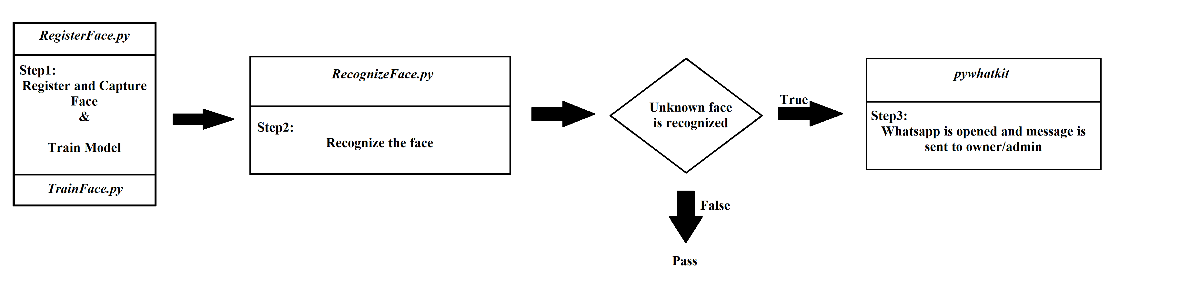
Architecture Diagram

Slide 13
Comparison
Characteristics | Existing system | Proposed system
Detection | It can’t detect anything | It detects the face
Alerting | It can’t alert in any form | It will sent message through WhatsApp
Features | Only stores the videos | Alert and detects the faces
Advantage | No advantage because it is only used to identify the criminals only after notifying them of theft, burglary, or any other illegal or criminal activities. | Alerts the user immediately when an anonymous / unknown person enters.
13

Slide 14
Software Requirements
Software Tool : PyCharm IDLE
Operating System : Windows 10 / 11
Processors : Any Intel or AMD X86-64 processor
RAM : 2GB
Graphics Card : No Specific graphics card required
14

Slide 15
Hardware Requirements
Operating System : Windows XP / Windows Vista
Processor : Intel Core 2 DUO / AMD Athlon 64 X2 5600+
Video card : NVIDIA Ge Force 7600 GT / ATI Radeon HD 2600 XT / Intel HD Graphics 3000
Memory : 2GB RAM
Resolution : 1024*768 minimum display resolution
External Device : Camera
15

Slide 16
Algorithm Usage
Three algorithms are used:
1. HAAR cascade
2. LBPH face recognition
3. face-trainer.yml
in which they are used in the gaming environment for the following purposes:
- HAAR cascade is a feature-based algorithm for object detection.
- LBPH is a Face-Recognition algorithm it is used to recognize the face.
- Face-trainer.yml is used to train the image in different ways.
16

Slide 17
List of Modules
Face-Registration
Face-Trainning
Face-Recognization
Alerting
17

Slide 18

Face-Registration
This is the snapshot of the module -Face-Registration
18

Slide 19
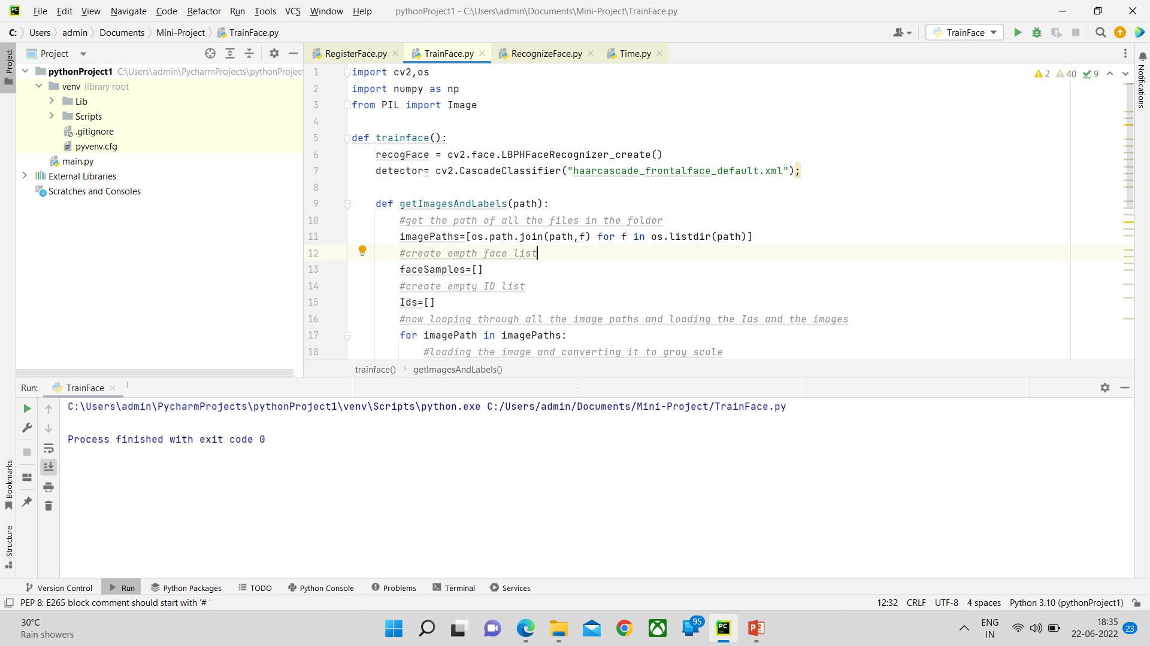
Face-Trainning
This is the snapshot of the module- Face-Trainninng.
19

Slide 20
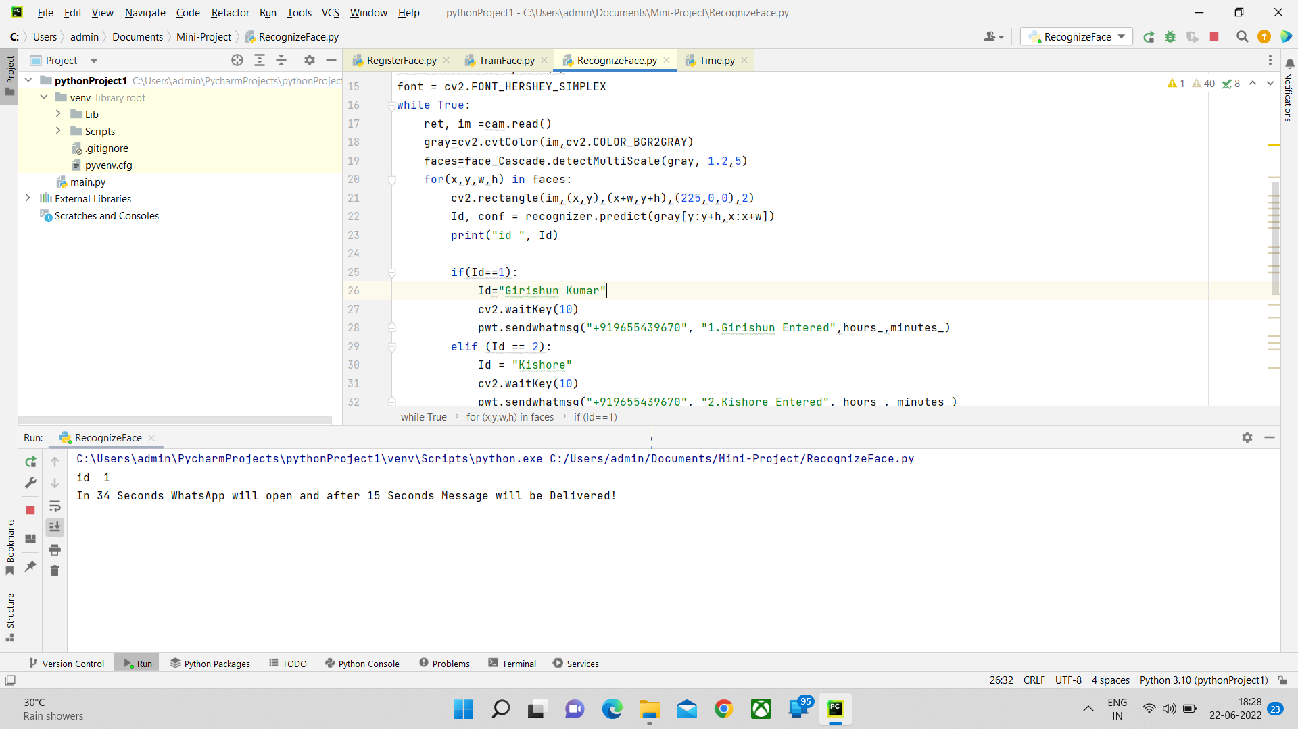
Face-Recognization
This is the snapshot of the module – Face-Recognization
20

Slide 21

Alerting
This is the snapshot of the module –Alerting message through WhatsApp.
21

Slide 22

Admin/Owners’ screenshot of receiving the message
This is the snapshot of the module –Admin/Owners’ screenshot of receiving the message.

Slide 23
Conclusion
We have many security options now. Technology is now a big part of our society and our foreseeable future, hence security is being an inevitable part. A system with 3 levels of security is implemented here. Even though many systems are available with many security options, a system with 3 levels of security at low cost is worth. Face recognition is the technology adopted here using machine learning, deep learning and WhatsApp is widely used, so the message is alerting through WhatsApp.
23

Slide 24
Future Enhancement
The scope of the project is more interactive and user-friendly. We are planning to integrate this machine learning project as a web application with an advanced python framework and the open-source platform called OpenCV. The OpenCV library makes programming easy to use. This comes up with advanced proficiencies like face detection, face tracking, facial recognition, and many more methods for artificial intelligence (AI).
By using this we are going to detect the faces of the persons passing through the camera, and check whether their photo matches with the data provided. If it matches it sends the name of the person entered or else sends unknown person entered / unknown person detected, then we can monitor through online using wifi and smart devices.
24

Slide 25
Reference
[1] Computer Vision with the OpenCV Library, O’Reilly Publication.
[2] M.A. Turk and A.P. Pentland, "Face Recognition Using Eigenfaces", IEEE Conf. on Computer Vision and Pattern Recognition, pp. 586-591, 1991.
[3] KyungnamKim” Face Recognition using Principle Component Analysis.
[4] G B Huang, H Lee and EL. Miller, "Learning hierarchical representation for Face verification with convolutional deep belief networks[C]", Proceedings of International Conference on Computer Vision and Pattern Recognition, pp. 223-226, 2012.
[5] Paul Viola and Matthew Jones, "Rapid object detection using a boosted cascade of simple features", Conference paper-IEEE Computer Society Conference on Computer Vision and Pattern Recognition.
[6] Ravishankara K, Dhanush, Vaisakh, Srajan I S “Whatsapp Chat Analyzer”.
25

Slide 26
THANK YOU
26

