Slide 1
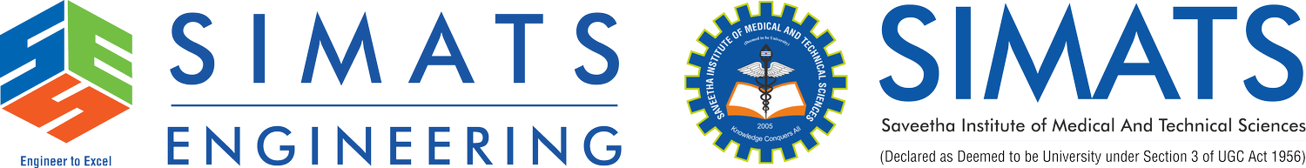
Security Attacks, Threats, Risks and Their Impact on Security Goals
CSA5116-CRYPTOGRAPHY AND NETWORK SECURITY
GUIDED BY: Dr.E.ANBALAGAN
PRESENTED BY: KANMANI L
(192511414)

Slide 2


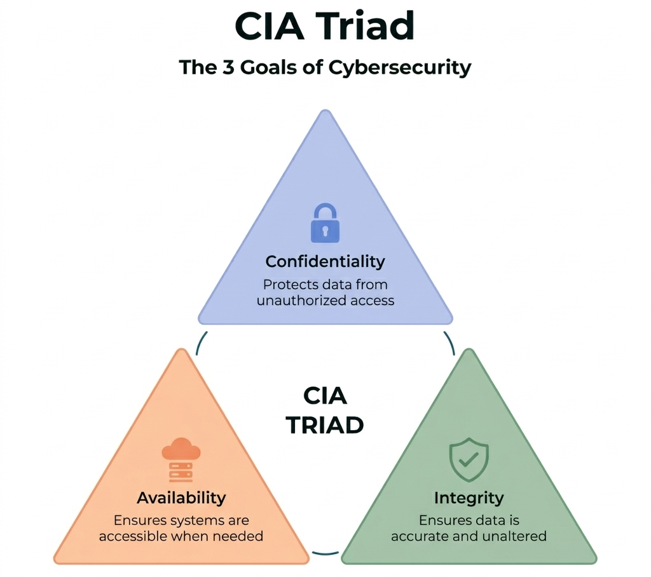
INTRODUCTION TO INFORMATION SECURITY
What are Security Goals? Security goals are the fundamental principles
that protect information and ensure secure communication.
Why are They Important?
Protect sensitive information
Prevent unauthorized access
Ensure reliable and secure systems
Build trust and ensure compliance Core Security Goals
Confidentiality – Protects data from unauthorized access.
Integrity – Ensures data remains accurate and unaltered.
Availability – Ensures authorized users can access information when needed.

Slide 3
Understanding Threats, Attacks & Risks
Threat
A potential danger that can harm a system or its information.
Examples: Hacker, Malware, Natural Disaster
Attack
An intentional attempt to exploit a system and gain unauthorized access.
Examples: Phishing, Ransomware, DoS Attack
Risk
The chance of loss or damage when a threat exploits a vulnerability.
Examples: Data theft, Financial loss, Service disruption
Hacker (Threat) → Phishing Email (Attack) → Stolen Password (Risk)
Threat → Vulnerability → Attack → Risk → Impact

Slide 4
TYPES OF SECURITY ATTACKS
Passive Attacks
Observe information without altering it.
Release of Message Contents – Unauthorized reading of data.
Traffic Analysis – Monitoring communication patterns.
Active Attacks
Modify, disrupt, or destroy information.
Masquerade – Impersonating an authorized user.
Replay Attack – Resending intercepted data.
Message Modification – Altering transmitted messages.
Denial of Service (DoS) – Disrupting access to services.
Passive Attack | Active Attack
Observes data | Modifies or disrupts data
Difficult to detect | Easier to detect
Affects Confidentiality | Affects Integrity & Availability

Slide 5
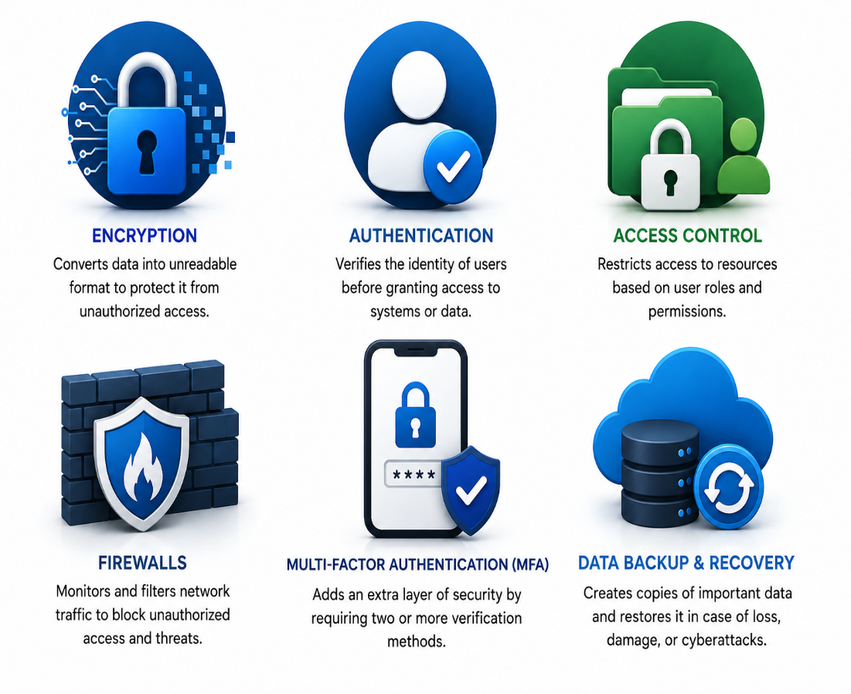
SECURITY MEASURES
Encryption
Protects sensitive information by converting it into unreadable cipher text.
Authentication
Verifies the identity of users before allowing access to systems or data.
Access Control
Restricts access to information based on user roles and permissions.
Firewalls
Monitors and filters network traffic to prevent unauthorized access.
Multi-Factor Authentication (MFA)
Strengthens security by requiring two or more verification methods.
Backup & Recovery
Ensures important data can be restored after cyberattacks or system failures.

Slide 6
IMPACT OF SECURITY THREATS
Data Breaches
Unauthorized access to confidential or sensitive information.
Financial Loss
Costs incurred due to cyberattacks, fraud, ransom payments, and system recovery.
Operational Disruption
Interruptions in business operations caused by attacks such as malware or Denial-of-Service (DoS).
Identity Theft
Personal or organizational information is stolen and misused for fraudulent activities.
Reputational Damage
Loss of customer trust, reduced credibility, and negative impact on an organization's image.

Slide 7
THANKYOU

