Slide 1
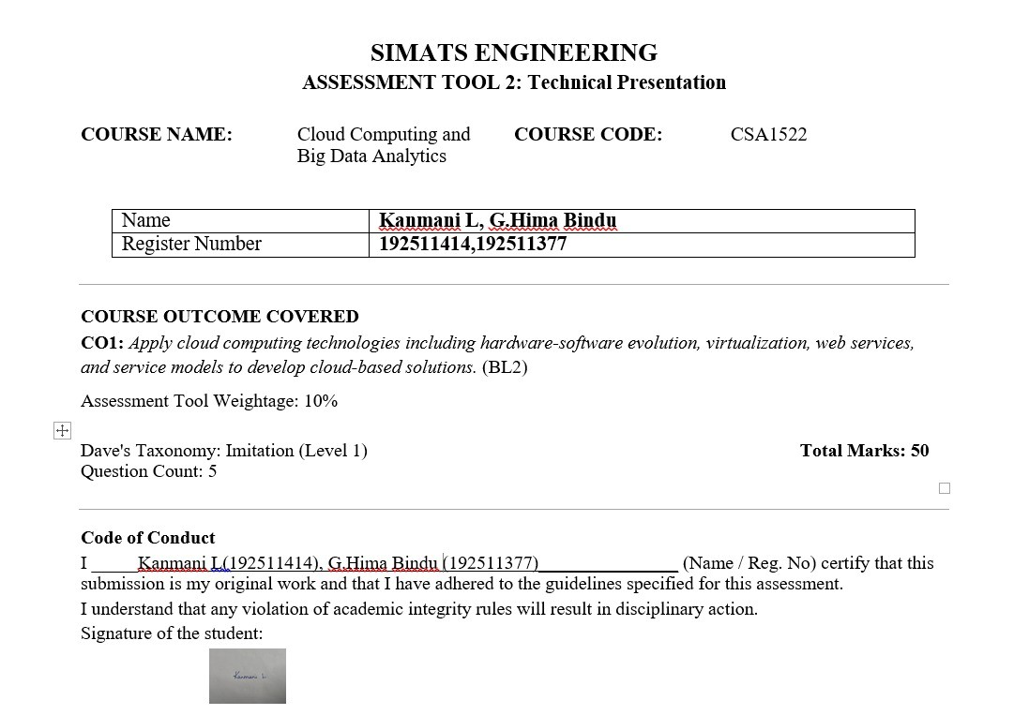

Slide 2
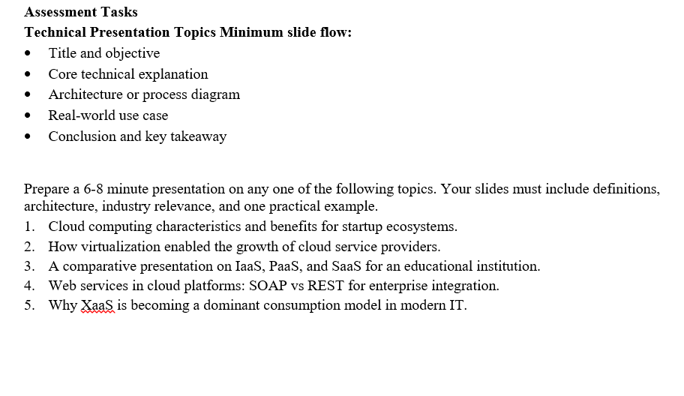

Slide 3
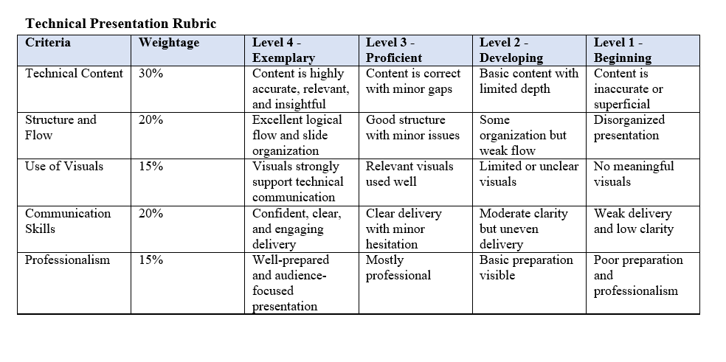

Slide 4
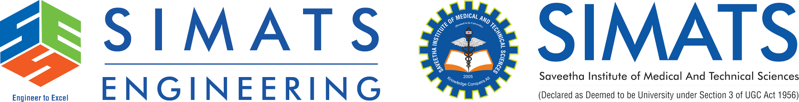
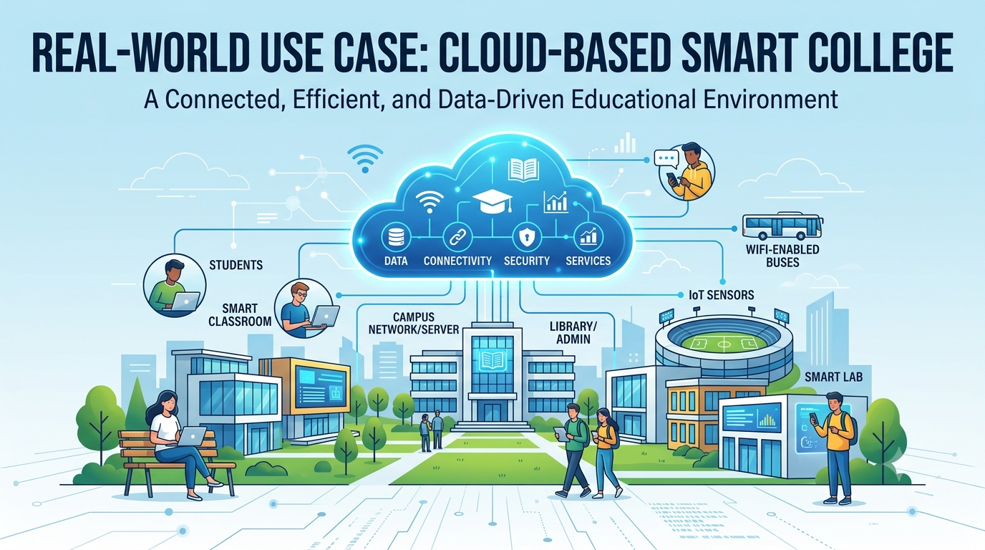
A Comparative Presentation
On Iaas, Paas, And Saas
For An Educational Institution.
CSA1522-CLOUDCOMPUTING AND BIGDATA ANALYTICS
Guided by: Dr.P.RAJARAM
Presented by: KANMANI L(192511414)
G.HIMA BINDU(192511377)

Slide 5


Cloud Computing in Education: Overview & Objectives
Cloud Computing in Education
Provides IT resources and digital services over the Internet.
Supports online learning, data storage, student management & collaboration.
Reduces the need for extensive physical IT infrastructure.
Objectives
Understand IaaS, PaaS & SaaS.
Compare their control, management & applications.
Explore their role in educational institutions.
Identify their practical and industry relevance.
Key Benefits
Cost Efficiency | Scalability | Anywhere Access | Easy Collaboration

Slide 6
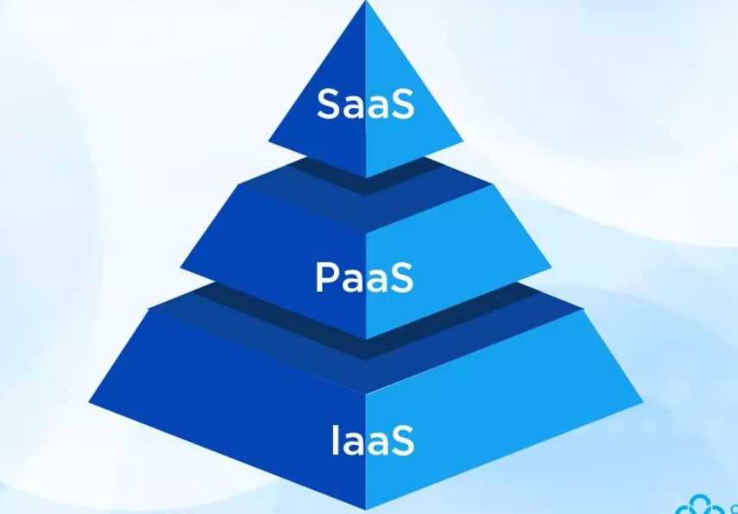
Understanding IaaS, PaaS & SaaS
IaaS – Infrastructure as a Service
Provides virtual servers, storage, and networking.
Educational Use: Hosts student databases and institutional systems.
Example: Amazon EC2
PaaS – Platform as a Service
Provides a platform to develop and deploy applications.
Educational Use: Builds attendance and learning portals.
Example: Google App Engine
SaaS – Software as a Service
Provides ready-to-use software over the Internet.
Educational Use: Email, collaboration, and learning tools.
Example: Google Workspace
Core Difference
IaaS → Infrastructure | PaaS → Application Development | SaaS → Ready-to-use Software

Slide 7
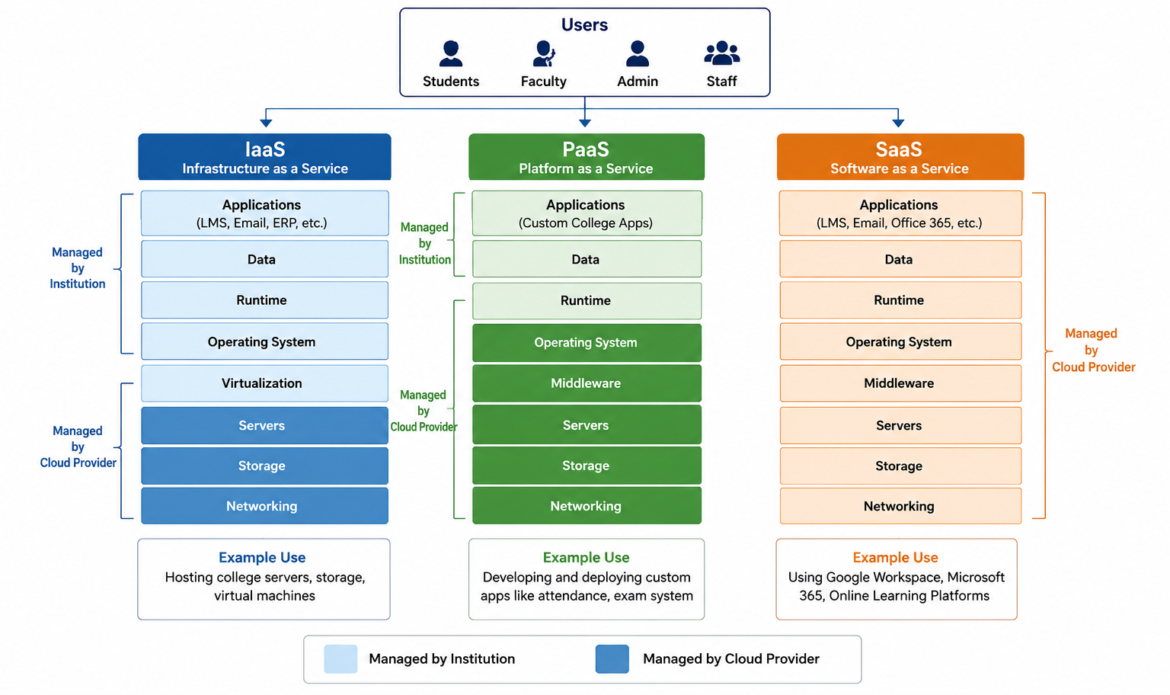
Cloud Service Model Architecture

Slide 8
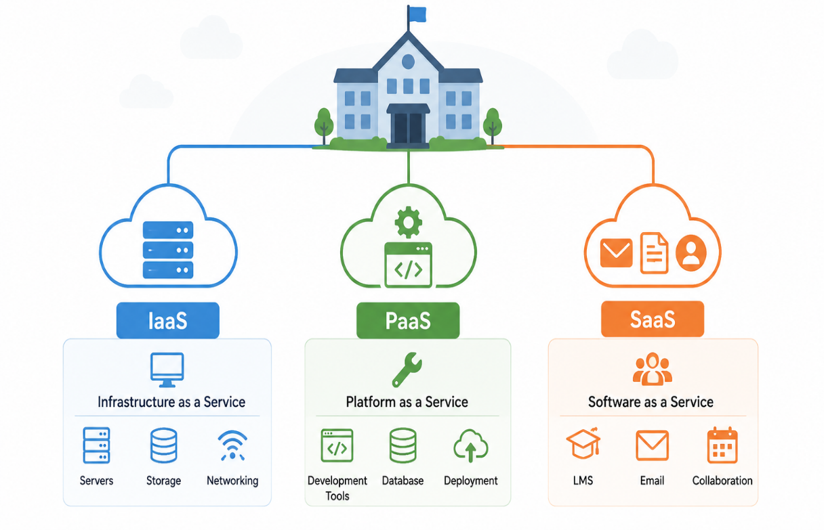
IaaS, PaaS & SaaS in an Educational Institution
IaaS – Infrastructure
Provides the IT foundation for college systems. Used for: Student databases • Virtual servers • Cloud storage
PaaS – Application Development
Provides a platform to build and deploy custom applications. Used for: Attendance systems • Learning Management Systems
• Student portals
SaaS – Ready-to-Use Applications
Provides software directly to students, faculty, and staff. Used for: Google Workspace • Microsoft 365 • Online learning tools
Primary Users
IT Administrators → IaaS | Developers → PaaS | Students & Faculty → SaaS

Slide 9
Comparative Analysis of IaaS, PaaS & SaaS
Criteria | IaaS | PaaS | SaaS
Provides | IT Infrastructure | Development Platform | Ready-to-use Software
Management | More user responsibility | Shared responsibility | Mostly provider-managed
Primary Users | IT Administrators | Developers | Students & Faculty
College Application | Host IT systems | Build custom applications | Use digital services
Example | AWS EC2 | Google App Engine | Google Workspace
IaaS → Maximum Control PaaS → Balanced Control & Convenience SaaS → Maximum Convenience
As we move from IaaS → PaaS → SaaS, user control decreases while ease of use increases.

Slide 10
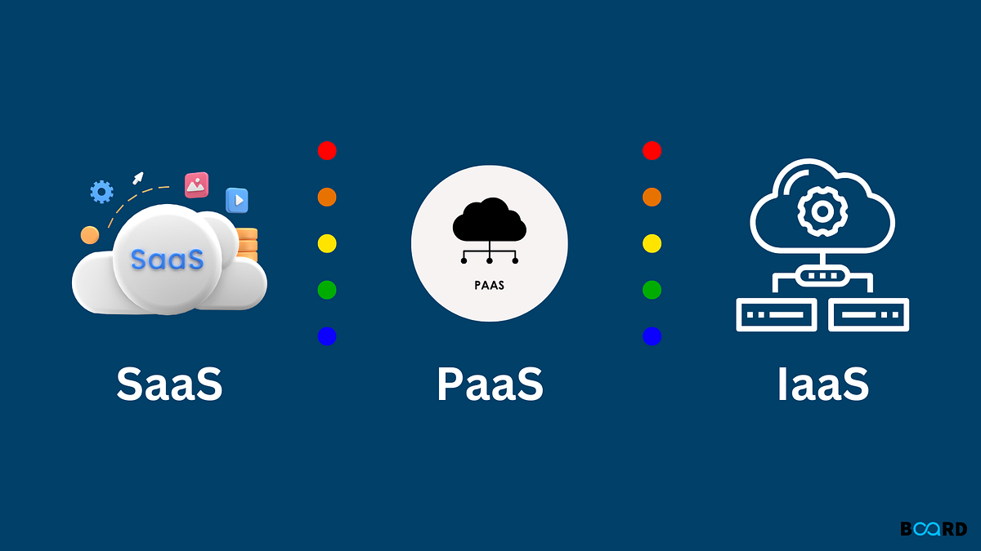
Real-World Use Case: Cloud-Based Smart College
College Using All Three Cloud Models
IaaS – Infrastructure Student Information System → Stores student records and databases on cloud servers.
PaaS – Platform Attendance & Learning Portal → Helps the college develop and run custom applications.
SaaS – Software Google Workspace / Microsoft 365 → Provides email, documents, file sharing, and collaboration.
Benefits
Lower Cost | Scalability | Easy Access | Better Digital Services

Slide 11
Industrial relevance and conclusion
Industry Relevance
Supports digital transformation in education and other industries.
Reduces dependence on costly physical IT infrastructure.
Helps organizations choose services based on cost, control, and technical needs.
Conclusion
IaaS is suitable when greater control is required.
PaaS is suitable for institutions developing customized digital solutions.
SaaS is suitable for everyday academic and administrative services.
A college can use a combination of all three to meet different requirements.
Key:The right cloud model depends on an institution's needs, resources, and desired level of control.

Slide 12
THANKYOU

Slide 13
