Slide 1
College code -7125
Name: N.KANMANI
Register number :712521121005
Data warehousing with IBM cloud Db2 warehouse

Slide 2
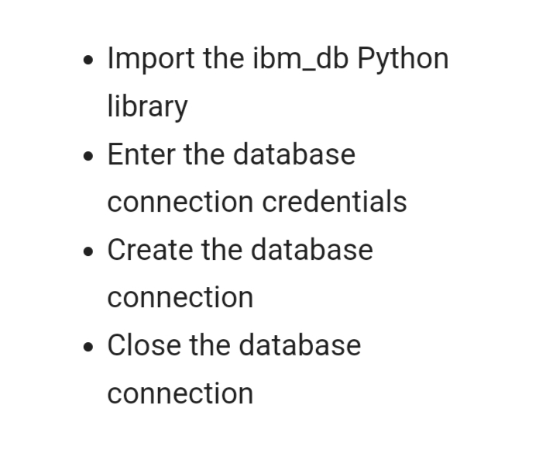
Connect to Db2 database on cloud using python:

Slide 3
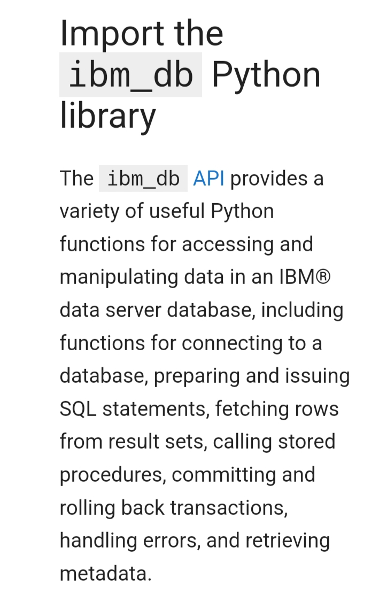

Slide 4
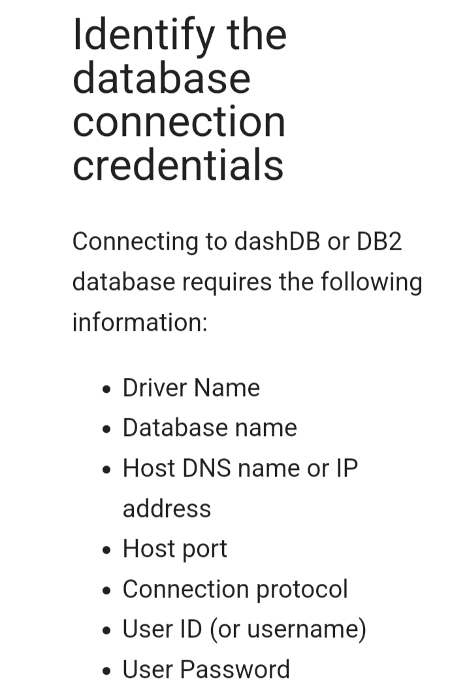

Slide 5
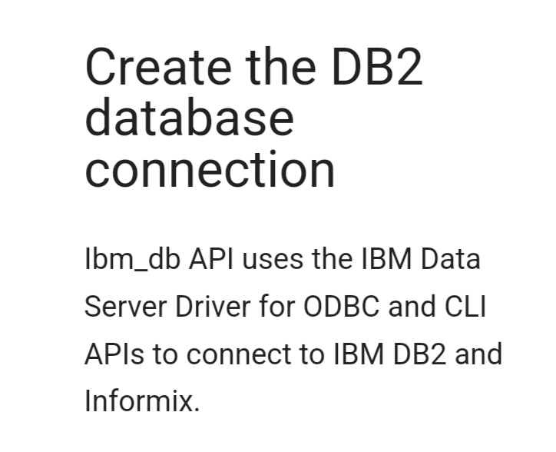

Slide 6
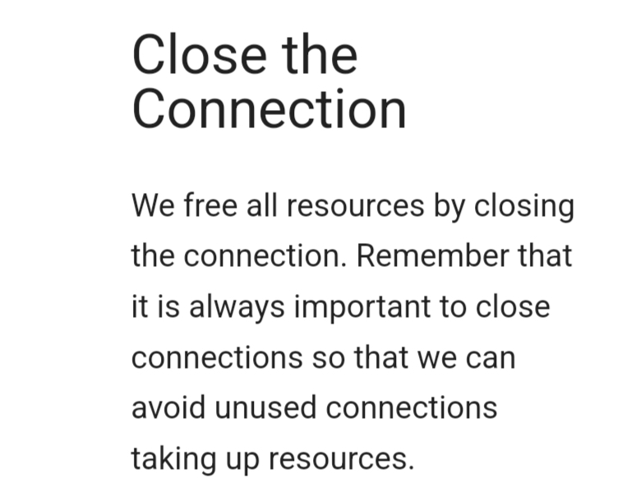

Slide 7
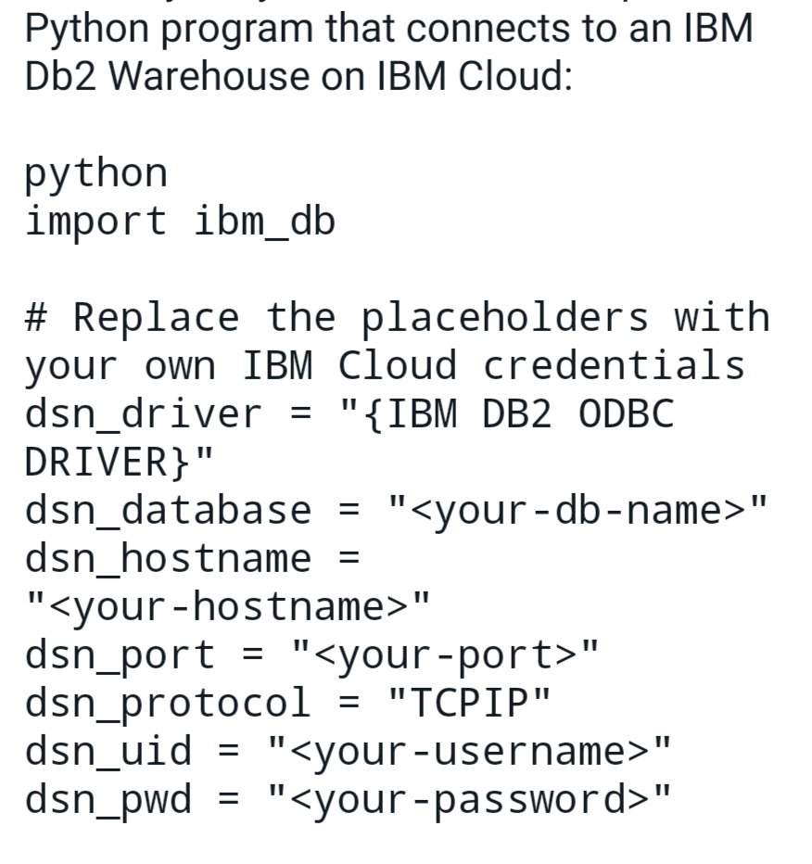

Slide 8
