Slide 1
College Code -7125
NAME: N.KANMANI
Register number:712521121005
Data warehousing with IBM cloud Db2 warehouse

Slide 2
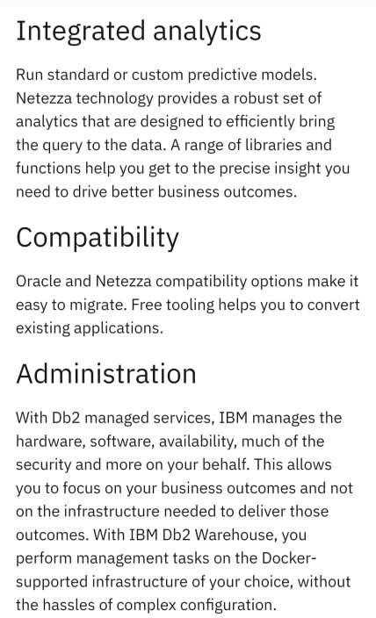

Slide 3
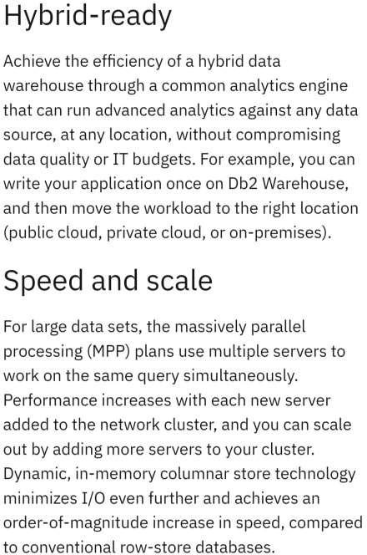

Slide 4
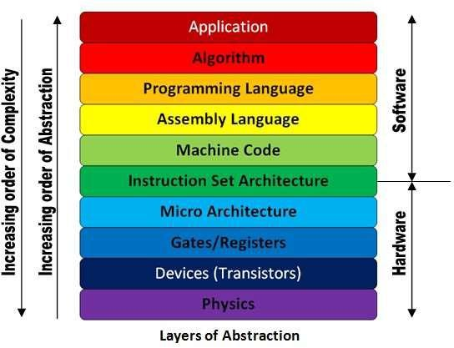

Slide 5
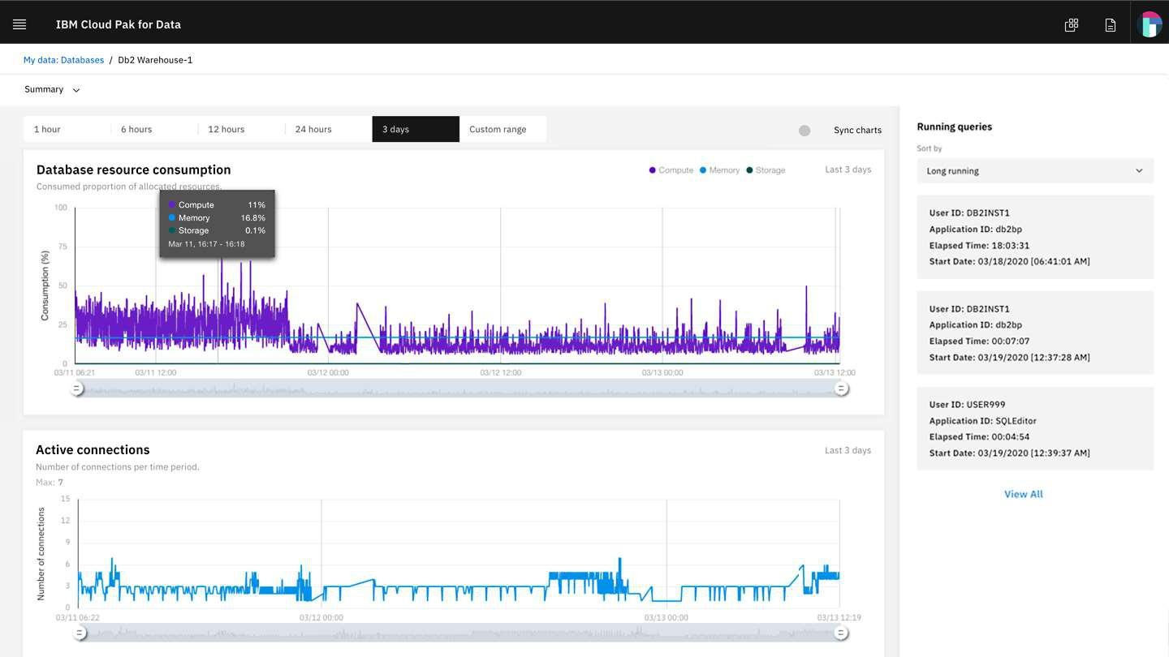

Slide 6
