Slide 1
Database Management Systems — PBL
Property Rental and Lease Management System
Review 2 — Logical Database Design and Normalization
Pakanati Priyakaran Reddy | Roll No: 25WU0101090
CSE AIML — Section Rhinos | Faculty: Dr. Sahithi
Woxsen University, School of Technology | 2026–27

Slide 2
ER Model to Relational Schema
Each entity becomes a table with a surrogate AUTO_INCREMENT primary key.
Every 1:M relationship becomes a foreign key on the "many" side.
Six relations: owner, property, tenant, lease, payment, maintenance.
No M:N relationship is stored directly: lease resolves Property–Tenant.
Review 2 • 2

Slide 3
Relational Schema
Table | Columns (PK underlined by *, FK marked)
owner | *owner_id, name, phone, email, address
property | *property_id, owner_id(FK), address, type, rent_amount
tenant | *tenant_id, name, phone, email, id_proof
lease | *lease_id, property_id(FK), tenant_id(FK), start_date, end_date, deposit
payment | *payment_id, lease_id(FK), amount, payment_date, mode
maintenance | *request_id, property_id(FK), tenant_id(FK), issue_desc, status
Review 2 • 3

Slide 4
Keys and Integrity Constraints
Constraint | Attribute(s) | Rule enforced
Primary key | owner_id, property_id, tenant_id, lease_id, payment_id, request_id | Unique row identity
Foreign key | property.owner_id, lease.property_id / tenant_id, payment.lease_id, maintenance.property_id / tenant_id | Referential integrity
NOT NULL | name, phone, address, dates, amounts | Mandatory data
CHECK | rent_amount > 0, deposit > 0, amount > 0, end_date > start_date | Valid values
DEFAULT | maintenance.status = 'Open' | New requests start Open
Review 2 • 4

Slide 5
Functional Dependencies
Primary key determines every non-key attribute; no non-key attribute determines another.
owner_id → name, phone, email, address
property_id → owner_id, address, type, rent_amount
tenant_id → name, phone, email, id_proof
lease_id → property_id, tenant_id, start_date, end_date, deposit
payment_id → lease_id, amount, payment_date, mode
request_id → property_id, tenant_id, issue_desc, status
Review 2 • 5

Slide 6
Normalization up to 3NF
Relation | 1NF | 2NF | 3NF | Remark
owner | Yes | Yes | Yes | All attributes depend only on owner_id
property | Yes | Yes | Yes | owner_id is an FK, no transitive dependency
tenant | Yes | Yes | Yes | All attributes depend only on tenant_id
lease | Yes | Yes | Yes | Surrogate lease_id avoids partial dependency
payment | Yes | Yes | Yes | All attributes depend only on payment_id
maintenance | Yes | Yes | Yes | All attributes depend only on request_id
Review 2 • 6

Slide 7
Data Dictionary (1/2)
Table | Attribute | Type | Constraint
owner | owner_id | INT | PK, AUTO_INCREMENT
owner | name / phone | VARCHAR(100) / (15) | NOT NULL
owner | email / address | VARCHAR(100) / (200) | —
property | owner_id | INT | FK → owner
property | type | VARCHAR(20) | Apartment / House / Shop / Office
property | rent_amount | DECIMAL(10,2) | CHECK > 0
tenant | name / phone / id_proof | VARCHAR | name, phone NOT NULL
Review 2 • 7

Slide 8
Data Dictionary (2/2)
Table | Attribute | Type | Constraint
lease | property_id / tenant_id | INT | FK → property / tenant
lease | start_date / end_date | DATE | CHECK end_date > start_date
lease | deposit | DECIMAL(10,2) | CHECK > 0
payment | lease_id | INT | FK → lease
payment | amount / payment_date | DECIMAL / DATE | CHECK amount > 0
payment | mode | VARCHAR(20) | Cash / UPI / Bank Transfer / Cheque
maintenance | issue_desc / status | VARCHAR | status DEFAULT 'Open'
Review 2 • 8

Slide 9
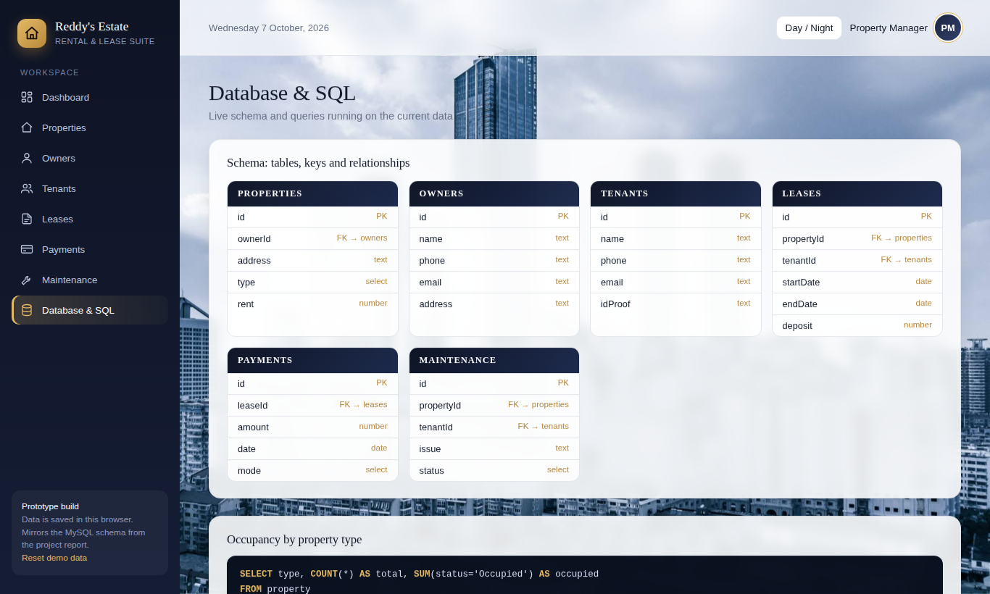
Schema Shown in the Prototype
The prototype has a Database & SQL page showing the six tables, PK / FK links and live queries.
Review 2 • 9

Slide 10
DDL Implementation (MySQL 8.0)
CREATE TABLE lease (
lease_id INT AUTO_INCREMENT PRIMARY KEY,
property_id INT NOT NULL,
tenant_id INT NOT NULL,
start_date DATE NOT NULL,
end_date DATE NOT NULL,
deposit DECIMAL(10,2) CHECK (deposit > 0),
CHECK (end_date > start_date),
FOREIGN KEY (property_id) REFERENCES property(property_id),
FOREIGN KEY (tenant_id) REFERENCES tenant(tenant_id)
);
Complete script: property_rental_schema.sql (6 tables, constraints, sample data, report queries)
Review 2 • 10

