Slide 1
Database Management Systems — PBL
Property Rental and Lease Management System
Review 3 (Final) — Working Prototype, Testing and Results
Pakanati Priyakaran Reddy | Roll No: 25WU0101090
CSE AIML — Section Rhinos | Faculty: Dr. Sahithi
Woxsen University, School of Technology | 2026–27

Slide 2
Recap: Problem and Design
Problem: manual rental records cause duplicates, missed renewals and payment errors.
Design: 6 normalized tables (3NF) — owner, property, tenant, lease, payment, maintenance.
Constraints: PK, FK, NOT NULL, CHECK, DEFAULT in MySQL 8.0.
Now: "Reddy's Estate" — a working prototype built on this design.
Review 3 (Final) • 2

Slide 3
Prototype: Reddy's Estate
Rental & Lease Suite for a single Property Manager.
Dashboard: occupancy ring, KPI strip, 6-month rent chart, recent payments, lease renewal alerts.
Six modules: Properties, Owners, Tenants, Leases, Payments, Maintenance — add, edit, remove, search.
Database & SQL page: live schema, keys and report queries on the current data.
Day / Night theme and Reset demo data button.
Review 3 (Final) • 3

Slide 4
Architecture
Layer | Technology
Prototype UI | HTML, CSS and JavaScript — runs in the browser, data kept in localStorage
Data model | Mirrors the 6-table MySQL schema (same entities, keys and rules)
Database | MySQL 8.0 script: property_rental_schema.sql (DDL, constraints, sample data)
Backend (DB-connected) | Python Flask + mysql-connector-python, parameterized queries
Repository | GitHub — prototype, SQL, Flask app, presentations, video link
Review 3 (Final) • 4

Slide 5
Modules and Database Mapping
Module | Tables used | Operations
Dashboard | property, lease, payment, maintenance | Read (aggregate, alerts)
Owners | owner | Create, Read, Update, Delete
Properties | property, owner, lease | CRUD + occupancy status
Tenants | tenant | Create, Read, Update, Delete
Leases | lease, property, tenant, payment | CRUD + rent status (Paid / Due)
Payments | payment, lease | Create, Read, Update, Delete
Maintenance | maintenance, property, tenant | Create, Read, Update, Delete
Review 3 (Final) • 5

Slide 6
Business Rules and Validation
Rule | Behaviour in the prototype
End date after start date | "End date must be after the start date."
Required fields | Every form field is required; numbers cannot be negative
No delete of referenced records | "Can't remove this owner — it's referenced by an existing property record."
Linked records only | Foreign keys chosen from dropdowns of existing records
Derived status | Occupied / Vacant and Paid / Due computed from leases and payments
Review 3 (Final) • 6

Slide 7
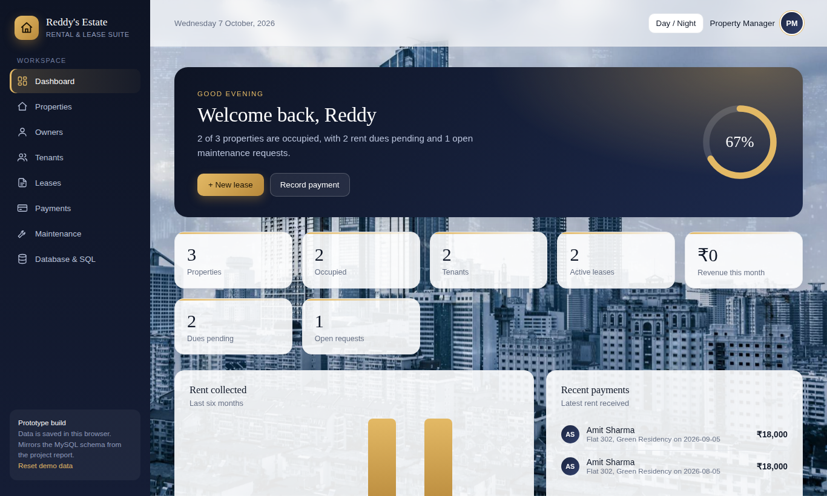
Demo: Dashboard
Occupancy ring, KPIs, rent chart and recent payments
Review 3 (Final) • 7

Slide 8
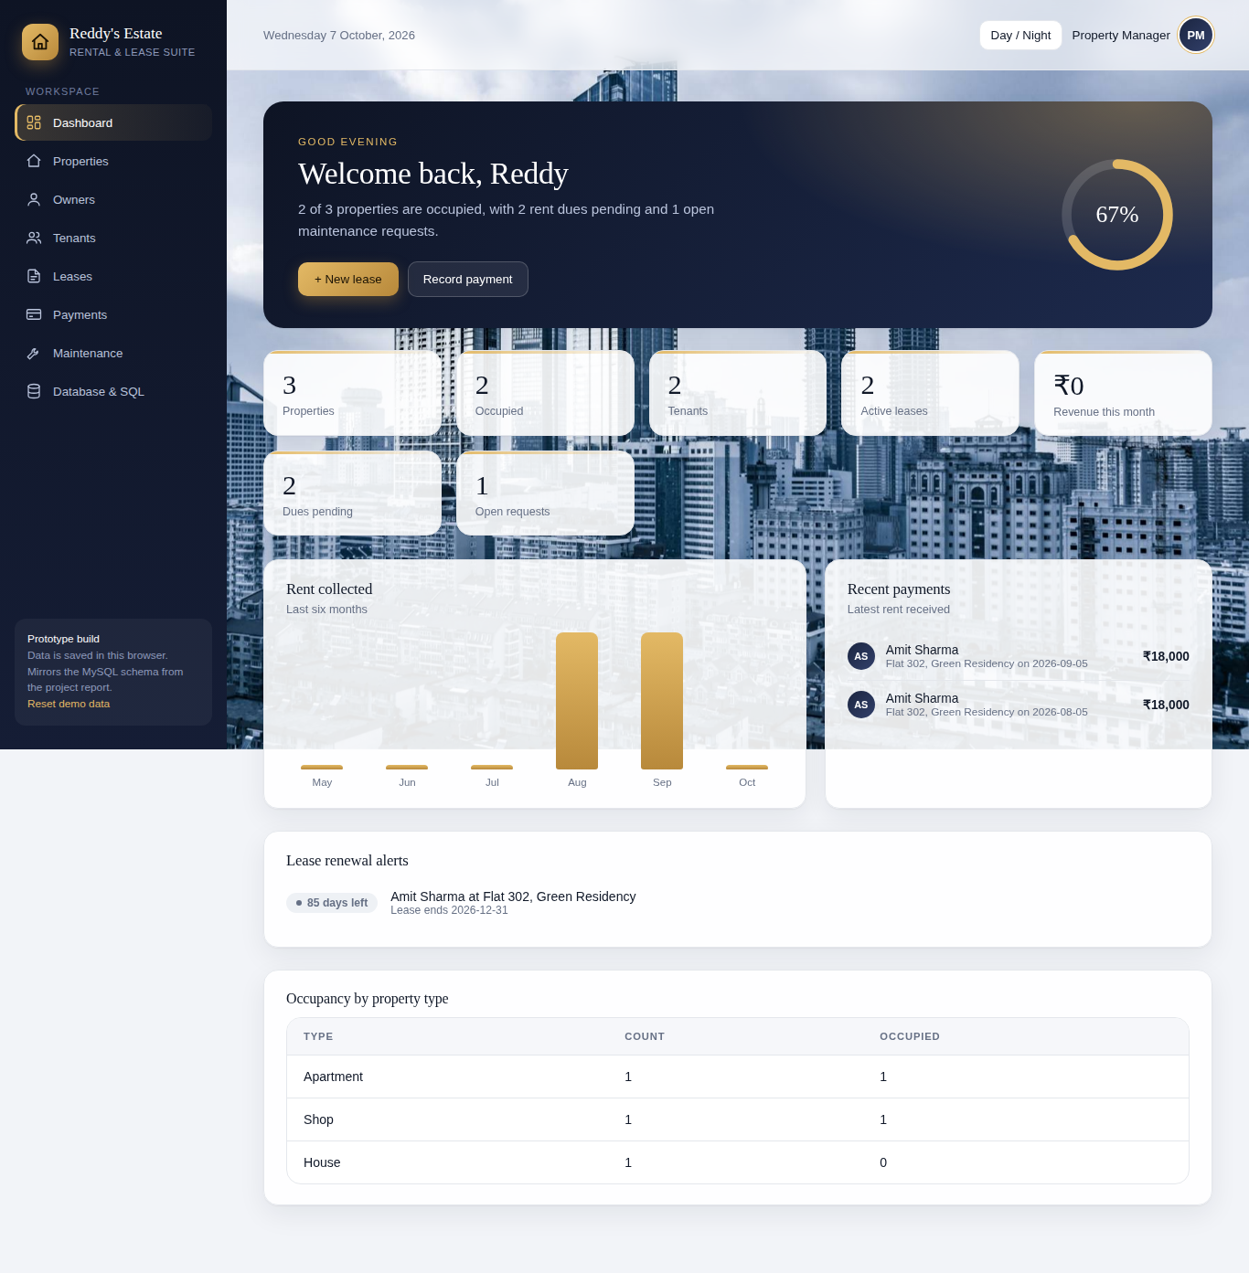
Demo: Alerts and Occupancy Report
Lease renewal alerts and occupancy by property type
Review 3 (Final) • 8

Slide 9
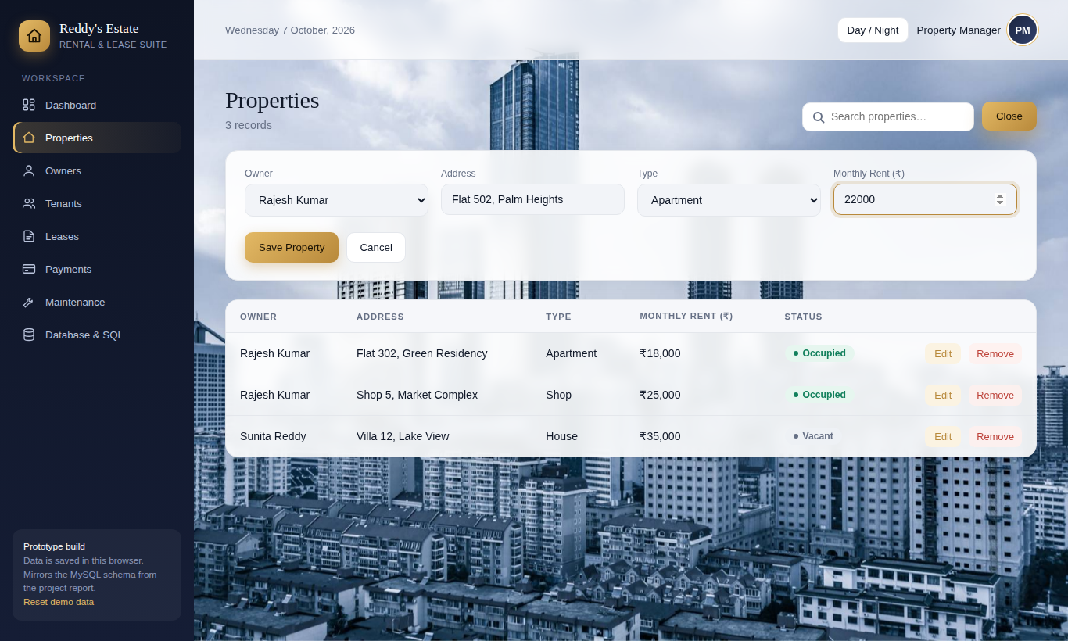
Demo: Add a Property (Create)
"+ New Property" form with owner chosen from a dropdown
Review 3 (Final) • 9

Slide 10
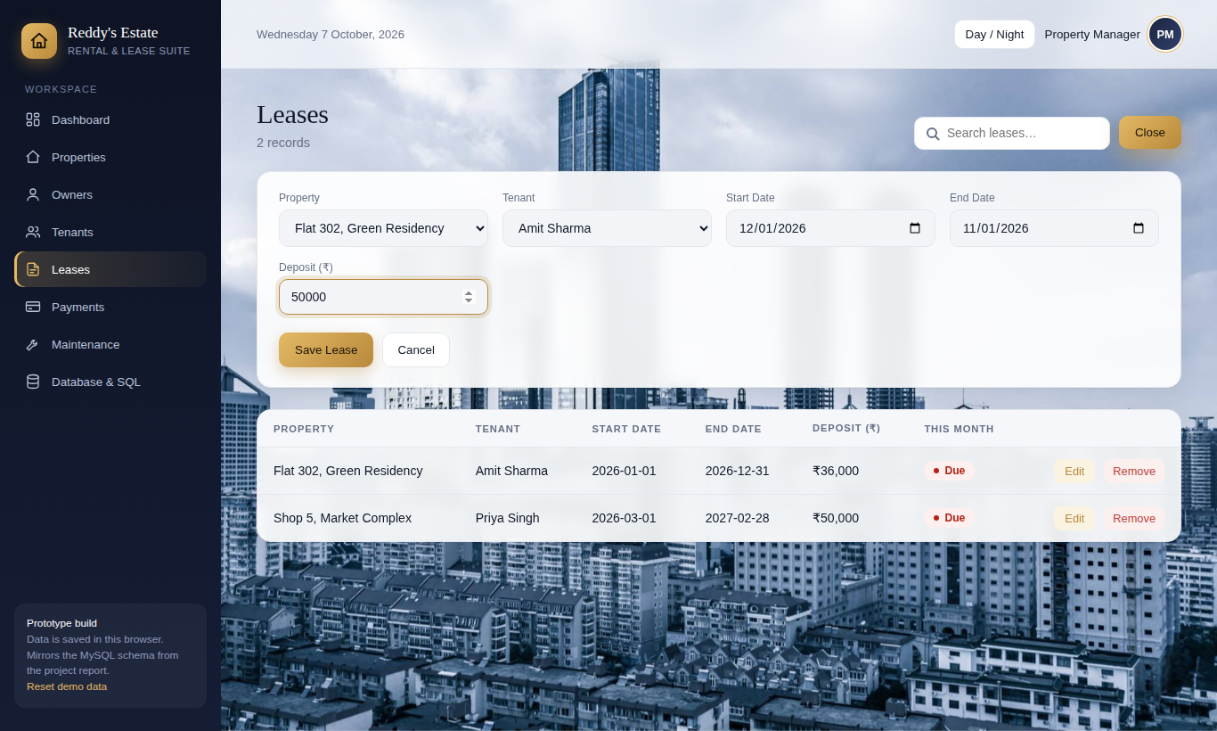
Demo: Lease Date Validation
End date before start date -> "End date must be after the start date."
Review 3 (Final) • 10

Slide 11
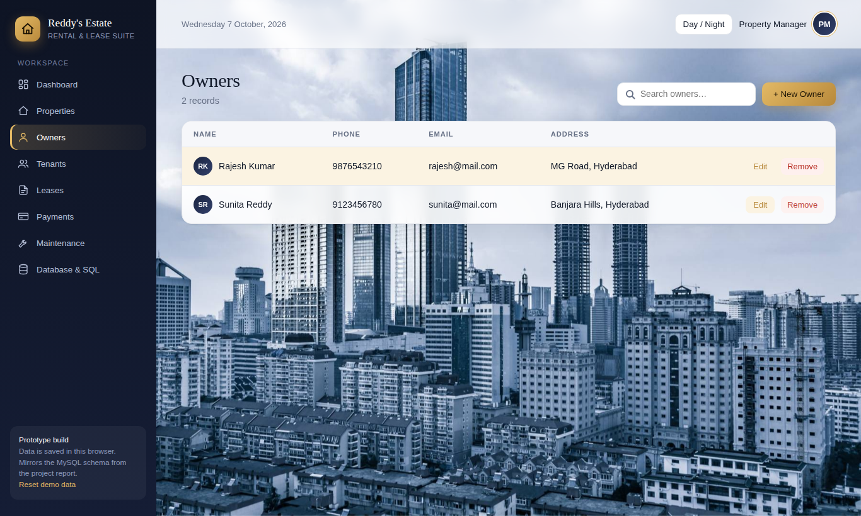
Demo: Referential Integrity
Removing an owner who has a property is blocked with an explanatory message
Review 3 (Final) • 11

Slide 12
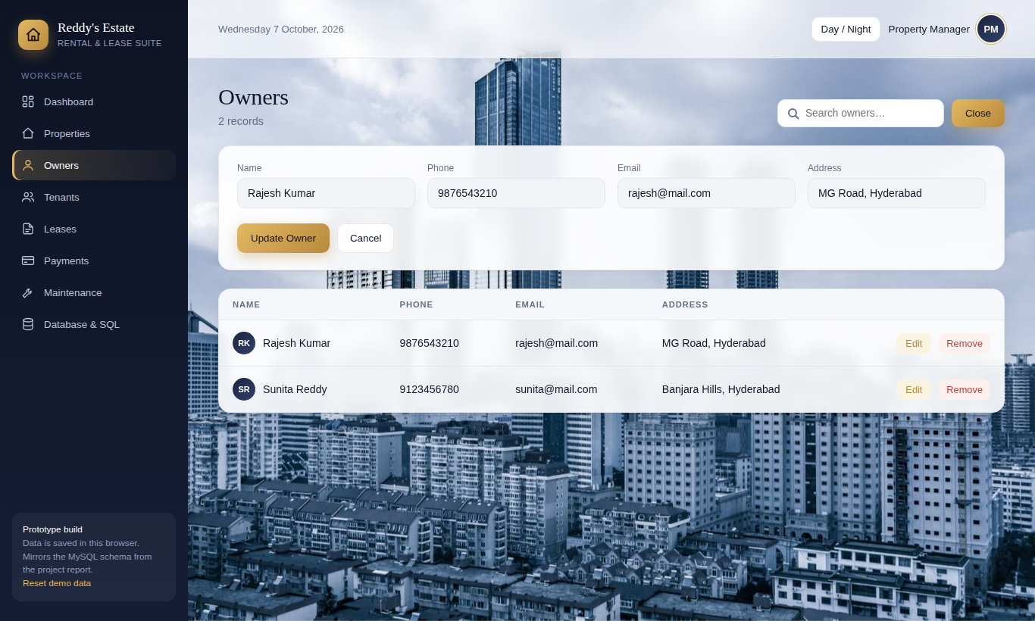
Demo: Edit a Record (Update)
Edit pre-fills the form; "Update" saves the change
Review 3 (Final) • 12

Slide 13
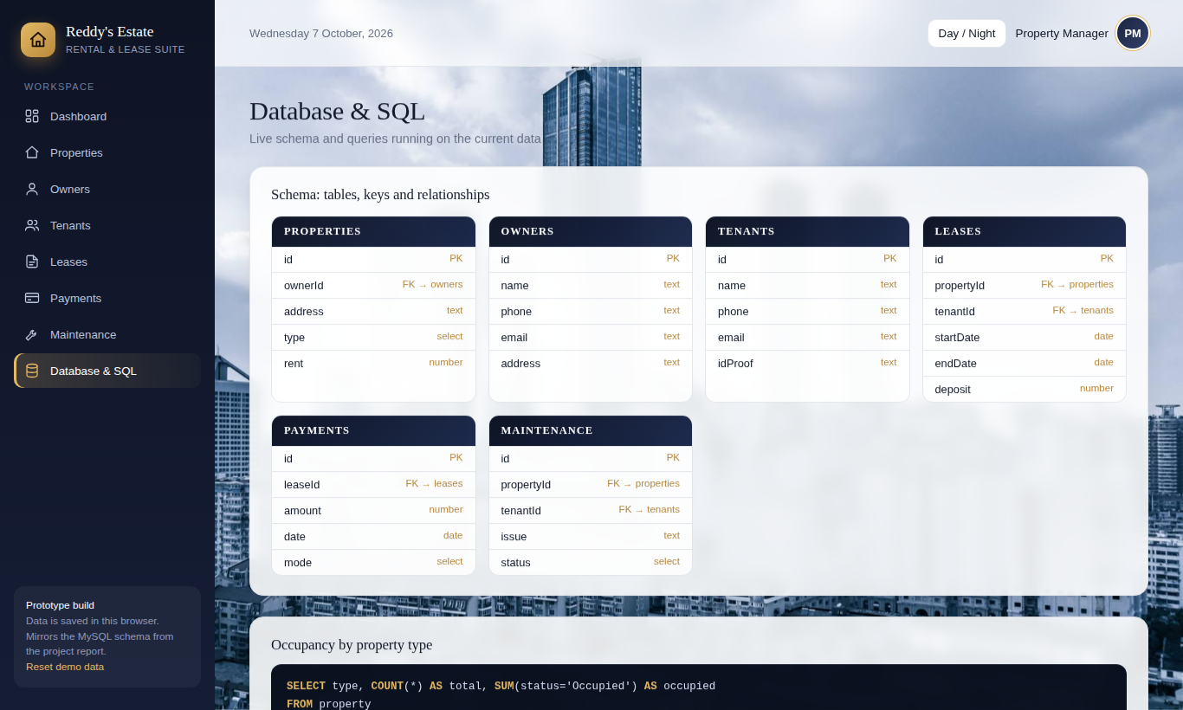
Demo: Database & SQL
Schema with PK / FK, plus report queries running on live data
Review 3 (Final) • 13

Slide 14
Reports Using SQL
Report | SQL concept
Occupancy by property type | GROUP BY + COUNT() + SUM(status = Occupied)
Properties with owners | JOIN property with owner
Overdue rent this month | JOIN lease, tenant, property + lease_id NOT IN (payments this month)
Revenue this month | SUM(amount) filtered by MONTH(payment_date)
Review 3 (Final) • 14

Slide 15
Testing and Results
ID | Feature | Action | Result
TC-01 | Add property | Valid data | Saved, shown in list — Pass
TC-02 | Lease dates | End before start | Rejected with message — Pass
TC-03 | Record payment | Payment for active lease | Saved; rent status becomes Paid — Pass
TC-04 | Maintenance | Log request | Saved with status Open — Pass
TC-05 | Delete owner | Owner with property | Blocked with message — Pass
TC-06 | Occupancy report | View by type | Counts correct — Pass
TC-07 | Required field | Empty name | Form rejects submission — Pass
TC-08 | Edit record | Update an owner | Changes saved — Pass
Review 3 (Final) • 15

Slide 16
Conclusion and Future Work
Delivered a normalized 3NF design and a working prototype (Reddy's Estate) with a MySQL script and Flask app.
Add, edit, remove and search work across six modules; rules enforced; all tests passed.
Limitations: data stored in the browser in the prototype, no login or roles, manual payments.
Future: connect the UI to MySQL, role-based login, online payments, revenue trends.
Review 3 (Final) • 16

Slide 17
Thank You
Questions are welcome.

