Slide 1
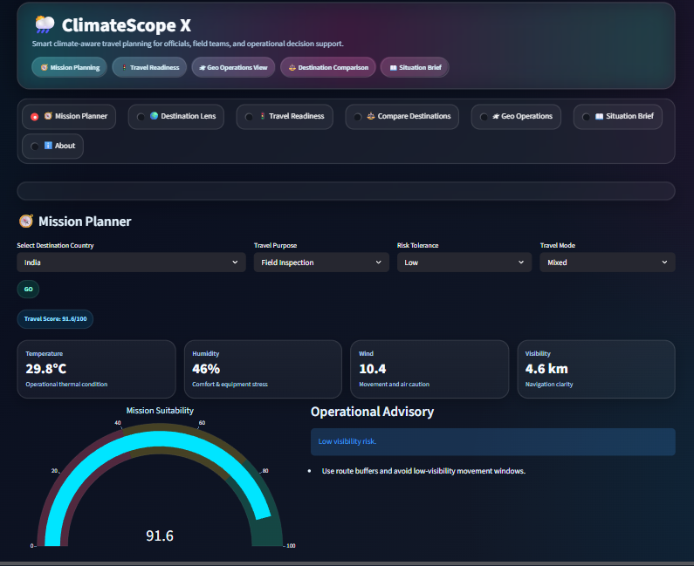
🌦️ ClimateScope X
Smart Climate-Aware Travel Planner for Field Operations
A data-driven decision support platform for officials, field teams, and operational travel planning under climate uncertainty.
Mission Planning
Travel Readiness
Geo Ops
Compare Destinations
Situation Brief
Presented by Dinesh Kanna • Infosys Springboard Project
Dinesh Kanna's Infosys Springboard ClimateScope Project

Slide 2
01 CONTEXT
Background & Problem Context
Operational Challenge
Why Existing Tools Fall Short
Field teams often travel in uncertain weather conditions.
Standard weather apps show values, but not mission suitability.
Officials need fast go / caution / delay decisions.
Climate impacts visibility, mobility, safety, and timing.
• Raw weather ≠ operational decision support
• No travel readiness scoring
• No comparative destination ranking
• No field-oriented advisory output
Dinesh Kanna's Infosys Springboard ClimateScope Project

Slide 3
02 PROJECT FOUNDATION
Problem Statement & Objectives
Problem Statement
Objectives
1. Weather dashboards do not clearly tell whether a destination is operationally suitable for travel.
2. Field inspections and official deployments require quick climate-aware decision support.
3. Without a readiness score, planning becomes slower, inconsistent, and more risk-prone.
• Build a climate-aware travel planning dashboard
• Convert multiple weather factors into a travel score
• Compare destinations for safer deployment
• Provide map-based and visual operational insights
Dinesh Kanna's Infosys Springboard ClimateScope Project

Slide 4
03 SOLUTION
ClimateScope X – Proposed Solution
ClimateScope X transforms global weather data into actionable travel readiness insights for officials and field teams.
🧭 Mission Planner
🌍 Destination Lens
Destination, purpose, risk tolerance, and mode-based planning
Country-level climate insight with suitability summary
🚦 Travel Readiness
⚖️ Compare Destinations
Safe vs risky destination ranking using score logic
Side-by-side destination suitability comparison
🛰 Geo Operations
📖 Situation Brief
Global map of climate-sensitive operational zones
Quick briefing for presentation and decision support
Dinesh Kanna's Infosys Springboard ClimateScope Project

Slide 5
04 ARCHITECTURE
System Workflow & Scoring Logic
Dataset Input
Preprocessing
Logic Engine
Risk Layer
Dashboard Output
GlobalWeatherRepository.csv
➜
Cleaning + feature selection
➜
Weighted travel suitability scoring
➜
Advisory + readiness classification
➜
Interactive Streamlit decision support
Key Weather Parameters
Temperature • Humidity • Wind • Visibility • Precipitation • UV • Pressure
Dinesh Kanna's Infosys Springboard ClimateScope Project

Slide 6
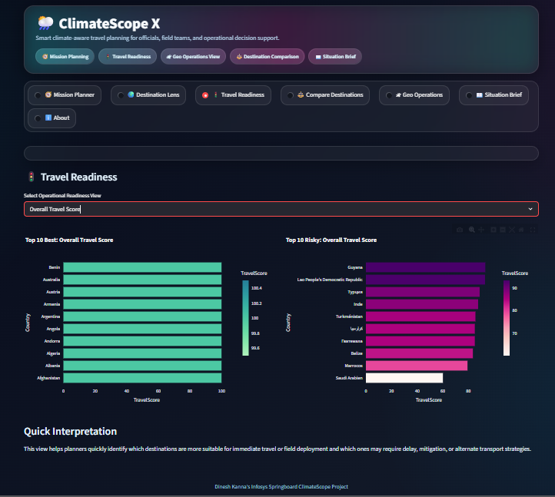
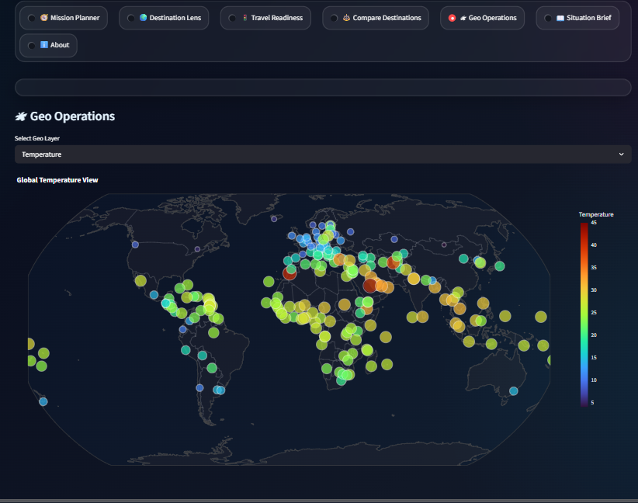
05 DEMO
Application Interface & Key Features
Mission Planner
Travel Readiness
Geo Operations
Premium dark neon glass UI with fast, presentation-friendly interactive views.
Dinesh Kanna's Infosys Springboard ClimateScope Project

Slide 7
06 IMPACT
Benefits & Real-World Use Cases
Benefits
Potential Use Cases
• Faster travel decisions for officials
• Climate-aware mission planning support
• Easy identification of safer destinations
• Reduced planning ambiguity
• Visual and explainable dashboard output
• Government inspection travel
• Disaster response field movement
• Climate-sensitive logistics planning
• Tourism / operations pre-screening
• Remote site deployment readiness
Dinesh Kanna's Infosys Springboard ClimateScope Project

Slide 8
07 CLOSURE
Future Scope & Conclusion
Future Scope
Conclusion
• Live weather API integration
• Real-time travel alerts and route advisories
• Multi-city route optimization
• Airport / road condition integration
• Predictive deployment recommendations
ClimateScope X demonstrates how weather analytics can be transformed into a practical decision-support system for field travel and operational planning.
It is simple, visual, and highly usable for real-world climate-aware travel readiness.
Thank You
Dinesh Kanna's Infosys Springboard ClimateScope Project

