Slide 1
FOG & EDGE COMPUTING · H9FECC
Smart Traffic Intersection
Monitoring System
A three-tier fog and edge computing architecture on AWS
Kishore Kanna Sekar
MSc in Cloud Computing · Student ID x24313530 · National College of Ireland
Lecturer: Giovani Estrada

Slide 2
MOTIVATION
Why Cloud-Only Monitoring Falls Short
Today's pain points
Objective
Congestion costs EU economies roughly 1% of GDP annually
Streaming every raw sensor value to the cloud is bandwidth heavy
Round-trip latency is too slow for safety-critical alerts
Fails when connectivity is intermittent
Push computation to the edge. Send only the signal, not the noise.
Simulate 4 IoT sensor streams
Aggregate + decide at a fog node
Serverless AWS cloud backend
Real-time dashboard
Smart Traffic Intersection Monitoring | Fog & Edge Computing on AWS
2 / 9

Slide 3
SYSTEM OVERVIEW
Three-Tier Architecture
01
Sensor / Edge Layer
4 simulated IoT sensor threads emitting readings every 2 s
02
Fog Layer
Virtual fog node: 15 s aggregation window, threshold logic, cloud dispatch
03
Cloud Layer (AWS)
Serverless ingest → queue → Lambda → DynamoDB → S3 dashboard
Bandwidth compression 60:1 between Fog and Cloud · Alert latency < 1 ms at the edge
Smart Traffic Intersection Monitoring | Fog & Edge Computing on AWS
3 / 9

Slide 4
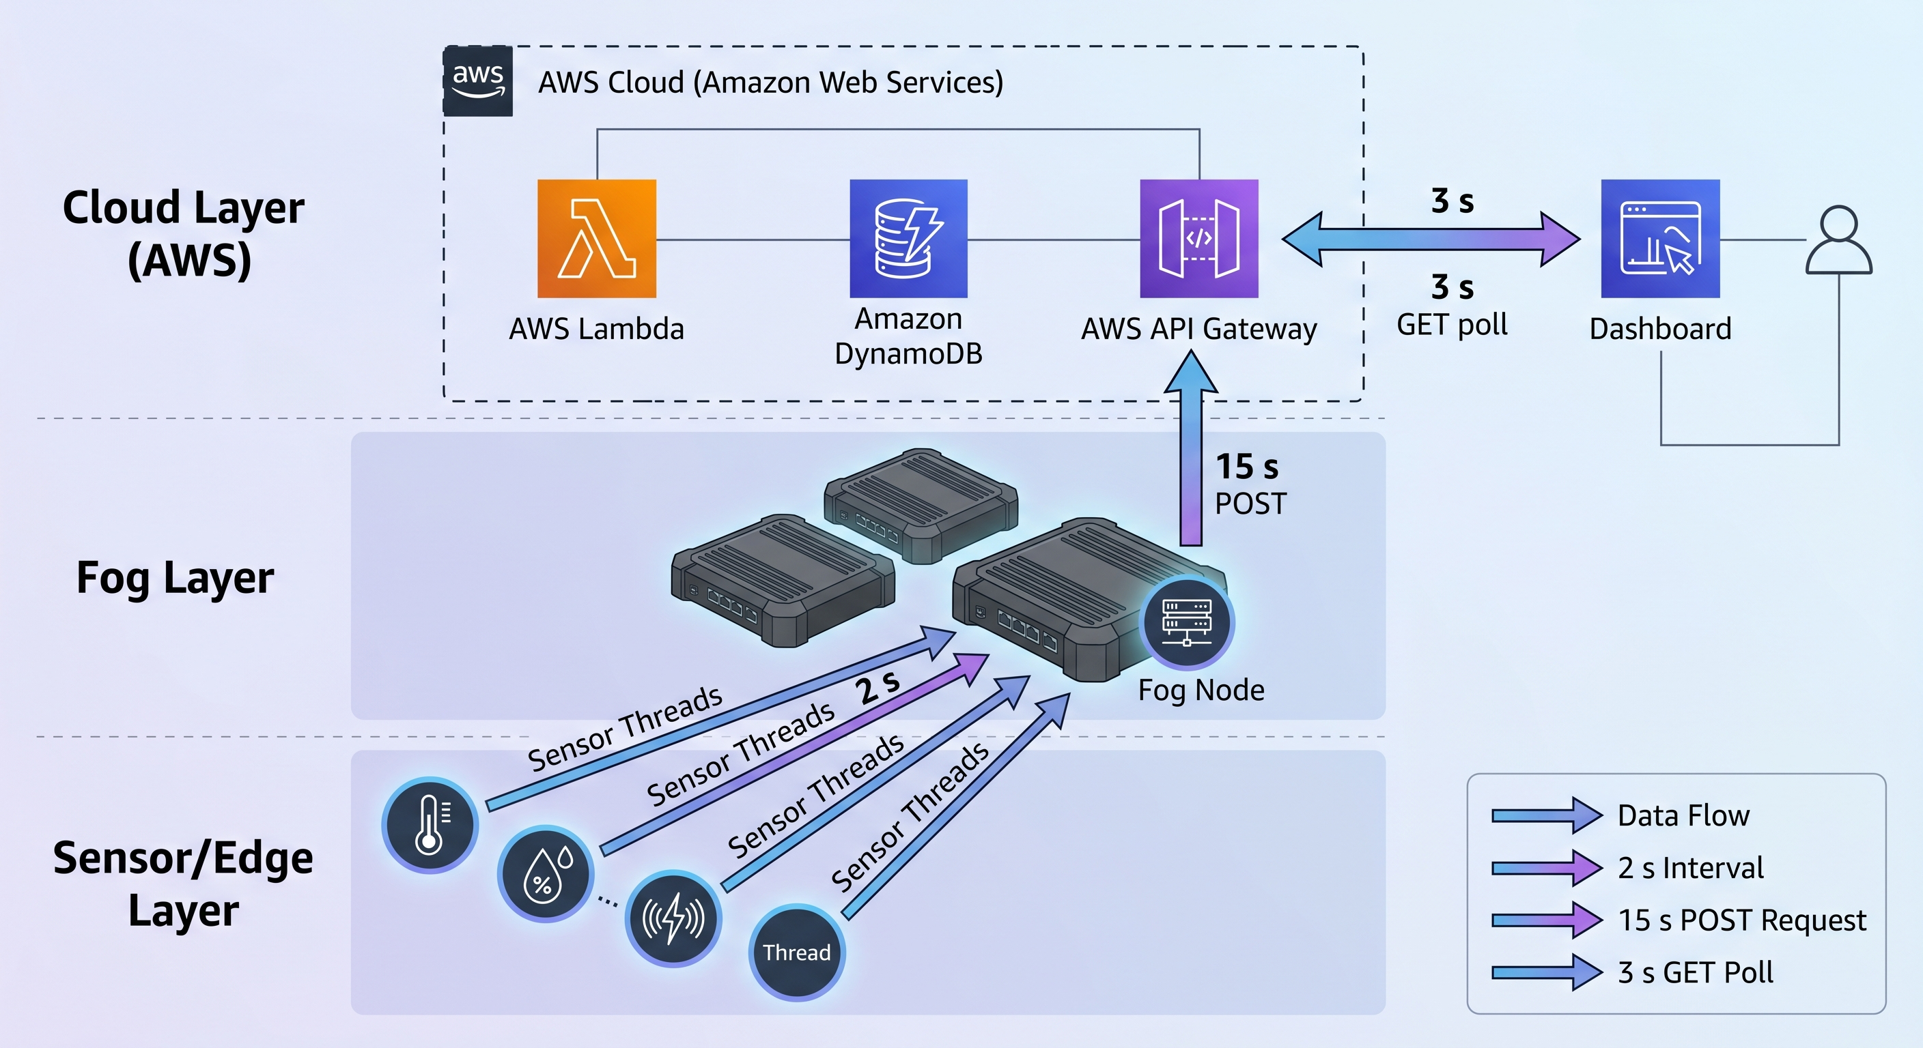
WALKTHROUGH
Architecture — End-to-End Data Flow
SENSOR / EDGE
Vehicle Count
Average Speed
Noise Level
Pollution (AQI)
daemon threads · 2 s interval
End-to-end latency · 15 s aggregation + ~50 ms API GW + ~10 ms SQS + ~200 ms Lambda + ~5 ms DynamoDB
Smart Traffic Intersection Monitoring | Fog & Edge Computing on AWS
4 / 9

Slide 5
LAYER 1
Sensor Layer — Four Correlated Streams
Python 3.9 SensorSimulator · daemon threads · thread-safe shared dict (threading.Lock)
Vehicle Count
Average Speed
5 – 45 per 2 s
5 – 60 km/h
Random integer traffic volume
Inversely correlated with count (congestion logic)
Noise Level
Pollution (AQI)
60 – 95 dB
0 – 500
Higher during heavy traffic, lower when free-flowing
Accumulates during buildup, decays during free flow
Smart Traffic Intersection Monitoring | Fog & Edge Computing on AWS
5 / 9

Slide 6
LAYER 2
Fog Layer — Edge Intelligence
FogNodeManager (Flask, port 5001)
CONGESTION ALERT
Background daemon aggregates every 15 s
Compound threshold rules run locally (< 1 ms)
In-memory ring buffer of last 10 summaries
Graceful degradation if cloud is unreachable
Local GET /status endpoint for the dashboard
vehicle_count > 30 AND avg_speed < 20 km/h
Compound rule avoids false positives from momentary speed drops.
POLLUTION ALERT
pollution_level > 150 AQI
EPA "Unhealthy" threshold — raised at the edge, no cloud round-trip.
120 raw readings per window → 1 summary payload = 60:1 bandwidth reduction
Smart Traffic Intersection Monitoring | Fog & Edge Computing on AWS
6 / 9

Slide 7
LAYER 3
Cloud Backend — Serverless on AWS
Event-driven ingest · zero servers to manage · Infrastructure-as-Code
API Gateway
Amazon SQS
AWS Lambda
POST /traffic-data direct-to-SQS (VTL) · GET /status
Decouples ingest from processing · batch size 10 · at-least-once
ProcessTrafficData writes batches · GetTrafficStatus reads latest
DynamoDB
Amazon S3
CloudFormation
PAY_PER_REQUEST · node_id (PK) + timestamp (SK) composite key
Static dashboard hosting · CORS · public bucket policy
SAM template (202 lines) — whole stack up in < 5 minutes
Fog → API Gateway → SQS → Lambda → DynamoDB → S3 Dashboard
Smart Traffic Intersection Monitoring | Fog & Edge Computing on AWS
7 / 9

Slide 8
DELIVERY
Implementation & CI/CD
~1,380
Stack
sensors.py
Python threading
lines of code across 9 artefacts
fog_node.py
Flask + requests
7-step
lambda_processor.py
boto3, Decimal
GetTrafficStatus.py
boto3, Decimal
GitHub Actions deployment pipeline
app.js / index.html
Chart.js dashboard
< 5 min
cloudformation.yaml
AWS SAM
full stack recreated from template
deploy.yml
GitHub Actions
Smart Traffic Intersection Monitoring | Fog & Edge Computing on AWS
8 / 9

Slide 9
RESULTS
What the Fog Layer Actually Buys You
60 : 1
< 1 ms
156+
cloud-bound bandwidth reduction
local decision latency at the edge
items persisted to DynamoDB in test
Fog nodes do more than filter — they convert raw streams into actionable edge intelligence.
Thank you — Questions?

