Slide 1


STUDENT RECORD SYSTEM
TEAM:
K.SUDHEER(24KB1A05P9)
K.ROHAN BALAJI(24KB1A05T3)
K.MANINDRA(24KB1A05W2)
K.GURU RAJA(24KB1A05W3)
NBKRIST 1st YEAR CSE-G

Slide 2

Student Record System: Introduction
The Student Record System manages data efficiently.
It stores, updates, and analyzes student information seamlessly.
Uses arrays to store students and linked lists for marks updates.

Slide 3

System Workflow
1
Data Entry
Input student details and marks.
2
Storage
Store students in arrays; create linked lists for marks.
3
Processing
Modify and compute data as needed.
4
Output
Generate reports and retrieve records.

Slide 4
System Modules
Student Registration
Mark Update
Report Generation
Search & Retrieval
Adds new students using arrays for storage.
Updates subject marks with linked lists.
Displays comprehensive student data.
Finds and accesses student records quickly.

Slide 5

Objectives and Goals
Primary Objective
Efficient management of student records.
Real-Time Access
Quickly retrieve up-to-date student information.
Accurate Data
Minimize errors in record keeping.
Simplified Reporting
Generate clear and concise reports easily.

Slide 6
Data Analysis & Visualization
Performance Graph
Student Grades Table
Key Metrics
Shows distribution of grades by subject.
Details scores using linked list data structure.
Average scores
Pass/fail rates

Slide 7
Advantages & Disadvantages
Advantages
Disadvantages
Fast retrieval with arrays
Fixed array size limits flexibility
Efficient mark updates via linked lists
Overhead managing linked lists
Strong data structure concepts
C language complexity for beginners

Slide 8
Future Enhancements
Dynamic Arrays
Implement resizing to handle more students.
GUI Interface
User-friendly system for easy interaction.
Cloud Integration
Enable remote data access and backup.
Student Portal
Allow students to view and update info.
Enhanced Security
Protect data with advanced safeguards.

Slide 9
Data Analysis & Visualization
Subject
Average Score
Pass Rate (%)
Mathematics
78
85
Science
82
90
English
75
88
History
80
92

Slide 10
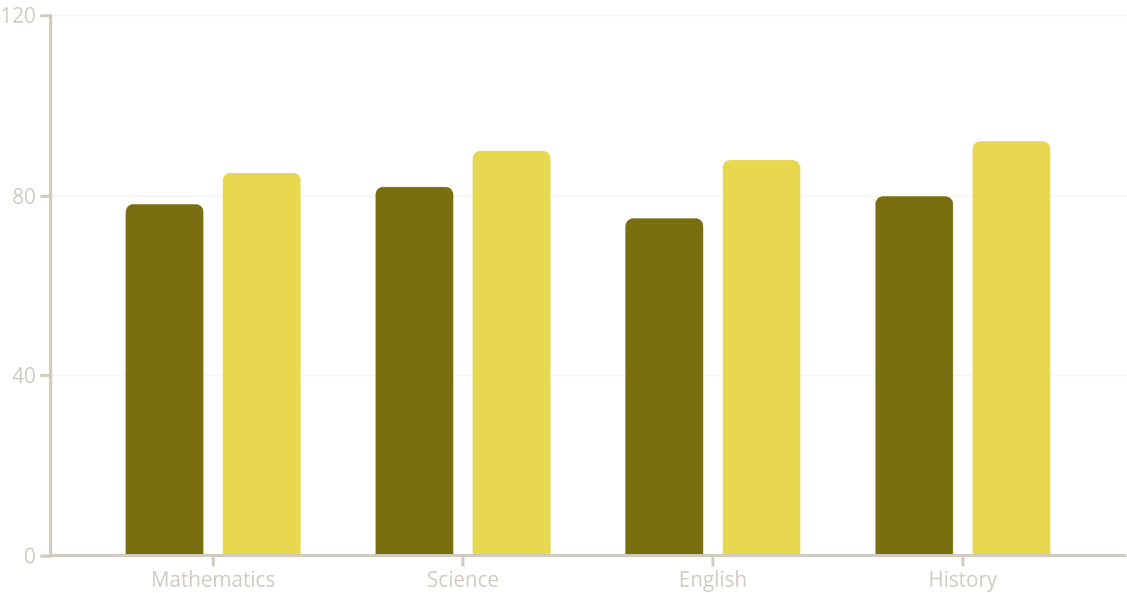
Student Grades Distribution
Average Score
Pass Rate (%)
This bar chart represents average scores and pass rates for each subject.
Science shows the highest pass rate at 90%, while English has the lowest average score.

Slide 11
Code link: - https://github.com/KannaSudheer/STUDENT-RECORC-SYSTEM/blob/main/main.c

Slide 12
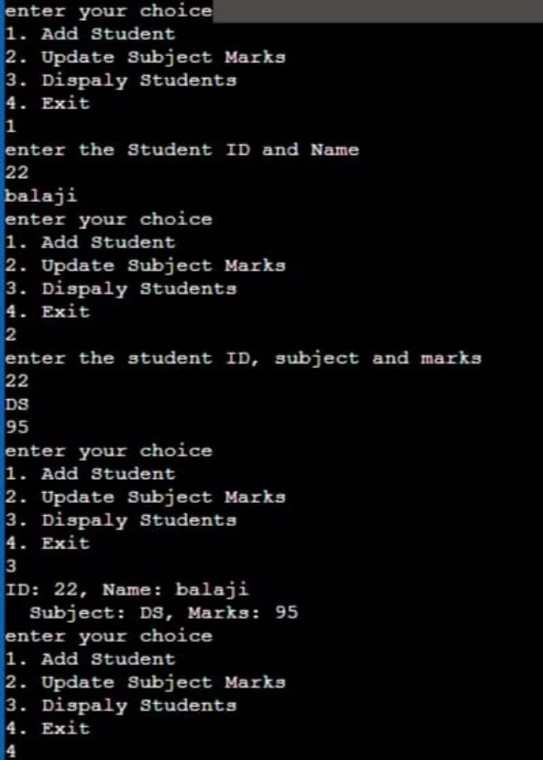
OUTPUT

Slide 13

Conclusion
The Student Record System improves data handling efficiency.
It delivers accuracy, scalability, and easy access.
Thank you! Ready for your questions.

Slide 14

Thank You

